Slide 1
Module 8
I²C — UVM+SV Verification
learn_uart_spi_i2c / Module 8

Slide 2
Learning objectives
• I²C UVM agent: I2cTransaction, I2cSequence,
I2cDriver, I2cMonitor, I2cScoreboard.
• Interface: i2c_if (clk, rst_n, start, addr, data_in,
scl, sda, clk_div_tick, busy, done) connects U…
• How to hook up a UVM monitor and scoreboard to a
bus-oriented DUT.
learn_uart_spi_i2c / Module 8

Slide 3
Prerequisites
• Module 7 (I²C protocol + RTL + basic TB).
• Verilator, Make, C++ compiler, UVM (UVM_HOME or
vendored UVM).
learn_uart_spi_i2c / Module 8

Slide 4
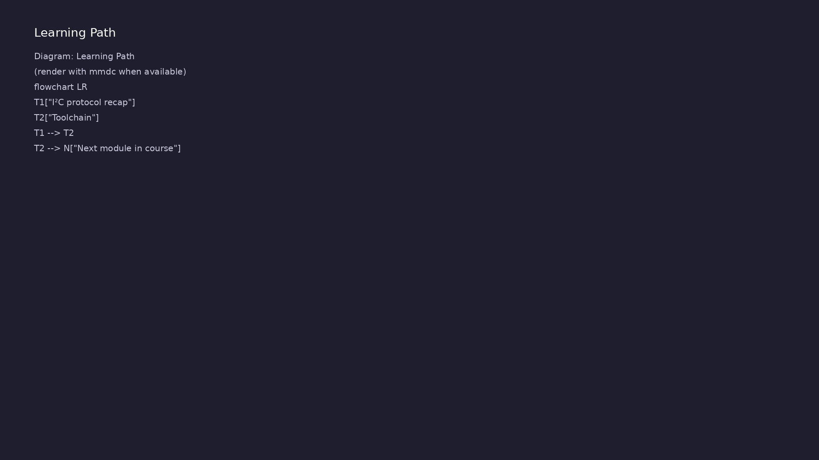
Learning path
Extend I²C verification to **UVM+SV** — I²C agent (transaction, sequence, driver, monitor, scoreboard); run on Verilator.
learn_uart_spi_i2c / Module 8

Slide 5
Overview
• Module 8 builds on Module 7 (I²C protocol + RTL +
basic testbench):
learn_uart_spi_i2c / Module 8

Slide 6
How to learn this module
learn_uart_spi_i2c / Module 8

Slide 7
Suggested learning path
• Read the detailed I²C learning guide:
I2C_LEARNING_GUIDE.md — what I²C is, how it works
(START/STOP…
• Read the protocols + UVM overview:
LEARNING_GUIDE_PROTOCOLS_AND_UVM.md — Part B § 5.
How UVM Maps t…
learn_uart_spi_i2c / Module 8
Notes:
From docs/MODULE8.md — read guides before running demos.

Slide 8
Design architecture
learn_uart_spi_i2c / Module 8

Slide 9
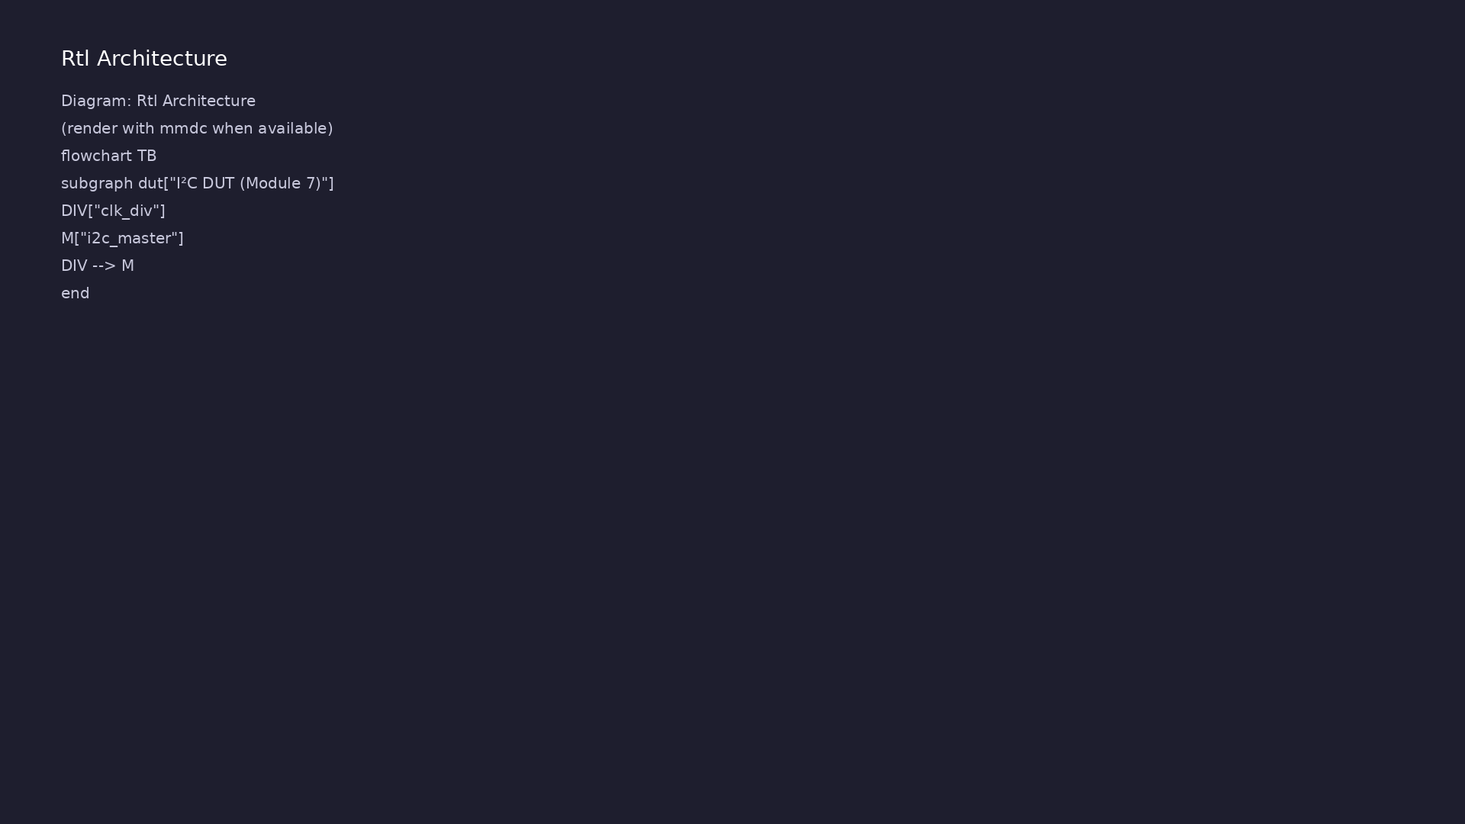
RTL / block architecture
Module 8: DUT / block hierarchy (see module8/examples/).
learn_uart_spi_i2c / Module 8

Slide 10
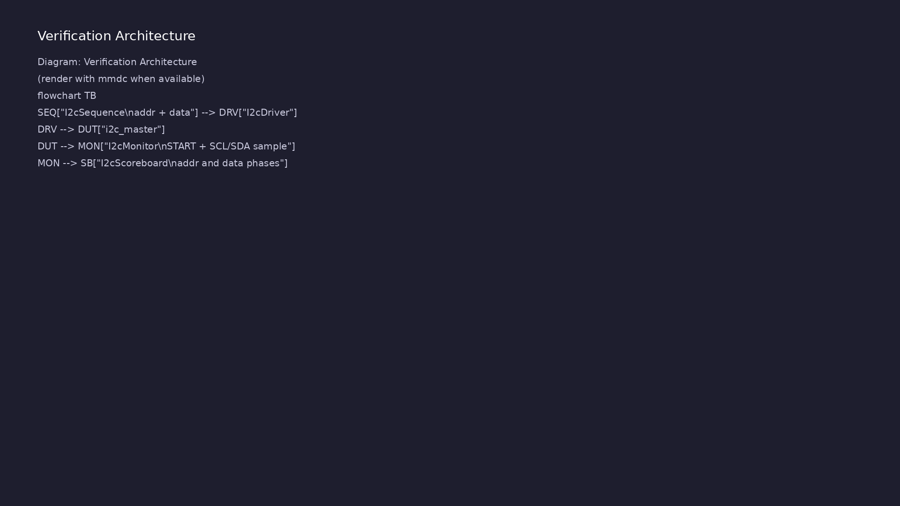
Verification environment architecture
Module 8: UVM layers, agents, and checkers for this phase.
learn_uart_spi_i2c / Module 8

Slide 11
1. I²C DUT (reused from Module 7)
• i2c_master + clk_div; i2c_if for UVM connection.
• Wire sequence: START → address+W → data → STOP.
learn_uart_spi_i2c / Module 8
Notes:
From MODULE8 Design Architecture.

Slide 12
2. UVM agent
• I2cTransaction holds `addr` + `data`; monitor fills
`observed_*`.
• I2cMonitor reimplements baseline bus sampling inside
UVM.
• I2cScoreboard checks address and data phases
independently.
learn_uart_spi_i2c / Module 8
Notes:
From MODULE8 Design Architecture.

Slide 13
3. Course capstone
• Compare UART (async), SPI (SCLK+CS), I²C (shared
bus) — same UVM skeleton, different monitors.
learn_uart_spi_i2c / Module 8
Notes:
From MODULE8 Design Architecture.

Slide 14
Verification & testing methods
learn_uart_spi_i2c / Module 8

Slide 15
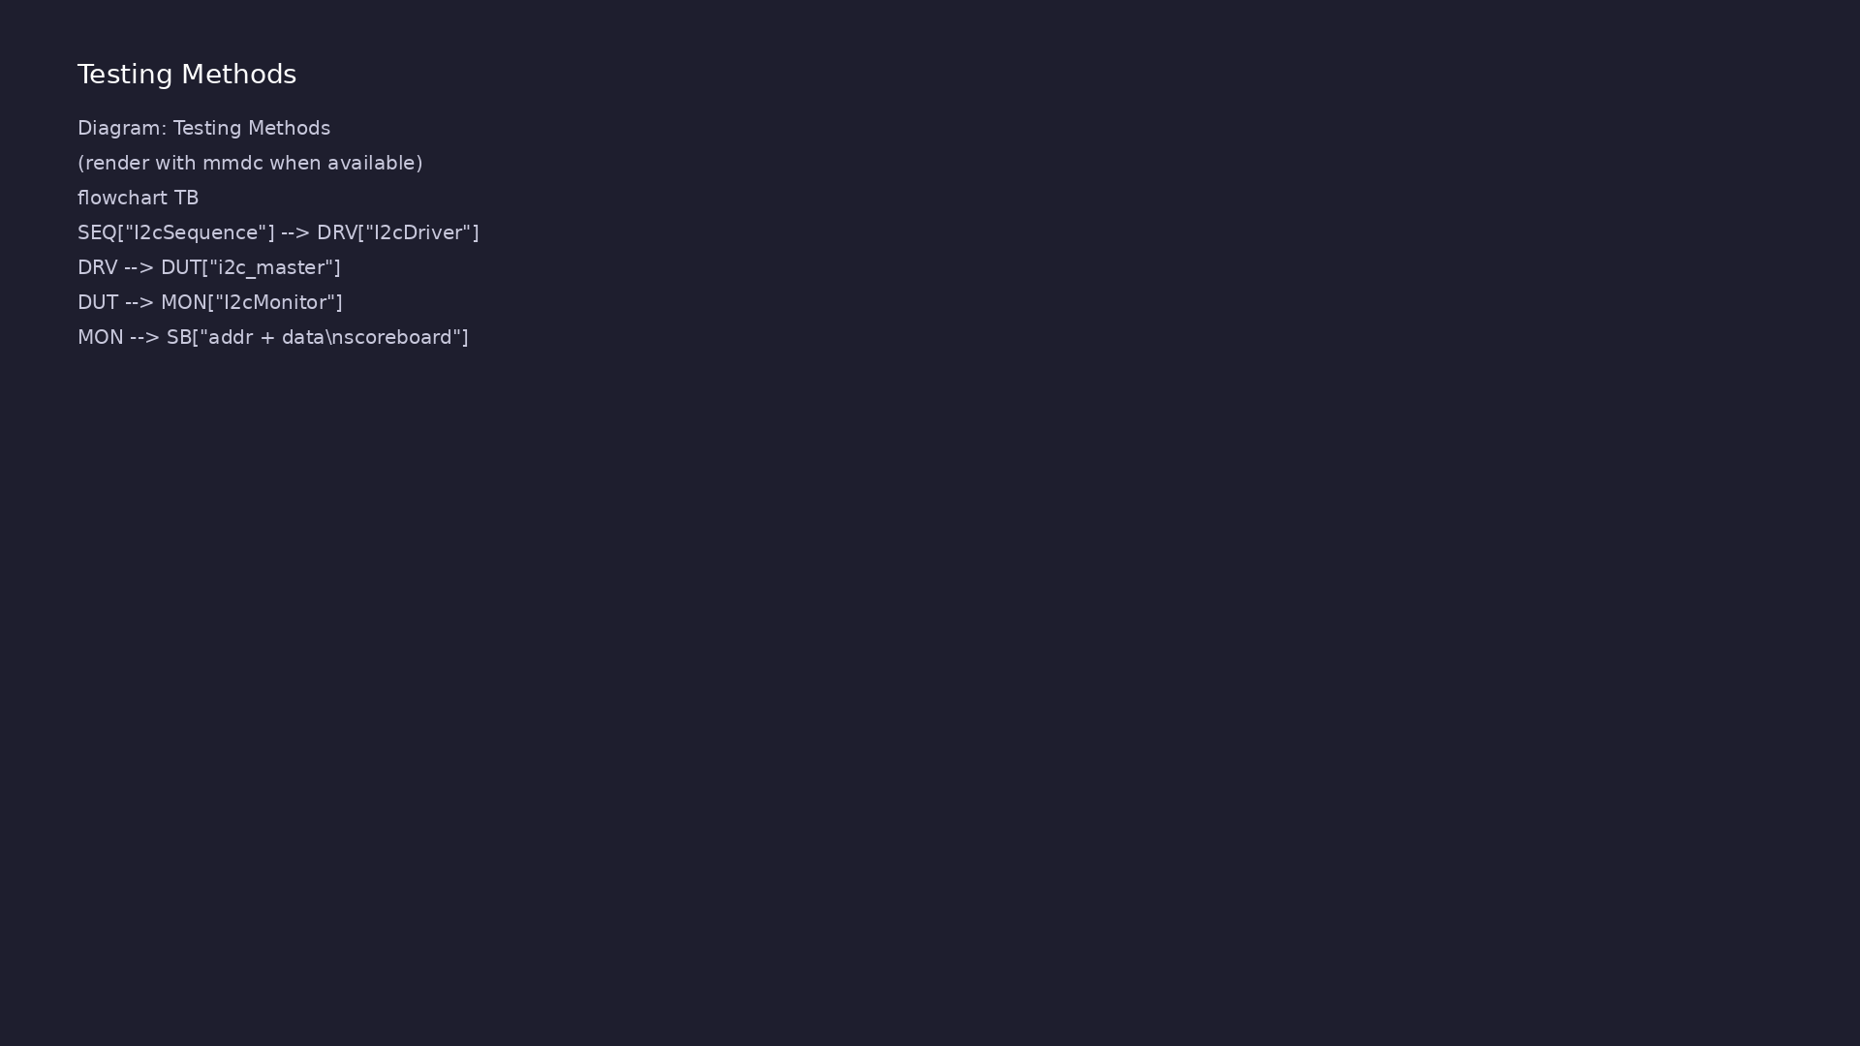
Testing and closure flow
Module 8: how tests, checks, and metrics close verification goals.
learn_uart_spi_i2c / Module 8

Slide 16
1. Two-phase scoreboard
• Separate checks for address+W byte and data byte —
catches shifted or merged fields.
learn_uart_spi_i2c / Module 8
Notes:
From MODULE8 Verification & Testing Methods.

Slide 17
2. Reuse baseline monitor logic
• Module 7 inline monitor → Module 8 I2cMonitor for
scalable tests.
learn_uart_spi_i2c / Module 8
Notes:
From MODULE8 Verification & Testing Methods.

Slide 18
3. Extensions
• ACK/NACK, reads, multi-master — [LEARNING_GUIDE §
8](LEARNING_GUIDE_PROTOCOLS_AND_UVM.md#8-i2c-uvm-…
learn_uart_spi_i2c / Module 8
Notes:
From MODULE8 Verification & Testing Methods.

Slide 19
Syllabus topics
learn_uart_spi_i2c / Module 8

Slide 20
1. I²C protocol recap
• START/STOP on SCL high; MSB-first address and data
on SDA.
learn_uart_spi_i2c / Module 8
Notes:
From MODULE8 Topics Covered.

Slide 21
2. Toolchain
• `make SIM=verilator TEST=test_i2c_uvm`;
`+UVM_TESTNAME=test_i2c_uvm`.
learn_uart_spi_i2c / Module 8
Notes:
From MODULE8 Topics Covered.

Slide 22
Hands-on examples
learn_uart_spi_i2c / Module 8

Slide 23
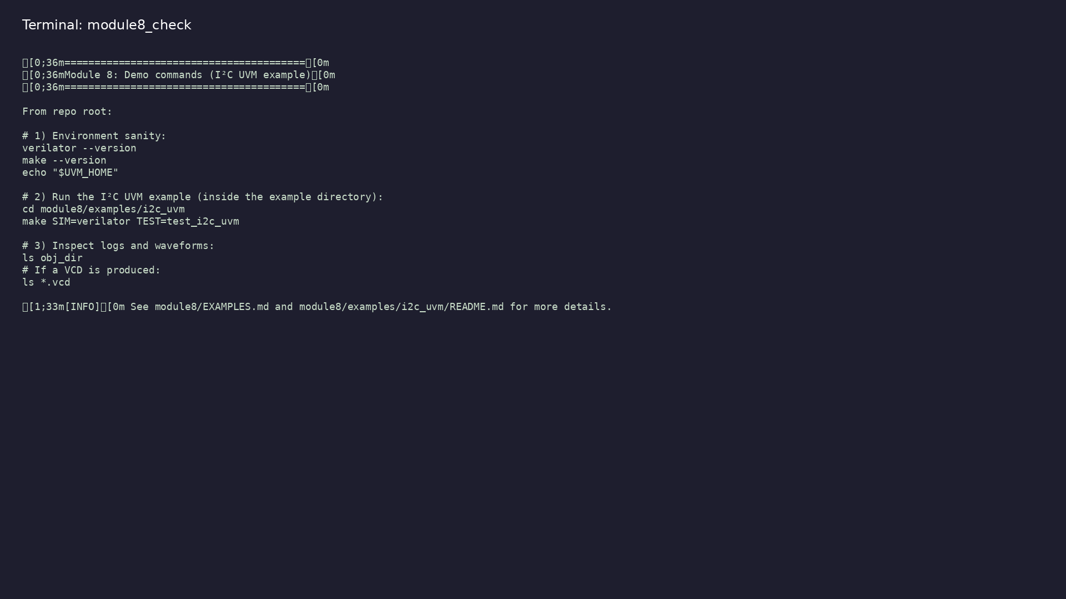
Module 8 self-check
$ ./scripts/module8.sh --help
learn_uart_spi_i2c / Module 8
Notes:
Run from course repository root.

Slide 24
Example 1: I²C UVM
• UVM phases and reporting (DRIVER, MONITOR,
SCOREBOARD).
• Scoreboard checks (expected vs observed address+data
from the bus).
• Final scoreboard summary (matches and mismatches).
learn_uart_spi_i2c / Module 8
Notes:
module8/examples/examples/i2c_uvm/README.md

Slide 25
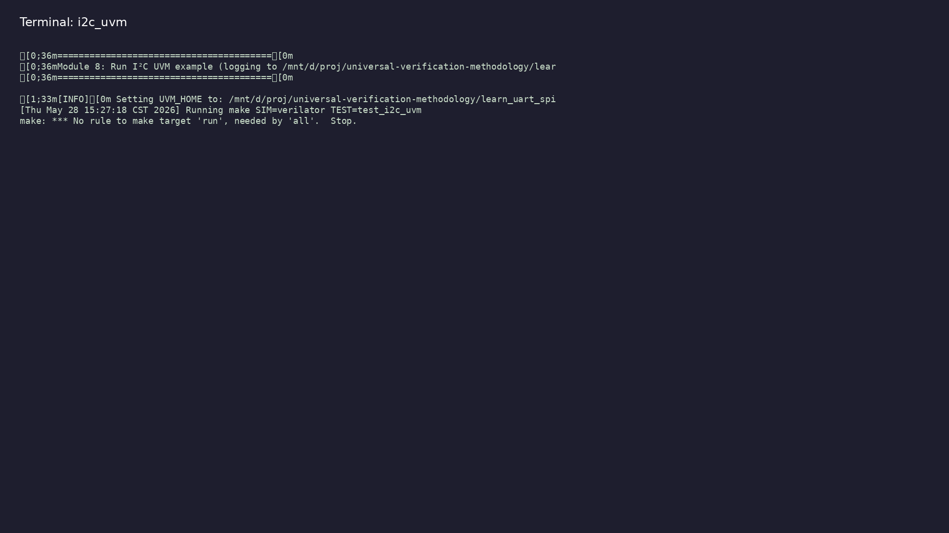
Demo: I²C UVM
$ ./scripts/module8.sh --run
learn_uart_spi_i2c / Module 8
Notes:
Hands-on: module8/examples/examples/i2c_uvm/

Slide 26
Practice & assessment
learn_uart_spi_i2c / Module 8

Slide 27
What you should know
• Describe the I²C UVM agent and how I2cMonitor maps
to SCL/SDA behavior.
• Explain two-phase scoreboard checking (address vs
data).
• Run `i2c_uvm` and interpret UVM / scoreboard output.
• Compare verification architecture across UART, SPI,
and I²C modules in this course.
learn_uart_spi_i2c / Module 8
Notes:
From MODULE8 Learning Outcomes.

Slide 28
Exercises
• Run i2c_uvm
• Trace one transaction
• Change the sequence
• Compare across protocols
learn_uart_spi_i2c / Module 8

Slide 29
Assessment checklist
• Can describe the I²C UVM agent and how it maps to
I²C (addr+data, monitor on SCL/SDA).
• Can run i2c_uvm and interpret UVM output.
• Can compare UVM structure across UART, SPI, and I²C.
learn_uart_spi_i2c / Module 8

Slide 30
Summary & next steps
• Extend I²C verification to **UVM+SV** — I²C agent
(transaction, sequence, driver, monitor, scoreboa…
• Complete module8/CHECKLIST.md
• Review module8/EXAMPLES.md and run each lab
• Next: Next module in course
learn_uart_spi_i2c / Module 8

