Slide 1
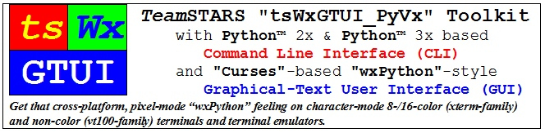
Use Cases

Slide 2
Use Cases Table of Contents (with slide show Hyperlinks)
Sample Screen Shots
Sample Platform Configurations
Command Line Interface (CLI)
tsLibCLI
tsToolsCLI
Graphical User Interface (GUI)
tsLibGUI
Remote Monitoring / Control
Site-Packages
Developer-Sandboxes

Slide 3
Use Cases: (Table of Contents) Sample Screen Shots
Command Line Interface (CLI)
Sample CLI Display
Graphical User Interface (GUI)
Sample GUI Widgets
Sample GUI Scrolled Windows (xterm 8-color)
Sample GUI Scrolled Windows (vt100 Black-on-White) & (vt100 White-on-Black)
Workstation Desktop for Development & Embedded Systems (HOST)
Sample Mac OS X Desktop with Parallels & VMware Hypervisors & 3 Guest OSs

Slide 4
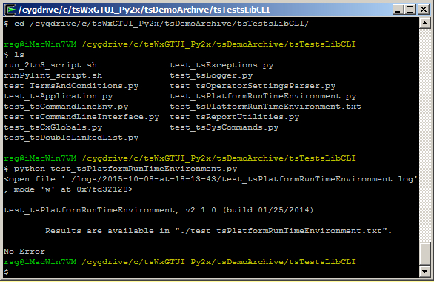
Use Cases: (Table of Contents) Sample CLI Display
The cd command, also known as chdir, changes the directory as specified.
The ls command lists files in the directory.
The python command executes the named program which displays the location of its results before terminating.

Slide 5
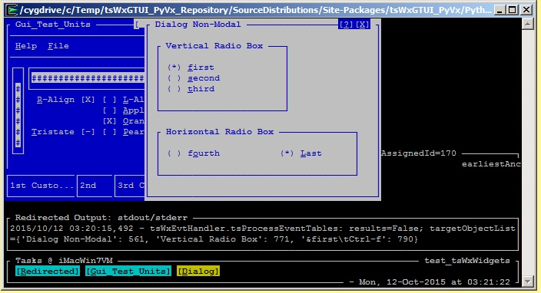
Use Cases: (Table of Contents) Sample GUI Widgets
Blue Frame (partially hidden)
With Menu Bar, Horizontal & Vertical Gauges, Check Boxes and Status Bar
White Dialog
With Window Control Buttons and Radio Boxes & Buttons
Black Redirected Output: stdout/stderr Frame
Output of date & time stamped debug statements
Output of colorized, date, time & severity-level stamped event notifications (not shown)
Task Bar Frame
With Network & Program Name, Task (Frame & Dialog) Focus Control Buttons, Idle Time Spinner and Current Date & Time

Slide 6
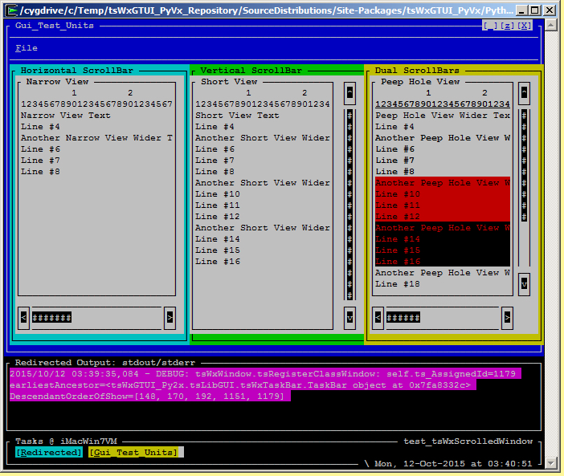
Use Cases: (Table of Contents) Sample GUI Scrolled Windows (xterm 8-color)
Blue Application Frame
With Menu Bar, Window Size & Close Control Buttons and three scrollable panels.
Three Scrollable Application Panels (Cyan Horizontal, Green Vertical & Yellow Dual )
Each with Multi-Colored & Non-Colored Text, Horizontal and/or Vertical scroll bars, associated clickable arrow buttons and clickable gauge depicting relative size and position or displayed text.
Black Redirected Output: stdout/stderr Frame
Output of colorized, date, time & severity-level stamped event notifications (debug-level shown)
Task Bar Frame
With Network & Program Name, Task (Redirected & Gui_Test_Units) Focus Control Buttons, Idle Time Spinner and Current Date & Time

Slide 7
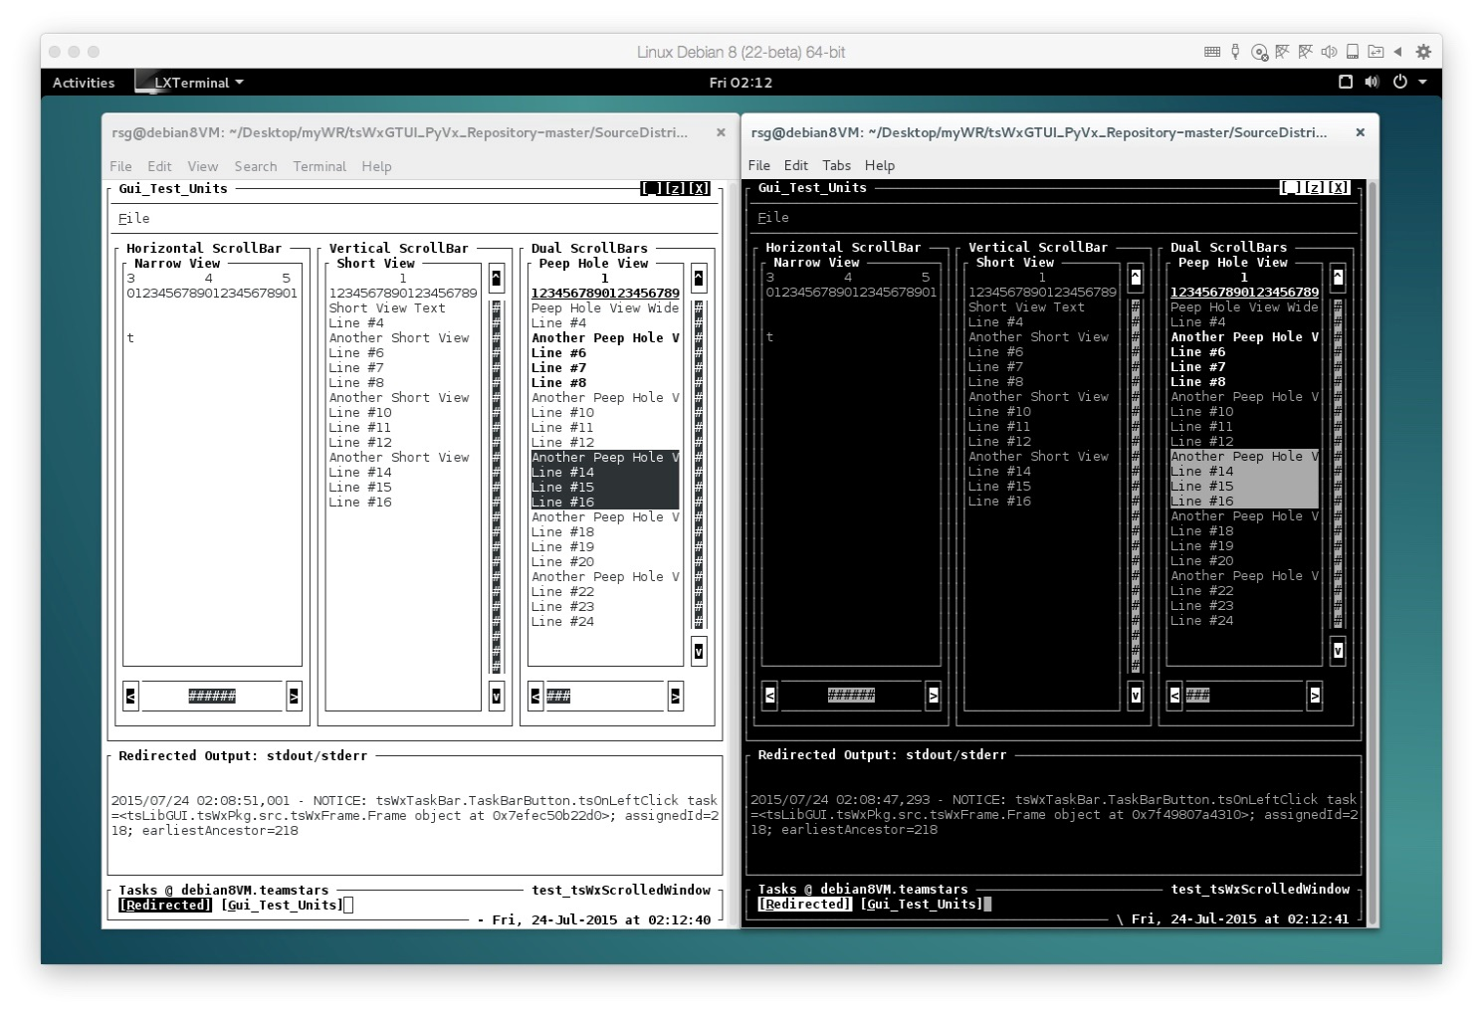
Use Cases: (Table of Contents) Sample GUI Scrolled Windows (vt100 Black-on-White) & (vt100 White-on-Black)
Outer-Most Application Frames
With Menu Bar, Window Size & Close Control Buttons and three scrollable panels.
Three Scrollable Application Panels (Horizontal, Vertical & Dual)
Each with Multi-Colored & Non-Colored Text, Horizontal and/or Vertical scroll bars, associated clickable arrow buttons and clickable gauge depicting relative size and position or displayed text.
Black Redirected Output: stdout/stderr Frame
Output of colorized, date, time & severity-level stamped event notifications (debug-level shown)
Task Bar Frame
With Network & Program Name, Task (Redirected & Gui_Test_Units) Focus Control Buttons, Idle Time Spinner and Current Date & Time

Slide 8
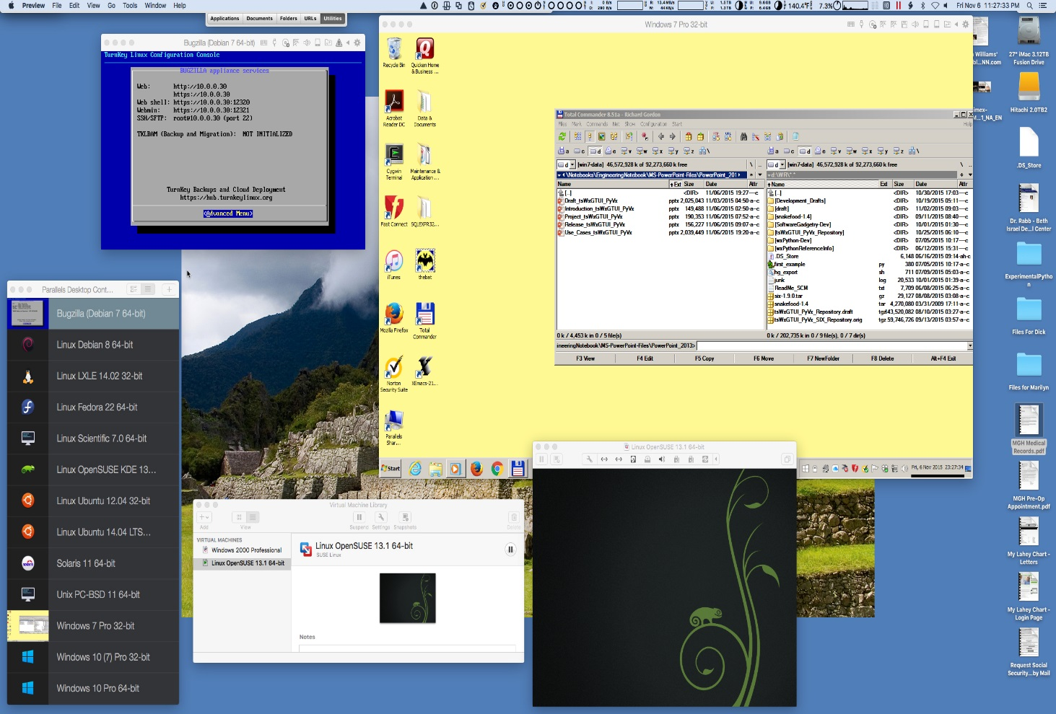
Use Cases: (Table of Contents) Sample Mac OS X Desktop with: Parallels & VMware Hypervisors & 3 Guest OSs
Hypervisor #1 (Parallels 11 Guest OS list in bottom left)
Bugzilla Database & Apache Server running on Debian Linux (dark blue window in top left)
Microsoft Windows 7 (yellow window in top right)
Hypervisor #2 (VMware Fusion 7 Guest OS list in bottom center)
OpenSUSE 13.1 Linux (black window in bottom right)

Slide 9
Use Cases: (Table of Contents) Block Diagrams
Toolkit Building Block Diagrams
Non-Networked (Stand-Alone) System (HW-SW) Block Diagram
Hardware Component Usage Notes
Operating System Software Component Usage Notes
Application Software Usage Notes
Networked (Stand-Among) System (HW-SW) Block Diagram
Local & Remote System Usage Notes

Slide 10
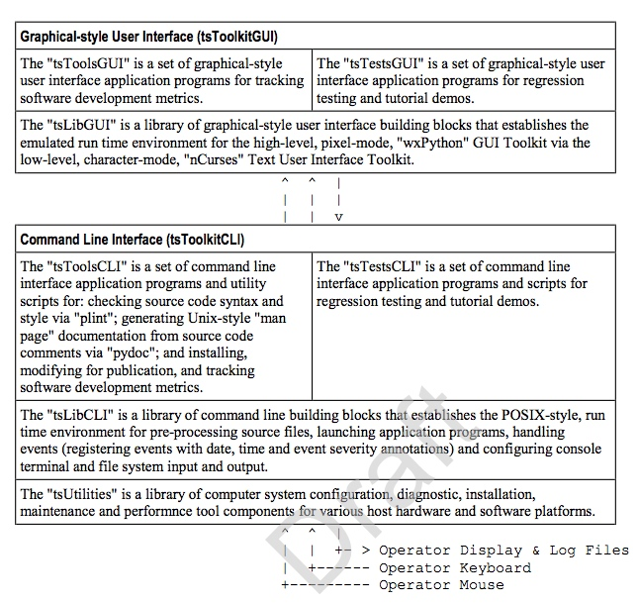
Use Cases: (Table of Contents) Toolkit Building Block Diagram
Cross-platform, Character-mode Curses-based emulation of Pixel-mode cross-platform wxPython GUI Application Programming Interface
Cross-platform, Linux-/Unix-like POSIX-based Command Line Interface
Operator’s Computer Terminal with Display, Keyboard and Mouse

Slide 11
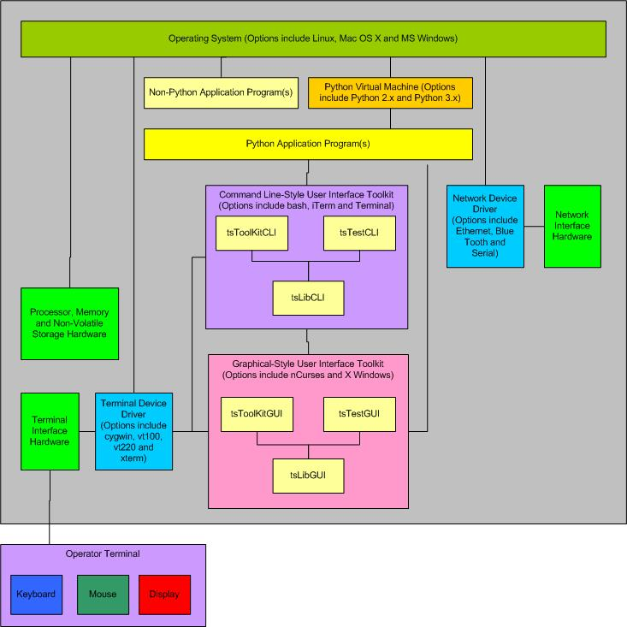
Use Cases: (Table of Contents) Non-Networked (Stand-Alone) Mode System (HW-SW) Block Diagram

Slide 12
Use Cases: (Table of Contents) Hardware Component Usage Notes
Processor, Memory, Storage and Communication Hardware - Platform specific resources that are required by the Operating System and Application software.
Network Hardware Interface - The optional platform specific Ethernet, blue-tooth and RS-232 serial port hardware for physical connections between the local system and one or more remote systems. It may also include such external hardware as gateways, routers, network bridges, switches, hubs, and repeaters. It may also include hybrid network devices such as multilayer switches, protocol converters, bridge routers, proxy servers, firewalls, network address translators, multiplexers, network interface controllers, wireless network interface controllers, modems, ISDN terminal adapters, line drivers, wireless access points, networking cables and other related hardware.
Terminal Hardware Interface - The platform specific hardware with connections to the device units of the Operator Terminal.
Operator Terminal - A device for human interaction that includes: A Keyboard unit for text input; A Mouse unit (mouse, trackball, trackpad or touchscreen with one or more physical or logical buttons) for selecting one of many displayed GUI objects to initiate an associated action.; A Display unit (1-color "ON"/"OFF" or multi-color two-dimensional screen) for output of text and graphic-style, tiled and overlaid boxes.

Slide 13
Use Cases: (Table of Contents) Operating System Software Component Usage Notes
Operating System - The platform specific software (such as Linux, Mac OS X, Microsoft Windows and Unix) that coordinates and manages the time-shared use of a platform's processor, memory, storage and input/output hardware resources by multiple application programs and their associated users/operators.
Network Device Driver Interface - The optional platform specific software whose layered protocol suite (such as TCP/IP) enables the concurrent sharing of the physical connection between the local system and one or more remote systems.
Terminal Device Driver - The platform specific software for transforming data (such as single button scan codes, multi-button flags and pointer position) to and from the platform independent formats (such as upper and lower case text, display screen column and row and displayed colors, fonts and special effects) used by the Command Line Interface and Graphical User Interface software.

Slide 14
Use Cases: (Table of Contents) Application Software Usage Notes
Non-Python Application Program - The application specific program that performs its service when its pre-compiled, platform specific machine code is executed. Typically, these services are used to analyze, edit, view, copy, move or delete those data and log files which are of interest or no longer needed.
Python Application Program - The application specific program that performs its service when executed by the Python Virtual Machine.
Command Line-Style Interface ("tsLibCLI") - The platform specific keywords arguments, positional arguments and their associated values and syntax of text used to request services from the Operating System and various Application Programs.
Graphical-Style User Interface ("tsLibGUI") - The platform specific tiled, overlaid and click-to-select Frames, Dialogs, Pull-down Menus, Buttons, CheckBoxes, Radio Buttons, Scrollbars and associated keywords, values and syntax of text used to request services from the Operating System and various Application Programs.
Python Virtual Machine - The platform specific program that loads, compiles Python language application program source code into platform independent tokenized byte-code and then interprets and executes the byte-code using a processor and operating system specific run time library.

Slide 15
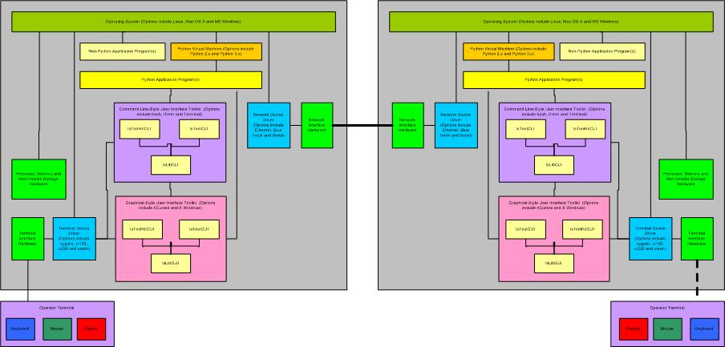
Use Cases: (Table of Contents) Networked (Stand-Among) Mode System (HW-SW) Block Diagram

Slide 16
Use Cases: (Table of Contents) Local & Remote System Usage Notes
Launch the Local (Left) Command Line Interface shell session (bash).
Set Local Working Directory
Login to Remote (Right) System, via SSH (secure shell) or SFTP (secure file transfer protocol), as user with/without administrative privileges.
Set Remote Working Directory
Transfer any missing application programs from Local to Remote System via SFTP
Launch one or more Remote Application(s)
Create archive of Remote Application logs directory(s)
Transfer archive(s) of Remote Application logs directory from Remote to Local System via SFTP
Logout of Remote System
Logout of Local System

Slide 17
Use Cases: (Table of Contents) Sample Platform Configurations
Readily available consumer-oriented configurations suitable for use as software & documentation development systems and as tag along “simulations” of customized application-specific embedded systems.
Hypervisor Virtual Machines
Third-party add-ons for host computers that are used to concurrently run one or more guest operating systems (and their applications).
Basic “Development” Laptop and Pseudo “Embedded” System
Platform with minimal resources: single-core processor with low horse-power and only enough memory to support host operating systems with both command line and graphical user interfaces.
Accessorized “Development” Laptop and Guest “Embedded” System
Platform with moderate resources: dual-core processor with average horse-power and enough memory to concurrently support host, hypervisor and at least one guest operating system with both command line and graphical user interfaces.
Accessorized “Development” Desktop and Guest “Embedded” Systems
Platform with additional resources: quad-core processor with sufficient horse-power and memory to concurrently support host, hypervisor and multiple guest operating systems with both command line and graphical user interfaces.

Slide 18
Use Cases: (Sample Platform Configurations) Hypervisor Virtual Machines
A hypervisor or virtual machine monitor (VMM) is a piece of computer software, firmware or hardware that creates and runs virtual machines.
A computer on which a hypervisor is running one or more virtual machines is defined as a host machine.
Each virtual machine is called a guest machine.
The hypervisor presents the guest operating systems with a virtual operating platform and manages the execution of the guest operating systems.
Multiple instances of a variety of operating systems may share the virtualized hardware resources.
Parallels Desktop for Mac, by Parallels, and VMware Fusion, by VMware are hypervisors that provides hardware virtualization only for Macintosh host computers with Intel x86 or x64 processors that are running Mac OS X. Each virtual machine can execute its own operating system, including versions of Microsoft Windows, Linux, BSD Unix, and MS-DOS.
VMware Workstation, by VMware, is a hypervisor that runs on x64 host computers (an x86 version of earlier releases was available) running Linux or Microsoft Windows. Each virtual machine can execute its own operating system, including versions of Microsoft Windows, Linux, BSD Unix, and MS-DOS.

Slide 19
Use Cases: (Sample Platform Configurations) Basic “Development” Laptop and Pseudo “Embedded” System
1998 Dell Inspiron 7000 Hardware
366 MHz Intel Pentium II processor
384 MB RAM
15.6” VGA (640x480) / SVGA (1024x768) pixel LCD display
Two Interchangeable 32 GB (4200 RPM) ATA hard drives
Microsoft Windows XP
Ubuntu Linux 12.04 LTS
Xircom Ethernet and 3Com WiFi Wireless Plug-in Network adapters for Microsoft Windows XP
Linksys WiFi Wireless Plug-in Network adapter for Ubuntu Linux 12.04 LTS
Development / Pseudo (non-optimized) Embedded Software
Microsoft Windows XP Configuration
Cygwin 1.7 (includes various GNU, Linux & Python components)
Office 2002
XEmacs
Python 2x & 3x
Ubuntu Linux 12.04 LTS Configuration
GNOME Desktop
LibraOffice
XEmacs
Python 2x & 3x

Slide 20
Use Cases: (Sample Platform Configurations) Accessorized “Development” Laptop and Guest “Embedded” System
2007 Apple MacBook Pro Hardware
2.33 GHz Intel Core 2 Duo processor
4 GB RAM
17” 1920x1200 pixel LCD display
160 GB (5400 RPM) SATA 1.5 Gb/s internal hard drive
1.5 TB (7200 RPM) SATA 3 Gb/s external hard drive
Ethernet Network Adapter
WiFi Wireless Network Adapter
Development / Embedded Software
MAC OS X 10.7.5 Lion
Wing IDE 3-4
LibreOffice
Xemacs
Python 2x & 3x
Guest (non-optimized) Embedded Software
Parallels Desktop 8 Hypervisor for running Guest OS:
Linux (Fedora 20 32-bit, OpenSuSE 12.2 32-bit, Scientific (CentOS) 6.4-6.5 64-bit, Ubuntu 12.04 32-bit) with Python 2.7 and 3.2 with Wing IDE 3, LibraOffice and XEmacs
Microsoft Windows (XP, 7, 8 & 8.1 each with Cygwin 1.7.8) with Wing IDE 3, AuthorIt-5, Office 2002 & XEmacs
Unix (PC-BSD 9.2-10.0, OpenIndiana 151a3 & OpenSolaris 11) with LibraOffice and Xemacs
VMware Fusion 7 Hypervisor for running Guest OS:
Linux (OpenSuSE 13.1)
Microsoft Windows (3.1)

Slide 21
Use Cases: (Sample Platform Configurations) Accessorized “Development” Desktop and Guest “Embedded” System
2013 Apple iMac Desktop Hardware
3.5 GHz Intel Quad Core i7 processor
16 GB RAM
27” 2560x1440 pixel LCD display
3 TB (7200 RPM) SATA 6 Gb/s internal hard drive with 128 GB Solid State Flash memory
Ethernet Network Adapter
WiFi Wireless Network Adapter
Development / Embedded Software
MAC OS X 10.11 El Capitan
Wing IDE 5
LibreOffice
Microsoft Office for Mac 2011
Xemacs
Python 2x & 3x
Guest (non-optimized) Embedded Software
Parallels Desktop 11 Hypervisor for running Guest OS:
Linux (Centos 7, Debian 8, Fedora 22, OpenSuSE 13.2, Scientific 7 & Ubuntu 14.04 LTS & 15.04) with Wing IDE 5, LibraOffice and XEmacs
Microsoft Windows (XP, 7, 8, 8.1 & 10) with Wing IDE 5, AuthorIt-5, Office 2002 & XEmacs
Unix (FreeBSD 11/PC-BSD 11, OpenIndiana 151a8 & OpenSolaris 11) with LibraOffice and Xemacs
VMware Fusion 7 Hypervisor for running Guest OS:
Linux (OpenSuSE 13.1)
Microsoft Windows (2000)

Slide 22
Use Cases: (Table of Contents) Command Line Interface (CLI)
Output to the User:
A chronological sequence of lines of text written from top to bottom and then scrolling off the top as each new line is written to the bottom of the terminal display.
Input from the User:
Via a computer terminal keyboard with input echoed to the display below the previous output.

Slide 23
Use Cases: (Table of Contents) CLI Building Blocks (tsLibCLI)
Application Building Blocks
tsCommandLineInterface
tsDoubleLinkedList
tsOperatorSettingsParser
tsReportUtilities
Application Diagnostics
tsExceptions
tsLogger
Application Configuration
tsCxGlobals
tsGistGetTerminalSize
tsPlatformRunTimeEnviroment
Application Launchers
tsApplication
tsCommandLineEnv
tsSysCommands

Slide 24
Use Cases: (Table of Contents) tsLibCLI
This library of building blocks is organized, by the functional scope of each component, into a collection of Python "modules".
When appropriate, tsLibCLI modules may import and use the services of:
any other tsLibCLI module
any module listed in the Python Global Module Index

Slide 25
Use Cases: (Table of Contents) tsApplication.py
Module enables the application program launched by an operator via a Command Line Interface (CLI) to also initialize, configure and use the same character-mode terminal with a Graphical-style User Interface (GUI).
Module registers and validates:
operator application settings inputs from command line keyword-value pairs and positional arguments.
instantiation settings input from applications via caller parameter list.
Module is the base class, for tsCommandLineEnv which itself is the base class for tsWxMultiFrameEnv.

Slide 26
Use Cases: (Table of Contents) tsCommandLineEnv.py
Class to initialize and configure the application program launched by an operator.
Class delivers those keyword-value pair options and positional arguments specified by the application, in its invocation parameter list.
Class wraps the Command Line Interface application with exception handlers to control exit codes and messages that may be used to co-ordinate other application programs.

Slide 27
Use Cases: (Table of Contents) tsCommandLineInterface.py
Class establishes methods that:
prompt or re-prompt the operator for input
validate that the operator has supplied the expected number of inputs and that each is of the expected type.\
does NOT validate the input value

Slide 28
Use Cases: (Table of Contents) tsCxGlobals.py
Module to establish configuration constants and macro-type functions for the Command Line Interface mode of the "tsWxGTUI" Toolkit.
Module provides a theme-based mechanism for modifying/restoring configuration constants as appropriate for various user roles and activities.

Slide 29
Use Cases: (Table of Contents) tsDoubleLinkedList.py
Class to establish a general purpose representation of a linked list with forward and backward pointers
Class provides methods to append, insert, delete and access the ordered list of entries.

Slide 30
Use Cases: (Table of Contents) tsException.py
Class to define and handle error exception events.
Class maps run time exception types into 8-bit exit codes
Class prints associated exception diagnostic message and trace back information

Slide 31
Use Cases: (Table of Contents) tsGistGetTerminalSize.py
Third-Party Module, derived from "terminalsize.py" by Justin T. Riley:
Module acquires the character size of the Python console window as a Python tuple (width, height) on host operating systems (such as Linux, Mac OS X, Microsoft Windows and Unix).

Slide 32
Use Cases: (Table of Contents) tsLogger.py
Class emulates a subset of Python logging API.
Class defines and handles prioritized, time and date stamped event message formatting and output to files and devices:
Log files are organized in a date and time stamped directory named for the launched application.
Log devices include the Unix-type syslog, stderr, stdout and stdscr (the Curses display screen).
Class also supports "wxPython"-style logging of assert and check case results.

Slide 33
Use Cases: (Table of Contents) tsOperatorSettingsParser.py
Class to parse the command line entered by the operator of an application program:
Platform-independent parsing algorithm extracts and returns the Keyword-Value pair Options and Positional Arguments that will configure and control the application during its execution.
Platform–specific parsing algorithm applies the standard Python library module ("argparse", "optparse" or "getopt") appropriate for the active Python version.

Slide 34
Use Cases: (Table of Contents) tsPlatformRunTimeEnvironment.py
Class to capture current hardware, software and network information about the run time environment for the user process.
Host processor hardware support includes various releases of Arm, x86, PowerPC, SPARC and others.
Host operating system software support includes various releases of Cygwin, Linux, Mac OS X, Unix, Windows and others.
Host virtual machine software support includes various releases of Java and Python.
Network identification support includes host name, aliases and ip-address list.
Environment Variable support includes user, session, shell, path and time zone
It makes this information available via a file (default is "./PlatformRunTimeEnvironment.txt").

Slide 35
Use Cases: (Table of Contents) tsReportUtility.py
Class defining methods used to format information for the operator’s display and log files:
Convert file size from numeric and string format with optional kilo-, mega-, giga-, tera-, peta-, exa-, zeta- and yotta-byte units
Convert time between string and seconds formats.
Construct a formatted log of multi-level nested Python dictionary contents
Construct a string of title and white space to separate one section of text from another.
Construct a string of white space appropriate for indenting level.
Construct the path to the next log file.
Create test summary after elapsed time with statistics details on the
Number of (total test runs, passing test run subtotal and failing test run subtotal)
Timestamp (startup, shutdown and elapsed)

Slide 36
Use Cases: (Table of Contents) tsSysCommands.py
Class definition and methods for:
Issuing shell commands to the host operating system
Receiving responses from the host operating system
Wrapping and using appropriate Python sub-process module methods.

Slide 37
Use Cases: (Table of Contents) tsToolsCLI
Developer Tools
tsStripComments
tsStripLineNumbers
tsTreeCopy
tsTreeTrimLines.py
Troubleshooter Tools
tsPlatformQuery
Project Tools
tsLinesOfCodeProjectMetrics

Slide 38
Use Cases: (Table of Contents) tsStripComments
Python application program, launched via a Command Line Interface (CLI) with options for the operator to designate input and output directories.
The application transforms an annotated, development version of a directory containing subdirectories and Python source files into an unannotated copy.
The unannotated copy is intended to conserve storage space when installed in an embedded system.
The transformation involves stripping comments and “docstrings” by detokenizing a tokenized version of each Python source file.
Non-Python files are trimmed of trailing whitespace.

Slide 39
Use Cases: (Table of Contents) tsStripLineNumbers
Python application program, launched via a Command Line Interface (CLI) with options for the operator to designate input and output directories.
Application strips line numbers from source code (such as from annotated documentation listings) that would not be required as reference points for conditional branching.

Slide 40
Use Cases: (Table of Contents) tsTreeCopy
Python application program, launched via a Command Line Interface (CLI) with options for the operator to designate input and output directories.
Application copies the files and directories contained in an input source directory to an output target directory.

Slide 41
Use Cases: (Table of Contents) tsTreeTrimLines.py
Python application program, launched via a Command Line Interface (CLI) with options for the operator to designate input and output directories.
Application copies the files and directories contained in an input source directory to an output target directory after stripping superfluous white space (blanks) from end of each line.

Slide 42
Use Cases: (Table of Contents) tsPlatformQuery
Python application program, launched via a Command Line Interface (CLI) with options for the operator to designate input and output directories.
Application uses tsPlatformRunTimeEnvironment module to capture and report current hardware and software information about the run time environment available to computer programs.

Slide 43
Use Cases: (Table of Contents) tsLinesOfCodeProjectMetrics
Python application program that:
Launches via Command Line Interface (CLI) with options designating input directory and output file
Scans an operator designated file directory tree containing the source files, in one or more programming language specific formats (such as Ada, Assembler, C/C++, Cobol, Fortran, PL/M, Python, Text, and various command line shells).
Accumulates and reports the number of code lines, blank/comment lines, words and characters for individual files, language subtotals and project totals.
Generates reports of software project progress and metrics for the software development project (such as labor, cost or contributed value, schedule and lines of code per day productivity).

Slide 44
Use Cases: (Table of Contents) Graphical User Interface (GUI)
Output to the user of text string characters to application-specified column and row (line) fields on a computer terminal display.
Input from the user via a pointing device (such as mouse, trackball, touchpad or touch screen) that is moved into a position by its operator before a mouse button is clicked to trigger a function button, radio button, checkbox or keyboard input operation.
Input from the user via a computer terminal keyboard that is echoed as output to a reserved area of the display that is written from top to bottom and then scrolling off the top as each new line is written to the bottom of the reserved area.

Slide 45
Use Cases: (Table of Contents) GUI Building Blocks (tsLibGUI)
“wxPython” API Mode
Application Building Blocks (partial listing)
Top-Level GUI Objects
Lower-Level GUI Objects
GUI Controls
GUI Events
GUI Sizers
Application Configuration
Application Diagnostics
Application Launchers
“Curses” API Mode
GraphicalTextUserInterface

Slide 46
Use Cases: (Table of Contents) Application Building Blocks partial listing (tsLibGUI)
Top-Level GUI Objects
tsWxFrame
tsWxDialog
tsWxPyOnDemandOutputWindow (Frame for RedirectedOutput)
tsWxTaskBar (Frame)
Lower-Level GUI Objects
tsWxPanel
tsWxStatusBar
GUI Controls
wxWxButton
tsWxCheckbox
tsWxGauge
tsWxMenuBar
tsWxRadioButton
tsWxScrollBar (Buttons & Gauge)
tsWxTaskBar (Buttons)
GUI Events
Keyboard / Mouse / Timer
GUI Sizers
tsWxBoxSizer
tsWxGridSizer

Slide 47
Use Cases: (Table of Contents) Top-Level GUI Objects (tsLibGUI)
tsWxFrame
A window whose size and position can (usually) be changed by the user. It usually has thick borders and a title bar, and can optionally contain a menu bar, toolbar and status bar. A frame can contain any window that is not a Frame or Dialog. It is one of the most fundamental of the wxWindows components.
A Frame that has a status bar and toolbar created via the CreateStatusBar / CreateToolBar functions manages these windows, and adjusts the value returned by GetClientSize to reflect the remaining size available to application windows.
By itself, a Frame is not too useful, but with the addition of Panels and other child objects, it user interfaces are constructed.
tsWxDialog
A window with a title bar and sometimes a system menu, which can be moved around the screen. It can contain controls and other windows and is often used to allow the user to make some choice or to answer a question.
Dialogs can be made scrollable, automatically, for computers with low resolution screens.
Dialogs usually contains either a single button allowing to close the dialog or two buttons, one accepting the changes and the other one discarding them (such button, if present, is automatically activated if the user presses the "Esc" key).

Slide 48
Use Cases: (Table of Contents) Lower-Level GUI Objects (tsLibGUI)
tsWxPanel
A window on which controls are placed. It is usually placed within a frame.
Its main feature over its parent class wxWindow is code for handling child windows and TAB traversal.
tsWxStatusBar
A narrow window that can be placed along the bottom of a frame to give small amounts of status information.
It can contain one or more fields, one or more of which can be variable length according to the size of the window.

Slide 49
Use Cases: (Table of Contents) GUI Controls (tsLibGUI)
wxWxButton
A control that contains a text string. It is one of the most common elements of a GUI. It may be placed on a dialog box or panel, or indeed almost any other window.
tsWxCheckbox
A labelled box that by default is either on (the checkmark is visible) or off (no checkmark). Optionally (When the wx.CHK_3STATE style flag is set) it can have a third state, called the mixed or undetermined state. Often this is used as a "Does Not Apply" state.
tsWxRadioButton
A labelled box which by default is either on (the checkmark is visible) or off (no checkmark). When the operator turns one RadioButton on, all other Radio Buttons within the same RadioBox group are automatically turned off.
tsWxMenuBar
Aa series of menus accessible from the top of a frame.
tsWxGauge
A horizontal or vertical bar which shows a quantity (often time). wxGauge supports two working modes: determinate and indeterminate progress. The first is the usual working mode (see SetValue() and SetRange()) while the second can be used when the program is doing some processing but you do not know how much progress is being done. In this case, you can periodically call the Pulse() function to make the progress bar switch to indeterminate mode (graphically it is usually a set of blocks which move or bounce in the bar control).
tsWxScrollBar
A control that represents a horizontal or vertical scrollbar. It is distinct from the two scrollbars that some windows provide automatically, but the two types of scrollbar share the way events are received.
tsWxTaskBar (buttons)
A narrow window with a taskbar icon (button) for each top level window (frame, dialog etc.). A taskbar icon appears in the "system tray" and responds to mouse clicks, optionally with a tooltip above it to help provide information.

Slide 50
Use Cases: (Table of Contents) GUI Events (tsLibGUI)
Keyboard
An event class that contains:
key identifier
key pressed/released state
Mouse
An event class that contains:
mouse identifier
button identifier
button state (pressed, released, single-clicked, double-clicked, triple-clicked)
current cursor position (display screen character cell row/column coordinates)
Timer
An event class to allow you to execute code at specified intervals.
Its precision is platform-dependent, but in general will not be better than 1 millisecond nor worse than 1 second.

Slide 51
Use Cases: (Table of Contents) GUI Sizers (tsLibGUI)
tsWxBoxSizer
The basic idea behind a box sizer is that windows will most often be laid out in rather simple basic geometry, typically in a row or a column or nested hierarchies of either.
A wx.BoxSizer will lay out its items in a simple row or column, depending on the orientation parameter passed to the constructor.
tsWxGridSizer
A grid sizer is a sizer which lays out its children in a two-dimensional table with all cells having the same size. In other words, the width of each cell within the grid is the width of the widest item added to the sizer and the height of each grid cell is the height of the tallest item.
An optional vertical and/or horizontal gap between items can also be specified (in pixels.)
Items are placed in the cells of the grid in the order they are added, in row-major order. In other words, the first row is filled first, then the second, and so on until all items have been added. (If necessary, additional rows will be added as items are added.) If you need to have greater control over the cells that items are placed in then use the wx.GridBagSizer.

Slide 52
Use Cases: (Table of Contents) Application Configuration (tsLibGUI)
tsWxGraphicalTextUserInterface
Class uses the Standard Python Curses API to initialize, manage and shutdown input (from a keyboard and mouse) and output (to a two-dimensional display screen).
Uses built-in or builds monochrome or “wxPython” 68-color palette for operator designated terminal or terminal emulator (vt100-family or xterm-family).
When appropriate, it substitutes available “Curses” 8-/16-colors for those “wxPython” 68-colors which are NOT available.
When appropriate, it synthesizes a single click “Curses” xterm-family mouse button input from a sequence of available press-release vt100-family mouse button input.
Builds platform-specific splash screen from configuration data extracted from txCxGlobals.
tsWxSplashScreen
Class to show a window with a thin border, displaying a "bitmap" (text) describing your application. The splash screen is shown during application initialization. The application then either explicitly destroys it or lets it time-out.
Became deprecated when tsWxGraphicalTextUserInterface module began building splash screen from configuration data extracted from txCxGlobals.
tsWx
Module to load all symbols that should appear within the wxPython wx emulation namespace.
Includes various classes, constants, functions and methods available for use by applications built with components from the “wxPython” emulation infrastructure.
The tsWx module is intended to be imported by each Toolkit user applications and Toolkit Test.
tsWxGlobals
The tsWxGTUI_PyVx Toolkit emulates the definitions of and references to constant and variable names used by the C++ based “wxWidgets” API and the wxPython interface wrapper used by Python programmers.
The tsWxGlobals module and emulated tsWxPython classes and methods are then imported by the tsWx module to emulate the “wxPython” wx module.

Slide 53
Use Cases: (Table of Contents) Application Diagnostics (tsLibGUI)
tsWxGraphicalTextUserInterface
Logs the following platform configuration information:
“Curses” GUI platform configuration constants
Keyboard, Mouse, Display
“Curses” GUI operator-designated run time configuration
Terminal Name / Type
Terminal Has Colors
Number of Colors
Number of Color-Pairs
Built-in Color Palette
Generated “wxPython”-style Color Palette
“wxPython”-style GUI Object configuration (including parent-child relationship(s), type, position, size, style, color-pair, title, label, border and curses GUI object handle etc.)
Logs the following run time event notification information:
Equipment Operator event notifications
Maintenance / Field Service event notifications
Developer Debug event notifications
tsWxLog (Future)

Slide 54
Use Cases: (Table of Contents) Application Launchers (tsLibGUI)
tsWxPyApp
PyApp class, based on tsWxEvtHandler, to represent the application and is used to:
Bootstrap the “wxPython”-style system and initialize the underlying GUI toolkit
Set and get application-wide properties
Implement the windowing system main message or event loop, and to dispatch events to window instances.
tsWxApp
App class, based on tsWxPyApp, to represent the application and is used to do the same things.
tsWxPySimpleApp
PySimple is a simple application class, based on tsWxApp.
You can just create one of these and then make your top level windows later, and not have to worry about OnInit.
tsWxPyOnDemandOutputWindow
PyOnDemandOutputWindow class that can be used for redirecting Python stdout and stderr streams.
It will do nothing until something is written to the stream at which point it will create a Frame with a text area and write the text there.
tsWxMultiFrameEnv
MultiFrameEnv class to enable an application using a Command Line Interface (CLI) to launch and use the same character-mode terminal with a Graphical-style User Interface (GUI).
It uses application specified configuration keyword-value pair options to initialize any application specific logger(s)
It wraps the CLI, underlying the GUI, and the GUI with exception handlers to control the exit codes and messages used to coordinate other application programs.

Slide 55
Use Cases: (Table of Contents) GraphicalTextUserInterface partial listing (tsLibGUI)
Curses Supervisor
tsWxGraphicalTextUserInterface.py
tsWxMultiFrameEnv.py
tsWxScrollBarButton.py
tsWxScrollBarGauge.py
tsWxSplashScreen.py
tsWxTaskBar.py
Curses Event Handler
tsWxEvtHandler.py
Curses Keyboard
tsWxCursesKeyCodesDataBase.py
Curses Mouse
tsWxCursesMouseButtonCodesDataBase.py
Curses Utilities
tsWxPythonPrivateLogger.py
tsWxCursesServices.py
tsWxWindowCurses.py
Curses Configuration
tsWx
tsWxGlobals.py
Curses Display
tsWxDisplay.py
tsWxScreen.py
tsWxColorDatabase.py
tsWxPythonColor16DataBase.py
tsWxPythonColor16SubstitutionMap.py
tsWxPythonColor256DataBase.py
tsWxPythonColor88DataBase.py
tsWxPythonColor8DataBase.py
tsWxPythonColor8SubstitutionMap.py
tsWxPythonColorDataBaseRGB.py
tsWxPythonColorNames.py
tsWxPythonColorRGBNames.py
tsWxPythonColorRGBValues.py
tsWxPythonMonochromeDataBase.py

Slide 56
Use Cases: (Table of Contents) Curses Supervisor (tsLibGUI)
tsWxGraphicalTextUserInterface.py
tsWxMultiFrameEnv.py
tsWxScrollBarButton.py
tsWxScrollBarGauge.py
tsWxSplashScreen.py
tsWxTaskBar.py

Slide 57
Use Cases: (Table of Contents) Curses Event Handler (tsLibGUI)
tsWxEvtHandler.py

Slide 58
Use Cases: (Table of Contents) Curses Keyboard (tsLibGUI)
tsWxCursesKeyCodesDataBase.py

Slide 59
Use Cases: (Table of Contents) Curses Mouse (tsLibGUI)
tsWxCursesMouseButtonCodesDataBase.py

Slide 60
Use Cases: (Table of Contents) Curses Utilities (tsLibGUI)
tsWxPythonPrivateLogger.py
tsWxCursesServices.py
tsWxWindowCurses.py

Slide 61
Use Cases: (Table of Contents) Curses Configuration (tsLibGUI)
tsWx
tsWxGlobals.py

Slide 62
Use Cases: (Table of Contents) Curses Display (tsLibGUI)
tsWxDisplay.py
tsWxScreen.py
tsWxColorDatabase.py
tsWxPythonColor16DataBase.py
tsWxPythonColor16SubstitutionMap.py
tsWxPythonColor256DataBase.py
tsWxPythonColor88DataBase.py
tsWxPythonColor8DataBase.py
tsWxPythonColor8SubstitutionMap.py
tsWxPythonColorDataBaseRGB.py
tsWxPythonColorNames.py
tsWxPythonColorRGBNames.py
tsWxPythonColorRGBValues.py
tsWxPythonMonochromeDataBase.py

Slide 63
Use Cases: (Table of Contents) Remote Monitoring / Control
Once you've logged into your local computer, you may then login to a remote computer using one or more secure shells ("ssh") or non-secure shells ("rsh") provided by the local operating system.
The Secure Shell ("ssh") is a cryptographic network protocol for secure data communication, remote command-line login, remote command execution, and other secure network services between two networked computers. It connects, via a secure channel over an insecure network, a server and a client running "ssh" server and "ssh" client programs, respectively.
The remote shell ("rsh") is a command line computer program that can execute shell commands as another user, and on another computer across a computer network. The remote system to which "rsh" connects runs the "rsh" daemon ("rshd").
The local and remote operating system's command line interfaces provides access to associated terminal interface and the TeamSTARS "tsWxGTUI_PyVx" Toolkit's Python and "nCurses" based character-mode user interfaces which then communicate.
This enables you to monitor and control one or more remote and local application programs, from the convenience of your local computer terminal, with greater speed and efficiency than possible with the larger communication traffic associated with pixel-mode.

Slide 64
Use Cases: (Table of Contents) Site-Packages
Site-Packages are the location where third-party packages are installed (i.e., those not part of the core Python distribution).
A Site-Package can only be used with those Python versions for which it has been explicitly installed.
For Linux, Mac OS X and Unix operating systems, one must have “root” or administrator privileges to write to the install location.
To facilitate application software development and deployment, Site-Packages:
Organize source code into a single layer set of subdirectories within the Site-Package directory.
Import modules, via static Site-Package directory relative path specifications.
Default Python Example: A Site-Package, installed for use with the platform’s default Python must be installed via
“python setup.py install”
Optional Python 2x Example: A Site-Package, installed for use with the platform’s add-on Python 2.7.10 must be installed via
“python2.7.10 setup.py install”
Optional Python 3x Example: A Site-Package, installed for use with the platform’s add-on Python 3.5.0 must be installed via
“python3.5.0 setup.py install

Slide 65
Use Cases: (Table of Contents) Developer-Sandboxes
A Developer-Sandbox is a testing environment that isolates untested code changes and outright experimentation from the production (Site-Package) environment or repository.
There should be one Developer-Sandbox for any or all Python 2x (second generation language) releases.
There should be one Developer-Sandbox for any or all Python 3x (third generation language) releases.
To facilitate software development and troubleshooting, Developer-Sandboxes:
Organize source code into a set of multi-level nested directories within the Developer-Sandbox directory.
Import modules, within try-except blocks, via dynamic multi-level nested path specifications.

