Slide 1
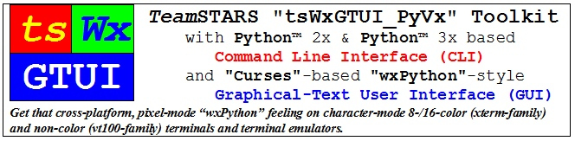

Slide 2
Key Points
Key Points: TeamSTARS “tsWxGTUI_PyVx” Toolkit
Key Points: Python Programming Language
Key Points: wxPython Graphical User Interface API
Key Points: Curses Terminal Control Library 1 of 3
Key Points: Curses Terminal Control Library 2 of 3
Key Points: Curses Terminal Control Library 3 of 3

Slide 3
Key Points: TeamSTARS “tsWxGTUI_PyVx” Toolkit
The TeamSTARS “tsWxGTUI_PyVx” Toolkit combines the multi-platform capabilities of:
“Python” programming language
“wxPython” graphical user interface application programming interface
“Curses” terminal control library
It creates a powerful, productive, rapid prototyping cross-platform toolkit for embedded systems.

Slide 4
Key Points: Python Programming Language
Excerpts From Wikipedia, the free encyclopedia:
“Python is a widely used general-purpose, high-level programming language.”
“Its design philosophy emphasizes code readability, and its syntax allows programmers to express concepts in fewer lines of code than would be possible in languages such as C++ or Java.”
“The language provides constructs intended to enable clear programs on both a small and large scale.”

Slide 5
Key Points: wxPython Graphical User Interface API
Excerpts From Wikipedia, the free encyclopedia:
“wxPython is a wrapper for the cross-platform GUI API (often referred to as a 'toolkit') wxWidgets (which is written in C++) for the Python programming language.”
“In computer programming, an application programming interface (API) is a set of routines, protocols, and tools for building software applications. An API expresses a software component in terms of its operations, inputs, outputs, and underlying types. An API defines functionalities that are independent of their respective implementations, which allows definitions and implementations to vary without compromising the interface. A good API makes it easier to develop a program by providing all the building blocks. A programmer then puts the blocks together.”
“It is implemented as a Python extension module (native code).“
“Like wxWidgets, wxPython is free software.”

Slide 6
Key Points: Curses Terminal Control Library 1 of 3
Excerpts From Wikipedia, the free encyclopedia:
“Curses-based software is software whose user interface is implemented through the Curses library, or a compatible library (such as Ncurses).”
“Curses is designed to facilitate GUI-like functionality on a text-only device, such as a PC running in console mode, a hardware ANSI terminal, a Telnet or SSH client, or similar.”

Slide 7
Key Points: Curses Terminal Control Library 2 of 3
“Curses-based programs often have a user interface that resembles a traditional graphical user interface, including 'widgets' such as text boxes and scrollable lists, rather than the command line interface (CLI) most commonly found on text-only devices. This can make them more user-friendly than a CLI-based program, while still being able to run on text-only devices.”

Slide 8
Key Points: Curses Terminal Control Library 3 of 3
“Curses-based software can also have a lighter resource footprint and operate on a wider range of systems (both in terms of hardware and software) than their GUI-based counterparts. This includes old pre-1990 machines along with modern embedded systems using text-only displays.”
“Curses is most commonly associated with Unix-like operating systems, although implementations for Microsoft Windows also exist.”

Slide 9
Table of Contents (with slide show Hyperlinks)
Introduction Sample Screenshots and Block Diagrams
Project Objectives, Plans and Implementation
Release Capabilities, Limitations and Issues
Use Cases User’s guide for the toolkit’s collection of application, tool, example and test programs which demonstrate the expected usage scenarios, coding techniques, look and feel.

Slide 10
Introduction (Table of Contents)
Sample Screen Shots
Command Line Interface (CLI)
Sample CLI Display
Graphical User Interface (GUI)
Sample GUI Widgets
Sample GUI Scrolled Windows (xterm 8-color)
Sample GUI Scrolled Windows (vt100 Black-on-White) & (vt100 White-on-Black)
Block Diagrams
Toolkit Building Block Diagrams
Non-Networked (Stand-Alone) System (HW-SW) Block Diagram
Networked (Stand-Among) System (HW-SW) Block Diagram

Slide 11
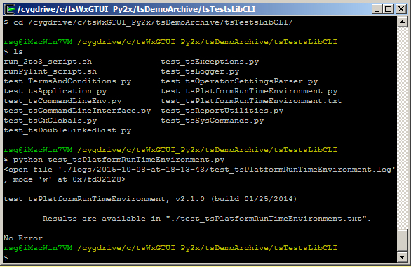
Introduction: Sample CLI Display
The cd command, also known as chdir, changes the directory as specified.
The ls command lists files in the directory.
The python command executes the named program which displays the location of its results before terminating.

Slide 12
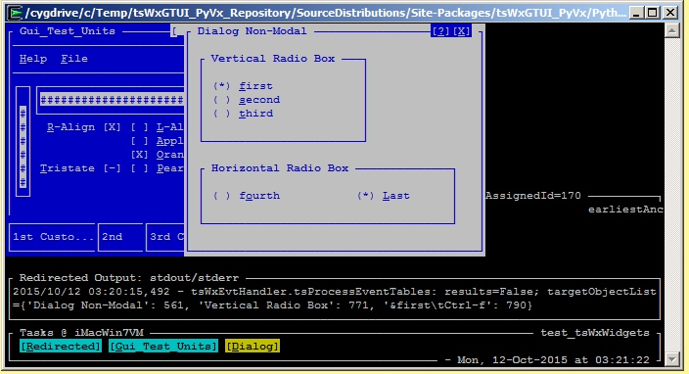
Introduction: Sample GUI Widgets
Blue Frame (partially hidden)
With Menu Bar, Horizontal & Vertical Gauges, Check Boxes and Status Bar
White Dialog
With Window Control Buttons and Radio Boxes & Buttons
Black Redirected Output: stdout/stderr Frame
Output of date & time stamped debug statements
Output of colorized, date, time & severity-level stamped event notifications (not shown)
Task Bar Frame
With Network & Program Name, Task (Frame & Dialog) Focus Control Buttons, Idle Time Spinner and Current Date & Time

Slide 13
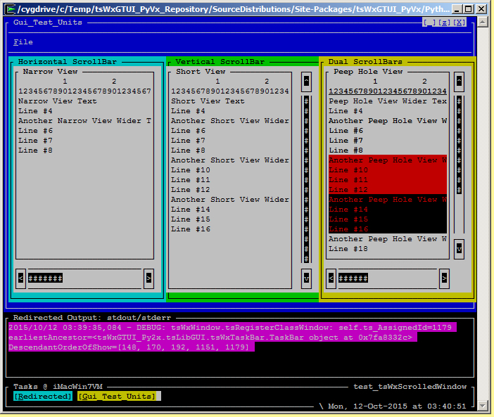
Introduction: Sample GUI Scrolled Windows (xterm 8-color)
Blue Application Frame
With Menu Bar, Window Size & Close Control Buttons and three scrollable panels.
Three Scrollable Application Panels (Cyan Horizontal, Green Vertical & Yellow Dual )
Each with Multi-Colored & Non-Colored Text, Horizontal and/or Vertical scroll bars, associated clickable arrow buttons and clickable gauge depicting relative size and position or displayed text.
Black Redirected Output: stdout/stderr Frame
Output of colorized, date, time & severity-level stamped event notifications (debug-level shown)
Task Bar Frame
With Network & Program Name, Task (Redirected & Gui_Test_Units) Focus Control Buttons, Idle Time Spinner and Current Date & Time

Slide 14
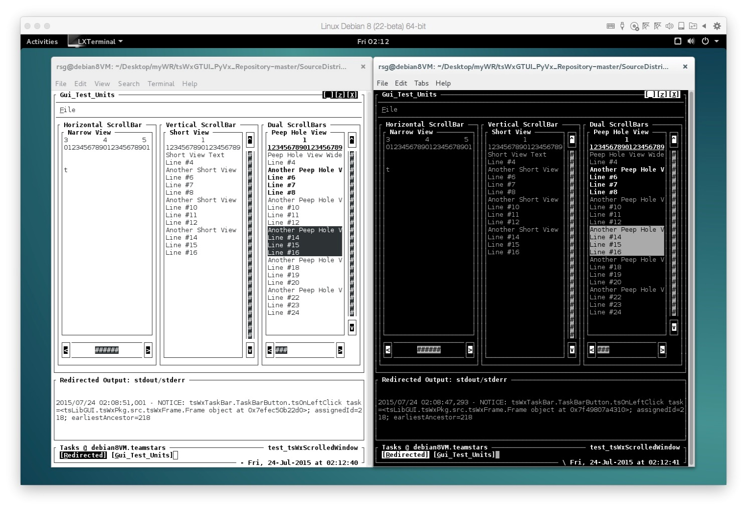
Introduction: Sample GUI Scrolled Windows (vt100 Black-on-White) & (vt100 White-on-Black)
Outer-Most Application Frames
With Menu Bar, Window Size & Close Control Buttons and three scrollable panels.
Three Scrollable Application Panels (Horizontal, Vertical & Dual)
Each with Multi-Colored & Non-Colored Text, Horizontal and/or Vertical scroll bars, associated clickable arrow buttons and clickable gauge depicting relative size and position or displayed text.
Black Redirected Output: stdout/stderr Frame
Output of colorized, date, time & severity-level stamped event notifications (debug-level shown)
Task Bar Frame
With Network & Program Name, Task (Redirected & Gui_Test_Units) Focus Control Buttons, Idle Time Spinner and Current Date & Time

Slide 15
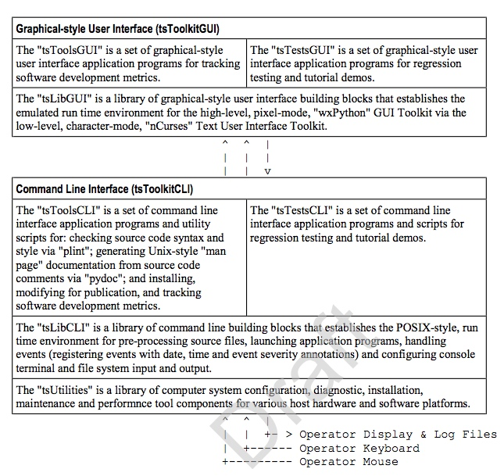
Introduction: Toolkit Building Block Diagram
Cross-platform, Character-mode Curses-based emulation of Pixel-mode cross-platform wxPython GUI Application Programming Interface
Cross-platform, Linux-/Unix-like POSIX-based Command Line Interface
Operator’s Computer Terminal with Display, Keyboard and Mouse

Slide 16
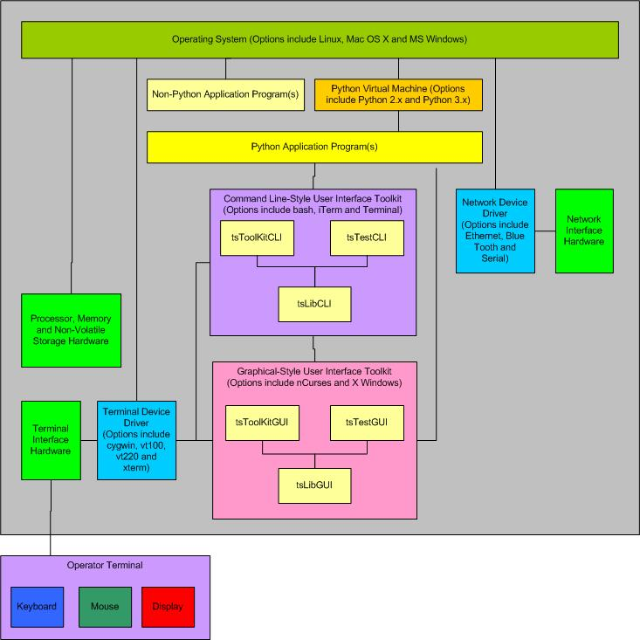
Introduction: Non-Networked (Stand-Alone) Mode System (HW-SW) Block Diagram

Slide 17
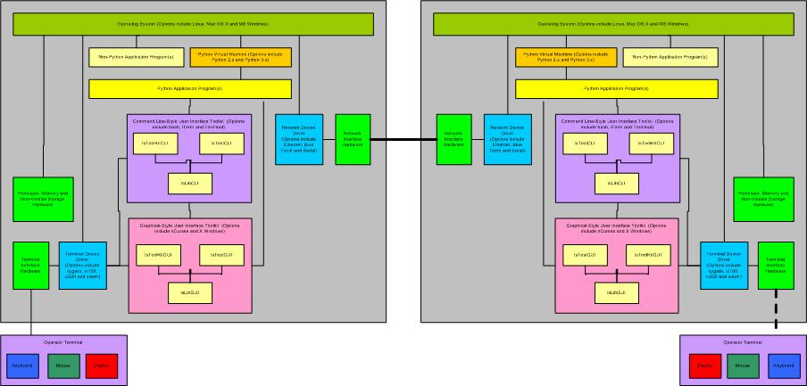
Introduction: Networked (Stand-Among) Mode System (HW-SW) Block Diagram

Slide 18
Project (Table of Contents)
Objectives
Goals (Capabilities)
Non-Goals (Limitations)
Plans
Applicable Technology
Software Architecture
Productivity Tools
Administrative Utilities
Implementation
Documentation for Training, Engineering, Operation & Troubleshooting
Developer Sandboxes
Installable Site Packages
Release & Publication

Slide 19
Project Objectives: Goals (Mission Critical Capabilities)
Provide a foundation of building block libraries, tools and utilities that:
lets you work more quickly and integrate your systems more effectively
facilitates the rapid prototyping of application software used to monitor, control and coordinate Mission Critical Equipment
The foundation components must be general purpose and re-usable in order to support the following markets:
Commercial (as in building energy management)
Industrial (as in power generation)
Medical (as in cat-scan)
Military (as in weapon control)
Foundation components must facilitate the rapid prototyping of application software on diverse assortment of:
General Purpose Desktop & Laptop Computer Systems
Application-Specific Embedded Computer Systems:
Automation (as in robotics)
Communication (as in network traffic)
Control (as in supervisory and feedback of equipment and processes)
Diagnostic (as in hardware and software failure modes and effects)
Instrumentation (as in sensor data acquisition and analysis)
Simulation (as in flight control)

Slide 20
Project Objectives: Goals (Cross-Platform Capabilities)
Foundation components must be compatible with and portable to a diverse assortment of popular and readily available hardware and software platforms:
Open (HW as in Arm & Intel microprocessor components; SW as in GNU’s Unix-like tool components & Linus Torvalds’ Linux operating system kernel components)
Proprietary (HW as in Dell, HP, IBM & Lenovo systems; SW as in Microsoft’s Windows & Oracle’s Solaris operating system components)

Slide 21
Project Objectives: Goals (Architecture Capabilities)
Foundation architecture must be modular to support product life-cycle.
Segregation of Python language generations (such as 1x, 2x and 3x) to facilitate:
Future Back-Porting Python 1x from Python 2x.
Future Back-Porting Python 2.0.x-2.6.x from Python 2.7.x using “Six”, a Python 2.x and 3.x compatibility library
Porting Python 3.x from Python 2x using Python syntactical converter “2to3”
Future Porting Python 4x from Python 3x using Python syntactical converter “3to4”
Non-Installable Developer Sandbox to facilitate foundation component development, maintenance and troubleshooting.
Installable Site-Package to facilitate foundation user’s application software development and deployment.
Foundation components must be customizable in order to support a diverse assortment of operators & organizations:
Customizable “txCxGlobals” file of organization-/product-specific usage terms & conditions and operator-specific CLI theme-based feature settings
Customizable “tsWxGlobals” file of organization-/product-specific GUI theme-based feature settings

Slide 22
Project Objectives: Goals (Documentation Audience)
Prospective & New Users seek reason to dig deeper or look elsewhere
Student Users seek rationale for unfamiliar computer hardware and software technology usage
Intermediate Users seek rationale for architecture, design and implementation of unfamiliar “Python”, "Curses" and "wxPython" programming techniques
Advance Users seek rationale for unfamiliar project planning and engineering techniques
Expert Users seek rationale for unfamiliar troubleshooting, maintenance, porting and enhancement techniques

Slide 23
Project Objectives: Goals (Documentation Capabilities)
Documentation for system administrators & installers, developers & maintainers, operators, troubleshooters and students.
Establish a reference library (for Objectives, Plans, Requirements, Architecture, Design, Implementation, Debug, Test & Release)
Orients & Trains new contributors & users
Focuses or reminds contributors of goals, non-goals, plans and unresolved issues
Establish a convenient reference library of third-party material, found on internet, which was relevant but might eventually be subject to change or removal
Computer & System Engineering (Definitions, Theory, Technology & Practices)
External Goods & Services Resources

Slide 24
Project Objectives: Goals (Engineering Notebook Capabilities)
Typical engineering project information with commentaries describing rationale and evolutionary changes (for System, Hardware, Software & Interfaces):
Concept, Dictionary, Use Cases & Development Plan
Requirement, Design, Test & Qualification Specifications
Release Notes & User’s Manual
Typical engineering project contributor information:
Document Authoring & Publishing Tools
Software Development Tools
Introduction and Training
In various formats with text, tables and complex graphical images requiring an office suite (such as from “Adobe”, “Microsoft“, “LibreOffice” etc.) application programs typically found on a general purpose desktop computer system.

Slide 25
Project Objectives: Goals (User “How-to-Guide” Capabilities)
Documents
Typical install, configure, operate and troubleshoot how-to guides with applicable terms and conditions for usage and redistribution.
In a plain text format suitable for embedded systems with only character-mode terminals.
Manual Pages
Typical on-line information about Command Line Interface & Graphical User Interface use and application programming for each building block and tool.
In a plain text format suitable for embedded systems with only character-mode terminals.

Slide 26
Project Objectives: Non-Goals (Host Virtual Machine Limitation)
Foundation will NOT provide “Magical” Host Virtual Machines which:
Runs incompatible Processor & Operating System Specific Applications:
You should NOT expect to be able to run application programs designed specifically for one processor make & model and one make & model operating system on a different processor and operating system.
You should ONLY expect to be able to run applications designed to run on a Python “virtual machine” that itself has been designed (by the Python Software Foundation) for the specific processor & operating system, tested and certified to correctly interpret and execute source code appropriate for the Python language generation (such as 1x, 2x or 3x).

Slide 27
Project Objectives: Non-Goals (GUI Virtual Machine Limitation)
Foundation will NOT provide “Magical” GUI Virtual Machines which:
Run incompatible GUI Applications:
You should NOT expect to be able to run pixel-mode “wxPython”, “wxWidgets”, “Qt” or “Tcl/Tk” applications that can copy graphic images from a file to the display and dynamically construct and output an array of pixels to the display which depicts the desired icons, graphic objects and text images.
You should ONLY expect to be able to run character-mode “wxPython”-style GUI applications designed to dynamically construct and output to the display an array or sequence Curses-standard alpha-numeric, punctuation and line-drawing characters (with escape sequences to control output to a desired display screen column and row position).

Slide 28
Project Objectives: Non-Goals (Retrofit Limitations)
Foundation will NOT provide “Magical” Python Virtual Machine cross-platforms for use with a diverse assortment of obsolete Hardware and Software platforms.
Open (HW such as 8-/16-bit Intel & Motorola microprocessors, 32-/64-bit Intel iAPX 432, i860; SW source code such as implemented in assembler, Ada, C/C++, FORTRAN and Python 1.x languages)
Proprietary (HW as in Digital Equipment Corp. & SGI systems; SW such as VAX/VMS & IRIX operating systems)
Even if others have or could obtain such long discontinued platforms, this Foundation author neither has nor seeks funding to obtain, reconstruct or simulate such platforms.

Slide 29
Project Plans: Adopt Cross-Platform Technology
Apply Hardware & Software Technology that lets you work more quickly and integrate your systems more effectively:
Popular, readily available and/or within the project budget
Suitable for rapid prototyping
Field proven with a long term track record of support
Software & Documentation must be free to study, modify, use and redistribute

Slide 30
Project Plans: Adopt Modular Software Architecture
Provide a framework for cross-platform software development:
Libraries of Application and Troubleshooting Building Block components.
Tools for Facilitating and Tracking developer productivity.
Utilities for Monitoring and Changing hardware and software configuration.
Tests (Unit, Integration, System, Regression and Acceptance) for design verification and quality assurance.
Examples for Algorithms, Coding Style, Programmer Productivity Metrics and System Performance.

Slide 31
Project Plans: Adopt Cross-Platform Software Environment
POSIX, a Unix-like operating system complying with the Portable Operating System Interface:
Apple Mac OS X (Darwin- & BSD-based Unix)
GNU/Linux (combination of free Unix-like GNU tools and free Linux kernel)
Microsoft Windows (requires Cygwin, the free Linux-like environment and command-line interface plug-in from Red Hat)
Unix (derived directly or indirectly from the original AT&T UNIX)
Python, an interpreted, object-oriented programming language and cross-platform virtual machine:
Python 3x (actively evolving & maintained 3rd generation language)
Python 2x (mature & actively maintained 2nd generation language)
Python 1x (obsolete & unmaintained 1st generation language)
wxPython, a cross-platform GUI Application Programming Interface

Slide 32
Project Plans: Adopt Python 2x Source Code Plan
Develop software in mature & actively maintained Python 2x (2nd generation language)
Create non-installable Python 2x Developer Sandbox to facilitate troubleshooting
“__init__.py” defines nested package structure and dependency relationships
Modules import from other modules & packages within “try-except” logic to report import errors
Create installable Python 2x Site-Package to facilitate to use of Toolkit building blocks in same manner as library components registered in Python Global Module Index.
Copy Python 2x Developer Sandbox
Replace “__init__.py” modules with empty ones
Replace “try-except” import logic with explicit references to site-package identifier

Slide 33
Project Plans: Adopt Python 3x Source Code Plan
Develop software in actively evolving & maintained Python 3x (3rd generation language)
Create non-installable Python 3x Developer Sandbox to facilitate troubleshooting
Copy non-installable Python 2x Developer Sandbox
Convert syntax of Python 2x to Python 3x (3rd generation language) using Python “2to3” utility
Debug to identify and resolve remaining issues
Create installable Python 3x Site-Package to facilitate to use of Toolkit building blocks in same manner as library components registered in Python Global Module Index.
Copy Python 3x Developer Sandbox
Replace “__init__.py” modules with empty ones
Replace “try-except” import logic with explicit references to site-package identifier

Slide 34
Project Plans: Adopt Development, Debug and Test Environment
Representative & Readily Available
Processors (32-/64-bit data register width)
Single Core --- A component containing a single processor performing all of the work.
Multi-Core or Multi-Processor --- One or more components containing multiple processors each performing their delegated portion of the work.
Processor-specific “Host” and optional “Guest” operating systems
Host OS --- Primary operating system connected to other computers or terminals to which it provides data or computing services via a hard-wired connection or switched telecommunication network.
Guest OS --- Secondary operating system that is either part of a partitioned system or part of a virtual machine (VM) setup.
Develop, Debug and Test on available Model Platforms

Slide 35
Project Plans: Adopt Python Virtual Machine (VM) Environment
A Cross-Platform Environment is created by VMs which are typically:
Implemented in a platform-independent programming language such as “C/C++”
Compiled into executable platform-specific VM building block library functions
Executed upon an operator’s shell command (such as “python DEMO.py –help”)
VMs typically execute the Python application, upon its launch, via the following process:
Compile any un-compiled Python application & imported source code into a processor-independent byte-code containing tokens for each standard Python statement or subprogram operation
Interpret the VM tokens
Execute VM token-associated executable platform-specific VM building block library functions

Slide 36
Project Plans: Adopt Python Virtual Machine (VM) Strategy
Foundation Original Author and Release Adopters
Default use of popular Python (2.x.y and 3.x.y) Virtual Machines developed:
by the Python Software Foundation (PSF)
for popular and readily available Intel processors (x86 & x64) and processor-specific operating systems.
Optional use of equivalent Python (2.x.y and 3.x.y) Virtual Machines (or the source code to build them) developed:
by the Python Software Foundation
for other, less popular, processor types and processor-specific operating systems.

Slide 37
Project Plans: Adopt Engineering Notebook Strategy
Engineering Notebooks (master in repository on development system)
Collection of commentaries that express opinions or offerings of explanations about events or situations that might be useful to installers, developers, operators, troubleshooters and distributors of the toolkit framework.
Formats include text, tables and complex graphical images requiring an office suite application programs (such as from “Adobe”, “Microsoft“, “LibreOffice” etc.) typically found on a general purpose workstation, desktop or laptop computer systems.
Project (master in repository on development system; copy in site-package on embedded system)
Excerpts from the Engineering Project Notebook that is in plain text format and suitable for embedded systems with only character-mode terminals.

Slide 38
Project Plans: Adopt Operator, System Administrator & Field Service Strategy
Documents (master in repository on development systems with copies in developer sandboxes; copies also in site-packages on embedded systems)
Typical install, configure, operate and troubleshoot how-to guides with applicable terms and conditions for usage and redistribution. In a plain text format suitable for embedded systems with only character-mode terminals.
Manual Pages (master in repository on development systems with copies in developer sandboxes; copies also in site-packages on embedded systems)
Typical on-line information about command line use and application programming for each building block and tool. Each is generated, by a Python source code processing tool, in a plain text format suitable for embedded systems with only character-mode terminals.

Slide 39
Project Implementation: Adopt Document Focus Strategy
System Administrators and Field Service will need to know or learn:
Hardware and Software Requirements for System and Applications
Available Product & Support Resources
How to Install, Configure, Operate and Troubleshoot the Hardware and Software for System and Applications
Operators will need to know or learn:
Available System and Application Hardware and Software features and how to use them
Developers will need to know or learn:
Hardware and Software Architecture
Hardware and Software Interfaces
Software Design and Qualification Requirements
How to Install, Configure, Operate and Troubleshoot the Hardware and Software for local and remote Systems and Applications

Slide 40
Release (Table of Contents)
Command Line Interface (CLI) Capabilities
Graphical User Interface (GUI) Capabilities
Local Monitoring / Control Capabilities
Pre-Alpha Stage Release Limitations
Release Issues

Slide 41
Release: Command Line Interface (CLI) Capabilities
Launch application programs with or without:
operator key word-value pair options
positional arguments
Create platform configuration and event log files for date and time stamped messages notifying operator and field service of situations requiring:
immediate action
later troubleshooting
Generate and return Unix-type exit code to coordinate operation of multiple collaborating scripts.

Slide 42
Release: Graphical User Interface (GUI) Capabilities
Launch character-mode wxPython-like application programs (mimicking the look and feel of native GUI applications on Microsoft Windows) with or without configurable options for:
Splash Screen containing:
Trademark, Copyright, License and/or Notice depending on screen size
Redirected Output containing:
Event log files for date and time stamped messages notifying operator of situations requiring immediate action
Taskbar containing:
A row of buttons that represent open programs, among which the user can switch back and forth by clicking on the appropriate button
Generate and return Unix-type exit code to coordinate operation of multiple collaborating scripts.

Slide 43
Release: Local Monitoring / Control Capabilities
Once you've logged into your local computer, you can launch one or more local shells (such as "sh" and "bash") associated with the local operating system's command line interface.
The local operating system's command line interface provides access to associated terminal interface and the TeamSTARS "tsWxGTUI_PyVx" Toolkit's Python and "nCurses" based character-mode user interfaces which enable you to monitor and control one or more local application programs.

Slide 44
Release: Pre-Alpha Stage Limitations
Designates a program or application that is not:
Feature complete
Independently tested
Usually be released to the public
Developers are still deciding on what features the source code and documentation should have and are seeking input from third-parties willing to try it and provide constructive feedback.
Current source code and documentation is subject to change without notice.
Previous versions of the source code and documentation are archived and remain available in the GitHub repository.

Slide 45
Use Cases (Table of Contents)
Model Platforms Readily Available Consumer-oriented Configurations

Slide 46
Use Cases: (Table of Contents) Model Platforms
Readily available consumer-oriented configurations suitable for use as software & documentation development systems and as tag along “simulations” of customized application-specific embedded systems.
Basic “Development” Laptop and Pseudo “Embedded” System
Platform with minimal resources: single-core processor with low horse-power and only enough memory to support host operating systems with both command line and graphical user interfaces.
Accessorized “Development” Laptop and Guest “Embedded” System
Platform with moderate resources: dual-core processor with average horse-power and enough memory to support host and a single guest operating system with both command line and graphical user interfaces.
Accessorized “Development” Desktop and Guest “Embedded” Systems
Platform with additional resources: quad-core processor with sufficient horse-power and memory to support host and several guest operating systems with both command line and graphical user interfaces.

Slide 47
Use Cases: Model Platforms Basic “Development” Laptop and Pseudo “Embedded” System
1998 Dell Inspiron 7000 Hardware
366 MHz Intel Pentium II processor
384 MB RAM
15.6” VGA (640x480) / SVGA (1024x768) pixel LCD display
Two Interchangeable 32 GB (4200 RPM) ATA hard drives
Microsoft Windows XP
Ubuntu Linux 12.04 LTS
Xircom Ethernet and 3Com WiFi Wireless Plug-in Network adapters for Microsoft Windows XP
Linksys WiFi Wireless Plug-in Network adapter for Ubuntu Linux 12.04 LTS
Development / Pseudo (non-optimized) Embedded Software
Microsoft Windows XP
Cygwin 1.7 (Python 2x & 3x)
Office 2002
Xemacs
Development / Pseudo (non-optimized) Embedded Software
Ubuntu Linux 12.04 LTS
GNOME Desktop
LibraOffice
Xemacs
Python 2x & 3x

Slide 48
Use Cases: Model Platforms Accessorized “Development” Laptop and Guest “Embedded” System
2007 Apple MacBook Pro Hardware
2.33 GHz Intel Core 2 Duo processor
4 GB RAM
17” 1920x1200 pixel LCD display
160 GB (5400 RPM) SATA 1.5 Gb/s internal hard drive
1.5 TB (7200 RPM) SATA 3 Gb/s external hard drive
Ethernet Network Adapter
WiFi Wireless Network Adapter
Development / Embedded Software
MAC OS X 10.7.5 Lion
Wing IDE 3-4
LibreOffice
Xemacs
Python 2x & 3x
Guest (non-optimized) Embedded Software
Parallels Desktop 8 Hypervisor for running GuestOS:
Linux (Fedora 20 32-bit, OpenSuSE 12.2 32-bit, Scientific (CentOS) 6.4-6.5 64-bit, Ubuntu 12.04 32-bit) with Python 2.7 and 3.2 with Wing IDE 3, LibraOffice and XEmacs
Microsoft Windows (XP, 7, 8 & 8.1 each with Cygwin 1.7.8) with Wing IDE 3, AuthorIt-5, Office 2002 & XEmacs
Unix (PC-BSD 9.2-10.0, OpenIndiana 151a3 & OpenSolaris 11) with LibraOffice and Xemacs
VMware Fusion 5 Hypervisor for running GuestOS:
Linux (OpenSuSE 13.1)
Microsoft Windows (3.1)

Slide 49
Use Cases: Model Platforms Accessorized “Development” Desktop and Guest “Embedded” System
2013 Apple iMac Desktop Hardware
3.5 GHz Intel Quad Core i7 processor
16 GB RAM
27” 2560x1440 pixel LCD display
3 TB (7200 RPM) SATA 6 Gb/s internal hard drive with 128 GB Solid State Flash memory
Ethernet Network Adapter
WiFi Wireless Network Adapter
Development / Embedded Software
MAC OS X 10.11 El Capitan
Wing IDE 5
LibreOffice
Microsoft Office for Mac 2011
Xemacs
Python 2x & 3x
Guest (non-optimized) Embedded Software
Parallels Desktop 11 Hypervisor for running GuestOS:
Linux (Centos 7, Debian 8, Fedora 22, OpenSuSE 13.2, Scientific 7 & Ubuntu 14.04 LTS & 15.04) with Wing IDE 5, LibraOffice and XEmacs
Microsoft Windows (XP, 7, 8, 8.1 & 10) with Wing IDE 5, AuthorIt-5, Office 2002 & XEmacs
Unix (FreeBSD 11/PC-BSD 11, OpenIndiana 151a8 & OpenSolaris 11) with LibraOffice and Xemacs
VMware Fusion 7 Hypervisor for running GuestOS:
Linux (OpenSuSE 13.1)
Microsoft Windows (2000)

Slide 50
Development Systems
General purpose commercial systems (laptop, desktop, mainframe or super computer) with suitable and/or readily upgradeable components:
Processing, memory, communication, input/output.
File storage (hard disk drive or solid state drive) resources.
A keyboard and mouse (trackball, touchpad or touchscreen)
A 12" to 60+" pixel-mode multi-font graphics display that supports at least 80 col x 40 row (640 x 480 pixels) and 16,777,216 colors.
Industry standard terminal emulators.
Usage:
Installing, configuring, maintaining, troubleshooting and running the operating system and application software.
Viewing system messages, status, manual pages and log files.

Slide 51
Embedded Systems
Computer systems customized and optimized with suitably limited but not readily upgradeable application-specific components:
Processing, memory, communication, input/output.
File storage (hard disk drive or solid state drive) resources.
A keyboard and mouse (trackball, touchpad or touchscreen)
A character-mode single font text display (whose size could be somewhere between that of a 3" smart phone and a 12" tablet) that supports the application (or its splash screen).
Industry standard terminal emulators.
Usage:
Installing, configuring, maintaining, troubleshooting and running the operating system and application software;
Viewing system messages, status, manual pages and log files.

Slide 52
Command Line Interface (CLI)
Output to the User:
A chronological sequence of lines of text written from top to bottom and then scrolling off the top as each new line is written to the bottom of the terminal display.
Input from the User:
Via a computer terminal keyboard with input echoed to the display below the previous output.

Slide 53
CLI Building Blocks (tsLibCLI)
Application Building Blocks
tsCommandLineInterface
tsDoubleLinkedList
tsOperatorSettingsParser
tsReportUtilities
Application Diagnostics
tsExceptions
tsLogger
Application Configuration
tsCxGlobals
tsGistGetTerminalSize
tsPlatformRunTimeEnviroment
Application Launchers
tsApplication
tsCommandLineEnv
tsSysCommands

Slide 54
CLI Tools (tsToolsCLI) 1 of 2
Developer Tools
tsStripComments
tsStripLineNumbers
tsTreeCopy
tsTreeTrimLines.py
Troubleshooter Tools
tsPlatformQuery

Slide 55
CLI Tools (tsToolsCLI) 2 of 2
Developer Productivity Tracking Tools
tsLinesOfCodeProjectMetrics
Total Files, Lines of Code & Comments
Subtotals (by language) Files, Lines of Code & Comments
Estimates labor cost/value, staffing and schedule per COCOMO-81 model. It computes software development effort as a function of program size and a set of "cost drivers" that include subjective assessments of product, hardware, personnel, and project attributes.

Slide 56
Graphical User Interface (GUI)
Output to the user of character strings to application-specified column and row (line) fields on a computer terminal display.
Input from the user via a pointing device (such as mouse, trackball, touchpad or touch screen) that is moved into a position by its operator before a mouse button is clicked to activate a function button, radio button , checkbox or keyboard input position.
Input from the user via a computer terminal keyboard that is echoed as output to a reserved area of the display that is written from top to bottom and then scrolling off the top as each new line is written to the bottom of the reserved area.

Slide 57
GUI Building Blocks (tsLibGUI)
Application Building Blocks (partial listing)
Top-Level GUI Objects
tsWxFrame
tsWxDialog
Lower-Level GUI Objects
tsWxPanel
tsWxStatusBar
GUI Controls
wxWxButton
tsWxCheckbox
tsWxGauge
tsWxMenuBar
tsWxRadioButton
tsWxScrollBar
tsWxTaskBar
GUI Events
Keyboard / Mouse / Tmer
GUI Sizers
tsWxBoxSizer
tsWxGridSizer
Application Configuration
tsWxGlobals
tsWxGraphicalTextUserInterface
tsWxSplashScreen
Application Diagnostics
tsWxLog (Future)
Application Launchers
tsWxApp
tsWxPyApp
tsWxPyOnDemandOutputWindow
tsWxPySimpleApp
tsWxMultiFrameEnv

Slide 58
Release (Table of Contents)
Where to get further information?
https://github.com/rigordo959/tsWxGTUI_PyVx_Repository

Slide 59
Issues (Table of Contents)
Engineering & User Issues and associated resolutions are documented within the:
Associated “GitHub” Public Repository
“./Documents”
“./Bugs.txt” file
“./Changes.txt” file
“./SourceDistributions”
“./Developer-Sandboxes” source code file(s)
“./Site-Packages” source code file(s)
Associated “GitHub” Private Database:
Author/Contributor Issues

Slide 60
Application Programs
Applications for automation, communication, control, diagnostic, instrumentation and simulation.
Applications typically require an "operator-friendly" Command Line Interface (CLI) or a Graphical-style User Interface (GUI) that can be controlled locally and/or remotely.

Slide 61
Capabilities: Remote Monitoring / Control
Once you've logged into your local computer, you may then login to a remote computer using one or more secure shells ("ssh") or non-secure shells ("rsh") provided by the local operating system.
The Secure Shell ("ssh") is a cryptographic network protocol for secure data communication, remote command-line login, remote command execution, and other secure network services between two networked computers. It connects, via a secure channel over an insecure network, a server and a client running "ssh" server and "ssh" client programs, respectively.
The remote shell ("rsh") is a command line computer program that can execute shell commands as another user, and on another computer across a computer network. The remote system to which "rsh" connects runs the "rsh" daemon ("rshd").
The local and remote operating system's command line interfaces provides access to associated terminal interface and the TeamSTARS "tsWxGTUI_PyVx" Toolkit's Python and "nCurses" based character-mode user interfaces which then communicate.
This enables you to monitor and control one or more remote and local application programs, from the convenience of your local computer terminal, with greater speed and efficiency than possible with the larger communication traffic associated with pixel-mode.

Slide 62
Limitations: Not Magical Cross-platform
Host Specific Native Applications
You will NOT be able to run native Linux, Mac OS X, Microsoft Windows and Unix applications on each other's development and embedded system platforms.
Pixel-mode "wxPython" / "wxWidgets" Applications
You will NOT be able to run pixel-mode applications on platforms with character-mode terminals or terminal emulators (such as vt100, vt220, Cygwin, linux, xterm, xterm-color, xterm-16color, xterm-88color and xterm-256color).

