Slide 1
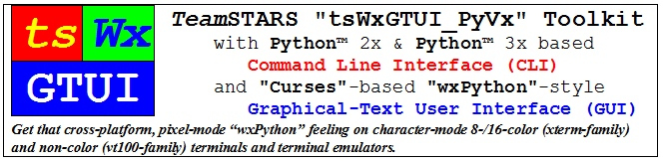
UseCase_6_Remote_User_Interface

Slide 2
Table of Contents (with slide show Hyperlinks)
System Applications
System Features
Operator Terminal Features

Slide 3
System Applications (Table of Contents)
An embedded system is a computer system having a dedicated function within a larger mechanical or electrical system, often with real-time computing constraints. It is embedded as part of a complete product often including hardware and mechanical parts.
Mechanical and electrical system functions for such application as:
Commercial (building energy management)
Industrial (electrical power generation)
Block Diagram of an Embedded System
Embedded System Monitor & Control Screenshot (prototype)
Medical (CAT-scan)
Military (weapon control)

Slide 4
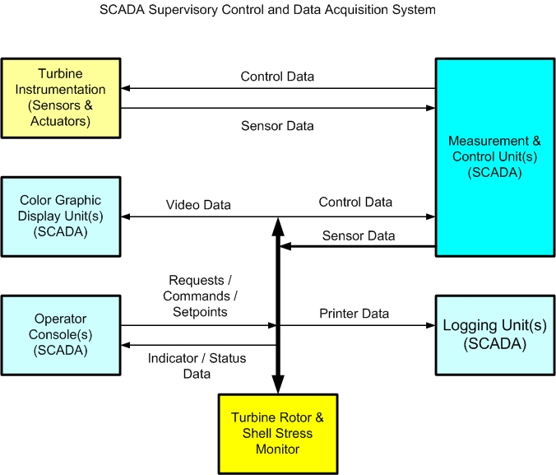
Block Diagram of an Embedded System (Table of Contents)
Electric Power Station with:
Local, multi-operator Control Room
Remote Supervisory Control and Data Acquisition System (SCADA)
Remote steam boiler manufacturer instrumentation and controls
Remote electrical generator manufacturer instrumentation and controls
Remote steam turbine manufacturer instrumentation, controls and embedded computer for:
Analysis of thermal and rotational stresses
SCADA settings, in automatic mode, or Operator guidance, in manual mode, for turbine pre-warming, readiness for startup and safe speed holds and rate of rotational speed acceleration and power load changes

Slide 5
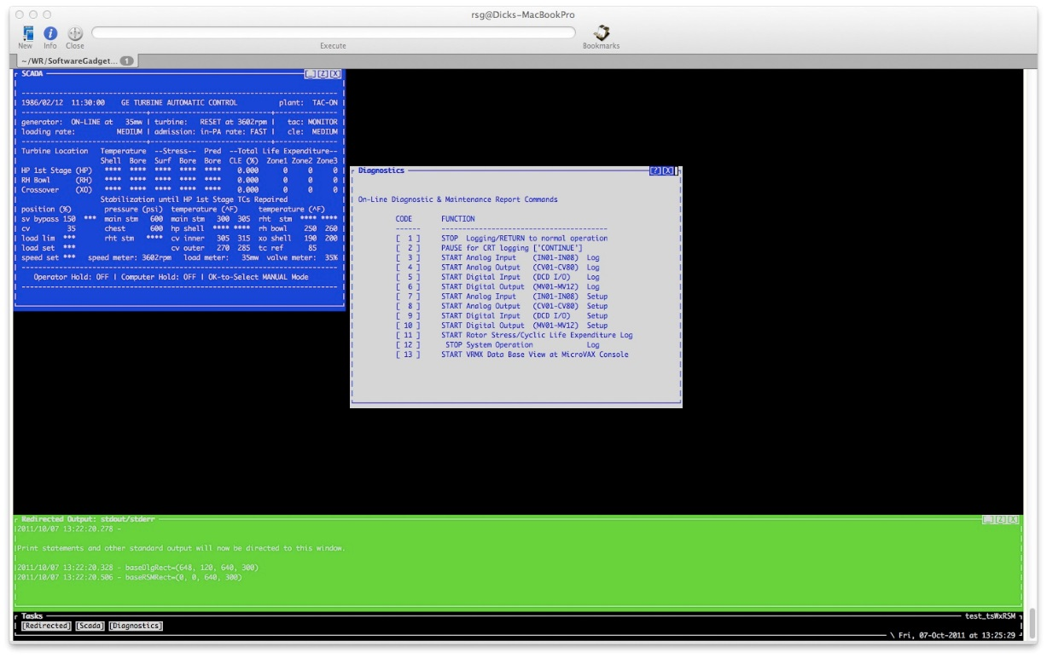
Embedded System Monitor & Control Screenshot (prototype) (Table of Contents)
Turbine Sensor Input, Calculated Stress & Life Expenditure Display (prototype) (white text on blue background)
Checkup On Line Diagnostic & Maintenance Report Dialog (prototype)(blue text on white background)
Redirected Output (Operator Advisory Message) Display (white text n green background)

Slide 6
Turbine Sensor Input, Calculated Stress & Life Expenditure Display (prototype) (Table of Contents)
1986/02/12 11:51:28 TURBINE ROTOR STRESS MONITOR mode: ON‑LINE
Turbine Location Temperature ‑‑Stress‑‑ Pred ‑‑Total Life Expenditure‑‑
‑‑‑‑‑‑‑‑‑‑‑‑‑‑‑‑‑‑‑‑‑‑‑‑‑‑‑‑‑‑‑‑‑‑‑‑‑‑‑‑‑‑‑‑‑‑‑‑‑‑‑‑‑‑‑‑‑‑‑‑‑‑‑‑‑‑‑‑‑‑‑‑‑‑‑‑
Shell Bore Surf Bore Bore CLE (%) Zone1 Zone2 Zone3
HP 1st Stage (HP) **** **** **** **** **** 0.000 ***** ***** *****
RH Bowl (RH) **** **** **** **** **** 0.000 ***** ***** *****
Crossover (XO) **** **** **** **** **** 0.000 ***** ***** *****
Not Valid until ... 12:51:28
CV01‑10: 3.00 36.75 37.34 4.39 10.94 7.57 7.88 0.00 0.00 33.61
CV11‑20: 20.61 0.00 0.02 0.00 18.60 ‑33.63 ‑0.07 0.02 99.96*******
CV31‑40: 0.00 0.00 0.00 79.98 0.00 0.00 0.00 0.00 0.00 33.81
CV41‑50: 31.30 0.00 0.02 0.00 0.00 ‑33.83 0.00 0.00 79.98*******
CV61‑70: ‑1.97 ‑1.31 ‑1.41 59.82 ‑0.60 ‑0.37 ‑0.42 0.00 0.00 30.12
CV71‑80: 28.46 0.00 0.04 0.00 0.00 ‑30.15 0.15 ‑0.01 54.96 9.96
M01‑12: FFFF FFFF FFFF M13‑24: FFFF FFFF FFFF M25‑36: FFFF FFFF FFFF
M37‑46: FT F F F F F F F F
MV01‑12: 2 0 0 0 0 0 0 0 0 0 0 0
IN01‑07: 100 **** 80 **** 60 50 0
IN08‑10: 1 HIGH DCD I/O: 0

Slide 7
Checkup On Line Diagnostic & Maintenance Report Dialog (prototype) (Table of Contents)
21:06:12.95 CHKUP Program Startup. Process: _TTA1.
CHKUP 2015/11/22 21:06:15.75
On Line Diagnostic & Maintenance Report Commands
CODE FUNCTION
[ 1 ] STOP Logging/RETURN to normal operation
[ 2 ] PAUSE for CRT logging ["CONTINUE"]
[ 3 ] START Analog Input (IN01 IN07) Log
[ 4 ] START Analog Output (CV01 CV80) Log
[ 5 ] START Digital Input (IN08/09/10) Log
[ 6 ] START Digital Output (M01 M36) Log
[ 7 ] START Analog Input (IN01 IN07) Setup
[ 8 ] START Analog Output (CV01 CV80) Setup
[ 9 ] START Digital Input (IN08/09/10) Setup
[ 10 ] START Digital Output (M01 M36) Setup
[ 11 ] START Rotor Stress/Cyclic Life Expenditure Log
[ 12 ] START System Operation Log
[ 13 ] START VRMX Data Base View at MicroVAX Console
Desired Command Code ? 3
This is a Command Line Interface implementation that will eventually be re-implemented as a Graphical User Interface using checkboxes instead of a prompt for keyboard input.

Slide 8
Redirected Output (Operator Advisory Message) Display (prototype) (Table of Contents)
Redirected Output: stdout/stderr
2011/10/07 13:22:20.278
Print statements and other standard output will now be directed to this window.
2011/10/07 13:22:20.328 - baseDlgRect=(648, 120, 640, 300)
2011/10/07 13:22:20.506 - baseRSMRect=(0, 0, 640, 300)

Slide 9
System Features (Table of Contents)
One or more local and remote computer systems, each with:
One or more single-core or multi-core processors
Volatile Random Access Memory for temporary data storage during operation
Non-volatile storage for operating system and application program configuration storage during planned system shutdowns and unplanned electric service interruptions.
electro-magnetic hard drive
electronic flash memory
An application specific centralized Supervisory Control and Data Acquisition (SCADA) System with one or more embedded Measurement and Control Unit (MCU) subsystems and an associated Application Programming Interface (NOT included in the “tsWxGTUI_PyVX” toolkit release) for:
analog sensor data input for temperature, pressure, speed, flow, position, voltage, current etc.
analog actuator output for control of equipment/valve position, panel meters, display brightness/contrast etc.
digital sensor data input for switch, circuit breaker relay open/close position etc.
digital actuator output for control of Klaxon horn alarms, annunciator panel lamps etc.

Slide 10
Operator Terminal Features (Table of Contents)
An embedded system may need one or more operators with specialized skills and associated assigned duties, depending on system size and complexity. The collaborating operators may each need to use one or more local and remote computer terminal devices that each include:
A keyboard and mouse used by the operator to input monitoring and control selections and data.
A display and optional printer used by the computer to output monitoring and control status, data, and troubleshooting information.

