Slide 1
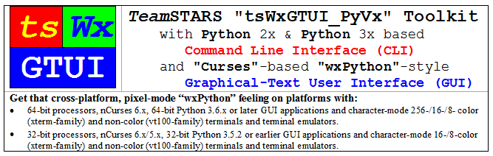
Release

Slide 2
Table of Contents (with slide show Hyperlinks)
Capabilities
Command Line Interface (CLI)
Graphical User Interface (GUI)
Local & Remote Monitoring and Control
Limitations
Pre-Alpha Stage Release
Engineering & User Issues and Associated Resolutions
Where to get further information?
GitHub Repository Author Screen
GitHub Repository Display
GitHub Repository Issues Display

Slide 3
Command Line Interface (CLI) Capabilities (Table of Contents)
Launch application programs with or without:
operator key word-value pair options
positional arguments
Create platform configuration and event log files for date and time stamped messages notifying operator and field service of situations requiring:
immediate action
later troubleshooting
Generate and return Unix-type exit code to coordinate operation of multiple collaborating scripts.

Slide 4
Graphical User Interface (GUI) Capabilities (Table of Contents)
Launch character-mode wxPython-like application programs (mimicking the look and feel of native GUI applications on Microsoft Windows) with or without configurable options for:
Splash Screen containing:
Trademark, Copyright, License and/or Notice depending on screen size
Redirected Output containing:
Event log files for date and time stamped messages notifying operator of situations requiring immediate action
Taskbar containing:
A row of buttons that represent open programs, among which the user can switch back and forth by clicking on the appropriate button
Generate and return Unix-type exit code to coordinate operation of multiple collaborating scripts.

Slide 5
Local & Remote Monitoring / Control Capabilities (Table of Contents)
Once you've logged into your local computer, you can:
Launch one or more local shells (such as "sh" and "bash") associated with the local operating system's command line interface.
Use a local secure shell (such as “ssh”) or a local non-secure shell (such as “rsh) to launch one or more remote shells (such as "sh" and "bash") associated with the remote operating system's command line interface.
The local and remote operating system's command line interface provides access to associated terminal interface and the TeamSTARS "tsWxGTUI_PyVx" Toolkit's Python and "Curses" (or “nCurses”) based character-mode user interfaces which enable you to monitor and control one or more local and remote application programs.

Slide 6
Pre-Alpha Stage Limitations (Table of Contents)
Designates a program or application that is NOT:
Feature complete
Independently tested
Usually released to the public
Developers are still deciding on what features the source code and documentation should have and are seeking input from third-parties willing to try it and provide constructive feedback.
Current source code and documentation is subject to change without notice.
Previous versions of the source code and documentation are archived and remain available in the GitHub repository.

Slide 7
Engineering & User Issues and Associated Resolutions (Table of Contents)
Associated “GitHub” Public Repository Issues Database:
Click on Menu Item of Interest (“Pull requests” | “Issues” | “Gist”) on Top-Line of Repository Display Window
Click on Release Subdirectory and File Items of Interest
Associated “GitHub” Public Repository Subdirectories and Files
Click on Release Subdirectory and File Items of Interest
“./Documents” Subdirectory
“./Bugs.txt” file
“./Changes.txt” file
“./SourceDistributions” Subdirectory
“./Developer-Sandboxes” source code file(s)
“./Site-Packages” source code file(s)

Slide 8
Where to get further information? (Table of Contents)
https://github.com/rigordo959/tsWxGTUI_PyVx_Repository

Slide 9
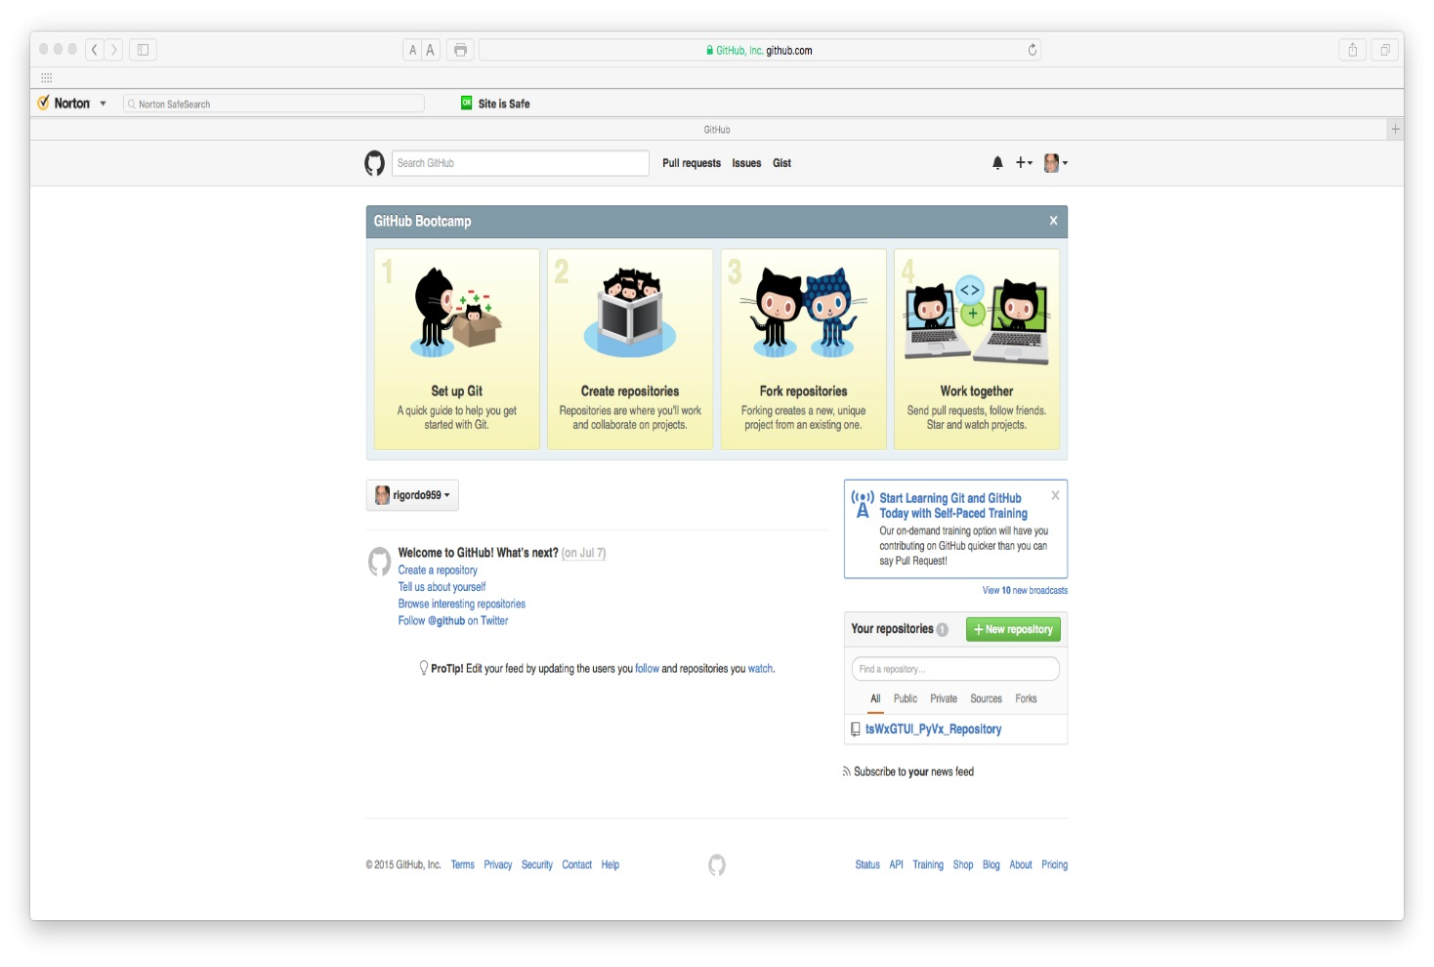
GitHub Repository Author Screen (Table of Contents)
Click on an Item of Interest (icon “Set up Git”, “Create Repositories”, “Fork Repositories” or “Work Together”) to initiate an activity
Click on an Item of Interest (menu “Pull requests”, “Issues” or “Gist) to initiate an activity or view its contents

Slide 10
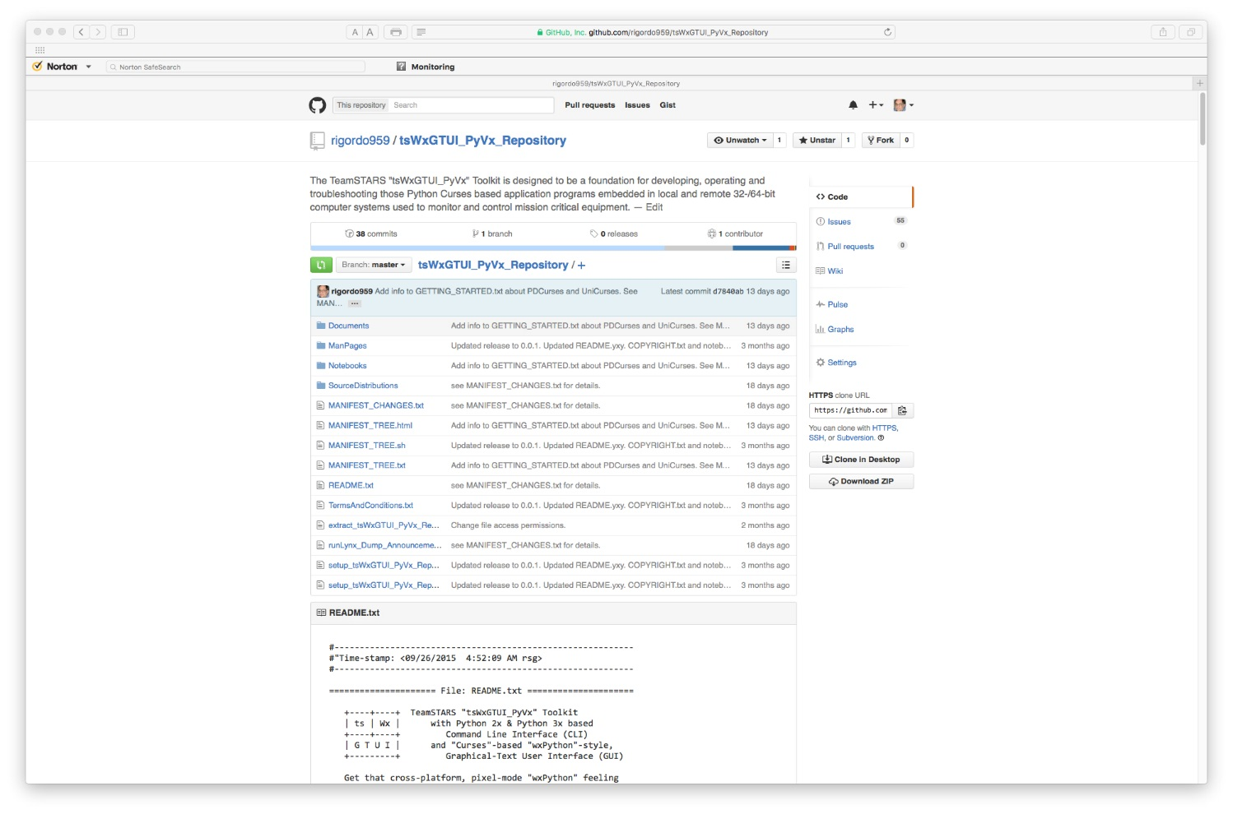
GitHub Repository Display (Table of Contents)
Click on an Item of Interest (menu “Pull requests”, “Issues” or “Gist) to initiate an activity or view its contents
Click on an Item of Interest (subdirectory or file) to view its contents

Slide 11
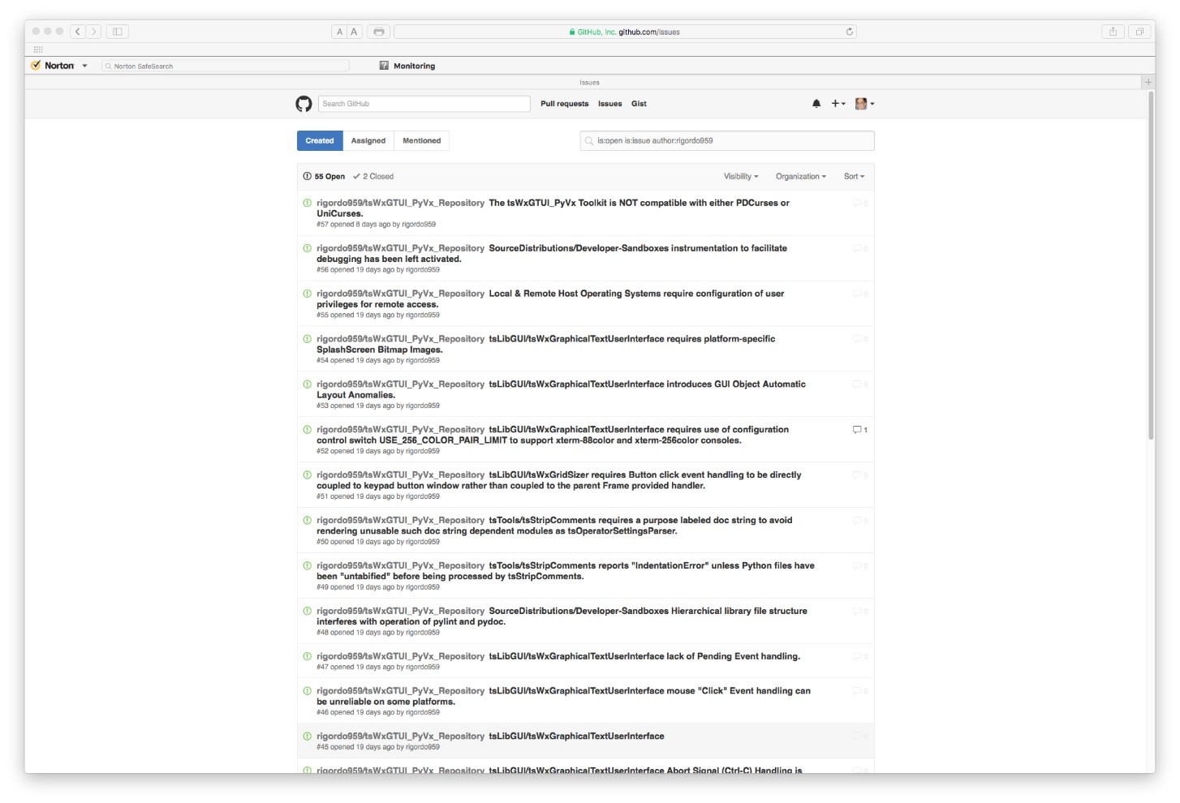
GitHub Repository Issues Display (Table of Contents)
Click on an Item of Interest (menu “Pull requests”, “Issues” or “Gist) to initiate an activity or view its contents
Click on an Item of Interest (Issue list entry) to view its reported details and any subsequent comments

