Slide 1
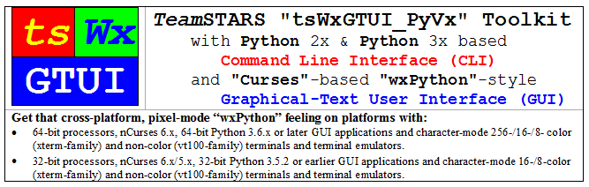
UseCase_1_Sample_Screen_Shots

Slide 2
Table of Contents (with slide show Hyperlinks)
Command Line Interface (CLI)
Sample CLI Display
Graphical User Interface (GUI)
Sample GUI Widgets
Sample GUI Scrolled Windows (xterm 8-color)
Sample GUI Scrolled Windows (vt100 Black-on-White) & (vt100 White-on-Black)
Laptop & Workstation for Development & Embedded Systems (HOST)
Professional Development Laptop System
Professional Development Workstation System
Screenshot Professional Development Workstation System

Slide 3
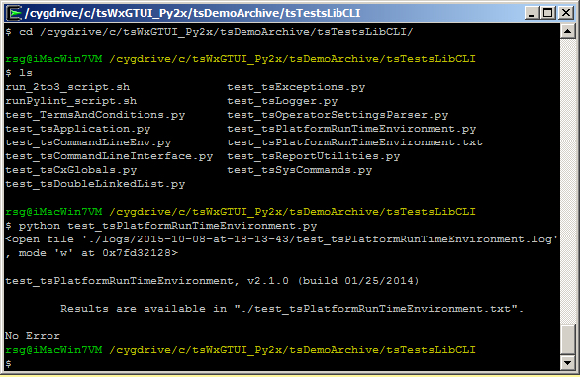
Sample CLI Display (Table of Contents)
The cd command, also known as chdir, changes the directory as specified.
The ls command lists files in the directory.
The python command executes the named program which displays the location of its results before terminating.

Slide 4
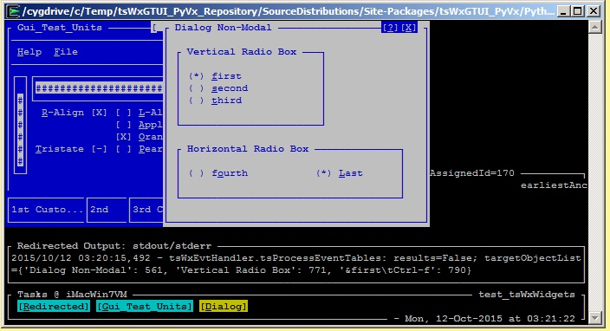
Sample GUI Widgets (Table of Contents)
Blue Frame (Application partially hidden)
With Title, Menu Bar, Horizontal & Vertical Gauges, Check Boxes and Status Bar
White Dialog (Application)
With Title, Window Control Buttons, Radio Boxes and Radio Buttons
Black Redirected Output (stdout/stderr) Frame (Application Option)
With Title and Output of
Date, Time & Severity-level stamped event notifications (optional colorization not shown)
Task Bar Frame (Application Option)
With Title, Application Frame & Dialog Focus Control Buttons and Output of
Network (Name or IP-Address) & Program Name
Idle Time Spinner and Current Date & Time

Slide 5
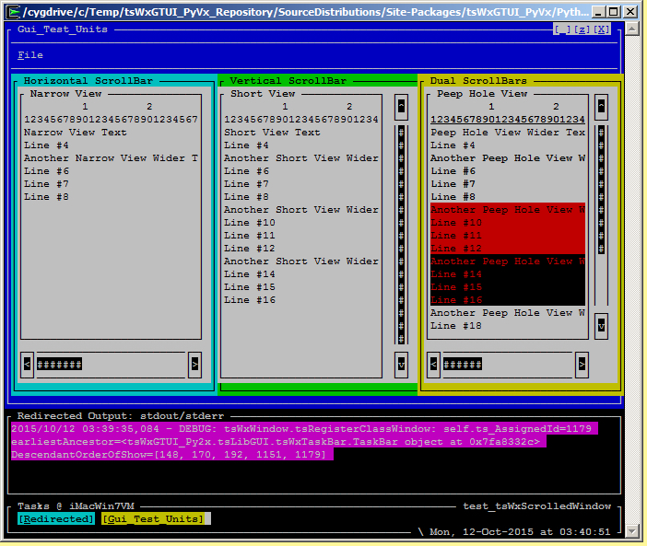
Sample GUI Scrolled Windows (xterm 8-color) (Table of Contents)
Blue Application Frame
With Title, Menu Bar, Window Size & Close Control Buttons and three scrollable panels.
Three Scrollable Application Panels (Cyan Horizontal, Green Vertical & Yellow Dual )
Each with Title and Output of
Multi-Colored & Non-Colored Text, Horizontal and/or Vertical scroll bars, associated clickable arrow buttons and clickable gauge depicting relative size and position or displayed text.
Black Redirected Output (stdout/stderr) Frame (Application Option)
With Title and Output of
Colorized, date, time & severity-level stamped event notifications (lowest severity debug-level shown)
Task Bar Frame (Application Option)
With Title, Application Frame Focus Control Buttons and Output of
Network (Name or IP-Address) & Program Name
Task (Redirected & Gui_Test_Units) Focus Control Buttons
Idle Time Spinner and Current Date & Time

Slide 6
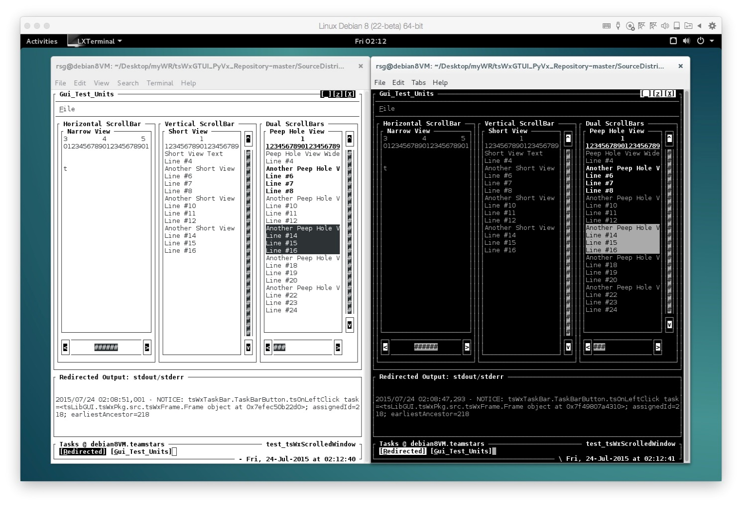
Sample GUI Scrolled Windows Normal (vt100 Black-on-White) & Reversed (vt100 White-on-Black) (Table of Contents)
Outer-Most Application Frames
With Menu Bar, Window Size & Close Control Buttons and three scrollable panels.
Three Scrollable Application Panels (Horizontal, Vertical & Dual)
Each with Non-Colored Text, Horizontal and/or Vertical scroll bars, associated clickable arrow buttons and clickable gauge depicting relative size and position or displayed text.
Black Redirected Output (stdout/stderr) Frame (Application Option)
With Title and Output of
Non-Colorized, date, time & severity-level stamped event notifications (lowest severity debug-level shown)
Task Bar Frame (Application Option)
With Title, Application Frame Focus Control Buttons and Output of
Network (Name or IP-Address) & Program Name
Task (Redirected & Gui_Test_Units) Focus Control Buttons
Idle Time Spinner and Current Date & Time

Slide 7
Professional Development Laptop System (Table of Contents)
2007 Apple MacBook Pro Hardware
2.33 GHz Intel Core 2 Duo processor
4 GB RAM
17” 1920x1200 pixel LCD display
160 GB (5400 RPM) SATA 1.5 Gb/s internal hard drive
1.5 TB (7200 RPM) SATA 3 Gb/s external hard drive
Ethernet Network Adapter
WiFi Wireless Network Adapter
Development / Embedded Software
MAC OS X 10.7.5 Lion
Wing IDE 3-4
LibreOffice
Xemacs
Python 2x & 3x
Guest (non-optimized) Embedded Software
Parallels Desktop 8 Hypervisor for running Guest OS:
Linux (Fedora 20 32-bit, OpenSuSE 12.2 32-bit, Scientific (CentOS) 6.4-6.5 64-bit, Ubuntu 12.04 32-bit) with Python 2.7 and 3.2 with Wing IDE 3, LibraOffice and XEmacs
Microsoft Windows (XP, 7, 8 & 8.1 each with Cygwin 1.7.8) with Wing IDE 3, AuthorIt-5, Office 2002 & XEmacs
Unix (PC-BSD 9.2-10.0, OpenIndiana 151a3 & OpenSolaris 11) with LibraOffice and Xemacs
VMware Fusion 7 Hypervisor for running Guest OS:
Linux (OpenSuSE 13.1)
Microsoft Windows (2000)

Slide 8
Professional Development Workstation System (Table of Contents)
2013 Apple iMac Desktop Hardware
3.5 GHz Intel Quad Core i7 processor
16 GB RAM
27” 2560x1440 pixel LCD display
3 TB (7200 RPM) SATA 6 Gb/s internal hard drive with 128 GB Solid State Flash memory
Ethernet Network Adapter
WiFi Wireless Network Adapter
Development / Embedded Software
MAC OS X 10.11 El Capitan
Wing IDE 5
LibreOffice
Microsoft Office for Mac 2011
Xemacs
Python 2x & 3x
Guest (non-optimized) Embedded Software
Parallels Desktop 11 Hypervisor for running Guest OS:
Linux (Centos 7, Debian 8, Fedora 22, OpenSuSE 13.2, Scientific 7 & Ubuntu 14.04 LTS & 15.04) with Wing IDE 5, LibraOffice and XEmacs
Microsoft Windows (XP, 7, 8, 8.1 & 10) with Wing IDE 5, AuthorIt-5, Office 2002 & XEmacs
Unix (FreeBSD 11/PC-BSD 11, OpenIndiana 151a8 & OpenSolaris 11) with LibraOffice and Xemacs
VMware Fusion 7 Hypervisor for running Guest OS:
Linux (OpenSuSE 13.1)
Microsoft Windows (2000)

Slide 9
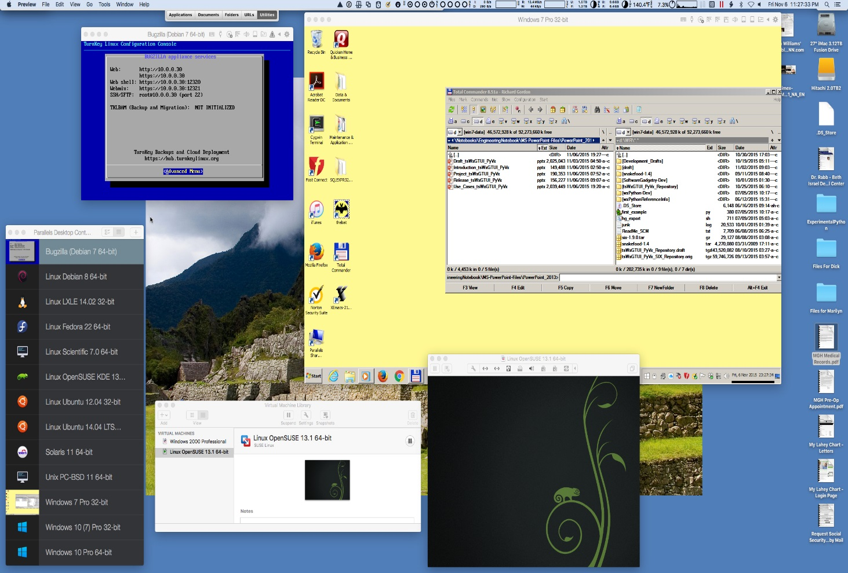
Screenshot Professional Development Workstation System (Table of Contents)
Compatibility/Incompatibility with the “tsWxGTUI_PyVx” Toolkit requires:
Single or multi-core 16-bit, 32-bit or 64-bit processor
Multi-User, Multi-Process, Multi-Threaded Operating System Linux, Mac OS X, Microsoft Windows (XP, or later, with free Linux-like Cygwin plug-in from Red Hat), Unix or any other OS type or version
NOTE: The Sample Desktop system can do more and do it faster than the Sample Laptop system. Intel-based Guest OS platforms substitute for their non-Intel counterparts.
Hypervisor #1 on Mac OS X Yosemite with Intel Quad Core i7 64-bit (Parallels 11 Guest OS list in bottom left black window)
Shown Running
64-bit (Debian Linux 7 running with Bugzilla Database & Apache Server in dark blue window at top left)
32-bit (Microsoft Windows 7 running in yellow window at top right
NOT Running
64-bit (CentOS 7 Linux, Fedora 22 Linux, Microsoft Windows 10, PC-BSD 11 Unix, Open Indiana/Solaris 11 Unix, Scientific 7 Linux, Ubuntu 14.04 Linux)
32-bit (eComStation 2.2 Beta5 OS/2, LXLE 14.02 Linux, Microsoft Windows XP, 8, 8.1, 10, Ubuntu 12.04 Linux)
16-bit (Microsoft Windows 98) 98)
Hypervisor #2 on Mac OS X Yosemite with Intel Quad Core i7 64-bit (VMware Fusion 7 Guest OS list in bottom center white window)
Shown Running
64-bit (Open SUSE 13.2 Linux running in black window at bottom right)
NOT Running
32-bit (Microsoft Windows 2000)
16-bit (Microsoft DOS 6.2 with Windows 3.1)

