Slide 1
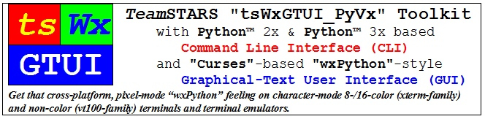
UseCase_2_Block_Diagrams

Slide 2
Table of Contents (with slide show Hyperlinks)
Toolkit Building Block Diagrams
Non-Networked (Stand-Alone) System (HW-SW) Block Diagram
Hardware Component Usage Notes
Operating System Software Component Usage Notes
Application Software Usage Notes
Networked (Stand-Among) System (HW-SW) Block Diagram
Local & Remote System Usage Notes

Slide 3
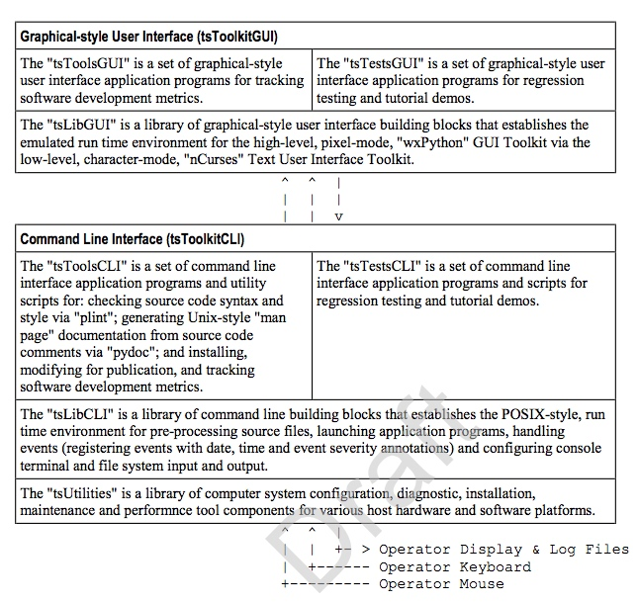
Toolkit Building Block Diagram (Table of Contents)
Cross-platform, Character-mode Curses-based emulation of Pixel-mode cross-platform wxPython Graphical User Interface (tsToolkitGUI)
Cross-platform, Linux-/Unix-like POSIX-based Command Line Interface (tsToolkitCLI)
Operator’s Computer Terminal with Display, Keyboard and Mouse

Slide 4
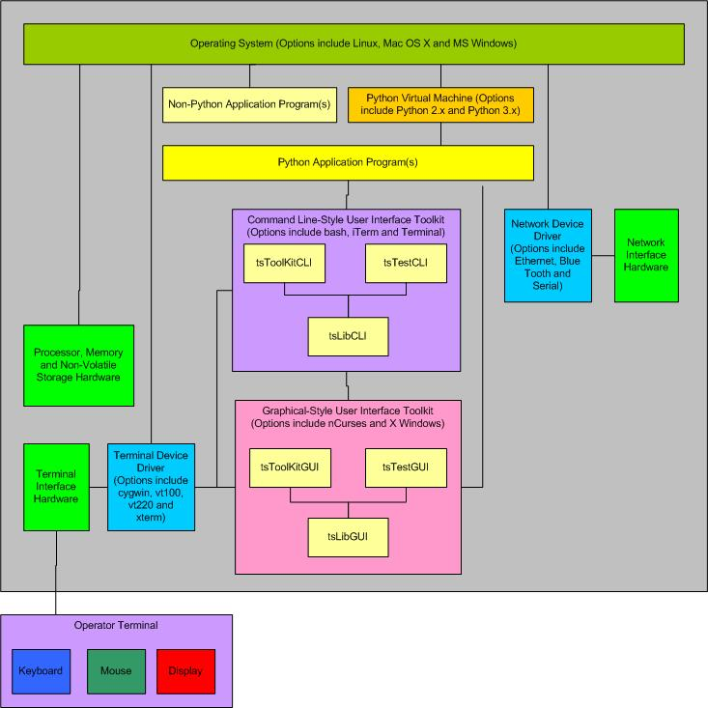
Non-Networked (Stand-Alone) Mode (Table of Contents) System (HW-SW) Block Diagram
Usage Notes
Hardware Components
Operating System Software Components
Application Software Components

Slide 5
Hardware Component Usage Notes (Table of Contents)
Processor, Memory, Storage and Communication Hardware - Platform specific resources that are required by the Operating System and Application software.
Network Hardware Interface - The optional platform specific Ethernet, blue-tooth and RS-232 serial port hardware for physical connections between the local system and one or more remote systems. It may also include such external hardware as gateways, routers, network bridges, switches, hubs, and repeaters. It may also include hybrid network devices such as multilayer switches, protocol converters, bridge routers, proxy servers, firewalls, network address translators, multiplexers, network interface controllers, wireless network interface controllers, modems, ISDN terminal adapters, line drivers, wireless access points, networking cables and other related hardware.
Terminal Hardware Interface - The platform specific hardware with connections to the device units of the Operator Terminal.
Operator Terminal - A device for human interaction that includes: A Keyboard unit for text input; A Mouse unit (mouse, trackball, trackpad or touchscreen with one or more physical or logical buttons) for selecting one of many displayed GUI objects to initiate an associated action.; A Display unit (1-color "ON"/"OFF" or multi-color two-dimensional screen) for output of text and graphic-style, tiled and overlaid boxes.

Slide 6
Operating System Software Component Usage Notes (Table of Contents)
Operating System - The platform specific software (such as Linux, Mac OS X, Microsoft Windows and Unix) that coordinates and manages the time-shared use of a platform's processor, memory, storage and input/output hardware resources by multiple application programs and their associated users/operators.
Network Device Driver Interface - The optional platform specific software whose layered protocol suite (such as TCP/IP) enables the concurrent sharing of the physical connection between the local system and one or more remote systems.
Terminal Device Driver - The platform specific software for transforming data (such as single button scan codes, multi-button flags and pointer position) to and from the platform independent formats (such as upper and lower case text, display screen column and row and displayed colors, fonts and special effects) used by the Command Line Interface and Graphical User Interface software.

Slide 7
Application Software Usage Notes (Table of Contents)
Non-Python Application Program - The application specific program that performs its service when its pre-compiled, platform specific machine code is executed. Typically, these services are used to analyze, edit, view, copy, move or delete those data and log files which are of interest or no longer needed.
Python Application Program - The application specific program that performs its service when executed by the Python Virtual Machine.
Command Line-Style Interface ("tsLibCLI") - The platform specific keywords arguments, positional arguments and their associated values and syntax of text used to request services from the Operating System and various Application Programs.
Graphical-Style User Interface ("tsLibGUI") - The platform specific tiled, overlaid and click-to-select Frames, Dialogs, Pull-down Menus, Buttons, CheckBoxes, Radio Buttons, Scrollbars and associated keywords, values and syntax of text used to request services from the Operating System and various Application Programs.
Python Virtual Machine - The platform specific program that loads, compiles Python language application program source code into platform independent tokenized byte-code and then interprets and executes the byte-code using a processor and operating system specific run time library.

Slide 8
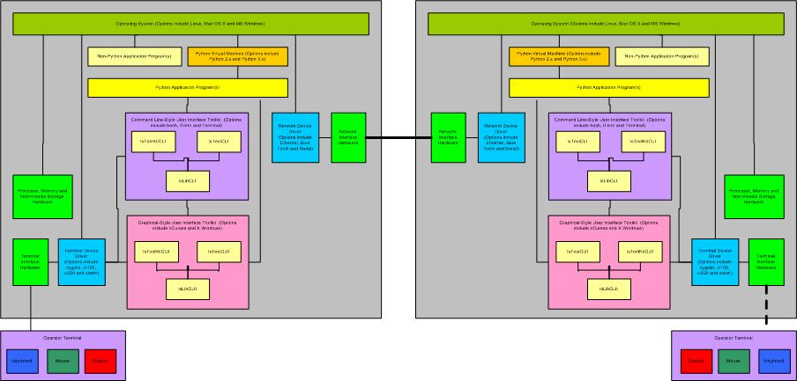
Networked (Stand-Among) Mode (Table of Contents) System (HW-SW) Block Diagram (Local & Remote System Usage Notes)

Slide 9
Local & Remote System (Table of Contents) Usage Notes
Launch the Local (Left) Command Line Interface shell session (bash).
Set Local Working Directory
Transfer any missing application programs from Local to Remote System via SFTP
Login to Remote (Right) System, via SSH (secure shell) or SFTP (secure file transfer protocol), as user with/without administrative privileges.
Set Remote Working Directory
Launch one or more Remote Application(s)
Create archive of Remote Application logs directory(s)
Logout of Remote System
Transfer archive(s) of Remote Application logs directory from Remote to Local System via SFTP
Logout of Local System

