Slide 1
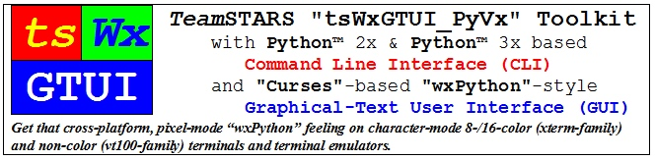
by Richard S. Gordon, a.k.a. Software Gadgetry

Slide 2
Table of Contents
DESIGN OVERVIEW
  Purpose
  Application Programs
  Development Systems
  Embedded Systems
  Command Line Interface (CLI)
  Graphical User Interface (GUI)
USAGE OVERVIEW
  Capabilities
  Limitations

Slide 3
Purpose
Provide a framework for creating, enhancing, troubleshooting, maintaining and supporting application programs that are suitable for embedded systems
Provide a software development toolkit with:
  Libraries of building-block components
  Tools for tracking and improving developer productivity
  Utilities for monitoring and changing hardware and software configuration
  Tests (unit, integration, system, regression and demonstration) for design verification and quality assurance

Slide 4
Application Programs
  Automation, communication, control, diagnostic, instrumentation and simulation application.
  Typically require an "operator-friendly" Command Line Interface (CLI) or a Graphical-style User Interface (GUI) that can be controlled locally and/or remotely.

Slide 5
Development Systems
Commercial laptop, desktop, mainframe or super computer systems for development, archiving, maintenance, troubleshooting and publishing of documents and source code.
General purpose use with suitable and/or upgradeable processing, memory, communication, input/output and file storage resources.
Typically have pixel-mode hardware suitable for email, web surfing, office suite and software development applications using their operating system's graphical user interface.

Slide 6
Embedded Systems
Mission-critical systems for commercial, industrial, medical and military applications.
Typically customized and optimized for a specific use with limited, application-specific processing, memory, communication, input/output and file storage resources.
Typically have character-mode hardware suitable only for troubleshooting and their operating system's command line console.

Slide 7
Command Line Interface (CLI)
Output to the user of a chronological sequence of lines of text written from top to bottom and then scrolling off the top as each new line is written to the bottom of the terminal display.
Input from the user via a computer terminal keyboard that is echoed to the display below the previous output.

Slide 8
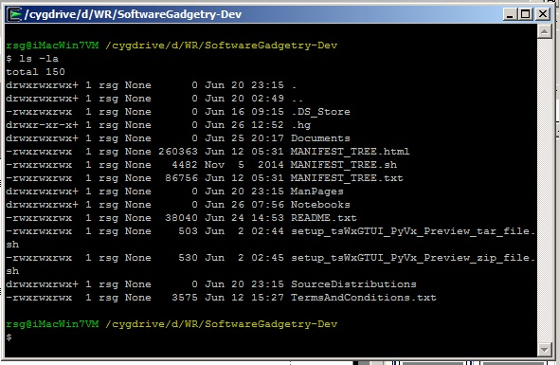
Sample CLI Display

Slide 9
CLI Building Blocks (tsLibCLI)
Application Building Blocks
  tsCommandLineInterface
  tsDoubleLinkedList
  tsOperatorSettingsParser
  tsReportUtilities
Application Diagnostics
  tsExceptions
  tsLogger
Application Configuration
  tsCxGlobals
  tsGistGetTerminalSize
  tsPlatformRunTimeEnviroment
Application Launchers
  tsApplication
  tsCommandLineEnv
  tsSysCommands

Slide 10
CLI Tools (tsToolsCLI)
Developer Tools
  tsChange_tsWxGTUI_PyVx
  tsChange_wxPython_API_Version
  tsStripComments
  tsStripLineNumbers
  tsTreeCopy
  tsTreeTrimLines.py
Troubleshooter Tools
  tsPlatformQuery
Developer Productivity Tracking Tools
  tsLinesOfCodeProjectMetrics
    Total Files, Lines of Code & Comments
    Subtotals (by language) Files, Lines of Code & Comments
    Estimates labor cost/value, staffing and schedule per COCOMO-81 model. It computes software development effort as a function of program size and a set of "cost drivers" that include subjective assessments of product, hardware, personnel, and project attributes.

Slide 11
Graphical User Interface (GUI)
Output to the user of character strings to application-specified column and row (line) fields on a computer terminal display.
Input from the user via a pointing device (such as mouse, trackball, touchpad or touch screen) that is moved into a position by its operator before a mouse button is clicked to activate a function button, radio button , checkbox or keyboard input position.
Input from the user via a computer terminal keyboard that is echoed as output to a reserved area of the display that is written from top to bottom and then scrolling off the top as each new line is written to the bottom of the reserved area.

Slide 12
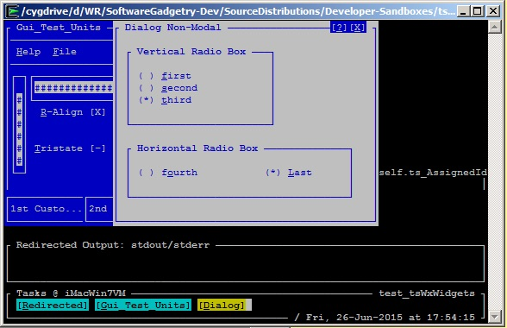
Sample GUI Display

Slide 13
GUI Building Blocks (tsLibGUI)
Application Building Blocks (partial listing)
  Top-Level GUI Objects
    tsWxFrame
    tsWxDialog
  Lower-Level GUI Objects
    tsWxPanel
    tsWxStatusBar
  GUI Controls
    wxWxButton
    tsWxCheckbox
    tsWxGauge
    tsWxMenuBar
    tsWxRadioButton
    tsWxScrollBar
    tsWxTaskBar
  GUI Events
    Keyboard / Mouse / Tmer
  GUI Sizers
    tsWxBoxSizer
    tsWxGridSizer
Application Configuration
  tsWxGlobals
  tsWxGraphicalTextUserInterface
  tsWxSplashScreen
Application Diagnostics
  tsWxLog (Future)
Application Launchers
  tsWxApp
  tsWxPyApp
  tsWxPyOnDemandOutputWindow
  tsWxPySimpleApp
  tsWxMultiFrameEnv

Slide 14
GUI Building Blocks (tsLibGUI)
Application Building Blocks
  tsCommandLineInterface
  tsDoubleLinkedList
  tsOperatorSettingsParser
  tsReportUtilities
Application Diagnostics
  tsExceptions
  tsLogger
Application Configuration
  tsCxGlobals
  tsGistGetTerminalSize
  tsPlatformRunTimeEnviroment
Application Launchers
  tsApplication
  tsCommandLineEnv
  tsSysCommands

Slide 15
Capabilities: Local Monitoring / Control
Once you've logged into your local computer, you can launch one or more local shells (such as "sh" and "bash") associated with the local operating system's command line interface.
The local operating system's command line interface provides access to associated terminal interface and the TeamSTARS "tsWxGTUI_PyVx" Toolkit's Python and "nCurses" based character-mode user interfaces which enable you to monitor and control one or more local application programs.

Slide 16
Capabilities: Remote Monitoring / Control
Once you've logged into your local computer, you may then login to a remote computer using one or more secure shells ("ssh") or non-secure shells ("rsh") provided by the local operating system.
The Secure Shell ("ssh") is a cryptographic network protocol for secure data communication, remote command-line login, remote command execution, and other secure network services between two networked computers. It connects, via a secure channel over an insecure network, a server and a client running "ssh" server and "ssh" client programs, respectively.
The remote shell ("rsh") is a command line computer program that can execute shell commands as another user, and on another computer across a computer network. The remote system to which "rsh" connects runs the "rsh" daemon ("rshd").
The local and remote operating system's command line interfaces provides access to associated terminal interface and the TeamSTARS "tsWxGTUI_PyVx" Toolkit's Python and "nCurses" based character-mode user interfaces which then communicate.
This enables you to monitor and control one or more remote and local application programs, from the convenience of your local computer terminal, with greater speed and efficiency than possible with the larger communication traffic associated with pixel-mode.

Slide 17
Limitations: Not Magical Cross-platform
Host Specific Native Applications
  You will NOT be able to run native Linux, Mac OS X, Microsoft Windows and Unix applications on each other's development and embedded system platforms.
Pixel-mode "wxPython" / "wxWidgets" Applications
  You will NOT be able to run pixel-mode applications on platforms with character-mode terminals or terminal emulators (such as vt100, vt220, Cygwin, linux, xterm, xterm-color, xterm-16color, xterm-88color and xterm-256color).

