Slide 1
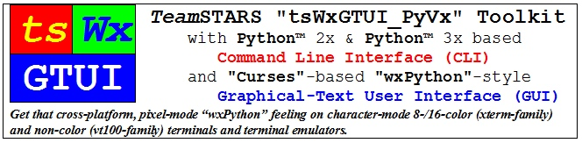
Release
TeamSTARS "tsWxGTUI_PyVx" Toolkit prepared & presented by Richard S. Gordon

Slide 2
Release
Table of Contents (with slide show Hyperlinks)
Capabilities
  Command Line Interface (CLI) Capabilities
  Graphical User Interface (GUI) Capabilities
  Local Monitoring / Control Capabilities
Limitations
  Pre-Alpha Stage Release Limitations
Engineering & User Issues and Associated Resolutions
Where and how to get further information?
TeamSTARS "tsWxGTUI_PyVx" Toolkit prepared & presented by Richard S. Gordon

Slide 3
Release (Table of Contents)
Command Line Interface (CLI) Capabilities
Launch application programs with or without:
  operator key word-value pair options
  positional arguments
Create platform configuration and event log files for date and time stamped messages notifying operator and field service of situations requiring:
  immediate action
  later troubleshooting
Generate and return Unix-type exit code to coordinate operation of multiple collaborating scripts.
TeamSTARS "tsWxGTUI_PyVx" Toolkit prepared & presented by Richard S. Gordon

Slide 4
Release (Table of Contents)
Graphical User Interface (GUI) Capabilities
Launch character-mode wxPython-like application programs (mimicking the look and feel of native GUI applications on Microsoft Windows) with or without configurable options for:
  Splash Screen containing:
    Trademark, Copyright, License and/or Notice depending on screen size
  Redirected Output containing:
    Event log files for date and time stamped messages notifying operator of situations requiring immediate action
  Taskbar containing:
    A row of buttons that represent open programs, among which the user can switch back and forth by clicking on the appropriate button
Generate and return Unix-type exit code to coordinate operation of multiple collaborating scripts.
TeamSTARS "tsWxGTUI_PyVx" Toolkit prepared & presented by Richard S. Gordon

Slide 5
Release (Table of Contents)
Local Monitoring / Control Capabilities
Once you've logged into your local computer, you can launch one or more local shells (such as "sh" and "bash") associated with the local operating system's command line interface.
The local operating system's command line interface provides access to associated terminal interface and the TeamSTARS "tsWxGTUI_PyVx" Toolkit's Python and "nCurses" based character-mode user interfaces which enable you to monitor and control one or more local application programs.
TeamSTARS "tsWxGTUI_PyVx" Toolkit prepared & presented by Richard S. Gordon

Slide 6
Release (Table of Contents)
Pre-Alpha Stage Limitations
Designates a program or application that is NOT:
  Feature complete
  Independently tested
  Usually released to the public
Developers are still deciding on what features the source code and documentation should have and are seeking input from third-parties willing to try it and provide constructive feedback.
  Current source code and documentation is subject to change without notice.
  Previous versions of the source code and documentation are archived and remain available in the GitHub repository.
TeamSTARS "tsWxGTUI_PyVx" Toolkit prepared & presented by Richard S. Gordon

Slide 7
Release (Table of Contents)
Engineering & User Issues and Associated Resolutions
Associated “GitHub” Public Repository Issues Database:
  Click on Menu Item of Interest (“Pull requests” | “Issues” | “Gist”) on Top-Line of Repository Display Window
  Click on Release Subdirectory and File Items of Interest
Associated “GitHub” Public Repository Subdirectories and Files
  Click on Release Subdirectory and File Items of Interest
    “./Documents” Subdirectory
      “./Bugs.txt” file
      “./Changes.txt” file
    “./SourceDistributions” Subdirectory
      “./Developer-Sandboxes” source code file(s)
      “./Site-Packages” source code file(s)
TeamSTARS "tsWxGTUI_PyVx" Toolkit prepared & presented by Richard S. Gordon

Slide 8
Release (Table of Contents)
Where and how to get further information?
https://github.com/rigordo959/tsWxGTUI_PyVx_Repository
TeamSTARS "tsWxGTUI_PyVx" Toolkit prepared & presented by Richard S. Gordon

Slide 9
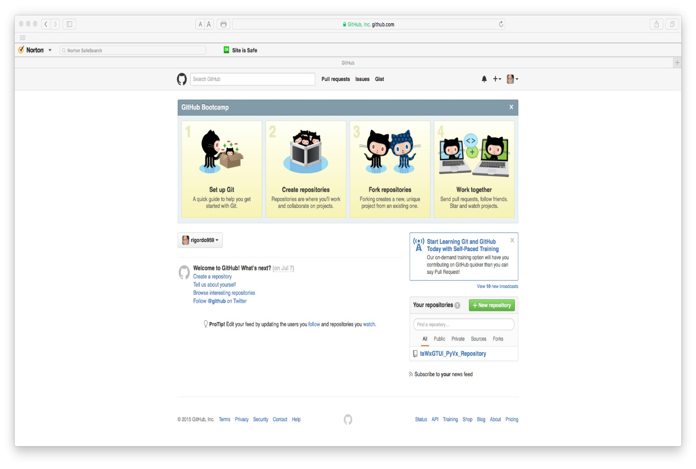
Release (Table of Contents)
Where and how to get further information?
GitHub Repository Author Screen
  Click on an Item of Interest (icon “Set up Git”, “Create Repositories”, “Fork Repositories” or “Work Together”) to initiate an activity
  Click on an Item of Interest (menu “Pull requests”, “Issues” or “Gist) to initiate an activity or view its contents
TeamSTARS "tsWxGTUI_PyVx" Toolkit prepared & presented by Richard S. Gordon

Slide 10
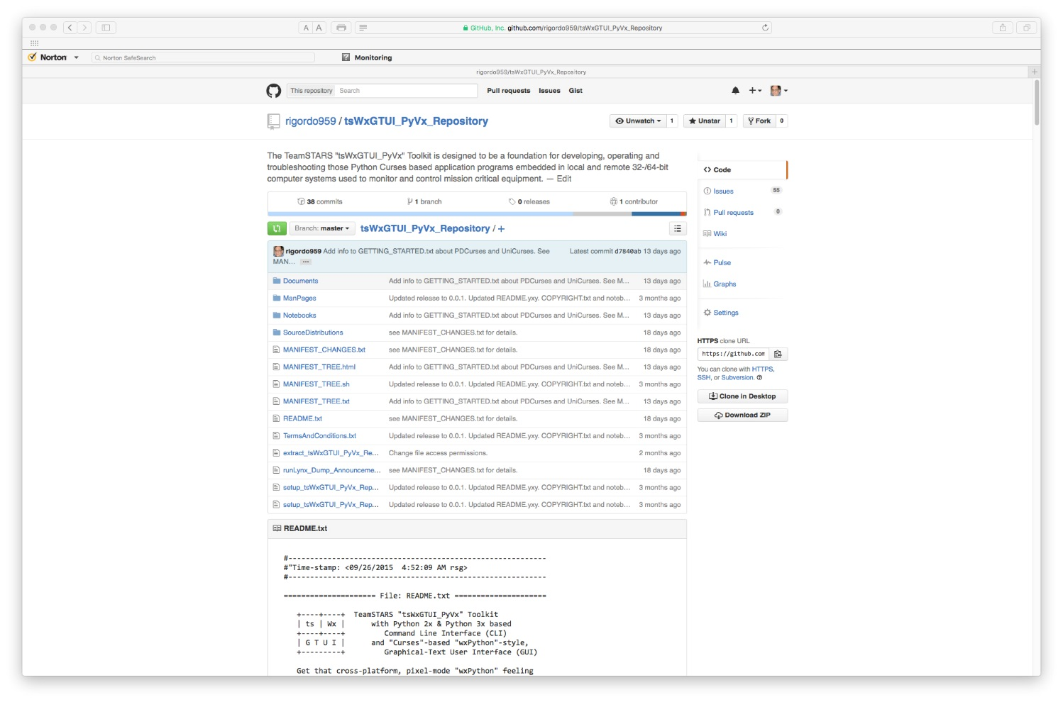
Release (Table of Contents)
Where and how to get further information?
GitHub Repository Display
  Click on an Item of Interest (menu “Pull requests”, “Issues” or “Gist) to initiate an activity or view its contents
  Click on an Item of Interest (subdirectory or file) to view its contents
TeamSTARS "tsWxGTUI_PyVx" Toolkit prepared & presented by Richard S. Gordon

Slide 11
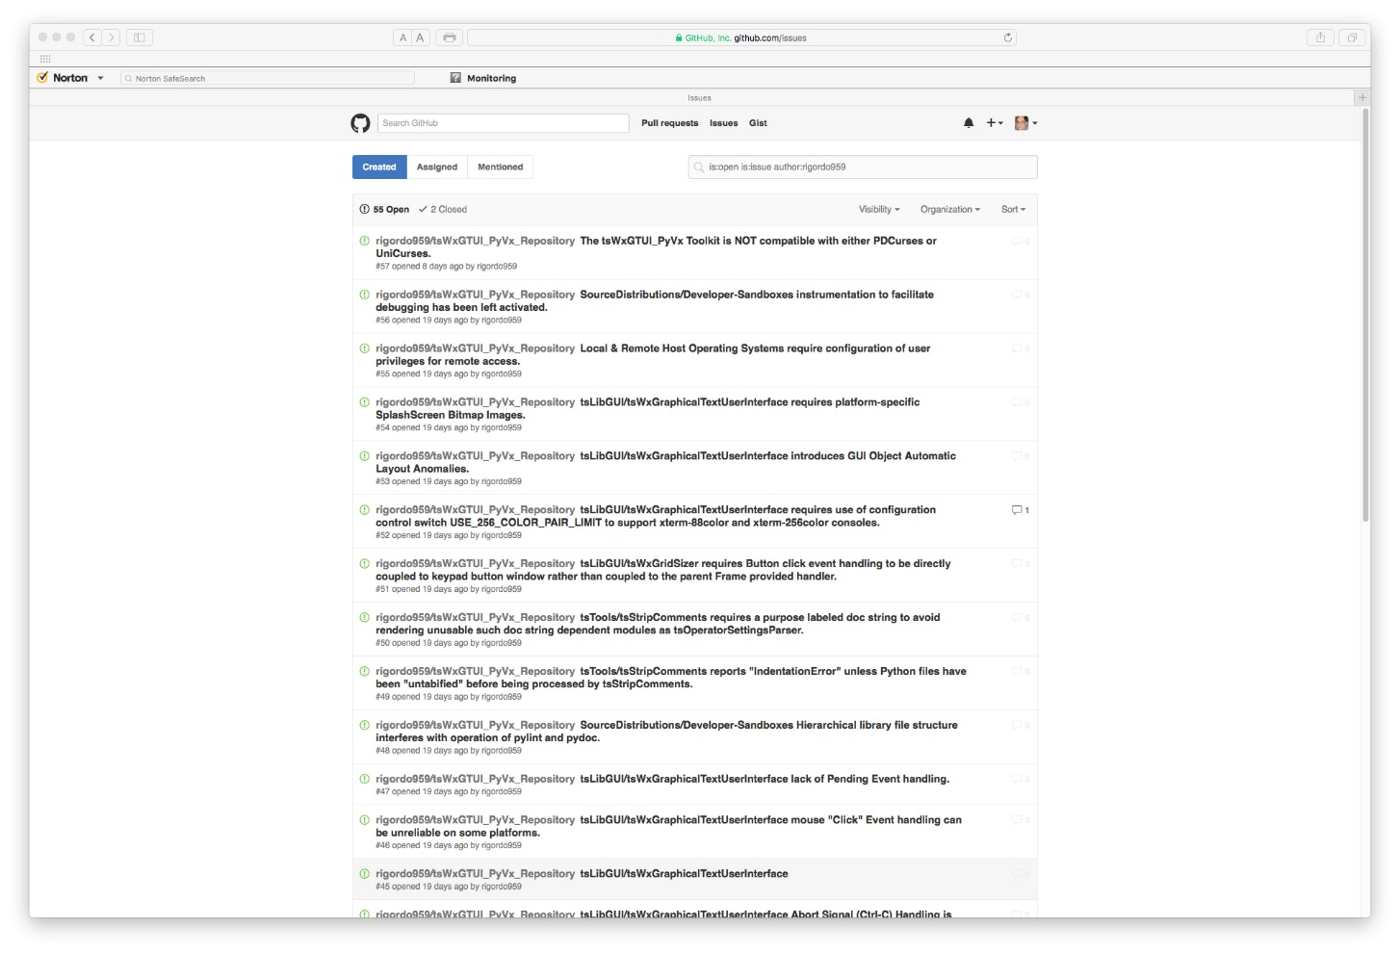
Release (Table of Contents)
Where and how to get further information?
GitHub Repository Issues Display
  Click on an Item of Interest (menu “Pull requests”, “Issues” or “Gist) to initiate an activity or view its contents
  Click on an Item of Interest (Issue list entry) to view its reported details and any subsequent comments
TeamSTARS "tsWxGTUI_PyVx" Toolkit prepared & presented by Richard S. Gordon

