Slide 1
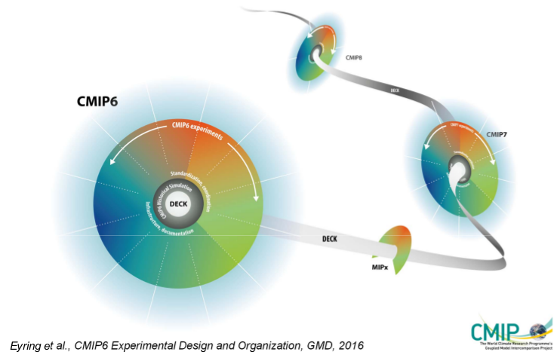

Directly driving data and metadata generation by
CMIP6 Data Request content thanks to XIOS
S. Sénési, (CNRM, Meteo-France)
Y. Meurdesoif, A. Caubel, S. Denvil (IPSL)
M.-P. Moine (Cerfacs)
Joint final IS-ENES2 workshop on Workflow Solutions in Earth System Modelling and Meta-Data Generation during Experiments - Lisbon, 26-29/09/2016
Notes:
This talk was initially planned to be given by Stephane Senesi from Meteo France.
Unfortunately he wasn’t able t join us here in Lisbon.
I prepared some last-minute slides to talk
I will try to make the job but, but please, be mild ☺
The object of this talk is to present a solution for driving data and metadata <SUITE TITRE>
Along with Stephane, other colleagues form IPSL here in the room are involved in this work : <NOMS> and at last myself.

Slide 2
Motivations
The CMIP6 Data Request (DRQ) :
CMIP6 data format & Controlled Vocabulary :
CMIP6 is pharaonic: 28 MIPs, 228 experiments, 2280 CMOR variables, 49 tables,…
DRQ gathers (heterogeneous) requirements from all MIPs
High variability in the DRQ: from one experiment to the other, from one simulated year to the next one, from a modelling group to an other depending on the MIPs it is engaged in,...
Standards naming convention for variables (CF), directories and files (DRS)
Mandatory attributes : a lot of metadata on files and variables (CMIP6 CVs)
Challenges:
Constraints:
Such a model’s output configuration is nearly intractable manually
Raises some workflow configuration problems (e.g. how to tell your model to output a variable only over a given time slice ?)
Post-processing is experienced as a critical step (additional pipe in the production workflow to monitor, often with limited computing efficiency, generating I/O traffic)
Modelling groups have to:
Configure their model outputs to conform (at best) to the DRQ
Post-process their data to comply with the CMIP6 format (CMORisation) : change format, names, units, add metadata, compute derived diagnosis…
Notes:
So to put things in their context even if obvious for each of us here in this room…
We are all involved in the CMIP6 machinery... That among other things, sticks some mandatory features in term of outputs and metadata
On one side, we have the DataRequest that specifies the variables to be produced
The DRQ reflects CMIP6 experimental design complexity and diversity
With 28 MIPs, more than 2 hundreds experiments, more than 2 thousands CMOR variables, classified into 49 tables
CMIP6 panels have each their own recommendations
This end-up with a DRQ showing a large variability: different request from one experiment to the other, from…<SUITE>
On the other side, we have CMIP6 data files format (DRS) and CMIP6 controlled vocabulary (CVs) the use of which ensures admission ticket to publication on ESGF
Thus, the modelling groups have to:
configure thein model ouptut … <SUITE>
and post-process their data so that they comply with… <SUITE>
These tasks are really challenging since, given the size of the exercise, its nearly unfeasible by hand
Moreover, it raises some workflow configuration problems <EXEMPLE>
Post-processing step is often experienced as a critical step (not to say traumatic) <SUITE>
So the idea here is to reduce at most the manual operations dealing with model output configuration and offline post-processing

Slide 3
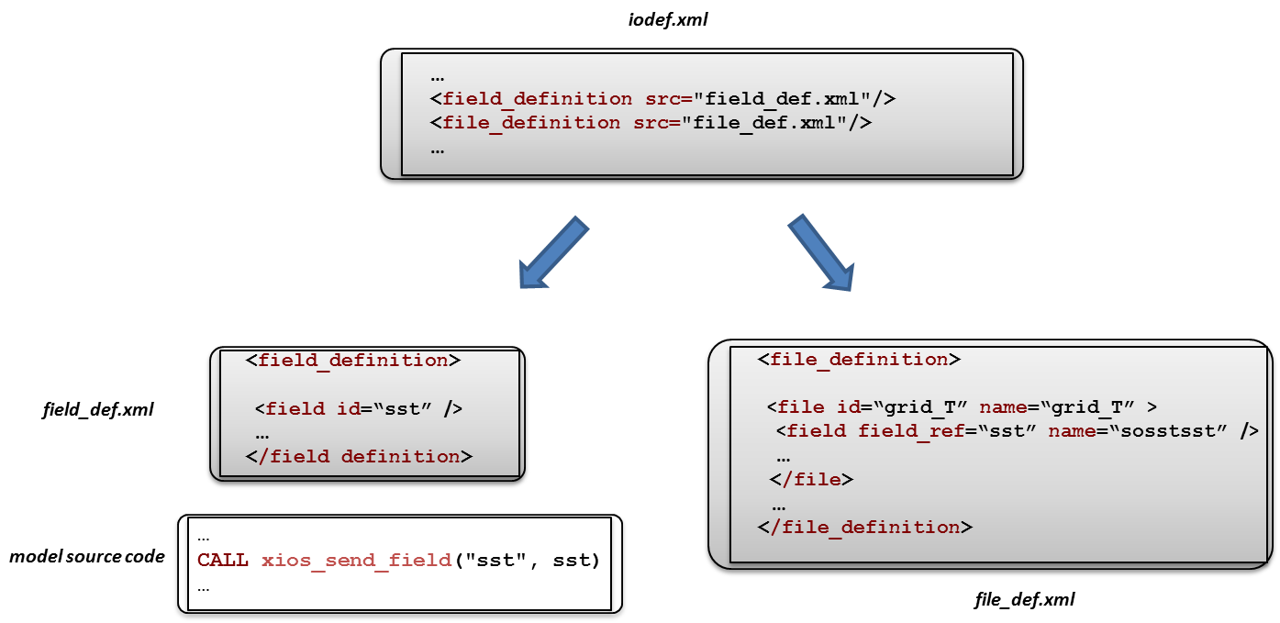
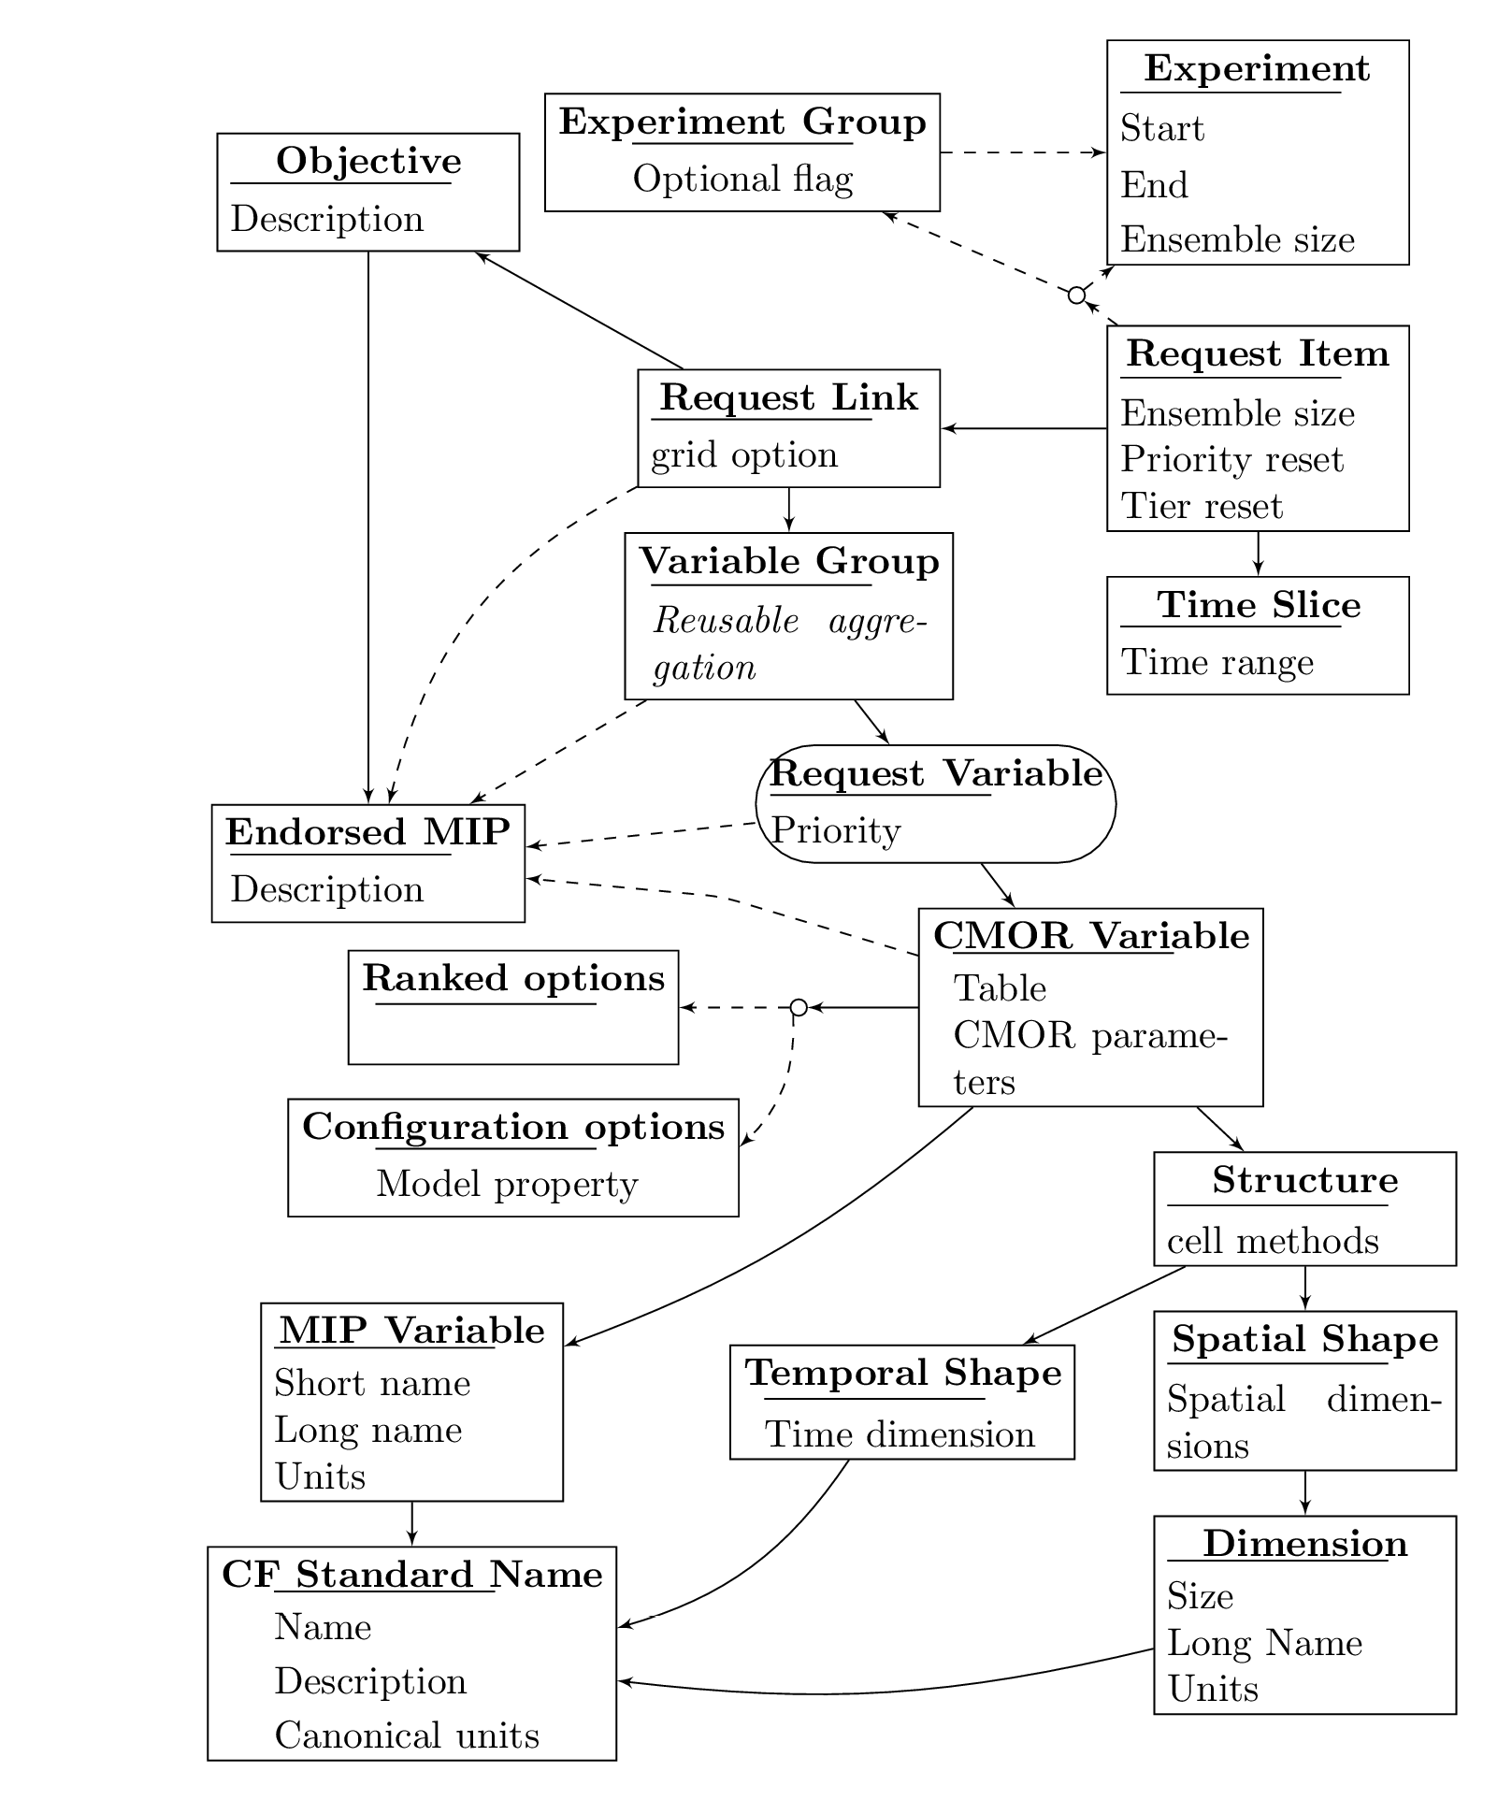
dr2xml, a tool to automate the configuration of XIOS-enabled models
Data Request python API + XML files
(Martin Juckes)
XIOS-enable model (e.g. NEMO)
iodef.xml
dr2xml
field_def.xml
Model
source code
file_def.xml
CMIP6-publication-ready data files
Notes:
For that purpose, a python tool named “dr2xml” have been developed by S. Senesi
It rely on 2 softwares : the DRQ developed by Martin Juckes on one hand and the IXOS I/O server developed at IPSL by Yann Meurdesoif on the the other hand
DRQ API along with 2 XML files (configuration and content files) helps to scan and query the DRQ content with cross-cutting criteria
XIOS, to be properly configured, expect 2 xml files, one defining fields (‘variables’ in the CMIP6 jargon) and another defining files, themselves containing field sections.
What dr2xml do is exploring the DRQ thanks to DreqPy and automatically generate file_def xml files so that XIOS writes CMIP6-publication-ready data files
I will show you an example in a next slide

Slide 4
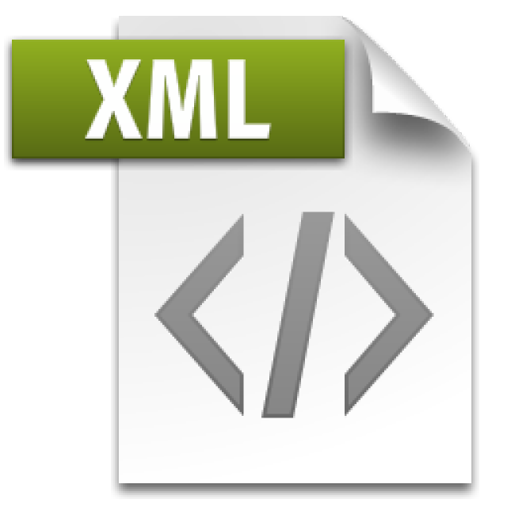
dr2xml, in practice
lab_and_model_settings:
settings related to a laboratory and a model
simulation_settings:
settings related to an experiment
Global attributes
Modeling group choices
Global attributes & choices
institution_id
model_id
model
source_type
references
contact …
mips
max_priority
tierMax
realms_per_context
excluded_vars
experiment_id
activity
realization_index
initialization_index
physics_index
forcing_index
parent_experiment_id …
from dreqPy import dreq # ------------------> Import dataRequest package
dq = dreq.loadDreq()
from dr2xml import generate_file_defs # ------> Import dr2xml
my_cvs_path=‘/home/user/CMIP6_CVs/’ # --------> Path to CMIP6 CVs (jason files)
generate_file_defs(dq, lab_and_model_settings, simulation_settings,
year=2000, context='nemo, printout=True)
nemo.xml (file_def)

Slide 5
dr2xml, features
1
Exploits the DRQ content and ’scoping’ tools to dynamically:
2
Relies on XIOS2 properties and pluggable processing filters(*):
(*) parallel and scalable
Identify the list of relevant CMOR variables (given MIP(s), experiment(s), tier(s), output priority(ies) and simulated year prescribed by the user)
Collect CMIP6 metadata associated to experiment(s) and CMOR variables (e.g. variable_id, standard_name, long_name, units, frequency, description,…)
Get cell_method* information (e.g.: ‘time mean over sea ice’)
Get spatial_shape* information (e.g.: ‘global field 7 pressure levels’; ‘ocean basin meridional section’)
Allows writing CF-compliant files
File structure is flexible: multi- or single-variable, splitting period
Can glue any attribute, attached to the files or to the fields
Can perform :
basic arithmetic operations (useful for units conversion)
time operations (e.g., time averaging, min/max)
spatial operations (e.g. zonal mean)
grid remapping (horizontal and vertical)
Has masking functions
3
Handles exceptions to the DRQ:
4
Handles complement to the DRQ:
Enable to specify a list of excluded variables (that ARE requested by MIPs but the modelling group WILL NOT output because of volumes, N/A, …)
Enable to specify a list of additional variables* (that ARE NOT requested by MIPs but the modelling group WANT TO output)
*features upcoming in next version

Slide 6
file_def.xml example
DRS compliant file name
File global
attributes
(CMIP6 CVs)
field_ref
adopted convention: CMIP_<var_shortname>
var_shortname
field local
attributes
(CMIP6 CVs)

Slide 7
Summary
<DQR-dr2xml-XIOS> pipeline is designed to facilitate the configuration of XIOS-enabled climate models on the road to CMIP6
Is the best way to conform (as far as we can) to the data request
Scraps the nightmare of a ‘by hand’ configuration
By dynamically analysing the simulated period (and adapting output configuration consequently), prevents from stop/restart operations
Thanks to XIOS pluggable operations, it can help convince groups to output more variables (that requiring simple operations on a model variable)
Files written by XIOS configured by dr2xml will be CMIP6-compliant
Avoid the CMORisation step in the data production workflow
Upcoming features (automatic configuration of) :
spatial regridding (horizontal and vertical)
various temporal and spatial aggregations (‘cell_method’)
homemade list of output variables

