Slide 1

Dr2xml Training
20 mai 2022
Gaëlle Rigoudy, CNRM, Meteo-France
Marie-Pierre Moine, Cerfacs
Dr2xml Training, 20 May 2022 0

Slide 2
Outline
Dr2xml
Introduction
Dr2xml, what’s this?
Brief history
The CMIP6 Data Request
General features
Utility
Cautions
Simple functional scheme
The ping file
Usage
Installation
Configuration
Execution
Verification
Functionalities
Basic functions
Customisation
Extended usage
GR Dr2xml Training, 20 May 2022 1

Slide 3
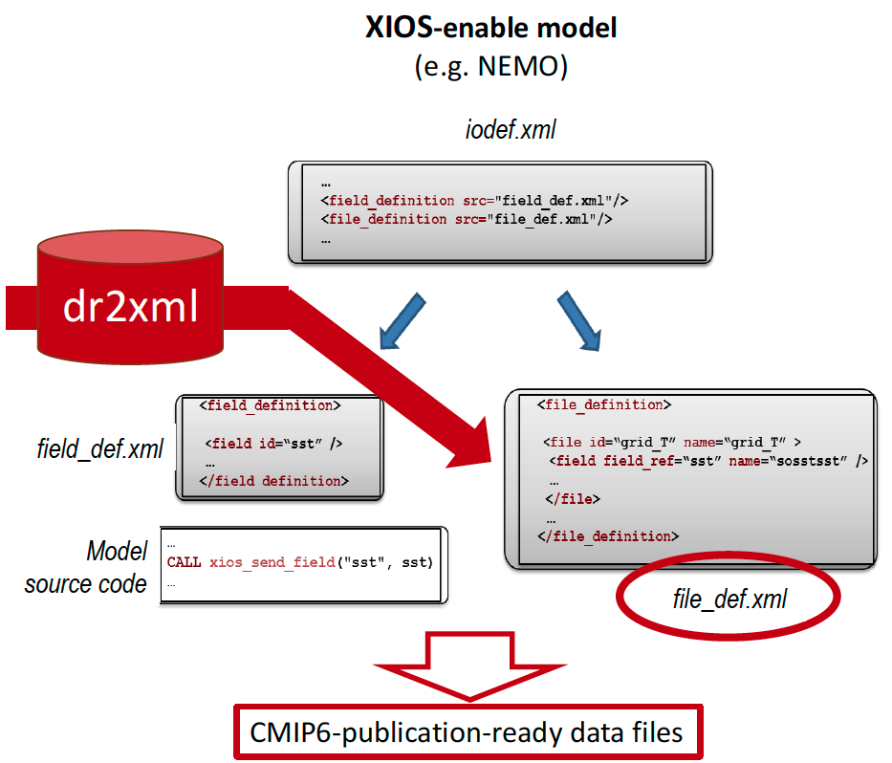
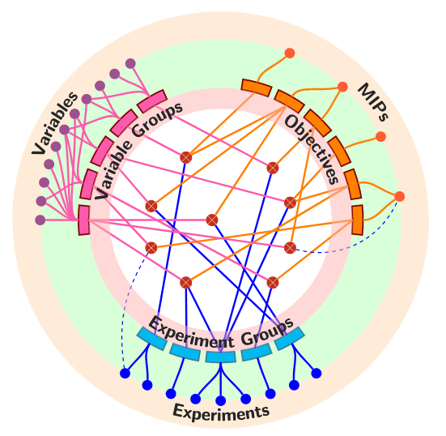
a) dr2xml, what’s this?
1. Introduction
Python tool
XIOS file-def XML writer
Automatic NetCDF file handling (naming, time-splitting, metadata, append write…)
fields and attributes (« variable » in XIOS vocab) in file
Automatic implementation of XIOS spatial & temporal filters
Useful for :
XIOS-enabled models (output management)
large number of fields to output
standard data (format and content)
adding a lot of mandatory attributes in the
netCDF output files
CMIP6 data request
CMIP6 production
Systematic production of CMIP6 compliant CF-netCDF files
Satisfying the CMIP6 Data Request
GR Dr2xml Training, 20 May 2022 2

Slide 4
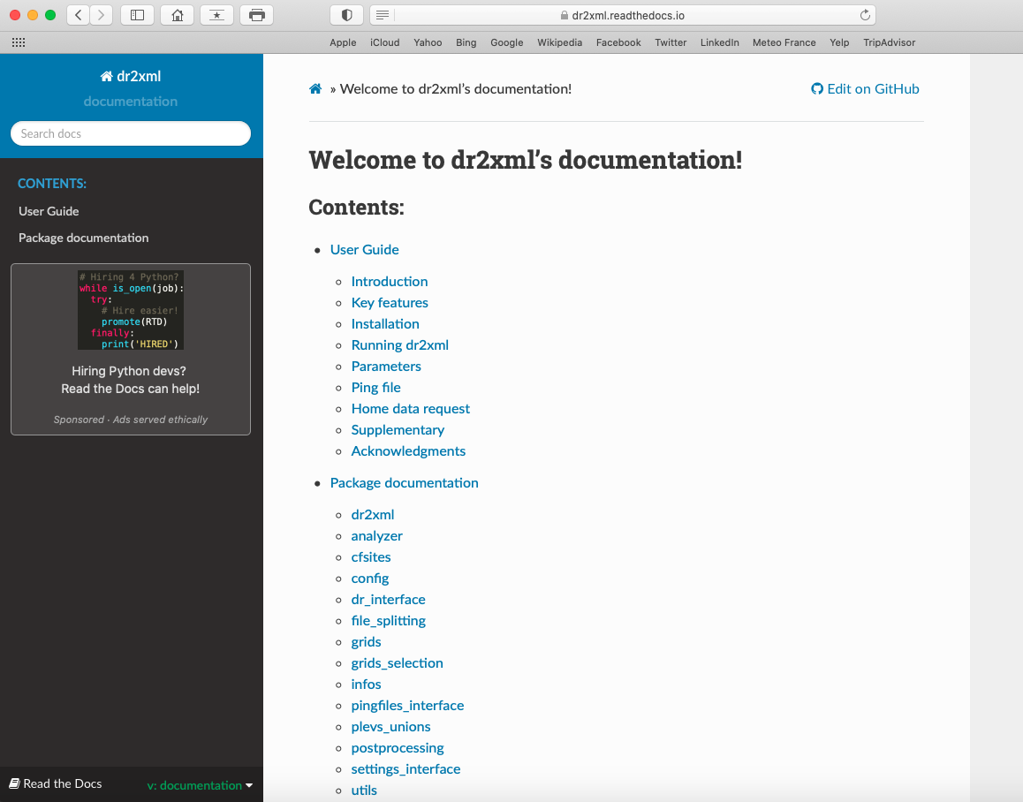
1. Introduction
b) brief history
Born with CMIP6 (Data Request)
Development started in sept. 2016 (S. Sénési, CNRM + M.P Moine, Cerfacs)
Now developed & maintained by G. Rigoudy, CNRM
Developed in close collaboration with the XIOS-dev Team (a lot of functionalities introduced in XIOS for CMIP6/dr2xml needs)
Used at IPSL and CNRM-CERFACS for climate models doing CMIP6
At CNRM-CERFACS: embedded in the modelling workflow (ECLIS)
At IPSL : used upstream of the modelling workflow (LibIGCM)
All along the dev period, phasing with:
The CMIP6 Data Request versions
The CMIP6 Controlled vocabulary
Stabilized version in July 2018 for CMIP6 (v1.13)
Last evolutions:
Code modularization
New functionalities
Python 3 - PEP8
Sources on Github: https://github.com/rigoudyg/dr2xml
ReadtheDocs documentation : https://dr2xml.readthedocs.io/en/documentation/ (not yet finalized)
GR Dr2xml Training, 20 May 2022 3

Slide 5
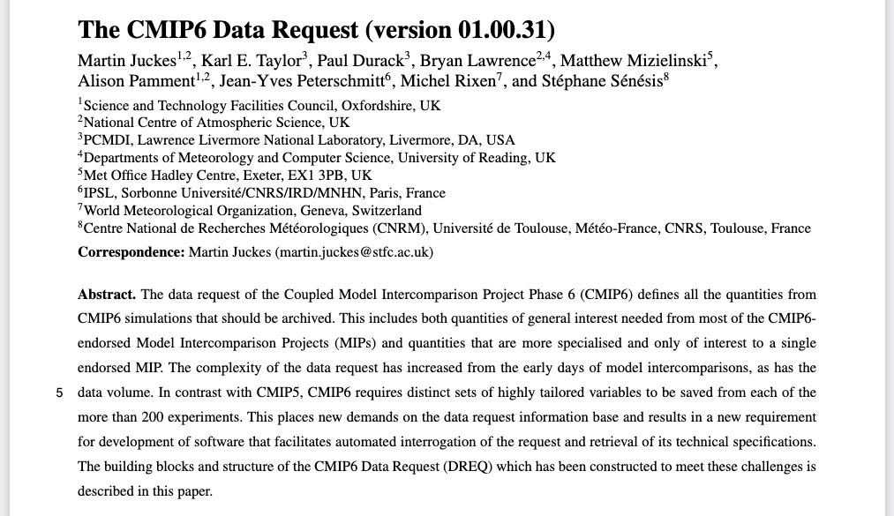
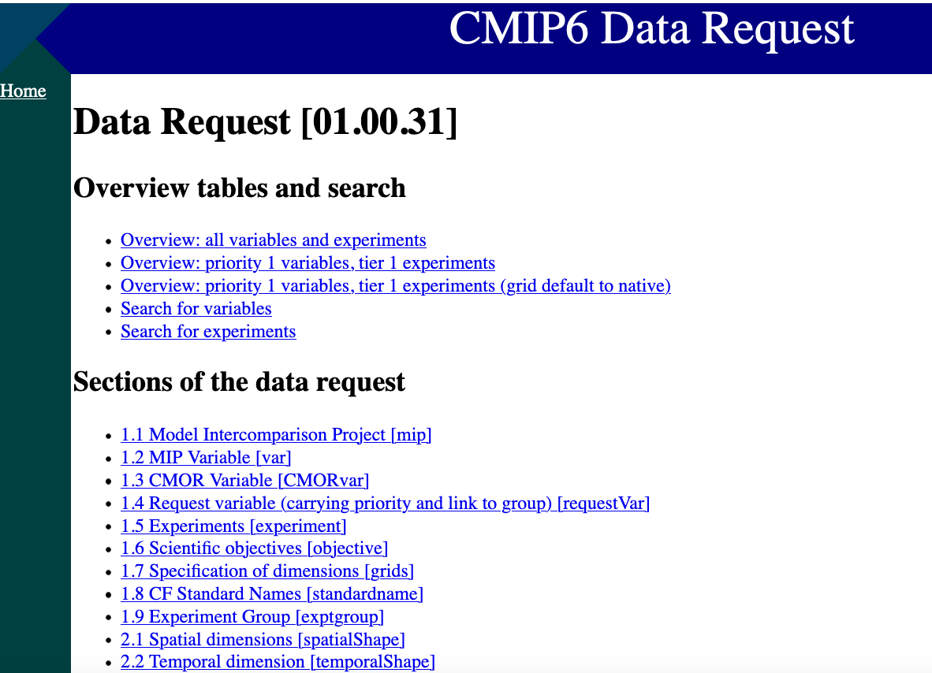
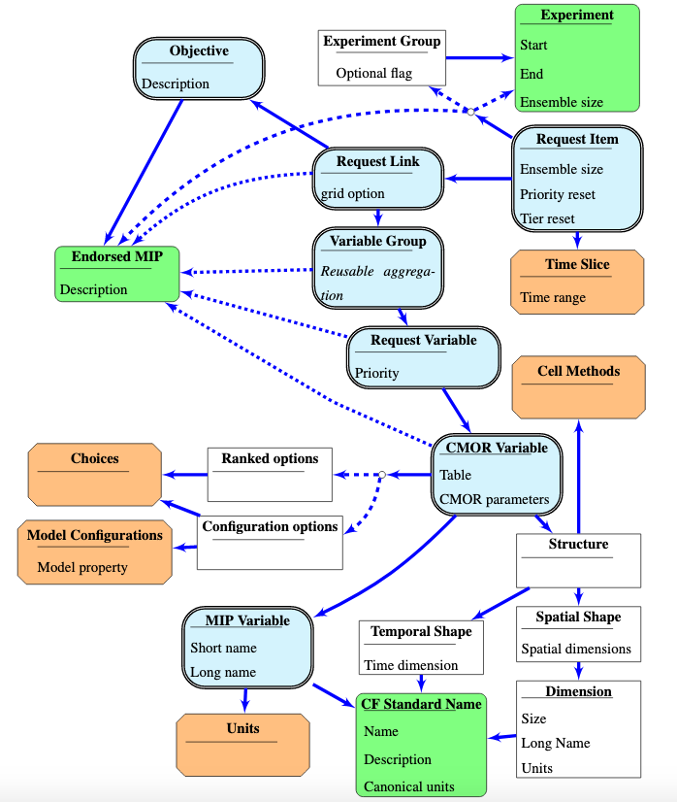
1. Introduction
c) the CMIP6 Data Request
Big picture :
Developed for CMIP6 by Martin Juckes since 2016 to…
Meet the challenge of model/MIP objectives/experiment design complexity and exposing number/diversity of diagnosis requested by each MIP
Fully enable the intercomparison :
« The thousands of diagnostics generated at each centre from hundreds of simulations should be produced and documented in a consistent manner to facilitate meaningful comparisons across models. Hence, for each experiment the MIPs have requested specific output to be archived and shared via the Earth System Grid Federation (ESGF), and the CMIP6 organisers have imposed requirements on file format and metadata »
http://clipc-services.ceda.ac.uk/dreq/index.html
Concretely :
Is a data base with:
a python API (facilitates automated interrogation of the data base)
a browsable html interface
That gives, for each CMIP6 simulation:
the variables that should be output (according to the selected priority)
on which grid/domain/levels
over which time period
at which frequency
with which netCDF attributes...
CMIP6 DR python API is used by dr2xml
MP Dr2xml Training, 20 May 2022 4

Slide 6
a) dr2xml utility
2. General features
Management of complex and various outputs, supporting:
all physical field shapes (1D, 2D, 3D, 4D, time-varying or constant)
all output frequencies (yearly, monthly, daily, 6-hourly, 3-hourly, 1-hourly, sub-hour)
choice of sampling period
on the fly diagnostic computation (ex. zonal means, interpolation on pressure levels, on observation sites…)
allows multivariate diagnostics (computing a diagnostics depending on 2 or more model native variables)
Avoids time-consuming post-processing steps:
no need to use CMOR
nor any other offline post-processing steps (even for diagnostic computation)
formatting/standardisation directly ensured (file names, global and local attributes, temporal axis)
Reduced risk of errors
“all included” and integrated post-processing
one tool does all : XIOS !
homogeneity, coherence, reliability, robustness
MP Dr2xml Training, 20 May 2022 5

Slide 7
b) cautions
2. General features
One shot ! which means…
no safety net once the production started
all requested variables and variables you need must be there !
Before running the whole simulation:
Dr2xml configuration must be carefully checked (a verbose log file enables to visualize the planned output variables)
It is highly recommended to perform a short test run and control/validate the output netCDF files, for e.g. with NCTIME and potentially PrePARE (if the simulation is a CMIP6 one)
MP Dr2xml Training, 20 May 2022 6

Slide 8
c) simple functional scheme
2. General features
DR2XML
MP XIOS-dr2xml Training, 12-16 April 2021 7

Slide 9
c) simple functional scheme
2. General features
User’s
experiment choices
User’s information about model/lab
configures
DR2XML
MP XIOS-dr2xml Training, 12-16 April 2021 8

Slide 10
c) simple functional scheme
2. General features
User’s
experiment choices
User’s information about model/lab
Data Reference Syntax (DRS)
File naming + tree directory conventions
configures
DR2XML
CMIP6 Controlled Vocabulary (CV)
uses
Thesaurus:
MIPs
experiments
institutions
models, …
MP Dr2xml Training, 20 May 2022 9

Slide 11
c) simple functional scheme
2. General features
User’s
experiment choices
User’s information about model/lab
Data Reference Syntax (DRS)
File naming + tree directory conventions
configures
Requested output variables according to the experiment [priority level, member, period], chosen
CMIP6 Data Request (DR)
DR2XML
CMIP6 Controlled Vocabulary (CV)
queries
uses
Thesaurus:
prescribes
MIPs
experiments
institutions
models, …
MP Dr2xml Training, 20 May 2022 10

Slide 12
c) simple functional scheme
2. General features
User’s
experiment choices
User’s information about model/lab
Data Reference Syntax (DRS)
File naming + tree directory conventions
configures
Requested output variables according to the experiment [priority level, member, period], chosen
CMIP6 Data Request (DR)
DR2XML
CMIP6 Controlled Vocabulary (CV)
queries
uses
Thesaurus:
prescribes
MIPs
experiments
institutions
models, …
builds
For each variable, get:
« List » of variables to output
CMOR name
shape
frequency
compute method (ex. temporal mean, spatial mean, masking)
metadata (ex. long name, standard name, units, description)
MP Dr2xml Training, 20 May 2022 11

Slide 13
c) simple functional scheme
2. General features
User’s
experiment choices
User’s information about model/lab
Data Reference Syntax (DRS)
File naming + tree directory conventions
configures
Requested output variables according to the experiment [priority level, member, period], chosen
CMIP6 Data Request (DR)
DR2XML
CMIP6 Controlled Vocabulary (CV)
queries
uses
Thesaurus:
prescribes
MIPs
experiments
institutions
models, …
builds
For each variable, get:
« List » of variables to output
CMOR name
shape
frequency
compute method (ex. temporal mean, spatial mean, masking)
metadata (ex. long name, standard name, units, description)
implements
MODEL
field_def.xml
grid_def.xml
XIOS spatial and temporal filters
ping_file
.xml
MP Dr2xml Training, 20 May 2022 12

Slide 14
c) simple functional scheme
2. General features
User’s
experiment choices
User’s information about model/lab
Data Reference Syntax (DRS)
File naming + tree directory conventions
configures
Requested output variables according to the experiment [priority level, member, period], chosen
CMIP6 Data Request (DR)
DR2XML
CMIP6 Controlled Vocabulary (CV)
queries
uses
Thesaurus:
prescribes
MIPs
experiments
institutions
models, …
builds
glues
For each variable, get:
« List » of variables to output
CMOR standard attributes
CMOR name
shape
frequency
compute method (ex. temporal mean, spatial mean, masking)
metadata (ex. long name, standard name, units, description)
implements
MODEL
field_def.xml
grid_def.xml
XIOS spatial and temporal filters
ping_file
.xml
MP Dr2xml Training, 20 May 2022 13

Slide 15
c) simple functional scheme
2. General features
User’s
experiment choices
User’s information about model/lab
Data Reference Syntax (DRS)
File naming + tree directory conventions
configures
Requested output variables according to the experiment [priority level, member, period], chosen
CMIP6 Data Request (DR)
DR2XML
CMIP6 Controlled Vocabulary (CV)
queries
uses
Thesaurus:
prescribes
MIPs
experiments
institutions
models, …
builds
glues
For each variable, get:
« List » of variables to output
CMOR standard attributes
CMOR name
shape
frequency
compute method (ex. temporal mean, spatial mean, masking)
metadata (ex. long name, standard name, units, description)
implements
MODEL
field_def.xml
grid_def.xml
XIOS spatial and temporal filters
XIOS
file_def.xml
One per context (one context per model component)
ping_file
.xml
MP Dr2xml Training, 20 May 2022 14

Slide 16
c) simple functional scheme (cont.)
2. General features
atmos
land
ocean
sea-ice
XIOS
file_def.xml
XIOS
file_def.xml
XIOS
file_def.xml
XIOS
file_def.xml
MP Dr2xml Training, 20 May 2022 15

Slide 17
c) simple functional scheme (cont.)
2. General features
atmos
land
ocean
sea-ice
XIOS
file_def.xml
XIOS
file_def.xml
XIOS
file_def.xml
XIOS
file_def.xml
included in
iodef.xml
MP Dr2xml Training, 20 May 2022 16

Slide 18
c) simple functional scheme (cont.)
2. General features
atmos
land
ocean
sea-ice
XIOS
file_def.xml
XIOS
file_def.xml
XIOS
file_def.xml
XIOS
file_def.xml
included in
iodef.xml
atmos
ocean
XIOS
XIOS
cpl
land
sea-ice
XIOS
XIOS
Coupled Model
MP Dr2xml Training, 20 May 2022 17

Slide 19

c) simple functional scheme (cont.)
2. General features
atmos
land
ocean
sea-ice
XIOS
file_def.xml
XIOS
file_def.xml
XIOS
file_def.xml
XIOS
file_def.xml
included in
iodef.xml
one file per physical field
append write
(-> split_freq)
Simultaneous writing of netCDF files (2nd level XIOS servers)
ocean
atmos
atmos
ocean
NetCDF files
NetCDF files
XIOS
XIOS
cpl
writes
land
sea-ice
writes
land
sea-ice
NetCDF files
NetCDF files
XIOS
XIOS
Ready to be published on ESGF.
Coupled Model
MP Dr2xml Training, 20 May 2022 18

Slide 20
d) the ping files
2. General features
CMIP6 Data Request (DR)
Standard variable names
atmos
ocean
XIOS
XIOS
cpl
land
sea-ice
XIOS
XIOS
Coupled Model
MP Dr2xml Training, 20 May 2022 19

Slide 21

d) the ping files
2. General features
CMIP6 Data Request (DR)
Standard variable names
atmos
XIOS field_def.xml
atmos
ocean
XIOS field_def.xml
Model output variable native names
(xios_send_field)
XIOS
XIOS
Written once for all
cpl
land
sea-ice
sea-ice
land
XIOS field_def.xml
XIOS field_def.xml
XIOS
XIOS
Coupled Model
MP Dr2xml Training, 20 May 2022 20

Slide 22
d) the ping files
2. General features
CMIP6 Data Request (DR)
Standard variable names
ping_file.xml
ping_file.xml
atmos
sea-ice
Written once for all
ping_file.xml
ping_file.xml
correspondence
ocean
land
correspondence
atmos
XIOS field_def.xml
ocean
atmos
ocean
XIOS field_def.xml
Model output variable native names
(xios_send_field)
XIOS
XIOS
Written once for all
cpl
land
sea-ice
sea-ice
land
XIOS field_def.xml
XIOS field_def.xml
XIOS
XIOS
Coupled Model
MP Dr2xml Training, 20 May 2022 21

Slide 23
2. General features
e) “sos_Omon” example (DR info.)
1.2 MIP Variable: [sos] Sea Surface Salinity
label : sos
provmip : [mip] OMIP [OMIP]
prov : OMIP.day
units : 0.001
title : Sea Surface Salinity
uid : 74a9891bcab2667dbcb66574c6370c86
procnote : ('',)
procComment :
1.8 CF Standard Names [sn ]: SeaSurfaceSalinity
description : […]
1.3 CMOR Variable: [sos] Sea Surface Salinity
label : sos
vid : [var] sos [74a9891bcab2667dbcb66574c6370c86]
title : Sea Surface Salinity
defaultPriority : 1
modeling_realm : ocean
type : real
2.3 Dimensions and related information [stid ]: Temporal mean, Global field (single level) [XY-na] [amse-tmn] [str-a098]
processing : Report on native horizontal grid as well as on a spherical latitude/longitude grid.
frequency : mon
rowIndex : 22
mipTable : Omon
description : Sea water salinity is the salt content of sea water, often on the Practical Salinity Scale of 1978. However, the unqualified term 'salinity' is generic and does not necessarily imply any particular method of calculation. The units of salinity are dimensionless and the units attribute should normally be given as 1e-3 or 0.001 i.e. parts per thousand.
[…]
1.8 CF Standard Names: [SeaSurfaceSalinity] Sea Surface Salinity
units : 1e-3
label : SeaSurfaceSalinity
title : Sea Surface Salinity
uid : sea_surface_salinity
description : […]
2.3 Dimensions and related information: [str-a098] Temporal mean, Global field (single level) [XY-na] [amse-tmn]
label : str-a098
spid : [spatialShape] XY-na [a656047a-8883-11e5-b571-ac72891c3257]
title : Temporal mean, Global field (single level) [XY-na] [amse-tmn]
cell_methods : area: mean where sea time: mean
cell_measures : area: areacello
description : For time mean fields, it may be useful to add information about the sampling interval in the cell_methods string. The syntax is to append, in brackets, 'interval: *amount* *units*', for example 'area: time: mean (interval: 1 hr)'. The units must be valid UDUNITS, e.g. day or hr.
[…]
MP Dr2xml Training, 20 May 2022 22

Slide 24
e) “sos_Omon” example (ping file)
2. General features
Let’s say we want to prepare file-def for the DECK/historical CMIP6 experiment, for the nemo context…
CMIP6 Data Request (DR)
Requests monthly mean of ocean sea surface salinity (sos_Omon) for DECK/historical simulation
ping_file.xml
ocean
DR2XML
ocean
XIOS field_def.xml
<field id= "CMIP6_sos” field_ref= "sss” > this * $convSpsu </field>
<field id= "sss" long_name= "sea surface salinity" standard_name= "sea_surface_salinity" unit= "1e-3" />
<!-- Conversion factor for salinity into PSU ( 35. / 35.16504 ) -->
<variable id="convSpsu" type="float" > 0.9953067 </variable>
ocean
<file id= "sos_Omon_gn" name= "sos_Omon_CNRM-CM6-1_historical_r1i1p1f1_gn_%start_date%-%end_date%"
output_freq= "1mo" append="true" […] >
XIOS
file_def.xml
[…]
<field name= "sos" field_ref= "CMIP6_sos_average" operation="average" detect_missing_value="True" default_value="1.e+20" prec="4" cell_methods="area: mean where sea time: mean" cell_methods_mode="overwrite"> […] </field>
[…]
<field id= "CMIP6_sos_average” field_ref ="CMIP6_sos" operation= "average” />
</file>
MP Dr2xml Training, 20 May 2022 23

Slide 25
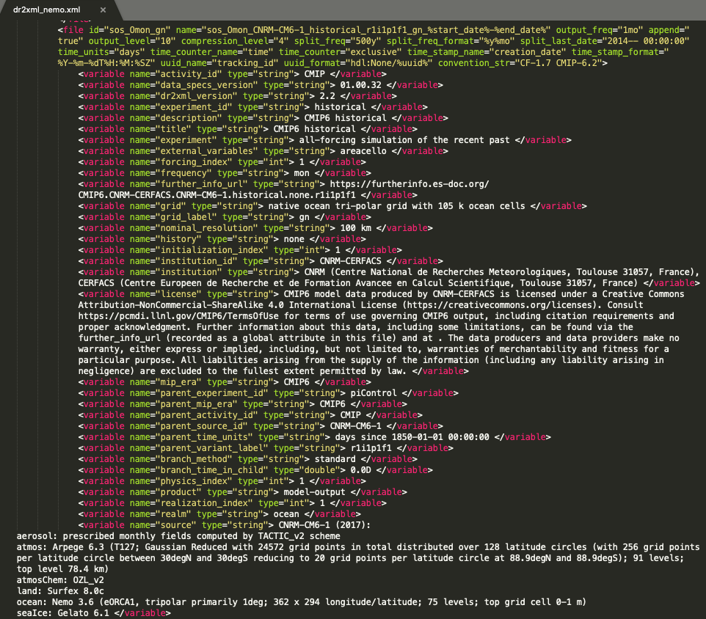
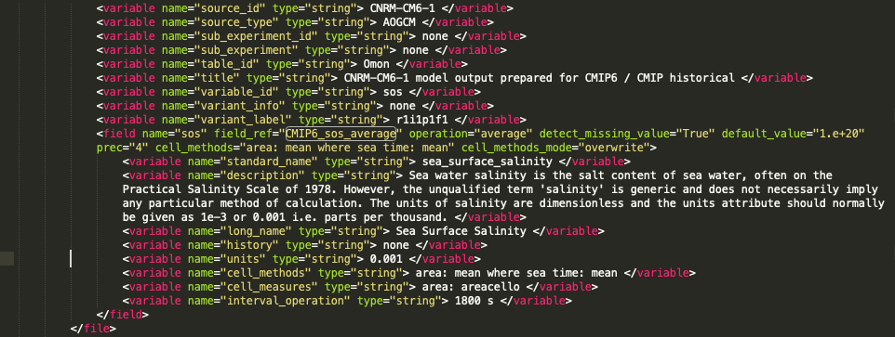
e) “sos_Omon” example (cont.)
2. General features
ocean
XIOS
file_def.xml
Arpege/Surfex: 28 758 lines !
Nemo/Gelato: 14 840 lines !
Trip: 383 lines
CNRM-CM6 coupled model
MP Dr2xml Training, 20 May 2022 24

Slide 26
a) installation
3. Usage
Dr2xml (+ XlsXwritter, six)
$ git clone https://github.com/rigoudyg/dr2xml.git
dreqPy (the CMIP6 Data Request)
$ pip install –upgrade [--user] dreqPy==01.00.32
or :
$ svn co http://proj.badc.rl.ac.uk/svn/exarch/CMIP6dreq/tags/01.00.32
CMIP6_CVs
$ git clone https://github.com/WCRP-CMIP/CMIP6_CVs
GR Dr2xml Training, 20 May 2022 25

Slide 27
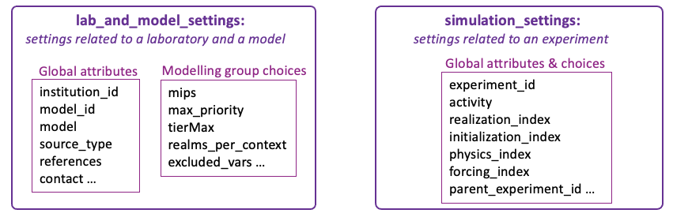
b) configuration
3. Usage
2 files of dr2xml settings (python dictionaries)
a set of model related XML files for XIOS : context, domains, field_defs
additional XML files, the so-called “ping_files” (one per context)
GR Dr2xml Training, 20 May 2022 26

Slide 28
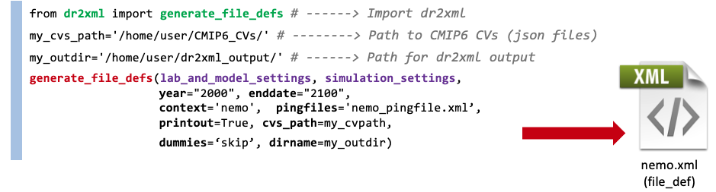
c) execution
3. Usage
GR Dr2xml Training, 20 May 2022 27

Slide 29

d) verification
3. Usage
Skipped variables (i.e. whose alias is not present in the pingfile):
>>> TABLE: Ofx 03/09 ----> sftof(1) ugrid(1) volcello(1)
>>> TABLE: SImon 01/20 ----> sirdgconc(1)
>>> TABLE: Omon 03/37 ----> msftmz(1) msftmzmpa(1) vsf(1)
Some Statistics on actually written variables per frequency+shape...
EmonZ P1 1 : ['sltbasin']
Omon P1 1 : ['hfbasin']
Omon P2 2 : ['htovgyre', 'htovovrt']
mon YB-na -------- --- 4
Omon P1 10 : ['bigthetao', 'so', 'thetao', 'thkcello’, 'umo’, 'uo', 'vmo', 'vo', 'wmo', 'wo']
mon XY-O -------- --- 10
PrimOday P1 1 : [u'so']
day XY-O -------- --- 1
2 user-friendly views in dr2xml log file
…That does not exempt from looking carefully at the generated file-def !
Some Statistics on actually written variables per variable...
-----------------------
--- VARNAME: bigthetao : Sea Water Convervative Temperature
-----------------------
* mon_Omon_XY-O_1
----------------
--- VARNAME: so : Sea Water Salinity
----------------
* mon_Omon_XY-O_1
* day_PrimOday_XY-O_1.0
Notebooks
dr2xml_demo
GR Dr2xml Training, 20 May 2022 28

Slide 30
a) basic functions
4. Functionalities
“basic functions” : ordinated and optimised combination of XIOS filters automatically implemented according to the specifications of the data request.
Spatial:
remapping on different grids
regridding on pressure levels
regridding on height levels (new !)
interpolation at observation sites
meridional/zonal means
Temporal:
sampling period
time mean / time point
diurnal cycle
XIOS ready to compute/output requested diagnostics according to the DR compute specification
Chaining and combination of both
GR Dr2xml Training, 20 May 2022 29

Slide 31
b) customisation
4. Functionalities
Filtering options :
curation : can filter out variables that are requested twice
selection :
filtering on experiment, on simulated year, or both
choosing the maximum priority level of variables to output
exclusion/inclusion : user can also provide lists of excluded/included…
variables (var)
tables (tbl)
pairs (var,tbl)
spatial shapes
metadata filtering : user can take the control on attributes to write in the NetCDF files
Notebooks
exercice1
Notebooks
exercice2
GR Dr2xml Training, 20 May 2022 30

Slide 32
b) customisation (cont.)
4. Functionalities
Add methods :
dr2xml allows to output additional variables = the so-called “home data request”
“cmor” variables : to output a variable that is defined in the CMIP6 Data Request but not requested for this experiment
“extra” variables : to output non ‘cmor’ variables but with all standards attributes ; variables are defined through additional table(s)
“perso” variables : to quicky output a model native variable, without caring about naming nor attributes (‘perso’ var. don’t need to be defined in the ping file)
“dev” variables : a flexible way to output variables with a minimal set of attributes, possibly on a different grid, customised on the fly ; useful during the model development phase (dev var don’t need to be defined in the field_def xml nor in the ping file)
Notebooks
exercice3
The “home data request” was used during CMIP6 production as a “safety net” to compensate DR potential lacks
MP Dr2xml Training, 20 May 2022 31

Slide 33

b) “home data request”
4. Functionalities
Home Data Request
User’s
experiment choices
User’s information about model/lab
Data Reference Syntax (DRS)
File naming + tree directory conventions
Additional output variables (not planned by the CMIP6 DR)
prescribes
configures
Requested output variables according to the experiment [priority level, member, period], chosen
CMIP6 Data Request (DR)
DR2XML
CMIP6 Controlled Vocabulary (CV)
queries
uses
Thesaurus:
prescribes
MIPs
experiments
institutions
models, …
builds
glues
For each variable, get:
« List » of variables to output
CMOR standard attributes
CMOR name
shape
frequency
compute method (ex. temporal mean, spatial mean, masking)
metadata (ex. long name, standard name, units, description)
implements
MODEL
field_def.xml
grid_def.xml
XIOS spatial and temporal filters
XIOS
file_def.xml
One per context (one context per model component)
ping_file
.xml
MP Dr2xml Training, 20 May 2022 32

Slide 34
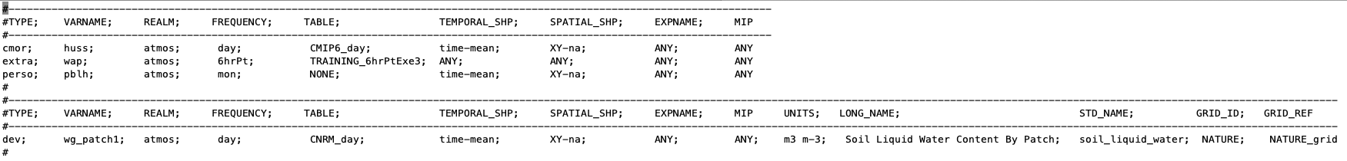
b) “home data request”
4. Functionalities
The “home data request” , brief user guide:
a simple text file
3 header lines
one line per home variable
9 [+5] columns, one per home variable parameter/attribute
parameter values are separated by ';'
no empty trailing lines
[…]
[…]
SOURCE_GRID; TARGET_H_GRID
MP Dr2xml Training, 20 May 2022 33

Slide 35
b) “home data request” (cont.)
4. Functionalities
TYPE = cmor
Example 1 : adding a CMIP6 variable with all of its CMOR standard attributes
--------------------------------------------------------------------------------------------------------------------------TYPE; VARNAME; REALM; FREQUENCY; TABLE; TEMPORAL_SHP; SPATIAL_SHP; EXPNAME; MIP
---------------------------------------------------------------------------------------------------------------------------- cmor; sos; ocean; day; CMIP6_Oday; time-mean; XY-na; ANY; ANY
Official CMIP6 varname…
…defined
for this realm/context
…at this frequency
…in this CMIP6 table
…with this temploral shape
…and with this spatial shape
To check consistency of user’s demand with respect to the chosen (VARNAME, TABLE)
MP Dr2xml Training, 20 May 2022 34

Slide 36
b) “home data request” (cont.)
4. Functionalities
TYPE = cmor
"Header": {
"data_specs_version": "01.00.30",
"cmor_version": "3.4",
"table_id": "Table Oday",
"realm": "ocnBgchem",
"table_date": "09 May 2019",
"missing_value": "1e20",
"int_missing_value": "-999",
"product": "model-output",
"approx_interval": "1.00000",
"generic_levels": "olevel",
"mip_era": "CMIP6",
"Conventions": "CF-1.7 CMIP-6.2"
},
"variable_entry": {
"sos": {
"frequency": "day",
"modeling_realm": "ocean",
"standard_name": "sea_surface_salinity",
"units": "0.001",
"cell_methods": "area: mean where sea time: mean",
"cell_measures": "area: areacello",
"long_name": "Sea Surface Salinity",
"comment": "Sea water salinity is the salt content of sea water, often on the Practical Salinity Scale of 1978 […]",
"dimensions": "longitude latitude time",
"out_name": "sos",
"type": "real",
"positive": "",
"valid_min": "",
"valid_max": "",
"ok_min_mean_abs": "",
"ok_max_mean_abs": ""
},
CMI6_Oday.json
Example 1 : adding a CMIP6 variable with all of its CMOR standard attributes
a CMIP6/CMOR official table (json file) containing several variables.
--------------------------------------------------------------------------------------------------------------------------TYPE; VARNAME; REALM; FREQUENCY; TABLE; TEMPORAL_SHP; SPATIAL_SHP; EXPNAME; MIP
---------------------------------------------------------------------------------------------------------------------------- cmor; sos; ocean; day; CMIP6_Oday; time-mean; XY-na; ANY; ANY
Most of this information is mirrored in the CMIP6 Data Request
MP Dr2xml Training, 20 May 2022 35

Slide 37
b) “home data request” (cont.)
4. Functionalities
TYPE = cmor
Example 1 : adding a CMIP6 variable with all of its CMOR standard attributes
--------------------------------------------------------------------------------------------------------------------------TYPE; VARNAME; REALM; FREQUENCY; TABLE; TEMPORAL_SHP; SPATIAL_SHP; EXPNAME; MIP
---------------------------------------------------------------------------------------------------------------------------- cmor; sos; ocean; day; CMIP6_Oday; time-mean; XY-na; ANY; ANY
official CMIP6 varname…
…defined
for this model component
…at this frequency
…in this CMIP6 table
…with this temporal shape
…and with this spatial shape
To check consistency of user’s demand with respect to the chosen (VARNAME, TABLE)
‘sos_Oday’ is well taken into account by dr2xml :
>>> TABLE Oday 01 ----> sos(1)
MP Dr2xml Training, 20 May 2022 36

Slide 38
b) “home data request” (cont.)
4. Functionalities
TYPE = extra
Example 2 : adding all variables included in a user-defined external Table with CMOR-like attributes
"Header": {
"data_specs_version": "01.00.13",
"table_id": "Table Prim6hrPt",
"realm": "land atmos ocean",
"cmor_version": "3.2",
"table_date": "12 July 2017",
"missing_value": "1e20",
"product": "model-output",
"approx_interval": "0.250000",
"generic_levels": "",
"mip_era": "PRIMAVERA",
"Conventions": "CF-1.7 CMIP-6.0"
},
"variable_entry": {
"thetapv2": {
"frequency": "6hr",
"modeling_realm": "atmos",
"standard_name": "theta_on_pv2_surface",
"units": "K",
"cell_methods": "time: point",
"cell_measures": "area: areacella",
"long_name": "Theta on PV +/- 2 Surface",
"comment": "",
"dimensions": "longitude latitude time1",
"out_name": "thetapv2",
"type": "real",
"positive": "",
"valid_min": "",
"valid_max": "",
"ok_min_mean_abs": "",
"ok_max_mean_abs": "",
"primavera_priority": "1"
},
PRIMAVERA_Prim6hrPt.json
a user-defined external table (json file) containing several additional variables.
CMIP6 (CMOR) like attributes used by dr2xml to build XIOS instructions (output_freq, operation, …) and to set XIOS variables (i.e. netCDF attributes)
MP Dr2xml Training, 20 May 2022 37

Slide 39
b) “home data request” (cont.)
4. Functionalities
TYPE = extra
Example 2 : adding all variables included in a user-defined external Table with CMOR-like attributes
TYPE; VARNAME; REALM; FREQUENCY; TABLE; TEMPORAL_SHP; SPATIAL_SHP; EXPNAME; MIP
--------------------------------------------------------------------------------------------------------------------------
extra; ANY; ANY; ANY; PRIMAVERA_Prim6hrPt; ANY; ANY; ANY; HighResMIP;
the user-defined external table containing several additional variables
means we want to output all the variables defined in the external Table…
… but only if the experiment is an HighResMIP one
All variables defined as a variable_entry in PRIMAVERA_Prim6hrPt.json are added by dr2xml (provided they are defined in the ping file) :
>>> TABLE Prim6hrPt 07 ----> ps(1.0) hus1000(1.0) thetapv2(1.0)
clt(1.0) va1000(1.0) ua1000(1.0) tslsi(1.0)
MP Dr2xml Training, 20 May 2022 38

Slide 40
b) “home data request” (cont.)
4. Functionalities
TYPE
= perso
Example 3 : adding a non-CMIP6 (model native) variable without any specific attributes. The variable has not to be defined in field_def XML file but not in the ping file (keep the original name)
--------------------------------------------------------------------------------------------------------------------
TYPE; VARNAME; REALM; FREQUENCY; TABLE; TEMPORAL_SHP; SPATIAL_SHP; EXPNAME; MIP
--------------------------------------------------------------------------------------------------------------------
perso; sst; ocean; day; CNRM_cnrmDay; time-mean; XY-na; ANY; ANY
native variable name in the model (not a CMIP6/CMOR name) ;
no need to be defined in the ping file.
sent by this model component
no json table associated in this case ; only here to set the <table> facet in the file name
‘sst’ is well taken into account by dr2xml (without being defined in the ping file, only in the field_def XML) :
>>> TABLE cnrmDay 01 --> sst(1)
MP Dr2xml Training, 20 May 2022 39

Slide 41
b) “home data request” (cont.)
4. Functionalities
TYPE
= dev
Example 4 : adding a non-CMIP6 (model native) variable, defining “on the fly” the target grid and its attributes (units, standard name…). Avoid to have this variable defined in XIOS field_def XML file and/or to write an extra json table. Can be seen as an hybrid of the ‘perso’ and ‘extra’ type (for devel. purpose only)
#------------------------------------------------------------------------------------------------------------------------------------------#TYPE; VARNAME; REALM; FREQUENCY; TABLE; TEMPORAL_SHP; SPATIAL_SHP; EXPNAME; MIP; UNITS; LONG_NAME; STD_NAME; SOURCE_GRID; TARGET_H_GRID
#------------------------------------------------------------------------------------------------------------------------------------------dev; hmv4; ocean; day; CNRM_day; time-mean; XY-perso; ANY; ANY; hmv4_units; hmv4 name; hmv4_name; complete_klev; FULL
attributes of hmv4
means domain regridding : “complete” → “FULL”
means a 3D field with a user defined shape :
an horizontal domain eventually to be remapped on TARGET_H_GRID (otherwise keep hmv4 on the SOURCE_GRID domain)
a customised vertical axis given by an additional dictionary in the simulation settings
like the “perso” case
sset['perso_sdims_description'] = {
'hmv4':{
'my_dimension':{
'stdname': 'altitude',
'long_name': 'my_long_name',
'positive': True,
'requested': '',
'value': '30 50 60',
'requested': '30 50 60',
'units': 'my_units',
'type': 'float',
'axis': 'Z' } } }
‘hmv4’ is well taken into account by dr2xml (without being defined in any XML file):
>>> TABLE day 01 --> hmv4 (1)
MP Dr2xml Training, 20 May 2022 40

Slide 42
c) extended usage
4. Functionalities
Dr2xml for daily research production
discipline : Adopt the good practices using the CMOR/CMIP6 standards, even for non CMIP6 production
flexibility : The user can free somewhat or a great from the DR, choosing to :
make a new simulation with the same output variables as in a given CMIP6 experiment
ignore all of from the CMIP6 DR and only specify its own outputs via the “home data request”
Adaptation to other projects (like CORDEX)
new functionalities implemented (e.g. interpolation to altitude level)
code cleaning to remove all CMIP6 hard-coded elements
code restructured to externalise everything that depends on the project
a new interface to define projects (CMIP6, CORDEX, etc.)
A new interface to avoid calling the CMIP6 Data Request
Notebooks
exercice4
+ Project’s
hands-on
GR Dr2xml Training, 20 May 2022 41

Slide 43



c) Adaptation to other projects
4. Functionalities
Home Data Request
User’s
experiment choices
User’s information about model/lab
Data Reference Syntax (DRS)
File naming + tree directory conventions
Additional output variables (not planned by the CMIP6 DR)
prescribes
configures
Requested output variables according to the experiment [priority level, member, period], chosen
CMIP6 Data Request (DR)
DR2XML
CMIP6 Controlled Vocabulary (CV)
queries
uses
Thesaurus:
prescribes
MIPs
experiments
institutions
models, …
builds
glues
For each variable, get:
« List » of variables to output
CMOR standard attributes
CMOR name
shape
frequency
compute method (ex. temporal mean, spatial mean, masking)
metadata (ex. long name, standard name, units, description)
implements
MODEL
field_def.xml
grid_def.xml
XIOS spatial and temporal filters
XIOS
file_def.xml
One per context (one context per model component)
ping_file
.xml
GR Dr2xml Training, 20 May 2022 42

Slide 44


c) Adaptation to other projects
4. Functionalities
User’s
experiment choices
User’s information about model/lab
project=CORDEX
dr2xml_src/project/
basics.py
used to write
Projects def. interface
Contains objects and functions used to write project configuration files
“builder”
CMIP6.py
json project interface
read by
“reader”
CORDEX.py
DR2XML
C3S-SF.py
XIOS
file_def.xml
Each project configuration file contains parameters (and possibly constraints on them) defining the characteristics of the output files (naming rule, expected attributes, …)
GR Dr2xml Training, 20 May 2022 43

Slide 45

summary
Dr2xml
DR-dr2xml-XIOS pipeline is designed to facilitate the configuration of XIOS-enabled climate models contributing to CMIP exercises
Is the best way to conform (as far as we can) to a data request as complex as the CMIP6 one
Scraps the nightmare of a “by hand” model output configuration
Dynamic analyse of the simulated period and adaptation of output configuration consequently
Files written by XIOS configured by dr2xml are CMIP6-compliant
Avoid the CMORisation step in the data production workflow
Can be used as well for daily research simulations, benefitting (or not…) from the CMIP6 standards
Has evolved to be used widely beyond CMIP6 and to integrate any project constraints (ex. CORDEX)
Without CMIP6 and the Data Request dr2xml won’t have existed, even less without XIOS, but now we’ve got it, sounds there is a life (for it) after CMIP6 !
MP Dr2xml Training, 20 May 2022 44

Slide 46

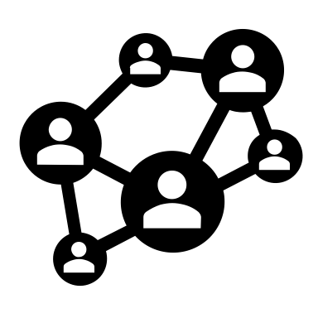

The End
Any questions ?
DR2XML
Slack channel :
Contact :
gaelle.rigoudy@meteo.fr
moine@cerfacs.fr
dr2xmlusers.slack.com
MP Dr2xml Training, 20 May 2022 45

Slide 47
hands-on (notebooks)
Dr2xml
PCform
LOGIN : stageXX
PASSWD: stageXX
Before starting the hands-on, please update the dr2xml_training sources:
cd $HOME/dr2xml_training ; git pull
Launch jupyter-notebook
Start with the dr2xml_demo notebook and next the exercises (1 to 4)
There is nothing to seek by yourself, the solution is in, and the notebook cells are commented
The objective is that you execute the cells step by step and understand what is done
In order to have all onboard, the content of the two dr2xml setting files are imported in the notebooks and modified on the fly though notebook cells (python dictionary updating) and ‘grep’ are done on the log files to popup the result in the notebook ; but you are encouraged to look at the two dr2xml settings files beforehand to get familiar with their content and navigate into the input/output directories to see what dr2xml uses/produces concretely.
MP Dr2xml Training, 20 May 2022 46

Slide 48
hands-on (notebooks)
Dr2xml
PCform
LOGIN : stageXX
PASSWD: stageXX
Dr2xml_demo notebook
Purpose: Training notebook for a first contact with dr2xml: how to configure? how to run?
Exercice 1: Change the general configuration
Objective: Configure so as to run dr2xml for another: (a) context/realm (b) CMIP6 experiment (c) model version
Exercice 2: Customize the outputs (simple way)
Objective: Try various simple methods to customize the ouputs by using the excluded/included keys: (a) exclude one table (b) exclude pairs of variable/table (c) include only one variable from one table
Exercice 3: Customize the output (more flexible ways)
Objective: Try a more sophisticated method to customize the ouputs: the so-called "home_data_request" (a) requesting additional CMIP6 standard variables, already existing in a CMIP6 Table (b) requesting a CMIP6 standard variable but that do not exist in the predefined CMIP6 Table for the frequency we want (c) requesting a CMIP6 standard variable but that do not exist in the predefined CMIP6 Table for the shape we want (d) requesting a totally new variable, that is not defined in the CMIP6 standards (2 ways) (e)-(h) a flexible way to add variables for development purpose
Exercice 4: Run a non CMIP6 experiment
Objective: configure dr2xml for a non-cmip6 experiment
MP Dr2xml Training, 20 May 2022 47

