Slide 1
Credit Card Fraud Detection
Optimizing Revenue and Customer Trust with Machine Learning
Presented by: Rigat David Mahanan | March, 2025

Slide 2
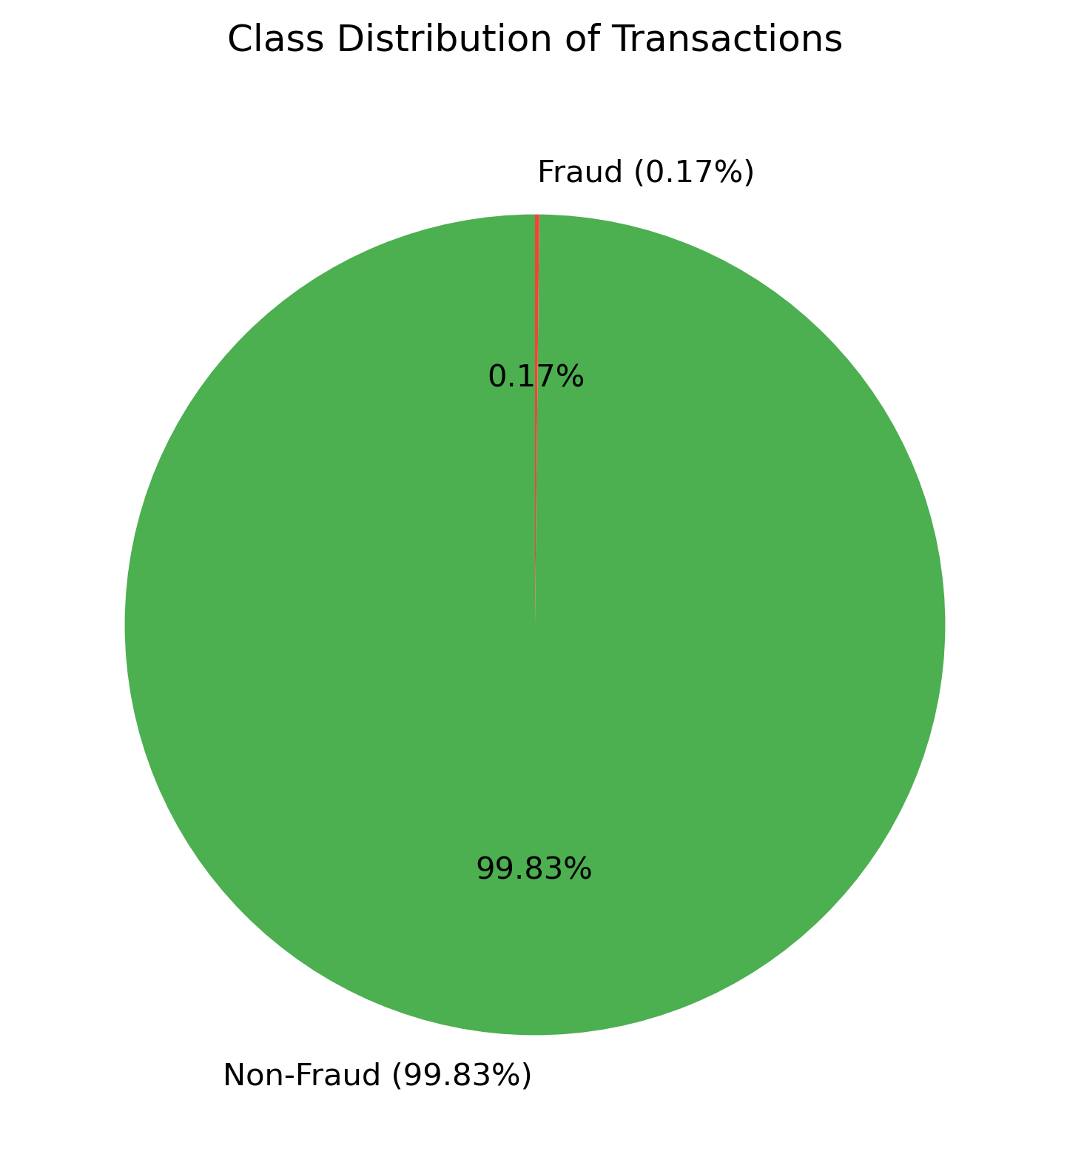
Project Overview
Objective: Build a fraud detection model for FriendPay using machine learning
Dataset:
284,807 transactions, only 0.172% frauds (492 cases).
Goal:
Build a model to catch frauds, minimize false positives, and boost revenue.
Data balancing (SMOTE), feature engineering, and model evaluation.

Slide 3
Data Collecting & Cleaning
Loaded dataset: 284,807 rows, 31 columns (V1-V28, Time, Amount, Class).
Cleaned: Removed 1,081 duplicates, final shape 283,726 rows.
Ensured data quality for reliable modeling.

Slide 4
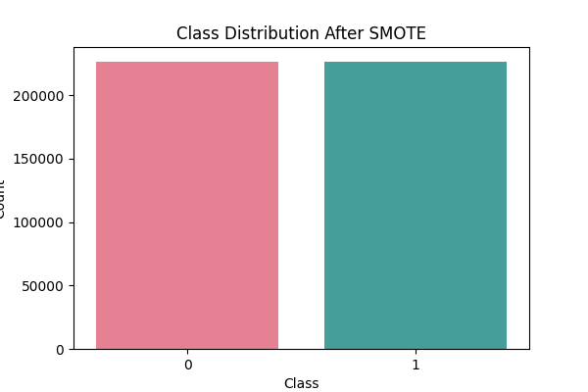
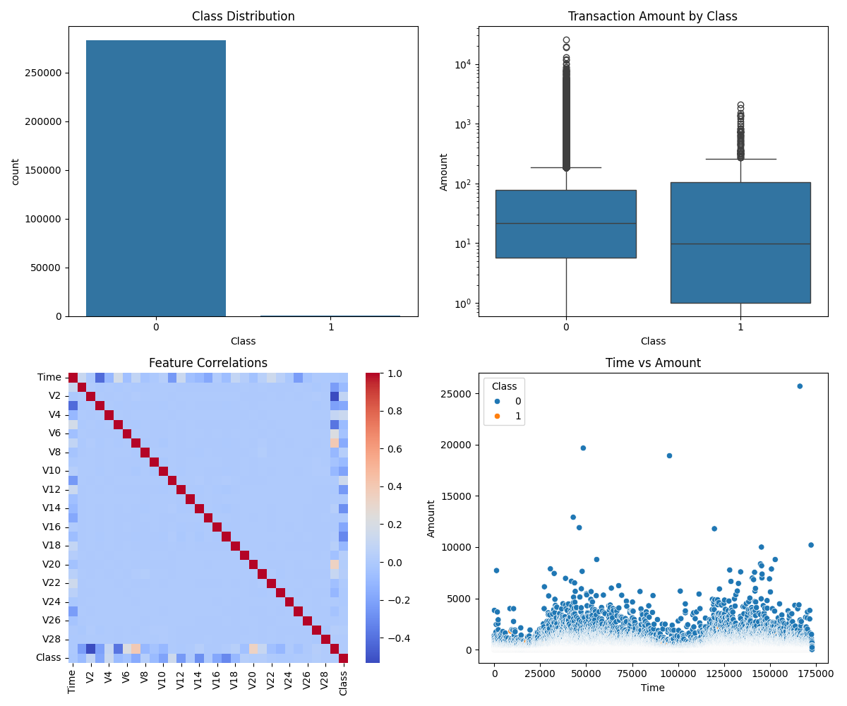
Data Exploration and Visualization
Class Distribution (Before & After SMOTE):
Before: Imbalance heavily skewed towards legitimate transactions (99.83% non-fraud, 0.17% fraud).
After: SMOTE applied to balance fraud cases.
Feature Correlation:
Heatmap used to identify relationships between features.
Log scale compresses this wide range, making medians and outliers visible without distortion.
Ensures both small and large transactions are interpretable, critical for spotting fraud patterns.
Scatter of Time vs. Amount shows frauds spread across time, often with distinct amounts.

Slide 5
Model Selection & Training
Selected Models:
Decision Tree
Gaussian Naïve Bayes
Logistic Regression
XGBoost
Feature Scaling & Hyperparameter Tuning Applied

Slide 6
Model Performance
Decision Tree:
Precision: 1.00, Recall: 1.00, F1-score: 1.00 (Legitimate)
Precision: 0.43, Recall: 0.72, F1-score: 0.54 (Fraud)
AUC-ROC: 0.5720
Gaussian Naïve Bayes:
Precision: 1.00, Recall: 0.98, F1-score: 0.99 (Legitimate)
Precision: 0.05, Recall: 0.81, F1-score: 0.10 (Fraud)
AUC-ROC: 0.4319
Logistic Regression:
Precision: 1.00, Recall: 0.97, F1-score: 0.99 (Legitimate)
Precision: 0.05, Recall: 0.87, F1-score: 0.10 (Fraud)
AUC-ROC: 0.7150
XGBoost:
Precision: 1.00, Recall: 1.00, F1-score: 1.00 (Legitimate)
Precision: 0.73, Recall: 0.80, F1-score: 0.76 (Fraud)
AUC-ROC: 0.8140

Slide 7
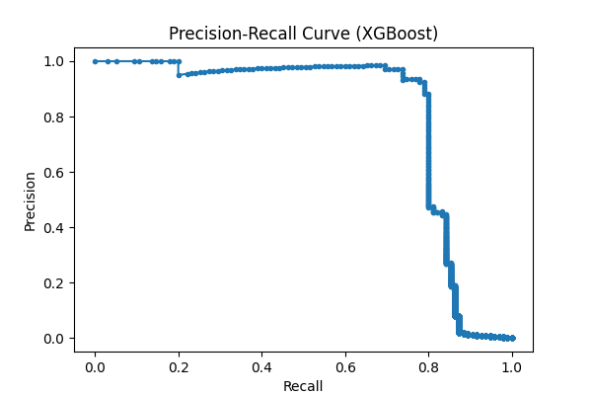
Precision-Recall Curve Analysis
XGBoost demonstrated the best balance between recall and precision, achieving an AUC of 0.81.
This curve illustrates the trade-off between precision and recall for different thresholds. A higher area under the curve (AUC) indicates better fraud detection performance.

Slide 8
Business Impact
Financial Protection
Reduces financial losses by detecting fraudulent transactions in real time.
Minimizes chargeback costs and unauthorized refunds.
Enhanced Security & Trust
Builds customer confidence in secure transactions.
Strengthens reputation by preventing
High recall minimizes fraud losses; low false positives preserve revenue and customer trust.

Slide 9
Conclusion & Observations
Key Findings:
XGBoost performed best for fraud detection, balancing recall & precision.
Logistic Regression also showed strong recall for fraudulent cases.
Next Steps:
Deploy model in production with continuous retraining.
Optimize feature selection for improved fraud detection.

