Slide 1

Covid-19 & Affects on Air Quality
Team Zebra

Slide 2
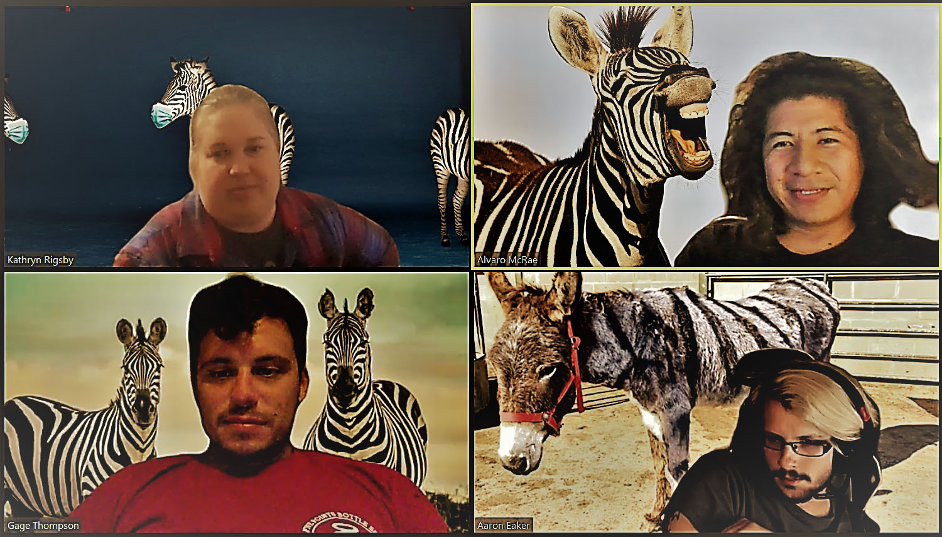
Team Zebra:
Kathryn Rigsby, Alvaro McRae,
Gage Thompson, Aaron Ecker

