Slide 1
COVID-19 &
AFFECTS ON AIR QUALITY
Team Zebra

Slide 2
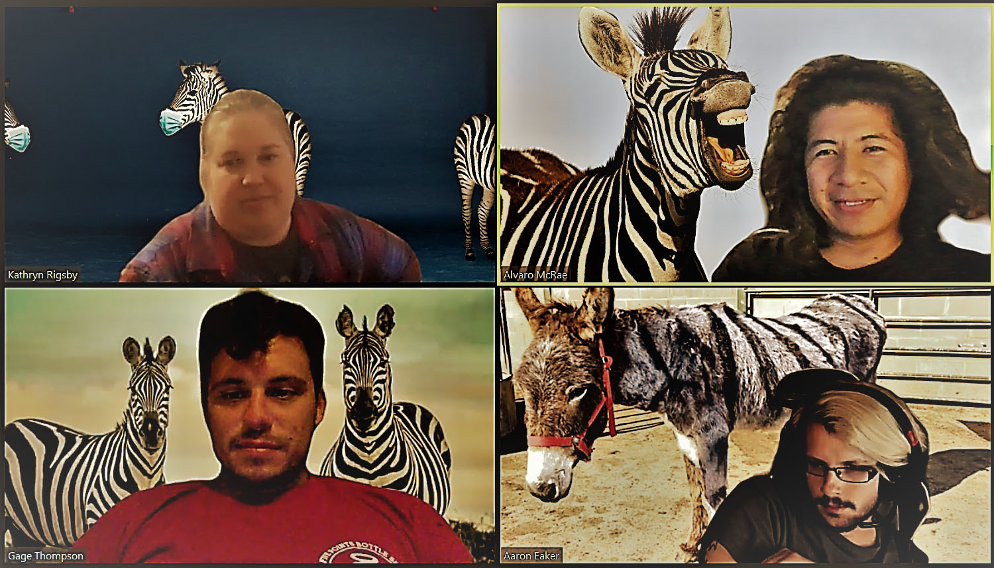
Team Zebra:
Kathryn Rigsby, Alvaro McRae,
Gage Thompson, Aaron Ecker

Slide 3
HYPOTHESIS
We believe that overall air quality, measured by Air Quality Index (AQI), has improved worldwide during the COVID-19 crisis and will explore this theme by researching data on air quality indexes before COVID-19 and throughout the crisis. In regions where the public health response has been strict, enacting policies such as travel bans and lockdowns, we expect to see improved levels of air quality. Conversely, regions that enacted less strict responses, we believe that air quality indexes will have improved at a lower rate. We also want to explore how air quality impacts the rate of infection, expecting to see a strong positive correlation of rates of infection(deaths) in regions with poorer air quality.

Slide 4
MOTIVATION & SUMMARY SLIDE
Define the core message or hypothesis of your project.
Describe the questions you asked, and why you asked them
Describe whether you were able to answer these questions to your satisfaction, and briefly summarize your findings

Slide 5
QUESTIONS & DATA
Elaborate on the questions you asked, describing what kinds of data you needed to answer them, and where you found it

Slide 6
DATA CLEANUP & EXPLORATION
Describe the exploration and cleanup process
Discuss insights you had while exploring the data that you didn't anticipate
Discuss any problems that arose after exploring the data, and how you resolved them
Present and discuss interesting figures developed during exploration, ideally with the help of Jupyter Notebook

Slide 7
DATA ANALYSIS
Discuss the steps you took to analyze the data and answer each question you asked in your proposal
Present and discuss interesting figures developed during analysis, ideally with the help of Jupyter Notebook

Slide 8
DISCUSSION
Discuss your findings. Did you find what you expected to find? If not, why not? What inferences or general conclusions can you draw from your analysis?

Slide 9
PROJECT POST MORTEM
Discuss any difficulties that arose, and how you dealt with them
Discuss any additional questions that came up, but which you didn't have time to answer: What would you research next, if you had two more weeks?

Slide 10
QUESTIONS
DOES ANYONE HAVE ANY QUESTIONS FOR US THIS EVENING?

