Slide 1

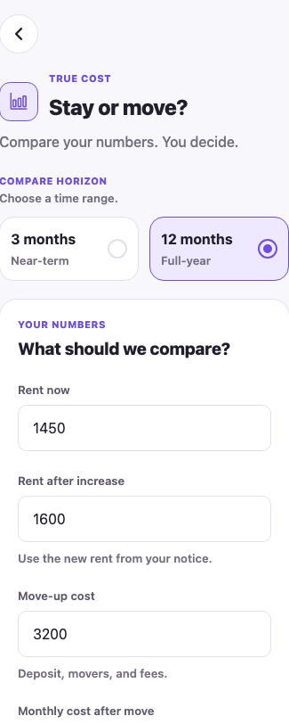
HOMEHEARTS
Housing help
that moves with you.
A Dallas-first mobile app for people facing a housing crisis — compare costs, find real help, and get ready to apply.
NO ACCOUNT NEEDED
LIVE DEMO SCREEN
React Native · Expo Go
Team HomeHearts · DP4 progress check

Slide 2
One app. Three decisions.
MOBILE-FIRST FLOW
The demo follows a simple path from uncertainty to a next action.
↔
01
⌖
02
✓
03
SIMPLE
MODERATE
COMPLEX
Compare staying vs. moving
Find housing assistance
Prepare documents + plan
See the total cost over 3 or 12 months, including the break-even point.
Answer a short intake and get Dallas-area programs ranked by fit and urgency.
Save a checklist, create an action plan, and use a ready-to-call provider script.
TARGET PLATFORM
TECHNOLOGY
APP SHAPE
iPhone + Android
portrait · Expo Go
React Native · Expo SDK 58 · TypeScript
Expo Router · Zustand + AsyncStorage
no account required
CORE TASK 1 IS FUNCTIONAL

Slide 3
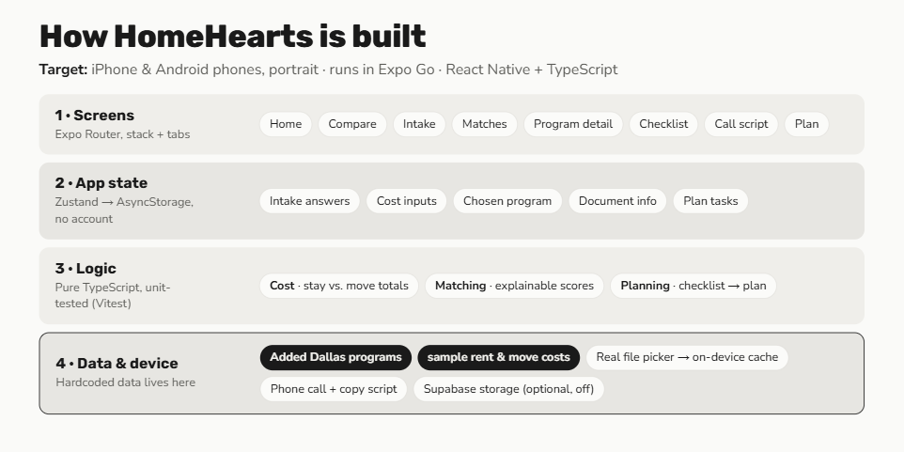
Progress, data, and the next build
Current implementation is a working, local-first prototype — ready to demonstrate the full decision-to-action flow.
CURRENT STATUS
Core features finished
The three connected tasks are implemented in a Dallas-first Expo Go build.
HARDCODED FOR THIS DEMO
8 Dallas-area resources
sample rent + move costs
on-device document metadata
provider call + copy script
NEXT BUILD
Replace curated fixtures with verified live data, then expand beyond Dallas.
Screens → state → logic → data + device
GITHUB
github.com/rigshank/HomeHearts
Team HomeHearts · Abhijith Utla · Krishang Mandala · Sreyasri Surapaneni · AJ Yaseen

