Slide 1
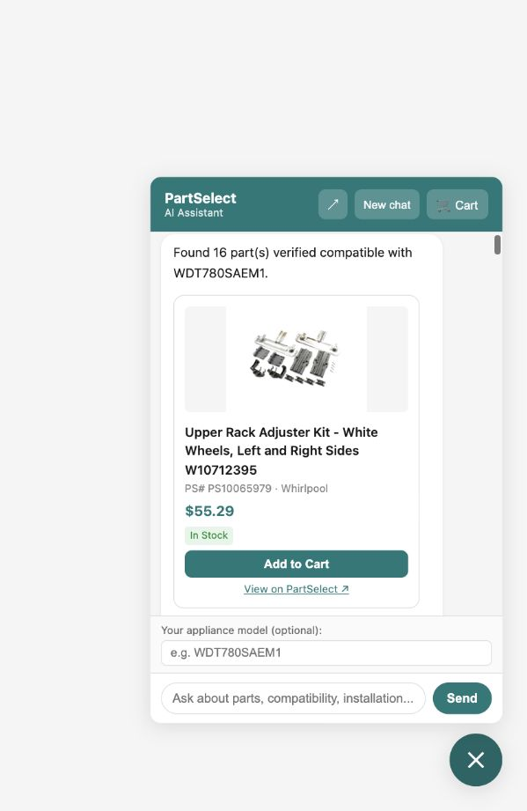
PartSelect AI Chat Agent
Appliance parts help, from diagnosis to cart
A demo-ready React + FastAPI assistant for dishwasher and refrigerator parts: search, compatibility, installation, troubleshooting, and cart actions.
Postgres + pgvector
Deterministic handlers
Live scrape fallback
Visual product cards are backed by structured metadata, not free-text parsing.

Slide 2
What the assistant can do
One chat surface covers the main appliance-parts shopping jobs.
Find compatible parts
Check compatibility
Model-aware catalog results with product cards
PS number + model lookup against compatibility rows
Installation guidance
Troubleshoot symptoms
Step-by-step instructions from catalog data
pgvector repair/article retrieval + synthesis
Cart actions
Live fallback
Session-grounded add/remove using recent parts
Selenium or Firecrawl for sparse runtime data

Slide 3
Backend flow: deterministic where it matters
LLMs classify and synthesize; e-commerce actions use explicit tools and database-backed state.
User
React widget
FastAPI router
Intent classifier
Handlers
PostgreSQL
pgvector
Live scrape
SSE stream
parts, sessions, cart
repair/article RAG
missing model/part pages
progress + done payload
Guardrails map each intent to allowed tools; cart mutations never go through the general LangGraph fallback.

Slide 4
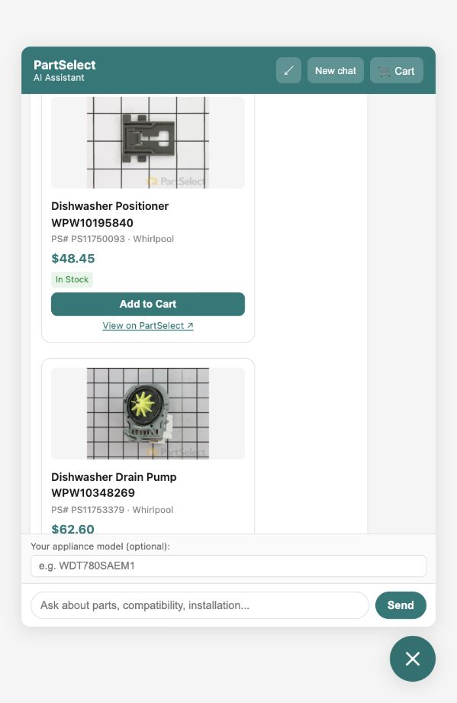
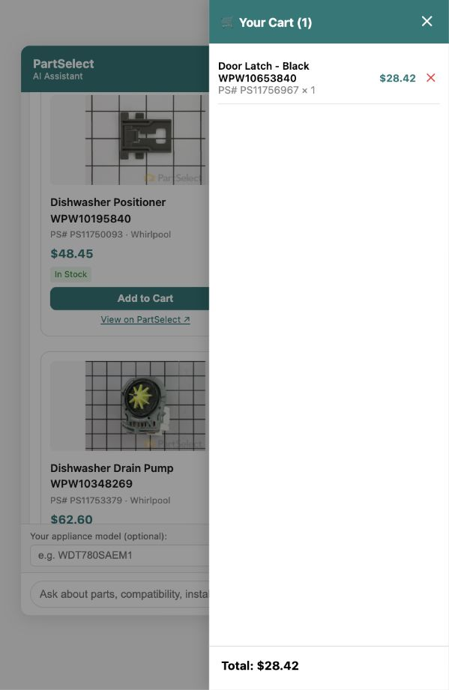
The UI is small, but the response is rich
The widget can be standalone or embedded; it restores session history and displays product metadata, stages, and cart state.
Chat response
Cart drawer
Model-aware cards, PartSelect links, Add to Cart buttons
Session cart can be updated by explicit PS number or contextual phrases like "add it".

Slide 5
Roadmap: make data fresher and queries faster
The next stage moves runtime scraping out of the hot path and adds caching around repeated work.
1
Nightly whole scrape
Run full catalog and repair/article refresh on a schedule; validate before promotion.
2
Database-first runtime
Serve model, part, compatibility, install, and troubleshoot flows from the refreshed DB.
3
Redis caching
Cache catalog lookups, compatibility checks, retrieval IDs, and live fallback responses.
4
UX upgrades
Add source badges, stronger empty states, related-part sections, and mobile polish.
Target production shape: scheduled data refresh + observable deterministic backend + cached reads + polished embeddable frontend.

