Slide 1









FINAL-YEAR ENGINEERING PROJECT
Hire on Demand
Development of an Intelligent Skills-Matching Assessment Platform
Computer Engineering : Business Intelligence
Rihab Boutrif
2025–2026
Academic Superviser : Mr Amor Messaoud Professionnal Supervisor : Mrs Azza Sandly
Hire on Demand • PFE Defense
1/24

Slide 2



PLAN
of presentation
3
01 | Introduction
02 | Company
03 | Problem & Existing Solutions
04 | Proposed Solution
05 | Functionnal & non functionnal scope
06 | Tech Stack
07 | UML
08 | Methodology & Framework
09 | Sprint Timeline
10 | Release 1
11 | Release 2
12 | Release 3
13 | Conclusion & Perspective

Slide 3

Introduction
Recruitment is increasingly digital, yet organisations still face the challenge of efficiently managing large volumes of candidate information and accurately identifying the most qualified profiles. Traditional recruitment methods may rely on subjective evaluations and provide limited evidence of candidates’ actual competencies. Intelligent technologies and objective skill assessment offer an opportunity to make recruitment more efficient, reliable, and evidence-based.
Hire on Demand • PFE Defense

Slide 4

TestoHire : Host Company
AI-Powered
Skill-Centered
Recruiter-Oriented
Intelligent candidate evaluation
Focus on demonstrated competencies
Supporting hiring decisions
TestoHire is a Tunisian technology startup focused on AI-powered talent assessment and skill-based recruitment.
Hire on Demand • PFE Defense

Slide 5

Problem
The Traditional Challenge
CV
→
Declared Skills
→
Manual Screening
→
Hiring Decision
High application volume
Self-declared skills
Limited verification
Manual comparison becomes time-consuming.
CV information does not necessarily prove proficiency.
Recruiters need objective evidence of competencies.
How can we transform candidate information into reliable evidence of skills?
Hire on Demand • PFE Defense

Slide 6





Existing Solutions & Identified Gap
LinkedIn Recruiter
TestGorilla
HackerRank
• Strong candidate sourcing & profile access
• Gap: skills are self-reported, not verified
• Structured tests with automated evaluation
• Gap: not built for sourcing or discovery
• Coding challenges, technical assessment
• Gap: no profile mgmt or recruiter discovery
Each platform is strong in one area but incomplete , no single solution unifies sourcing, verified assessment, and recruiter discovery.
Hire on Demand • PFE Defense

Slide 7

Hire on Demand : The Proposed Solution
CV
→
AI Profile
→
Assessment
→
Proctoring
→
Evaluation
→
Ranking
→
Recruiter Search
→
Discovery
An integrated recruitment workflow built around skills and verified competencies.
Candidate → Assessment → Evidence → Recruiter
Hire on Demand • PFE Defense

Slide 8



























Platform Functional Scope
Administrator
Recruiter
Candidate
Secure authentication and access control.
Secure authentication and profile management.
Account creation and secure authentication (email/SSO).
User account management: creation, suspension, deletion.
Subscription plan, tier changes and billing history.
CV upload in PDF format.
Subscription plan management: creation, modification, deletion.
Remaining candidate-view quota.
Automated CV processing and skill extraction.
Candidate search, filtering and profile consultation.
Profile review, correction and modification.
Access to platform statistics and monitoring information.
Saving candidates into named directories.
Annual profile update to stay active.
Candidate viewing history with advanced filtering.
Automatic assignment of skill-based assessments.
Scores, reports, rankings and anti-cheating info.
Proctored assessments adapted to skill and seniority.
Initiate and manage conversations with candidates.
Assessment scores and detailed reports.
Personal rankings — regional, national, international.
Earn and share badges from performance thresholds.
Reply to recruiters via integrated communication.
Hire on Demand • PFE Defense

Slide 9








Non-Functional Requirements
Performance
Security
CV parsing under 1s • search under 3s for 50k records
HTTPS/TLS 1.2+, bcrypt, RBAC
Usability
Maintainability
Traceability
Registration & CV upload under 5 min
Modular features
Every assessment action logged & timestamped
Hire on Demand • PFE Defense

Slide 10
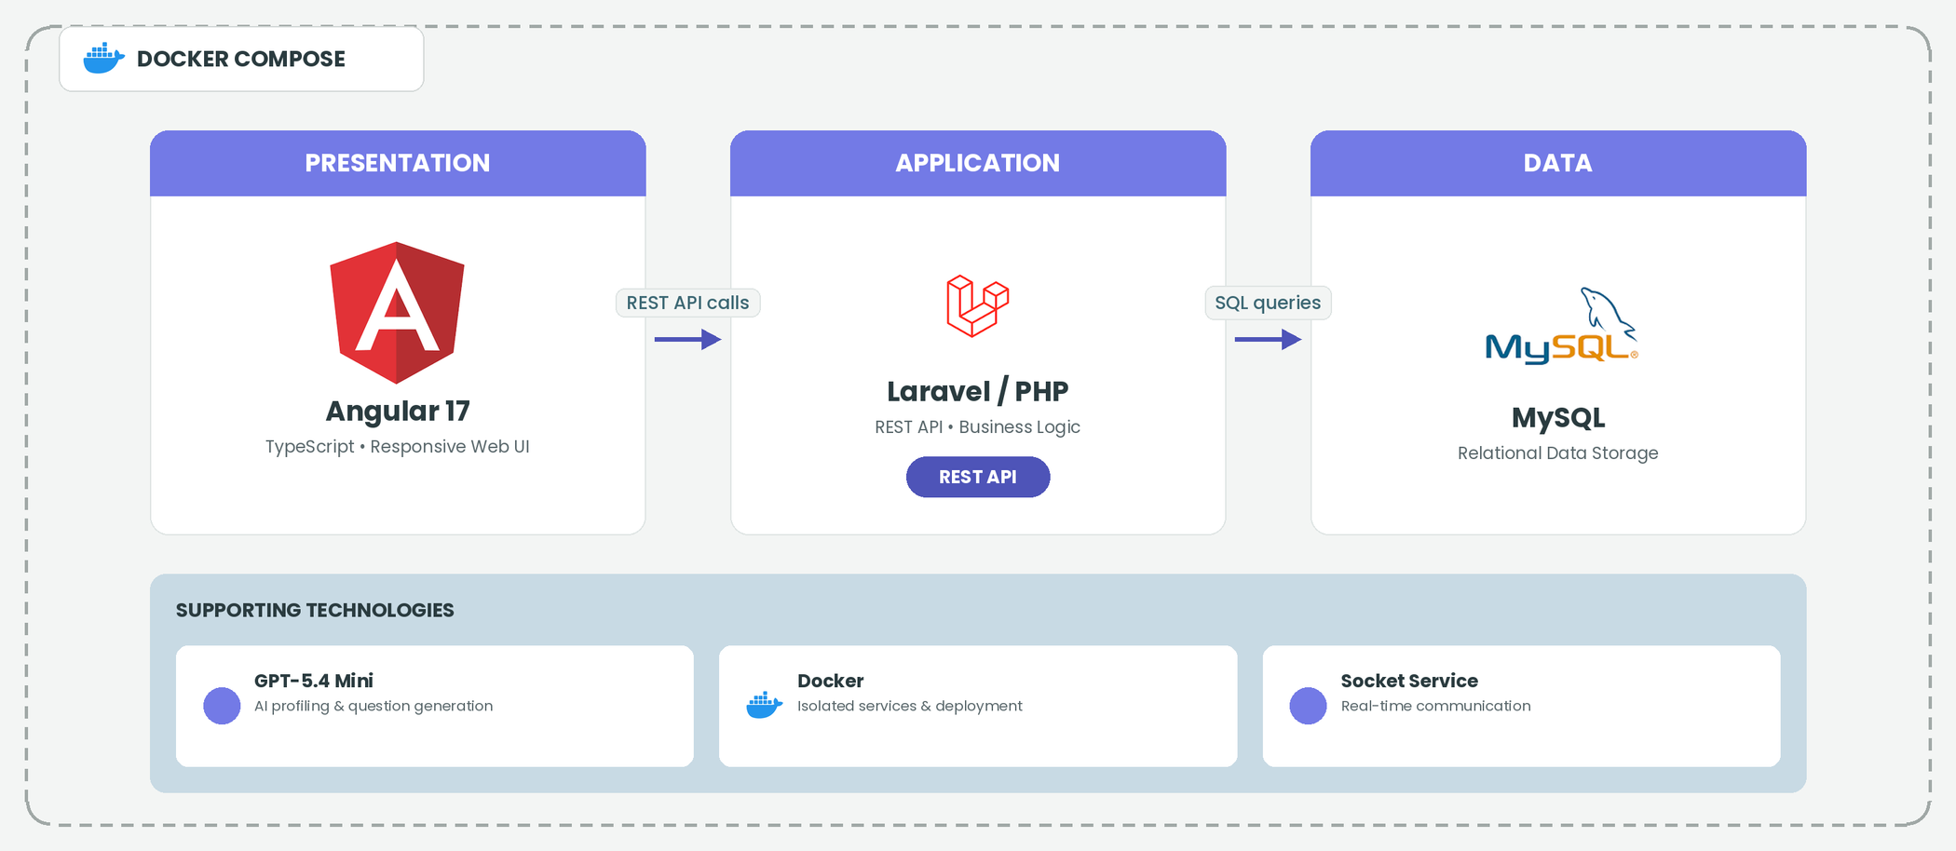
System Architecture & Technology Stack
Hire on Demand • PFE Defense

Slide 11
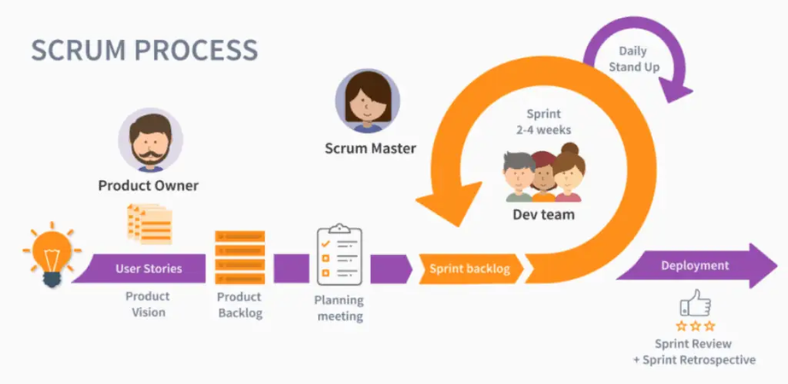
Framework: Scrum
STANDARD SCRUM CYCLE
WHY SCRUM
A fit for an incremental, multi-domain platform
Incremental delivery
Multiple functional domains could be implemented and released one at a time.
Predictable cadence
Fixed sprint cycles kept progress easy to monitor throughout the PFE period.
Validated increments
Each sprint closed with a review before the next set of features began.
SCRUM TEAM ON HIRE ON DEMAND
Product Owner & Scrum Master
Enterprise supervisor (dual role) : defines and prioritises the backlog, validates sprint increments.
Development Team
Project student, lead developer : designs, implements, tests and integrates every sprint, across front-end, back-end and AI.
Hire on Demand • PFE Defense

Slide 12
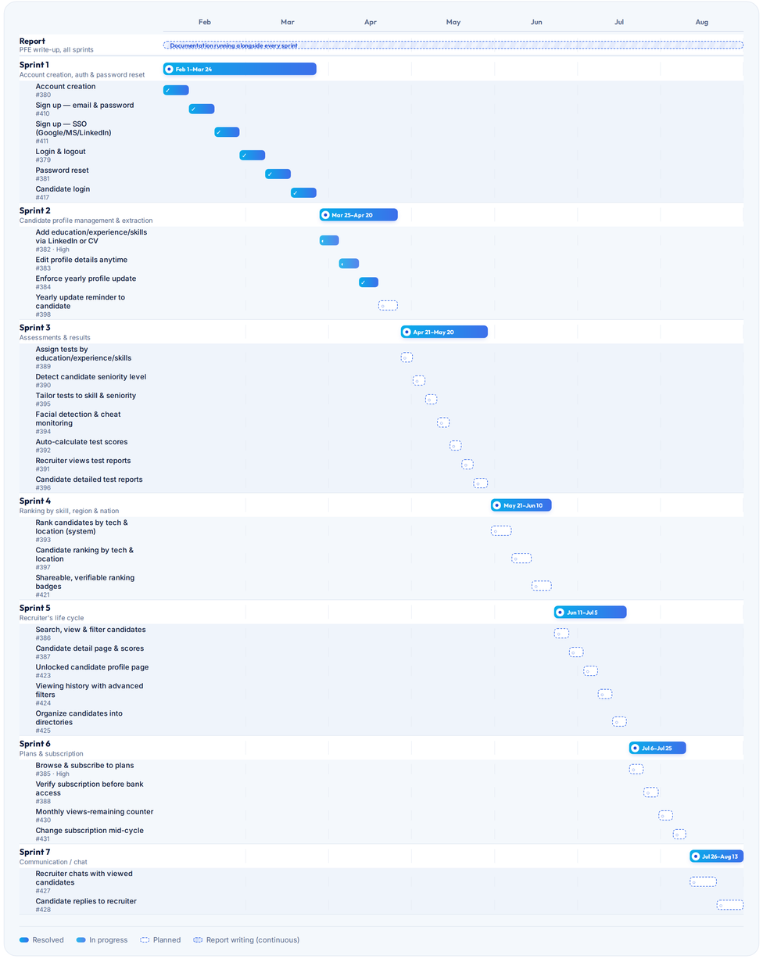
Sprint Timeline
Seven Scrum sprints delivered the platform's features incrementally between 01 Feb and 13 Aug 2026.
7
31
28
SPRINTS
STORIES
WEEKS
THE 7 SPRINTS
1
Account creation, auth & password reset
Feb 1 – Mar 24, 2026
2
Candidate profile management & extraction
Mar 25 – Apr 20, 2026
3
Assessments & results
Apr 21 – May 20, 2026
4
Ranking by skill, region & nation
May 21 – Jun 10, 2026
5
Recruiter's life cycle
Jun 11 – Jul 5, 2026
6
Plans & subscription
Jul 6 – Jul 25, 2026
7
Communication / chat
Jul 26 – Aug 13, 2026
Hire on Demand • PFE Defense

Slide 13
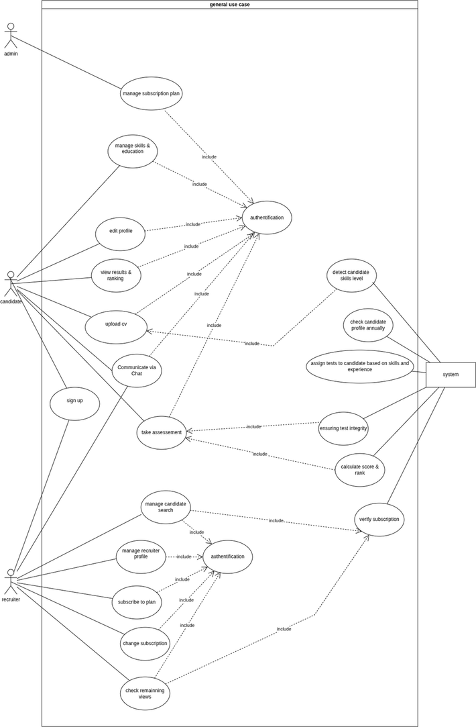
Global Use Case Diagram
<< system >>
HIRE ON DEMAND
    Profile Processing
    Assessment & Proctoring
    Evaluation & Ranking
    Candidate Search
    Profile Access
    Subscription
    Communication
Hire on Demand • PFE Defense

Slide 14
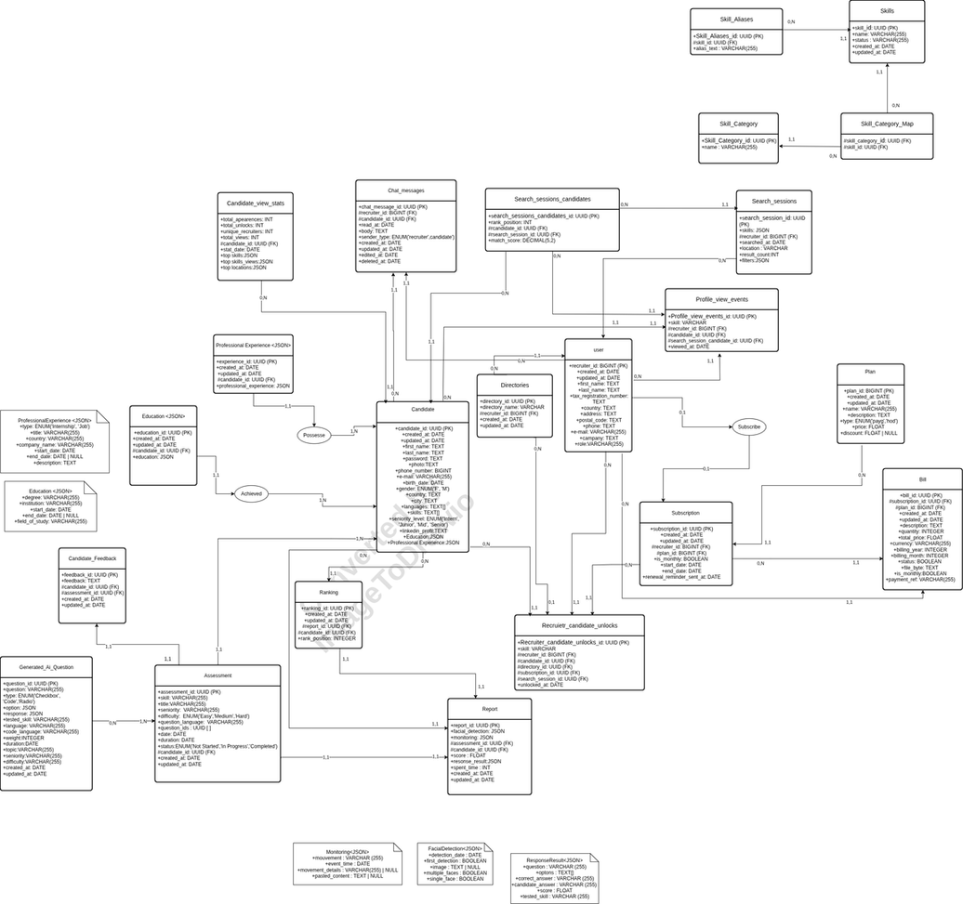
Database Design : ERD
Hire on Demand • PFE Defense

Slide 15
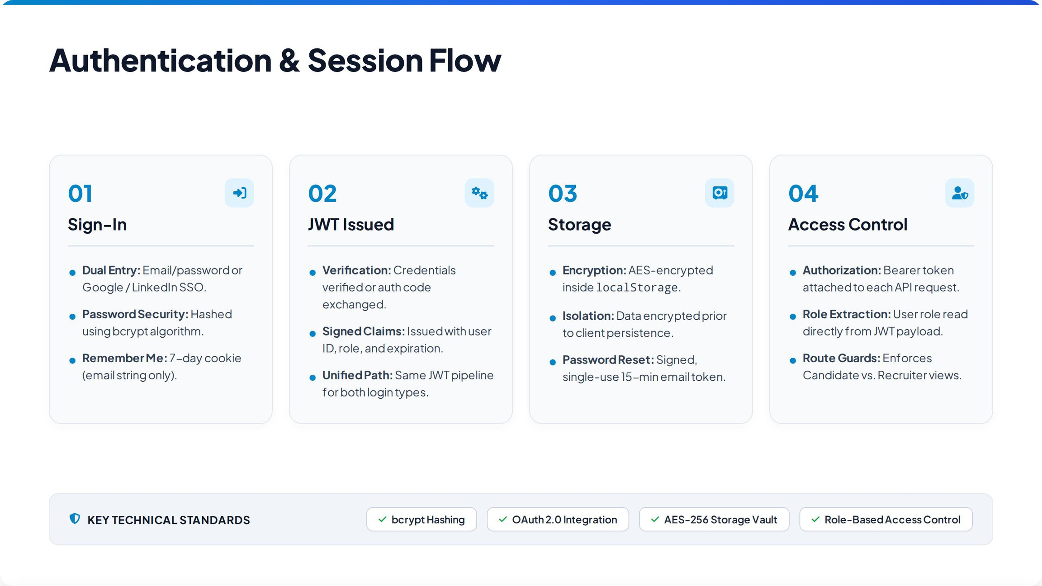

Slide 16
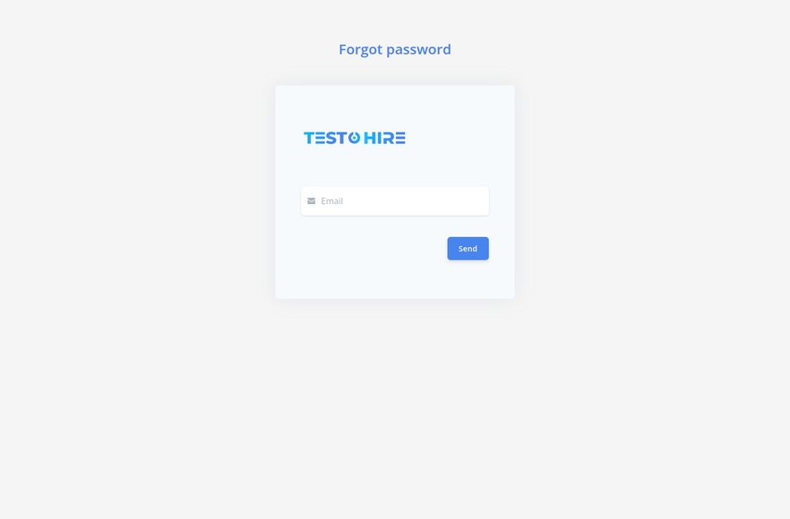
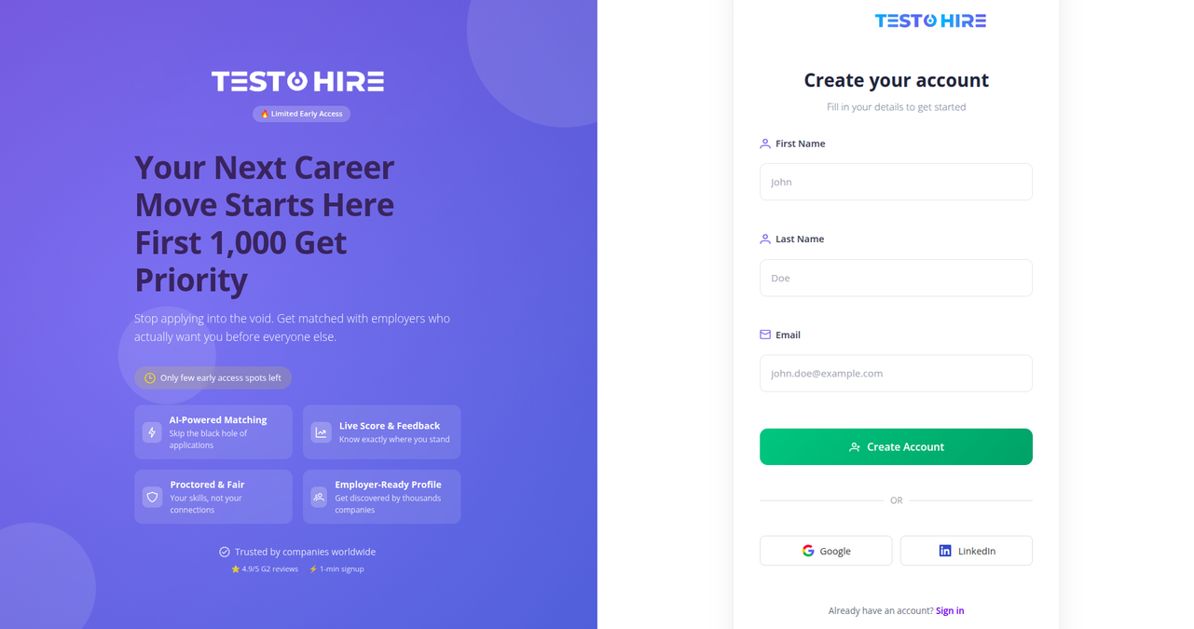
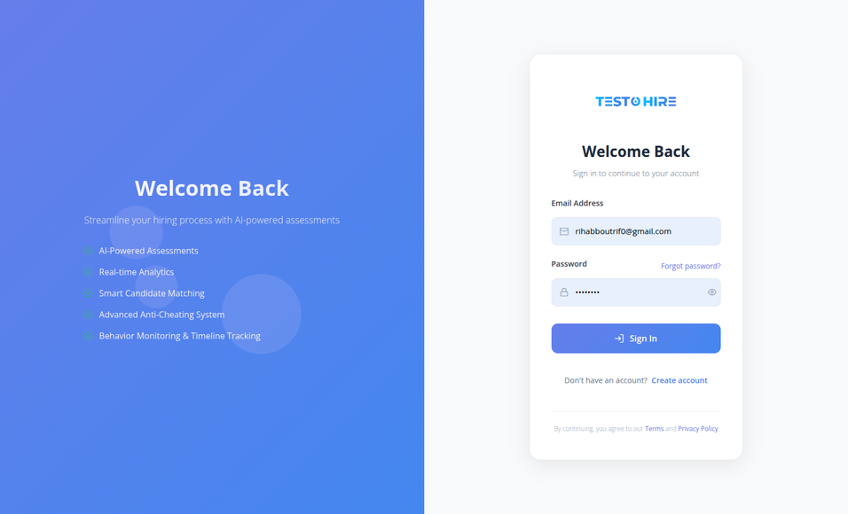
Implementation : Authentication
Hire on Demand • PFE Defense

Slide 17
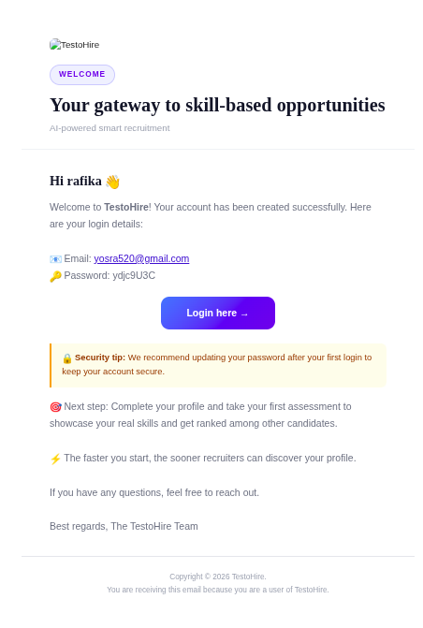
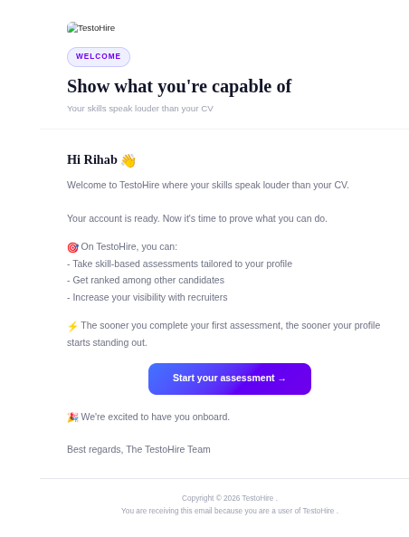
Implementation : Registration Email
Hire on Demand • PFE Defense

Slide 18
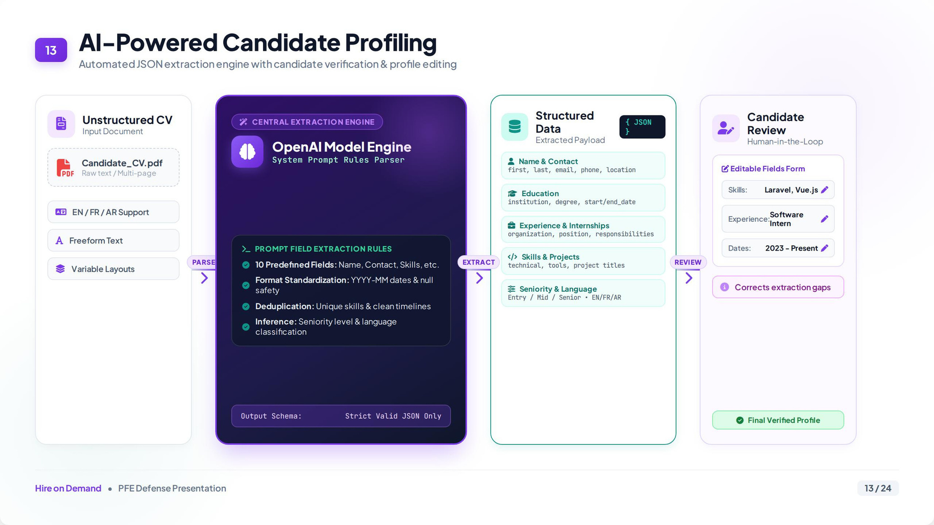
SK
Skill Canonicalization
Alias Resolution
“K8s” → “Kubernetes”
Known alias → mapped to its canonical skill
No match → created as pending, admin notified
›
Approved → promoted to the skill catalog
One Skill, Every Time

Slide 19
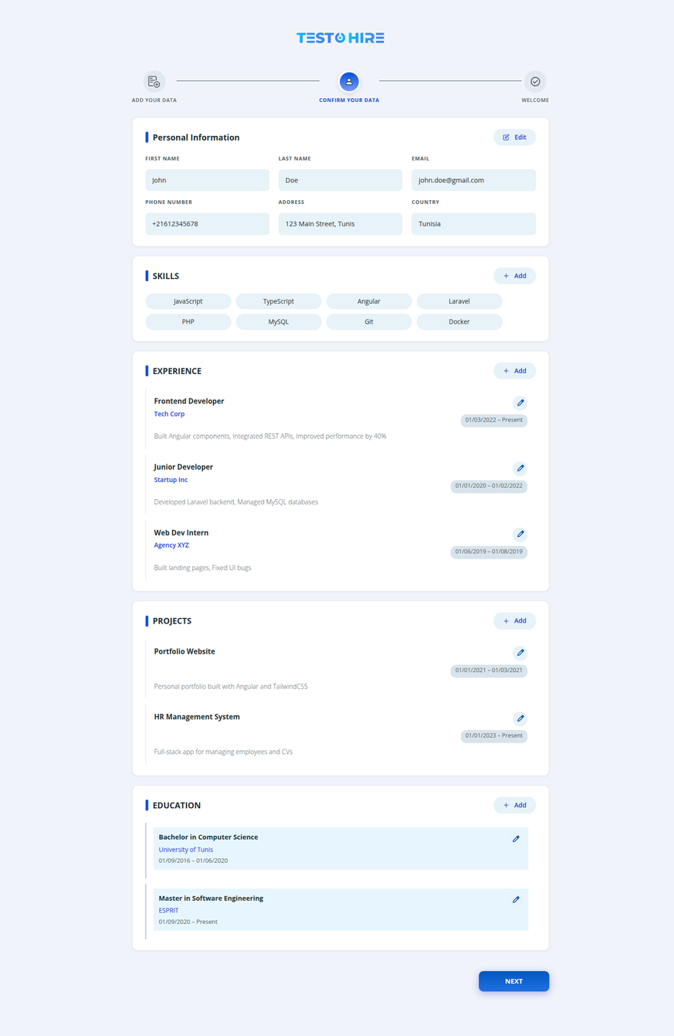
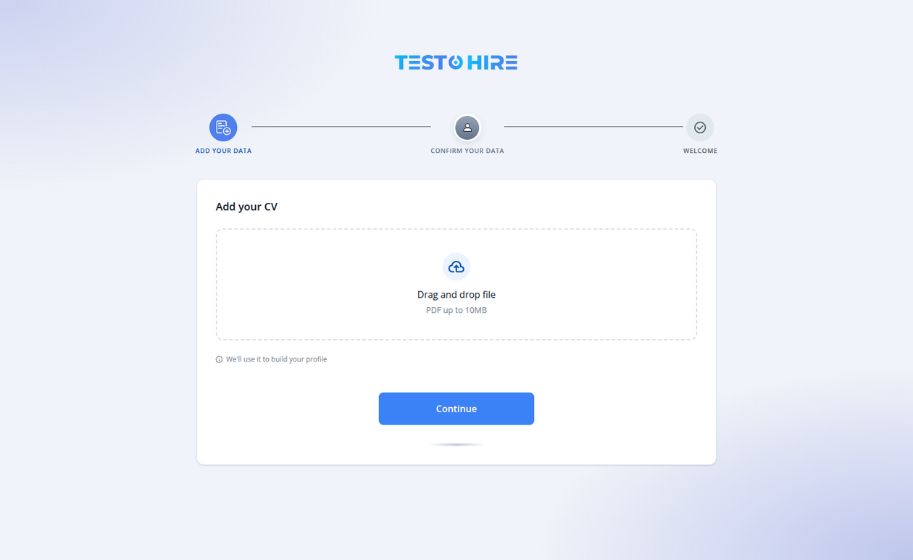
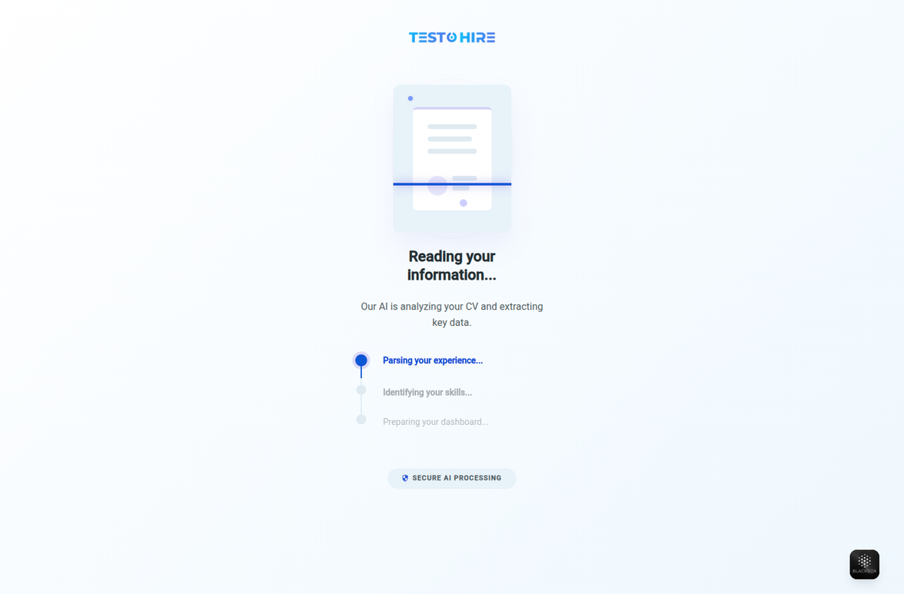
Implementation : Candidate Experience
Hire on Demand • PFE Defense

Slide 20
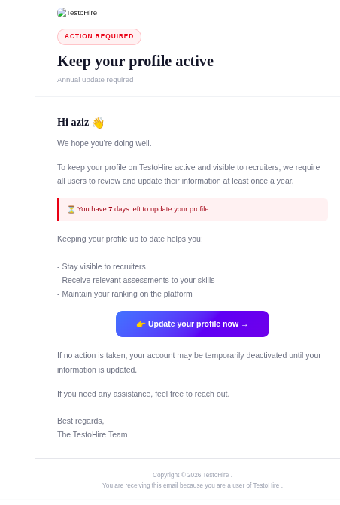
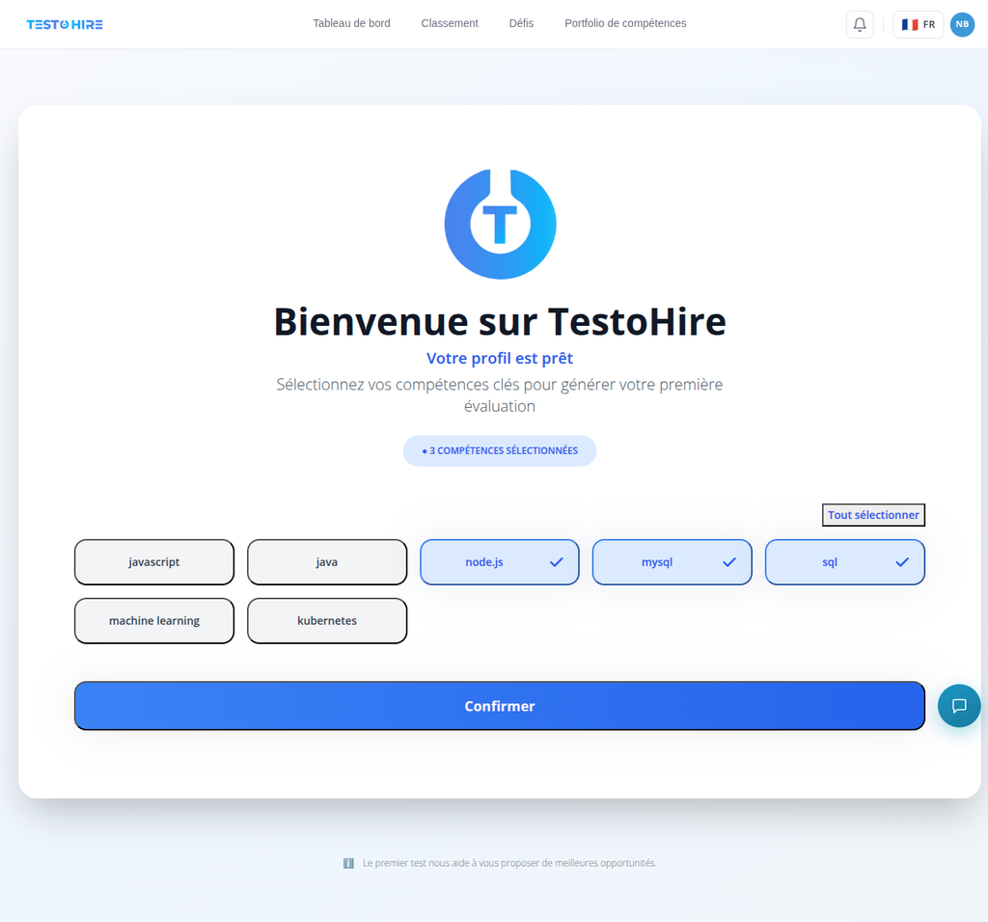
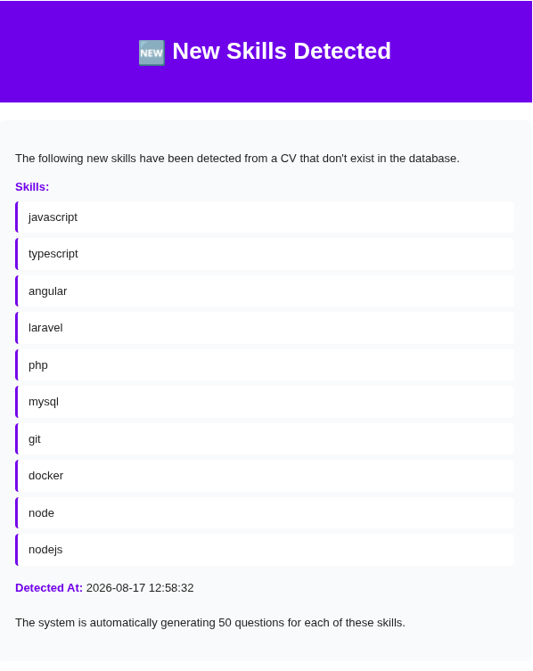
Implementation : Update Check & new skills detected Emails
Hire on Demand • PFE Defense

Slide 21
Assessment Assignment & Eligibility
Candidate Profile → One Assessment Created per Declared Skill
Eligibility Gate
Checked automatically every time a candidate opens the Assessment List : an ineligible test cannot be started
✓ Eligible
✕ Restricted
Start button is active : the assessment can be opened and begun
Start button is disabled : the reason and remaining wait time are shown instead
First Month
Subsequent Months
Skill Cooldown
  Max 4 assessments allowed in the first calendar month after registration
  Counter resets once that calendar month ends
  Max 2 assessments allowed per month, every month after the first
  Applies across all skills combined, not per skill
  6 months must elapse before the same skill can be reassessed
  Same 6-month lock is applied after a confirmed cheating violation on that skill
With Editor
21 questions · 32 min
Without Editor
20 questions · 17 min
Hire on Demand • PFE Defense

Slide 22
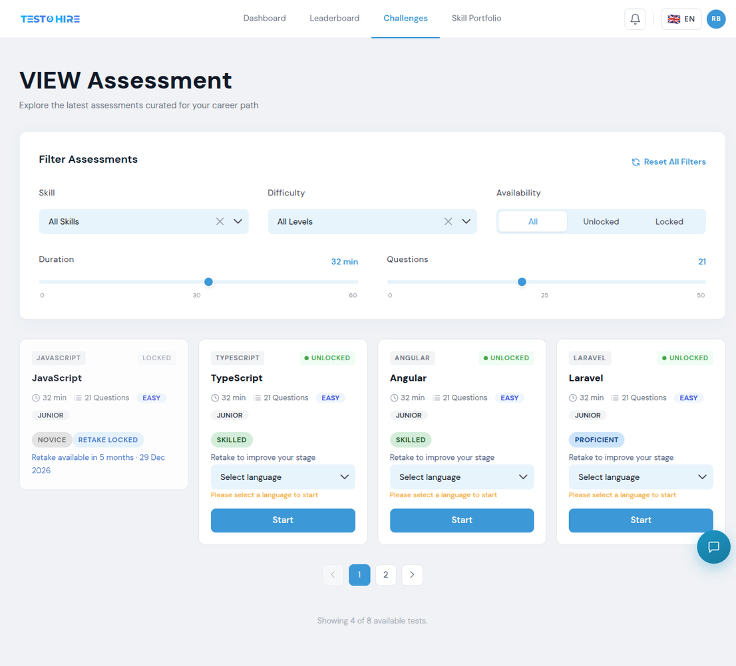
Implementation : Assessment Page
Hire on Demand • PFE Defense

Slide 23

AI Question Generation
Skill + Seniority
Check Generated AI Questions bank
≥ 50 questions already stored
< 50 questions stored
Reuse stored questions
Keep what exists + generate the rest (GPT-5.4 mini)
Assessment questions ready
Radio & Checkbox for every skill • Code Editor added only for skills that require it
Hire on Demand • PFE Defense

Slide 24
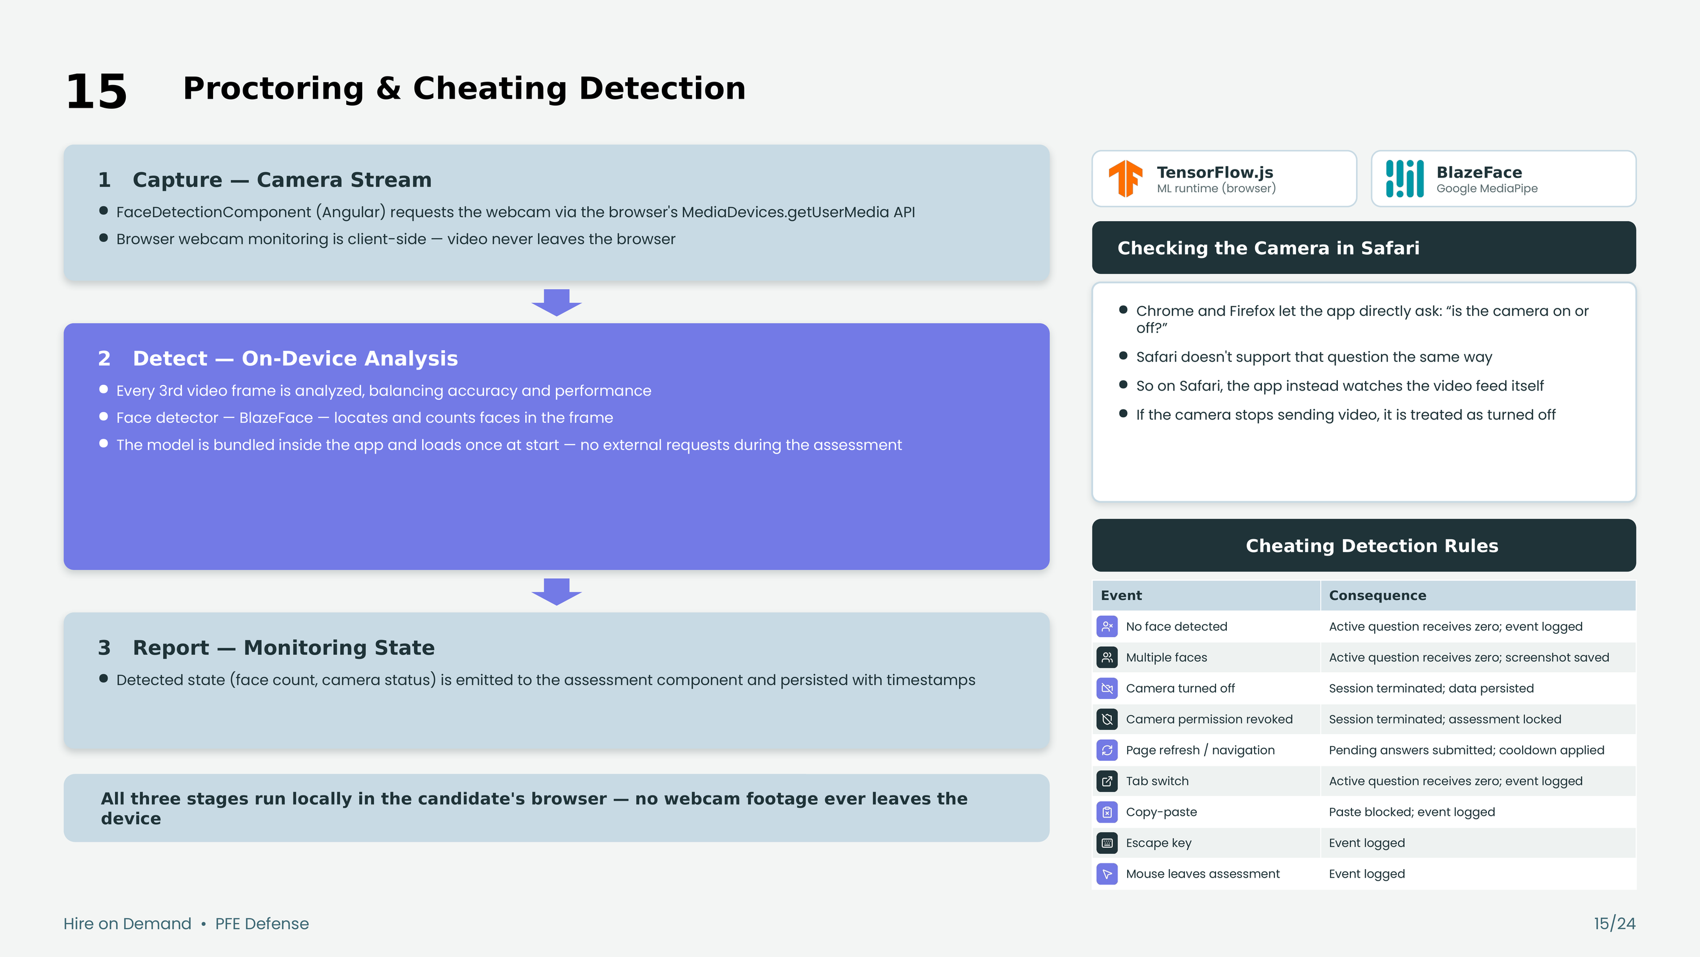

Slide 25





Execution Hub : Sandboxed Code Execution
Candidate Submits Code
Docker
Laravel
1
Container runtime
Service framework
While answering a Code Editor question, the candidate writes a solution and optionally requests to run it.
Why It Runs in a Sandbox
Execution Hub Receives the Request
• Every submission gets its own disposable container — nothing persists between runs
• No network access from inside the container: code can’t reach external services
• CPU, memory, and execution-time limits prevent runaway or malicious scripts
2
A Dockerised Laravel microservice spins up an isolated container to handle the submitted code.
Code Runs in a Sandboxed Container
3
The container is fully isolated from the host and from other candidates’ sessions — no shared state, no side effects.
Runtime Feedback Returned
4
Output or errors are sent back to the candidate’s editor in real time, before final submission.
Hire on Demand • PFE Defense

Slide 26




AI-Powered Evaluation & Scoring
ANSWER TYPE
GRADING METHOD
CHEATING CHECK
FINAL SCORE
Radio / Checkbox
Exact match against correct answer(s)
Flagged (cheating) questions are zeroed before scoring
Final Score %
Code Editor
Mapped to a competency stage
Graded by GPT-5.4 mini — binary 0 / 1
Grading runs first, then the cheating check overrides any flagged answer to zero — so a proctoring violation can never inflate a score.
Competency stage
Novice
Developing
Proficient
Skilled
Master
0–40%
41–60%
61–75%
76–90%
91–100%
Hire on Demand • PFE Defense

Slide 27
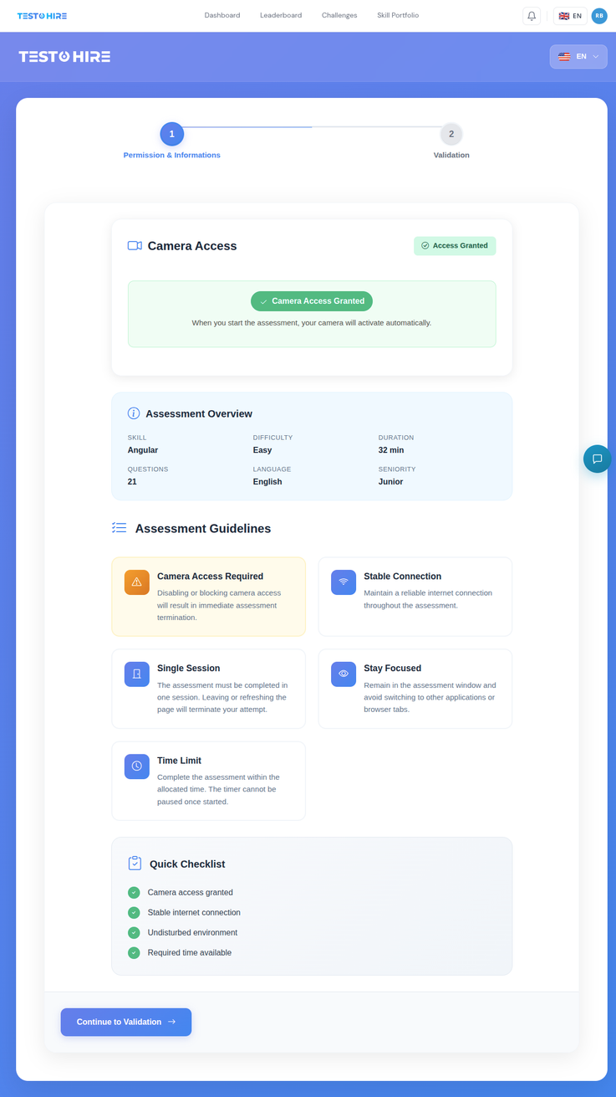
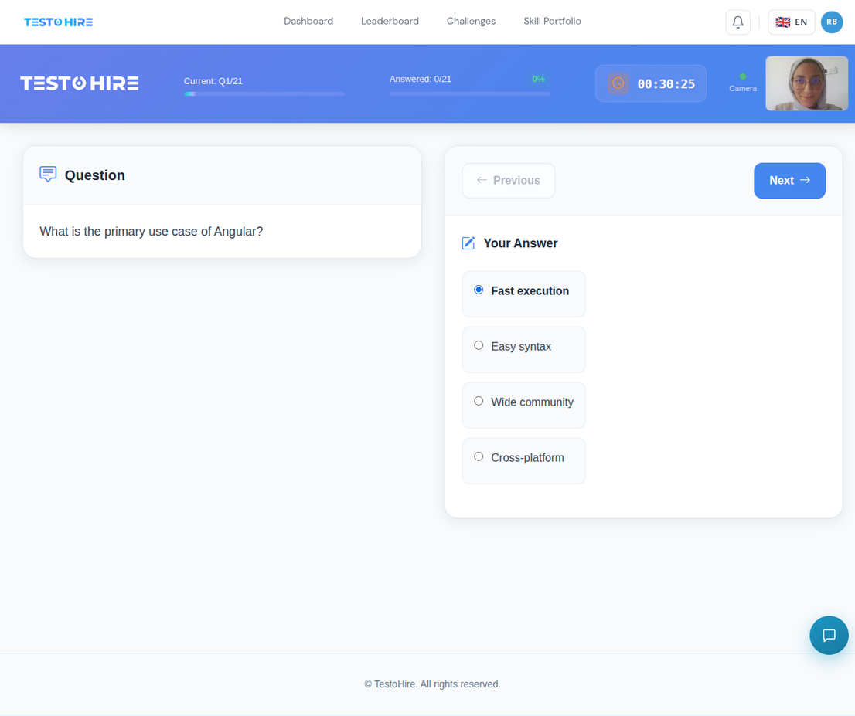
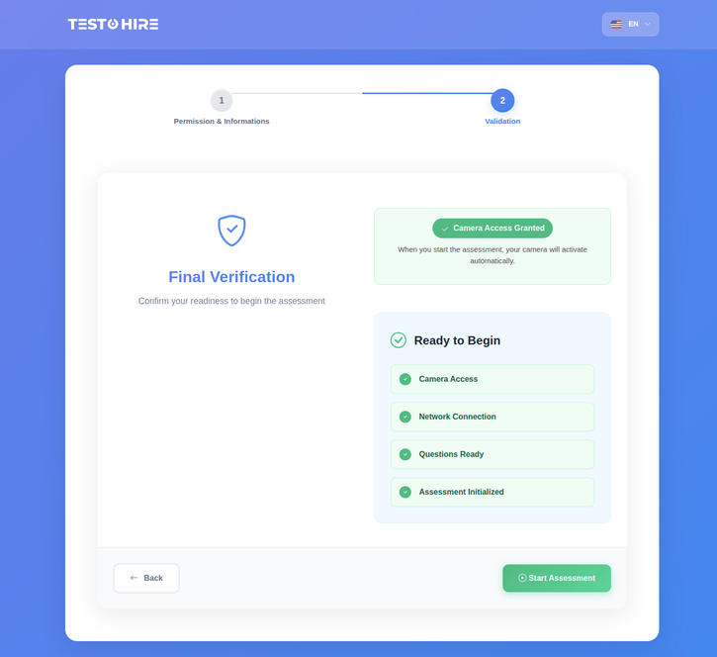
Implementation : Assessment & Results
Hire on Demand • PFE Defense

Slide 28
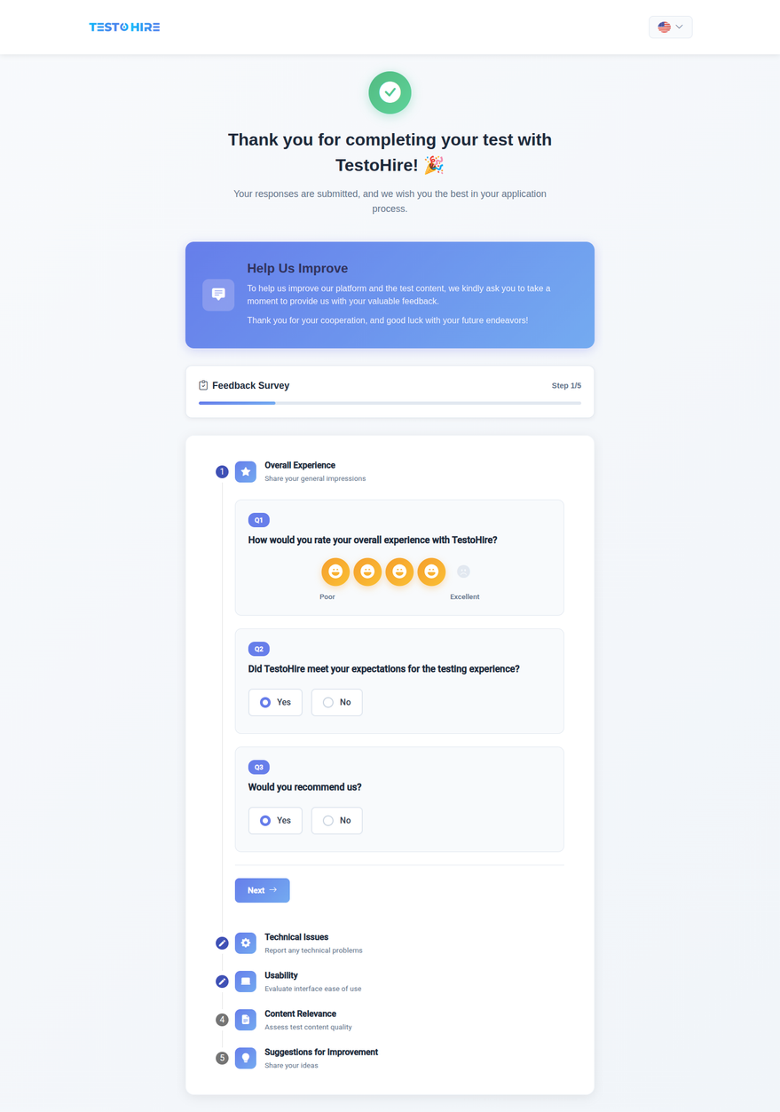
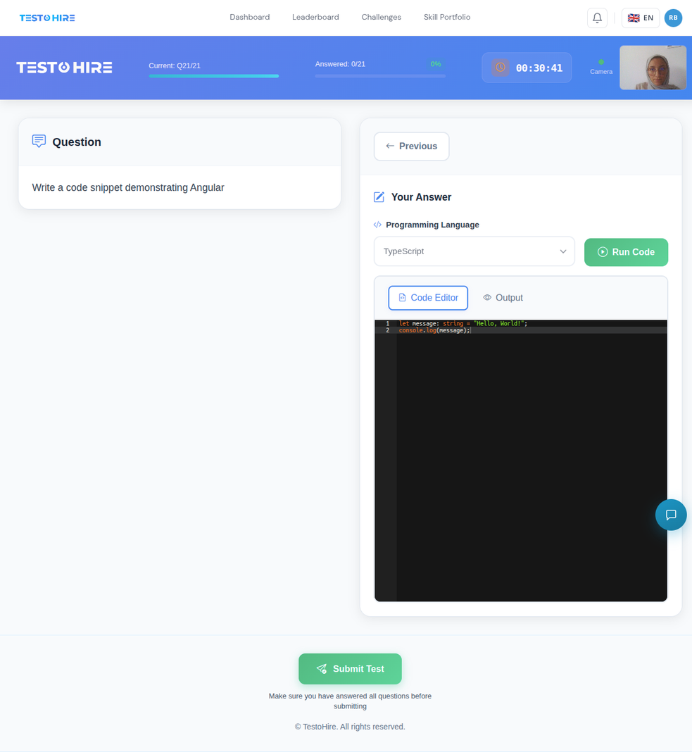
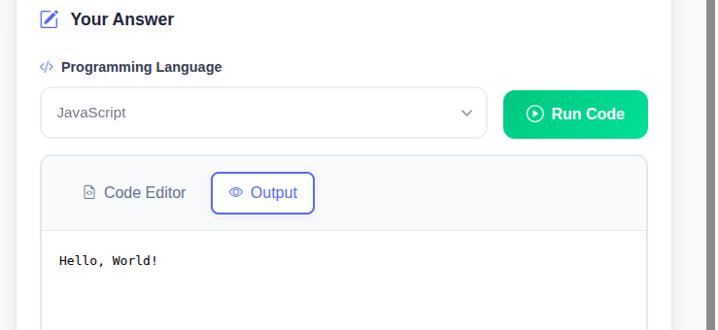
Implementation : Assessment & Results
Hire on Demand • PFE Defense

Slide 29
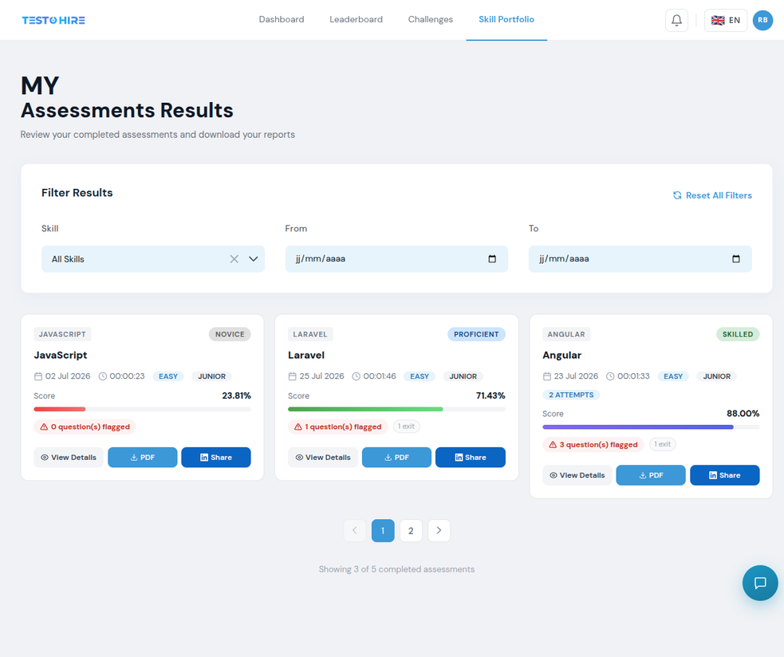
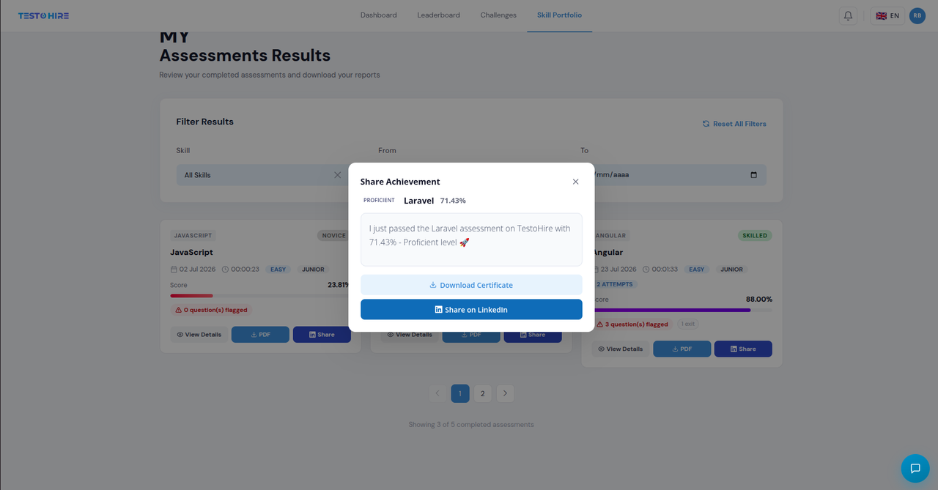
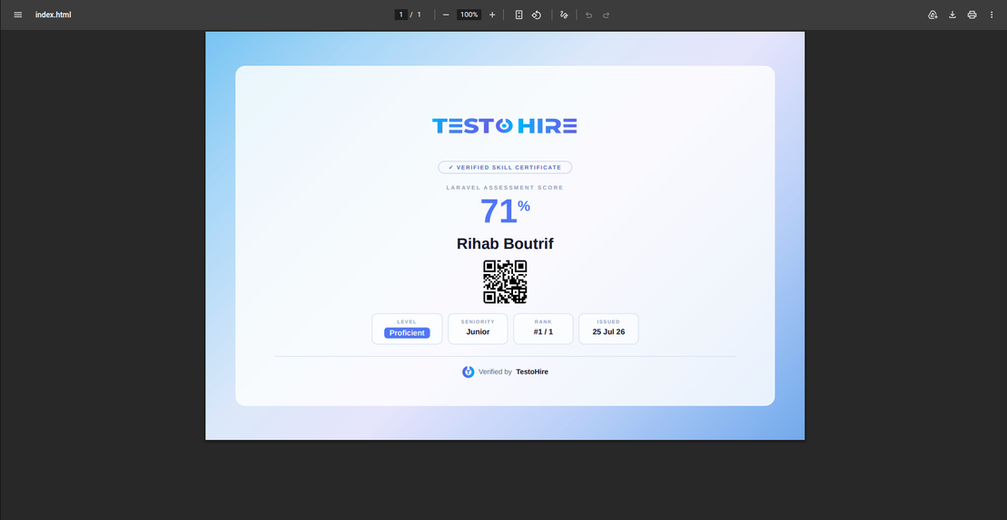
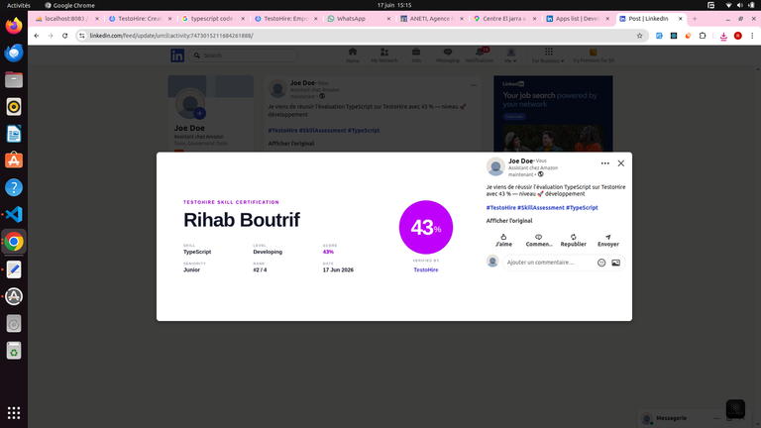
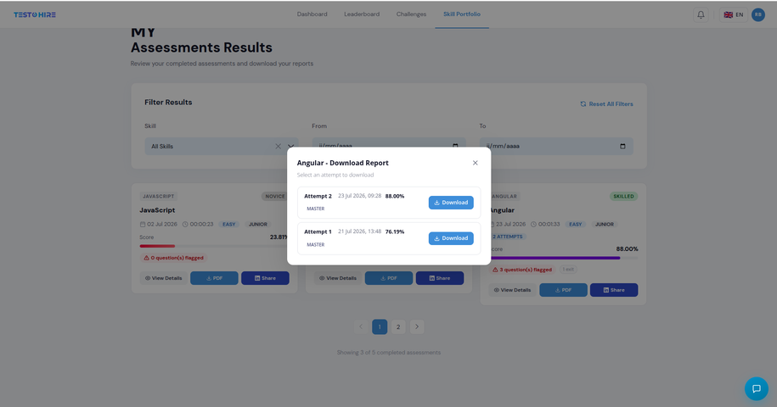
Implementation : Assessment & Results
Hire on Demand • PFE Defense

Slide 30
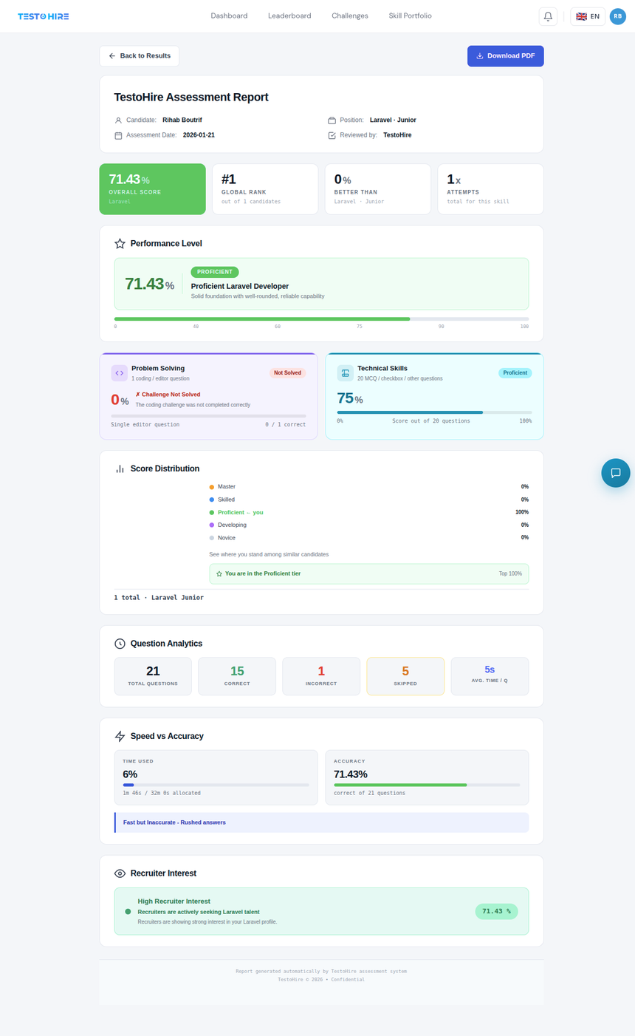
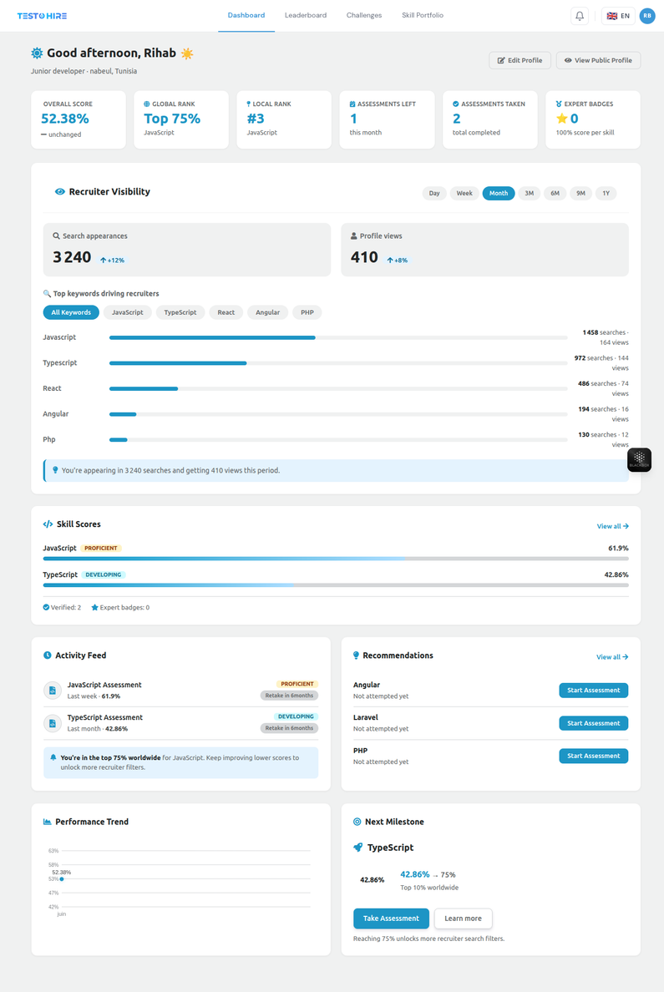
Implementation : Assessment & Results
Hire on Demand • PFE Defense

Slide 31



Skill Ranking & Leaderboard
Candidate Picks a Skill → Leaderboard Generated for That Skill
Geographic Filter (Optional)
Narrows the same leaderboard to a region : Continent → Country → State
✓ Your Entry
○ Other Candidates
Full identity shown — name, photo, exact rank and score
Identity hidden — rank and score still visible, name and photo anonymized
Worldwide Ranking
Regional Ranking
Large Leaderboards
    Compares your score to every candidate assessed on that skill
    Shows your exact position and percentile
    Same comparison, limited to the selected geographic filter
    Worldwide and regional percentiles shown side by side
    Results are loaded page by page, not all at once
    Keeps the leaderboard fast even with thousands of candidates
Example
Skill : React · Country : Tunisia
Result
Rank #12 of 340 · Top 4% Worldwide
Hire on Demand • PFE Defense

Slide 32
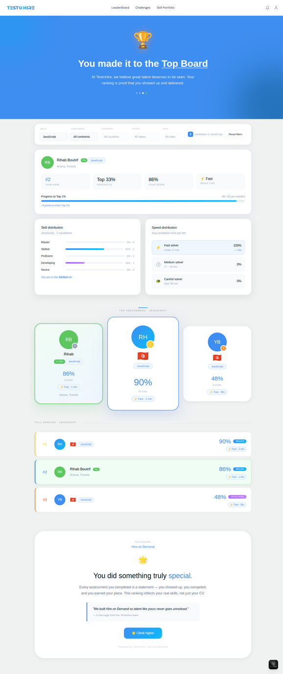
Implementation : Assessment, Results & Ranking
Hire on Demand • PFE Defense

Slide 33


Recruiter Experience
Search
→
Filter
→
Unlock
→
View
→
Organize
→
Chat
Candidate Discovery
Candidate Evaluation
Recruiter Organization
Search by skills and profile information.
Filtering and result exploration.
Profile access. Assessment reports.
Recruiter history.
Viewed candidates.
Directories.
Candidate management.
Hire on Demand • PFE Defense

Slide 34
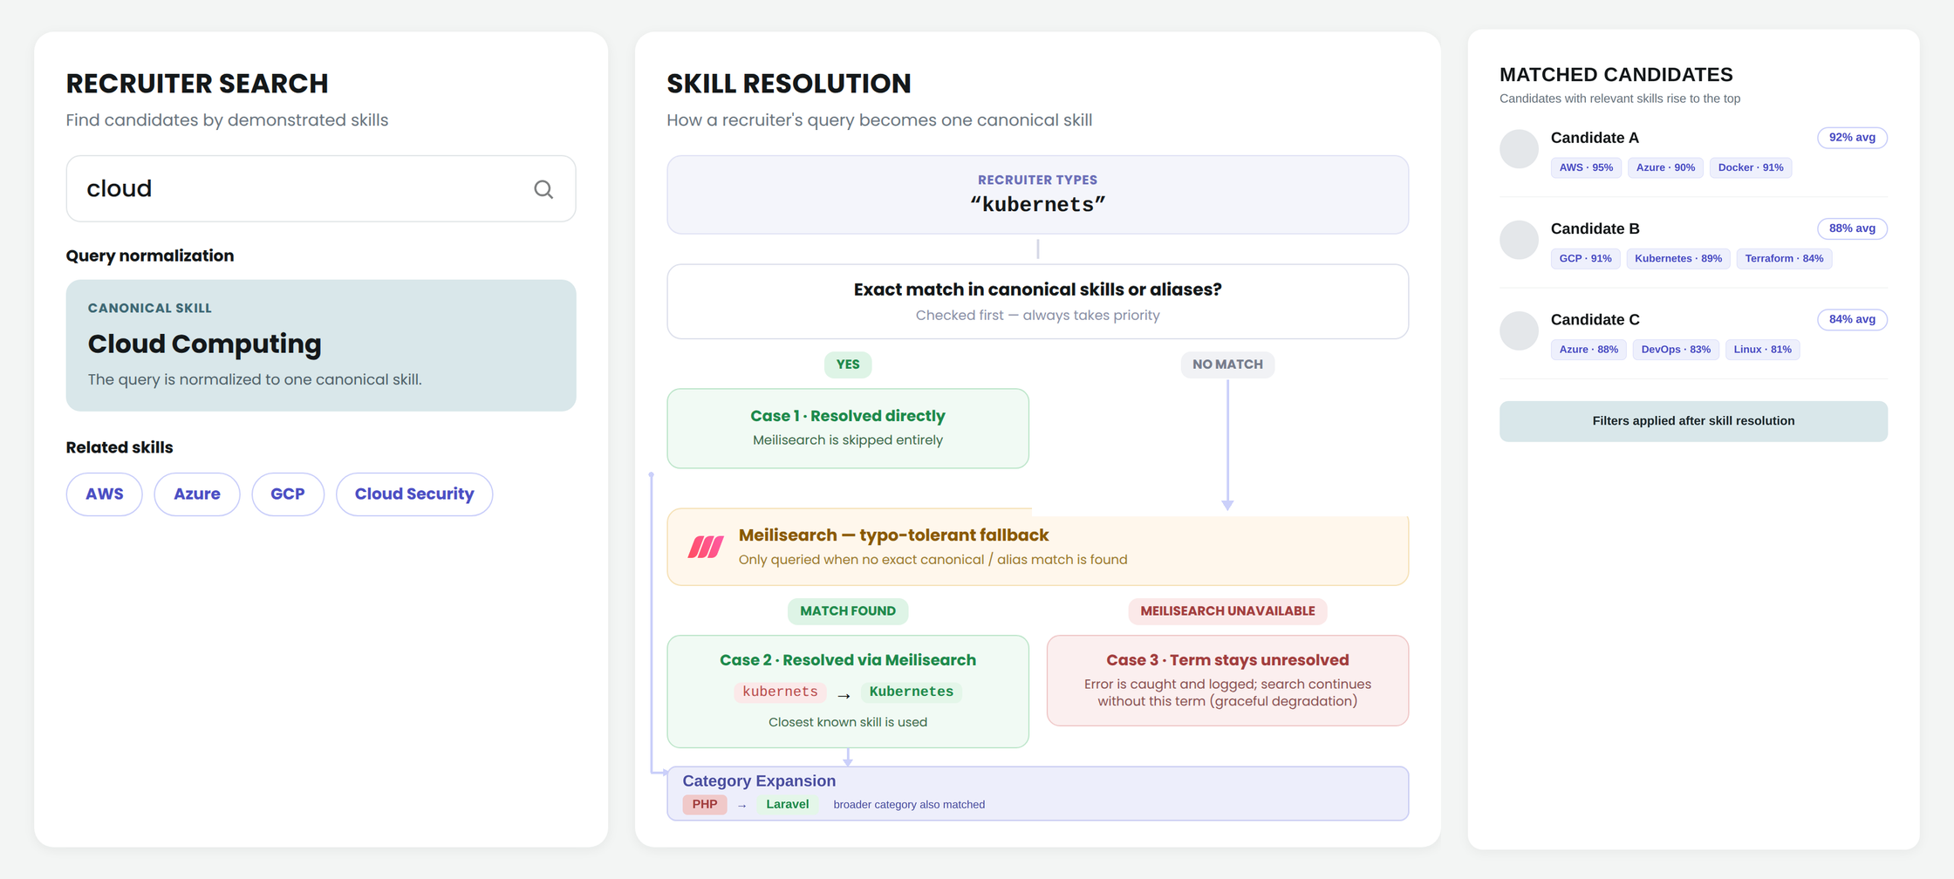
Recruiter Search: Skill Resolution Engine
Hire on Demand • PFE Defense

Slide 35
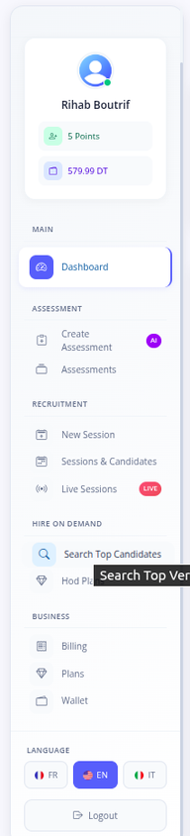
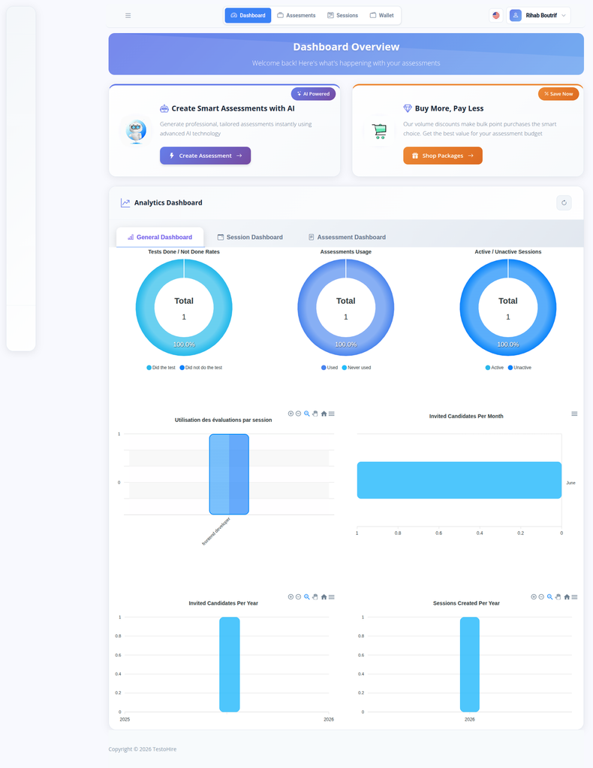
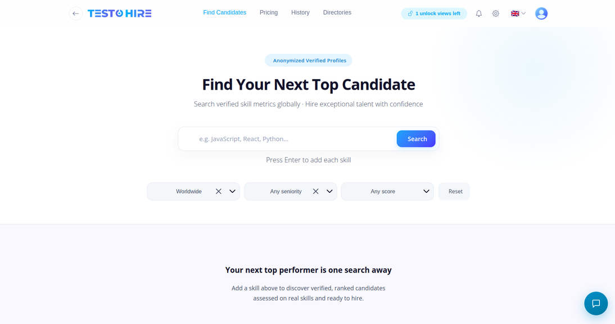
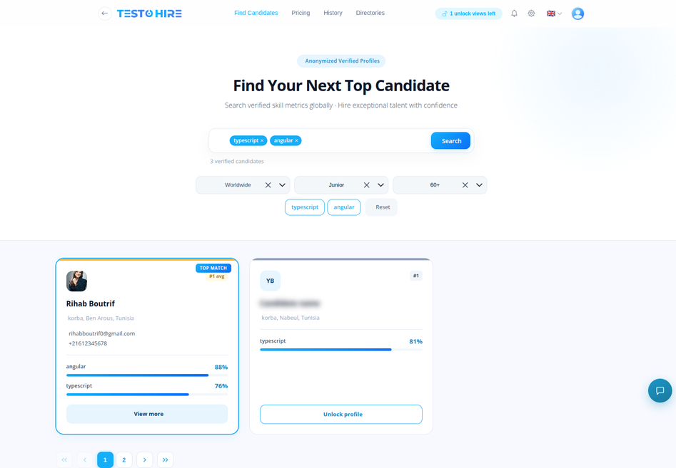
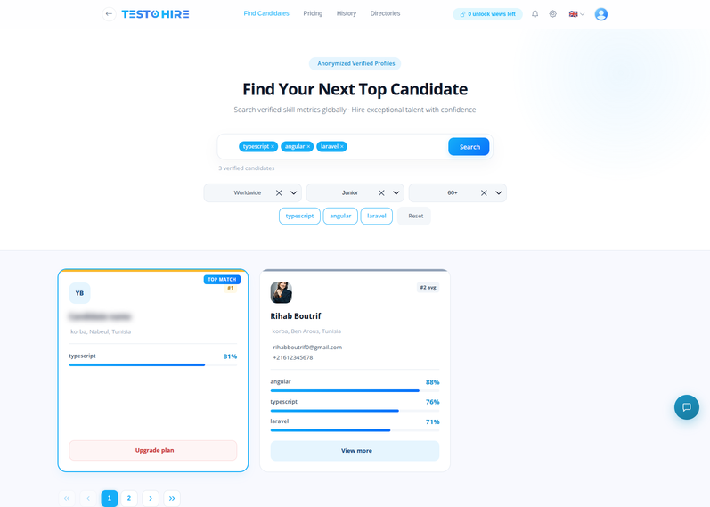
Implementation : Recruiter Experience
Hire on Demand • PFE Defense

Slide 36
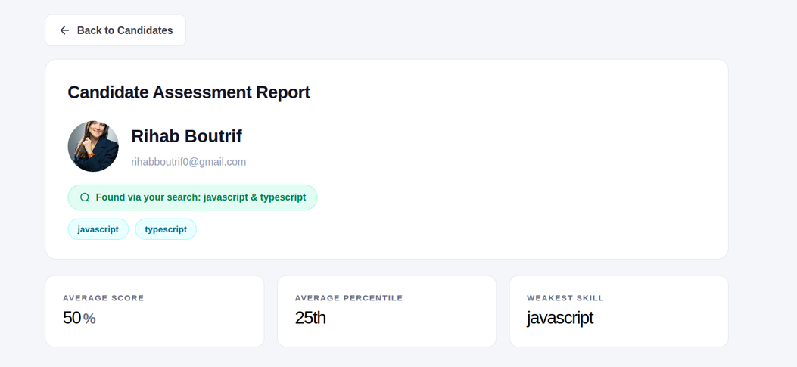
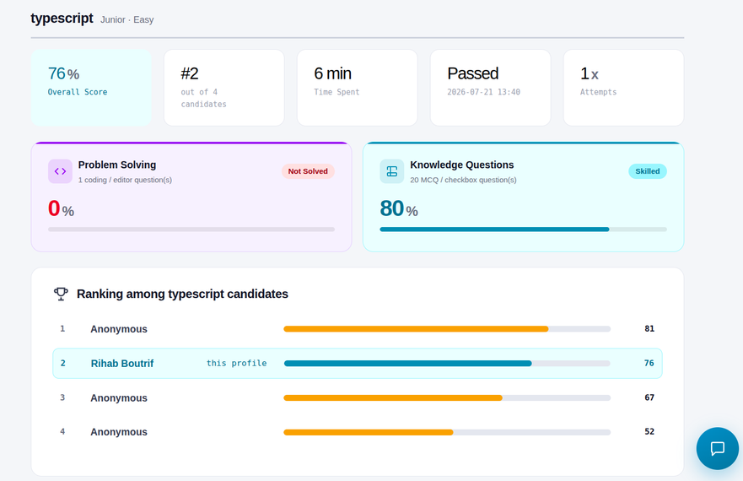
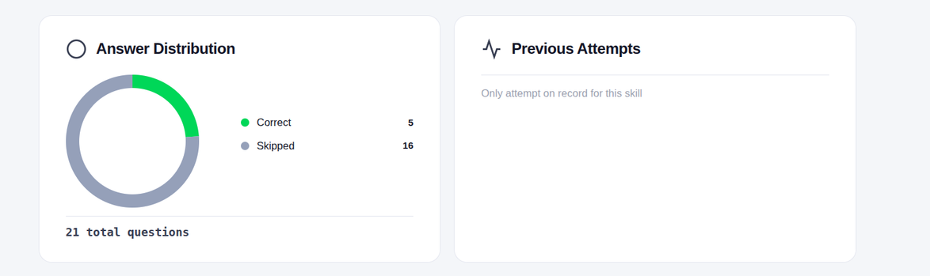
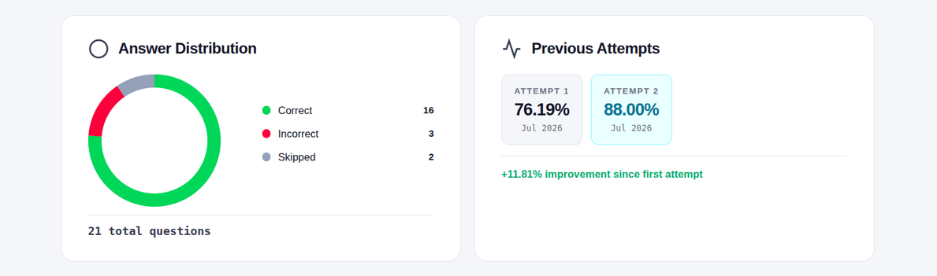

Slide 37
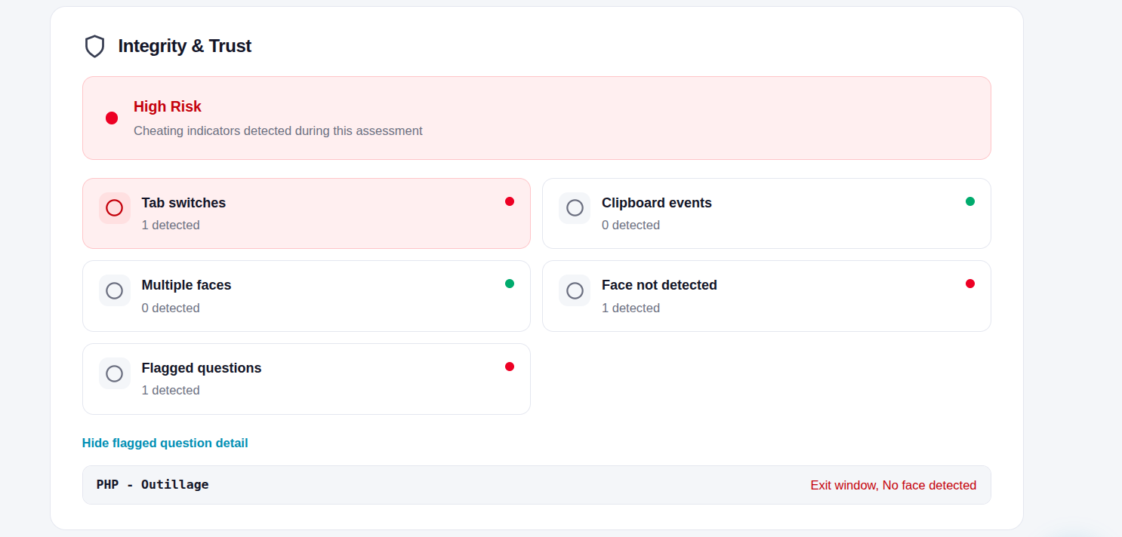
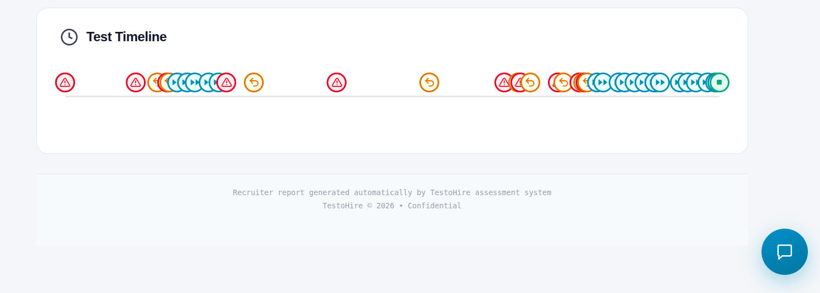

Slide 38
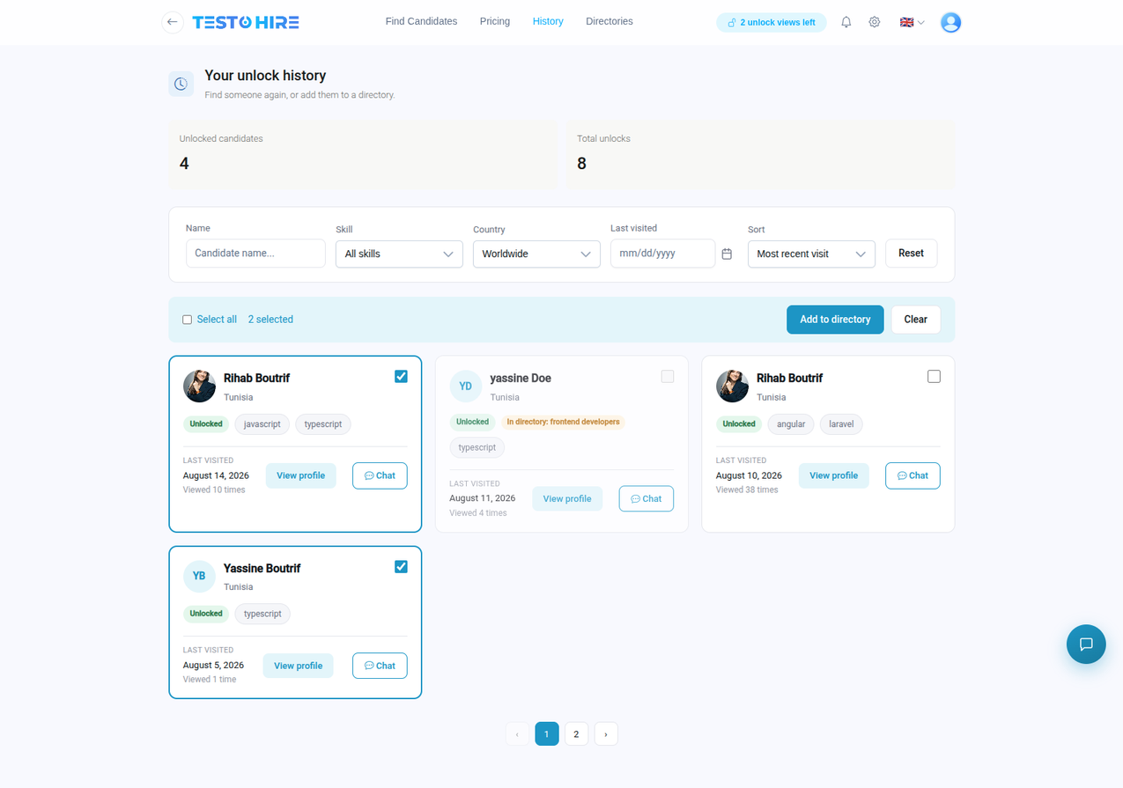
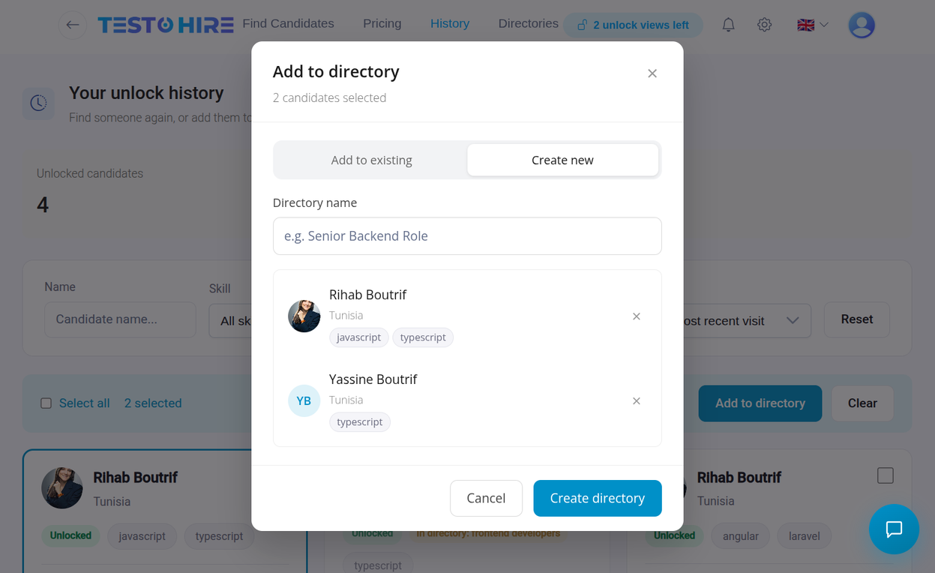
Hire on Demand • PFE Defense

Slide 39
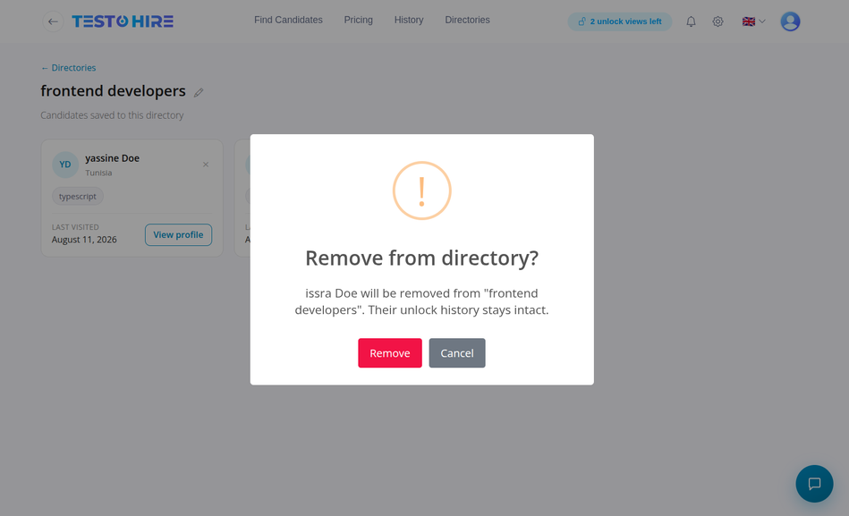
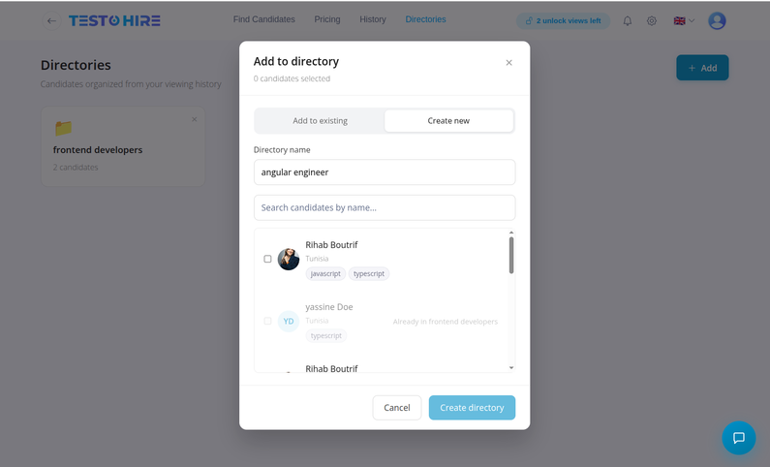




Slide 40

Recruiter Subscription & Billing
Recruiter browses HOD packages
Selects a payment method
Wallet balance checked, deducted, subscription activated instantly
Konnect gateway : redirect, pay, then confirm
Subscription activated : quota available
Konnect payment only → Spring Boot Billing System generates PDF invoice
11 days before monthly expiry → automated renewal reminder email
Billing runs as a separate external service (Spring Boot) , kept independent from the HOD subscription module
Hire on Demand • PFE Defense

Slide 41






Implementation : Subscription & Communication
Hire on Demand • PFE Defense

Slide 42

Hire on Demand • PFE Defense

Slide 43


Real-Time Chat: Architecture & Flow
Frontend
Backend
Socket Service
Database
chat UI + socket client
auth, validation, persistence
real-time event delivery (own Docker image)
conversations & messages
Message flow
Recruiter
chat UI + socket client
sends
Backend validates + persists
sends
Candidate
chat UI + socket client
Socket Service pushes event
delivers
delivers
Either side can send — the message is always persisted before Socket Service pushes it to the other participant.
Conversation & Message Rules
Why a Separate Socket Service
One conversation per recruiter–candidate pair, created on first message
Deployed as its own Docker image, independent from the main backend
Only recruiters can start a conversation; candidates can only reply
Backend stays responsible for business rules and persistence only
Sender can modify or delete their own message — ownership checked server-side
Real-time layer can scale or restart without affecting the main app
Opening a conversation marks its unread messages as read, server-side
Hire on Demand • PFE Defense

Slide 44



Implementation : Subscription & Communication
Hire on Demand • PFE Defense

Slide 45





Conclusion & Perspectives
CONCLUSION
Hire on Demand provides an integrated recruitment platform that combines AI-powered candidate profiling, skill-based assessments, proctoring, automated evaluation, ranking, and recruiter search. The project addresses the gap between declared skills and verified competencies, supporting more structured and informed recruitment decisions.
Future Perspectives
Semantic candidate–job matching
Match profiles with job requirements.
Smarter recommendations
Improve candidate discovery and suggestions.
Adaptive assessments
Adjust evaluation to candidate performance.
Complex & scanned CVs
Improve extraction from difficult documents.
Analytics & scalability
Extend insights and support larger volumes.
Hire on Demand • PFE Defense

Slide 46


THANK YOU
FOR YOUR ATTENTION

