Slide 1

AI-Powered Diabetes Risk Prediction
A Machine Learning Approach to Early Diagnosis and Intervention

Slide 2

Problem Statement
Diabetes is a chronic and increasingly prevalent disease worldwide, leading to significant health complications like heart disease, kidney failure, and blindness if not diagnosed early. However, early detection remains a challenge, especially in remote or under-resourced areas where routine medical screening is limited. The lack of accessible diagnostic tools leads to delayed interventions, increasing the risk of severe complications and placing a substantial burden on healthcare systems.

Slide 3

About The Project
This project is a Diabetes Prediction App that utilizes machine learning techniques to predict the likelihood of diabetes based on user input parameters such as glucose levels, blood pressure, insulin levels, etc. It is built as a web application using Streamlit as the front-end framework.
Languages used : Python
Frontend Framework : Streamlit
Machine Learning Model : Random Forest Classifier (using Scikit-learn)
Libraries: Pandas, NumPy, Matplotlib, Seaborn, Joblib
Functionality :
Collects user input through sliders
Predicts diabetes likelihood based on health factors
Visualizes feature distributions and correlations
Evaluates model accuracy and feature importance
Provides real-time predictions with probability

Slide 4

Procedure
Data Loading & Preprocessing: Load and split the dataset (80% train, 20% test).
Exploratory Data Analysis: Summarize data and visualize feature distributions, Create a correlation heatmap.
Model Training & Tuning: Train a Random Forest model, Use GridSearchCV for hyperparameter tuning.
Model Evaluation: Measure accuracy and plot feature importance & ROC curve.
User Input & Prediction: Collect health data via Streamlit sliders, Predict diabetes likelihood and display results.
Model Saving: Option to save the trained model.

Slide 5
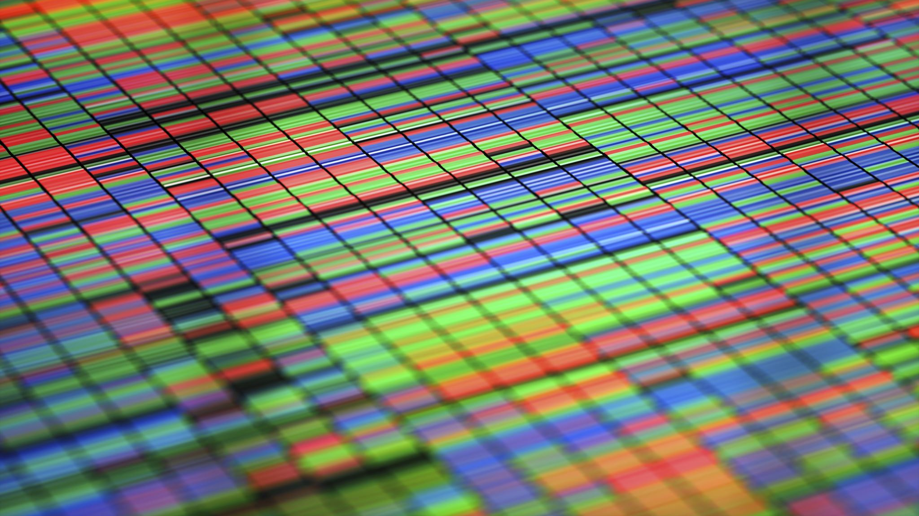
Algorithms Used
Random Forest Classifier: An ensemble learning algorithm that builds multiple decision trees during training. It combines the predictions of each tree to improve accuracy and reduce overfitting. It is highly effective for classification tasks like predicting diabetes based on health parameters.
GridSearchCV: A hyperparameter tuning technique that systematically tests different parameter combinations for the Random Forest model. By using cross-validation, it selects the best-performing model with the optimal parameters, enhancing the model's predictive performance.

Slide 6
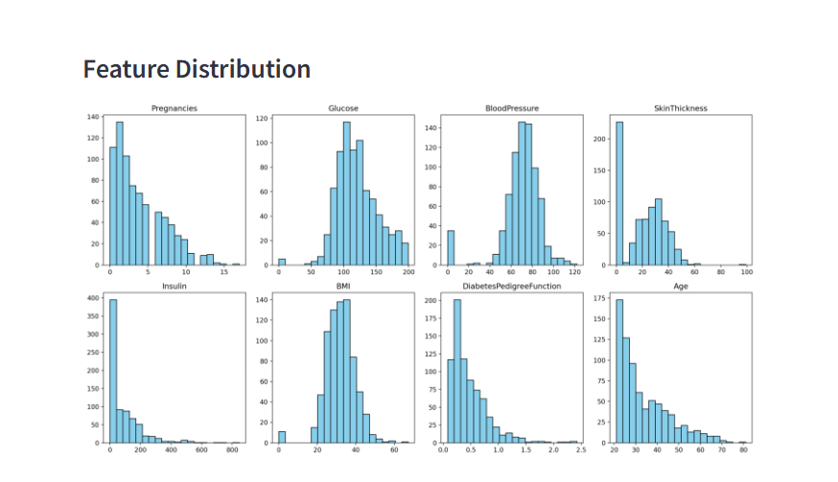
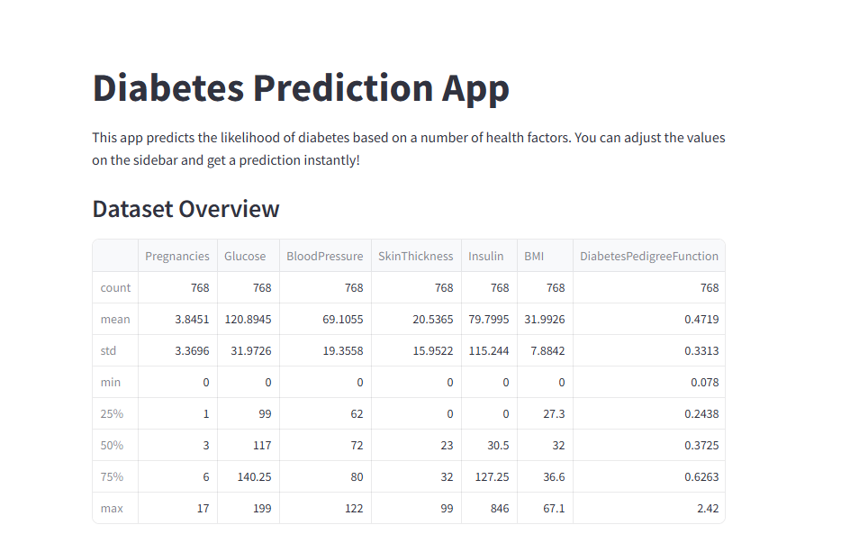
Implementation
Data Preprocessing: Loaded the diabetes dataset and split it into training and testing sets, Handled data imbalances and cleaned the dataset as necessary.
Feature Selection and Visualization: Visualized the feature distributions using histogram.

Slide 7
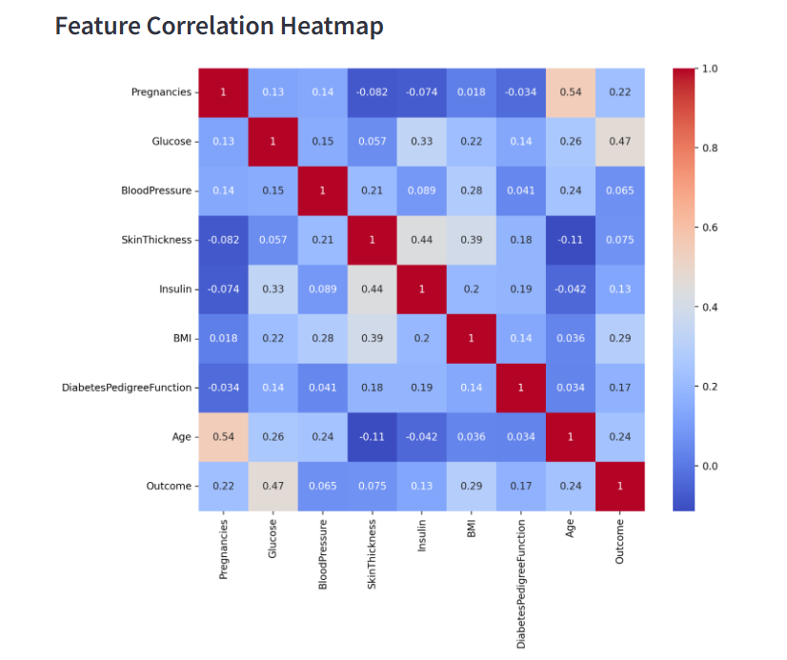
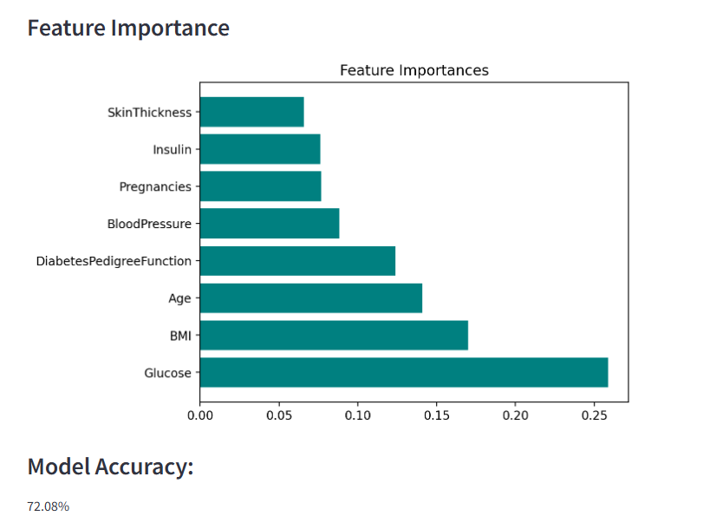
Implementation
Feature Selection and Visualization: created a correlation heatmap to explore the relationships between features.

Slide 8
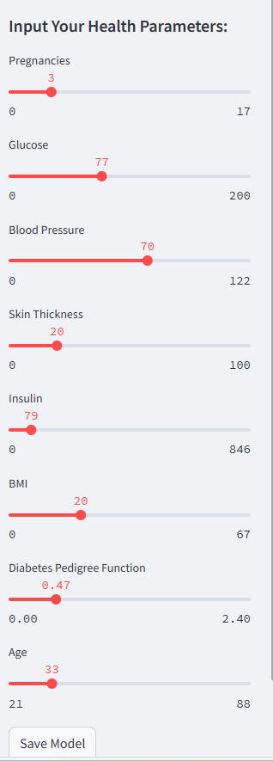
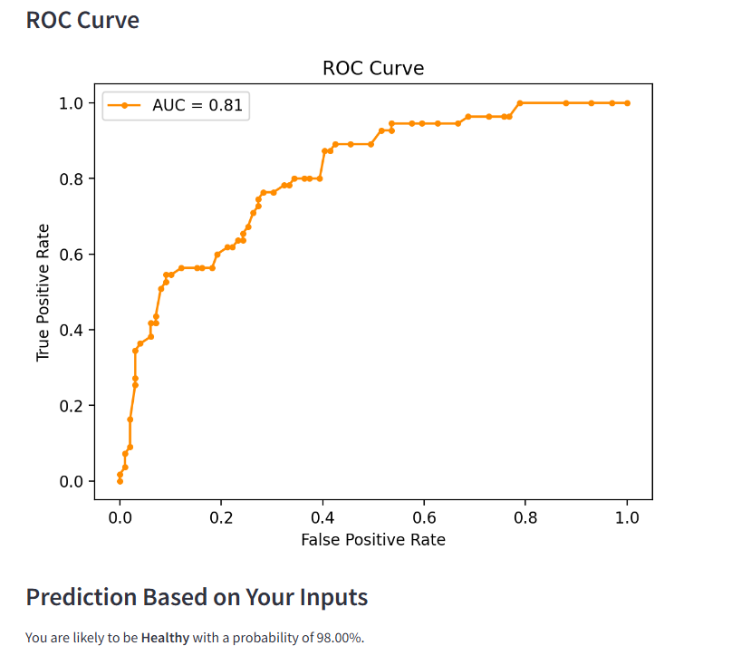
Implementation
Model Evaluation: Assessed the model's performance using metrics like accuracy and AUC (Area Under the ROC Curve), Visualized the ROC curve to evaluate the classifier's performance.
User Input & Prediction: Collected real-time user inputs via sliders in the app. Generated predictions based on these inputs, indicating the likelihood of diabetes.
Model Deployment: Integrated the trained model into a Streamlit web app, allowing for interactive user input and real-time predictions. Provided an option to save the trained model for future use.

Slide 9
Key Features
Real-Time Predictions: Instantly predicts the likelihood of diabetes based on user inputs.
User-Friendly Interface: Simple and interactive input sliders for key health parameters.
Advanced Machine Learning: Utilizes a tuned Random Forest algorithm for accurate diabetes prediction.
Data Visualization: Provides histograms for feature distributions and a correlation heatmap for better insight into the dataset.
Model Insights: Displays feature importance to help users understand which factors influence predictions the most.
Performance Metrics: Includes accuracy score and ROC curve to evaluate model performance.
Model Persistence: Option to save the trained model for future predictions.

Slide 10

Future work
Integration with Wearable Devices: Collect real-time health data from wearables to improve prediction accuracy and enable continuous monitoring.
Mobile Application Development: Extend the app to mobile platforms for on-the-go access and wider user adoption.
Enhanced Model Accuracy: Experiment with more advanced machine learning algorithms like XGBoost or deep learning for improved prediction accuracy.
Incorporation of More Health Metrics: Include additional health factors like physical activity levels, diet, and genetics to refine predictions.
Longitudinal Data Analysis: Implement methods to track patient health data over time and predict diabetes progression.
Explainability and Transparency: Introduce model explainability tools (e.g., SHAP) to give users more insight into individual predictions.

