Slide 1
ALGORITHMS & CODE
Presented by: ABDUL RAHEEM RIHAM AHAMED

Slide 2
Table of Contents
Introduction
Algorithms Purpose and Functions
Coding
Difference in algorithms & code at a glance for Binary Search
Coding flow
Code Execution
Summary

Slide 3
Introduction
By standard, programmers follow a life cycle during a development of a program called the Software Development Life Cycle(SDLC), during which there are 2 particular stages called Designing and Coding.
Algorithms, pseudo code, flow charts, ERDs, Class diagrams etc. are ways of designing the program.
Designing a program is that the process by which the logic of the program is satisfactorily captured in such how that a programmer can understand. intrinsically designing methods don't require a programing language , anything that's not logic of the program, shouldn't be captured at this stage.
Coding a program is that the process of manufacturing substance of the logic that was written within the previous step, so as to get the intended output of the program. At this stage, usage of code standards, work flow models, programming languages, IDEs, linting etc. are crucial.

Slide 4
Algorithms Purpose and Functions
An algorithm may be a series of steps or a group of rules that logically describes the intended flow of a program so as to realize an expected output.
Algorithms are often written in any tongue , as long as there's a clear flow which will cause a particular output. Therefore nearly anyone could write an algorithm.
However this doesn't mean that an algorithm may be a fit all situations and is that the perfect method for capturing logic.
In programming, before coding it's well advised to write down an algorithm in order that the subsequent qualities are maintained;
Precision- What must be done is clearly stated
Finite-The algorithm ensures that a limited number of instructions are executed
Generalization- The series defined within the algorithm applies to a multiple situations
Input & Output- It ensures an input is given and an output is obtained

Slide 5
Coding
Coding is that the major a part of development, during this stage equally of data grasped during the previous steps are manipulated so as to supply a considerable product.
This stage must be done employing a programing language , and may only be achieved through the knowledge of a programmer.
There are largely notable differences between code and an algorithm. An algorithm is usually followed by coding but coding doesn't necessarily need to be preceded by the writing of an algorithm.
However if an algorithm has been written, and if it's did not capture everything of the logic that the code should employ, then the coding also will inherit the problems(lack of instruction) the algorithm had.
Coding, although not noticeable, generally may be a results of tons of algorithms.

Slide 6
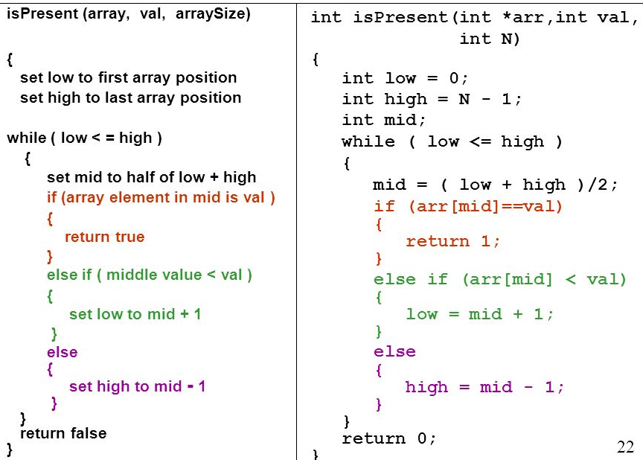
Difference in algorithms & code at a glance for Binary Search

Slide 7
In the figure, an algorithm has been written for a searching method called Binary Search using the programing language C++.
A simple check out the two identifies a transparent difference, the algorithm part are often understood by anyone thanks to the usage of a tongue but the code variant can only be understood by a programmer that knows C++.
As such, algorithms are often effectively wont to visualize logic to clients of latest Lanka Hospital that don't have programming experience. an easy explanation are often provided additionally in order that complex bits of the algorithm like loops are often understood.
The reason on why algorithms are getting used even within the modern age, is to determine efficient communication between clients and therefore the designers.
One thing to also note is that the incontrovertible fact that the code variant are often run, and understood by a machine but not an algorithm.
There are several steps to be followed even before code will provide any significant output.

Slide 8
Coding flow
In order for a seasoned programmer to succeed in the standards thrown at him, he would follow a group of defined steps. I, personally suggest the following;
Comprehending the problem- When a drag is to be solved, reading whatever information provided is important until a general understanding has been reached
Dry Run- Produce a sample set of knowledge that you simply expect as output from the program
Writing algorithms, pseudo code etc.- this may offer you a rough foundation to figure with, and therefore the entirety of the logic will are scoped fully.
Translate algorithms, pseudo code etc. to code & debug-Use a programing language to convert the logic into a functioning program to get data almost like what has been obtained in step 2.
Optimize- Repetitive code are often put in functions, data structures are often employed, security-ensured features are often used etc. at this stage, refactoring is also done
Debug- If the code doesn't produce the expected set of from the rehearsal , rewrite and obtain obviate any code that stands within the way of proper functionality.
Write useful comments-In order to make sure that the codebase is straightforward to urge conversant in , comments must be written.
Code review & execute- Execute code and review it using multiple tools available.

Slide 9
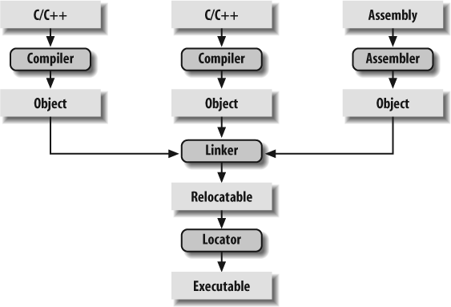
Code Execution

Slide 10
Preprocessing - Processing where and what files are required, conditional blocks(if/else), macros etc.
Compiling – An object file is generated with the help of a compiler, this object file can not be understood by humans, assembly language is used by programmers to troubleshoot errors exist at this stage
Linking - A linker is used to bind any involved object files and/or libraries that have been used during the coding stages in order to produce a fully functioning executable that can be accessed/run.
Loading - When the executable is run (double-clicked), the executable is copied from hard disk to memory and then provided to the user.

Slide 11
REFERENCE
Jen Wei (2021) Algorithm, Available at: https://www.techopedia.com/definition/3739/algorithm (Accessed: 10th January 2021).
Null (2021) What is Coding?, Available at: https://www.computersciencedegreehub.com/faq/what-is-coding/ (Accessed: 10th January 2021).
Jhon Spacey (2016) Algorithms vs code, Available at: https://simplicable.com/new/algorithm-vs-code#:~:text=An%20algorithm%20is%20a%20series,steps%20that%20machines%20can%20execute. (Accessed: 11th January 2021).

Slide 12
THANK YOU

