Slide 1


Slide 2




sheSecure
Project Overview
A women safety app with the aim to increase safety and security to women of all age and for empowering women by using technology as a social tool
Page 3
Notes:
Illustration:
- https://www.freepik.com/free-vector/couple-riding-supermarket-shopping-cart_2238492.htm

Slide 3
ACTIVITIES | DETAILED ACTIVITIES | ALLOTED WEEKS
Proposal & Planning | Extensive Research on various aspects of women safety and Security Analyzing existing Solution Understanding user needs ,gathering data on safety statistics Outlining project scope and setting objectives | 0-1 0-1 1-3 3-4
Analysis & Design | Evaluation on costs ,market demand for financial feasibility Evaluation on technology stack Creating system architecture, database scheme and functionality A detailed project plan with timelines | 4-5 5-6 5-6
Skill Development | Acquiring knowledge for Twilio API,JAVA Learning Android Studio for mobile app development Understanding MONGODB for data storage | 6-8
Implementation | Building the mobile Application Testing and Debugging the entire app Development on testing environment Final Deployment in the market | 8-13 13-14 14-15
Page
Notes:
Illustration :
https://www.freepik.com/free-vector/teamwork-characters-operator-crew-front-screen-presentations_4997765.htm

Slide 4
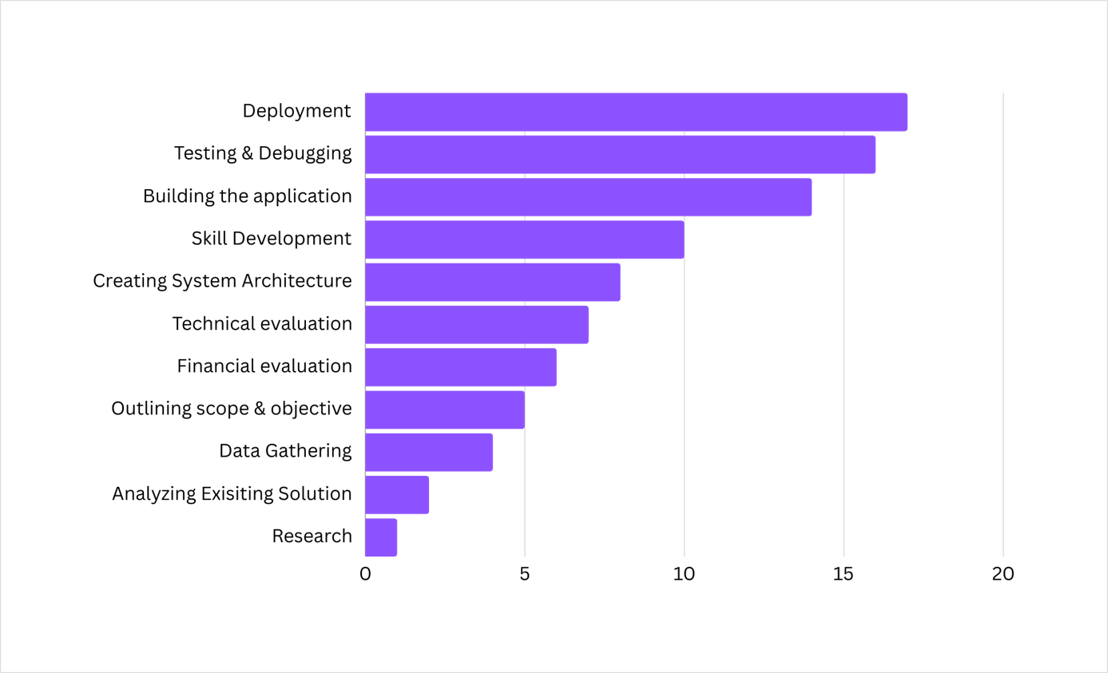
Gantt Chart
Task duration(week)
Task done
Notes:
Illustration :
https://www.freepik.com/free-vector/teamwork-characters-operator-crew-front-screen-presentations_4997765.htm

Slide 5
NODES | ACTIVITIES | WEEKS RECQUIRED | Predecessors
A | Extensive Research | 1 | -
B | Analyzing Existing Solution | 1 | A
C | Understanding & Gathering Data on User Needs | 2 | -
D | Outlining Project Scopes | 1 | B,C
E | Financial Feasibility | 1 | D
F | Evaluation on Technology Stack | 1 | E
G | Creating System Architecture | 1 | F
H | Detailed Plan Project | 1 | D
I | Acquiring Knowledge for APIs | 2 | J
J | Learning Android Studio and work with Emulators | 2 | G,H
K | Learning MongoDB and database handlings | 2 | I
L | Building Mobile Application | 4 | J
M | Testing and Debugging | 2 | L,K
N | Final Deployment | 1 | M
Page
Notes:
Illustration :
https://www.freepik.com/free-vector/teamwork-characters-operator-crew-front-screen-presentations_4997765.htm

Slide 6
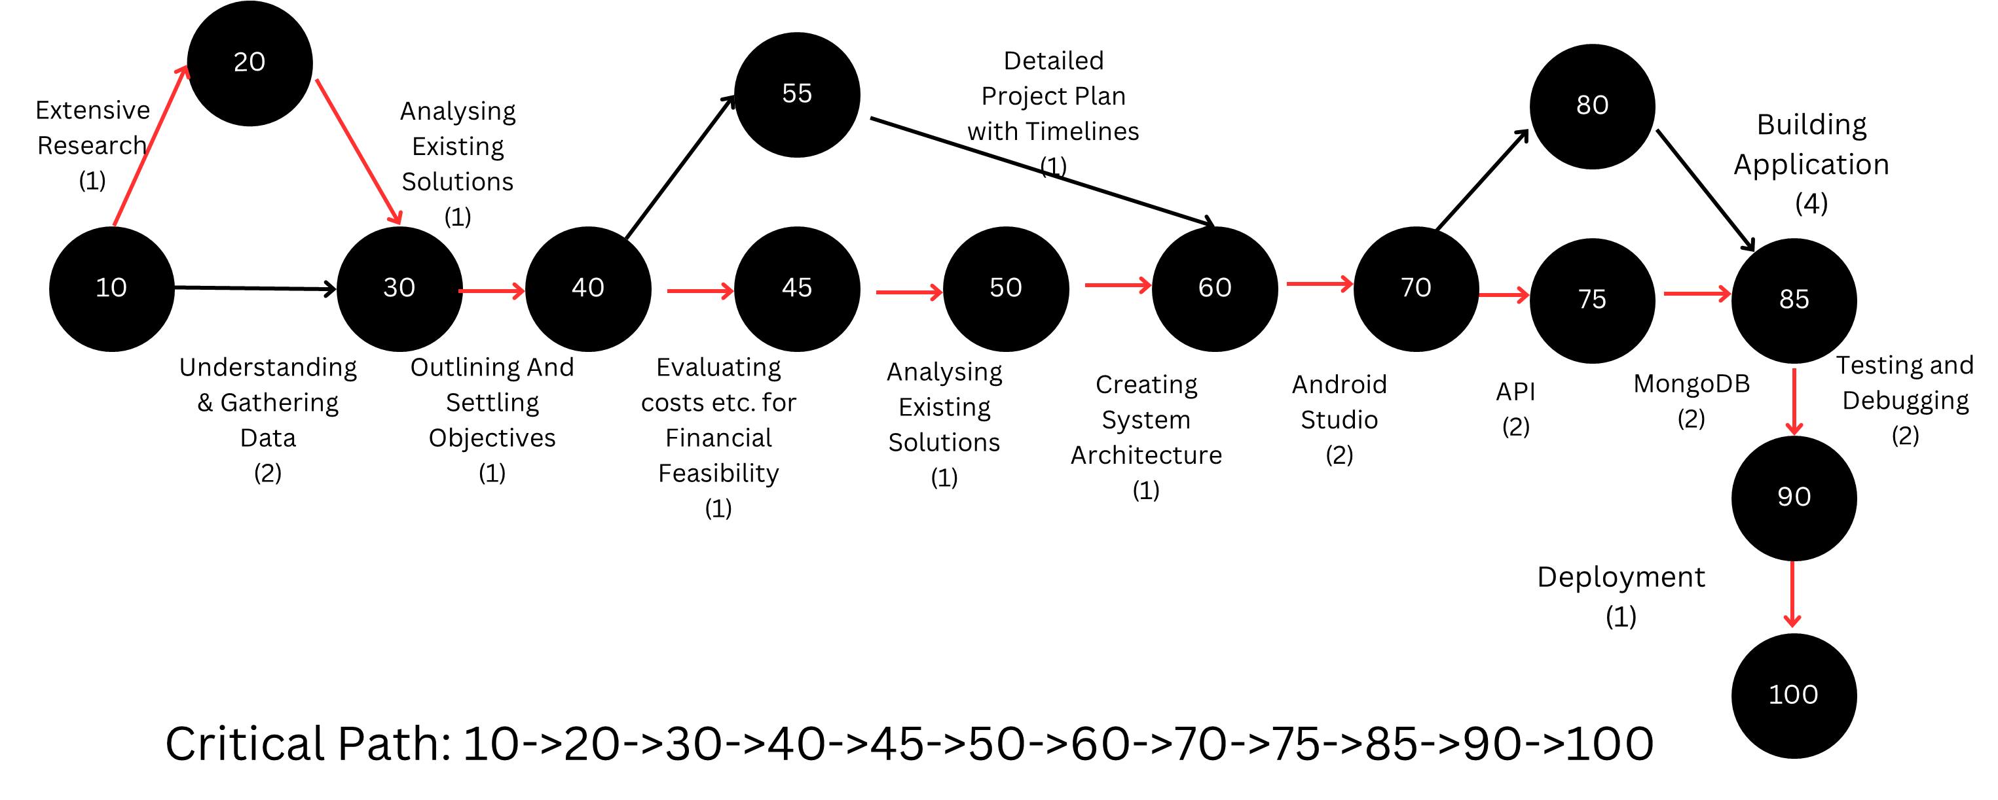
Pert Diagram
Page 8
Notes:
Illustration:
- https://www.freepik.com/free-vector/couple-riding-supermarket-shopping-cart_2238492.htm

Slide 7

sheSecure
Fishbone Diagram
Quality
Cost
Scope
Time
Insufficient focus on code review
Scope creep due to additional features
Budget constraint
Unrealistic project timelines
Inadequate quality assurance
Unforeseen expenses
Unclear project objectives
Unexpected delays
Inadequate user feedback in corporation
Replicating real scenarios difficulties
Overly complex convoluted code
Misinterpretation
of user requirements
Compatability
issues
Lack of comprehensive test coverage
Inconsistencies in coding standard
Inadequate communication
Designing
Testing
Coding
Listening
Page 8
Notes:
Illustration:
- https://www.freepik.com/free-vector/couple-riding-supermarket-shopping-cart_2238492.htm

Slide 8

Team
KICHU EKTA BANABO
FATEEN NOOR RAFEE
21004120
RIHILA SUMAYYA
NOWSHIN MAHJABIN
210041110
21004128
Page 17
Notes:
Illustration :
https://www.freepik.com/free-vector/teamwork-characters-operator-crew-front-screen-presentations_4997765.htm

Slide 9

Thank You!
Notes:
Illustration:
- https://www.freepik.com/free-vector/couple-riding-supermarket-shopping-cart_2238492.htm

