Slide 1


Slide 2


OUTLINE
01.
Evaluating potential alternatives
02.
Comprehensive Analysis
03.
Comparison between Alternatives
04.
Defining versatility of SheSecure
Page 6
Page 2
Notes:
Illustration:
https://www.freepik.com/free-vector/cartoon-characters-coworking-center-creative-space-freelancers-designers-work-together_3266662.htm

Slide 3




EXISTING ALTERNATIVES:
bSafe-Never walk Alone
I’m Safe- Women Safety App
PunjabPolice- Women Safety App
NoonLight
BY BIPPER USA
BY FREE2LIVE TECH
BY SafeTrek
BY PSCA
Page 3
Notes:
Illustration:
https://www.freepik.com/free-vector/floating-group-devices_3979449.htm
https://www.freepik.com/free-vector/teamwork-characters-operator-crew-front-screen-presentations_4997765.htm

Slide 4



sheSecure
Key Features
01.
Emergency Alert System
Virtual Companion
02.
Safe Route Planner
03.
Page 4
Notes:
Illustration :
https://www.freepik.com/free-vector/teamwork-characters-operator-crew-front-screen-presentations_4997765.htm

Slide 5

sheSecure
Key Features
04.
High Danger Area Alert
Daily Notifications
05.
Self Defense Tutorial
06.
Page 5
Notes:
Illustration :
https://www.freepik.com/free-vector/teamwork-characters-operator-crew-front-screen-presentations_4997765.htm

Slide 6
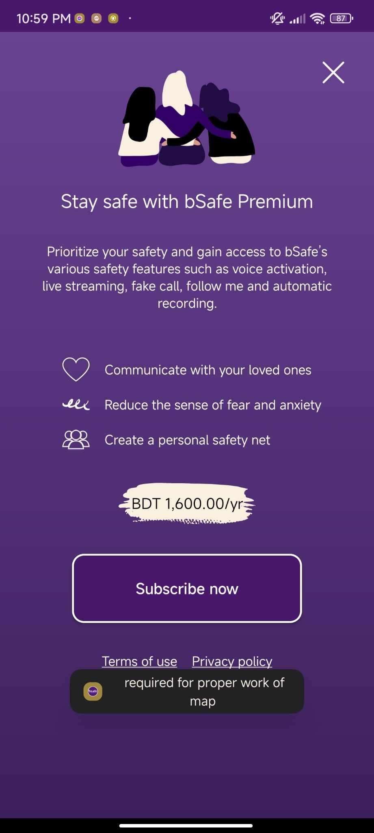
bSafe-Never Walk Alone
01.
Emergency Alert System
Location tracking using GPS
02.
Auto Audio-video Activation
03.
Page 6
Notes:
Illustration :
https://www.freepik.com/free-vector/teamwork-characters-operator-crew-front-screen-presentations_4997765.htm

Slide 7
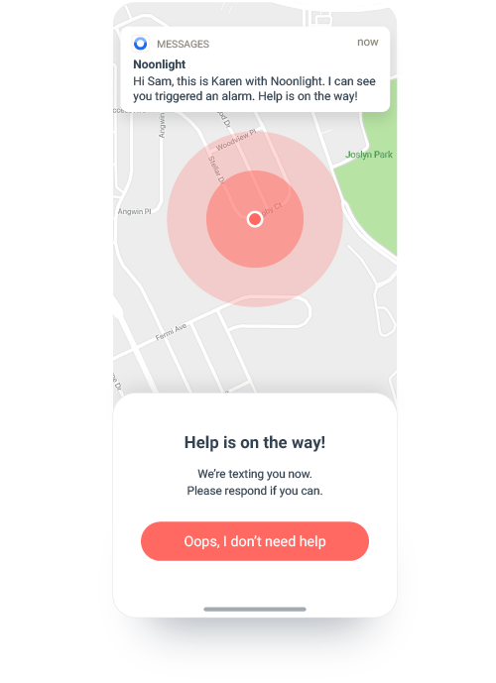
Noonlight
01.
Safety Button And Safety Network
Notes On Timeline
02.
Advanced Profile Sharing
03.
Page 7
Notes:
Illustration :
https://www.freepik.com/free-vector/teamwork-characters-operator-crew-front-screen-presentations_4997765.htm

Slide 8
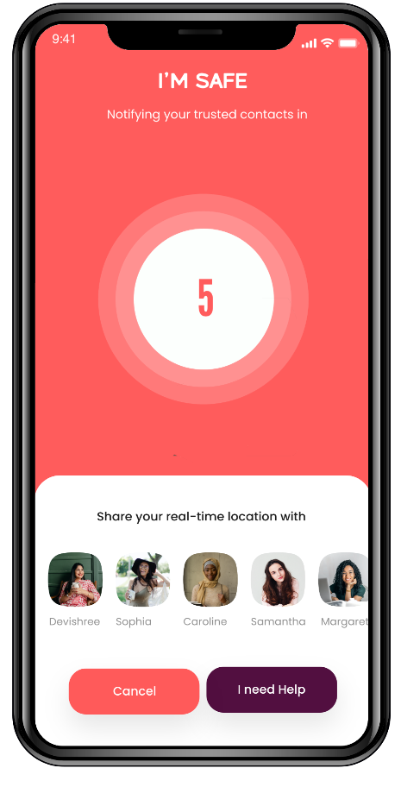
I’m Safe- Women Safety App
01.
Safety Button And Safety Network
Emergency Alert System
02.
Location tracking using GPS
03.
Page 8
Notes:
Illustration :
https://www.freepik.com/free-vector/teamwork-characters-operator-crew-front-screen-presentations_4997765.htm

Slide 9
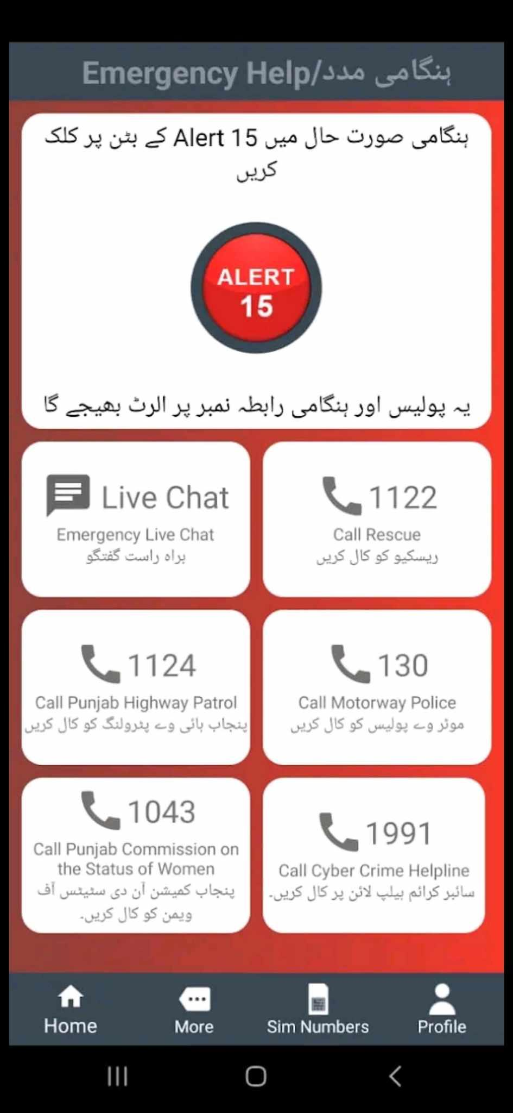
PunjabPolice- Women Safety App
01.
Provides Location Reviews
Emergency Alert System
02.
Live Chat
03.
Page 9
Notes:
Illustration :
https://www.freepik.com/free-vector/teamwork-characters-operator-crew-front-screen-presentations_4997765.htm

Slide 10
ISSUES WITH THE EXISTING ALTERNATIVES
bSafe-Never walk Alone
I’mSafe- Women Safety App
Noonlight
PunjabPolice- Women Safety App
Limited
Functionality
Lack of
Scalability
PAYWALL
(costs bdt 1600/yr)
Regional Barriers
(only available in the United States)
Regional Barriers
(only available in Punjab)
Page 10
Notes:
Illustration:
https://www.freepik.com/free-vector/floating-group-devices_3979449.htm
https://www.freepik.com/free-vector/teamwork-characters-operator-crew-front-screen-presentations_4997765.htm

Slide 11
Comprehensive Comparison:
Criteria | SheSecure | I’mSafe
Functionality | Advanced | Basic SOS
Ease Of Use | Simplified | Simplified
Target Group | Women of all ages | Women of all ages
Scalability | Scalable over time | Long periods between update
Security | Strong | Strong
Organizational Impact | No | Yes
Strategic Alignment | Strong | Limited
Technological Factors | Versatile | Basic
Page 11
Notes:
Illustration :
https://www.freepik.com/free-vector/teamwork-characters-operator-crew-front-screen-presentations_4997765.htm

Slide 12
Comprehensive Comparison:
Criteria | SheSecure | bSafe-NeverWalkAlone
Functionality | Advanced | Recording and SOS
Ease Of Use | Simplified | Faulty
Target Group | Women of all ages | Women of all ages
Scalability | Scalable over time | Only 3 updates in last year
Security | Strong | Weak
Organizational Impact | No | No
Strategic Alignment | Strong | Limited
Technological Factors | Versatile | Good Enough
Page 12
Notes:
Illustration :
https://www.freepik.com/free-vector/teamwork-characters-operator-crew-front-screen-presentations_4997765.htm

Slide 13
Comprehensive Comparison:
Criteria | SheSecure | Noonlight
Functionality | Advanced | Safety Button
Ease Of Use | Simplified | Faulty
Target Group | Women of all ages | Women of all ages
Scalability | Scalable over time | Long periods between update
Security | Strong | Weak
Organizational Impact | No | No
Strategic Alignment | Strong | Limited
Technological Factors | Versatile | Basic
Page 13
Notes:
Illustration :
https://www.freepik.com/free-vector/teamwork-characters-operator-crew-front-screen-presentations_4997765.htm

Slide 14
Comprehensive Comparison:
Criteria | SheSecure | PunjabPolice- Women Safety App
Functionality | Advanced | Multiple
Ease Of Use | Simplified | Faulty
Target Group | Women of all ages | Women of Punjab
Scalability | Scalable over time | Limited
Security | Strong | Moderate
Organizational Impact | No | No
Strategic Alignment | Strong | Limited
Technological Factors | Versatile | Basic
Page 14
Notes:
Illustration :
https://www.freepik.com/free-vector/teamwork-characters-operator-crew-front-screen-presentations_4997765.htm

Slide 15
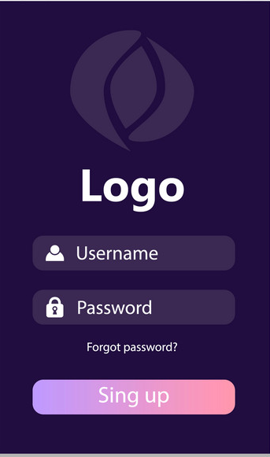
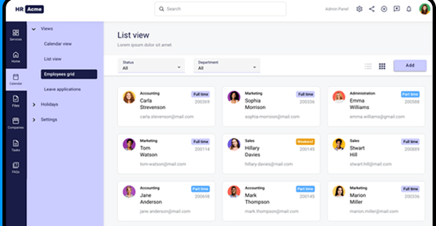
Design Alternatives
WEB APPLICATION
MOBILE
APPLICATION
Page 15
Notes:
Illustration:
- https://www.freepik.com/free-vector/couple-riding-supermarket-shopping-cart_2238492.htm

Slide 16

Advantages of sheSecure
v
01.
User friendly interface
Innovative functionalities that set the app apart from others currently available in the market
02.
04.
Scalability enhancements to align with current requirements
03.
Always ensuring high level security
Page 16
Notes:
Illustration:
https://www.freepik.com/free-vector/cartoon-characters-coworking-center-creative-space-freelancers-designers-work-together_3266662.htm

Slide 17

Team
KICHU EKTA BANABO
FATEEN NOOR RAFEE
21004120
RIHILA SUMAYYA
NOWSHIN MAHJABIN
210041110
21004128
Page 17
Notes:
Illustration :
https://www.freepik.com/free-vector/teamwork-characters-operator-crew-front-screen-presentations_4997765.htm

Slide 18
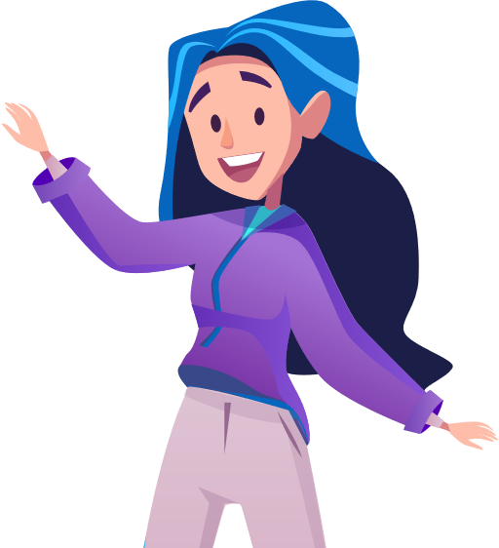
Thank You!
Notes:
Illustration:
- https://www.freepik.com/free-vector/couple-riding-supermarket-shopping-cart_2238492.htm

