Slide 1
A Dynamic Hardware Architecture for Future Networks
Master Thesis by Richard Huber
1st Intermediate Presentation
Advisor: Ariane Keller
Co-Advisors: Dr. Stephan Neuhaus, Daniel Borkmann
Professor: Prof. Dr. Bernhard Plattner
Notes:
/Users/richardhuber/ma/repos/ma/documents/presentations/intermediate1/intermediate1.odp

Slide 2
The Autonomic Network Architecture (ANA)
Abstraction model and framework for interconnecting network protocol implementations
Design goals of ANA:
  scalability
    adding more functionality
    different ways of integrating functionality
  adaptability
    changes in the network environment
    changes in the traffic mix
    changes in the node platform
LANA: Software prototype implementation
Notes:
Starting introduction with ANA
Scalability:
more functionality: adding IPv6
diff. ways of integrating functionality: address agnostic
Adaptability:
network environment: outgoing phys. link breaks down
traffic mix: change from highly reactive protocol to a more streaming-like protocol
node platform: battery almost empty
LANA: mostly lives in linux kernel space

Slide 3
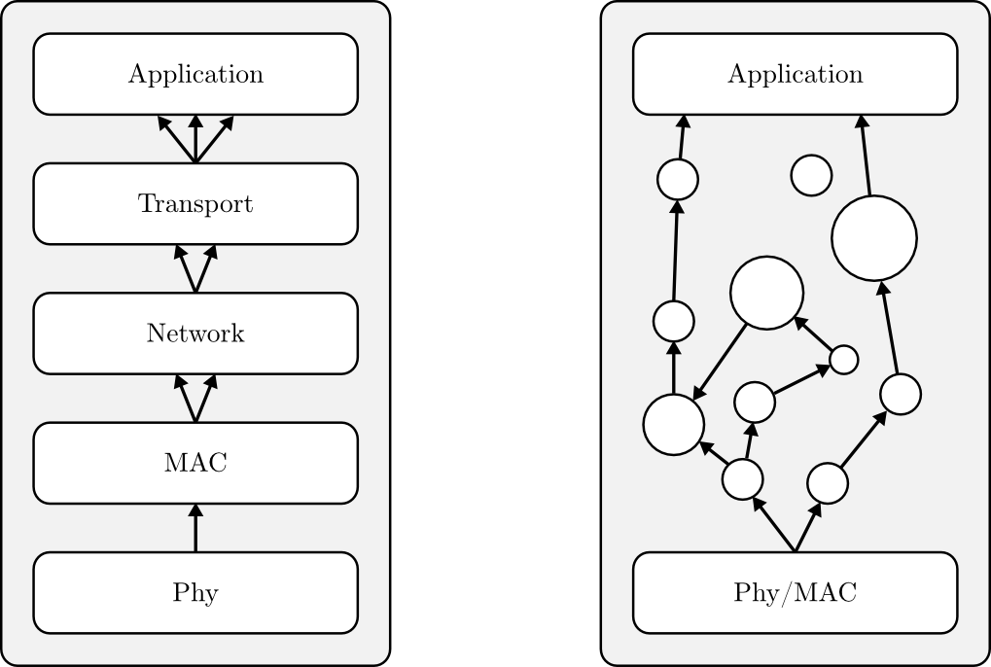
The Autonomic Network Architecture (ANA)
Strongly layered architecture of the current internet
Adaptable architecture of ANA, functional blocks (FB) are interconnected on demand

Slide 4
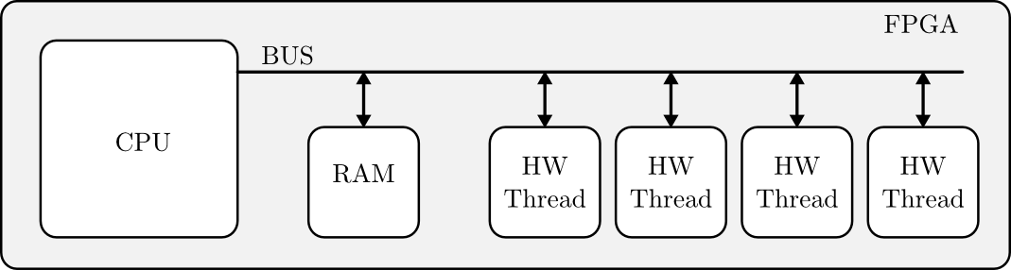
ReconOS
Heterogeneous multi-core architecture
Hardware threads
  execute tasks on behalf of the CPU
  are partially reconfigurable
  have access to some operating system objects

Slide 5
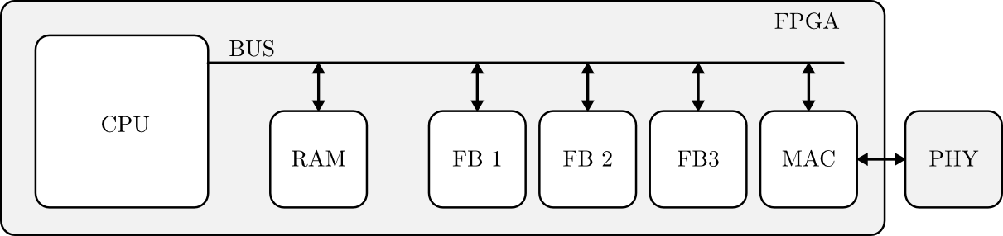
Hardware Support for ANA
Use ReconOS to extend LANA with hardware support
Execute functional blocks in hardware threads if they require
  high computational performance
  low latency

Slide 6
Shared Memory Concept of ReconOS
ReconOS uses shared memory to exchange data between threads
Shared memory accessed by bus system (PLB)
With ANA as use case, PLB is the bottleneck of ReconOS

Slide 7
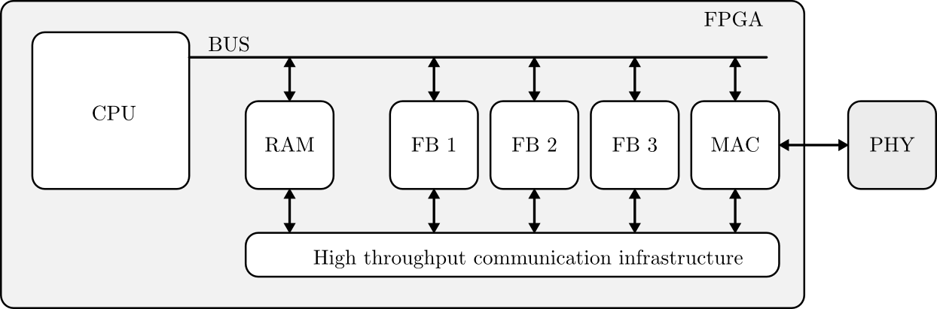
Goal of this Thesis
Extend the ReconOS architecture
Provide an infrastructure for high throughput data transfer
  between HW threads
  between SW and HW threads

Slide 8
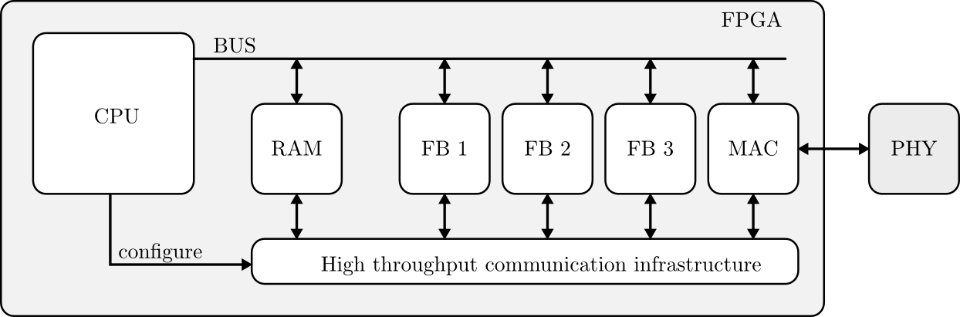
Goal of this Thesis
Provide an interface for configuring the communication infrastructure from software

Slide 9
Task List
Familiarization
Evaluation of possible architectures
Communication between HW blocks
Configuration interface
Communication between HW blocks and SW
Performance evaluation
Final report

Slide 10
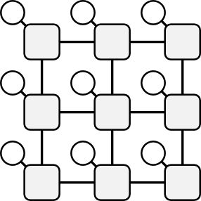
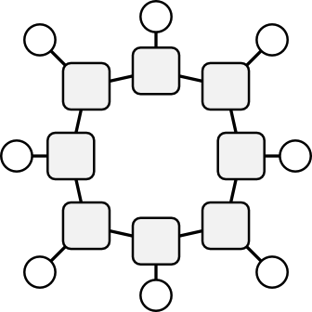
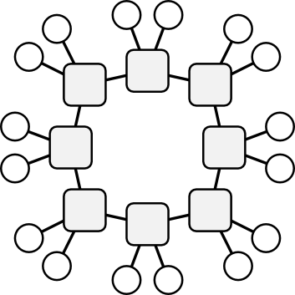


Evaluation of Possible Architectures
Network on Chip (NoC)
  Good trade-off between performance and resource utilization
Functional blocks are interconnected by switches
Choose topology and routing algorithm
Grid
Ring
Ring with
2 FB/Switch
FB
Switch

Slide 11
Area Utilization Measure of NoC Topology
For each individual link
  Calculate the worst case load on this link
  Adapt number of parallel wires to this worst case load
Sum up the wires of all individual links
Total number of wires is a good measure for the area utilization of a NoC topology

Slide 12
Total number of lines
Grid
Ring (1 FB/SW)
Ring (2 FB/SW)

Slide 13
Task List
Familiarization
Evaluation of possible architectures
Communication between HW blocks
Configuration interface
Communication between HW blocks and SW
Performance evaluation
Final report

Slide 14
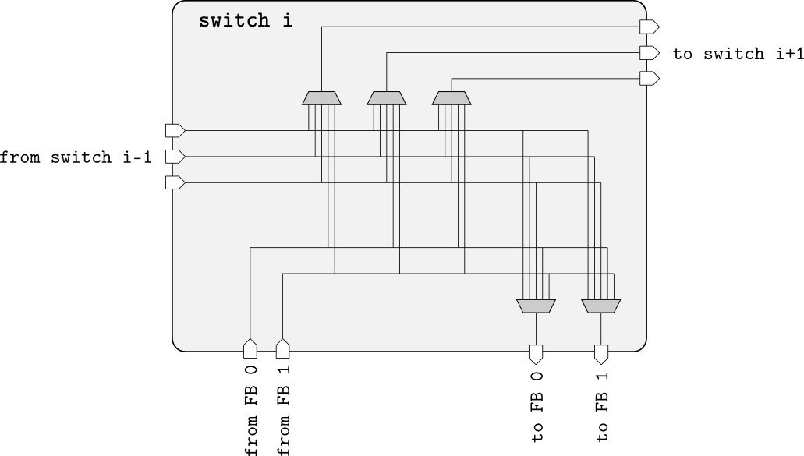
Switch Design
Implemented in VHDL
Functional verification in simulation

Slide 15
Challenges
High testing and verification effort (typical for VLSI development)
Custom testbench development
Write entities as generic as possible
Usability seems not to be the VLSI tool vendor's design principle

Slide 16
Summary
Use ReconOS to implement hardware support for ANA
Global bus used by ReconOS is system bottleneck
Use NoC for interconnecting HW threads
Ring topology with 2-4 FB per switch is a good trade of between hardware resource utilization and performance
Switch implemented and tested in simulation

Slide 18
Evaluation of possible Architectures
Single Bus
  Throughput does not scale
Multibus
  Length and capacity of interconnecting wires do not scale
Peer to Peer
  Chip area utilization and wire length do not scale
Network on Chip (NoC)
  Good trade-off between performance and resource utilization

