Slide 1
A Dynamic Hardware Architecture for Future Networks
Master Thesis by Richard Huber
Final Presentation
Advisor: Ariane Keller
Co-Advisors: Daniel Borkmann, Dr. Stephan Neuhaus
Professor: Prof. Dr. Bernhard Plattner
Notes:
/Users/richardhuber/ma/repos/ma/documents/presentations/final/final.odp

Slide 2
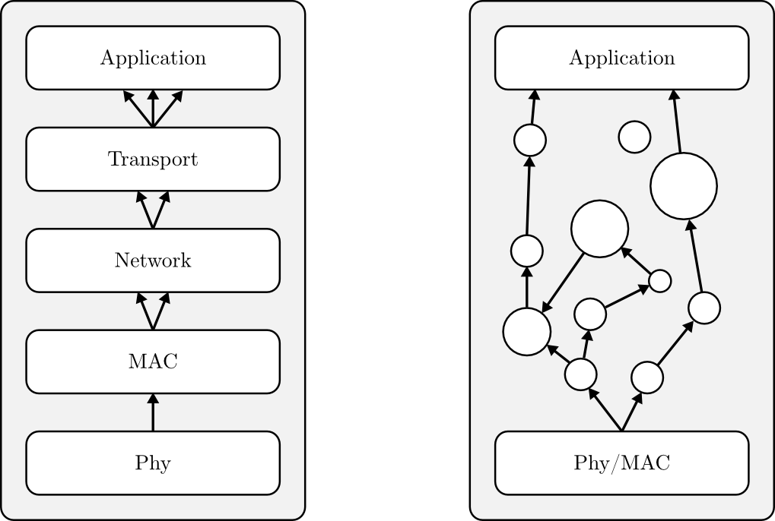
The Autonomic Network Architecture (ANA)
Strongly layered architecture of the current internet
Adaptable architecture of ANA, functional blocks (FB) are interconnected on demand

Slide 3
Hardware Support for ANA
ANA needs hardware support because:
  ANA trades performance for flexibility
  Traditional architectures benefit from hardware support
Static nature of ASICs conflicts with flexibility of ANA
Use partially reconfigurable FPGA → ReconOS

Slide 4
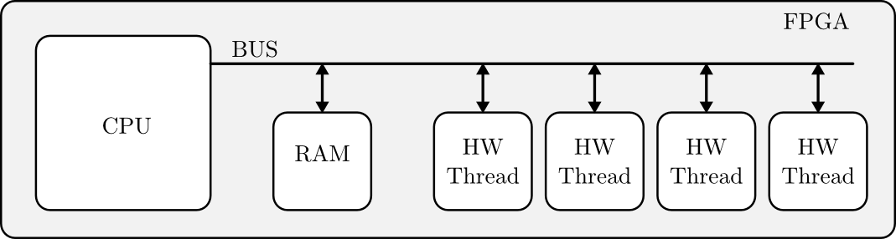
ReconOS
Heterogeneous multi-core architecture
Hardware threads
  execute tasks on behalf of the CPU
  are partially reconfigurable
  have access to some operating system objects

Slide 5
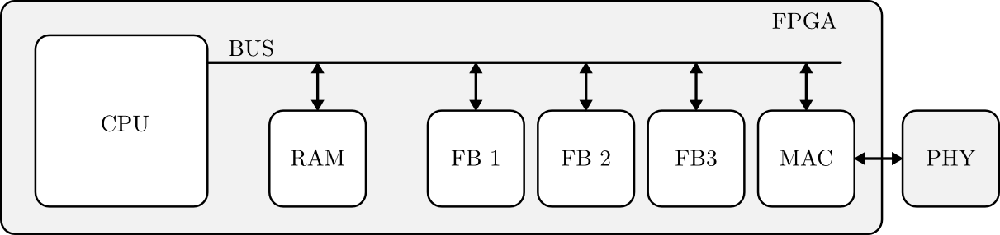
Hardware Support for ANA
Use ReconOS to extend LANA with hardware support
Execute functional blocks in hardware threads if they require
  high computational performance
  low latency

Slide 6
Shared Memory Concept of ReconOS
ReconOS uses shared memory to exchange data between threads
Shared memory accessed by bus system
With ANA as use case, BUS is the bottleneck of ReconOS

Slide 7
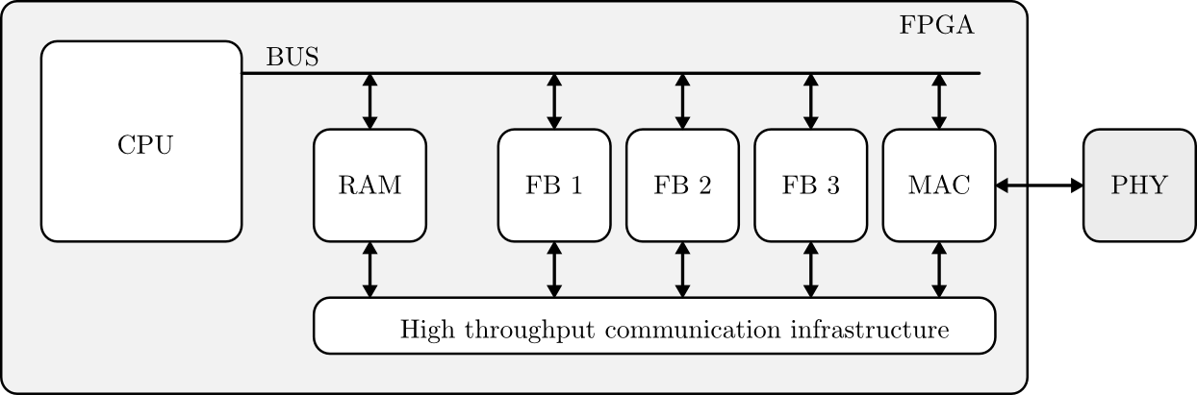
Goal of this Thesis
Extend the ReconOS architecture
Provide an infrastructure for high throughput data transfer
  between HW threads
  between SW and HW threads

Slide 8
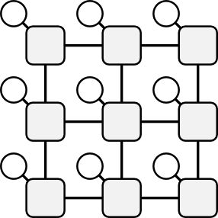
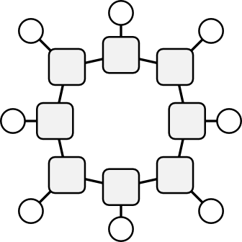
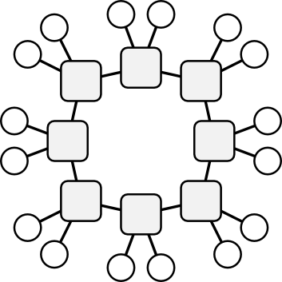


Architecture
Network on Chip (NoC)
  Good trade-off between performance and resource utilization
Functional blocks are interconnected by switches
Choose topology and routing algorithm
Grid
Ring
Ring with
2 FB/Switch
FB
Switch

Slide 9
Topology Evaluation
Grid
Ring (1 FB/SW)
Ring (2 FB/SW)

Slide 10
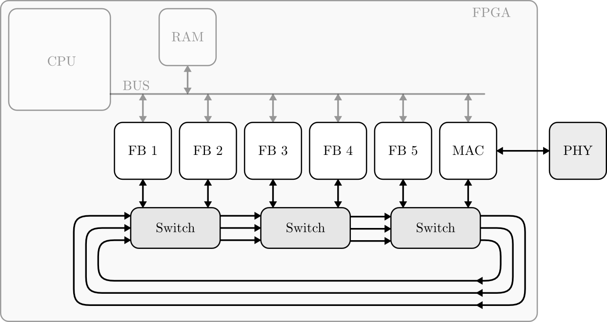
Implementation
Selected topology: Ring with 2 FB per switch
Notes:
Stand bei letzter Präsentation
Bemerke: die Hardwarethreads sind immer noch am BUS angehängt, benuzten ihn aber nur für die Konfiguration, nicht zum Datentransfer.

Slide 11
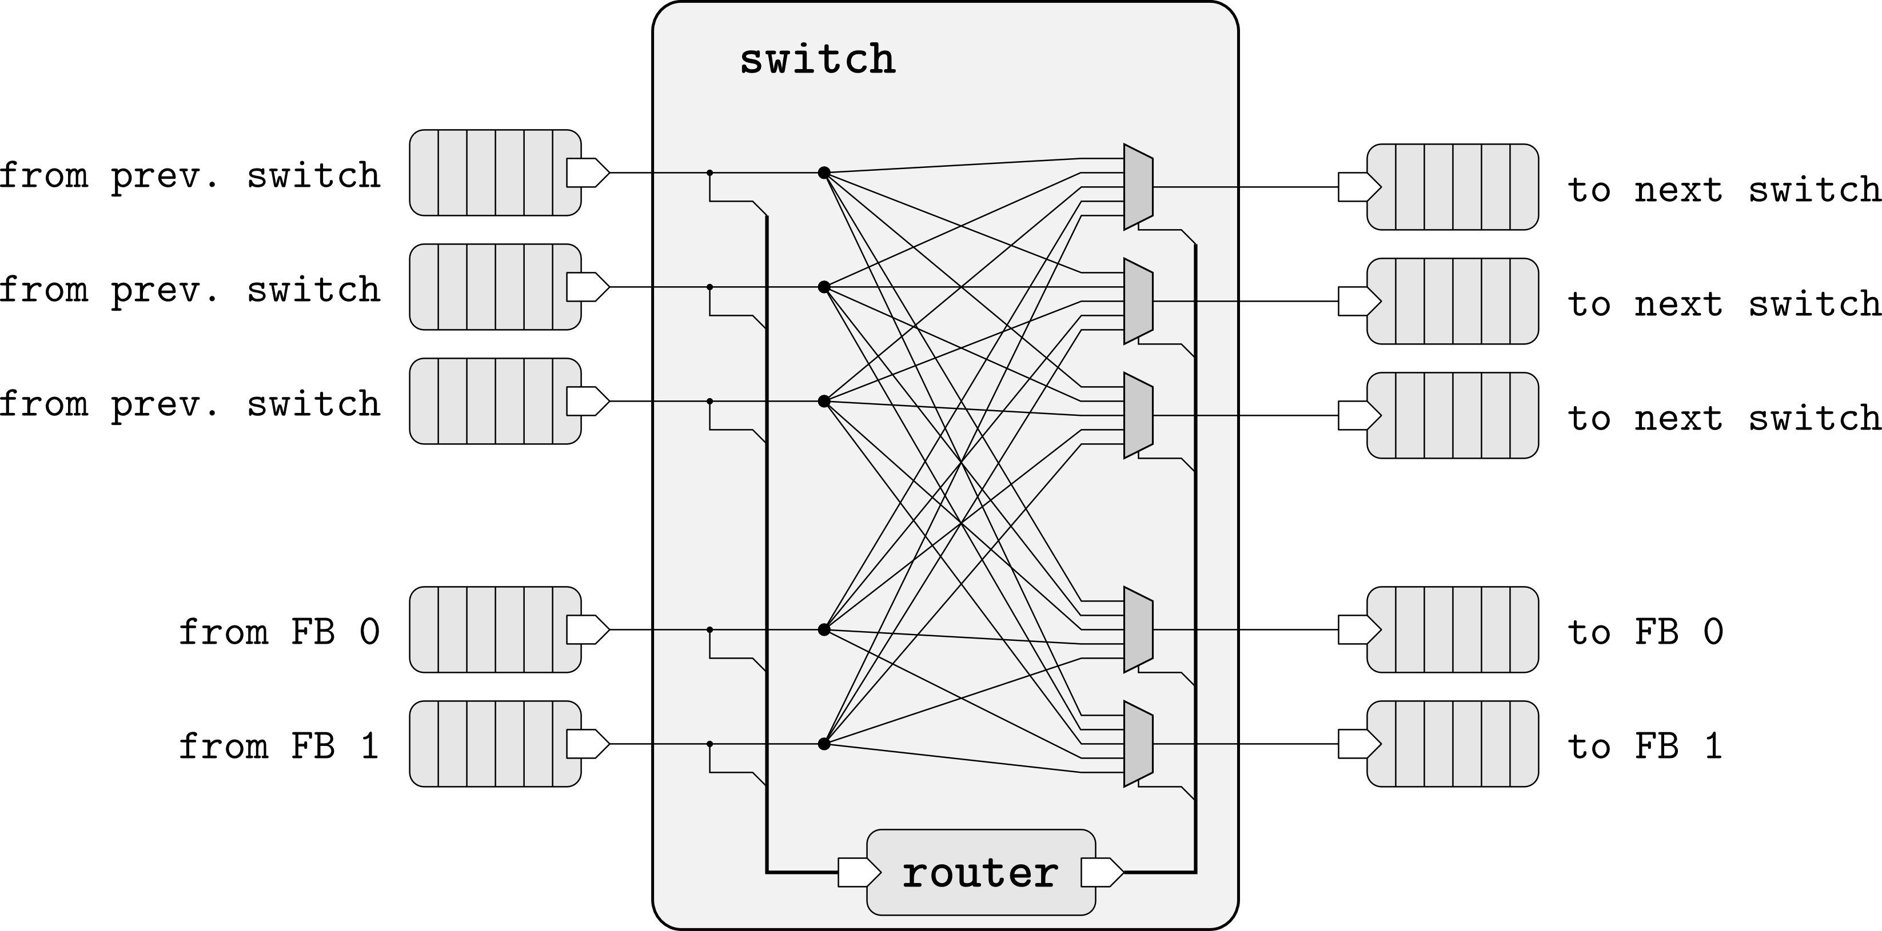
Switch Design

Slide 12
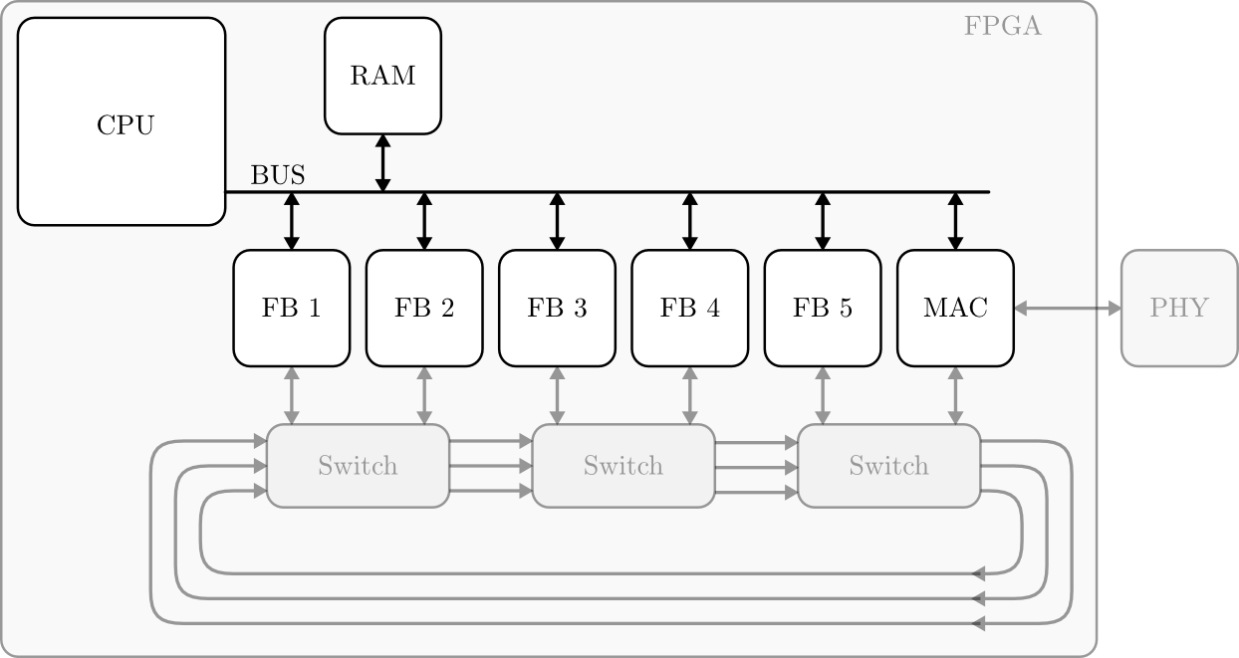
Hardware – Software Data Transfer
Transfer data between HW- and SW-Threads

Slide 13
Hardware – Software Data Transfer
Problems:
  Synchronization
  Serialization
  High interrupt overhead
ReconOS provides:
  Shared memory for HW- and SW-Threads
  Thread-safe message passing interface

Slide 14
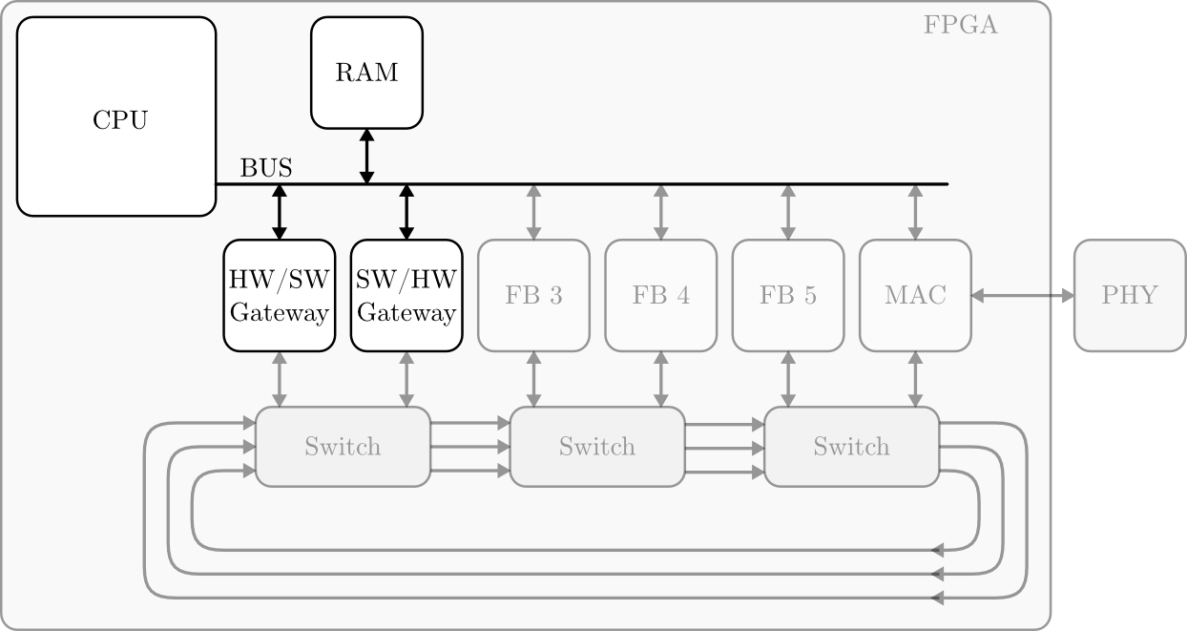
Hardware – Software Data Transfer
Notes:
Im zweiten Teil fokusieren wir auf den Datenaustausch zwischen Software, die in der CPU läuft, und den Hardwarethreads
Ein Hardwarethread ist zuständig für den Transfer von Daten von HW nach SW und ein anderer für den Transfer von SW nach HW.

Slide 15
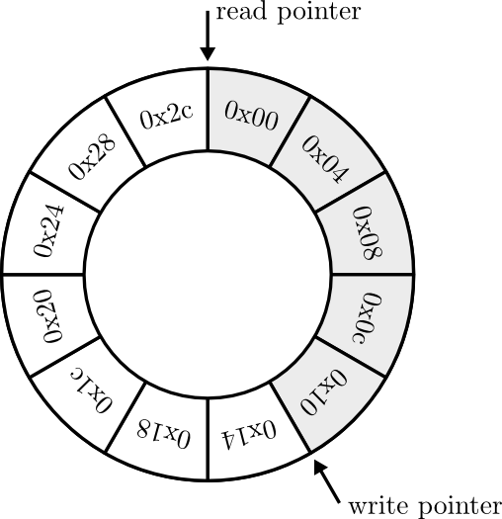
Principle of SW/HW gateway
Use a part of the shared memory as ring buffer
Exchange read/write pointers using message boxes

Slide 16
When to exchange read/write pointer
Sending pointer after every packet generates a high interrupt load
  Aggregate packets
Timely delivery of packets
  First packet starts a timer
  Send write pointer when timer expires
  Reset timer when sending write pointer for other reasons
Non-blocking write access
  Send write pointer when amount of free space below treshold
Delay-sensitive packets
  Packets have 'delay-sensitive' flag
  When flag set, send write pointer immediately

Slide 17
Challenges
Hardware
  Write code as generic as possible
Simulation
  Very complex BUS interface of HW-threads
  Simulating overall system is a Herculean task
  Custom testbench development
Software
  Data representation (MSB-LSB, Endianness)
  Multithreaded SW (Race conditions)
Usability seems not to be the VLSI tool vendor's design principle

Slide 18
Summary
Use ReconOS to implement hardware support for ANA
  Global bus used by ReconOS is system bottleneck
Build NoC for interconnecting HW threads
  Ring topology with 2-4 FB per switch
HW/SW gateway using ring buffer

Slide 20
The Autonomic Network Architecture (ANA)
Abstraction model and framework for interconnecting network protocol implementations
Design goals of ANA:
  scalability
    adding more functionality
    different ways of integrating functionality
  adaptability
    changes in the network environment
    changes in the traffic mix
    changes in the node platform
LANA: Software prototype implementation
Notes:
Starting introduction with ANA
Scalability:
more functionality: adding IPv6
diff. ways of integrating functionality: address agnostic
Adaptability:
network environment: outgoing phys. link breaks down
traffic mix: change from highly reactive protocol to a more streaming-like protocol
node platform: battery almost empty
LANA: mostly lives in linux kernel space

Slide 21
Adapt Links to Worst-Case Traffic
For each individual link
  Calculate the worst case traffic on this link
  Adapt number of parallel channels to this worst case load
Sum up the channels of all individual links
Good measure for the resources used by the links

Slide 22
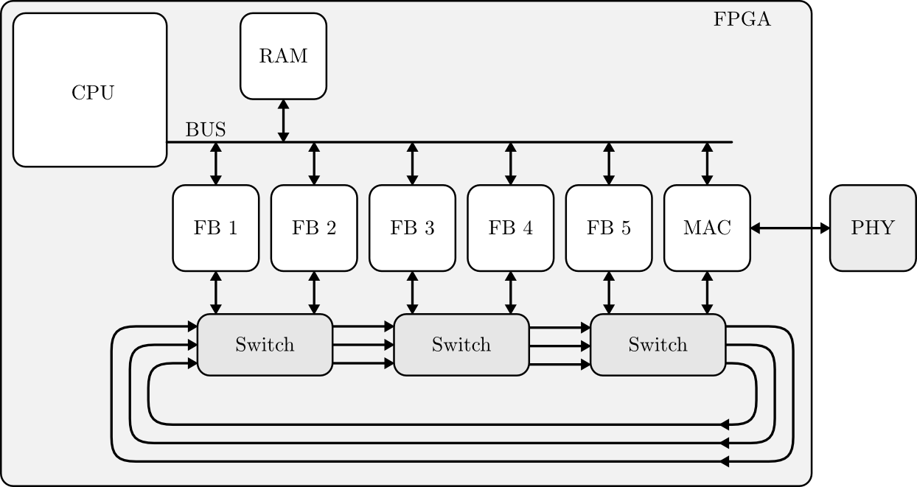
Hardware – Software Data Transfer
Two possible approaches
  a) Distributed: All FB read/write data to RAM
      More interrupts
  b) Centralized: A Pair of HW threads build a HW/SW gateway
      Higher latency
Notes:
Die beiden Möglichkeiten, die wir diskutiert haben:
a) Alle FB senden ihre Daten unabhängig in die SW
vs.
b) FB senden alle Daten über NoC zu einem Gateway
Ausgelöste Interrupts:
a) mehr, b) weniger
Latenz
a) geringer
b) grösser
Wobei das bei starker Last durch die geringere Anzahl Interrupts aufgehoben wird.
Darum: Entscheid für b)

Slide 23
Hardware Resources
 | FF |  | LUT
 | Abs. | Rel. | Abs. | Rel.
Platform | 301440 | 100.00% | 150720 | 100.00%
System | 16058 | 5.33% | 15541 | 10.31%
Switch IP | 606 | 0.20% | 731 | 0.49%

