Slide 1
ORDERING AND INVENTORY MONITORING APPLICATION
PROPONENTS: Reynan Jhay A. Busano
Eljay Ralden C. Secuya

Slide 2
INTRODUCTION
Importance of managing orders and inventory in small cafes
Common issues: manual processes, inefficiencies, and errors
Relevance of digital solutions for improving operations

Slide 3
STATEMENT OF THE PROBLEM
Challenges faced by Alter’s Café:
Limited visibility into inventory levels makes it difficult to manage ingredients stock efficiently.
Tracking sales data manually is time-consuming and prone to errors.
Inefficient order management processes lead to delays and customer dissatisfaction.

Slide 4
OBJECTIVE OF THE STUDY
Main Objective: The main goal of the study is to develop a digital solution for Alter’s Café that addresses its specific challenges and improves its overall operational efficiency.
Specific Objectives: These include gathering data on the café's needs, identifying common challenges, designing and developing the application, and testing and implementing the system.

Slide 5
SCOPE AND LIMITATION
Scope:
The scope includes making order processing more efficient, simplifying inventory monitoring, and tracking sales data effectively.
Limitations:
Limitations include the absence of full sales data analytics such as charts, authentication, and the need for manual adjustment of ingredient stock levels.

Slide 6
REVIEW OF RELATED LITERATURE
Local Studies
Technological Innovation: Studies by Castillo-Vergara et al. (2021) and Macailao (2023) highlight the role of technology in improving efficiency. These studies emphasize the importance of digital solutions tailored to the specific needs of businesses.
Digital Marketing and Sustainability: Mia et al. (2024) and Sebastian Chavez et al. (2021) discuss how digital marketing strategies and technology adoption are crucial for the sustainability and growth of food-related businesses.
Operational Efficiency: Castillo et al. (2020) and Bahillo (2022) showcase the potential of digital solutions in optimizing processes and future-proofing operations.
Customer Engagement: Studies by Claudine Sykimte (2023) and Umunna (2021) emphasize the importance of innovative digital solutions and communication strategies in engaging customers.
Self-Service Technologies: Research by Jenelen (2019) and Margate et al. (2020) highlights the benefits of self-service technologies and mobile applications in enhancing customer satisfaction and operational efficiency.
Foreign Studies
Mobile Food-Ordering Apps (MFOAs): Cankat (2021) and Sharma et al. (2023) discuss the critical role of MFOAs in improving customer satisfaction and loyalty.
Digital Marketing for SMEs: Herawati et al. (2023) show how digital marketing can boost engagement and social media presence for small businesses.
Automation and Efficiency: Salih et al. (2023) and Rahman (2020) highlight the benefits of automated inventory management and responsive online food ordering applications.
Customer Engagement via Social Media: Tsiotsou (2020) explains how social media enhances customer engagement and satisfaction.

Slide 7
SYNTHESIS
Critical Need for Digital Solutions: The studies reviewed emphasize that small-scale cafes like Alter's Café can greatly benefit from digital solutions tailored to their specific needs.
Operational Efficiency: Digital solutions improve efficiency by streamlining operations such as order processing and inventory management.
Customer Engagement: Enhancing customer engagement through digital platforms is crucial for business growth and customer satisfaction.
Technological Innovation: Embracing technological advancements is essential for the sustainability and competitiveness of small cafes like Alters Cafe.

Slide 8
RESEARCH METHODOLOGY
Key Points to Discuss:
Agile Methodology
Collaborative and Iterative Approach
Requirements Analysis
Planning and Design
Implementation

Slide 9
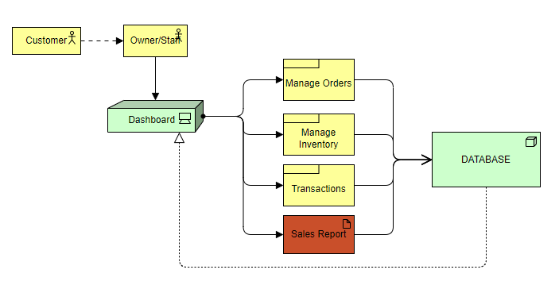
SYSTEM ARCHITECTURE FRAMEWORK
Key components and their interactions

Slide 10
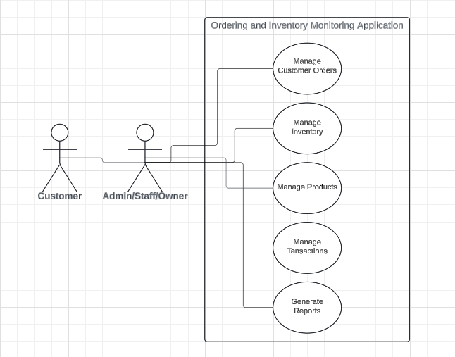
USE CASE DIAGRAM
adding orders
updating inventory/products
generating reports

Slide 11
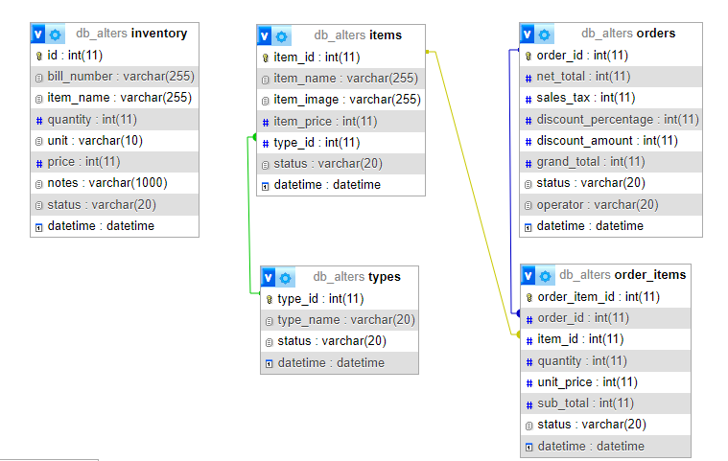
ENTITY RELATIONSHIP DIAGRAM

Slide 12
REFERENCES
-, P. S., & -, S. B. (2023). Unlocking Customer Engagement: the Power of Mobile Apps in Enhancing Customer Experience. International Journal For Multidisciplinary Research, 5(3), 1–7. https://doi.org/10.36948/ijfmr.2023.v05i03.4103
Ashley, M. N., Margate, C. F., Ravina, M. C., Pido, J. J. G., & Young, M. N. (2020). Seiton: A Mobile Inventory Management System Application for Micro, Small and Medium-sized Enterprise. Doi: 10.1109/ICETAS51660.2020.9484183
Bahillo, E. L. (2022). Documented Experiences among Food Service Businesses towards Future-Proofing the Industry. JPAIR Multidisciplinary Research, 49(1), 17–36. https://doi.org/10.7719/jpair.v49i1.625
Benedict Mia, I., Jimenez, S., Habaradas, R., Jaye Ranieses, J., Javier, C., & Enriquez, J. (2024). Digital Technology Adoption Among Philippine Micro-, Small-,and Medium-Sized Enterprises: Barriers, Enablers & Challenges During COVID-19. Journal of Business, Ethics and Society, 4(1), 0–17. https://doi.org/10.61781/4-1i2024/1bmlm
Cankat, E. (2021). Journal of Retailing and Consumer Services Role of mobile food-ordering applications in developing restaurants ’ brand satisfaction and loyalty in the pandemic period. 62(May). https://doi.org/10.1016/j.jretconser.2021.102608
Castillo-Vergara, M., Quispe-Fuentes, I., & Poblete, J. (2021). Technological innovation in the food industry: A bibliometric analysis. Engineering Economics, 32(3), 197–209. https://doi.org/10.5755/j01.ee.32.3.26000
Castillo, A. M. M., Salonga, L. J. L., Sia, J. A. L., & Young, M. N. (2020). Improving Fast-Food Restaurants ’ Method of Operation : Automated Drive-Through Ordering System. 1838–1849.
Claudine Sykimte. (2023). Revolutionizing the Dining Experience: Exploring Digital Innovations in Food Ordering for Enhanced Customer Satisfaction. International Journal of Advanced Research in Science, Communication and Technology, 698–703. https://doi.org/10.48175/ijarsct-12358
De los Santos, J. R., Suyom, J. R., Comora, M. B., de los Santos, G. N., de los Santos, M. G., & Aruy, R. C. (2021). Imbentaryo App: An Intelligent Inventory and Decision Support System. Doi: 10.1109/IT51528.2021.9390123
Franklin, W. S., Salazar, M. S., Martínez-García, S., Ureña-Aguirre, J. P., & Altamirano, S. (2023). UAVs for Business Adoptions in Smart City Environments: Inventory Management System. Electronics, 12(9), 2090-2090. Doi: 10.3390/electronics12092090
Herawati, A., Sarwani, S., Listyawati, L., Kamariyah, S., & Widiarto, D. S. (2023). Strengthening spice coffee SMEs based on digital marketing for sustainable business improvement. Abdimas: Jurnal Pengabdian Masyarakat Universitas Merdeka Malang, 8(2), 336–346. https://doi.org/10.26905/abdimas.v8i2.8982
Jenelen, F. (2019). University of Caloocan City. May, 1960.
King, H. (2022). Chapter 7 Digital Technology to Enable Food Safety Management Systems. July 2020. https://doi.org/10.1007/978-3-030-44735-9
Kurnaedi, D., Oktora, E., Nasrullah, I., Prayoga, A., & Pramanto, F. A. (2023). Asset and Inventory Data Monitoring Application Design PT. Transmarco. Bit-Tech, 5(3), 174-181. Doi: 10.32877/bt.v5i3.731
Macailao, M. C. (2023). Assessment of electronic payment platforms adoption and perceived benefits of local coffee shops in poblacion, cauayan city, isabela, philippines. May.
Margate, Ashley & Ravina, Ma & Pido, Jeric & Young, Michael. (2020). Seiton: A Mobile Inventory Management System Application for Micro, Small and Medium-sized Enterprise. 1-5. 10.1109/ICETAS51660.2020.9484183.
Maryam, H., Ali, K., & Sarah, M. (2019). Effective implementation of agile methodologies in inventory management systems. International Journal of Information Systems and Software Engineering, 14(2), 89-105.
Morokhovych, V., & Morokhovych, B. (2023). Digital Technologies as an Important Factor of the Restaurant Business Development. Restaurant and Hotel Consulting. Innovations, 6(1), 27–36. https://doi.org/10.31866/2616-7468.6.1.2023.278469
Noah, A., Ray, K., & Rohel, J. (2021). Mobilizing the streets: the role of food vendors in urban life. Food, Culture, and Society, doi: 10.1080/15528014.2020.1860454
Profile, S. E. E. (2020). Implementation of Responsive Online Food Ordering Application with Social Media Integration A Project Submitted to University of Derby for the Degree of BSc ( Hons ) in. January 2018. https://doi.org/10.13140/RG.2.2.32716.36486
R. Islam, A. M. and M. H. (2018). This document is discoverable and free to researchers across the globe due to the work of AgEcon Search . Help ensure our sustainability . ａ ｃ ｔ ｏ ｒ ｓＩ ｎ ｆ ｌ ｕ ｅ ｎ ｃ ｉ ｎ ｇＰ ｒ ｉ ｃ ｅｏ ｆＡ ｇ ｒ ｉ ｃ ｕ ｌ ｔ ｕ ｒ ａ ｌＰ ｒ ｏ ｄ ｕ ｃ ｔ ｓ ａ ｎ ｄＳ ｔ ａ ｂ ｉ ｌ ｉ ｔ ｙＣ ｏ ｕ ｎ ｔ ｅ. AgEcon Search, 18.
Rodgers, S. (2019). Innovation in food service technology and its strategic role. International Journal of Hospitality Management, 26(4), 899–912. https://doi.org/10.1016/j.ijhm.2006.10.001
Salih, H. S., Ghazi, M., & Aljanabi, M. (2023). Implementing an Automated Inventory Management System for Small and Medium-sized Enterprises. Iraqi Journal for Computer Science and Mathematics, 4(2), 238–244. https://doi.org/10.52866/ijcsm.2023.02.02.021
Sebastian Chavez, J. B., Anne Magsino, N. G., & Alberto Madrilejos, F. (2021). Effectiveness of Digital Marketing Strategies of Coffee Shops in Tagaytay amidst Covid-19 Pandemic. International Journal of Management and Commerce Innovations, 9(2), 467–479. www.researchpublish.com
Tsiotsou, R. H. (2020). Social media and customer engagement. The Routledge Handbook of Service Research Insights and Ideas, September, 373–387. https://doi.org/10.4324/9781351245234-19
Umunna, J. N. (2021). Social Media Marketing Strategies for Increasing Customer Engagement. 1–148.
Virginia, B. (2020). Agile methodologies in system development: A practical guide. TechPress.
Ying, C. (2019). Data-driven Approaches to Inventory Management.

Slide 13
PILOT TESTING

Slide 14


