Slide 1
MA161 Discrete Mathematics I
Week 2 (Part 2) Lectures
Arguments, Rules of Inference

Slide 2
Introduction
Mathematical logic is often used for logical proofs. Proofs are valid arguments that determine the truth values of mathematical statements (or proposition).
An argument is a sequence of statements. The last statement is the conclusion and all its preceding statements are called premises (or hypothesis). The symbol “∴”, (read therefore) is placed before the conclusion.
A valid argument is one where the conclusion follows from the truth values of the premises.
Use Rules of Inference provide the templates or guidelines for constructing valid arguments from the statements that we already have.

Slide 3
Objectives
By the end of this week, you should be able to:
Recognize whether a sequence of statements is a valid argument
Apply rules of inference to check that an argument is valid.

Slide 4
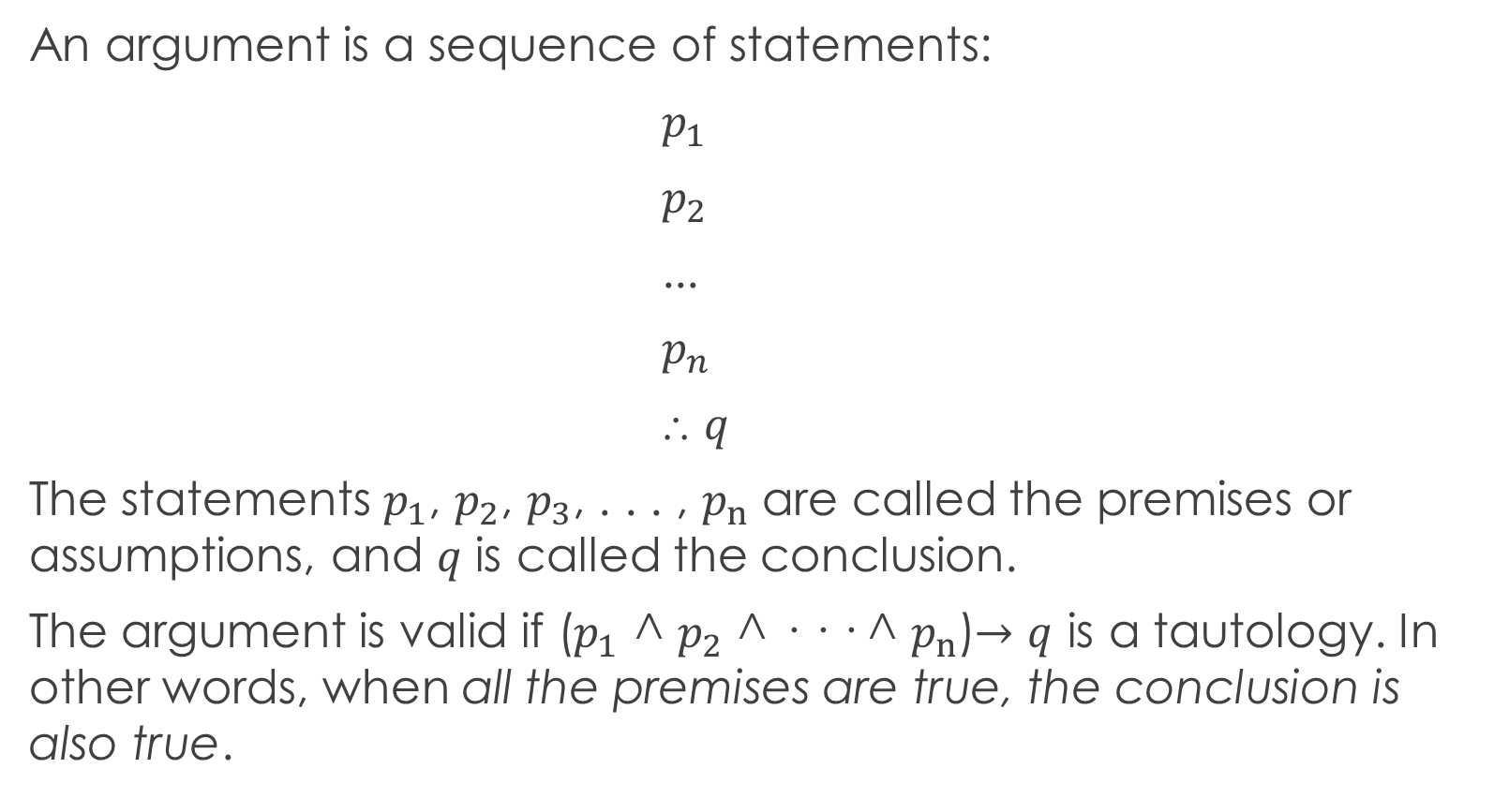
Valid Arguments in Propositional Logic
An argument is a sequence of statements:
$p_{1}$
$p_{2}$
...
$p_{n}$
⸫ $q$
The statements $p_{1}$, $p_{2}$, $p_{3}$, . . . , $p_{n}$ are called the premises or assumptions, and $q$ is called the conclusion.
The argument is valid if ($p_{1}$ ^ $p_{2}$ ^ · · · ^ $p_{n}$)$→q$ is a tautology. In other words, when all the premises are true, the conclusion is also true.

Slide 5
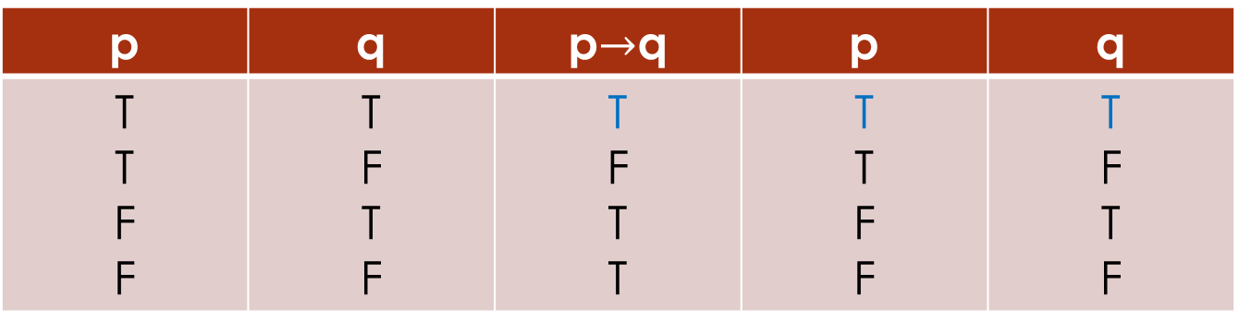
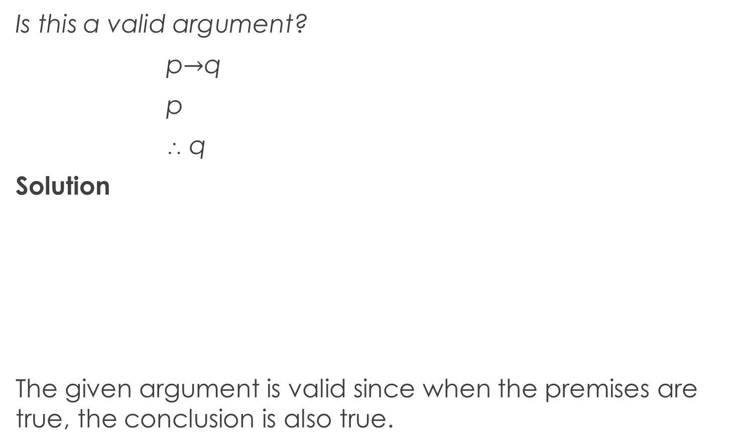
Example 1
Is this a valid argument?
p$→$q
p
⸫ q
Solution
The given argument is valid since when the premises are true, the conclusion is also true.
p | q | p$→$q | p | q
T T F F | T F T F | T F T T | T T F F | T F T F

Slide 6
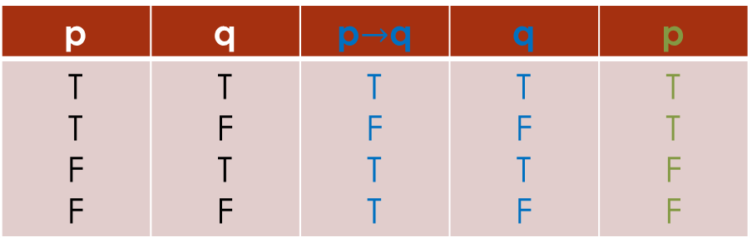
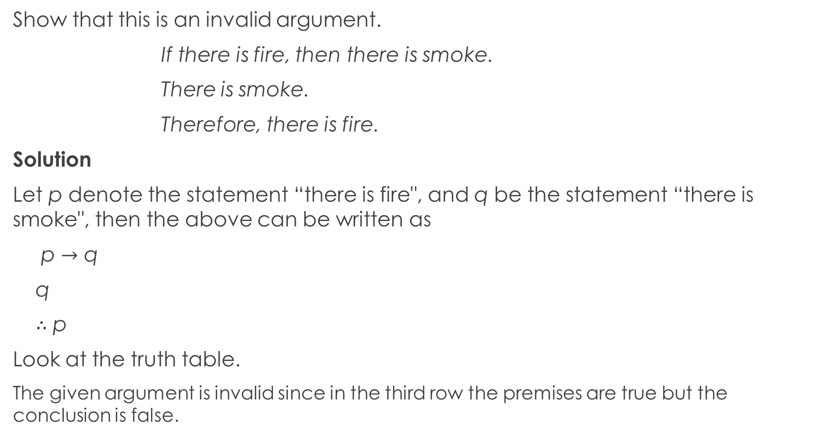
Example 2
Show that this is an invalid argument.
If there is fire, then there is smoke.
There is smoke.
Therefore, there is fire.
Solution
Let p denote the statement “there is fire", and q be the statement “there is smoke", then the above can be written as
p $→$ q
q
$∴$ p
Look at the truth table.
The given argument is invalid since in the third row the premises are true but the conclusion is false.
p | q | p$→$q | q | p
T T F F | T F T F | T F T T | T F T F | T T F F

Slide 7
Fallacies
A fallacy is a kind of error in reasoning.
The term "fallacy" is ambiguous, It can refer either to
a kind of error in an argument,
a kind of error in reasoning (including arguments, definitions, explanations, and so forth),
a false belief, or
the cause of any of the previous errors including what are normally referred to as "rhetorical techniques.“
A fallacy is an error that results in an invalid argument. i.e. A fallacy is an argument that is not valid.

Slide 8
Examples of famous Fallacies
Appeal to Money
The Fallacy of Appeal to Money uses the error of supposing that,
if something costs a great deal of money, then it must be better
if someone has a great deal of money, then they're a better person in some way unrelated to having a great deal of money.
Similarly it's a mistake to suppose that
if something is cheap it must be of inferior quality,
if someone is poor financially then they're poor at something unrelated to having money.
He's rich, so he should be the president of our Parents and Teachers Organization.
Band Wagon - These fallacies occur when a proposition is claimed to be true or good solely because many people believe it to be so.
Everyone on campus is wearing Air Jordans. I need to buy those sneakers.
All my friends are doing a low carb diet. That must be the only way to lose weight.

Slide 9
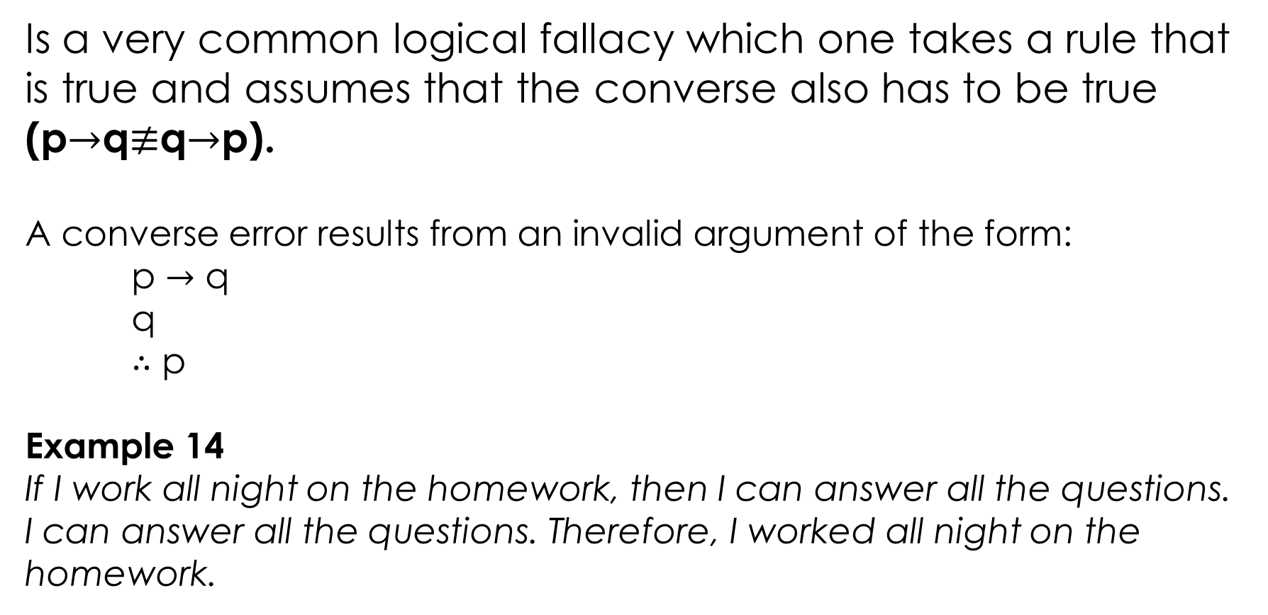
Converse Error
Is a very common logical fallacy which one takes a rule that is true and assumes that the converse also has to be true (p$→$q$≢$q$→$p).
A converse error results from an invalid argument of the form:
p $→$ q
q
$∴$ p
Example 14
If I work all night on the homework, then I can answer all the questions.
I can answer all the questions. Therefore, I worked all night on the homework.

Slide 10
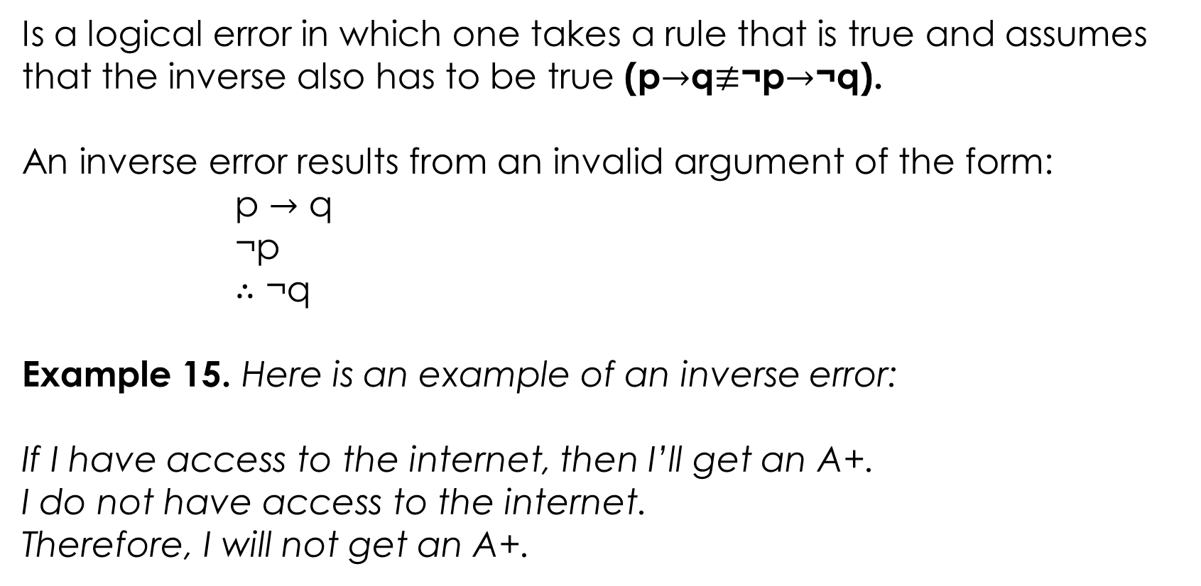
Inverse Error
Is a logical error in which one takes a rule that is true and assumes that the inverse also has to be true (p$→$q$≢$¬p$→$¬q).
An inverse error results from an invalid argument of the form:
p $→$ q
¬p
$∴$ ¬q
Example 15. Here is an example of an inverse error:
If I have access to the internet, then I’ll get an A+.
I do not have access to the internet.
Therefore, I will not get an A+.

Slide 11
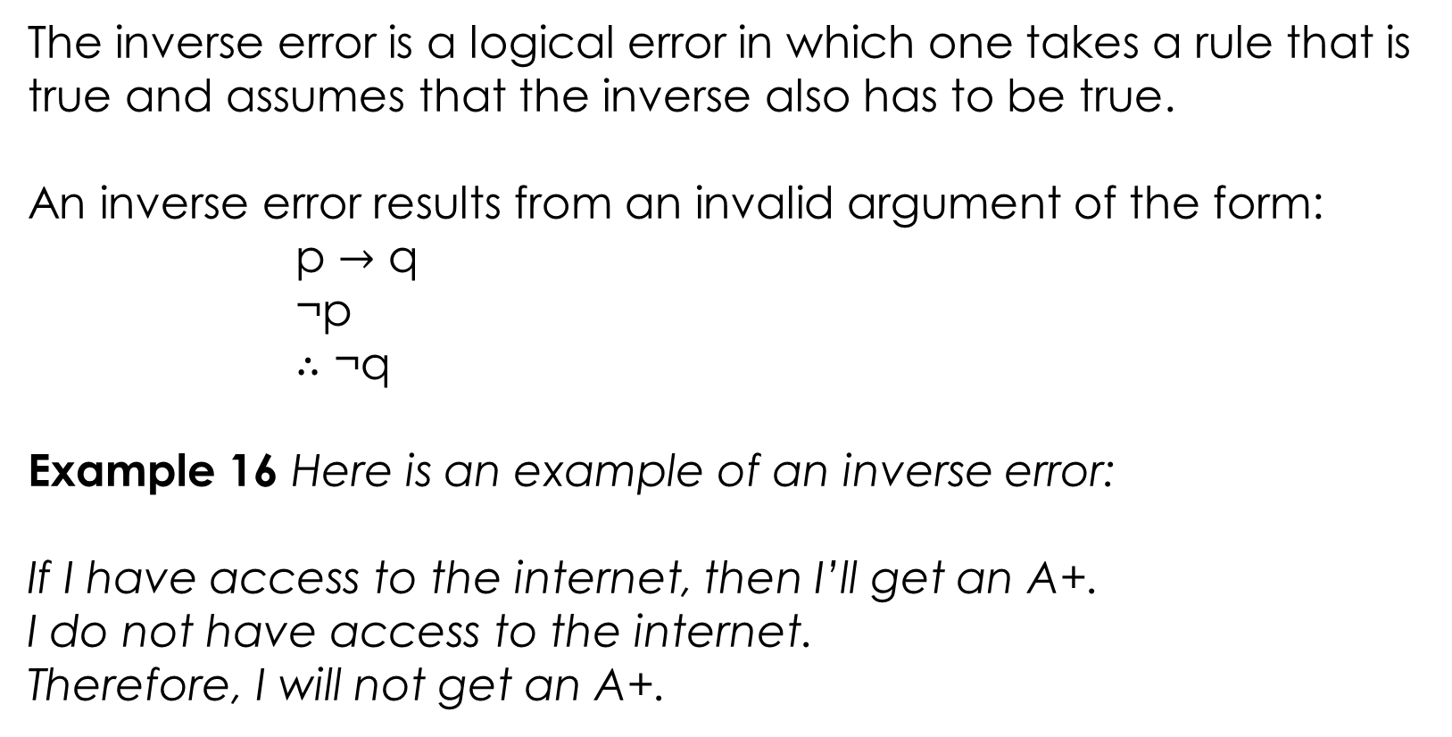
Inverse Error
The inverse error is a logical error in which one takes a rule that is true and assumes that the inverse also has to be true.
An inverse error results from an invalid argument of the form:
p $→$ q
¬p
$∴$ ¬q
Example 16 Here is an example of an inverse error:
If I have access to the internet, then I’ll get an A+.
I do not have access to the internet.
Therefore, I will not get an A+.

Slide 12
Example 17
Which of the following error, inverse or converse error committed in the reasoning?
If you study, then you would get a good grade.
You get a good grade.
Therefore, you studied.
If you study, then you would get a good grade.
You did not study.
Therefore, you would not get a good grade.

Slide 13
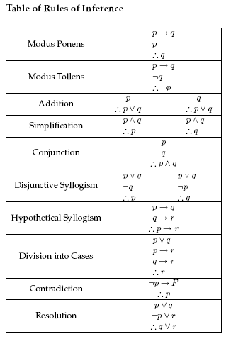
Rules of Inference
When an argument becomes too complicated, it is no longer practical to analyze it using a truth table.
We can apply rules of inference to check that an argument is valid.
Rules of Inference provide the templates or guidelines for constructing valid arguments from the statements that we already have.

Slide 14
Modus Ponens
If p and p→q are two premises,
we can use Modus Ponens to derive q.
p→q
p
∴q
Example 3
"If you have a password, then you can log on to facebook", p→q
"You have a password", p
Therefore − "You can log on to facebook“ q

Slide 15

Example 4
Note that the “p" and “q" in the modus ponens rule can actually stand for compound statements --- they don't have to be "single letters". For example:
Note:
is taking the place of p in the modus ponens rule, and is taking the place of q. That is, and are compound statements which are substituted for “p" and “q" in modus ponens.
if-then statement is listed first and the "if"-part is listed second. It doesn't matter which one has been written down first, and as long as both pieces have already been written down, you may apply modus ponens.
the statement didn't take part in the modus ponens step. Perhaps this is part of a bigger proof, and will be used later. The fact that it came between the two modus ponens pieces doesn't make a difference.

Slide 16
Modus Tollens
If p→q and ¬q are two premises,
we can use Modus Tollens to derive ¬p.
p→q
¬q
∴¬p
Example 5
"If you have a password, then you can log on to facebook", p→q
"You cannot log on to facebook", ¬q
Therefore − "You do not have a password "

Slide 17
Addition
If p is a premise, we can use Addition rule to derive p∨q.
p
∴p∨q
Or If q is a premise, we can use Addition rule to derive p∨q.
q
∴p∨q
Example 6: Let p be the proposition, “He studies very hard”, and q be the proposition “He is a very bad student”. The following arguments are valid according to the Addition Rule.
“He studies very hard”
Therefore − "Either he studies very hard Or he is a very bad student."
Also
“He is a very bad student
Therefore − "Either he studies very hard Or he is a very bad student."

Slide 18
Simplification
If p∧q is a premise, we can use Simplification rule to derive p.
p∧q
∴p
Or If p∧q is a premise, we can use Simplification rule to derive Q.
p∧q
∴q
Example 7
"He studies very hard and he is the best boy in the class", p∧q Therefore − "He studies very hard“∴q
Also
"He studies very hard and he is the best boy in the class", p∧q Therefore − "He is the best boy in the class“∴q

Slide 19
Conjunction
If p and q are two premises, we can use Conjunction rule
to derive p∧q
p
q
∴ p∧q
Example 8
Let p − “He studies very hard”
Let q − “He is the best boy in the class”
Therefore − "He studies very hard and he is the best boy in the class"

Slide 20
Disjunctive Syllogism
If ¬p and p∨q are two premises, we can use Disjunctive Syllogism to derive q or p.
¬p ¬q
p∨q p∨q
∴q ∴p
Example 9
"The ice cream is not vanilla flavored", ¬p
"The ice cream is either vanilla flavored or chocolate flavored", p∨q
Therefore − "The ice cream is chocolate flavored”

Slide 21
Hypothetical Syllogism
If p→q and q→r are two premises, we can use Hypothetical Syllogism to derive p→r
p→q
q→r
∴p→r
Example 10
"If it rains, I shall not go to school”, p→q
"If I don't go to school, I won't need to do homework", q→r
Therefore − "If it rains, I won't need to do homework“.

Slide 22
Division into cases
If p∨q, p→r and q→r are three premises, we can use division into cases to derive r.
p∨q
p→r
q→r
∴r
Example 11
"If it rains then I do not go to school", p→r
"If I wake up late, then I do not go to school", q→r
“It rains, or I wake up late” p∨q
Therefore − “I do not go to school"

Slide 23
Contradiction
If ¬p→F is a premise, we can use contradiction cases to derive p.
¬p→F
∴p
Resolution
If p∨q, ¬p∨r are two premises, we can use resolution to derive q∨r.
p∨q
¬p∨r
∴ q∨r

Slide 24
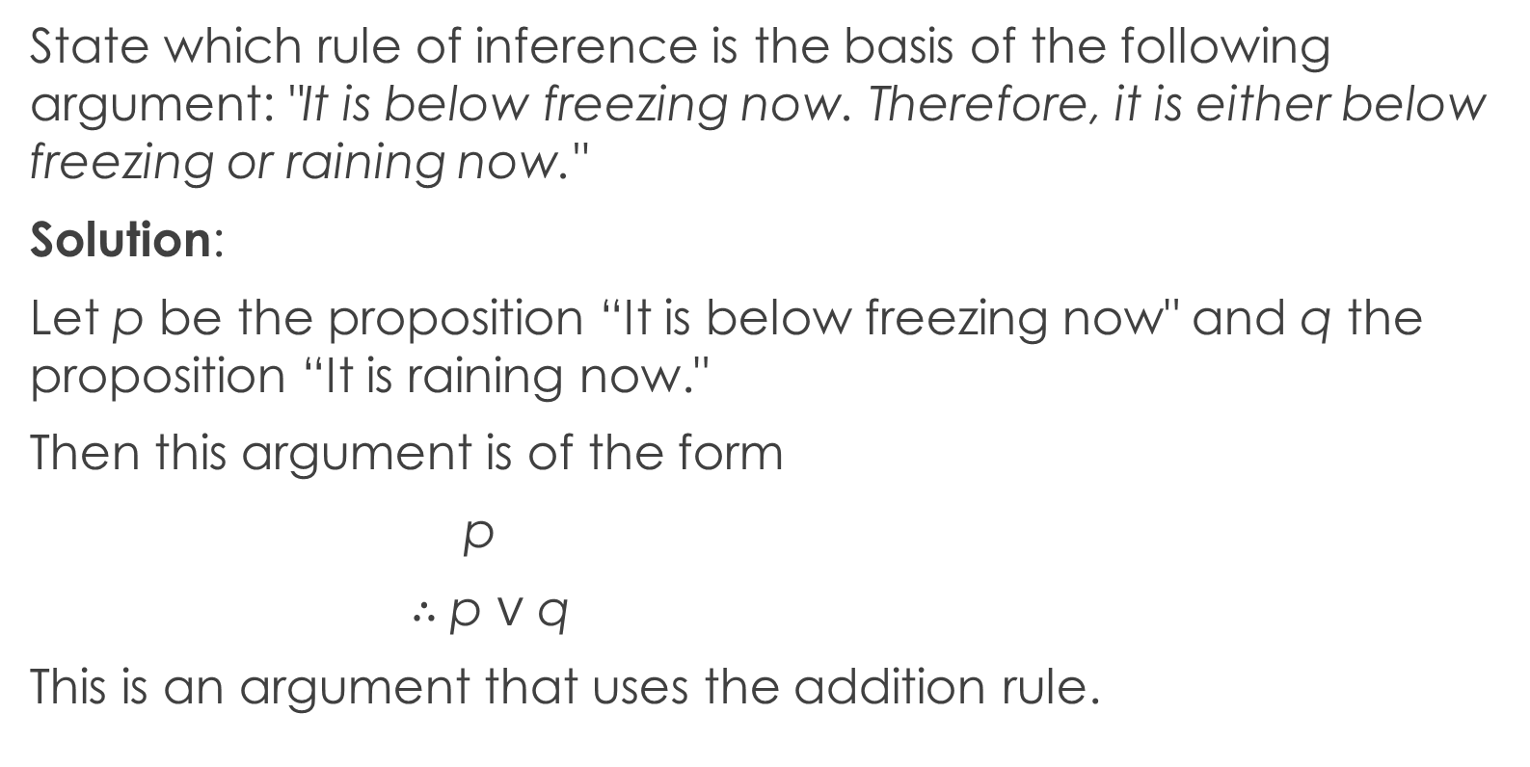
Example 12
State which rule of inference is the basis of the following argument: "It is below freezing now. Therefore, it is either below freezing or raining now."
Solution:
Let p be the proposition “It is below freezing now" and q the proposition “It is raining now."
Then this argument is of the form
p
$∴$ p ∨ q
This is an argument that uses the addition rule.

Slide 25
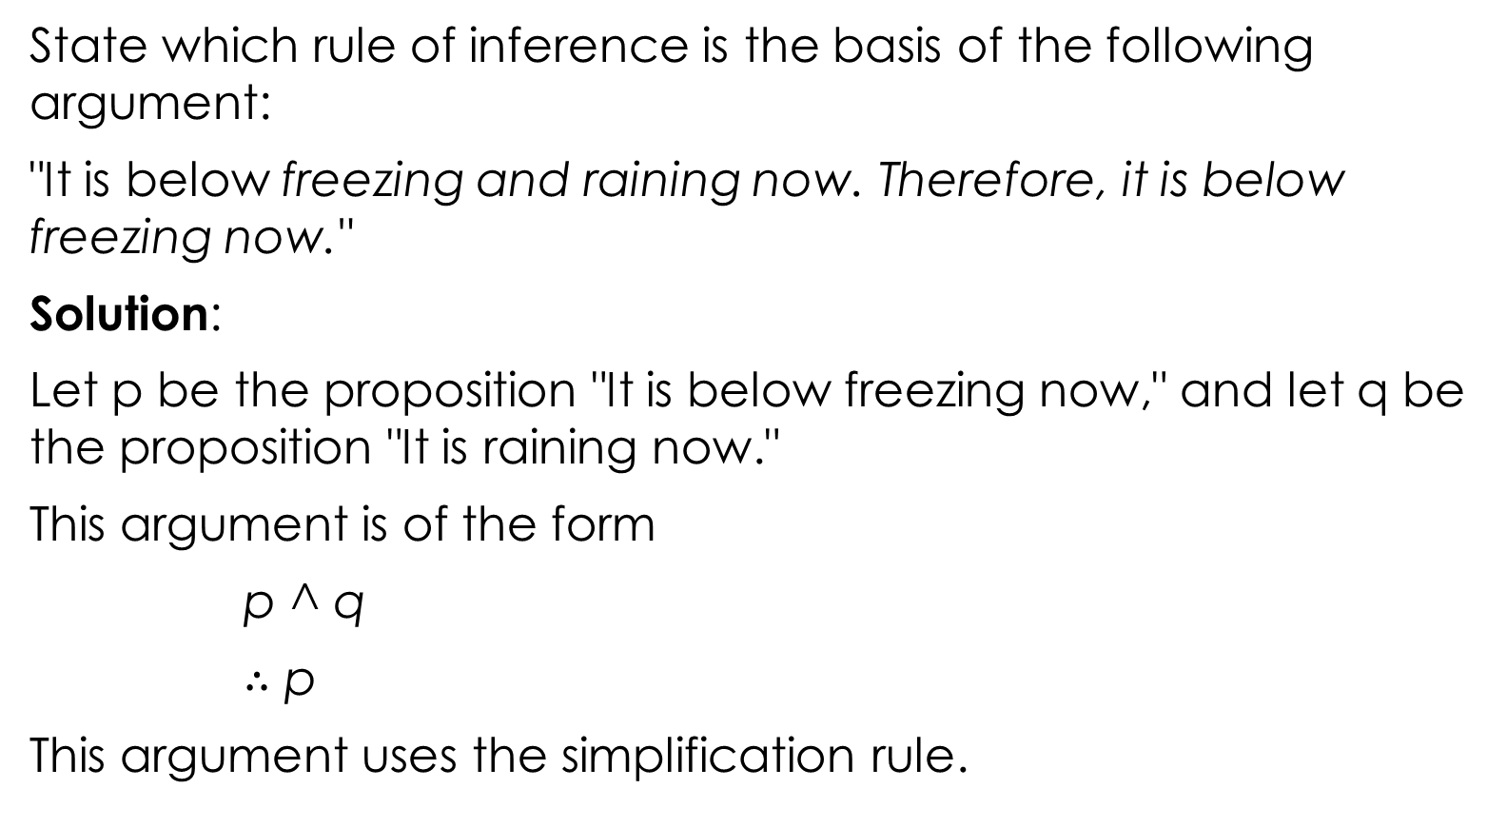
Example 13
State which rule of inference is the basis of the following argument:
"It is below freezing and raining now. Therefore, it is below freezing now."
Solution:
Let p be the proposition "It is below freezing now," and let q be the proposition "It is raining now."
This argument is of the form
p ^ q
$∴$ p
This argument uses the simplification rule.

Slide 26
Several rules of inference
When there are many premises, several rules of inference are often needed to show that an argument is valid.
This is illustrated by Examples below, where the steps of arguments are displayed on separate lines, with the reason for each step explicitly stated.
These examples also show how arguments in English can be analyzed using rules of inference.

Slide 27
Example 14
Show that the hypotheses
‘It is not sunny this afternoon and it is colder than yesterday’, ‘We will go swimming only if it is sunny’, ‘If we do not go swimming, then we will take a canoe trip’, and ‘If we take a canoe trip, then we will be home by sunset’ lead to conclusion ‘We will be home by sunset’.
Solution
Let p be the proposition ‘It is sunny this afternoon’,
q the proposition ‘It is colder than yesterday’,
r the proposition ‘We will go swimming’,
s the proposition ‘We will take a canoe trip’,
and t the proposition ‘We will be home by sunset’.

Slide 28
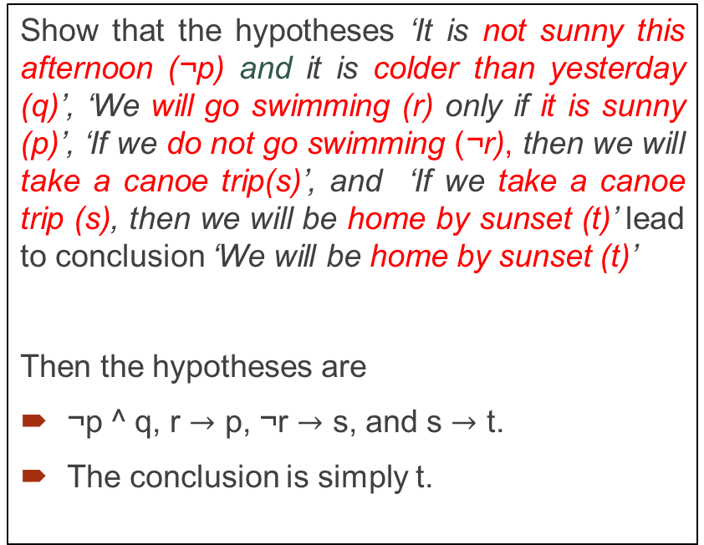
Example 14 cnt…
Show that the hypotheses ‘It is not sunny this afternoon (¬p) and it is colder than yesterday (q)’, ‘We will go swimming (r) only if it is sunny (p)’, ‘If we do not go swimming (¬r), then we will take a canoe trip(s)’, and ‘If we take a canoe trip (s), then we will be home by sunset (t)’ lead to conclusion ‘We will be home by sunset (t)’
Then the hypotheses are
¬p ^ q, r $→$ p, ¬r $→$ s, and s $→$ t.
The conclusion is simply t.
We construct an argument to show that our hypotheses lead to the desired conclusion as follows.
We begin with premises --- statements that you're allowed to assume. The conclusion is the statement that you need to prove.
We operate on the premises using rules of inference until you arrive at the conclusion.
The statements in logic proofs are numbered so that you can refer to them, and the numbers go in the first column. The actual statements go in the second column. The third column contains your justification for writing down the statement.

Slide 29
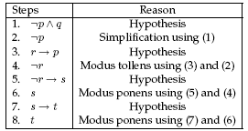
Example 14 cnt…
Show that the hypotheses ‘It is not sunny this afternoon (¬p) and it is colder than yesterday (q)’, ‘We will go swimming (r) only if it is sunny (p)’, ‘If we do not go swimming (¬r), then we will take a canoe trip(s)’, and ‘If we take a canoe trip (s), then we will be home by sunset (t)’ lead to conclusion ‘We will be home by sunset (t)’
Then the hypotheses are
¬p ^ q, r $→$ p, ¬r $→$ s, and s $→$ t.
The conclusion is simply t.
We construct an argument to show that our hypotheses lead to the desired conclusion as follows.
Note that we could have used a truth table to show that whenever each of the four hypotheses is true, the conclusion is also true. However, because we are working with five propositional variables, p, q, r, s and t, such a truth table would have 32 rows.

Slide 30
Example 15
Show that the hypotheses below are valid.
‘If you send me an email message, then I will finish writing the program’, ‘If you do not send me an email message, then I will go to sleep early’, and ‘If I go to sleep early, then I will wake up feeling refreshed’ lead to the conclusion ‘If I do not finish writing the program, then I will wake up feeling refreshed’.
Solution
Let p be the proposition ‘You send me an e-mail message’,
q the proposition ‘I will finish writing the program’,
r the proposition ‘I will go to sleep early’, and
s the proposition ‘I will wake up feeling refreshed’.

Slide 31
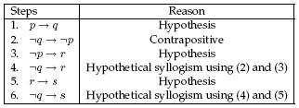
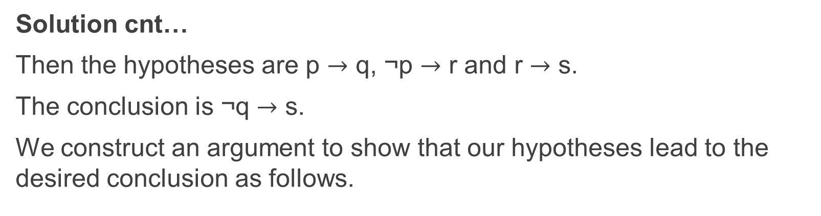
Solution cnt…
Then the hypotheses are p $→$ q, ¬p $→$ r and r $→$ s.
The conclusion is ¬q $→$ s.
We construct an argument to show that our hypotheses lead to the desired conclusion as follows.

Slide 32
The End

