Slide 1
Real-Time Emotion Recognition System
Author: Muhammed Rishal K
Class: S6 CSE2
Reg No: MEA23CS060
Submitted To: HOD of CSE
Dr. Najeeb K
MEA Engineering College

Slide 2
Introduction
Emotion recognition is an application of AI and Computer Vision.
Helps machines understand human emotions through facial expressions.
Used in healthcare, security, and human-computer interaction. This system detects emotions in real-time using webcam.

Slide 3
Problem Statement
Machines cannot naturally understand human emotions. Need for automated emotion detection systems.
Build a real-time accurate and efficient system.

Slide 4
Objectives
Develop CNN-based emotion classification model. Train model using facial expression dataset.
Integrate with real-time webcam. Achieve accurate and fast predictions.

Slide 5
Scope of the Work
Detect emotions like Happy, Sad, Angry, Neutral, Fear, Surprise. Real-time processing.
Extendable to web and mobile applications. Useful in mental health monitoring.

Slide 6
Technologies Used
Python
TensorFlow / Keras OpenCV
NumPy
CNN (Deep Learning)

Slide 7
System Design
Webcam Input
Face Detection
Preprocessing
CNN Model
Emotion Output

Slide 8
Methodology
Dataset collection Data preprocessing Model training Evaluation
Real-time deployment
1
2
3
4
5

Slide 9
Implementation
Used FER dataset
Built CNN with multiple layers Trained model for classification Saved model in .keras format Integrated with OpenCV

Slide 10
Real-time emotion detection Face bounding box
Output Screenshots
Emotion labels displayed

Slide 11
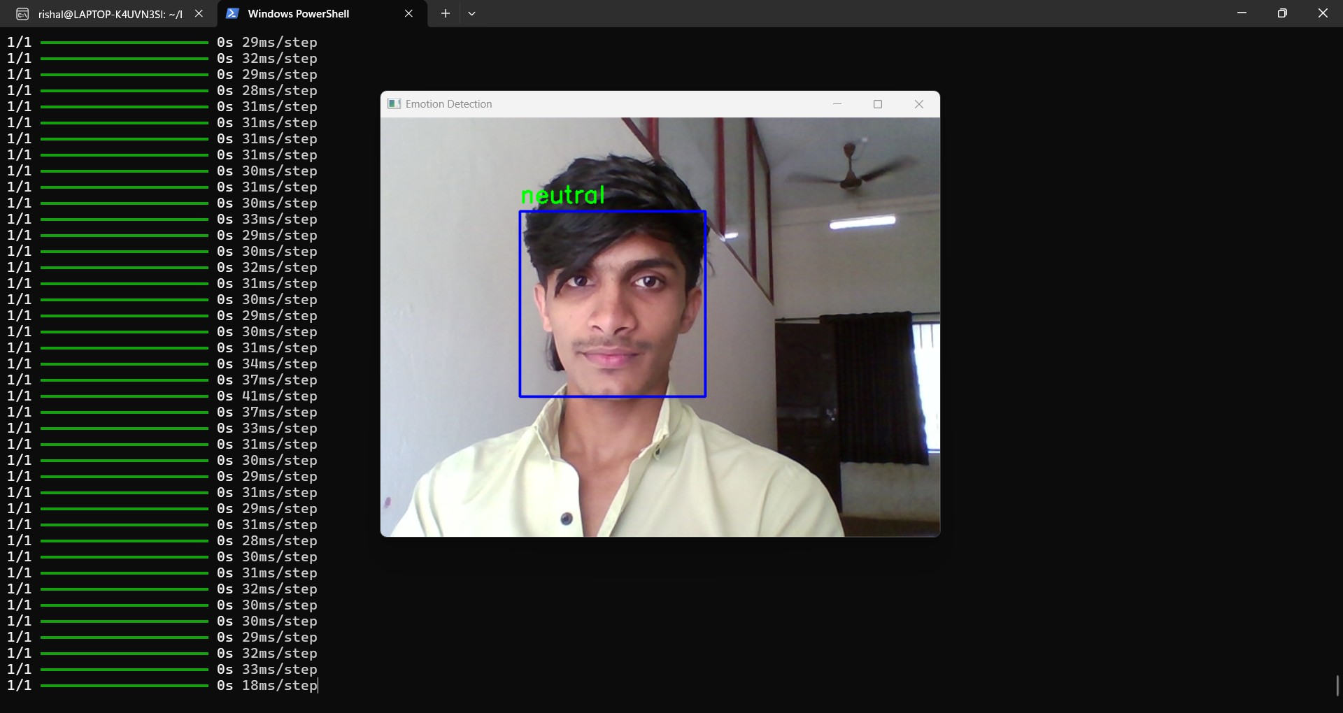
Output 1

Slide 12
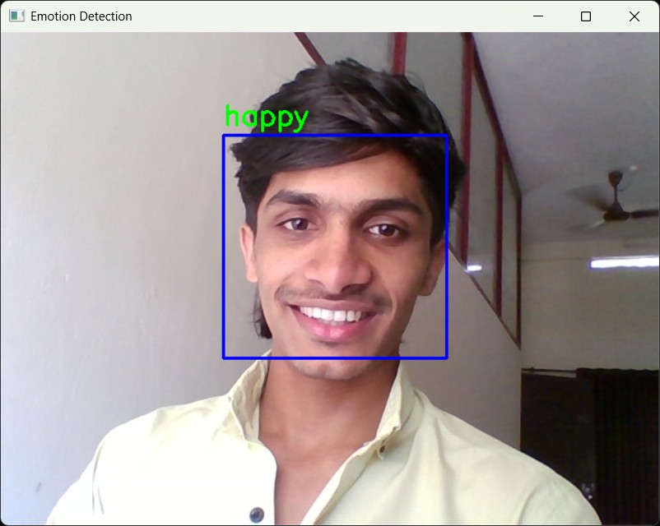
Output 2

Slide 13
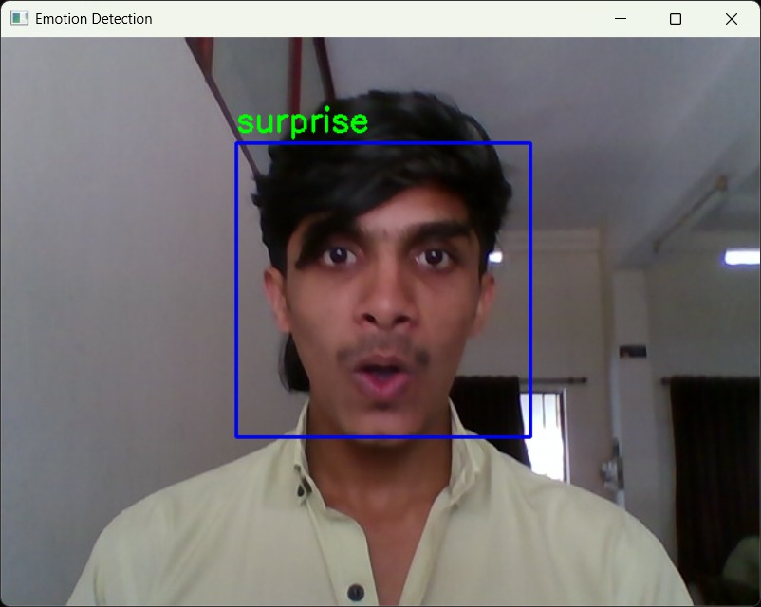
Output 3

Slide 14
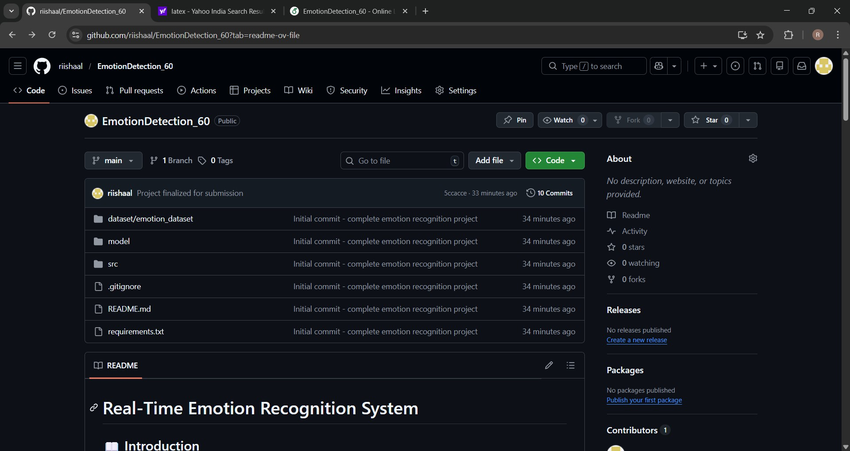
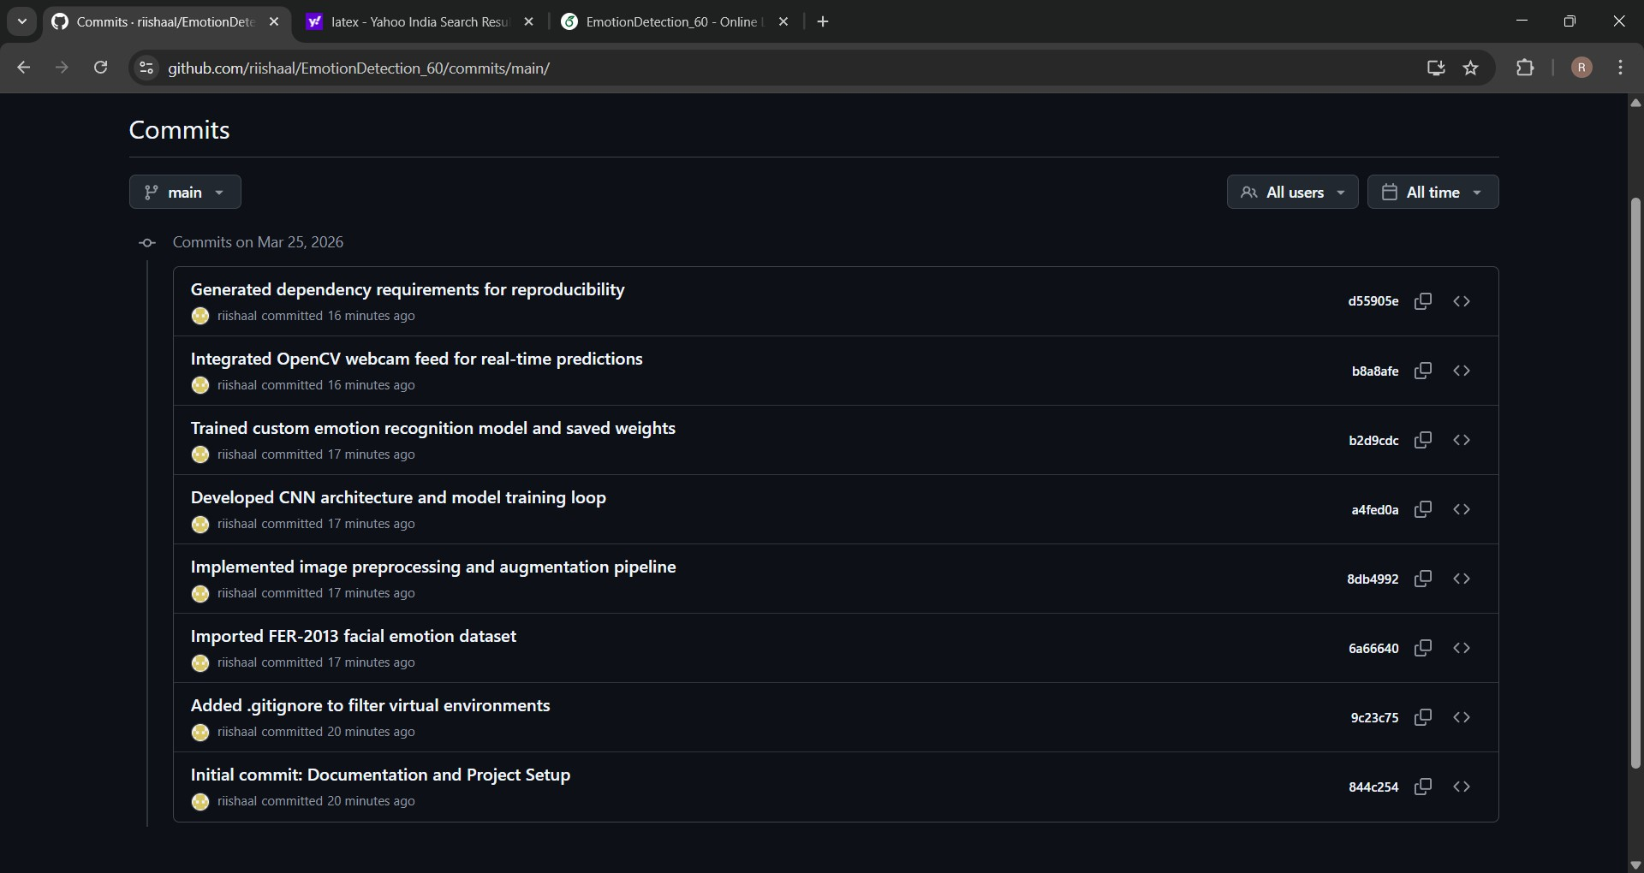
GitHub Overview
GitHub Link:
https://github.com/riishaal/EmotionDetection₆0
Repository Structure
Commit History

Slide 15
Challenges Faced
Dataset imbalance Accuracy improvement Real-time processing
Platform compatibility issues

Slide 16
Results and Conclusion
Successfully implemented real-time system Achieved 55% accuracy
Efficient on CPU Demonstrates AI application

Slide 17
Future Scope
Improve accuracy using advanced models Deploy as mobile/web app
Use transfer learning Add analytics

Slide 18
References
TensorFlow Documentation
https://www.tensorflow.org/
OpenCV Documentation
https://opencv.org/
FER-2013 Dataset (Kaggle)
https://www.kaggle.com/datasets/msambare/fer2013
Keras Documentation
https://keras.io/
Facial Expression Recognition using CNN
IEEE Paper / Google Scholar

