Slide 1

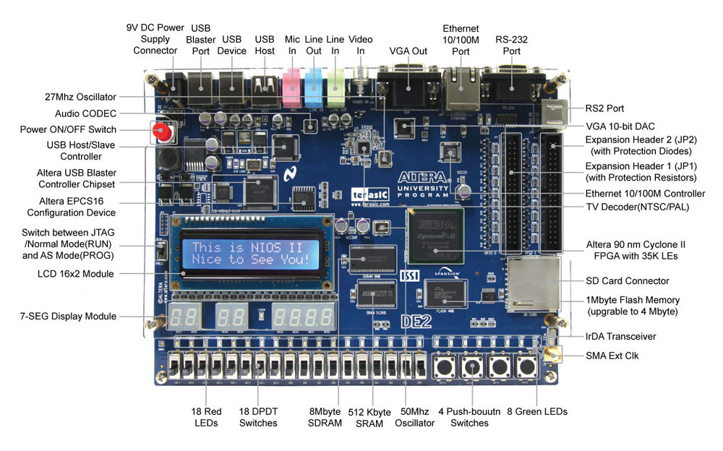
ISIS Hardware
Abstract
The application of cryptographic algorithms in hardware is utilized for security and performance reasons in various public-key cryptosystems. The goal of this project is to present one such algorithm, a systolic modular exponentiation system, in VHDL on our FPGA board. FPGAs (field-programmable gate arrays) are composed of programmable logic blocks and reconfigurable connections that enables the blocks to be set up in a logic gate system. VHDL (Very High Speed Integrated Circuit Hardware Description Language) is a hardware programming language that is used to write text models of logic circuits. The group has been able to represent a systolic system for modular exponentiation in VHDL that implements arithmetic and logic functions.
Abstract
The application of cryptographic algorithms in hardware is utilized for security and performance reasons in various public-key cryptosystems. The goal of this project is to present one such algorithm, a systolic modular exponentiation system, in VHDL on our FPGA board. FPGAs (field-programmable gate arrays) are composed of programmable logic blocks and reconfigurable connections that enables the blocks to be set up in a logic gate system. VHDL (Very High Speed Integrated Circuit Hardware Description Language) is a hardware programming language that is used to write text models of logic circuits. The group has been able to represent a systolic system for modular exponentiation in VHDL that implements arithmetic and logic functions.

