Slide 1
Sakura Holidays Commercial-ad
BY – Ritesh Paudel

Slide 2
Agenda
Introduction about projects
Aim and Objectives
Concept Research
Process

Slide 3
Introduction to the project
The goal of the project was to crate a professional promotional video for Sakura Holidays, the very first luxury tourist bus operator in Nepal. The emphasis remains on their imported 2x1 Elite Class seats from Thailand, the comfort, digital convenience and luxury service they offer on the Pokhara and Lumbini routes.
The video also highlights Sakura’s its digital booking platform, which includes luxury 2x1 seating configuration and payment facilities ( eSewa, Khalti, Mastercard). Employing video, narration and few motion graphics and user centered design, the objective is to create branding opportunities and serve to draw in further travel enthusiasts to the Sakura Holidays travel experience.

Slide 4
Aim and objectives
Aim
Produce a commercial video for Sakura Holidays that is professional and attractive to showcase their high-end tourist bus services, specifically new elite class 2x1 seating and digital reservation system which can cater both locals and oversea tourists.

Slide 5
Objectives
To show luxury of Sakura Holidays’ buses, with VIP seating and it wider space areas.
To show how easy it is to book a ticket through their app or on their website.
To promote internet payment services such as eSewa, Khalti and Mastercard.
To use multimedia talents such as video editing, sound design, and motion graphics.
To create a brand image with the help of cinematic visuals and story.

Slide 6
Concept Research
Researched Travel ads from Redbus, TripAdvisor, Goibibo.
Learned about how they create engaging visual shots and features,
Concentrated towards what Nepali Travelers required on Lumbini & Pokhara routes.
Showcased luxury seating on Sakura and an app-based booking process in the concept.
Applied the findings to script, shot and design

Slide 7
Pre- production Overview
Developed pre production process one by one with every detail before the planning of the shoot.
Also met with the client to learn about the ad objectives
Script writing and the story were done.
Chosen model and shooting location was finalized.
.Got camera and editing stuff ready.

Slide 8
Script development
the script captures a smooth digital to physical travel journey as from tapping the app to settling into elite 2x1 coach seats.
It places the viewer in the shoes of a modern traveler, highlighting convenience, class, and tech-enabled comfort.
Story progression mirrors user behavior: plan, book, ride — blending luxury travel with relatable, real-life moments.

Slide 9
Storyboard design
Clear Visual Plan – Offered a visual shot by shot break down, so there was less guesswork during filming.
Streamlined Location Planning – Grouped scenes by location to minimize travel.
Shot Organization – Helped us organize the order we shot things based on the camera angles and lighting setups.
Time Management – Days an action should take, determining what is reasonable to shoot in a day.
Team Leadership – Provided the crew and cast with a unified vision and increased productivity.
Fewer Takes – Planning the visuals in advance led to fewer on set errors and retakes

Slide 10
Location and planning
Selected a modern and clean apartment to mirror the simplicity of using Sakura Holidays’ app.
For the next scene bus stop location was planned and had the permission to shoot.
When it comes to lighting, these locations were chosen to maximize on natural light to give a premium look.
Sites was readily accessible and pre approved to circumvent any last minute hassles.

Slide 11
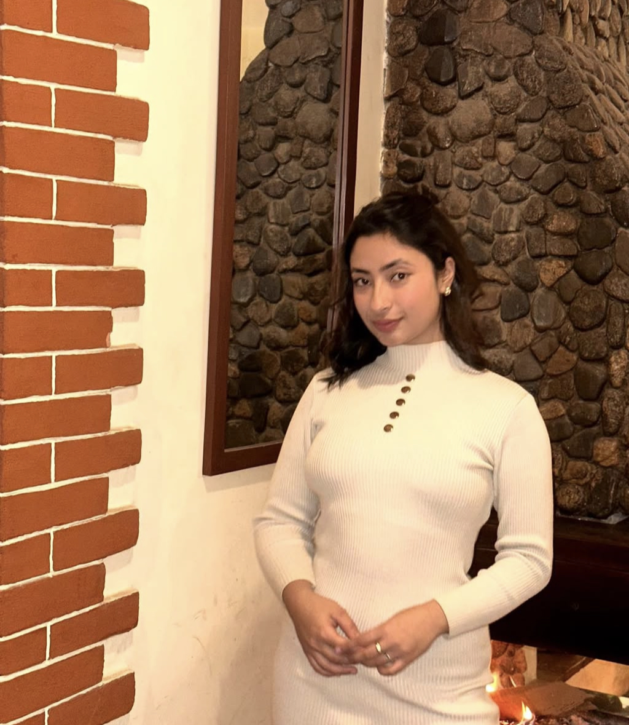
Casting and styling
Chose a model with elegant presence and corporate looks after shortlisting.
A calm presence and professional look model was finalized.
She was dressed in a formal and professional look signifying premium travel marker going for a business trip.
She fit the neat views and the current brand feel of the commercial.

Slide 12
Production phase
Filmed inside the Sakura bus into a clean ambience and later on at the apartment to mirror the comfort and convenience
Filmed with Sony A7III for beautiful 4K cinematic perfectly complimented with smooth gimbal shots.
Soft and natural lighting for clear, premium visuals was used.
Collaborated well with team-mates for efficient co-ordination and assistance on technical tasks.
Followed pre planned storyboard to complete all shots efficiently without missing it.

Slide 13
Filiming techniques
Wide angle and close ip shot shots were taken to show the luxury seats and booking app.
Gimbal was used for steady shots to avoid shaky videos.
Soft lighting was used to give mordern and bright feel.
Extra scene were shot for editing option.
Simple background was setup which helped viewers to focus on the main features.

Slide 14
Camera movement and framing
Used gimbal for steady tracking of the shot making video look professional
Closeup shot of the app interface and luxury seats to highlight key features.
Showed the full interior of the bus in wide angle position.
Main subjects like the model, mobile sceen were kept in the center to grab attention.
Composition done to make the video visually appealing.

Slide 15
Challenges faced
Model availabily caused delay on the shoot and was shifted after few days.
Background noise inteference cause to take the shots again.
Limited shooting time with the model
Was difficult to handle camera in tight spaces.
Natural lighting was inconsistent.
Coordination with the team memebrs was hard.

Slide 16
Post- production overview
Post prodcution involve of editing, color grading and selceting the best clips from the footages to make detailed video.
It focued on refining the footages.
Adding audio made more depth and emotion and helped create a good final product.

Slide 17
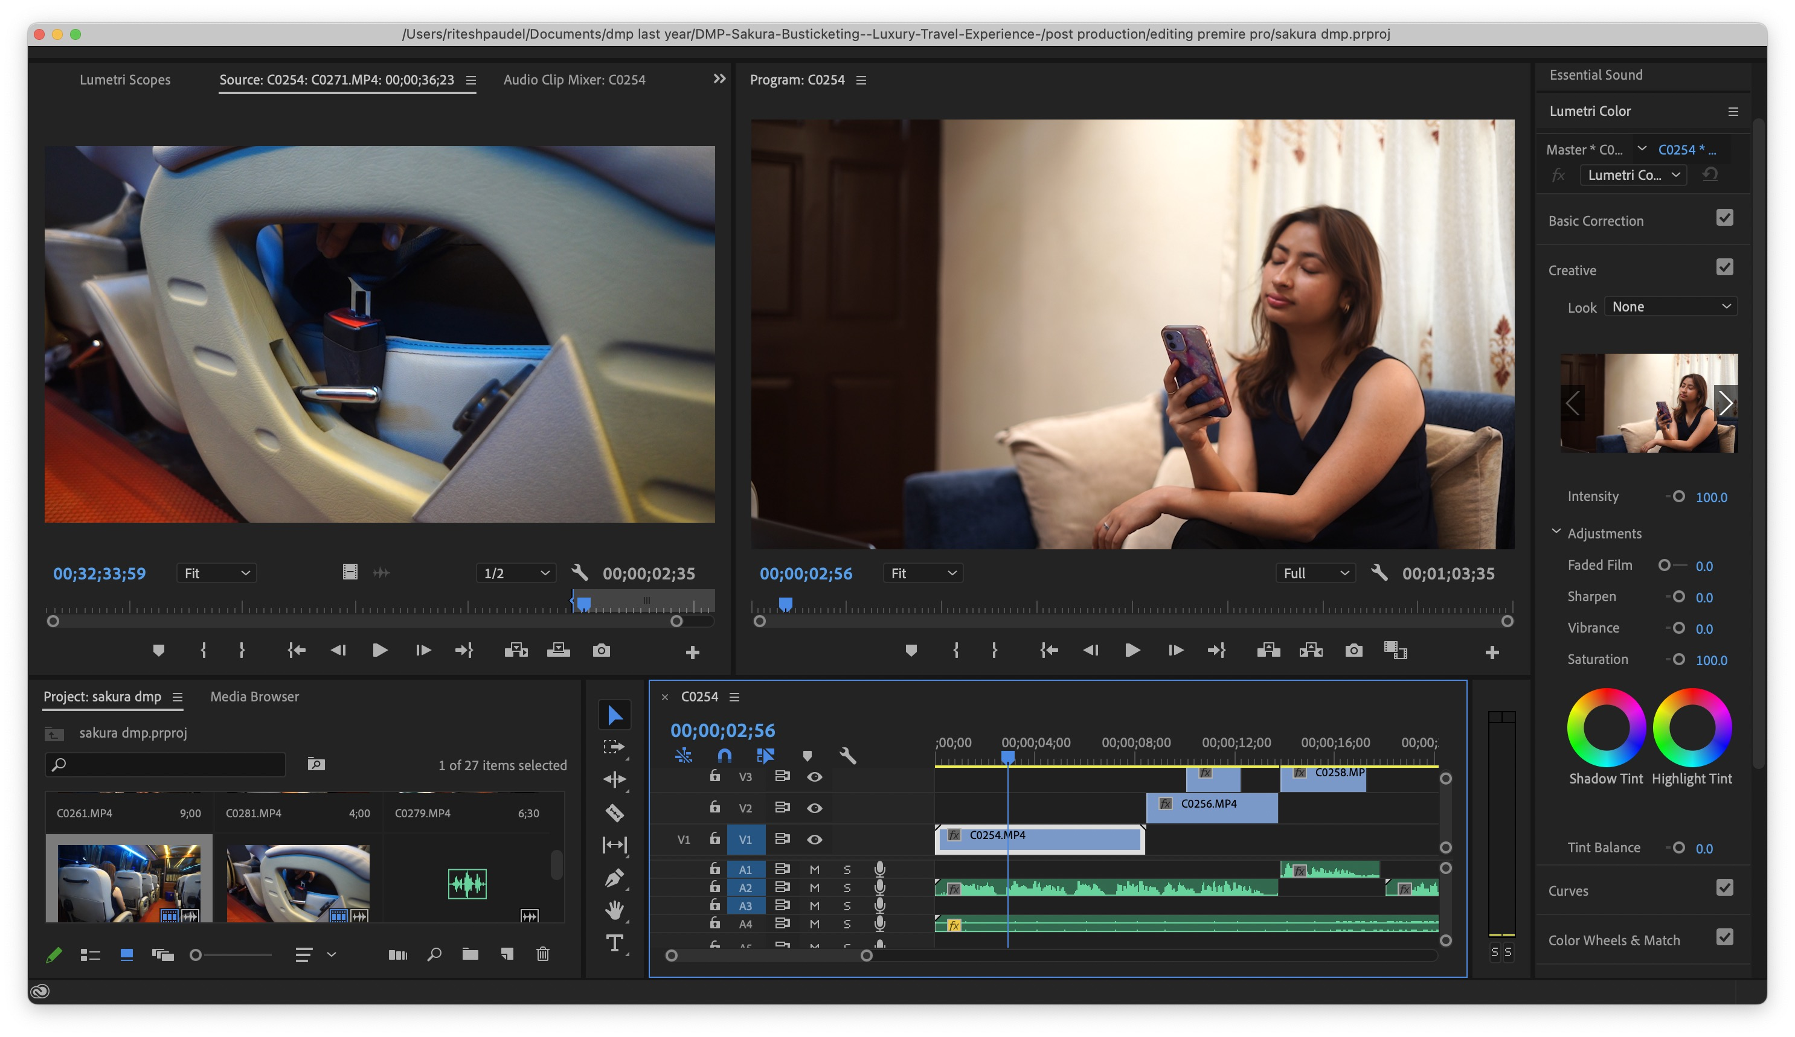
Editing
Edited on Adobe Premiere Pro.
Designed and laid out raw clips according to the storyboards.
Added fitting transitions and cuts.
Inserted text overlays and motion graphics to make the content easier to understand and more visually appealing.
Small edits to ensure a professional final product.

Slide 18
Final rendering
This project was rendered at High definition resolutions after editing
Made sure the video was played in Full HD (1080p) to achieve the best possible definition on all devices.
Delivered the video in MP4 file type.
The rendered video was successfully prepared and distributed on online platforms such as the website, and social media sites.

Slide 19
Techniques and technology used
Utlized sony a7iii for high quality footages with gimbal stablizer for smooth tracking shots.
Soft and natural lighting was used.
Adobe premiere pro was used for editing as well as color correction.
Integrated audio with background music.
Final rendered in mp4 for optimal quality.

Slide 20
conclusiom
I was able to build on the video production work I used to do for the Sakura Holidays commercial. I learned how to run a project from initial idea to completed export, script writing, filming and editing.
I also got some idea in motion graphics using Canva and advanced editing in Adobe Premiere Pro. I learned on professional equipment, like the Sony A7III and a gimbal as well as learned to use camera, audio etc. and This project also showed me how to deal with real-world hiccups, such as location troubles and scheduling conflicts. It was a chance to push the boundaries, creatively and technically, as a multimedia student.

