Slide 1
Patient visits hospital
Health facility submits claim
Claim adjudication by HIB / SSF
1 · Journey
2 · Knowledge
3 · Rules & review
4 · Proposal
1
2
3
4
5
6
7
8
9
10
11
12
13
14
Membership verification
Hospital card and care
Nothing paid at the counter
Claim document
Entered in openIMIS
Facility check and submission
System verification
Identity and cross-claim rules
Completeness check
Benefit package check
Ranked review queue
Reviewer decision
Settlement recommended
Approval and payment
★ dashed = the hops this study adds (8 · 11 · 12)
WEEK 5 PROGRESS · KNOWLEDGE-ENGINEERING CASE STUDY · OPENIMIS / HEALTH INSURANCE BOARD & SOCIAL SECURITY FUND, NEPAL
Detecting Duplicate & Cross-Scheme Claims
The journey of a claim, and where knowledge stops fraud — the claim-adjudication process, the ontology and knowledge base, the rules and their failed cases, and a proposed solution for HIB and SSF, walked through as one claim from the patient's hand to the final reviewer.
Grishma Rijal · Rijan Ghimire · Milan Maharjan · Biwash Budhathoki
Part 1 The claim journey — Grishma Rijal · Part 2 Ontology & knowledge base — Rijan Ghimire · Part 3 Reviewers, rules & failed cases — Milan Maharjan · Part 4 Proposed solution & future work — Biwash Budhathoki
Built from the Claim Journey web app (React + Node) · synthetic Nepal claim book · no real patient data
Notes:
Week 5 progress, in four parts. Week 1 mapped the system, Week 2 chose duplicate and cross-scheme claims, Weeks 3-4 built the knowledge base and prototype; Week 5 walks the whole thing as one claim. Grishma opens with the recap.

Slide 2
Part 1 · Grishma Rijal
Recap from Weeks 1–4, then the claim journey — from the patient's hand to the final reviewer
Patient visits hospital
Health facility submits claim
Claim adjudication by HIB / SSF
1 · Journey
2 · Knowledge
3 · Rules & review
4 · Proposal
1
2
3
4
5
6
7
8
9
10
11
12
13
14
Membership verification
Hospital card and care
Nothing paid at the counter
Claim document
Entered in openIMIS
Facility check and submission
System verification
Identity and cross-claim rules
Completeness check
Benefit package check
Ranked review queue
Reviewer decision
Settlement recommended
Approval and payment
★ dashed = the hops this study adds (8 · 11 · 12)
openIMIS Nepal — Week 5 · the claim journey, the knowledge base and the proposal
Notes:
Grishma. One minute of recap, then walk the audience along the map once; every later slide keeps the same stepper at the top.

Slide 3
PART 1 · RECAP
Where we are — from Week 1 to Week 5
Patient visits hospital
Health facility submits claim
Claim adjudication by HIB / SSF
1 · Journey
2 · Knowledge
3 · Rules & review
4 · Proposal
1
2
3
4
5
6
7
8
9
10
11
12
13
14
★ dashed = the hops this study adds (8 · 11 · 12)
Week | What we did | What it established
Week 1 — domain & system | Mapped HIB and SSF, openIMIS and the claim lifecycle from the HIB (Aug 2020), HIB / SSF / GIZ (Apr 2024) and MoHP / SIL Nepal (Nov 2024) presentations; dated gap ledger | HIB: 7.7 M enrolled, 4.9 M active (2024); about 50,000 claims a day for 26 central reviewers (10 in 2020); the HIB ↔ SSF silo; National ID named by HIB as the fix
Week 2 — the problem | Fraud typology (NHCAA, World Bank 2018, EHFCN); how the 26 reviewers separate right from wrong; why that knowledge is tacit; how other countries detect fraud; scope confirmed by the supervisor | Duplicate and cross-scheme claims as the target; a first rule catalog; fraud about 5.5 % of claims and 20–27 % rejections in Nepal (Ranabhat / Ghimire 2022-23; Katmandu Journal, Jan 2026)
Weeks 3–4 — knowledge base & prototype | Scraped openIMIS knowledge base; HIB expert interview; 25 openIMIS repositories read; two-engine prototype on an 18-claim book; Nepal synthetic generator | openIMIS has no duplicate check (reason 6 commented out); existing engine 0 vs our 6 on the small book; identity resolution is the ceiling
Week 5 — this deck | The Claim Journey web app (React + Node): 14 hops, ranked queue, reviewer loop; the HIC ontology and naming standards; evaluation on 9,786 synthetic claims | 418 of 454 frauds caught at 92 % precision; a ranked queue reaches 418 frauds where the random 5 % sample reaches 17–32; a deployable design
The thread: Week 1 found that 26 people review 50,000 claims a day and that HIB and SSF cannot see each other; Week 2 named the fraud that exploits both; Weeks 3–5 build and test the knowledge that closes the gap.
Sources: HIB presentation (Aug 2020); HIB, SSF and GIZ presentations (Apr 2024); MoHP / SIL Nepal (Nov 2024); World Bank SHI study (2018); NHCAA; Week 2 rule catalog; Week 3-4 report
openIMIS Nepal — Week 5 · the claim journey, the knowledge base and the proposal
1
Notes:
Grishma. Keep to one minute: four rows, one thread.

Slide 4
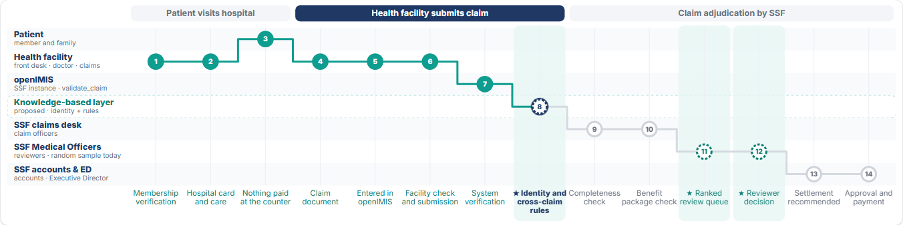
PART 1 · THE CLAIM-ADJUDICATION PROCESS
The claim journey — three lanes, fourteen hops, seven owners
Patient visits hospital
Health facility submits claim
Claim adjudication by HIB / SSF
1 · Journey
2 · Knowledge
3 · Rules & review
4 · Proposal
1
2
3
4
5
6
7
8
9
10
11
12
13
14
Membership verification
Hospital card and care
Nothing paid at the counter
Claim document
Entered in openIMIS
Facility check and submission
System verification
Identity and cross-claim rules
Completeness check
Benefit package check
Ranked review queue
Reviewer decision
Settlement recommended
Approval and payment
★ dashed = the hops this study adds (8 · 11 · 12)
Rows are owners
Columns are hops
Teal is done, the ring is where we are
Dashed teal hops are ours
patient, hospital, openIMIS, our layer, claims desk, Medical Officers, accounts and the Executive Director
HIB's own workflow for claim processing, in its three lanes
faded hops are skipped for that claim: a rejection jumps 7 → 14, a clean claim 11 → 13
8 identity and cross-claim rules · 11 ranked queue · 12 the reviewer decision that teaches the rules
Sources: HIB workflow for claim processing (HIB, 2025); actors and the claim lifecycle, HIB presentation (Apr 2024); the Claim Journey web app, Journey page
openIMIS Nepal — Week 5 · the claim journey, the knowledge base and the proposal
2
Notes:
Presenter: Grishma. Walk the audience along the map once. Every later slide shows the same stepper at the top, so people always know where we are.

Slide 5
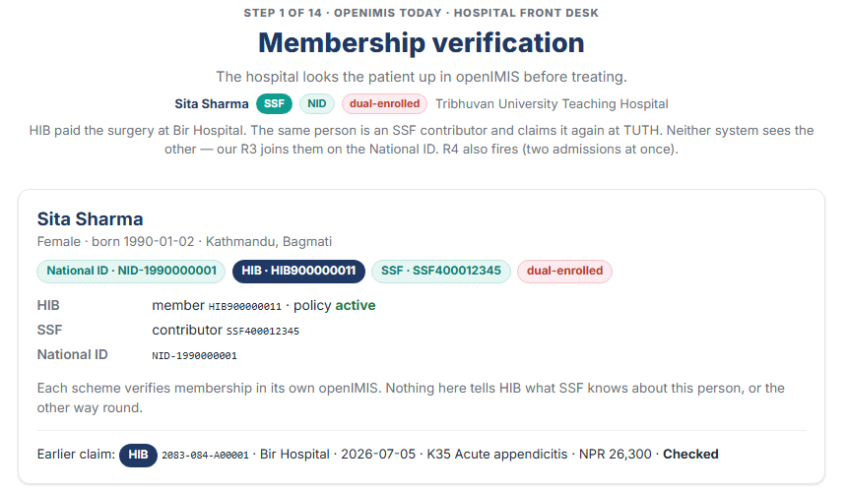
PART 1 · PATIENT AND HOSPITAL
Hops 1–3 — the patient visits the hospital, membership is checked in one scheme only
Patient visits hospital
Health facility submits claim
Claim adjudication by HIB / SSF
1 · Journey
2 · Knowledge
3 · Rules & review
4 · Proposal
1
2
3
4
5
6
7
8
9
10
11
12
13
14
Hospital · Patient
Membership verification
Hospital card and care
Nothing paid at the counter
★ dashed = the hops this study adds (8 · 11 · 12)
• Membership verification. The front desk looks the patient up in the scheme's openIMIS. HIB's openIMIS knows nothing about SSF, and the other way round.
• Hospital card and care. Treatment follows need and the benefit package: NPR 100,000 per family per year at HIB; the doctor's NMC registration number goes on the prescription.
• Nothing paid at the counter. Money flows scheme → facility, never to the patient (10 % co-payment on diagnostics since January 2024). The facility is the economic beneficiary of every line, which is why fraud enters through the claim.
• What is already known here. Member number, policy status, National ID for about 60 % of adults, and any earlier claims — inside this scheme.
Sources: HIB presentation (Apr 2024) — benefit package and enrolment; claim adjudication report (2025) — NPR 100,000 ceiling, 10 % co-payment; app: Journey, step 1
openIMIS Nepal — Week 5 · the claim journey, the knowledge base and the proposal
3
Notes:
Presenter: Grishma. Point out the 'Earlier claim' line on the screenshot: HIB already paid the surgery at Bir Hospital, and SSF's front desk cannot see that.

Slide 6
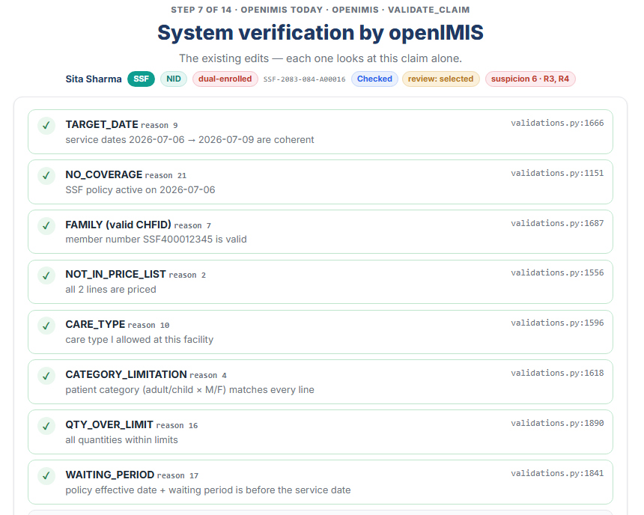
PART 1 · HOSPITAL CLAIM ADMIN AND OPENIMIS
Hops 4–7 — the facility submits, openIMIS checks each claim on its own
Patient visits hospital
Health facility submits claim
Claim adjudication by HIB / SSF
1 · Journey
2 · Knowledge
3 · Rules & review
4 · Proposal
1
2
3
4
5
6
7
8
9
10
11
12
13
14
Hospital · openIMIS
Claim document
Entered in openIMIS
Facility check and submission
System verification
★ dashed = the hops this study adds (8 · 11 · 12)
• Claim document (4). Card, invoices, discharge summary or OPD ticket, prescription with the NMC number.
• Entered in openIMIS (5). Keyed in, or sent by the EMR as an HL7 FHIR R4 Claim; about 70 % of HIB-empanelled hospitals submit electronically. A Bikram-Sambat claim code is assigned, e.g. 2083-084-000123.
• Facility verification (6). HIB rejects about one claim in five, mostly for a missing NMC number, tests without prescriptions and medicines that differ from the prescription.
• System verification (7). validate_claim runs the edits: dates, coverage, member, price list, care type, category, quantity cap, waiting period. Two edits are switched off in the code: reason 6 duplicated and reason 8 diagnosis not in list.
Sources: MoHP / SIL Nepal (Nov 2024) — 180+ EMRs on FHIR; claim adjudication report (2025) — rejection causes; openimis-be-claim_py, claim/validations.py lines 38, 40, 1098 ff.; app: Journey, step 7
openIMIS Nepal — Week 5 · the claim journey, the knowledge base and the proposal
4
Notes:
Presenter: Grishma. The screenshot is the animated checklist of the real openIMIS edits, with 6 and 8 shown as disabled. Emphasise: every edit looks at this one claim.

Slide 7
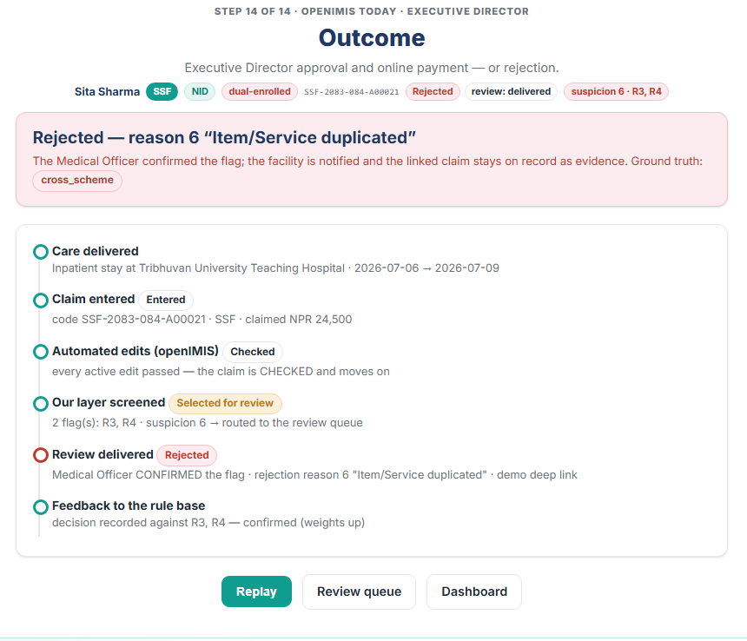
PART 1 · HIB CLAIMS DESK, MEDICAL OFFICERS, ACCOUNTS, EXECUTIVE DIRECTOR
Hops 9–14 — adjudication, a random sample, then money that cannot be recalled
Patient visits hospital
Health facility submits claim
Claim adjudication by HIB / SSF
1 · Journey
2 · Knowledge
3 · Rules & review
4 · Proposal
1
2
3
4
5
6
7
8
9
10
11
12
13
14
Claims desk · Medical Officers · Accounts · Exec. Director
Completeness check
Benefit package check
Ranked review queue
Reviewer decision
Settlement recommended
Approval and payment
★ dashed = the hops this study adds (8 · 11 · 12)
• Completeness and benefit-package checks (9–10). Attachments, NMC number, prescription coverage, identity on the card, policy in force, prices, annual ceiling.
• Manual review (11–12). Medical Officers examine a random 5 % sample; the rest is never opened. Reviewers apply their own clinical logic, which is not written down anywhere.
• Settlement and payment (13–14). The account section recommends the amount, the Executive Director approves, payment is made online after the monthly batch. After that, a wrong payment is a recovery case, not a correction.
• The claim you saw was paid by HIB at Bir Hospital and claimed again at TUTH under SSF. Both systems said yes.
Sources: HIB presentation (Apr 2024) — 26 reviewers, Executive Director approval; HIB domain-expert interview (2025) — random sampling, reviewers' own logic; app: Journey, step 14
openIMIS Nepal — Week 5 · the claim journey, the knowledge base and the proposal
5
Notes:
Presenter: Grishma. The screenshot shows the timeline of the whole journey for the cross-scheme claim after the reviewer confirmed the flag (reason 6).

Slide 8
PART 1 · BETWEEN HOP 7 AND HOP 9 · WHAT WE FOUND IN THE CODE AND THE INTERVIEWS
The gap — nobody compares a claim with the person's other claims
Patient visits hospital
Health facility submits claim
Claim adjudication by HIB / SSF
1 · Journey
2 · Knowledge
3 · Rules & review
4 · Proposal
1
2
3
4
5
6
7
8
9
10
11
12
13
14
openIMIS
System verification
★ dashed = the hops this study adds (8 · 11 · 12)
What an honest system would ask | openIMIS today | Where we found it
Has this service already been billed for this person today? | Reason 6 DUPLICATED is commented out; zero references | claim/validations.py:38
Does the diagnosis justify the treatment? | Reason 8 ICD_NOT_IN_LIST is commented out; no protocol in the system | claim/validations.py:40 · HIB expert: 'standard treatment protocol'
Was this person treated twice at once? | No check; the frequency edit only runs if a service has a frequency set (none do) | claim/validations.py:1636
Has the other scheme already paid for this? | Impossible: HIB and SSF are separate openIMIS instances with separate ledgers; no shared person identifier | openIMIS Nepal, SSF wiki · knowledge base 04
Is this a rejected claim coming back with new codes? | No memory of rejections across submissions | claim.services enter_and_submit
Which claims should a reviewer open first? | claim_sampling: random.shuffle, 5 % | openimis-be-claim_sampling_py
This is the study's scope. A knowledge-based layer that resolves who the person is, keeps the claim history across facilities and schemes, applies explainable rules, and ranks claims for the reviewer. It never rejects: it explains.
Sources: openIMIS repositories (cloned and read, 2026); HIB / GIZ (Apr 2024) — the HIB ↔ SSF silo; HIB expert interview (2025); Week 2 rule catalog
openIMIS Nepal — Week 5 · the claim journey, the knowledge base and the proposal
6
Notes:
Presenter: Grishma, hand-over to Rijan. Six questions, six 'no'. The next part shows the knowledge we collected to answer them.

Slide 9
Part 2 · Rijan Ghimire
Ontology and knowledge base — our sources, the standards a Nepali claim uses, and the synthetic data
Patient visits hospital
Health facility submits claim
Claim adjudication by HIB / SSF
1 · Journey
2 · Knowledge
3 · Rules & review
4 · Proposal
1
2
3
4
5
6
7
8
9
10
11
12
13
14
Our layer
Membership verification
Hospital card and care
Nothing paid at the counter
Claim document
Entered in openIMIS
Facility check and submission
System verification
Identity and cross-claim rules
Completeness check
Benefit package check
Ranked review queue
Reviewer decision
Settlement recommended
Approval and payment
★ dashed = the hops this study adds (8 · 11 · 12)
openIMIS Nepal — Week 5 · the claim journey, the knowledge base and the proposal
Notes:
Rijan. Provenance first, then the ontology, then the standards table, then the synthetic book.

Slide 10
PART 2 · SOURCES WITH PROVENANCE
The knowledge base — what we know and where it came from
Patient visits hospital
Health facility submits claim
Claim adjudication by HIB / SSF
1 · Journey
2 · Knowledge
3 · Rules & review
4 · Proposal
1
2
3
4
5
6
7
8
9
10
11
12
13
14
Our layer
Identity and cross-claim rules
★ dashed = the hops this study adds (8 · 11 · 12)
Source | What we took from it | Where it is used
HIB domain expert (interview, 2025) | Existing rule engine vs our addition · random sampling · SSF schemes · the claim vault · standard treatment protocol · reviewers use their own logic | Rules R2 (vault), STG; reviewer hops 11–12
Claim adjudication report with references (2025) | HIB's rejection causes (~20 %), benefit package, co-payment, FHIR uptake (~70 %), SSF (85 % of claims via openIMIS), Korea HIRA / Taiwan NHI, PM-JAY | Journey facts; Part 4 comparison
openIMIS code, 25 repositories | validate_claim and the disabled reasons 6 and 8; statuses 2/4/8/16/1; review status; json_ext; Nepali claim codes; claim_sampling; claim_ai_quality hook | Engine 1 (ported edits); integration blueprint
openIMIS website and wiki (scraped knowledge base) | Nepal deployment, SSF pages, AI claims module, FHIR implementation guide | Ontology alignment; sources
Standards bodies | WHO ICD-10/11, ICHI; HL7 FHIR R4; NMC registration; ISO 3166-2:NP; DHIS2 HMIS; NLEM 2021 | Ontology bindings; Ontology page
World Bank / NHCAA fraud typology | 16 fraud types, 9 red flags, 11 detection methods | Every rule declares the fraud type it detects
openIMIS PR #214 synthetic-data generator | Bulk generator structure; gaps: no fraud label, no duplicates, one policy per family | Our Nepal generator extends it
Sources: as listed; Week 1 presentations (HIB Aug 2020; HIB / SSF / GIZ Apr 2024; MoHP / SIL Nov 2024) underpin the journey facts; knowledge base in Week 3-4/knowledge_base, ontology/, repos/REPOS.md
openIMIS Nepal — Week 5 · the claim journey, the knowledge base and the proposal
7
Notes:
Presenter: Rijan. Provenance matters in knowledge engineering: every rule in the ontology records which of these sources it was derived from (prov:wasDerivedFrom).

Slide 11
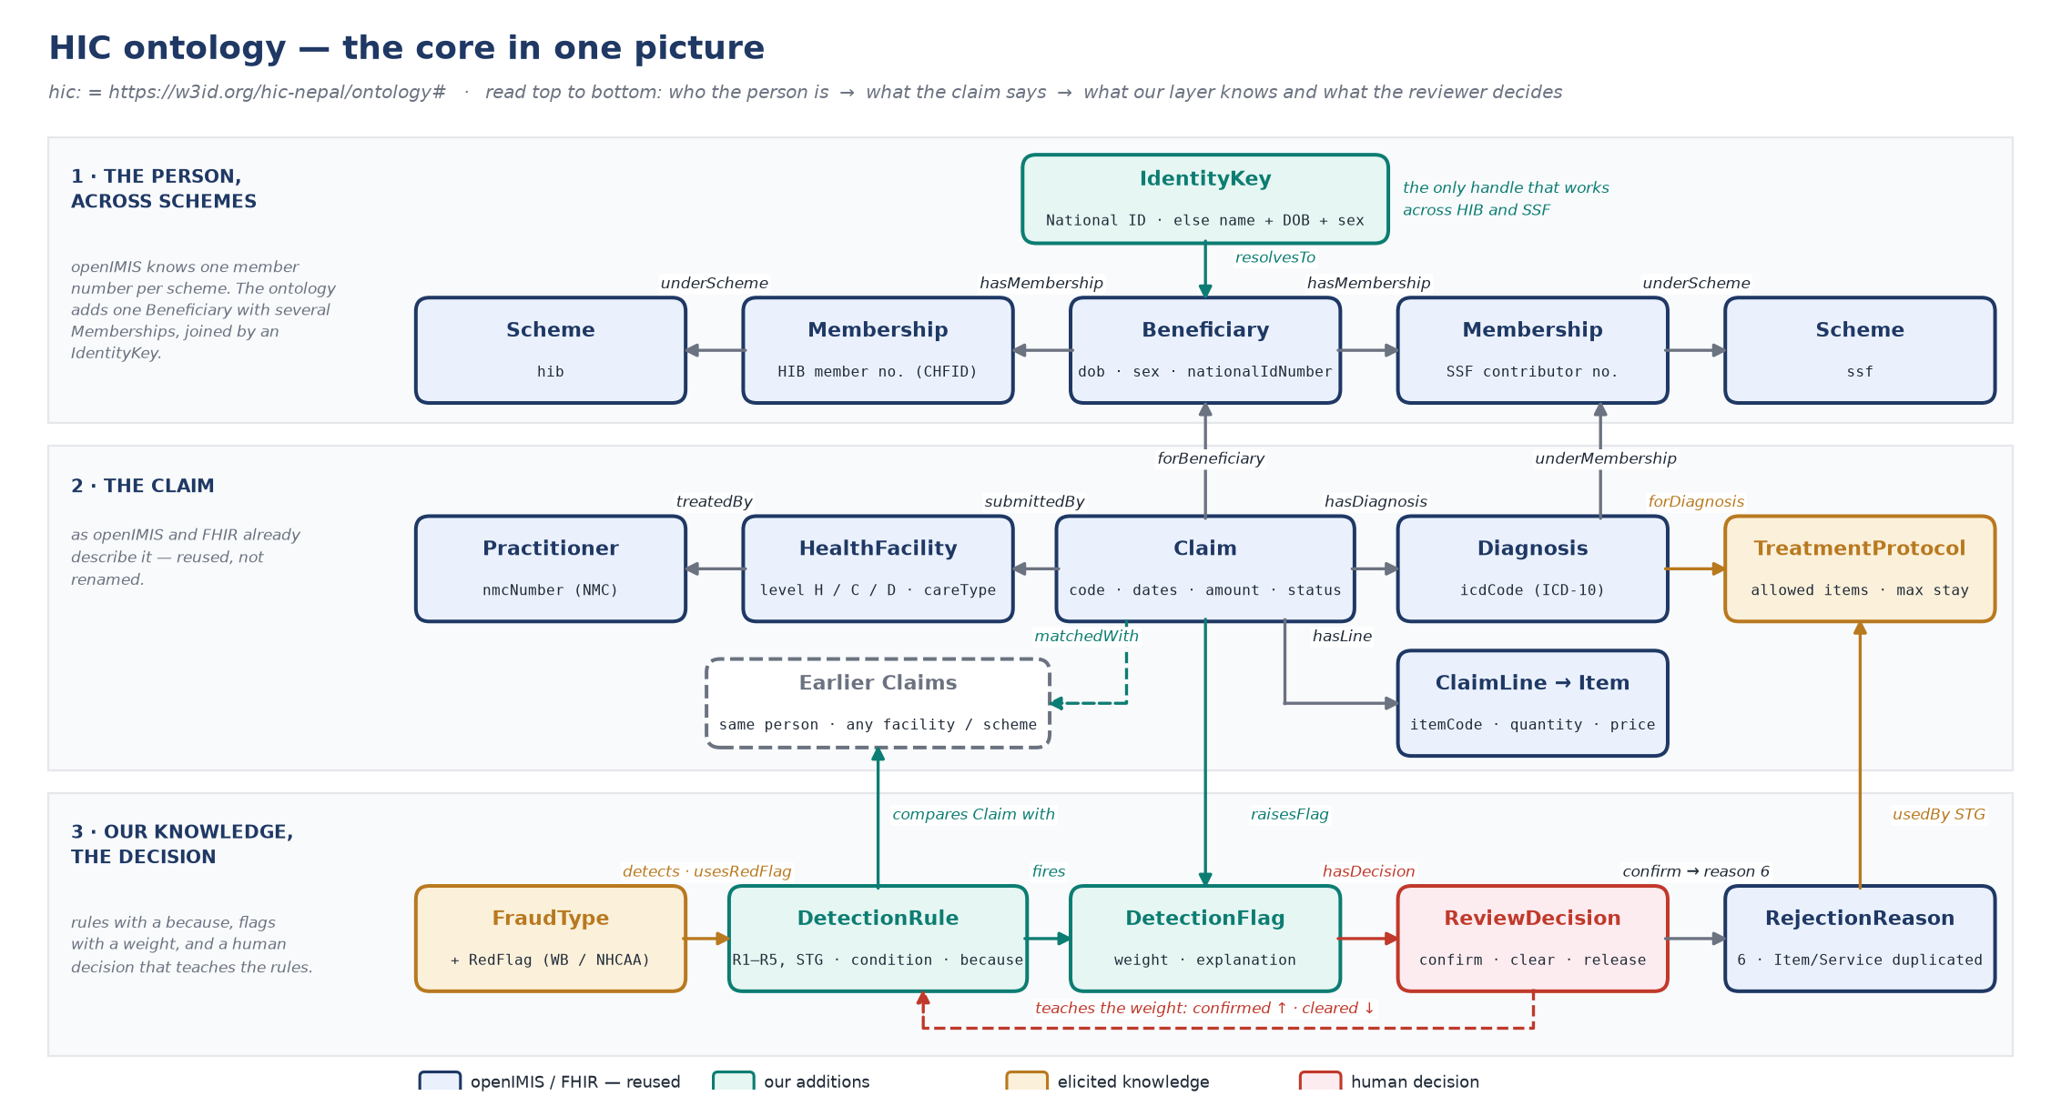
PART 2 · ONTOLOGY · OWL 2 / TURTLE · PREFIX HIC: · 44 CLASSES · 62 PROPERTIES · 697 TRIPLES
The HIC ontology — a person, not a member number
Patient visits hospital
Health facility submits claim
Claim adjudication by HIB / SSF
1 · Journey
2 · Knowledge
3 · Rules & review
4 · Proposal
1
2
3
4
5
6
7
8
9
10
11
12
13
14
Our layer
Identity and cross-claim rules
★ dashed = the hops this study adds (8 · 11 · 12)
• One Beneficiary, several Memberships. openIMIS has no concept of the same person across HIB and SSF. The ontology adds Beneficiary → Membership → Scheme and an IdentityKey: National ID first, else name + date of birth + sex.
• Rules are objects. Each DetectionRule carries a condition, a plain-language because, a weight, the FraudType it detects, the RedFlag it uses and its provenance. That is what makes every flag explainable.
• Everything else is reused. Claim ≡ fhir:Claim; ICD-10 codes; openIMIS statuses and rejection reasons as individuals; World Bank / NHCAA typology.
• Naming standards. UpperCamelCase classes, lowerCamelCase properties, stable rule IDs R1–R5 and STG, every term labelled and defined, SKOS matches to external vocabularies.
Sources: Week 2 ontology sketch (11 concepts) extended; openIMIS data model and FHIR R4 Claim mapping (openIMIS wiki); World Bank (2018) / NHCAA typology; files in Week 3-4/ontology, validated with rdflib and competency questions
openIMIS Nepal — Week 5 · the claim journey, the knowledge base and the proposal
8
Notes:
Presenter: Rijan. Teal boxes are our additions, blue is openIMIS/FHIR-aligned, gold is elicited knowledge. The only cross-scheme handle is IdentityKey.

Slide 12
PART 2 · KNOWLEDGE BASE · WHICH CODES A NEPALI CLAIM ACTUALLY USES
Coding standards — international, HIB & SSF, and Nepali hospitals
Patient visits hospital
Health facility submits claim
Claim adjudication by HIB / SSF
1 · Journey
2 · Knowledge
3 · Rules & review
4 · Proposal
1
2
3
4
5
6
7
8
9
10
11
12
13
14
Hospital · Our layer
Entered in openIMIS
Identity and cross-claim rules
★ dashed = the hops this study adds (8 · 11 · 12)
On the claim | International standard | HIB and SSF today | Nepali hospitals today | In our ontology
The diagnosis | ICD-10 (WHO); ICD-11 successor | ICD-10, up to five codes; never validated | ICD-10 for HMIS and claims; ICD-11 training since Dec 2021 | Diagnosis · icdCode
The treatment | ICHI (WHO) · SNOMED CT | Not used: local price-list codes | Hospital tariff codes mapped to the price list | Service · itemCode
Medicines | ATC / DDD (WHO) | Price-list items; NLEM 2021 as reference | Brand or generic names; NLEM | MedicalItem
Laboratory tests | LOINC | Not used: local codes | Local test names | Service
The patient | National ID | CHFID or SSF number, each scheme its own; National ID for some | Registration number; the scheme card | Beneficiary · IdentityKey
The doctor | NMC registration | NMC number required on the prescription | NMC number on prescriptions | Practitioner · nmcNumber
The claim itself | HL7 FHIR R4 Claim | EMR → openIMIS over FHIR (~70 % of hospitals); SSF ↔ openIMIS over FHIR | FHIR from the EMR, or keyed in | Claim ≡ fhir:Claim
What happens to it | openIMIS statuses, reasons 1–21 | Entered → Checked → Processed → Valuated / Rejected | Notified, resubmits | ClaimStatus · RejectionReason
Pattern: diagnosis, doctor and exchange format are standardised; treatment, tests and medicines are not; and the patient has no identifier both schemes share. The ontology keeps the local codes and records where an international binding would go.
Sources: MoHP / SIL Nepal (Nov 2024) — FHIR R4, ICD-10 / ICD-11 roadmap; openIMIS Nepal and SSF pages; WHO Nepal (Dec 2021); MoHP digital health; DoHS HMIS; NLEM 2021; claim adjudication report (2025); app: Ontology page
openIMIS Nepal — Week 5 · the claim journey, the knowledge base and the proposal
9
Notes:
Presenter: Rijan. This is the Ontology page of the app condensed into one table.

Slide 13
PART 2 · KNOWLEDGE BASE · SYNTHETIC DATA, NO REAL INDIVIDUALS · SEED 42
Synthetic Nepal claim book — parameters and numbers
Patient visits hospital
Health facility submits claim
Claim adjudication by HIB / SSF
1 · Journey
2 · Knowledge
3 · Rules & review
4 · Proposal
1
2
3
4
5
6
7
8
9
10
11
12
13
14
Hospital
Entered in openIMIS
★ dashed = the hops this study adds (8 · 11 · 12)
Parameter | Value | Why
People / claims | 8,037 insurees · 9,786 claims · 14 % inpatient · NPR 37.8 M claimed | Realistic scale for a scale test
Place | 7 provinces, 77 districts, weighted by the 2021 census; 440 facilities incl. 25 real HIB referral hospitals | District hospitals, PHCCs and health posts per district
Names | Romanised Nepali names with spelling variants (e.g. Sharma / Sarma) | Needed for the identity-resolution ceiling
Schemes | HIB family policies (with a lapsed share) · SSF for working-age adults · 654 dual-enrolled | Only dual-enrolled people can commit cross-scheme fraud
Identity | National ID for 60 % of adults (3,475 of 8,037 people); CHFID / SSF numbers always | National ID coverage is partial in reality
Providers | Every facility has a pool of doctors with NMC numbers on each claim | HIB stores the treating doctor's NMC number
Protocols | 24 diagnoses with allowed services and a maximum length of stay; generic inpatient items always allowed | Elicited standard treatment protocol
Fraud injected | 454 claims, 4.6 % (HIB estimate ≈ 5.5 %): within-scheme duplicates, split billing, cross-scheme (incl. 29 hard cases), impossible overlaps, resubmissions, upcodes | Ground truth for precision and recall
Honest look-alikes | Legitimate split visits, repeated dialysis, lapsed policies, off-list items | To measure false positives
Sources: HIB presentation (Apr 2024) — 442 facilities, dual-scheme reality; Ranabhat / Ghimire (2022-23) — fraud about 5.5 %; openIMIS PR #214; generator Week 3-4/synthetic_data/nepal_synthetic_claims.py
openIMIS Nepal — Week 5 · the claim journey, the knowledge base and the proposal
10
Notes:
Presenter: Rijan, hand-over to Milan. The important design choice: ground truth on every claim, so the layer scores itself.

Slide 14
Part 3 · Milan Maharjan
Reviewers, rules and failed cases — the rule catalog, the ranked queue, a worked example, where it fails, and the learning loop
Patient visits hospital
Health facility submits claim
Claim adjudication by HIB / SSF
1 · Journey
2 · Knowledge
3 · Rules & review
4 · Proposal
1
2
3
4
5
6
7
8
9
10
11
12
13
14
Our layer · Medical Officers
Membership verification
Hospital card and care
Nothing paid at the counter
Claim document
Entered in openIMIS
Facility check and submission
System verification
Identity and cross-claim rules
Completeness check
Benefit package check
Ranked review queue
Reviewer decision
Settlement recommended
Approval and payment
★ dashed = the hops this study adds (8 · 11 · 12)
openIMIS Nepal — Week 5 · the claim journey, the knowledge base and the proposal
Notes:
Milan. The rules are the Week 2 catalog made executable; the failures are the honest part.

Slide 15
PART 3 · FROM THE WEEK 2 CATALOG TO EXECUTABLE RULES
The rule catalog — six rules with an if, a because and a weight
Patient visits hospital
Health facility submits claim
Claim adjudication by HIB / SSF
1 · Journey
2 · Knowledge
3 · Rules & review
4 · Proposal
1
2
3
4
5
6
7
8
9
10
11
12
13
14
Our layer
Identity and cross-claim rules
★ dashed = the hops this study adds (8 · 11 · 12)
Rule | If | Because | Weight | Fired | Precision
R1 Within-scheme duplicate | same person · same scheme · same date · a shared service | one service cannot be billed twice | high +3 | 141 | 93 %
R2 Split billing (vault) | same person · same facility · same visit date · different lines | one episode possibly split into two claims | medium +2 | 108 | 79 %
R3 Cross-scheme duplicate | same identity key · different scheme · dates within ±2 days · same diagnosis or a shared service | HIB and SSF do not see each other | high +3 | 72 | 96 %
R4 Impossible overlap | two inpatient stays · different facilities · overlapping dates | nobody is admitted in two places at once | high +3 | 36 | 100 %
R5 Resubmission gaming | an earlier rejected claim · same diagnosis · within 7 days · codes changed | the claim is re-shaped to slip past the edit | medium +2 | 50 | 98 %
STG Off-protocol treatment | a service outside the protocol for the diagnosis, or a stay above its maximum | the diagnosis does not warrant the service | medium +2 | 71 | 100 %
Scoring: identity key → claim history across facilities and schemes → rules → suspicion = sum of weights → ranked queue. A flag never rejects; it puts the claim in front of a Medical Officer with the reason. Parameters: R3 window ±2 days, R5 look-back 7 days, quantity cap 30, reviewer budget 5 %.
Sources: Week 2 rule catalog (WEEK2_rule_catalog); World Bank (2018) / NHCAA fraud typology; HIB expert interview (2025) — vault, protocol; app: Rules page; counts on the 9,786-claim book
openIMIS Nepal — Week 5 · the claim journey, the knowledge base and the proposal
11
Notes:
Presenter: Milan. The 'because' column is what the reviewer reads. R2 has the lowest precision on purpose: honest split visits look the same, and the reviewer clears them.

Slide 16
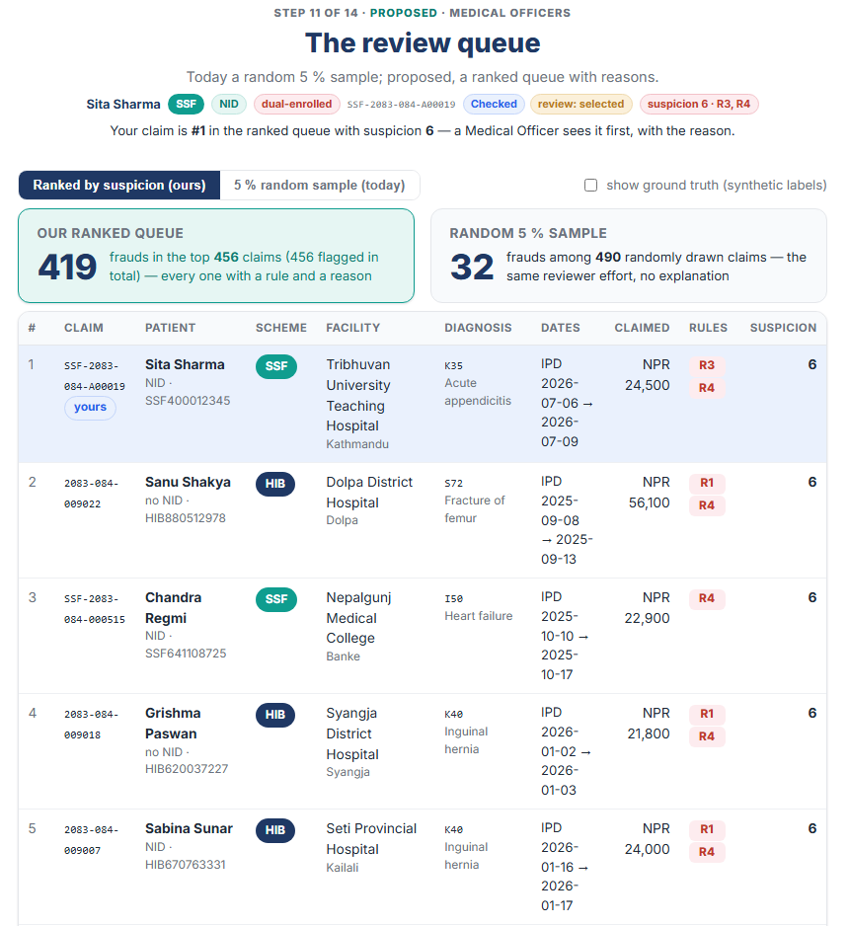
PART 3 · HOP 11 · MEDICAL OFFICERS
The reviewer's queue — ranked with reasons instead of a random sample
Patient visits hospital
Health facility submits claim
Claim adjudication by HIB / SSF
1 · Journey
2 · Knowledge
3 · Rules & review
4 · Proposal
1
2
3
4
5
6
7
8
9
10
11
12
13
14
Medical Officers
Ranked review queue
★ dashed = the hops this study adds (8 · 11 · 12)
418
17–32
frauds in our ranked queue
frauds in a random 5 % sample
Same reviewer effort, about 489 claims
• Every row carries its rules and a reason the reviewer opens the claim already knowing what to look at.
• Suspicion orders the queue. R3 + R4 together score 6; a lone R2 scores 2 and sits at the bottom.
• Random sampling stays as a control and for claims that carry no flag: today's 1-in-20 chance is kept as a toggle in the app.
• Ground truth can be shown for the synthetic book, to check the queue live during a demo.
Sources: HIB presentation (Apr 2024) — 26 reviewers for about 50,000 claims a day; HIB expert interview (2025) — random sampling; app: Journey step 11. Random draw varies with the seed: 17 in the evaluation run, 32 in the app's live draw.
openIMIS Nepal — Week 5 · the claim journey, the knowledge base and the proposal
12
Notes:
Presenter: Milan. Live demo option: switch the toggle between 'ranked' and '5 % random' in the app.

Slide 17
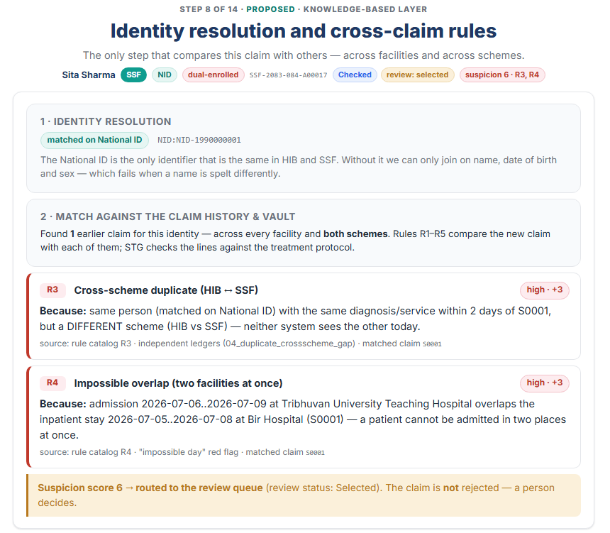
PART 3 · HOP 8 AND HOP 12 · THE CROSS-SCHEME SCENARIO
Worked example — one appendectomy, two schemes, two hospitals
Patient visits hospital
Health facility submits claim
Claim adjudication by HIB / SSF
1 · Journey
2 · Knowledge
3 · Rules & review
4 · Proposal
1
2
3
4
5
6
7
8
9
10
11
12
13
14
Our layer · Medical Officers
Identity and cross-claim rules
Reviewer decision
★ dashed = the hops this study adds (8 · 11 · 12)
What the layer says, in the reviewer's words
• Identity. Sita Sharma matched on National ID NID-1990000001: HIB member HIB900000011 and SSF contributor SSF400012345.
• History. One earlier claim, HIB, Bir Hospital, K35 acute appendicitis, 5–8 July, NPR 26,300, status Checked.
• R3 fires (+3): same person, same diagnosis within 2 days, different scheme. Neither system sees the other today.
• R4 fires (+3): admission 6–9 July at TUTH overlaps the stay 5–8 July at Bir Hospital.
• Suspicion 6 → review status Selected. The claim is not rejected: a Medical Officer decides.
• Decision. Confirm records rejection reason 6 'Item/Service duplicated' and the linked claim as evidence; clear or release teach the rules the other way.
Sources: the HIB ↔ SSF silo (HIB / GIZ, Apr 2024); Week 2 sample rule — same beneficiary + service + overlapping dates + different payer; app: Journey steps 8 and 12, scenario 'Cross-scheme duplicate (HIB → SSF)'
openIMIS Nepal — Week 5 · the claim journey, the knowledge base and the proposal
13
Notes:
Presenter: Milan. Read the two 'because' sentences aloud: that is the explainability requirement met.

Slide 18
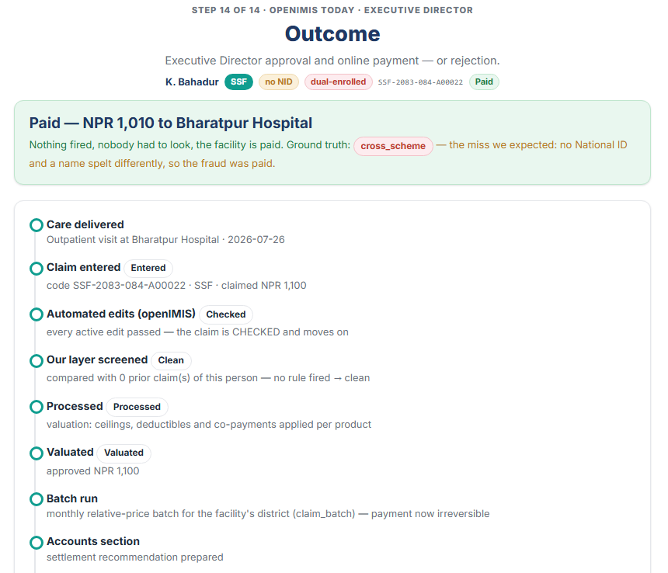
PART 3 · FAILED AND HARD CASES ON THE SYNTHETIC BOOK
Where it fails — recall by fraud type and the hard cases
Patient visits hospital
Health facility submits claim
Claim adjudication by HIB / SSF
1 · Journey
2 · Knowledge
3 · Rules & review
4 · Proposal
1
2
3
4
5
6
7
8
9
10
11
12
13
14
Our layer · Exec. Director
Identity and cross-claim rules
Approval and payment
★ dashed = the hops this study adds (8 · 11 · 12)
Fraud type | Planted | Caught | Recall | What happens
Within-scheme duplicate | 124 | 124 | 100 % | R1
Same-episode split billing | 83 | 83 | 100 % | R2, but 23 honest splits are flagged too
Resubmission after rejection | 49 | 49 | 100 % | R5
Impossible overlap | 33 | 31 | 94 % | 2 missed when the identity key differs
Cross-scheme duplicate | 70 | 68 | 97 % | R3 on National ID or composite key
Off-protocol upcode | 66 | 63 | 95 % | STG; 3 use only allowed codes
Cross-scheme, hard: no National ID + name spelt differently | 29 | 0 | 0 % | Paid. The composite key cannot join Sarma and Sharma
Three honest failures. The hard cross-scheme case is the identity ceiling and the argument for National-ID linkage. R2's false positives are the price of catching split billing, and the reviewer clears them. STG over-fired at first (34 % precision) until the protocols learned that generic inpatient items are always allowed.
The lapsed-policy scenario is caught by the existing engine at hop 7 (reason 21 no coverage) before our layer runs: the two engines are complementary, not competing. Overall on the book: 91.9 % precision, 92.1 % recall, 37 false positives, 36 misses.
Sources: Week 3-4 report §9 (the C018 miss); synthetic_data/out/RESULTS.md; app: Journey, scenario 'the hard case we miss', and Dashboard, recall by fraud type
openIMIS Nepal — Week 5 · the claim journey, the knowledge base and the proposal
14
Notes:
Presenter: Milan, hand-over to Biwash. Be explicit that the 0 % row is by construction: we planted cases we knew the composite key could not join.

Slide 19
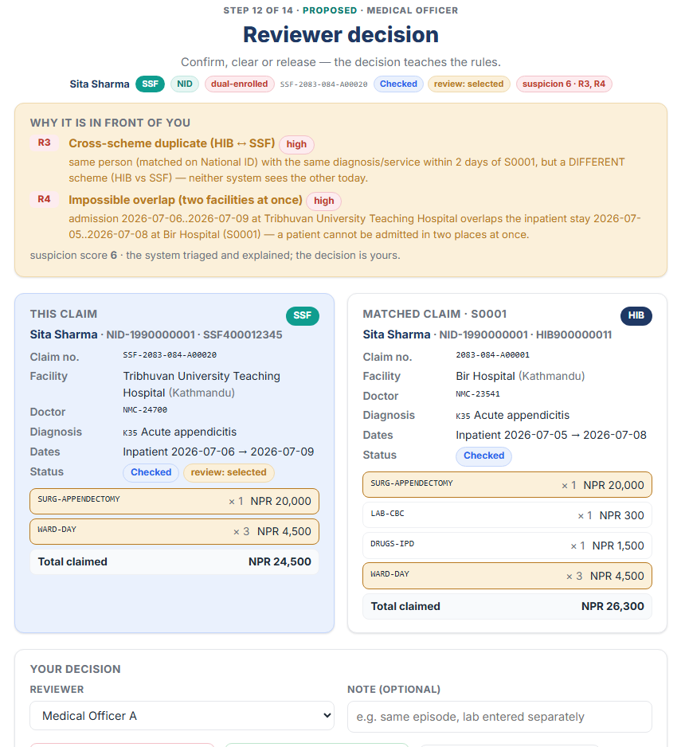
PART 3 · HOP 12 · CAPTURING TACIT KNOWLEDGE BY DECISION
The learning loop — reviewers teach the rules: confirm, clear, release
Patient visits hospital
Health facility submits claim
Claim adjudication by HIB / SSF
1 · Journey
2 · Knowledge
3 · Rules & review
4 · Proposal
1
2
3
4
5
6
7
8
9
10
11
12
13
14
Medical Officers
Reviewer decision
★ dashed = the hops this study adds (8 · 11 · 12)
Capturing the experts' own logic
• Confirm. The flag was right: rejection reason 6, the linked claim stays as evidence, the rule's weight goes up.
• Clear. A person looked and let it through: the rule is a little less sure of itself next time.
• Release. Pay, but keep the flag on record for the facility's profile.
• Every decision is stored against the rules that fired with a note. The dashboard counts confirmed, cleared and released per rule; automatic re-weighting is the next build step.
• This is how 'experts use their own logic' becomes knowledge the study can keep: elicitation by decision, not by interview alone.
Sources: Week 2 — why reviewer knowledge is tacit (Polanyi 1966; Shadbolt & Smart 2015) and the elicitation method; app: Journey step 12 and the Dashboard learning-loop table
openIMIS Nepal — Week 5 · the claim journey, the knowledge base and the proposal
15
Notes:
Presenter: Milan. The decision panel compares the new claim with the matched claim side by side, which is the reviewer's actual task.

Slide 20
Part 4 · Biwash Budhathoki
Proposed solution — an additive layer inside openIMIS, what other countries do, how accuracy improves, and future work
Patient visits hospital
Health facility submits claim
Claim adjudication by HIB / SSF
1 · Journey
2 · Knowledge
3 · Rules & review
4 · Proposal
1
2
3
4
5
6
7
8
9
10
11
12
13
14
Our layer · Medical Officers
Membership verification
Hospital card and care
Nothing paid at the counter
Claim document
Entered in openIMIS
Facility check and submission
System verification
Identity and cross-claim rules
Completeness check
Benefit package check
Ranked review queue
Reviewer decision
Settlement recommended
Approval and payment
★ dashed = the hops this study adds (8 · 11 · 12)
openIMIS Nepal — Week 5 · the claim journey, the knowledge base and the proposal
Notes:
Biwash. Architecture, a short comparison, the evidence, the next steps, then the references.

Slide 21
PART 4 · A REAL-LIFE DESIGN FOR HIB AND SSF
Proposed solution — an additive knowledge layer inside openIMIS
Patient visits hospital
Health facility submits claim
Claim adjudication by HIB / SSF
1 · Journey
2 · Knowledge
3 · Rules & review
4 · Proposal
1
2
3
4
5
6
7
8
9
10
11
12
13
14
Our layer · Medical Officers
Identity and cross-claim rules
Ranked review queue
Reviewer decision
★ dashed = the hops this study adds (8 · 11 · 12)
Hospital EMR / openIMIS UI
★ Hook after submit
★ Identity index
★ Rule base
FHIR R4 Claim or manual entry → enter_and_submit → validate_claim (Engine 1, unchanged)
Same pattern as claim_ai_quality: bind to claim.enter_and_submit, run after the edits, write results to Claim.json_ext['fraud'] and set review status Selected
National ID first, else name + DOB + sex; one index over both schemes' claim history (the 'vault')
R1–R5 + STG as ontology individuals with weights; protocols and price list as reference data
openIMIS reviewer UI
★ Ranked queue
★ Decision feedback
extFields renders json_ext columns: rules, suspicion, because; 'Item/Service duplicated' (6) already exists as a reason
Replaces random.shuffle in claim_sampling with suspicion order; keeps a random slice as control
confirm / clear / release stored against the rules that fired → weights; audit trail with provenance for every flag
Why additive: no change to openIMIS's own edits, statuses or payment; deployable per scheme first (within-scheme rules R1, R2, R4, R5, STG), and cross-scheme R3 as soon as both schemes expose a shared identity index. Cross-scheme prerequisite: National-ID capture at enrolment and a data-sharing agreement between HIB and SSF, or a neutral matching service.
Rollout: 1 within-scheme module at HIB (R1, R2, R4, R5, STG) → 2 ranked queue for Medical Officers → 3 National-ID capture and the shared identity index → 4 cross-scheme R3 with SSF.
Sources: Week 1 recommendation — National-ID-keyed cross-scheme check (HIB, Apr 2024); openimis-be-claim_ai_quality_py as the integration pattern; openIMIS wiki — AI-based claim adjudication; blueprint Week 3-4/repos/REPOS.md §10
openIMIS Nepal — Week 5 · the claim journey, the knowledge base and the proposal
16
Notes:
Presenter: Biwash. Teal boxes are new; white boxes exist today. The whole layer can be a Django module like claim_ai_quality.

Slide 22
PART 4 · COMPARISON, SHORT · CONTINUES THE WEEK 2 REVIEW
How other countries detect fraud — and what we borrow
Patient visits hospital
Health facility submits claim
Claim adjudication by HIB / SSF
1 · Journey
2 · Knowledge
3 · Rules & review
4 · Proposal
1
2
3
4
5
6
7
8
9
10
11
12
13
14
Our layer · Medical Officers
Identity and cross-claim rules
Ranked review queue
★ dashed = the hops this study adds (8 · 11 · 12)
System | What they do | Result reported | What we borrow
South Korea, HIRA | Single payer; 99 % electronic claims; automatic error checks at the gateway, then electronic review criteria, then expert review | Gateway returns 2.7 % inpatient claims as unreviewable; review support flags 23 % multi-error inpatient claims | Layered review: automatic edits → knowledge rules → expert; explanations for the expert
Taiwan, NHI | Single payer; fully automated submission and examination; IC card; real-time linkage against duplicate services | Administrative cost about 1 % of medical spend; claims filed within 24 h | One identity across all providers; near-real-time checks before payment
India, PM-JAY | National anti-fraud unit, analytics on claims, provider profiling | Documented anti-fraud toolkit for a large scheme | Fraud typology; provider-level features (NMC number, facility profile)
openIMIS AI claims module | Per-item classifier in the review step, 80,000+ claims a day in Nepal's pilot | Complements manual review | The hook point and json_ext pattern; our rules explain where a classifier cannot
Caveat. Korea and Taiwan are single-payer, near-universal, one-dataset systems. Nepal has two payers and partial National-ID coverage, so the transferable lesson is not 'one system' but one identity and checks before payment, which is exactly what hops 8 and 11 add.
Sources: HIRA (South Korea) — claim review using IT; Taiwan NHI / MOHW; National Health Authority (India) anti-fraud framework and guidebook (Sep 2024); World Bank SHI study (2018); claim adjudication report (2025) refs 22, 62, 67–73; openIMIS AI claims solution
openIMIS Nepal — Week 5 · the claim journey, the knowledge base and the proposal
17
Notes:
Presenter: Biwash. Keep this short: one line per country, then the caveat.

Slide 23
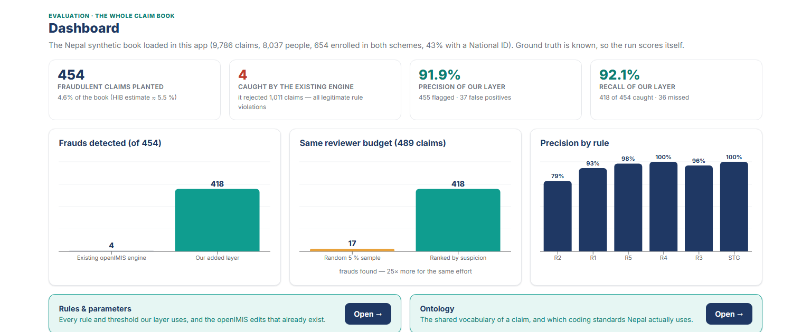
PART 4 · 9,786 CLAIMS · 454 PLANTED FRAUDS · SAME REVIEWER BUDGET AS TODAY'S 5 % SAMPLE
Accuracy in claim verification — evidence on the synthetic book
Patient visits hospital
Health facility submits claim
Claim adjudication by HIB / SSF
1 · Journey
2 · Knowledge
3 · Rules & review
4 · Proposal
1
2
3
4
5
6
7
8
9
10
11
12
13
14
Our layer · Medical Officers
Identity and cross-claim rules
Ranked review queue
Reviewer decision
★ dashed = the hops this study adds (8 · 11 · 12)
4 → 418
91.9 %
92.1 %
≈ 15×
frauds caught: existing engine → with our layer
precision (37 false positives)
recall (36 missed, 29 of them the hard cases)
more fraud per reviewer hour than the random 5 % sample
What changes for HIB and SSF
• Before payment, not after. Flags arrive between system verification and settlement, while a correction is still cheap.
• Reviewers see fewer, better claims. The same 5 % budget covers the claims that matter, each with a reason.
• Rejections become explainable. Reason 6 with the linked claim; reason 8's job done by the STG rule.
• Evidence for policy. The 0 % hard cases quantify what National-ID linkage would buy.
• Limits. Synthetic data; real recall depends on National-ID coverage and name quality; protocols need clinical validation.
Sources: Week 1 metric — share of claims safely triaged with a correct justification; Week 2 evaluation plan — precision@N and false-positive rate; app: Dashboard; synthetic_data/out/RESULTS.md
openIMIS Nepal — Week 5 · the claim journey, the knowledge base and the proposal
18
Notes:
Presenter: Biwash. Say clearly: these are synthetic numbers; the method is what we validated, and the next step is real HIB data.

Slide 24
PART 4 · FROM THE WEEK 2 ACCESS PLAN TO A PILOT
Future work — next steps, in order
Patient visits hospital
Health facility submits claim
Claim adjudication by HIB / SSF
1 · Journey
2 · Knowledge
3 · Rules & review
4 · Proposal
1
2
3
4
5
6
7
8
9
10
11
12
13
14
Exec. Director
Approval and payment
★ dashed = the hops this study adds (8 · 11 · 12)
# | Next step | Why | Hop
1 | Probabilistic identity matching: name normalisation, transliteration variants, date-of-birth tolerance; then National-ID linkage between HIB and SSF | The only cause of the 0 % hard cases | 8
2 | Validate the treatment protocols with clinicians and bind services to ICHI | STG precision depends on protocol quality | 8
3 | Automatic re-weighting of rules from reviewer decisions (confirm / clear / release) | Turns elicitation-by-decision into learning | 12
4 | Pilot as an openIMIS module on real HIB data with Medical Officers | Synthetic numbers must be confirmed on real claims | 8 · 11 · 12
5 | Provider profiling: facility- and doctor-level features (NMC number) and R6 for repeat offenders | Fraud is concentrated in a few providers | 8
6 | Devanagari names and the Nepali UI; SSF claim-vault synchronisation | Deployment realities | 5 · 8
In one sentence: openIMIS already checks every claim; nobody checks the person. A knowledge-based layer that knows who the person is, remembers their claims across facilities and schemes, and explains its suspicion to a reviewer turns a random 5 % sample into a ranked, explainable review, before the money leaves.
Sources: Week 2 access plan (Track A proxy experts, Track B NHRC ethics + university letter to HIB via GIZ); Week 3-4 report §10; everything shown runs locally from Week 3-4/mvp
openIMIS Nepal — Week 5 · the claim journey, the knowledge base and the proposal
19
Notes:
Presenter: Biwash. Close with the one-sentence summary and open for questions.

Slide 25
PART 4 · CARRIED OVER FROM THE WEEK 1 AND WEEK 2 DECKS, EXTENDED IN WEEKS 3–5
References (1 of 2) — Nepal, openIMIS and the case-study sources
Patient visits hospital
Health facility submits claim
Claim adjudication by HIB / SSF
1 · Journey
2 · Knowledge
3 · Rules & review
4 · Proposal
1
2
3
4
5
6
7
8
9
10
11
12
13
14
★ dashed = the hops this study adds (8 · 11 · 12)
1. HIB — 'openIMIS: an Implementation Experience in Nepal', Dr. Radhika Thapaliya et al., Health Insurance Board, AeHIN Hour, 11 Aug 2020 (presentation).
2. HIB, SSF and GIZ — 'Status of openIMIS in Nepal', Kalu Singh Karki (HIB), Dr. Roshan Koju (SSF), GIZ, AeHIN Hour, 30 Apr 2024 (presentation): scale, claim flow, ED approval, 26 reviewers, SSF mechanisms, HIB ↔ SSF silo, National-ID linkage.
3. MoHP / SIL Nepal — 'Updates on Standards and Interoperability in Nepal', Ramesh Raj Subedi and Sanjaya Poudel, AeHIN Hour 327, 27 Nov 2024: 180+ EMRs, FHIR R4, ICD-10 / ICD-11 roadmap.
4. HIB — Workflow for Claim Processing (three lanes), HIB presentation, 2025; HIB domain-expert interview notes, 2025 (existing rule engine, random sampling, SSF schemes, claim vault, standard treatment protocol).
5. openIMIS Initiative — Nepal Health Insurance page; AI Claims Solution; demo server; openIMIS wiki: FHIR R4 Claim mapping, Claim module scope, Improved Claims Review, AI-based Claim Adjudication (accessed Jul–Sep 2026).
6. openIMIS GitHub organisation — openimis-be-claim_py (validations.py), claim_sampling_py, claim_ai_quality_py, fhir_py, frontend claim module; PR #214 synthetic-data generator (merged 15 Jul 2026).
7. Government of Nepal — National Health Insurance Policy 2014; Health Insurance Act 2017; Health Insurance Regulation 2019. MoHP — IHIMS Roadmap 2023–2030; National Digital Health Blueprint.
8. Ranabhat et al. / Ghimire et al. — Evaluation of Nepal's National Health Insurance Program, Health Research Policy & Systems (2022/2023); PMC9862822 (fraud about 5.5 %; 25–30k claims a day).
9. Katmandu Journal — Nepal's health-insurance scheme running out of money and trust, 13 Jan 2026 (20–27 % rejection; backlog); Himalayan Times analysis (Mar 2026); GoN FY 2082/83 health policy.
10. World Bank — openIMIS in Nepal (2025); WHO — Global Monitoring Report on UHC (2019); Mills, A. — Health care systems in low- and middle-income countries, NEJM 2014;370:552-7.
openIMIS Nepal — Week 5 · the claim journey, the knowledge base and the proposal
20
Notes:
References, cited by organisation and date. Slides never cite recordings; the presentations are cited as the organisation's presentation on its date.

Slide 26
PART 4 · CARRIED OVER FROM THE WEEK 2 DEEP-DIVE, EXTENDED IN WEEKS 3–5
References (2 of 2) — fraud, country systems, knowledge engineering and standards
Patient visits hospital
Health facility submits claim
Claim adjudication by HIB / SSF
1 · Journey
2 · Knowledge
3 · Rules & review
4 · Proposal
1
2
3
4
5
6
7
8
9
10
11
12
13
14
★ dashed = the hops this study adds (8 · 11 · 12)
11. NHCAA — The Challenge of Health Care Fraud (3–10 % of US spending). World Bank — Preventing, Detecting and Deterring Fraud in Social Health Insurance Programs (HNP Discussion Paper, Nov 2018). EHFCN — Waste Typology Matrix (2014); CMS — Fraud, Waste & Abuse; NCCI / MUE.
12. National Health Authority (India) — Anti-Fraud Framework & Practitioners' Guidebook (Sep 2024); PM-JAY penalty / de-empanelment data (FY 2025-26). GKV-Spitzenverband (Germany) — §197a SGB V fraud-unit reports.
13. HIRA (South Korea) — Health Insurance Claim Review Using IT; 'What we do'; Kwon S., Case study: Republic of Korea, WHO Kobe Centre; Kim J.A. et al., J Korean Med Sci (2017). Taiwan NHI / MOHW — automated claims examination; ML fraud-detection studies.
14. NHSO Thailand — strategic purchasing and e-claim audit (PLOS Global Public Health, 2023); RSSB Rwanda — CBHI and RHIP (2020); PhilHealth 'ghost dialysis' coverage (2019).
15. Gee, J. & Button, M. — The Financial Cost of Healthcare Fraud 2014/15, University of Portsmouth. CMS — Fraud Prevention System reports to Congress (2012–2015).
16. Polanyi, M. — The Tacit Dimension (1966). Cooke, N. J. — Varieties of Knowledge Elicitation Techniques, IJHCS (1994). Shadbolt, N. & Smart, P. — Knowledge Elicitation: Methods, Tools and Techniques (2015). Hoffman, Crandall & Shadbolt — CDM, Human Factors (1998).
17. Ericsson & Simon — Protocol Analysis (1984/1993). Schreiber et al. — CommonKADS (2000). ISO 704 / OBO Foundry / W3C — naming and ontology conventions (surveyed in Week 3-4/ontology/01).
18. WHO — ICD-10, ICD-11, ICHI; WHO Nepal — medical recorders trained on ICD-11 (15 Dec 2021); MoHP Digital Health — the transition from ICD-10 to ICD-11; HL7 — FHIR R4; LOINC; SNOMED International; ATC / DDD; ISO 3166-2:NP; DoHS — HMIS portal (DHIS2); PLOS One (2024) on DHIS2 data quality; NLEM Nepal 2021 (6th revision).
19. Health-insurance claim adjudication report with references (project document, 2025): HIB rejection causes, benefit package, co-payment, FHIR uptake, SSF share of openIMIS claims, country comparison (refs 22, 62, 67–78).
20. Team documents — Week 1 report and deck; Week 2 fraud deep-dive, rule catalog and deck; Week 3-4 report, deck, knowledge base, prototype, synthetic data, ontology and the Claim Journey web app.
openIMIS Nepal — Week 5 · the claim journey, the knowledge base and the proposal
21
Notes:
References, cited by organisation and date. Slides never cite recordings; the presentations are cited as the organisation's presentation on its date.

Slide 27
Patient visits hospital
Health facility submits claim
Claim adjudication by HIB / SSF
1 · Journey
2 · Knowledge
3 · Rules & review
4 · Proposal
1
2
3
4
5
6
7
8
9
10
11
12
13
14
Our layer · Medical Officers
Identity and cross-claim rules
Ranked review queue
Reviewer decision
★ dashed = the hops this study adds (8 · 11 · 12)
THANK YOU · QUESTIONS WELCOME
openIMIS already checks each claim on its own — our layer catches what only appears when you compare claims across facilities and schemes
Part 1 · The claim journey
Part 2 · Knowledge
Part 3 · Rules & review
Part 4 · Proposed solution
HIB's 14 hops; nobody compares a claim with the person's other claims
HIC ontology, Nepal's coding standards, a labelled synthetic claim book
six explainable rules, a ranked queue, honest failures
an additive openIMIS module; one identity, checks before payment
Grishma Rijal · Rijan Ghimire · Milan Maharjan · Biwash Budhathoki
Week 5 · Demo: Week 3-4/mvp → npm run dev → http://localhost:5173 · deep links /?scenario=cross_scheme&step=7 · /?scenario=cross_hard&step=13
Notes:
Closing. Offer the live demo: the cross-scheme scenario at step 8, and the hard case at step 14.

