Slide 1
HAND GESTURE RECOGNITION
Parangat Narsingh Pradhan (2018009122)
Rijesh Shrestha (2018011897)
CSE-D, G-1

Slide 2
HAND GESTURE RECOGNITON ??
Hand Gesture Recognition in simple terms is a way of human computer interaction.
Gesture provided by humans as an input acts as a way for computers to understand human language.

Slide 3
PROS OF HAND GESTURE RECOGNITION
No physical contact needed with the computer.
Physically challenged people will also be able to use it.
Communicating at a certain distance is possible.
Replacement of Mouse and Keyboard.

Slide 4
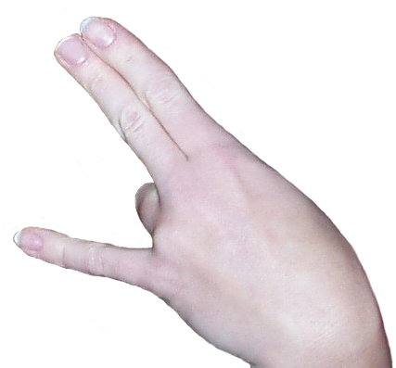
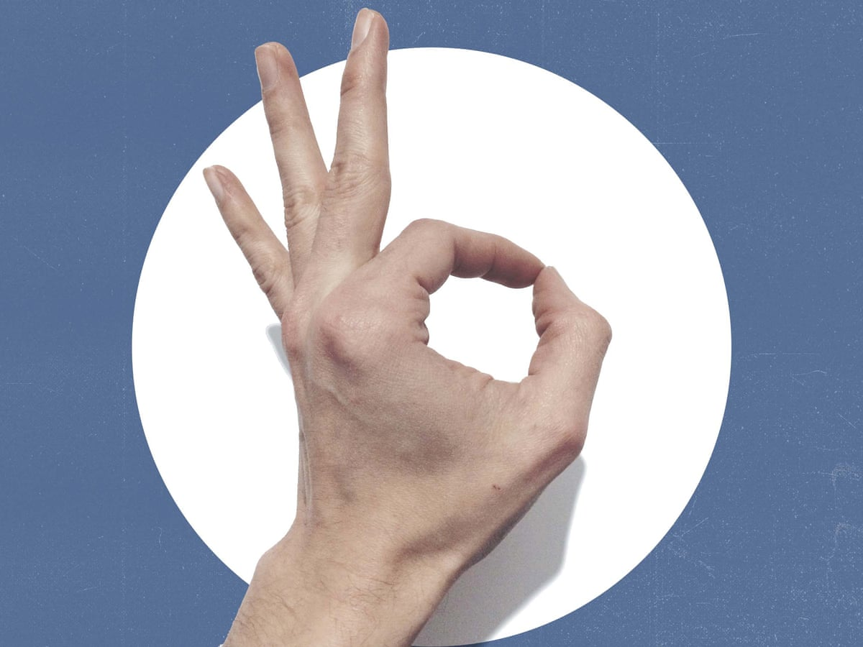
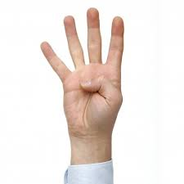

EXAMPLES OF HAND GESTURES

Slide 5
How hand gesture recognition works
Various gestures are given to the computer as input.
These gestures are then converted into commands and perform the related task.
Then the system is trained for identifying the various gestures given by the user.

Slide 6
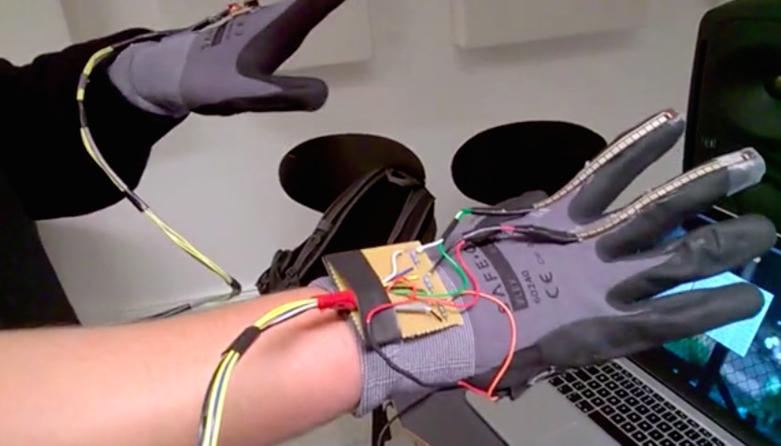
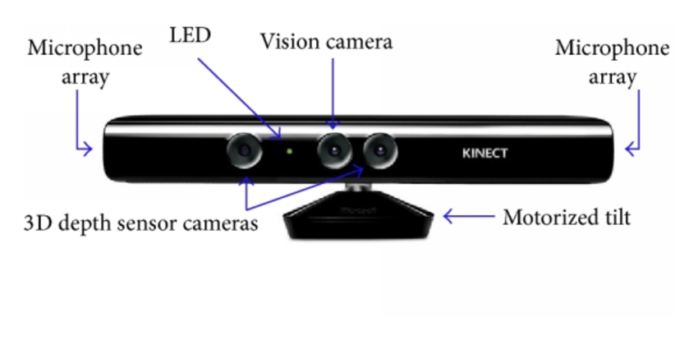
HOW OTHERS HAVE TRIED SOLVING THE PROBLEM
Using glove consisting of Ardunino and flexible potentiometers.
Using Microsoft Kinect sensor.
Using Convolutional Neural Network.

Slide 7
setup
The setup consists of a single camera to capture the gesture formed by the user and takes the hand input image as an input to proposed algorithm.

Slide 8
APPROACH USED
Here the recognition of sign language tells the corresponding sign language using Contour Analysis and Feature Extraction Technique.
CONVEX HULL: Given a set of points in the plane. The convex hull of the set is the smallest Convex polygon that contains all the points oof it.
CONVEXITY DEFECTS: Convexity Defect is a cavity in an object segmented out from an image.

Slide 9
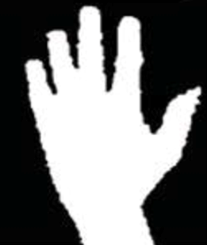
PROCESS
STEP 1:
Creation of image threshold. Isolating the foreground from the background is essential as we want the hand to be the region of interest.

Slide 10
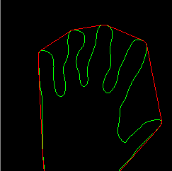
STEP 2:
Finding contours. The hand is identified using an inbuilt function that finds Contours which OpenCV provides. The function is later then returns an array of coordinates of the formation of the contour.

Slide 11
STEP 3:
Convex hull and convexity defects. The data obtained from the Contour's is later used to obtain entity known as "Convexity Defects". They are the irregularities in contours. Based on the value of this, we can identify how many fingers are present. This is valuable information as it provides information to which letter is corresponding.
CALCULATION:
We compute a triangle. Let the sides be "a", "b" and "c". This triangle is formed by the starting point of the contour, the ending point of the contour and the farthest point of the contour. (a,b,c respectively). "a" is computed as follows
a=math.sqrt((end[0])**2+(end[1]-start[1]0**2)[7]
Similarly b and c are also calculated.

Slide 12
Challenges faced
Background removal
Lighting conditions
Comparison time

Slide 13
Thank you

