Slide 1

Introduction to Software Engineering for Engineers
Milestone presentation – Advanced Prototype

Slide 2

Agenda
Design Pattern
Coding conventions
Specify Context of Use
Design solution
Summary of changes

Slide 3
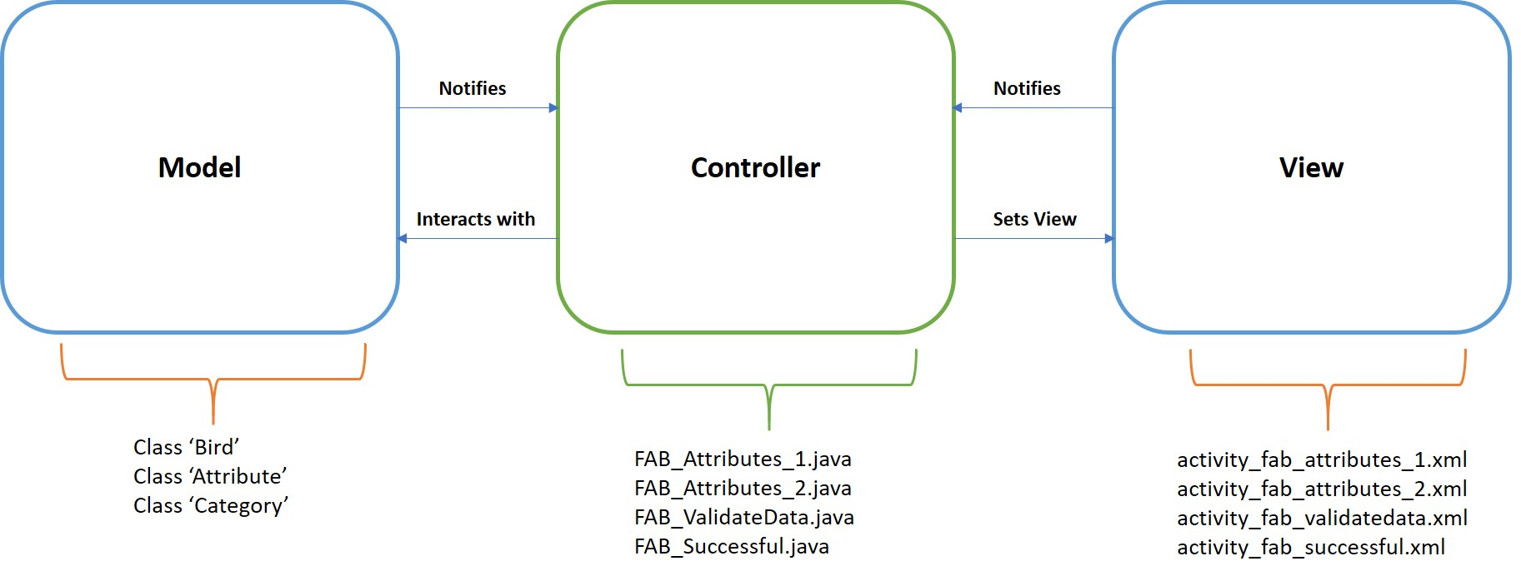
Design Pattern

Slide 4
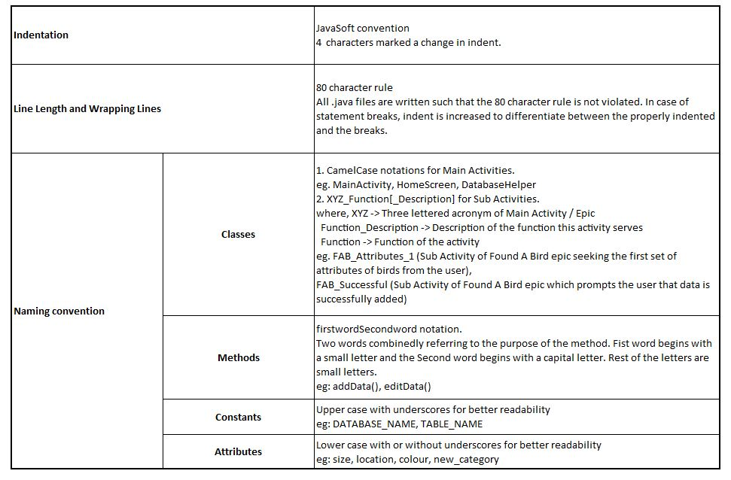
Coding Conventions

Slide 5
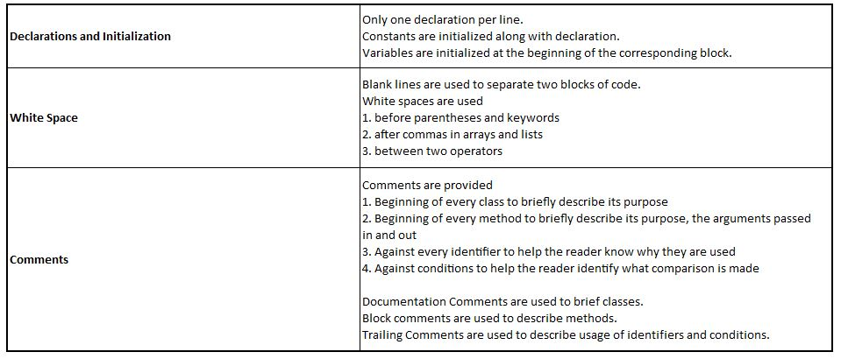
Coding Conventions

Slide 6
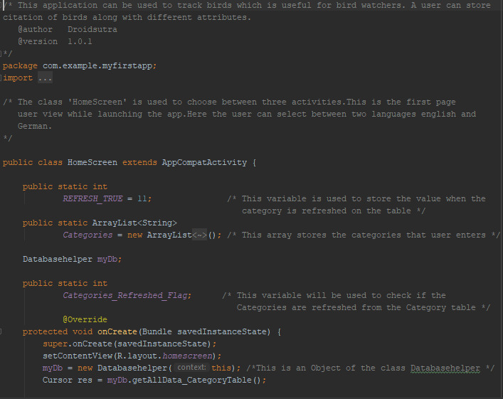
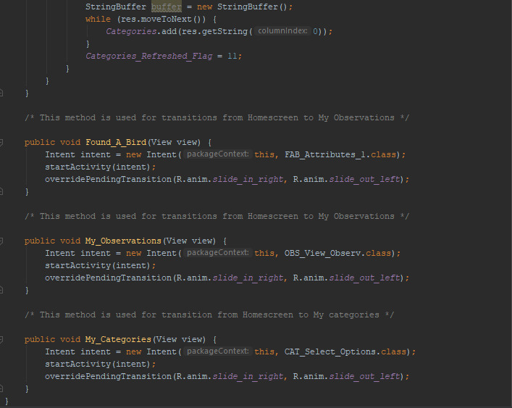
Coding Conventions
Screenshots from HomeScreen activity
Documentation comment
Comment briefing the class
Comments briefing the method
Comments briefing the variables
Main Activity following CamelCase notation
Sub Activity following XYZ_Function[_Description] notation

Slide 7
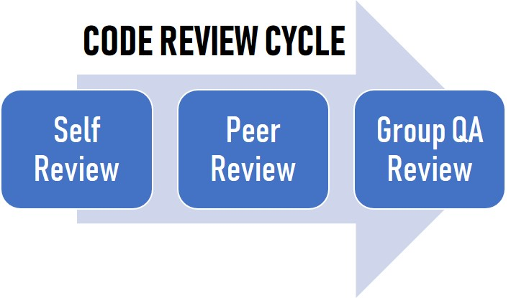
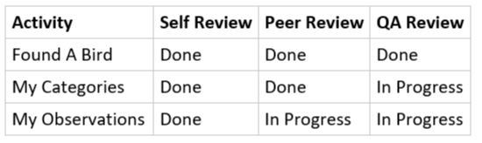
Code Review
Code Review Status

Slide 8
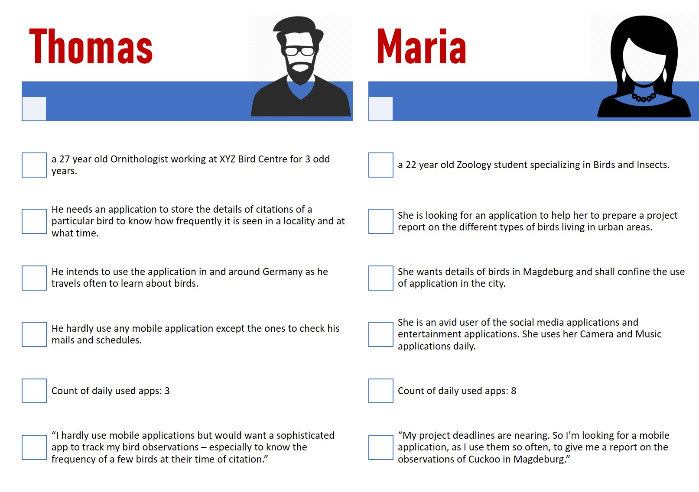
Specify context of use

Slide 9
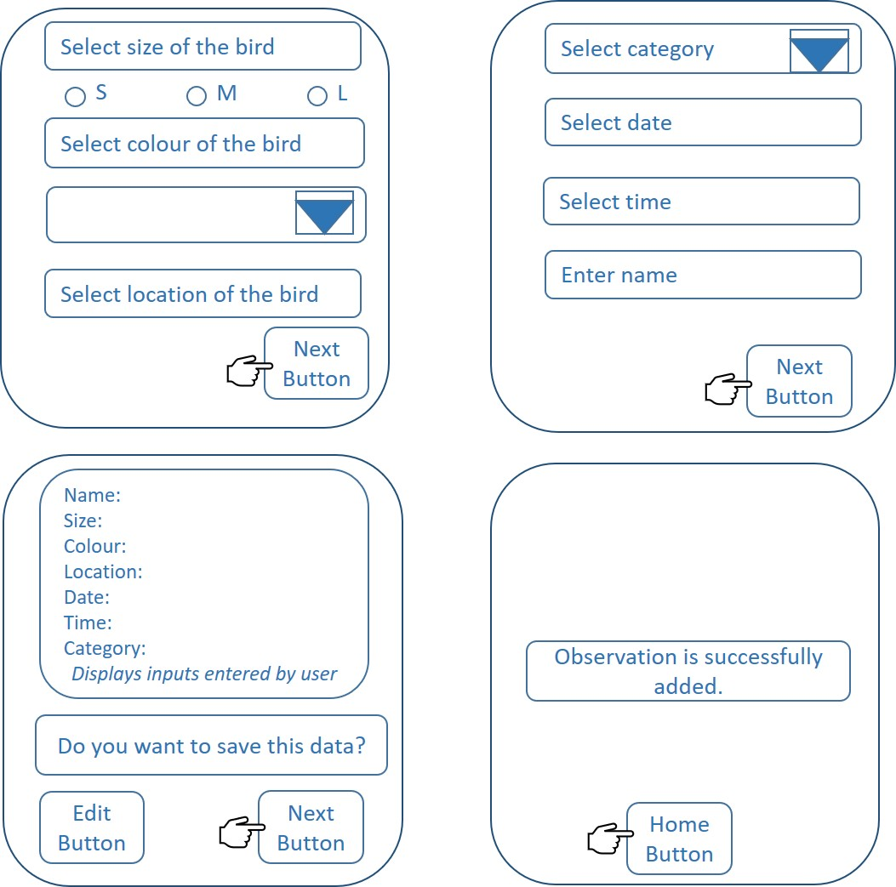
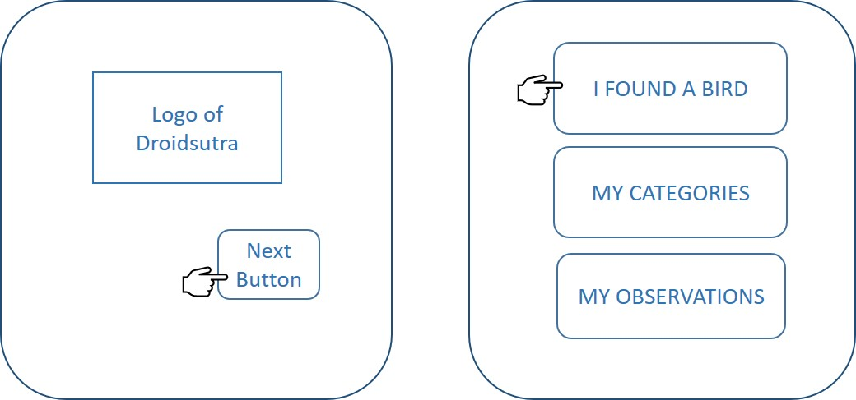
Design Solution - EPIC 01 Found a Bird

Slide 10
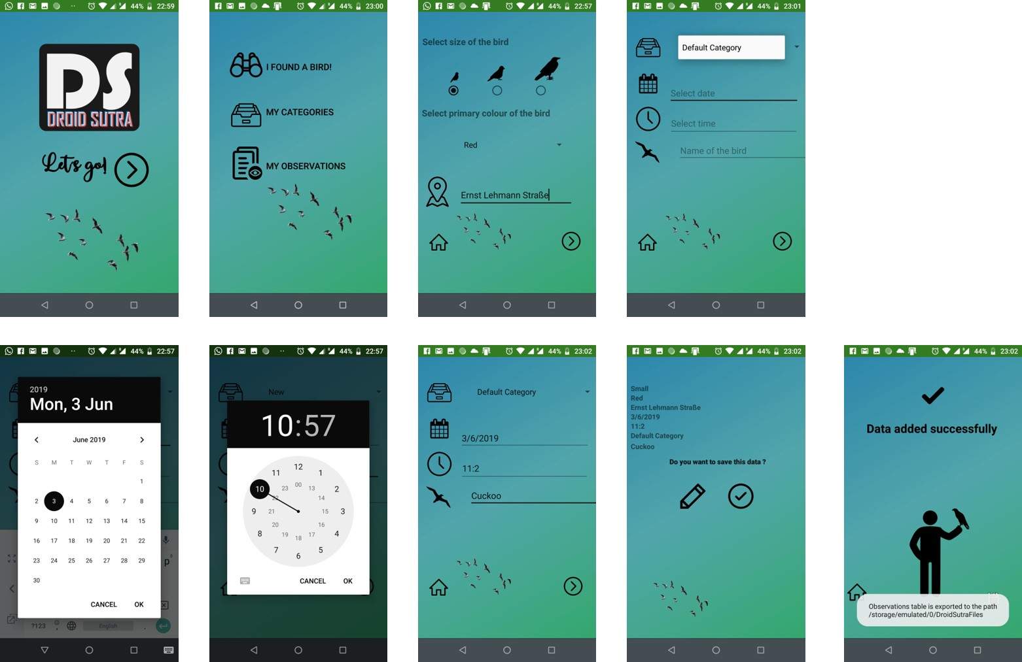
Design Solution - EPIC 01 Found a Bird

Slide 11
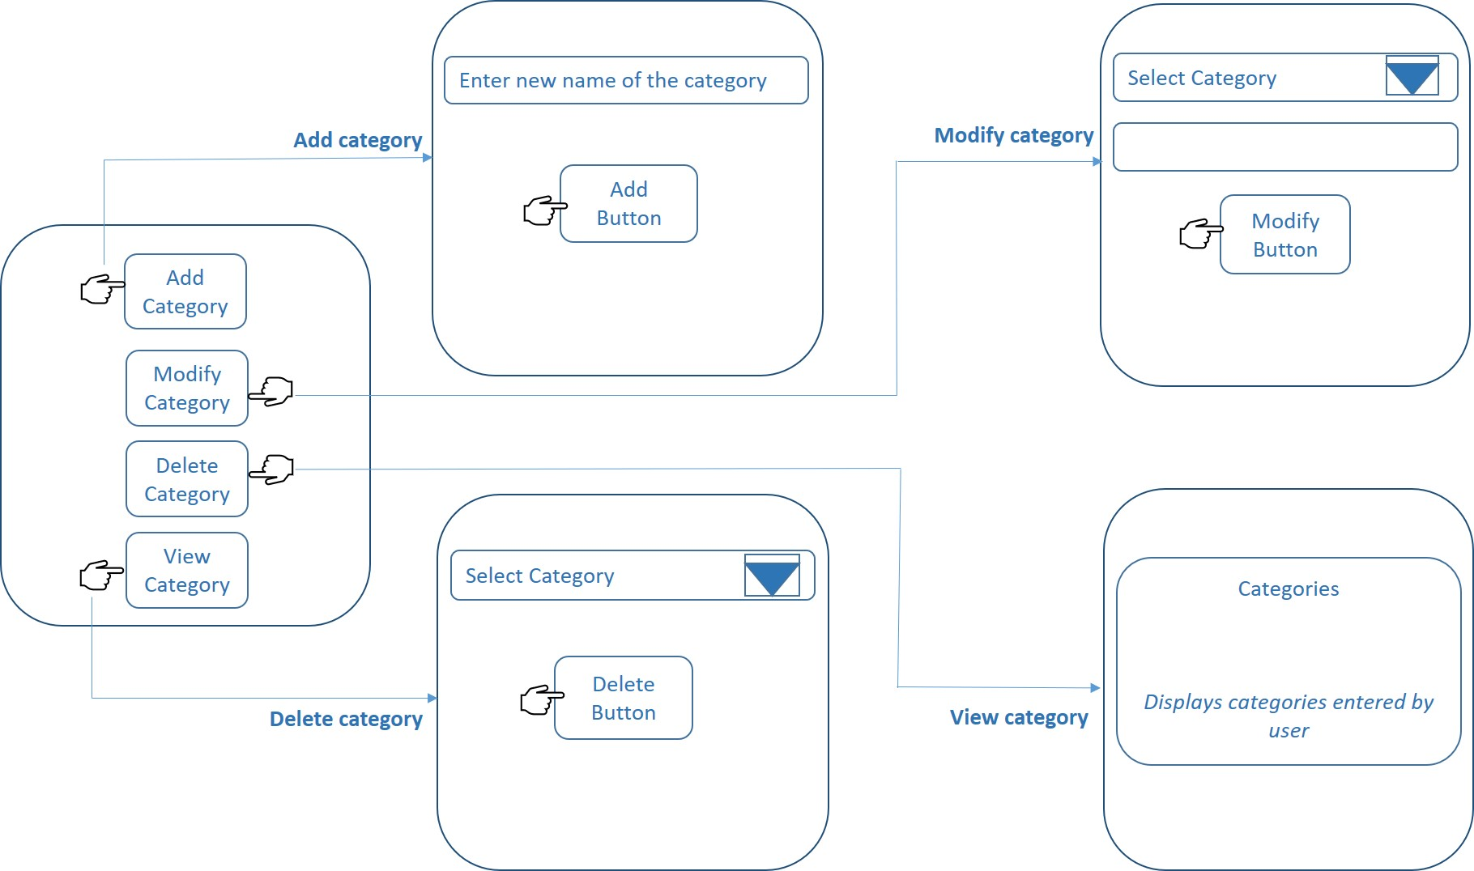
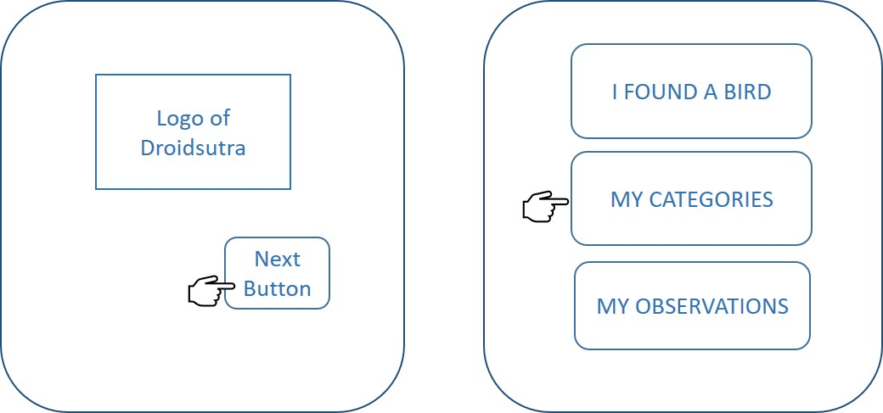
Design Solution – EPIC 02 My Categories

Slide 12
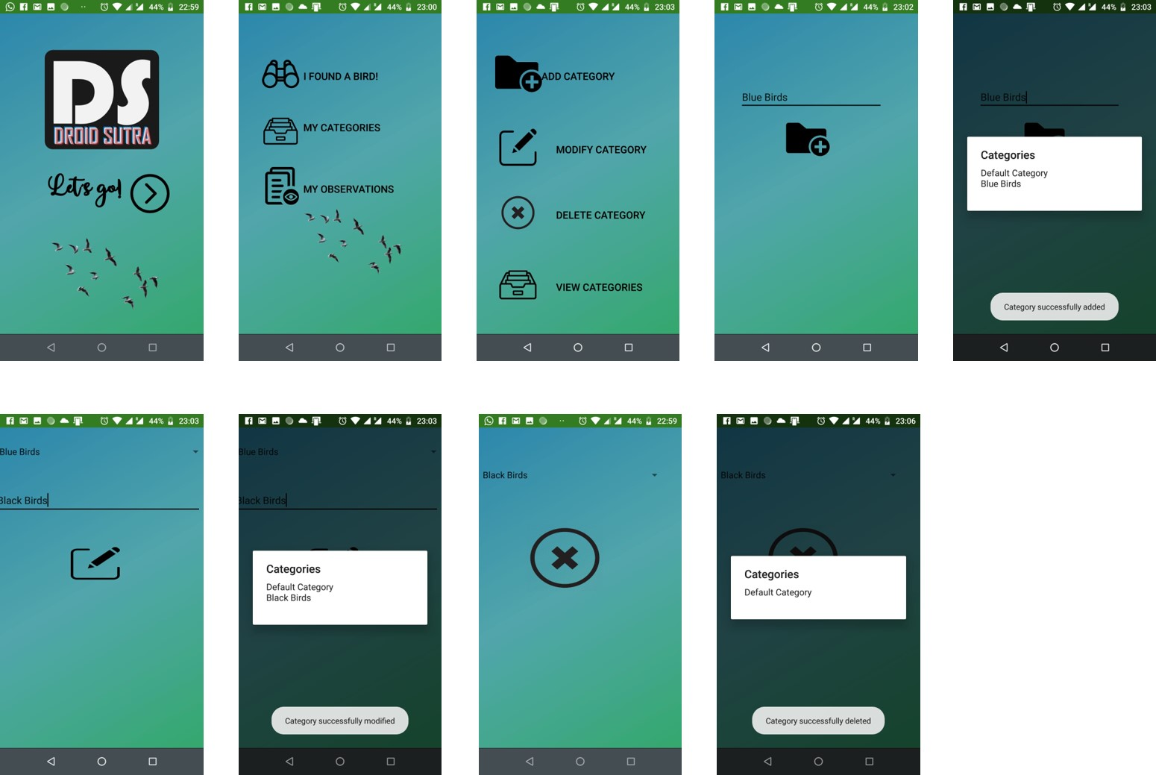
Design Solution – EPIC 02 My Categories

Slide 13

Summary of changes
Changed Requirements (CR):
Added Requirements (AR):
CR01. Location of citation of the bird
[Manual text input -> location from GPS]
AR01. Suggestion for names of the bird from database.
AR02. Description and notes field for user to enter
his/her detail of the bird.
CR02. Date and time of citation of the bird
[Manual text input -> Date and Time pickers]
CR03. Colour of the bird
[Three prominent colours of the bird
-> One single colour]
AR03. Exporting observations table in CSV format.
AR04. Wikipedia link corresponding to the bird in
Observations view.
AR05. Multi language support (English or German)
throughout the application.

Slide 14
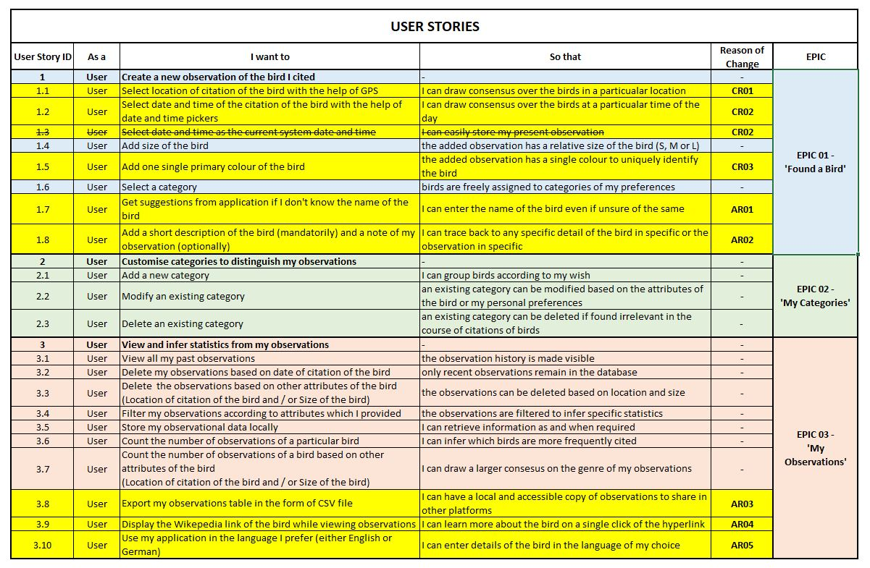
Summary of changes – in User Stories

Slide 15
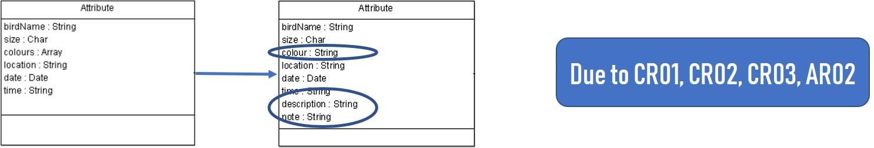
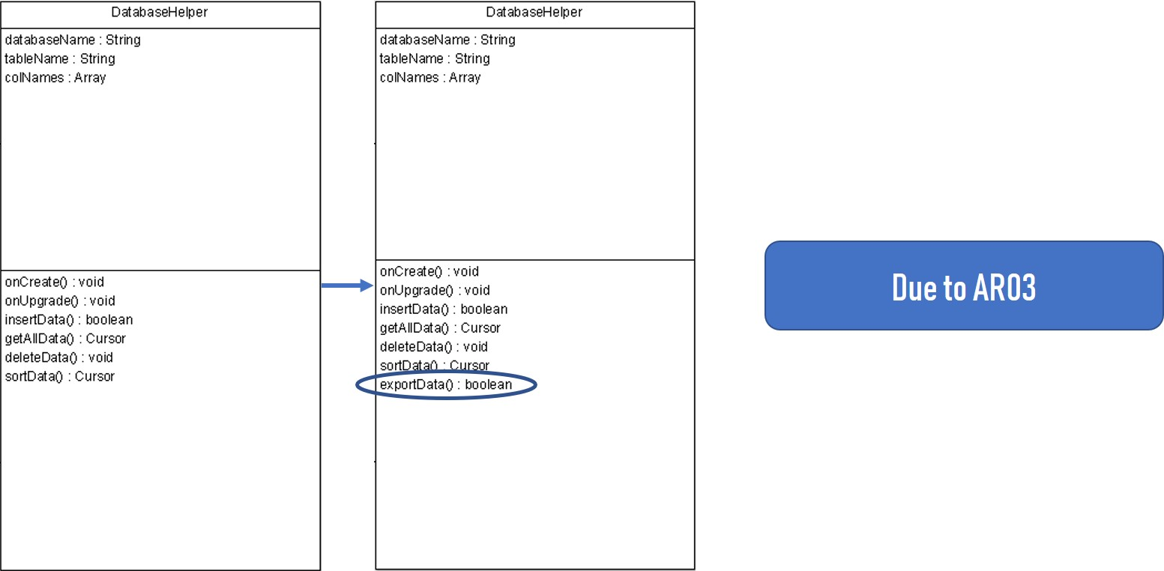
Summary of changes – in Class Diagram

Slide 16
Thank you!

