Slide 1

Introduction to Software Engineering for Engineers
Milestone presentation

Slide 2
Agenda
Sprint planning
Requirements
System Design
Project Dashboard

Slide 3
Sprint planning

Slide 4
Requirements
Weekly meetings on Wednesdays 11:15 to 11:30 with customer
Brainstorming with teammates
Wrong assumptions
Central repo -> Local repo
Categories based on attributes->based on user preference
GPS Location ->Manual entry

Slide 5
Requirements - User Stories

Slide 6
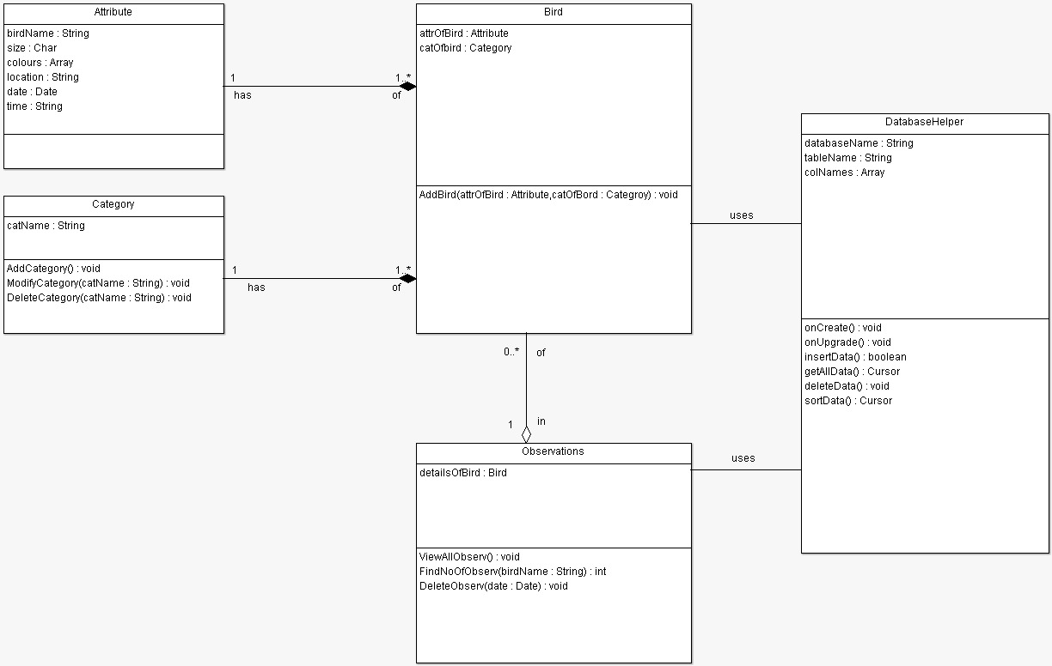
System Design – Class Diagram

Slide 7
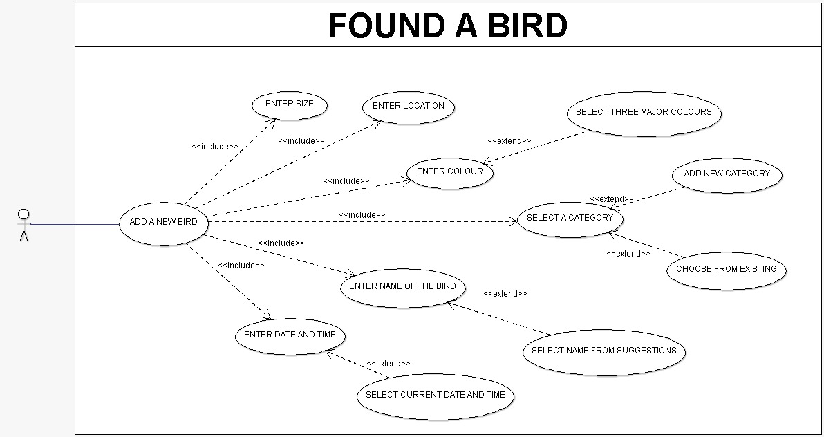
Requirements – Use Case Diagram

Slide 8
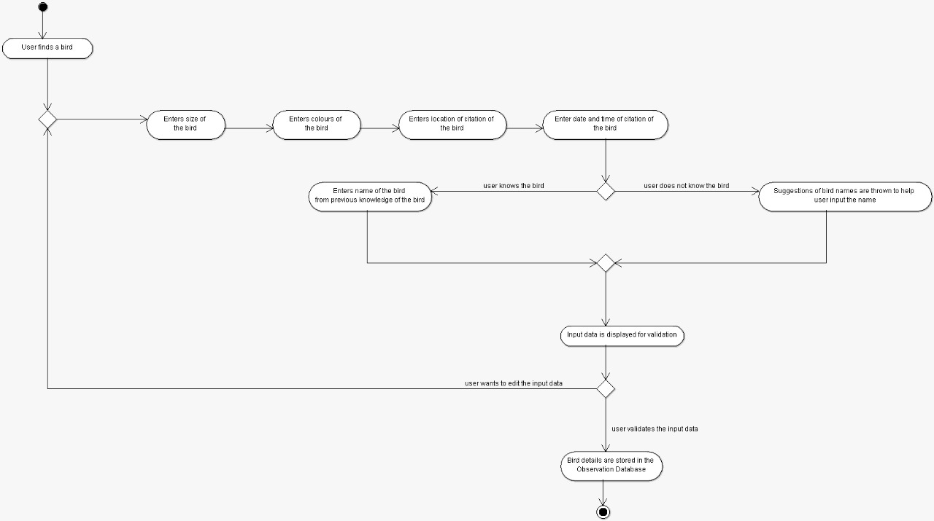
System Design – Activity Diagram

Slide 9
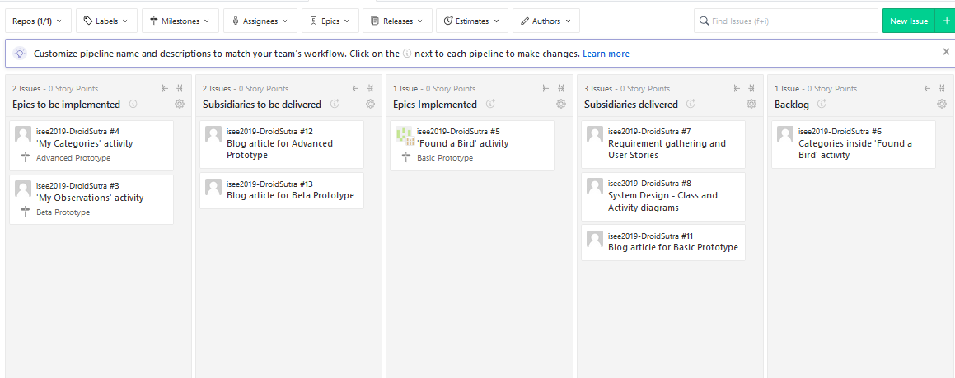
Project Dashboard

Slide 10
Thank you!

