Slide 1

SECURITY ANALYTICS
TEAM 8
RIJISH GANGULY
SIBORA SERANAJ
Project Manager – Susan Jacobs

Slide 2


Background
1.5 billion malicious connection attempts per day on the Duke network
One untapped area is research into the types of attacks and learning how universities are targeted.
Deploy Honeypots with sensors to collect data in order to recognize patterns and build a statistical model

Slide 3


A honeypot is a network-attached system set up as a decoy to lure cyberattackers and to detect, deflect or study patterns of hacking attempts (in order to gain unauthorized access to information systems.)

Slide 4

“The goal of the STINGAR project is to enable low friction generation of threat intelligence, data sharing, and action on threat intelligence for the higher education community”
Duke IT has partnered with several partner schools who have agreed to deploy this system and share data

Slide 5
THINGS to Explore
1. Differences between attacks on cloud and local honeypots
2. Patterns in evolution of attacks over time, at indicator level and sensor level
4. See if indicators return after being blocked
5.Make inferences from geographical data
3. Attack classification based on distribution of number of connections, number of sensors hit, usernames, password tried and urls used

Slide 6






Slide 7
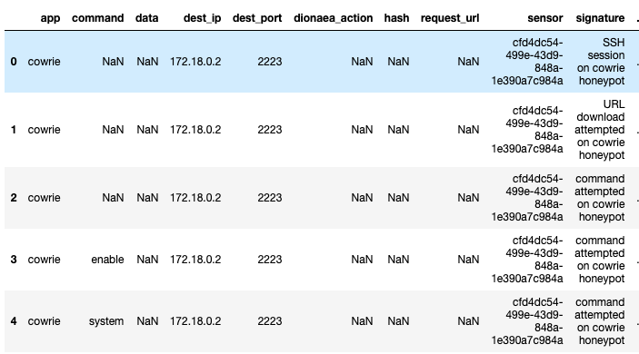
DATA

Slide 8
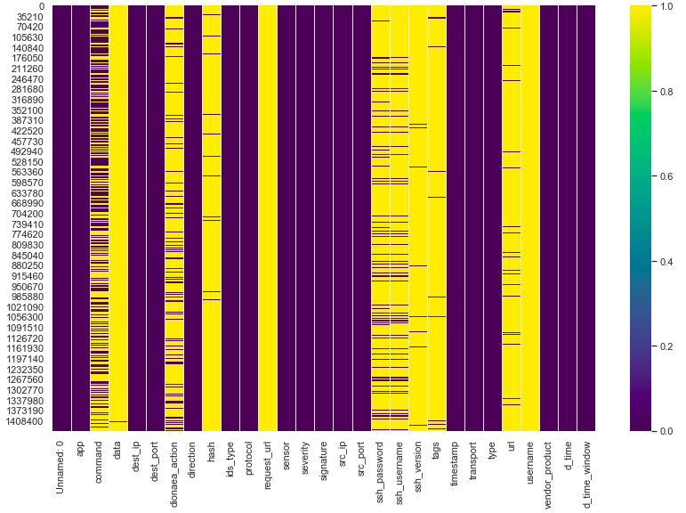
Challenges

Slide 9
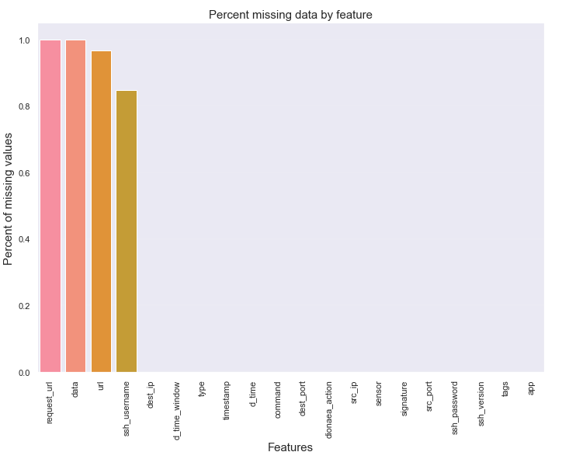
Challenges

Slide 10
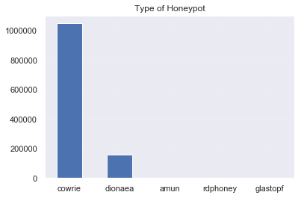
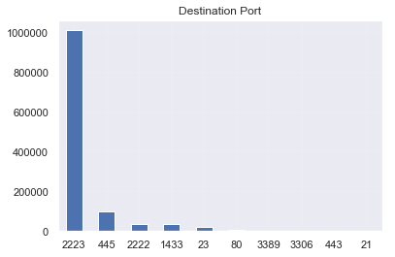
DATA
VISUALIZATION

Slide 11
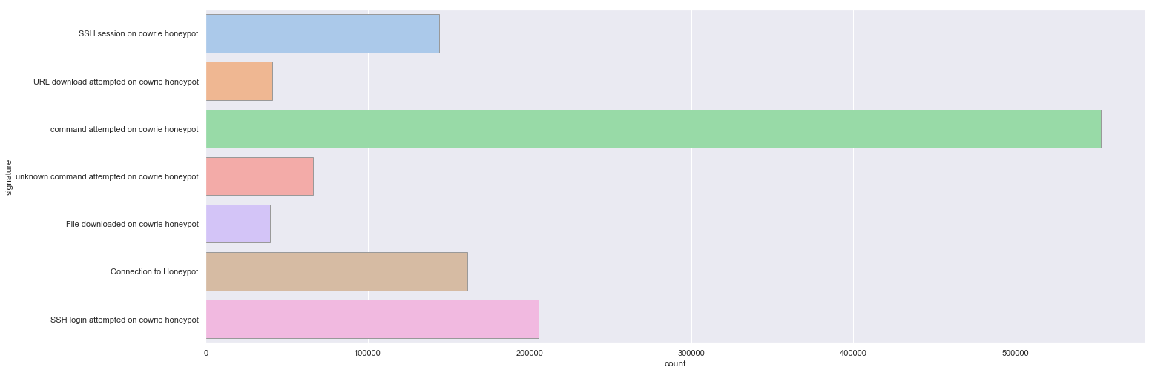
Attack Signature
SSH session on cowrie honeypot
URL download attempted on cowrie honeypot
Command attempted on cowrie honeypot
Unknown command attempted on cowrie honeypot
File downloaded on cowrie honeypot
Connection to honeypot
SSH login on cowrie honeypot

Slide 12
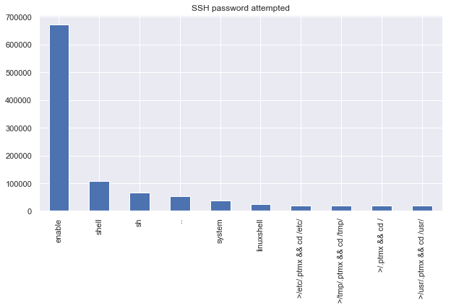

Slide 13
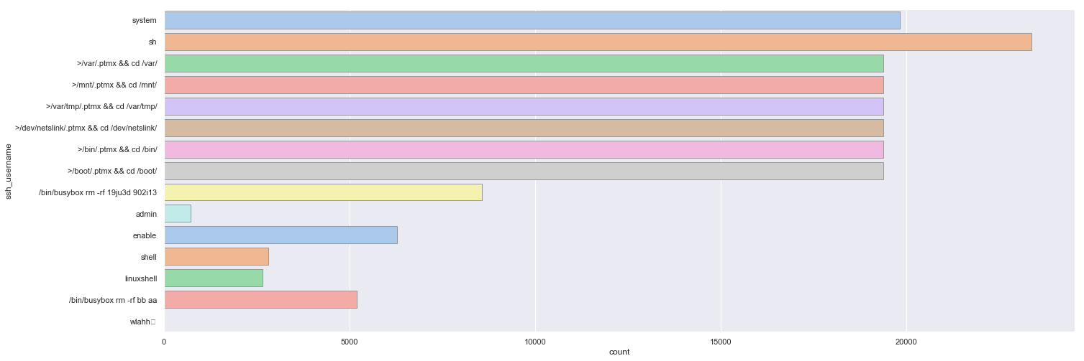
SSH username attempted
system
sh
>/var/.ptmx && cd /var/
>/mnt/.ptmx && cd /mnt/
>/var/tmp/.ptmx && cd/var/tmp/
>/dev/netslink/.ptmx && cd /dev/ netslink/
>/bin/.ptmx && cd /bin/
>/boot/.ptmx && cd /boot/
>/bin/busybox rm –rf 19ju3d 920i13
admin
enable
shell
linuxshell
/bin/busybox rm –rf bb aa
wlahh

Slide 14
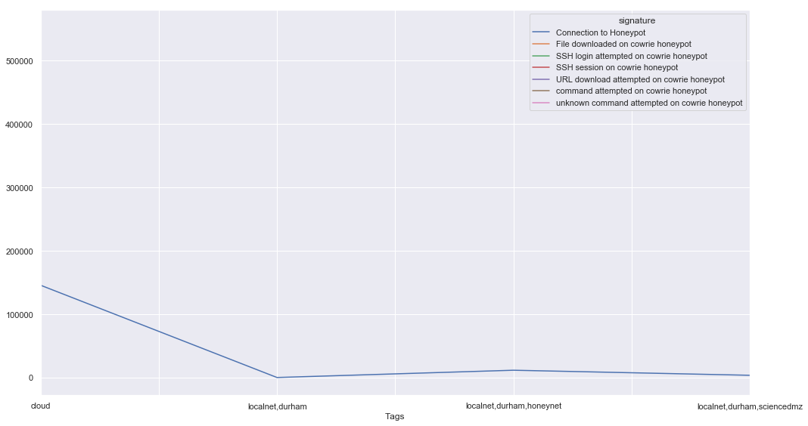

Slide 15
Next steps and current Work
Feature Engineering
Supervised Learning
Unsupervised Learning

Slide 16


Inference from geographical data
Limitations:
Attackers may alter their IP address
General Idea:
Use attacker’s IP to locate the country of attack
Find the population for each country and the percentage of people with internet access
Calculate the Rate of Attacks per Internet User

Slide 17
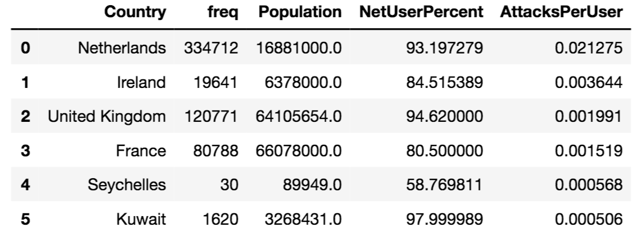
DATA

Slide 18
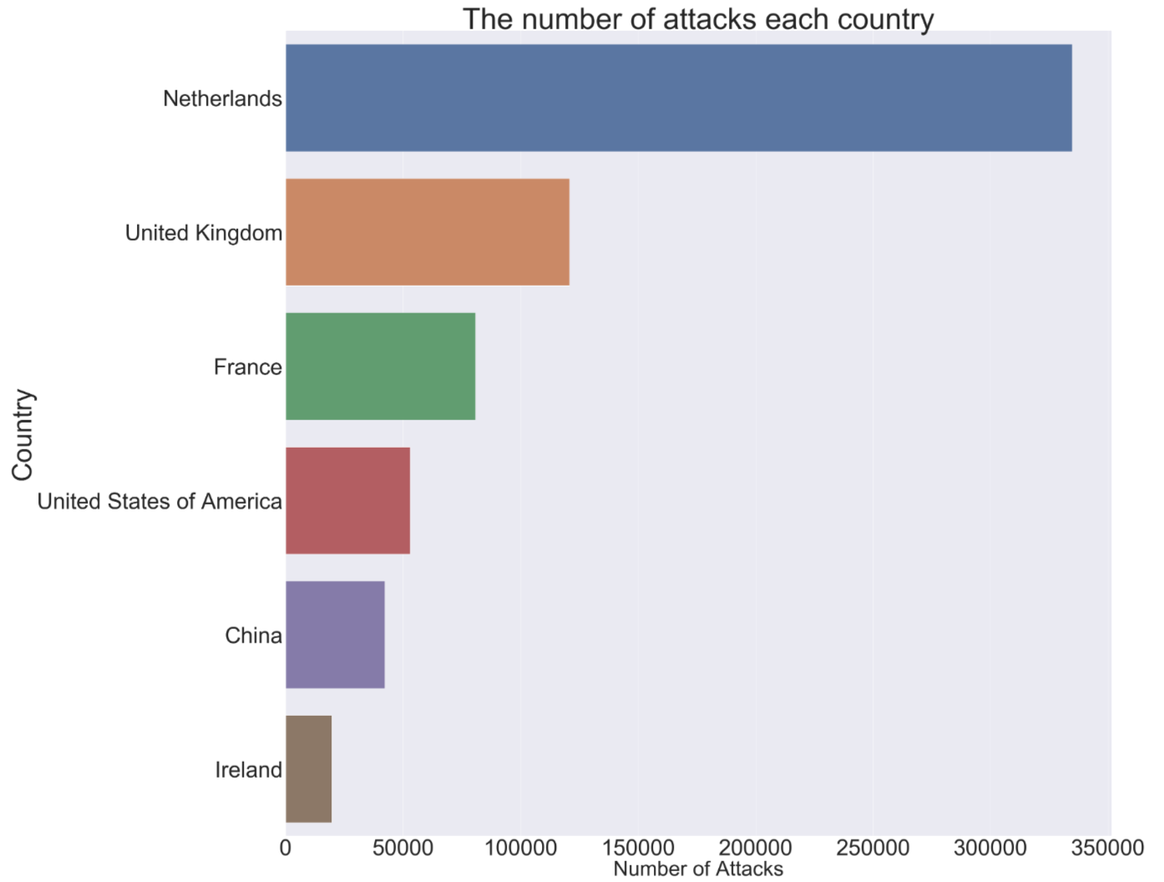
The number of attacks in each country
NUMBER OF ATTACKS

Slide 19
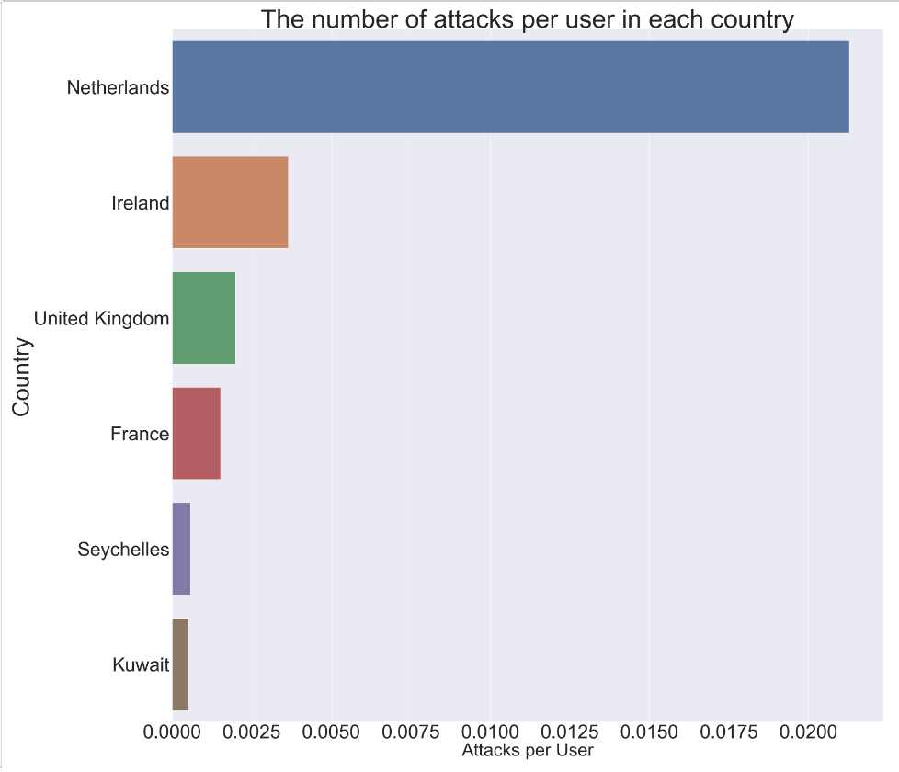
NUMBER OF ATTACKS PER USER

Slide 20
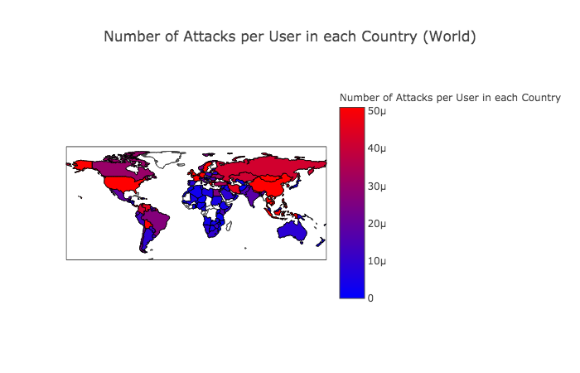

Slide 21
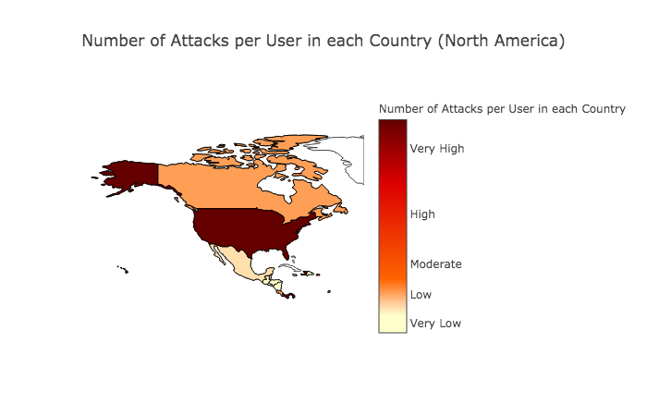

Slide 22
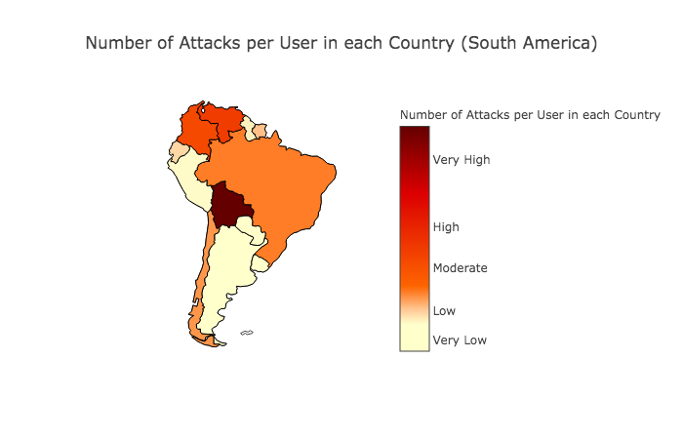

Slide 23
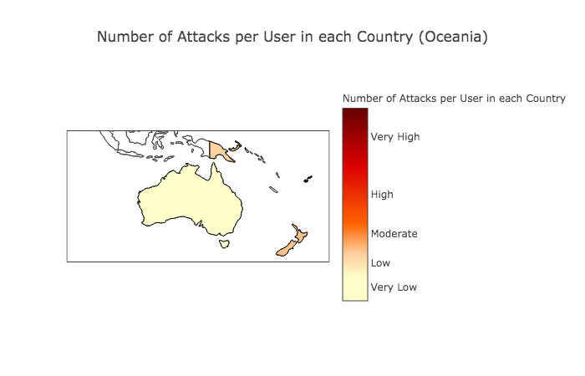

Slide 24
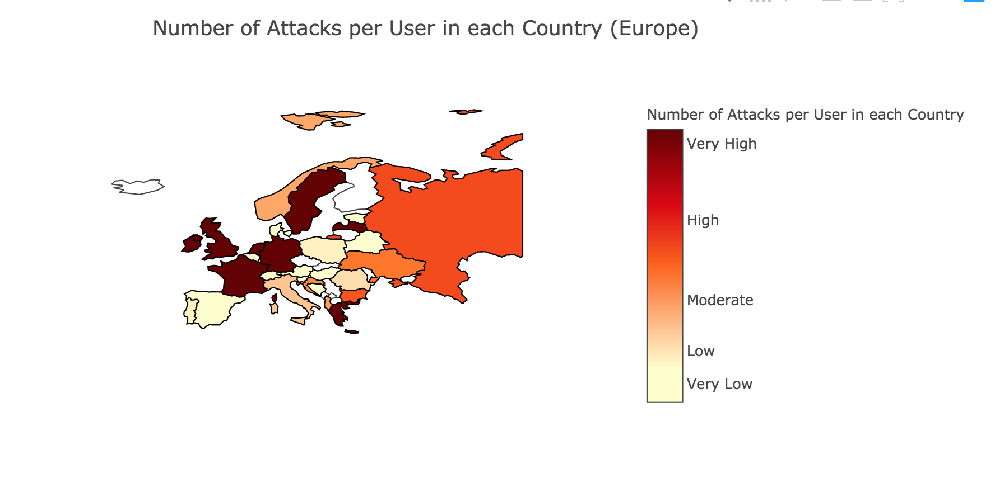

Slide 25
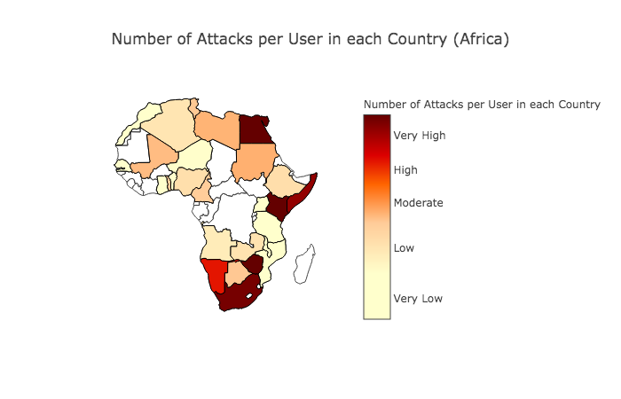

Slide 26
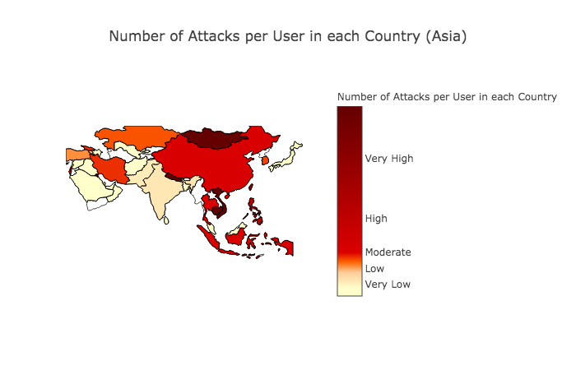

Slide 27
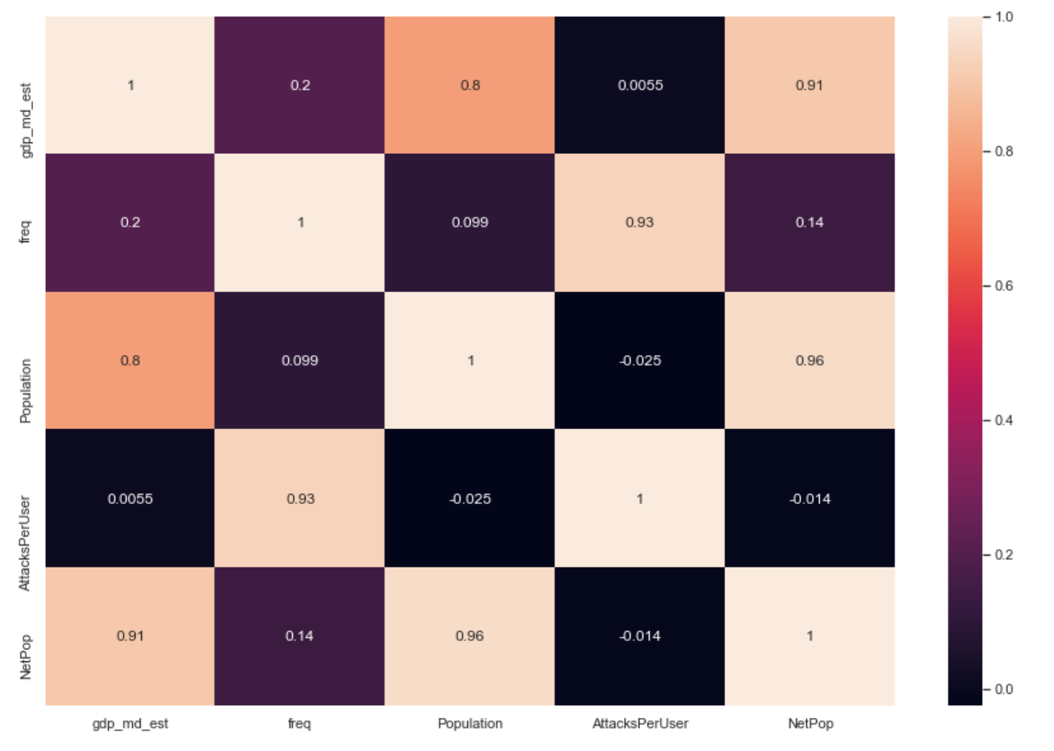
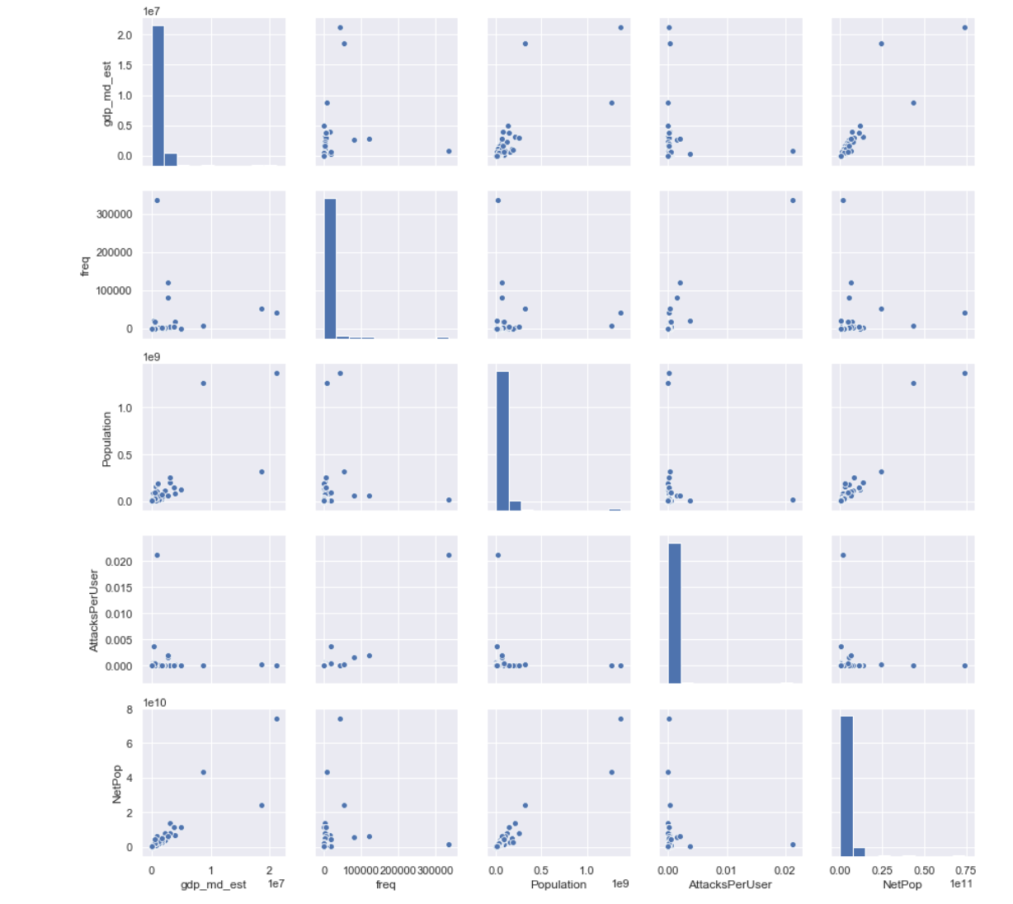
Modelling Attempt
Correlation between variables
Pair plot

Slide 28
Linear Regression Model
Frequency of attack as y variable
The features used were – GDP, Population, Attacks per user and Population with access to the internet
The Linear Regression Model was statistically insignificant
Mean Absolute Error - 2073.2054110298554
Mean Squared Error - 13059894.863763131
Root Mean Squared Error - 3613.84765364606

Slide 29
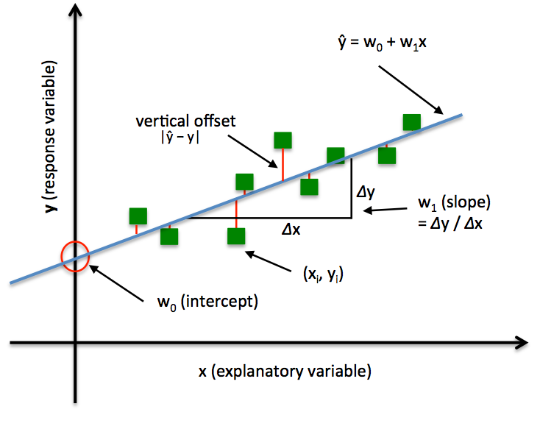
Future WORK
IDEAS:
Add Gender Disparity Index, Law Enforcement Index
Try to identify bot-nets by observing time interval between attacks
CHALLENGES:
A lot of our data is string data, which makes categorization difficult.

