Slide 1

PREDICTING CUSTOMER CHURN & FORECASTING USAGE- ENERGY INDUSTRY - Laxman Kumar Boorugu

Slide 2
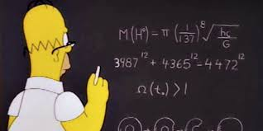
Objective
A few Energy producing companies are supplying power to domestic the customers (Retail) as well as companies (Industrial), there is a chance of customer can move from one company services to another.
Here objective is: Predicting whether a given customer will churn using previous data and forecasting usage for next 2 Weeks and 2 Months.

Slide 3
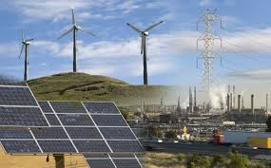
OVERVIEW ABOUT THE INDUSTRY
Electricity retailing began at the end of the 19th century when the bodies which generated electricity for their own use made supply available to third parties. In the beginning, electricity was primarily used for street lighting and trams. The public could buy once large scale electric companies had been started.
U.S. energy companies produce oil, natural gas, coal, renewable fuels, as well as electricity from clean energy sources such as wind, solar, and nuclear power.
Today, America has one of the most diverse energy markets in the United States and is one of the leaders in the $6 trillion global energy market.

Slide 4
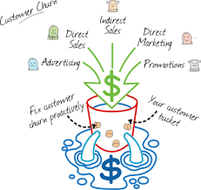
Customer churn
Churn:
Definition: Churn means customer moves from One Company to another company.
Churn Reasons:
Churn Impact: The top 20 percent of a utility’s customers generate 80 percent of its net profit. Moreover, the bottom 30 percent of customers eat up 50 percent of the profits that other customers generate, according to Accenture. (https://www.tibco.com/blog/2014/06/09/how-big-data-analytics-can-help-utilities-reduce-customer-churn/) , (http://blog.inalign.com/5-ways-energy-services-companies-can-reduce-customer-churn)

Slide 5
Exploratory Data Analysis & Feature Engineering

Slide 6
List of the Attributes in the Dataset
Categorical (Ordinal (O) or Nominal (N)) | Numerical
AGE(O) | FREQOFMOVING
FAMILYSIZE(O) | LATEFEEPAYMENTS
TYPEOFHOUSING(O) | AVGCOMPLAINTSRAISED
HOUSEHOLDANNUALINCOME(O) | AVGCOMPLAINTSRESOLVED
AGEOFBUILDING(O) | AVGDAILYUSAGE
AGEOFCUSTOMERACCOUNTINDAYS(O)
EDUCATION(O)
HOUSEOWNERSHIP(N)
MODEOFPAYMENT(N)
TYPEOFPLANI(N)
TYPEOFPLANII(N)
TARGET(N)

Slide 7
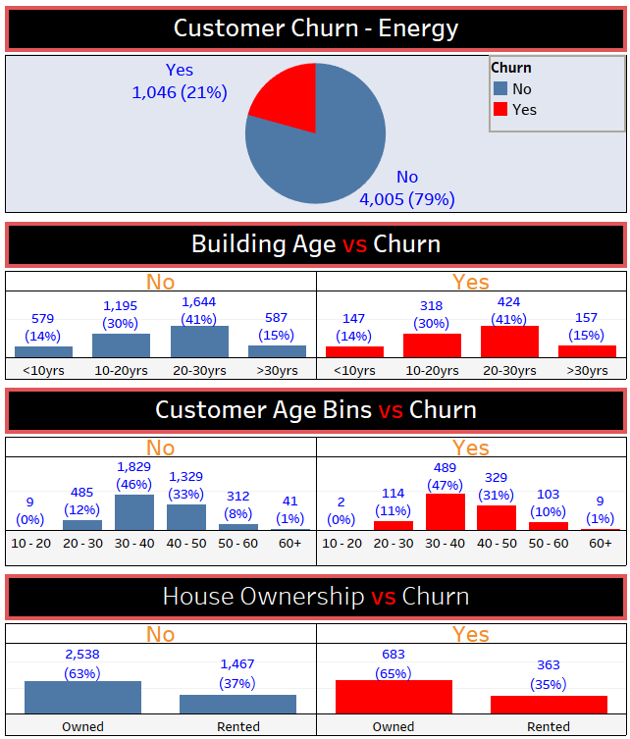
The following are the observations from the EDA
21% of the records are Events (Churn), 79% of the records are Non-Events (Not Churn).
With in Events(Churn)
41% of Customers in 20- 30Yrs Building Age, 30% in 10 – 20Yrs
47% of Customers in 30 – 40Yrs age group, 31% in 40 -50Yrs
65% of customers are owned ,
35 % rented

Slide 8
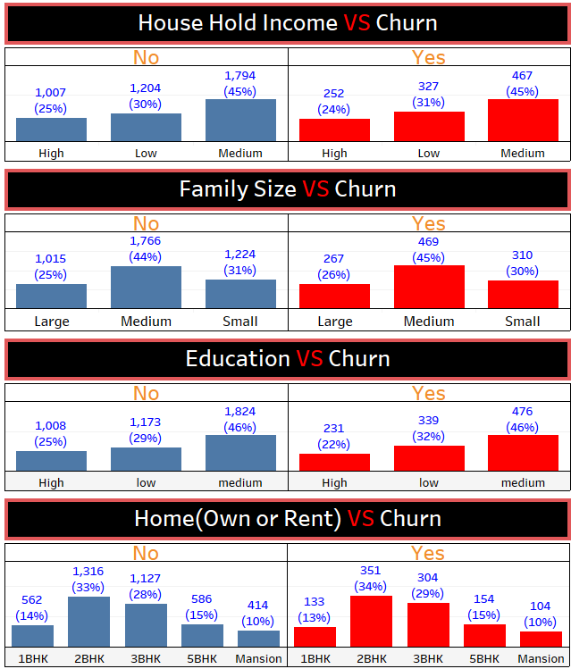
45% of customers in Medium Family size, 30% in Age, 26%
in large.
45% of customers in age group, 31% in low, 24% in high
46% of churn customers are with Education level ‘Medium’, 32% with low, 22% with High
34% churn Customers with 2-BHK, 29% with

Slide 9
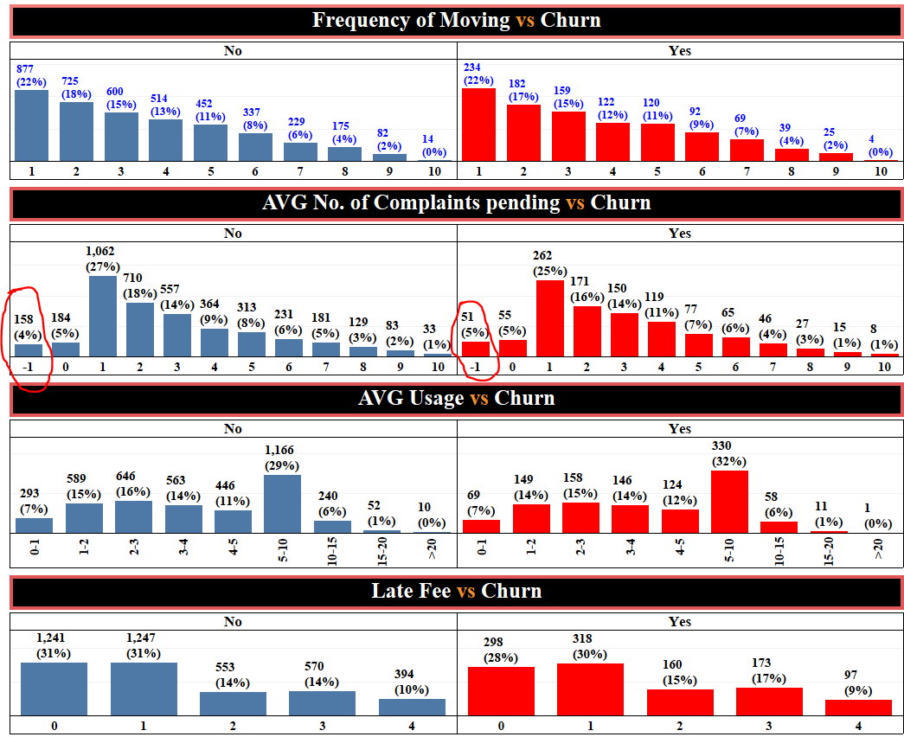
22% of churn Customers Moved 1 time, 17% 2 times, 15% with 3 times
25% of customers churn with Complaints did not solve, 31%
in low, 24% in high.
(Pending is having –ve values)
32% of churn customers are with AVG usage 5- 10
30% churn Customers 1 time
late fee.

Slide 10
Predictive Modeling on Customer Churn

Slide 11
Error Metrics to evaluate the Model Performance
From the above Confusion Matrix, We can say Accuracy, Precision are
evaluating metrics for the classification.

Slide 12
Predictive Models - Customer Churn
Objective of this project is predicting whether a given customer will churn.
Predicting Customer churn comes under Classification Model since the Target variable has the pre defined values such are : Yes, No
There following Machine Learning Models can be implemented to predict the customer churn.
Logistic Regression
Naïve Bayesian
C5.0
Support Vector Machines
Random Forest
RPART
KNN
Bagging
Boosting
Neural Network
Ensemble – Combining better models

Slide 13
Evaluation of Models
Train Data set
MODEL | TP | FN | FP | TN | Sensitivity | Specificity | Recall | Precision | Accuracy
Logistic | 2398 | 406 | 610 | 122 | 0.85521 | 0.16667 | 0.95159 | 0.79721 | 0.71267
C5.0 | 2804 | 0 | 732 | 0 | 1.00000 | 0.00000 | 1.00000 | 0.79299 | 0.79299
Naïve Bayesian | 2804 | 0 | 732 | 0 | 1.00000 | 0.00000 | 1.00000 | 0.79299 | 0.79299
SVM | 2804 | 0 | 730 | 2 | 1.00000 | 0.00273 | 0.99929 | 0.79344 | 0.79355
SVM_Linear Tuning | 2804 | 0 | 732 | 0 | 1.00000 | 0.00000 | 1.00000 | 0.79299 | 0.79299
SVM_Polynomial Tuning | 2804 | 0 | 732 | 0 | 1.00000 | 0.00000 | 1.00000 | 0.79299 | 0.79299
Svm_Radial Tuning | 2804 | 3 | 0 | 729 | 0.998931 | 1.00000 | 0.79366 | 1.00000 | 0.99915
SVM_sigmoid Tuning | 2803 | 1 | 732 | 0 | 0.999643 | 0.00000 | 1.00000 | 0.79293 | 0.79270
Random Forest | 2804 | 0 | 0 | 732 | 1.00000 | 1.00000 | 0.79299 | 1.00000 | 1.00000
Knn | 2804 | 0 | 634 | 98 | 1.00000 | 0.13388 | 0.96623 | 0.81559 | 0.82070
Rpart | 2804 | 0 | 732 | 0 | 1.00000 | 0.00000 | 1.00000 | 0.79299 | 0.79299
Bagging | 2796 | 8 | 724 | 8 | 0.99715 | 0.01093 | 0.99715 | 0.79432 | 0.79299
Boosting | 2801 | 3 | 726 | 6 | 0.99893 | 0.00820 | 0.99786 | 0.79416 | 0.79383
Neural Network | 2581 | 223 | 35 | 697 | 0.92047 | 0.95219 | 0.78737 | 0.98662 | 0.92704
Ensemble - Staking Better Models | 2804 | 0 | 732 | 0 | 1.00000 | 0.00000 | 1.00000 | 0.79299 | 0.79299

Slide 14
Test Data set
MODEL | TP | FN | FP | TN | Sensitivity | Specificity | Precision | Recall | Accuracy
Logistic | 1025 | 176 | 263 | 51 | 0.85346 | 0.16242 | 0.79581 | 0.79581 | 0.71023
C5.0 | 1201 | 0 | 314 | 0 | 1.00000 | 0.00000 | 0.79274 | 0.79274 | 0.79274
Naïve Bayesian | 1201 | 0 | 314 | 0 | 1.00000 | 0.00000 | 0.79274 | 0.79274 | 0.79274
SVM | 1201 | 0 | 314 | 0 | 1.00000 | 0.00000 | 0.79274 | 0.79274 | 0.79274
SVM_Linear Tuning | 1201 | 0 | 314 | 0 | 1.00000 | 0.00000 | 0.79274 | 0.79274 | 0.79274
SVM_Polynomial Tuning | 1201 | 0 | 314 | 0 | 1.00000 | 0.00000 | 0.79274 | 0.79274 | 0.79274
SVM_Radial Tuning | 1201 | 0 | 311 | 3 | 1.00000 | 0.00955 | 0.79431 | 0.79431 | 0.79472
SVM_sigmoid Tuning | 1201 | 0 | 314 | 0 | 1.00000 | 0.00000 | 0.79274 | 0.79274 | 0.79274
Random Forest | 1201 | 0 | 312 | 2 | 1.00000 | 0.00637 | 0.79379 | 0.79379 | 0.79406
KNN | 1201 | 0 | 290 | 24 | 1.00000 | 0.07643 | 0.8055 | 0.80550 | 0.80858
Rpart | 1201 | 0 | 314 | 0 | 1.00000 | 0.00000 | 0.79274 | 0.79274 | 0.79274
Bagging | 1189 | 12 | 313 | 1 | 0.99001 | 0.00318 | 0.79161 | 0.79161 | 0.78548
Boosting | 1193 | 8 | 313 | 1 | 0.99334 | 0.00318 | 0.79216 | 0.79216 | 0.78812
Neural Network | 861 | 340 | 225 | 89 | 0.71690 | 0.28344 | 0.79282 | 0.79282 | 0.62706
Ensemble - Staking Better Models | 1201 | 0 | 311 | 3 | 1.00000 | 0.00955 | 0.79431 | 0.79431 | 0.79472
Electing the Model:
From the above error metrics table, we can finalize the model “KNN” is forecasting better than rest of all models.

Slide 15
Tools Implemented
1) R-Language: This is used to implement the Machine learning Algorithms.
2) Tableau: This is used to implement the Exploratory Analysis.
3) Excel: This is used to store the data as well as to do the data validation ( It is explained in the next steps).
4) CSV: Final and confirmed data set has been converted into CSV, Since comparatively R prefers than others to read the data fast

Slide 16
Thank you

