Slide 1
Purpose
1)Validate client side websites by using multiple data combinations. 2)Ability to create and change data in runtime by using API call before each test cycle.
3)Ability to externally control the data that is being changed.
4)Control test flow based on external input.

Slide 2
Description
The suite's test class picks up data from the input.ods files and executes each test for multiple data combinations.(Based on data provided in the input file.).API call is used to update the test data before each test cycle. For example: Lets say there is a test which goes to the <Order Now> page , and validates that the <Delivery> and <Collection> options are available. For the first cycle of the test , suite makes an API call to change the delivery option to <No> and then the test script goes to the <Order Now> page and validates that only <Collection> option appears. For the next cycle both options and enabled through API call and then test script goes back to the <Order Now> page and ensures that both options are now available on page.(and so on).So we can have multiple lines in input sheet to test for different ON/OFF combinations for <Delivery> and <Collection>

Slide 3
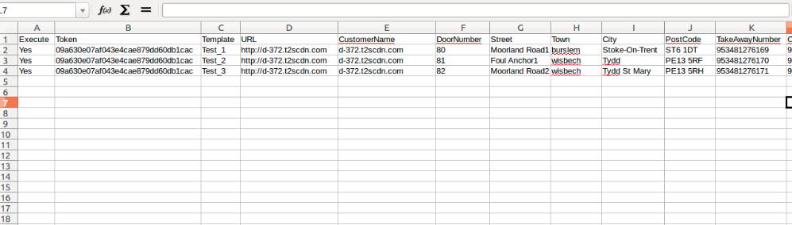
Suite Components – Input.ods
Has test data which drives the page level tests.(e.g - >if there are 3 lines of data , then test will run 3 times for each data set).Each sheet will have data specific to one test.(e.g - test related to Contact page will be on one sheet, test related to Order Now will be in another sheet etc).
In below excel , the customername , doornumber etc is pulled from ods sheet.

Slide 4
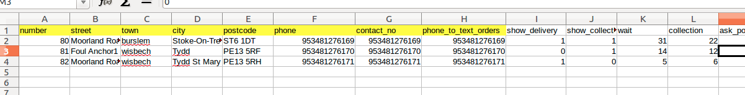
Suite Components – Json_Input.ods
Has data which is used to create the Json files which are later used for data creation
Column names are mapped to the herokuapp API's field names.
Relevant data in Json_Input.ods is populated into Input.ods (Using Class – DATACreationCreateJSON)

Slide 5
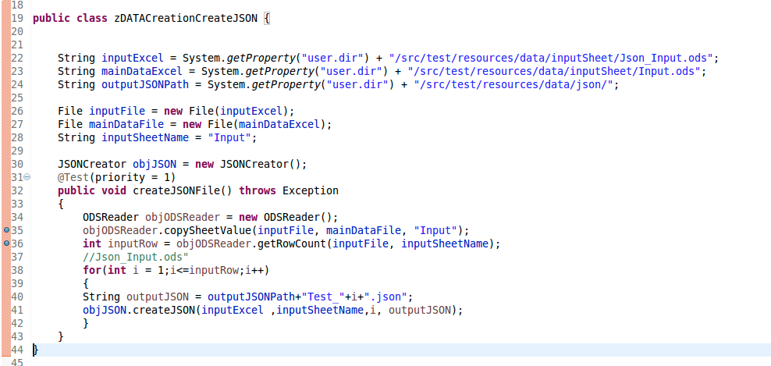
Suite Components – DATACreationCreateJSON
Creates JSON files based on the Input in the Json_Input sheet and places files in designated location.
Copies Data from Json_Input.ods to the Input.ods so that the data used in the test class matches with the data used while creating data.
Same data source is not used because the API field names may change ; the input.ods is insulated from these changes and field changes have to be done only in one sheet.After that user doesnt need to worry about mapping.

Slide 6
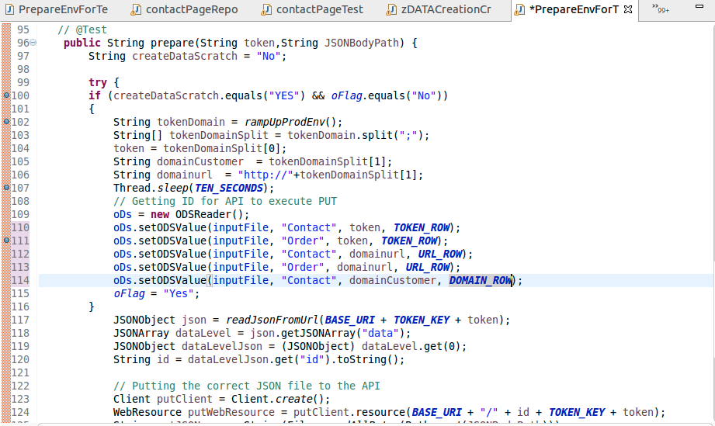
Suite Components – Prepare Method (Reused for current suite)
Creates a new customer site using herocupp api
Retrieves token number,domain url and saves it to Input.ods. Runs once per test or several times based on setting
Uses the token and updates customer site data by using new JSON data for each execution cycle

Slide 7
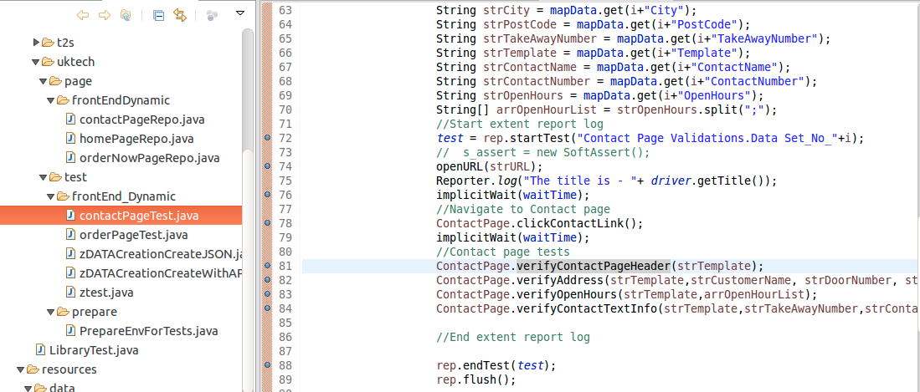
Suite Components – TestNG Tests – e.g ContactPageTest
Calls prepare method to create test data based on JSON files (Data created for specific run cycle).
Gets validation related data from the Input.ods file
Contains TestNG page related tests and validations.

Slide 8
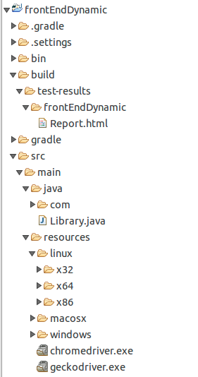
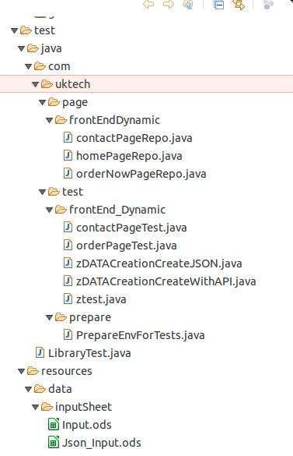
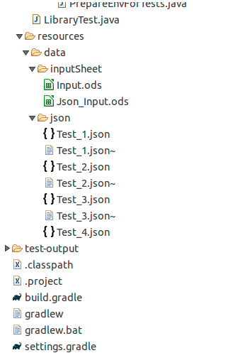
Suite Folder Structure

