Slide 1
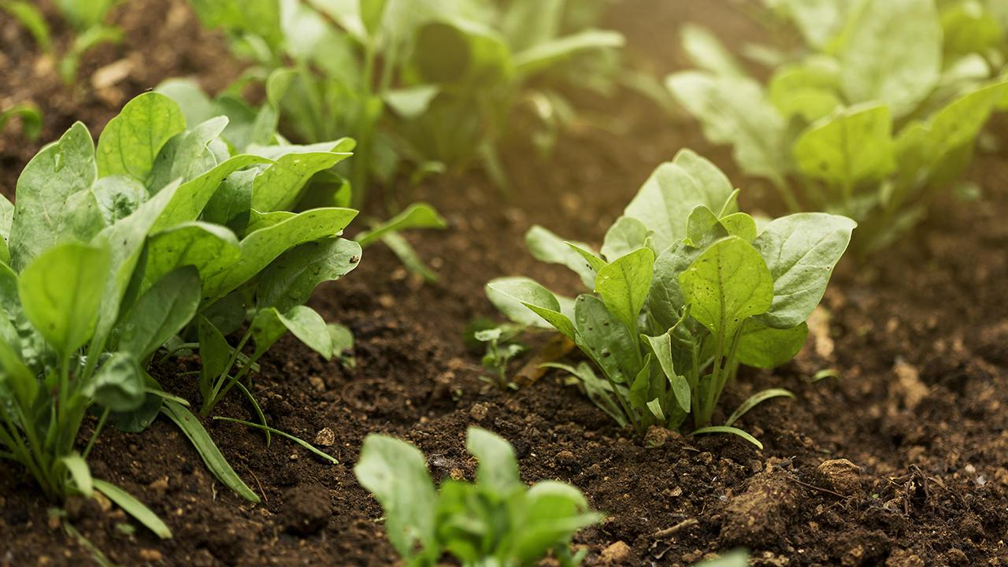

Crop Care
Team Tejas
Rijul Kansal (21BCE0342)
Ananya Garg (21BCE0518)
Telvin (21BCE3558) Anik Gupta(21BCE0405)

Slide 2
Problem Statement
In India, the increasing population and the alarming rate of famine affecting over 16% of the population highlight a pressing need for agricultural interventions. One major issue is the lack of accurate information available to farmers, leading to poor crop choices, low yields, and financial strain. This dire situation is evident in the high rate of farmer suicides, with over 300 occurring daily, often due to insufficient returns on their crops. Additionally, an integrated model is not available that provides solutions for these challenges,making the things even harder for farmers in making informed decisions and improving their livelihoods.

Slide 3
Proposed Solution
To address agricultural challenges in India, we plan to develop a comprehensive Machine Learning (ML) model. Our holistic approach aims to empower farmers with content and sustain ableives, optimizing farming practices and financial planning while contributing to increased agricultural output in India.
Crop Prediction: Utilizing advanced algorithms, it recommends suitable crops based on specific parameters,aiding inexperienced farmers in maximizing yield.
Pest and Disease Prediction: By analyzing historical data and real-time monitoring, this model forecasts threats to crops, enabling proactive measures to minimize losses.
Personalized Fertilizer Recommendations: Tailored advice based on crop types and soil conditions enhances production efficiency.
Yield of Cultivation Estimation: Insights into yield potential and input costs help farmers make informed decisions, maximizing returns and avoiding debt cycles.

Slide 4
Tech Stack
1. Android App – Kotlin, Android Studio, Rest Apis, XML, Firebase, Tensor Flow
2. Backend – Flask, Open AI, Hugging Model
3. ML – Python, Numpy, Pandas, Regression Models, Random Forest,
Decision Tree, Classification Models, Sklearn, Seaborn, Matplotlib, YOLOv8, NLP, TensorFlow, OpenCV
4. Datasets – Kaggle, Roboflow
5. UI-UX – Figma

Slide 5
FUTURE PROSPECT
Collaboration with Agricultural Institutes and Businesses: Partner with institutes and businesses for farmers to access competitive prices on pesticides, fertilizers, and tools.
Integration with Government and Vendors: Integrate with the Government of India and vendors to enable direct crop sales, ensuring seamless transactions.
Holistic Farming Support: Leverage technology for streamlined agricultural practices, enhancing profitability.
Ecosystem Enhancement: Foster collaborations among farmers, institutes, businesses, and government entities.
Empowerment and Revolutionization: Empower farmers through innovative solutions, revolutionizing the agricultural landscape.

Slide 6
Business model
Our proposed solution for our project involves offering free model searches initially, followed by a monthly subscription fee. Additionally, our business model includes exclusive features such as a multilingual chatbot, accessible through payment. Furthermore, we aim to integrate farmers and fertilizer manufacturers, which will enhance our application's value proposition and utility.

