Slide 1
SOFTWARE MODELLING AND DESIGN

Slide 2
BAYMAX “A Healthcare Project”
PRESENTED BY :
Roshni Bhirad PC-08
Sayali Parulekar PC-11
Sanchita Biswas PC-17
Rakshit Chawla PC-29
Rijul Sherathia PC-30
Shruti Gupta PC-44
Rahul Arya PC-47
Smit Kesarkar PC-50
Karthik Jain PC-62

Slide 3
SCOPE
Software opens up to a LOGIN Screen
LOGIN for both Patients as well as Doctors is accepted
Admin can also login using his username and password
Sign-Up option is also available but only for patients
For Patient LOGIN, the screen opens a ‘New Consult’ Form with additional facility of ‘Follow Up’
The Patient enters the symptoms and any allergies that he has
Patient then awaits for a prescription

Slide 4
A doctor is assigned to the patient based on the symptoms provided
For Doctor LOGIN, the screen opens to a multiple Patient display with their symptoms and any allergies(if mentioned by patient)
The Doctor then diagnoses the patient and prescribes medicine
Once medicine is prescribed, the patient can view the prescription
Alternatives for the medicine with same drug and cheaper cost can also be viewed by the patient
Details of the consultant doctor are also available

Slide 5
Based on this, patient history is updated in the database
A database administrator can add/remove any patient/doctor if any kind of malpractice or misuse is reported/found
The database administrator also administers the pharmacy and periodically updates it with any new medicine or deletes any obsolete medicines

Slide 6
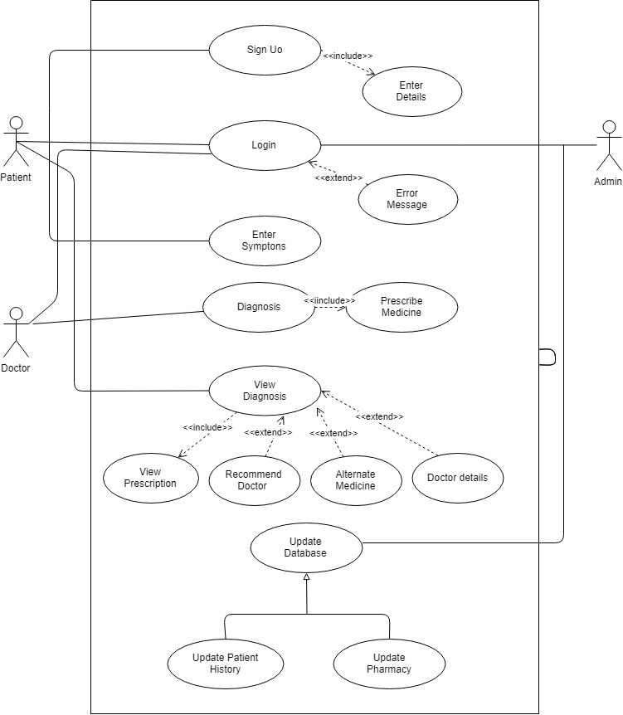
USE CASE DIAGRAM

Slide 7
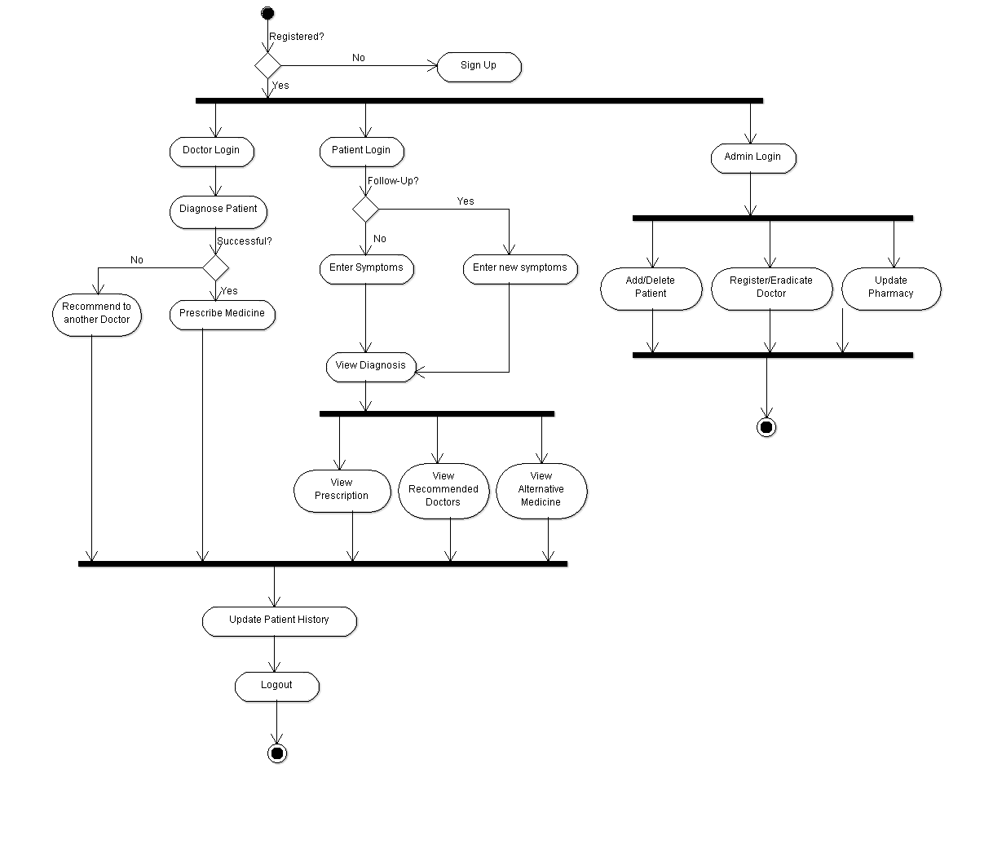
ACTIVITY DIAGRAM

Slide 8
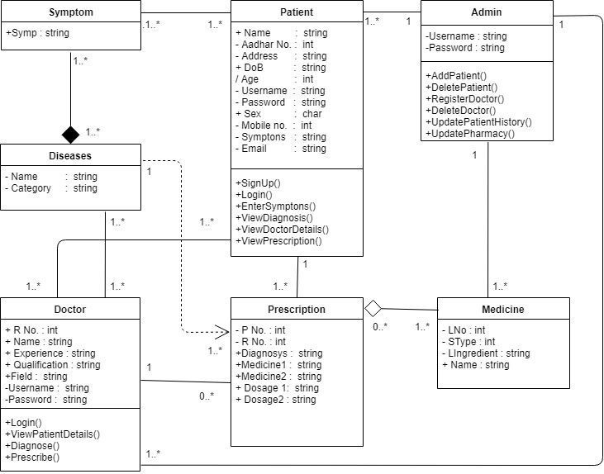
CLASS DIAGRAM

Slide 9
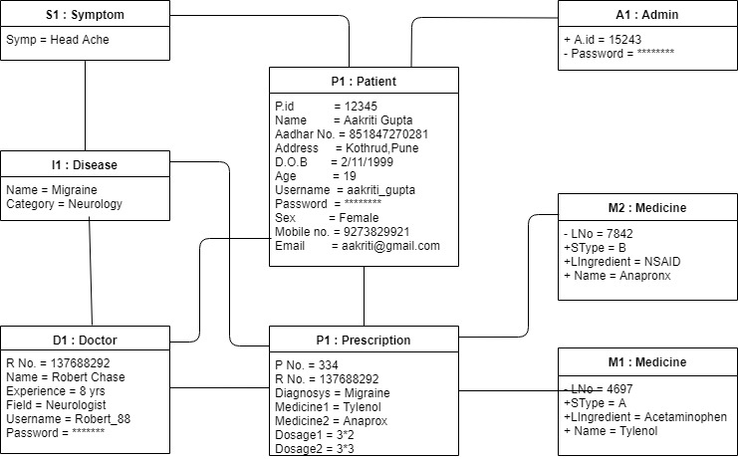
OBJECT DIAGRAM

Slide 10
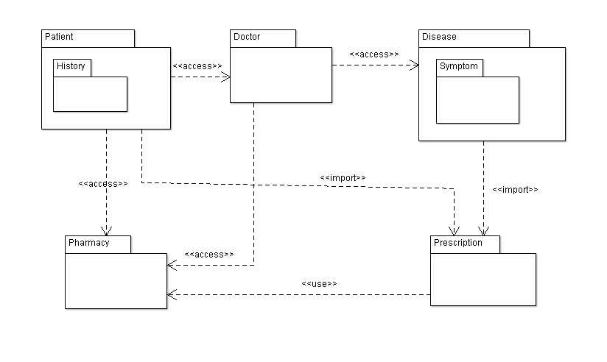
PACKAGE DIAGRAM

Slide 11
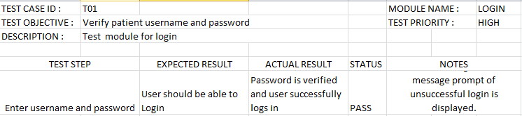
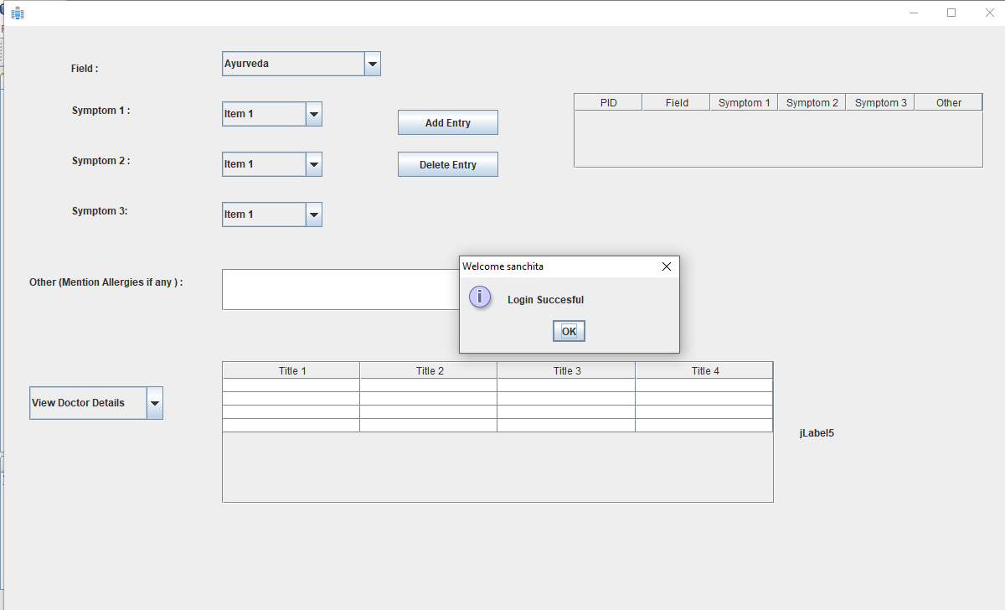
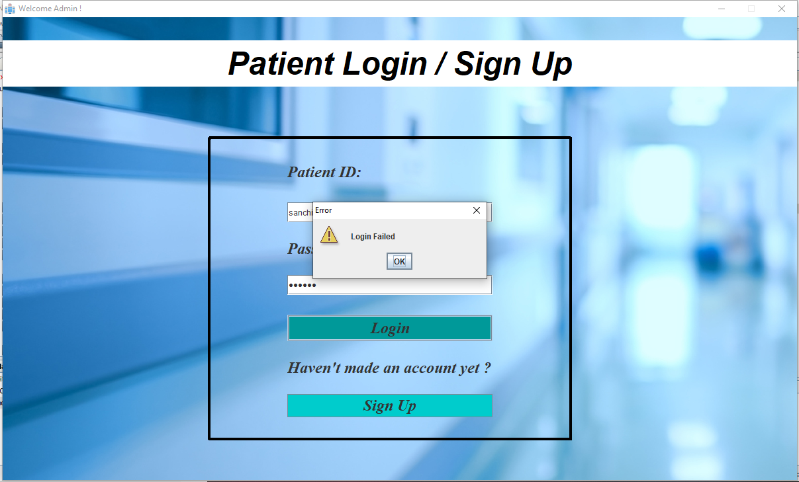
TEST CASE 1

Slide 12
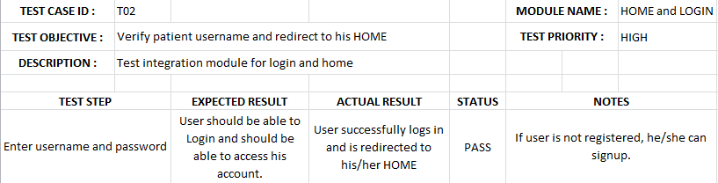
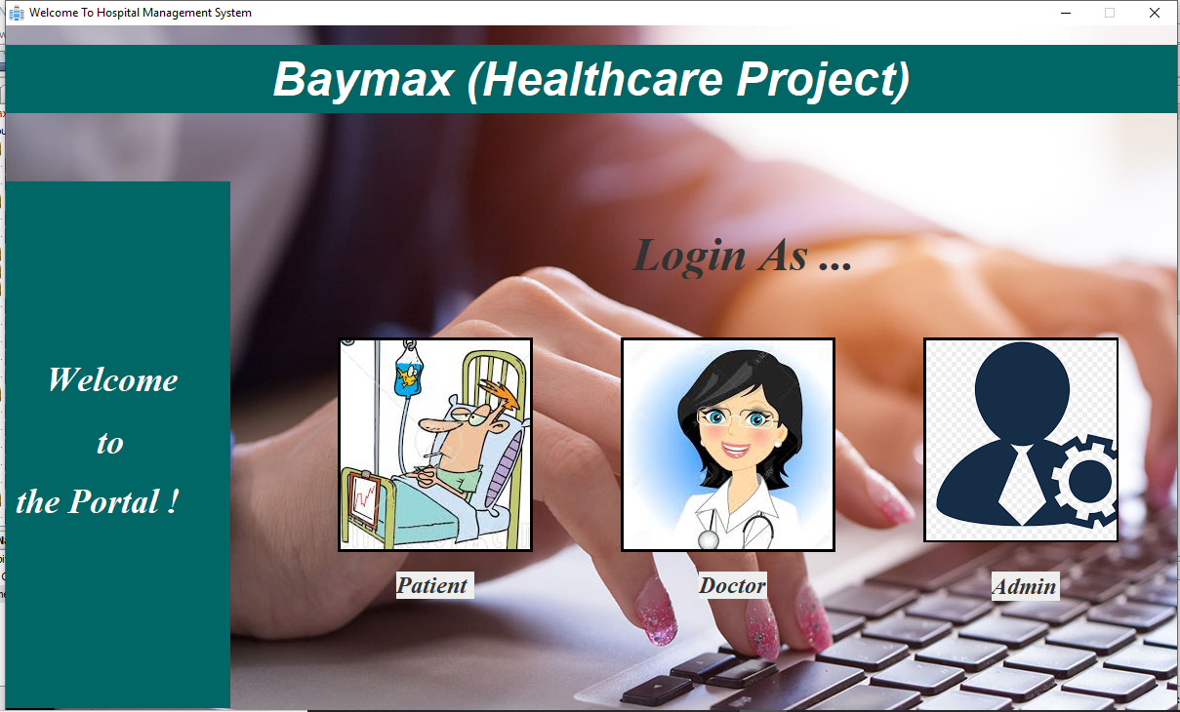
TEST CASE 2

Slide 13
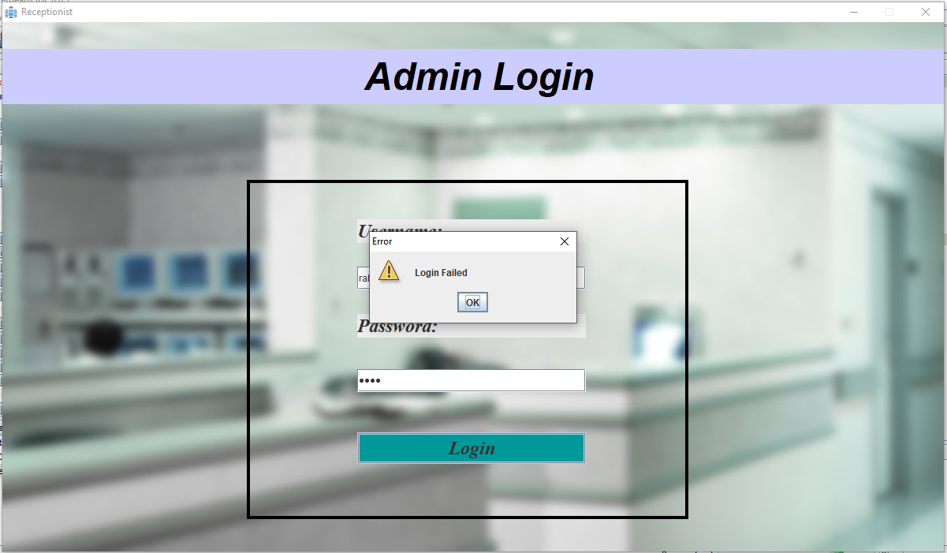
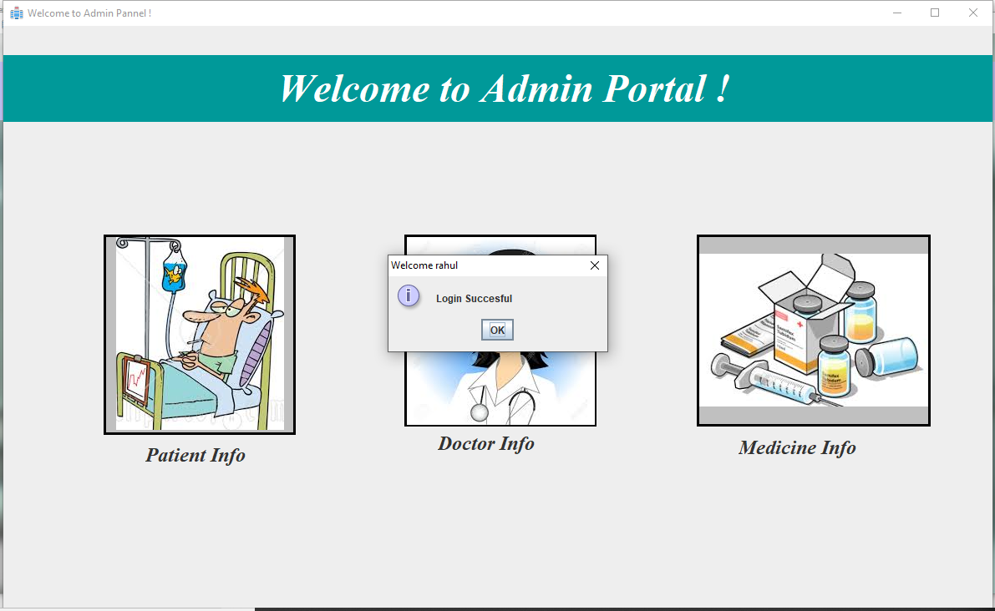

Slide 14
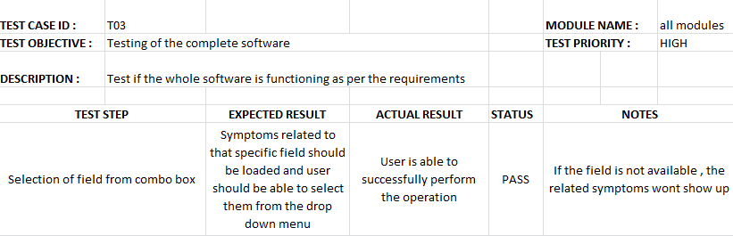
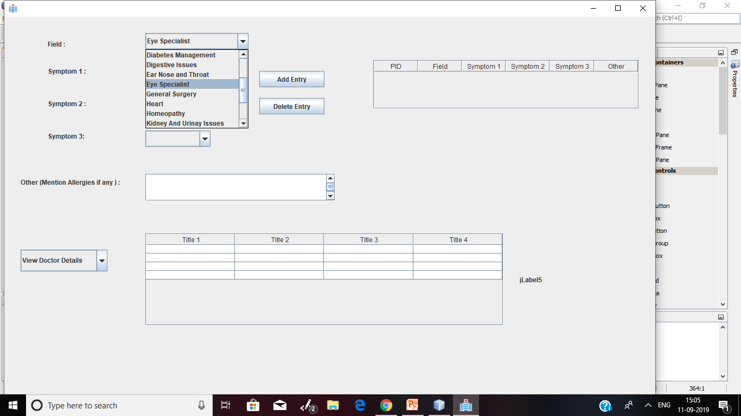
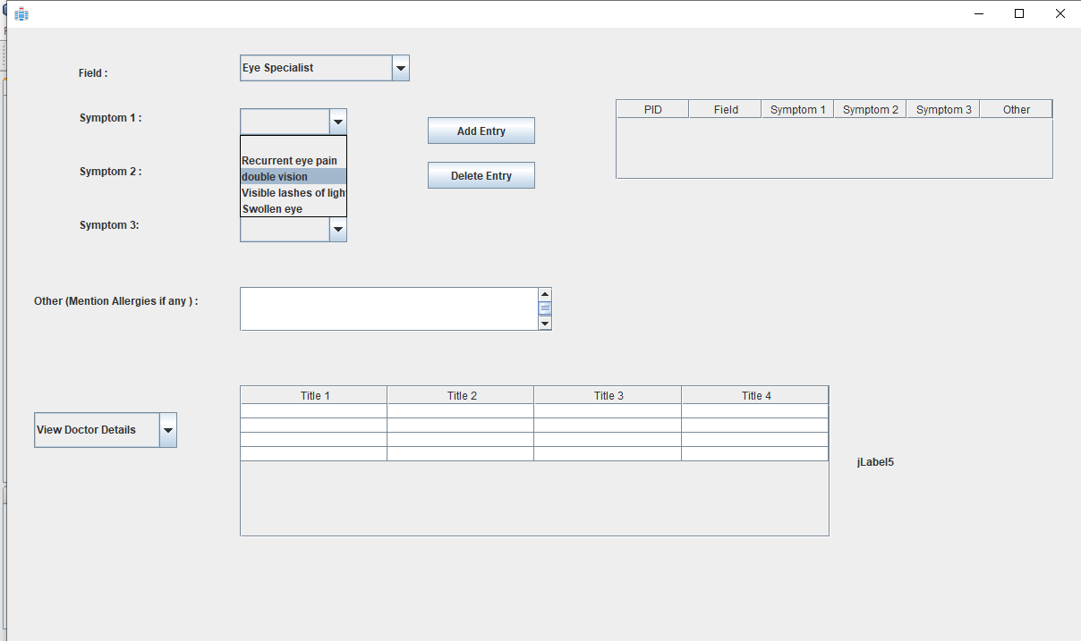
TEST CASE 3

