Slide 1


PROJECT PRESENTATION
SPARK VIRTUAL ASSISTANT
SUBMITTED IN PARTIAL FULFILLMENT OF THE REQUIREMENT FOR THE AWARD
OF THE DEGREE OF
BACHELOR OF ENGINEERING
FEB-MAY 2022
Submitted To:
Submitted By:
NAME
ANMOL KAUR
RIJUL SHAKYA
PRATYUSH SARASWAT
UID
20BCS9453
20BCS1580
20BCS1593
Er. PRIYA RANA(Supervisor)
Er. BHAVANA VERMA(Co-Supervisor)
DEPARTMENT OF COMPUTER SCIENCE & ENGINEERING CHANDIGARH UNIVERSITY GHARUAN, MOHALI

Slide 2

CONTENT
Introduction
Objectives
Technology used
Designs
Screenshots
Outcomes

Slide 3

INTRODUCTION
SPARK VIRTUAL ASSISTANT is made is developed to manage the computer applications. The purpose of the software project is to develop the Virtual assistant to manage the facility for user in computer.In this we are able see the concept of AI and ML .With the help of tkinter a user friendly environment is seen the concept ofconnectivity of python and MySQL is also seen ,with open CV a strong security system is implemented . Our virtual assistant mainly consists of a python and MySQL connectivity and a concept of artificial intelligence also seen ,With the help of tkinter and PyQT5 we will make the GUI .Different tools are present in in our application.

Slide 4
OBJECTIVES
The main aim of developing this system to implement the concept of AI and ML in operating system . The number of persons who wants to use OS face many problem . Using this system user can search the application which he wants to run.And a strong security system is also there which can make our Virtual assistant secure. We make many application to show the working of this assistant.
The proposed system is designed to help the user to meet the demand of accessing the application easily. The proposed system gives the procedural approach of how to bridge the gap between user , OS, and application. This application will provide a common ground for all the three parties (i.e. user , OS, and application) and will ensure the fulfillment of the demand for user .

Slide 5
Technology used
The whole Project is divided into two parts the front end and the back end.
Front End Software
Python
tkinter
Back End Software
python
MySQL
OpenCV
tenserflow
PyAudio
Pyttsx3
Operating System : Windows 10, Windows 11
IDE : Visual Studio Code,

Slide 6
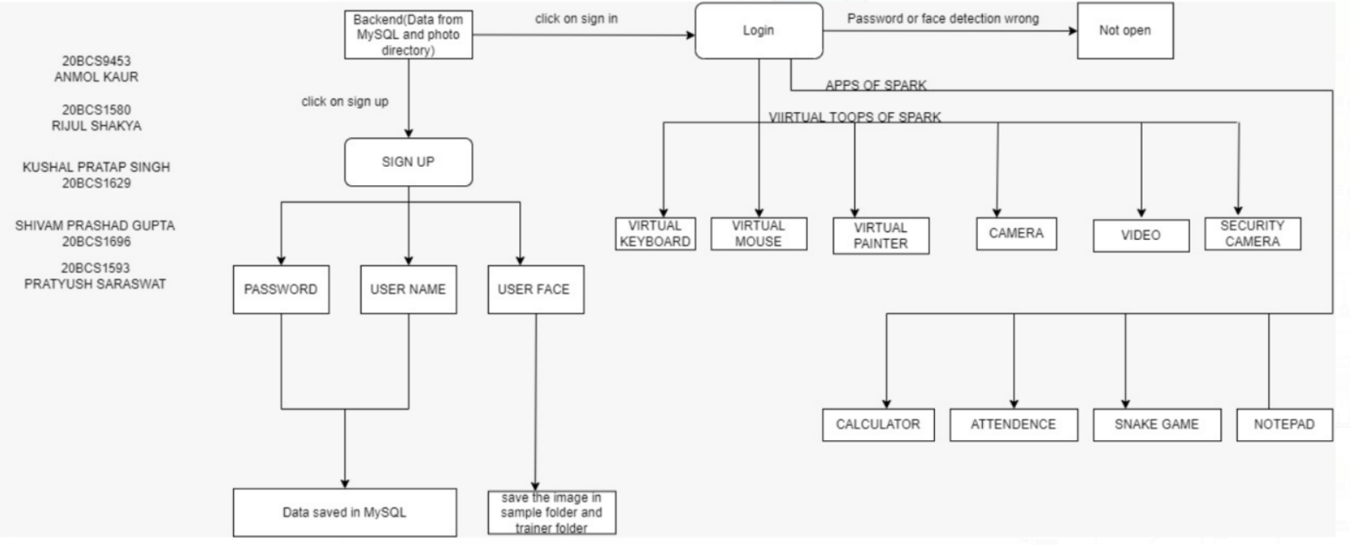
DESIGNS (DFD DIAGRAM)

Slide 7
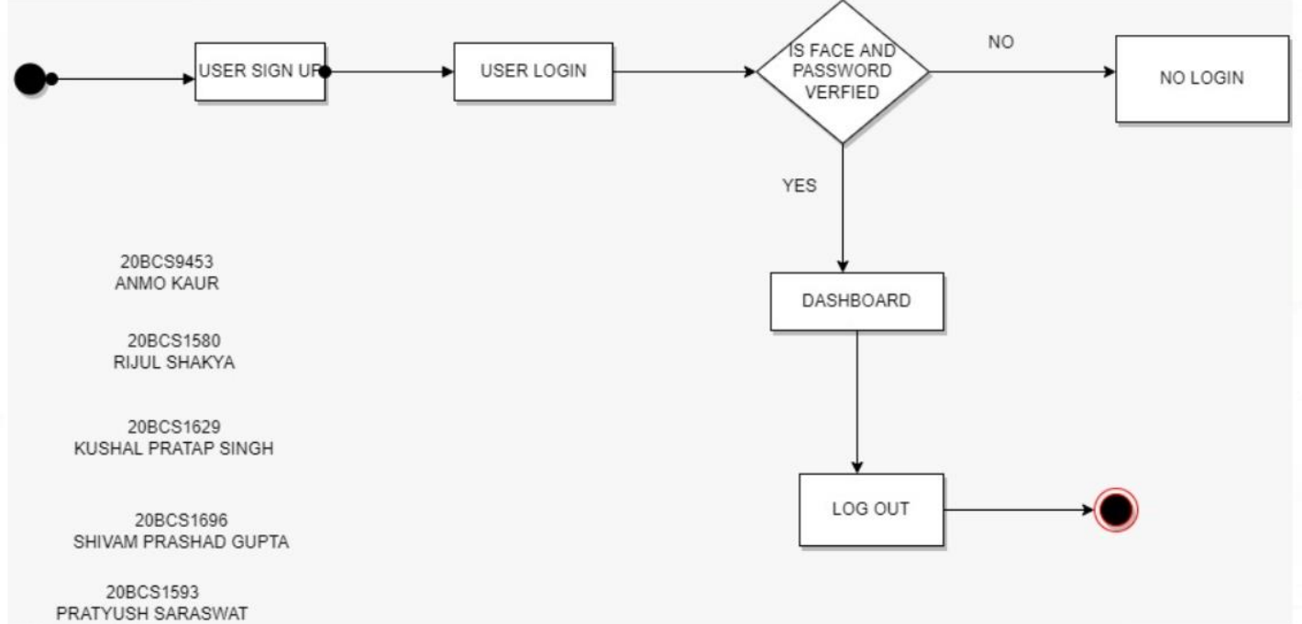
DESIGNS (ACTIVITY DIAGRAM)

Slide 8
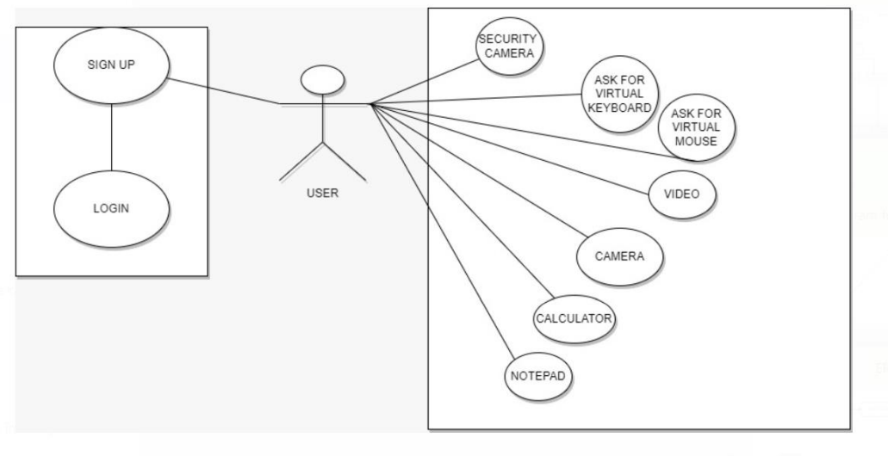
DESIGNS (USER CASE DIAGRAM)

Slide 9
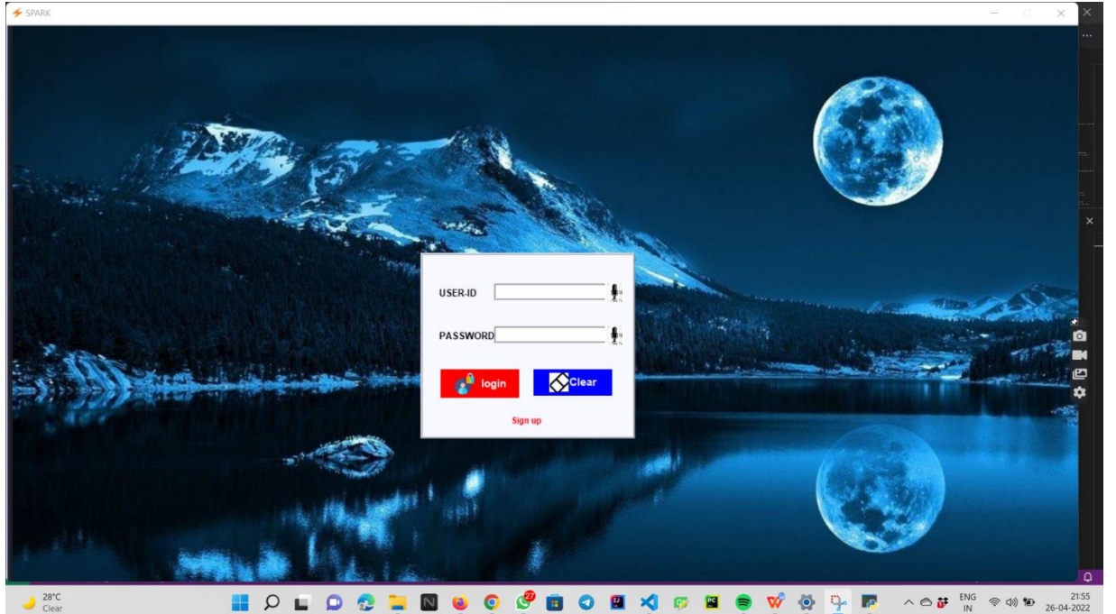
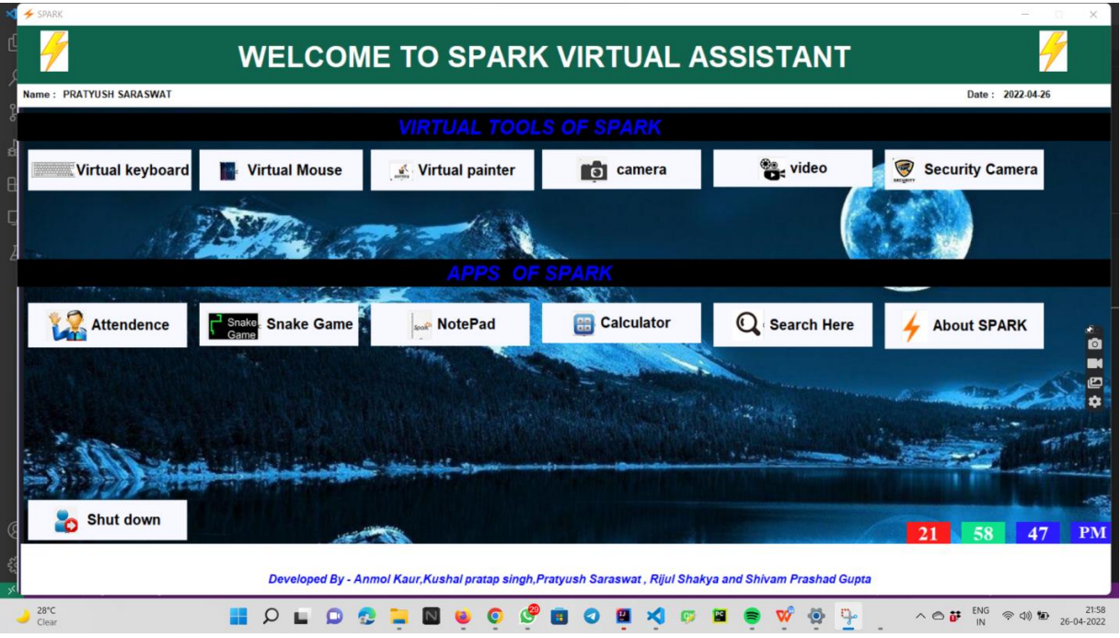
SCREENSHOTS

Slide 10
OUTCOMES
Our Application can be used by any of the OS as it has all the function required by any OS & it also stores helps the user.
Secondly, we have created many special tools for user & the user can easily acess the application in our virtual assistant .
We have the created the GUI in such a manner that it is easy for the user to use the OS.
The Virtual Assistant will continue to play an important role in the development strategy of business because it provides a double-edged solution to improve profitability by effectively lowering cost and increasing revenue through efficiency

