Slide 1
Factors influencing the revenue of AirBNB (New York)

Slide 2
AGENDA
Objective
Background
Key findings
Recommendations
Appendix:
Data sources
Data methodology
Data model assumptions

Slide 3
OBJECTIVE
Increase the revenue of Airbnb New York
Popular hosts that acquires most properties
Pricing ranges, types of properties and neighbourhood preferred by customers

Slide 4
BACKGROUND
Price Column have certain irregularities, like minimum price is 0$.
There is decline in the revenue due to covid restrictions in the last few months
Host and neighborhood group data are provided, currently there is no services that can help the host to price their services accurately according to the demand of the properties.listing activity and metrics in NYC, NY for 2019.n had some irregularities such as the minimum price was 0$ which is not possible.

Slide 5
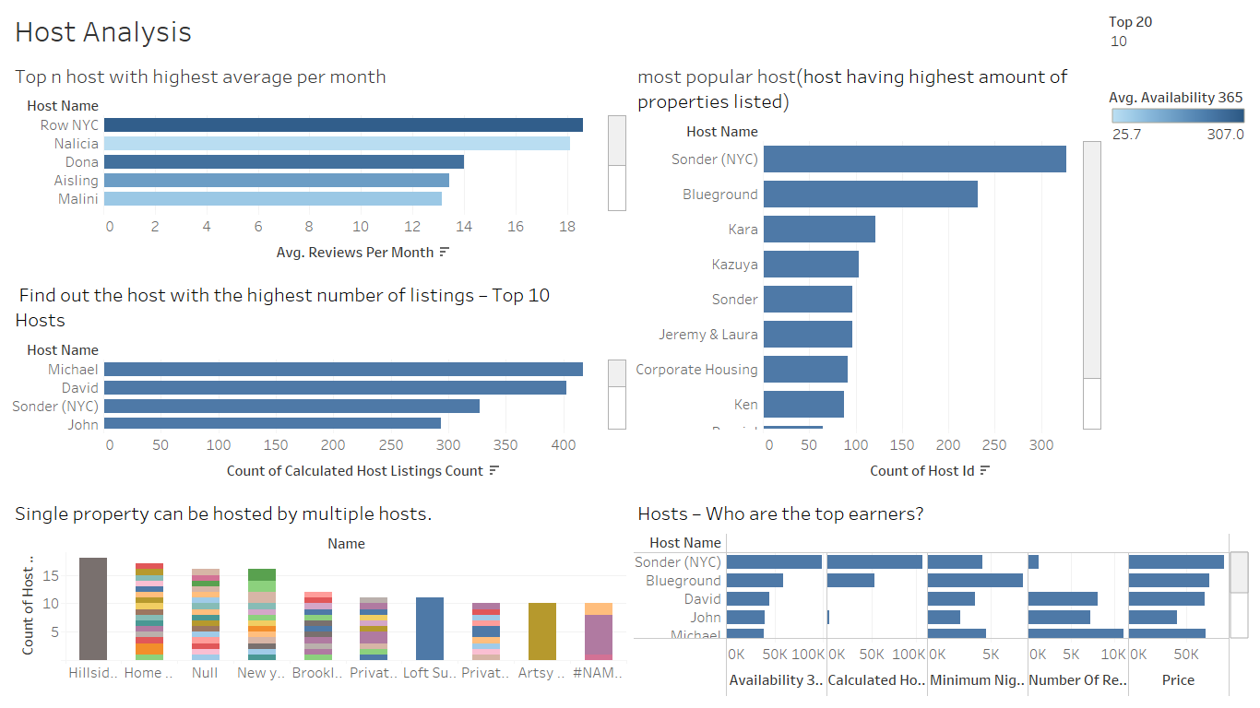
Most popular Host in terms of reviews , listing properties and top Earners
Sonder (NYC) is among the highest in the properties listed category, but its not the case for the top n review counts or the top calculated host listing counts. Thus the popular listing will not mean that host can have more customers.
We can see from the charts that single property can be hosted by multiple hosts. The property called Hillside Hotel is been hosted by 18 host
From the last chart we can see the top earning host in this business, based on availability, no of reviews, Prices and the minimum night count. All these factors accounting in the same result as we saw for the highest amount of property listed category

Slide 6
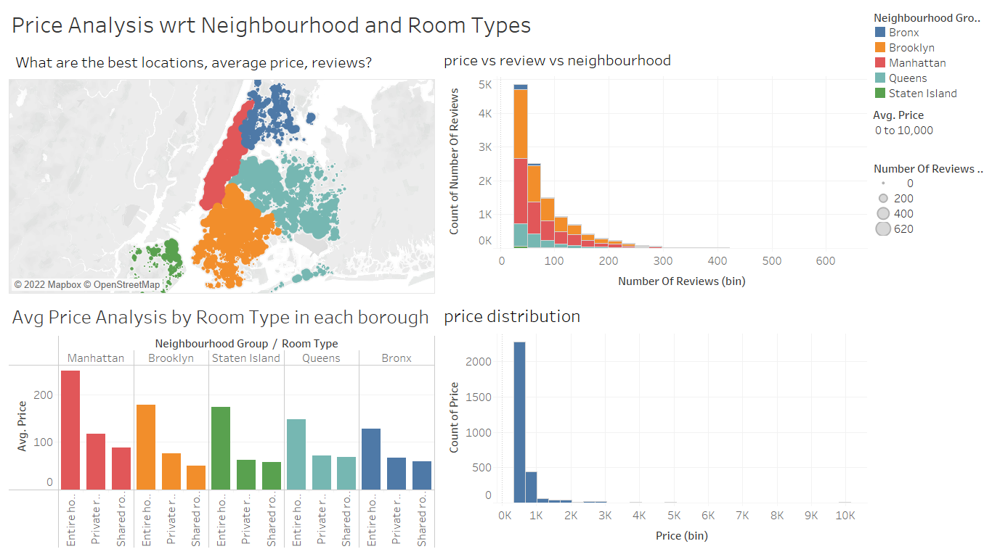
Price Analysis for the neighbourhood group and the Room Types Availability
Manhattan is the most expensive neighborhood group with avg pricing of 176.2, followed by Brooklyn with 119.6, Queens have 91.5,Bronx and Staten Island has avg price of about 85. The avg Price for all the room types is at the higher range compared to all the other neighborhood group.
We decide to exclude the null values for the price column since it showed minimum price to be 0$ which is not possible.
There is more demand for the entire room / dept compared to shared and Private room.
Manhattan has the highest charged properties ranging from 89 to 249.5, followed by Brookly with 50.5 to 178.3
From charts we can say that Brooklyn neighbourhood has highes no of reviews with affordable pricings for the properties

Slide 7
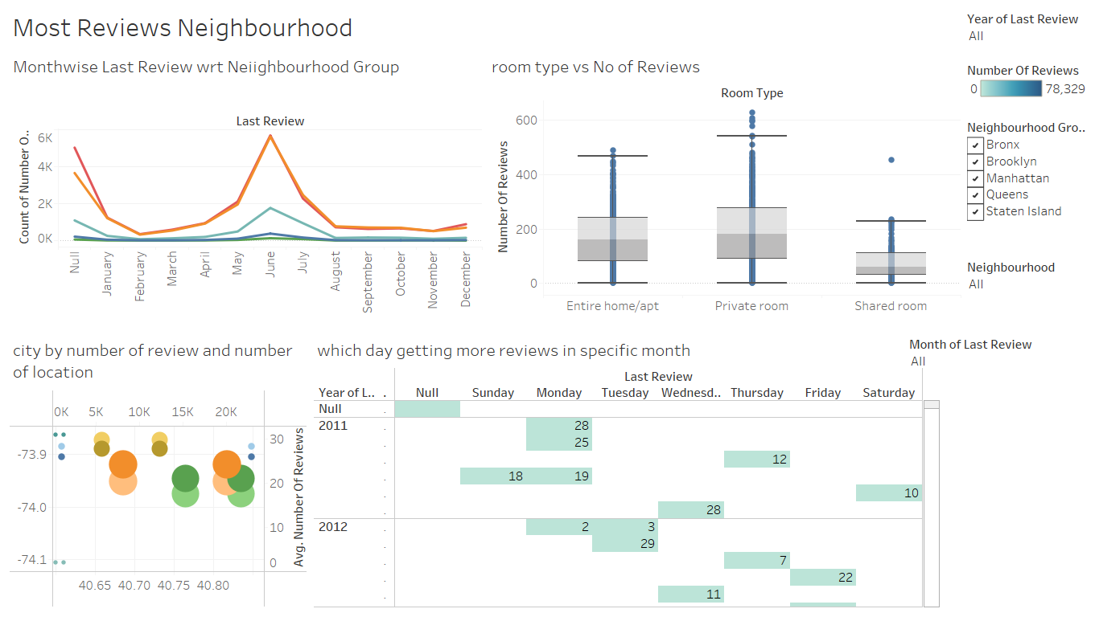
The Property Choices based on the Reviews , availability of the rooms
The calendar chart determines the busied days depending on the color of the day.
We can observe that few customers visited Bronx and Staten Island. Manhattan is the busiest Neighbourhood Group
The year 2019 has most of the reviews, so we can say most of the visits we done in 2019.
Brooklyn Bath Beach has the highest number of reviews.

Slide 8
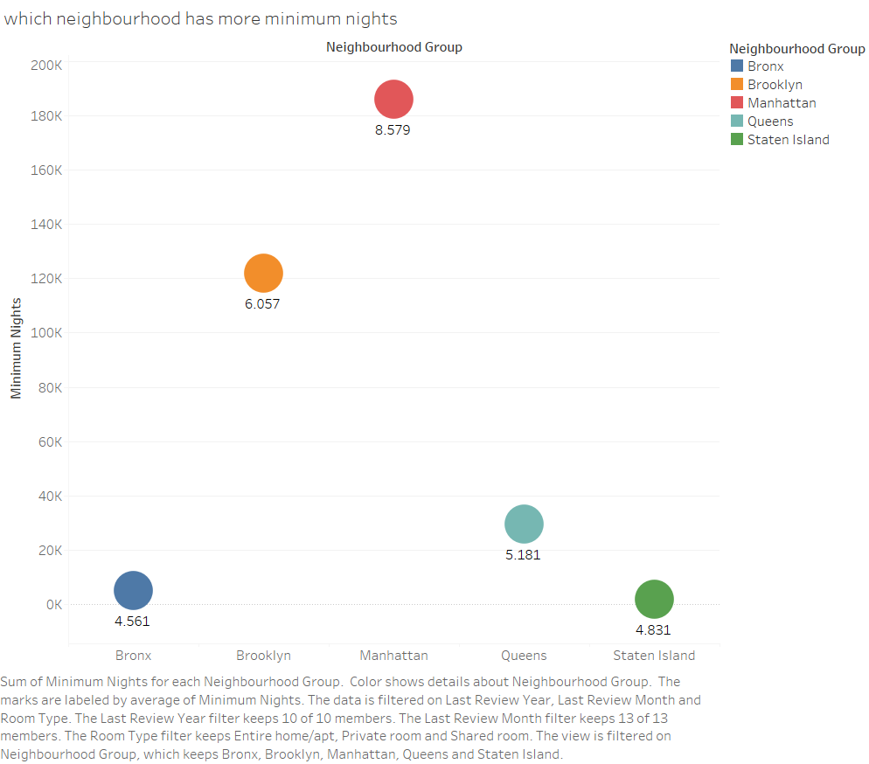
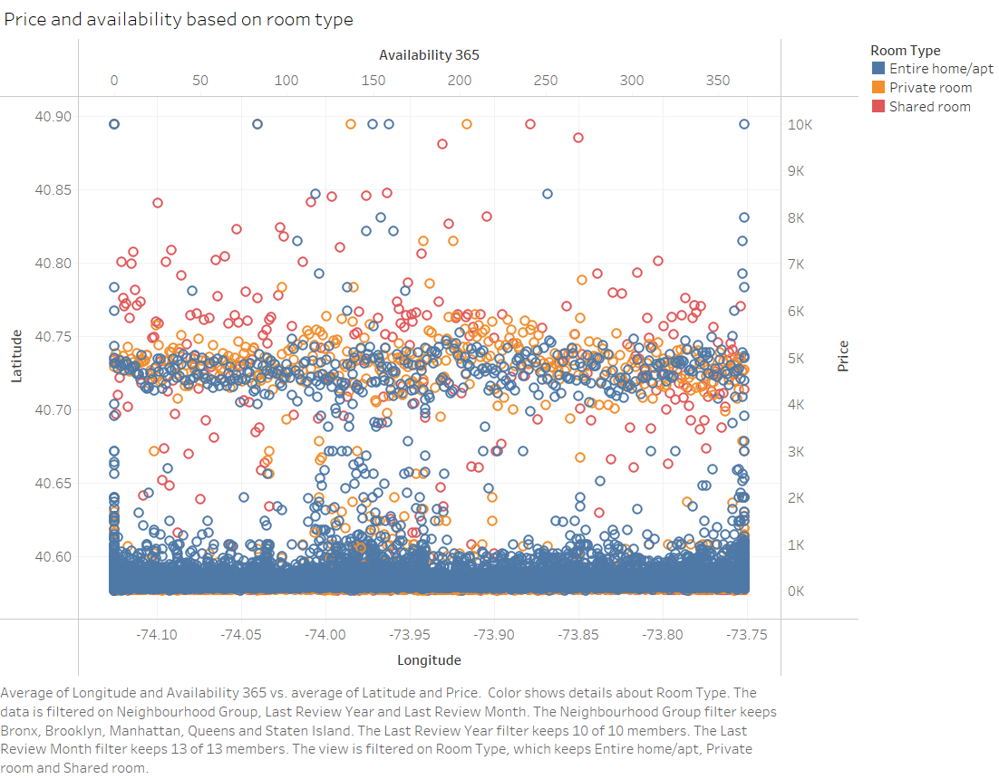
5. There is more availability for the Entire room type followed by Private and then Shared Room type, depending on the average prices
6. Manhattan is the more preferred minimum nights with the average minimum nights of 8.5 followed by Brooklyn with 6 , Queens with 5 and Bronx and Staten Island with 4.5 and 4.8 approximately.

Slide 9
APPENDIX - DATA SOURCES:
The data dictionary.
Host demographics such as neighborhood group, Host name, Host id,.
Property name, location, pricing, room types, availability of the room
Customers preferences shown in the responded like the minimum nights booked, number of reviews, reviews per months.
The data source used:
New York AirBnB Dataset

Slide 10
APPENDIX - DATA METHODOLOGY
Used Tableau for the visualization for getting insights
Host Analysis done with respect to highest calculated hosting list, reviews per month and the top earners
Price Analyzed based on the reviews, availability of the rooms and the choices of the room types and locations.

Slide 11
APPENDIX - DATA ASSUMPTIONS
In the analysis we have excluded null values as null values didn’t impact the analysis of the data
Top Host preferences and the reviews for the property are the most impactful data that determined the customer preferences
Prices and room availability are the next immediate factors that affects the customers choice of property selection.

