Slide 1
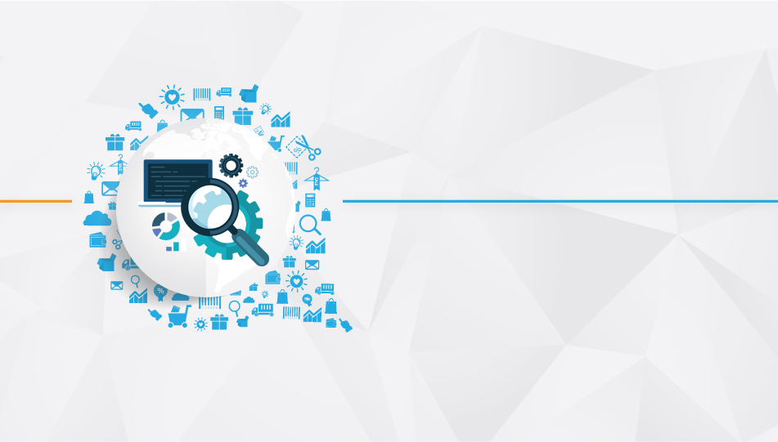

CDP : Spring boot Developer

Slide 2
Objective
Define and demonstrate Spring boot
Developing and deploying application using spring boot
Design and develop web applications using spring boot
Develop and deploy applications using JPA and Spring Boot.
Develop and deploy rest application
Define and Demonstrate Actuator
Define and demonstrate HAL
Define and Demonstrate spring boot messaging (RabbitMQ)
Develop and deploy application for Spring boot documentation
Developing end to end application using spring boot
Developing and deploying cloud native application.
CDP : Infogain Certified Spring Boot Developer Schedule
Date | Day | Topic
18-Jul-18 | Wednesday | Spring Boot -1
20-Jul-18 | Friday | Spring Boot -2
26-Jul-18 | Thursday | Spring Boot-3
TBD

Slide 3
Session 3 - Objective
Define and Demonstrate spring boot messaging (RabbitMQ)
Develop and deploy application for Spring boot documentation
Developing end to end application using spring boot
Developing and deploying cloud native application.

Slide 4
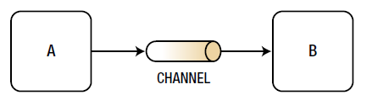
Spring Boot : Messaging
Simple messaging process, whereby it communicates from point A to point B through whatever media is possible.
Messaging Use Cases:
Delivery Guaranteed
• Developers need to make sure that the message they are sending reaches its destination. Sender knows that message is delivered or not ( Acknowledge).
Decoupled :
Scalable and High Available
• Every time a system experiences high-request demands, it needs to be scalable and not have a single point of failure.
Asynchronous
• Applications must be very quick and be able to respond to a request as soon as possible.
Interoperability
• An important factor when creating messaging systems is the ability to produce/send a message and be able to understand that message when consuming/receiving.
Nowadays, interoperability is possible with new brokers like the one that implements the AMQP protocol or even with simple RESTful APIs or WebSockets that, regardless of the implementation, enable the producer and consumer
to interoperate seamlessly.
Notes:
Decoupled
• When dealing with software architecture, developers look for decoupled
components for easy integration, extensibility, and simple operation
and maintenance. But how can you achieve decoupling? Messaging is
part of the solution, because it allows you to think in your own business
domain, which is a bounded context. The information you produce/
send is your main concern, regardless of how the consumer/receiver
will implement its own business logic.

Slide 5
Messaging Models
producer/publisher
A JMS client that creates and sends messages.
consumer/subscriber
A JMS client that receives messages.
queue
A staging area that contains messages that have been sent and are waiting to be read (by only one consumer). Contrary to what the name queue suggests, messages don't have to be received in the order in which they were sent. A JMS queue only guarantees that each message is processed only once
topic
A distribution mechanism for publishing messages that are delivered to multiple subscribers.

Slide 6
Messaging Patterns
A design pattern is a solution to a commonly known problem in the software design. By the same token, messaging patterns attempt to solve problems with messaging designs.
Message type patterns: Describe different forms of messaging, such as string (maybe plain text, JSON and/or XML), byte array, object, etc.
Message channel patterns: Determine what kind of a transport (channel) will be used to send a message and what kind of attributes it will have.
Routing patterns: Describe a way to send messages between producer and consumers by providing a routing mechanism (filtering that’s dependent on a set of conditions) in an integrated solution.
Service consumer patterns: Describe how the consumers will behave when messages arrive, such as adding a transactional approach when processing the message.
Contract patterns: Contracts between the producer and consumer to have simple communications, such as when you do some REST calls.
Message construction patterns: Describe how a message is created so it can travel within the messaging system. For example, you can create an “envelope” that can have a body (the actual message) and some headers (with a correlation ID or a sequence or maybe a reply address).
Transformation patterns: Describe how to change the content of the message within the messaging system
Notes:
Message channel patterns: Determine what kind of a transport (channel)
will be used to send a message and what kind of attributes it will have.
The idea here is that the producer and consumer know how to connect to
the transport (channel) and can send and receive the message. Possible
attributes of this transport include a
request-reply feature and a unidirectional channel, which you will learn
about very soon. One example of this pattern is the point-to-point channel.

Slide 7
AMQP with Spring Boot
The AMQP model is made up of messages that are published to exchanges. These exchanges distribute the messages to queues based on bindings (rules). The consumers then fetch/pull messages from these queues.
Exchanges, Bindings, and Queues : These keywords are also known as AMQP entities
Exchanges: Entities where the producer sends messages. The exchange will use bindings to route the messages to the correct queue.
Bindings: The rules that connect an exchange with another exchange or a queue. This is a string value
Queue: Store the messages (in memory or on disk) until they are consumed by applications.

Slide 8
RabbitMQ and Spring Boot
RabbitMQ is an open source message broker software (sometimes called message-oriented middleware) that originally implemented the Advanced Message Queuing Protocol (AMQP) and has since been extended with a plug-in architecture to support Streaming Text Oriented Messaging Protocol (STOMP), Message Queuing Telemetry Transport (MQTT), and other protocols ^{[1]}.
Software list for RabbitMQ:
Er Language : https://www.erlang.org/downloads
RabbitMQ : https://www.rabbitmq.com/install-windows.html
Configuration for RabbitMQ:
spring.rabbitmq.host=localhost
spring.rabbitmq.port=5672
spring.rabbitmq.username=guest
spring.rabbitmq.password=guest

Slide 9
Spring Boot Documenting
The traditional approach of API documentation is either by writing service specification documents or using static service registries. With a large number of microservices, it would be hard to keep the documentation of APIs in sync.
Microservices can be documented in many ways. This section will explore how microservices can be documented using the popular Swagger framework.
The following example will use Springfox libraries to generate REST API documentation. Springfox is a set of Java- and Spring-friendly libraries.
<dependency>
<groupId>io.springfox</groupId>
<artifactId>springfox-swagger2</artifactId>
<version>2.3.1</version>
</dependency>
<dependency>
<groupId>io.springfox</groupId>
<artifactId>springfox-swagger-ui</artifactId>
<version>2.3.1</version>
</dependency>

Slide 10
Spring Boot Security
Adding basic authentication to Spring Boot is pretty simple. Add the following dependency to pom.xml. This will include the necessary Spring security library files:
<dependency>
<groupId>org.springframework.boot</groupId>
<artifactId>spring-boot-starter-security</artifactId>
</dependency>

Slide 11
Thank You

Slide 12

www.infogain.com
Infogain Corporation, HQ
485 Alberto Way Los Gatos, CA 95032 USA
Phone: 408-355-6000
Fax: 408-355-7000
Pune
7th Floor, Bhalerao Towers, CTS No.1669 - 1670, Behind Hotel Pride,
Shivaji Nagar, Pune - 411005
Phone : +91-20-66236700
Infogain Irvine
41 Corporate Park, Suite 390 Irvine, CA 2606 USA
Phone: 949-223-5100
Fax: 949-223-5110
Infogain Austin
Stratum Executive Center Building D 11044 Research Boulevard Suite 200
Austin, Texas 78759
Noida
A-16, Sector 60, Noida Gautam Budh agar, 201301 (U.P.) India
Phone: +91-120-2445144
Fax: +91-120-2580406
Dubai
P O Box 500588 Office No.105, Building No. 4, Dubai Outsource Zone,
Dubai, United Arab Emirates
Tel: +971-4-458-7336

