Slide 1


BUSA3021 Report COVID-19’S IMPACT ON INTERNATIONAL STUDENT MOVEMENT AND MARKET SHARE For Macquarie International
Authors
Rijwa Abbas
Alec Boyd
Adam Gebbie
Chieh-Ying Lo
Ryan Siva

Slide 2
Table of contents
Executive Summary
Background
Research questions/methodologies
Western countries response to Covid-19
Australian response to Covid-19
Australian education exports
Diving deeper
Beyond 2021
Scenario analysis
Summary & recommendations
Appendix
Data sources
Additional information

Slide 3
Insights | Executive Summary
Australian International Student Exports witnessed a staggering 17% reduction in Western countries' market share following the COVID-19 pandemic. While competitor countries such as the U.S.A, U.K, and Canada recovered due to policy and intervention and timely border openings, Australian higher education exports have continued to suffer due to border restrictions.
Australia's main education export partners include China, India, Brazil, Nepal, Columbia, and Vietnam. A closer examination of China, India & Brazil indicates that focusing on these partners will allow Australia to regain market share. Analysis indicates that the International Students from the aforementioned countries are choosing to study in neighbouring countries, mainly The U.S.A or Canada, owing to Australian border restrictions and working rights.
Each education partner has had a peak intake in Australia over the last five years, and one opportunity for Australia is to bench these peaks and aim to fill the gap. Of the main education partners, most significant opportunity lies with China, India and Brazil, which saw a 34%, 44% and 50% decrease in students respectively (~48,000 students) as Covid-19 emerged. Based on forecasting techniques, Australia can recover market share by growing international student intake by 60% yearly. Data suggests Australia should model the U.S and Canada where possible and focus on promoting working rights for students in Australia.

Slide 4
Statement of Work
The purpose of this report is to provide detailed insight and recommendation on how Australia may react to strengthen market share in education exports post-Covid-19 pandemic.
This report is based on a variety of analyses and collated data on international student movements across western countries pre/post the Covid-19 pandemic.
Forecasting and Regression techniques have been used alongside other analytics tools and expertise to detail:
What is happening with international students in Western Countries
Why international students are returning to certain countries
Where international students are going if not Australia
How Australia can reposition to attract more international students
When Australia should act.

Slide 5
Background

Slide 6
Introduction
Due to Covid-19, international student market has been impacted since 2020 and western countries has implemented different policies for international students, which turned out different results in the market.
The purpose of this report is to analyse and research the international student market in western countries as well as Australian major international student origin countries, providing recommendations based on insights for Macquarie International.

Slide 7
Background | International students in Western Countries over time
Australia, Canada & U.K trending upward from 2015.
U.S.A trending downward.
All Western Countries experienced sharp decline in international student numbers at beginning of Pandemic.
U.S.A and Canada have seen the most significant increases followed by U.K.
Australia has continued to decline.

Slide 8
Background | Growth in International Students from Covid-19
The key callouts in this graph are:
156% growth in International Students in the U.S.A.
33% growth in International Students in the U.K.
11% growth in International Students in Canada.
-32% growth in international Students In Australia.

Slide 9
Research

Slide 10
Research | Research Questions
Which policies and interventions have other Western Countries implemented to stimulate International Student growth?
Who are Australia’s top education export partners and where are they now electing to study?
Under which scenarios can Australia recover lost market share?

Slide 11
Research | Western Higher Education Market Share
Market Share for Australia peaked pre-pandemic at 39% but has since reduced to 22% and has not yet begun to recover.
Conversely, Market share for the U.S.A dropped to 13% and has since jumped to 28%.
United Kingdom market share has grown consistently despite the pandemic now sitting at 22% and on par with Australia.

Slide 12
Policy & Interventions

Slide 13
Policy | Policy and Intervention - Canada

Slide 14
Policy | Policy and Intervention – U.S.A

Slide 15
Policy | Policy and Intervention – U.K
Columbia, Dom Republic, Ecuador. Haiti, Panama, Peru, Venezuela
U.K revisits 2019 Education Strategy based on 12% IS growth despite Covid19 focusing on new priority markets:
India, Indonesia, Saudi Arabia, Vietnam and Nigeria, with Brazil, Mexico, Pakistan, Europe, China, and Hong Kong
New Student Immigration Route Launched – Streamlines immigration process for international students
Countries with ‘Red’ travel status now reduced to 7 countries globally. All vaccinated International students welcome.
U.K hits 80% double dose vaccination
Vaccine certificates issued by India and Hong Kong now recognised
Travel ban imposed due to Delta variant
Initial Covid-19 outbreak
Jan-20
Apr-20
Jul-20
Oct-20
Jan-21
Apr-21
Jul-21
Oct-21
Notes:
https://monitor.icef.com/2021/02/uks-updated-international-education-strategy-commits-to-growth-targets-and-post-pandemic-recovery/
https://www.gov.uk/guidance/coronavirus-covid-19-student-sponsors
https://www.ukcisa.org.uk/Information--Advice/Studying--living-in-the-UK/Coronavirus-Covid-19-info-for-international-students#:~:text=All%20sponsored%20students%20must%20be,%2Dto%2Dface%20attendance).
https://www.gov.uk/guidance/red-list-of-countries-and-territories
https://study-uk.britishcouncil.org/moving-uk/coronavirus

Slide 16
Policy | Policy and Intervention - Australia
The first COVID-19 case in Australia was reported
Australia banned the entry of foreign nationals who had been in mainland China, and ordered its own returning citizens who had been in China to self-quarantine for 14 days
Australia’s boarders to all non-residents close/Lockdown restrictions progressively implemented by Australian government including schools and universities begin their movement to online learning
142,000 doses of the Pfizer–BioNTech COVID-19 vaccine arrived in Australia / 300,000 doses of the Oxford–AstraZeneca vaccine, which arrived at Sydney airport.
The NSW Government announced that it would fund temporary crisis accommodation as part of a $20 million package to support stranded international students.

Slide 17
Beyond 2021| Western Countries
Market Share.
The -32% growth in Market share for Australia has resulted in Australia having 22% of western country education exports.

Slide 18
Policy | Summary and Analysis
In 2019 (before COVID19) Australia was ranked as the largest market share of the main competitors at 39%. By June 2021 that market share plummeted by 17% to an bi-annual total of 22%.
Australia experienced dramatic market share loss due to the lack of federal policies accounting for IS movement. Competitors applied such policies that allowed for IS students to be granted access into their country for study, thus increasing their market shares.
Competitors Advantage
UK opening of borders from June 2020
USA opening of borders from July 2020
Canadas easing of restrictions from June – October 2020
Australia's has tourniquet IS
Australia's borders have remained locked since February 2020.
This has caused Australia’s international student growth to drop to -32% in 2021 from 2020.
Australia is now in a position of strategic disadvantage as students have chosen competitors

Slide 19
Australia’s educational exports

Slide 20
Diving Deeper | Australia
Australia’s 6 main education export partners are China, India, Nepal, Brazil, Columbia and Vietnam.
Whilst Vietnamese and Nepalese education exports were declining pre-Covid, all other markets were inclining until the pandemic.

Slide 21
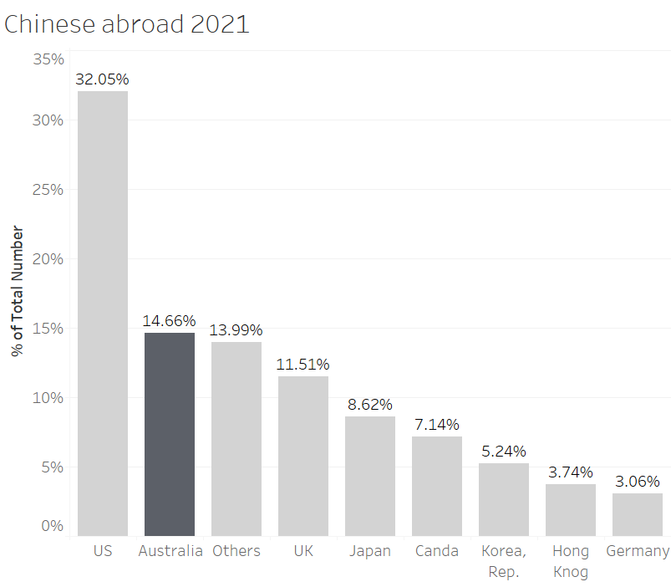
Diving Deeper | China
Pre-covid, the number of Chinese students studying in Australia was increasing and remained stable due to the location advantage and graduate visa policy.
During pandemic, the number of Chinese student has dropped 34%. The border restriction has discouraged new Chinese students to study in Australia.
In 2021, Australia is the second large country where Chinese students are choosing to study; however, UK has close market share of Chinese students as Australia.

Slide 22
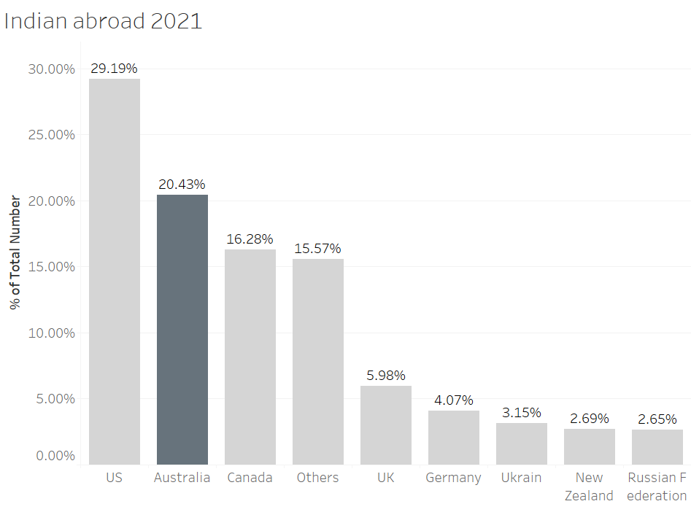
Diving Deeper | India
Pre-covid, the number of Indian students were increasing for Australia, however, owing to border closure the number of visa application fell significantly.
Most Indian Students seemed to have opt for US due to comparatively feasible border restriction.
Canada, a strong competitor for Indian International Students due to strong knit Indian community and suitable Post Study work visas, too, suffered owing to border restriction

Slide 23
Diving Deeper | Brazil
Pre Covid-19, Australia saw a massive 68% increase to 16,435 Brazilian International Students studying in Australia. Data suggest this is due to the ability for Brazilians to work whilst study and vocational education.
Current Brazilian enrolments are approximately 50% (8710).
Data suggest Brazilians are choosing to study in neighbouring Argentina, Portugal or the U.S.A

Slide 24
Forecasting International Student applications

Slide 25
Beyond 2021| Recovering Australian market Share
Market Share.
The -32% growth in Market share for Australia has resulted in Australia having 22% of western country education exports.

Slide 26
Beyond 2021| Recovering Australian market Share (Time Series)

Slide 27
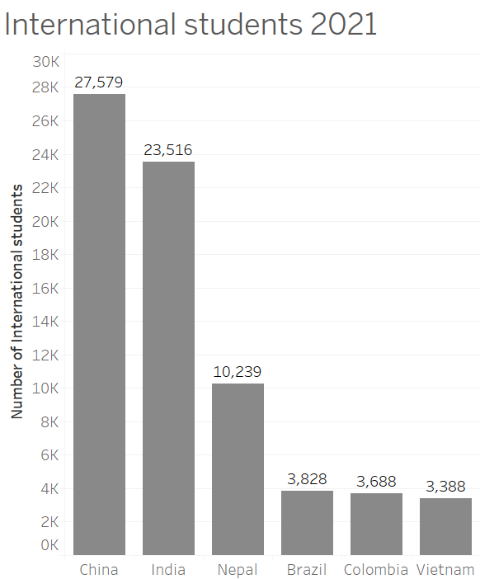
Beyond 2021| Recovering Australian market Share
Australian market share 2021 = 22% With majority exports from 6 main countries.
Market Share Recovery Analysis:
Scenario 1 = 5% increase in international Students
Scenario 2 = 10% increase in international Students
Scenario 3 = 25% increase in international Students
Scenario 4 = 50% increase in international Students
Scenario 5 = 75% increase in international Students
Scenario 6 = 100% increase in international Students
A model has been built to calculate the scenarios. See appendix.
Expected market share recovery in terms of student applications to be between 50% and 75% across the next 3 years.
Scenario analysis example from Excel

Slide 28
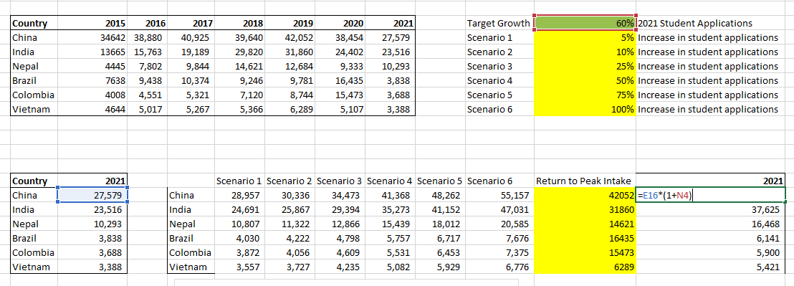
Beyond 2021| Recovering Australian market Share
Using the excel model, goal seek and scenario manager, in order return to peak intake for top 6 export countries, Australia will need to increase student applications by 60% on 2021 student applications.

Slide 29
Beyond 2021| Recovering Australian market Share
Is at least 60% increase in student applications realistic post-pandemic?
What is the net benefit to Macquarie per international student? With no change, Australia will continue to bring in ~70,000 students from our top export partners per year. Can further calculation be conducted to understand a cost/benefit analysis on current gov’t policy?

Slide 30
Beyond 2021| Recovering Australian market Share
This slide compares the time series forecast based on historical data and the 60% growth scenario forecast based on vaccination rates in the excel model.
Both models indicate by 2024, Australia will be on track to achieve ~300,000 IS per annum. Second only to Canada.
Should Australia be looking to Canada more than other countries to adopt IS policy?

Slide 31
Insights | Recommendations
Australia has lost a large proportion of their international student customer base to competitors.
Strategy needs to applied to attract new IS customers and potentially regain churned customers.
Firstly federal policies must be implemented to reopen borders for IS movement. This policy is out of Australian Education Institution’s control.
Macquarie International can focus on the top 6 origin counties and come up with marketing strategies to target international students from these countries.
Hiring Macquarie students who are in top 6 origin countries to do marketing campaigns in local schools and attract local students who are interested in studying abroad.
Consider joint marketing efforts with vocational education providers and industry to attract international students back to Australia.
Demonstrate the cost-benefit of one international student and apply to the scenarios in the previous slides. Justify the need for return to peak international student intake.

Slide 32
Thank You

Slide 33
Appendix

Slide 34
Appendix | References and Data Sources
COVID-19 Restrictions on U.S. Visas and Entry, NAFSA, https://www.nafsa.org/regulatory-information/covid-19-restrictions-us-visas-and-entry#countryproclamations
SEVP Broadcast Message 2003-01: COVID-19 and Potential Procedural Adaptations for F and M Students, NAFSA, https://www.nafsa.org/regulatory-information/sevp-broadcast-message-2003-01-covid-19-and-potential-procedural-adaptations
Suspension of Routine Visa Services, Travel State Government, https://travel.state.gov/content/travel/en/News/visas-news/suspension-of-routine-visa-services.html
SEVP Online Course Guidance for F and M Students for Fall 2020, Travel State Government, https://travel.state.gov/content/travel/en/News/visas-news/sevp-online-course-guidance-for-f-and-m-students-for-fall-2020.html
CDC Expands Negative COVID-19 Test Requirement to All Air Passengers Entering the United States, Centers for Disease Control and Prevention https://www.cdc.gov/media/releases/2021/s0112-negative-covid-19-air-passengers.html
Visa Services Operating Status Update, Travel State Government, https://travel.state.gov/content/travel/en/News/visas-news/visa-services-operating-status-update.html
Monthly Non-immigrant Visa Statistic, Travel State Government, https://travel.state.gov/content/travel/en/legal/visa-law0/visa-statistics/nonimmigrant-visa-statistics.html

Slide 35
Appendix | References and Data Sources
student visas granted—higher education and postgraduate research streams, 2008–2020
https://www.homeaffairs.gov.au/research-and-stats/files/student-temporary-grad-program-report-december-2020.pdf
Primary Student visa grants by the applicant's country of citizenship
https://www.homeaffairs.gov.au/research-and-statistics/statistics/visa-statistics/study
International HE Student Enrolment in Australia
https://www.aph.gov.au/About_Parliament/Parliamentary_Departments/Parliamentary_Library/pubs/rp/rp2021/Quick_Guides/OverseasStudents
COVID-19: a chronology of state and territory government announcements (up until 30 June 2020)
https://www.aph.gov.au/About_Parliament/Parliamentary_Departments/Parliamentary_Library/pubs/rp/rp2021/Chronologies/COVID-19StateTerritoryGovernmentAnnouncements
Timeline of COVID-19 in Australia: the first year
https://deborahalupton.medium.com/timeline-of-covid-19-in-australia-1f7df6ca5f23

Slide 36
Appendix | References and Data Sources
University Student Flow, UNESCO http://uis.unesco.org/en/uis-student-flow
Canadian Tuition fees https://www150.statcan.gc.ca/t1/tbl1/en/tv.action?pid=3710004501&cubeTimeFrame.startYear=2015+%2F+2016&cubeTimeFrame.endYear=2021+%2F+2022&referencePeriods=20150101%2C20210101
Temporary Residents: Study Permit Holders – Monthly IRCC Updates
https://open.canada.ca/data/en/dataset/90115b00-f9b8-49e8-afa3-b4cff8facaee
Coronavirus disease (COVID-19): Canada’s response
https://www.canada.ca/en/public-health/services/diseases/2019-novel-coronavirus-infection/canadas-reponse.html#ta
COVID-19 Intervention Timeline in Canada
https://www.cihi.ca/en/covid-19-intervention-timeline-in-canada
COVID-19 resources
https://www.cihi.ca/en/covid-19-resources

Slide 37
Appendix | References and Data Sources
COVID-19 vaccination in Canada
https://health-infobase.canada.ca/covid-19/vaccination-coverage/
UK Historical International Student Data
https://www.ukcisa.org.uk/Research--Policy/Statistics/International-student-statistics-UK-higher-education
UK International Student Breakdown
https://www.hesa.ac.uk/news/27-01-2021/sb258-higher-education-student-statistics
https://www.hesa.ac.uk/news/27-01-2021/sb258-higher-education-student-statistics/numbers
https://www.hesa.ac.uk/news/27-01-2021/sb258-higher-education-student-statistics/location
UK Covid19 response
https://study-uk.britishcouncil.org/moving-uk/coronavirus
https://www.universityworldnews.com/post.php?story=20210910141029864

Slide 38
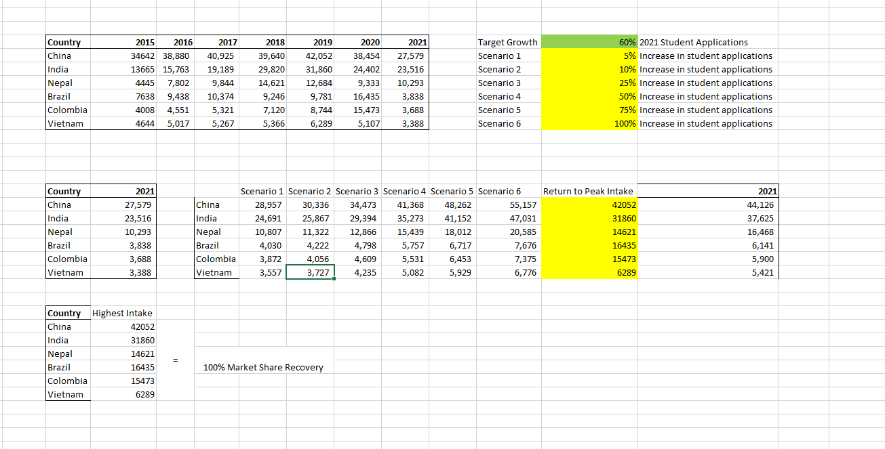
Appendix | Additional information – Excel Model

Slide 39
Beyond 2021| Top exporting Countries of IS to Australia
Australia’s IS market recovery Scenario analysis based on vaccinated students from top 6 export countries returning
Scenarios Run:
100% Market Share Recovery
50% Market Share Recovery
25% Market Share Recovery
10% Market Share Recovery
5% Market Share Recovery
We are assuming visas will be granted to those persons double vaccinated with a federally approved COVID19 vaccine.
Weights change according to vaccination rates of origin country.
Scenario analysis example from Excel
Scenario Summary - Chinese IS Market Share Recovery
 |  | Current Values: | 50% Rate | 25% Rate
Changing Cells:
Recovery rate | $B$14 | 100% | 50% | 25%
Result Cells:
2022 | $D$10 | 34,465 | 17,233 | 8,616
2023 | $D$11 | 44,432 | 22,216 | 11,108
2024 | $D$12 | 47,573 | 23,787 | 11,893
2025 | $D$13 | 50,715 | 25,358 | 12,679

Slide 40
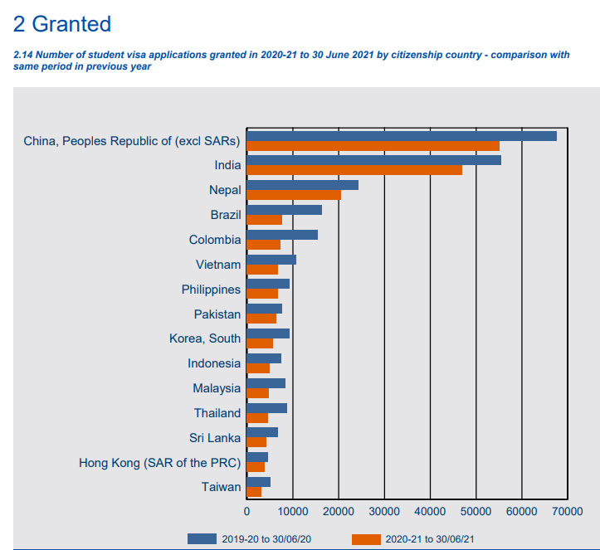
Beyond 2021| Top exporting Countries of IS to Australia
Data collected from Home Affairs
Temporary Students Report 2021
China
India
Nepal
Brazil
Colombia
Vietnam

Slide 41
1oo% Market share recovery assumes that all the international students are fully vaccinated and it will take a year to recover as pre-covid situation.
The forecast trend shows that Australian International student market will keep growing in next five year.
India IS
Nepal IS
Brazil IS
Columbia IS
Vietnam IS

Slide 42
Beyond 2021| Australia Forecast by Top 6 Origin Countries - 50% Weighted
50% market share recovery rate assumes that top 6 origin countries would still be impacted by covid-19 in 2022 and would start recovering from 2023.
The recovery rate would increase slightly. China and India would still have large market share but it would take at least 4 years to recover as pre-covid.

Slide 43
Beyond 2021| Australia Forecast by Top 6 Origin Countries - 25% Weighted
When the market recovery rate is 25%, the international student market in Australia would drop dramatically and it is not likely to recover as pre-covid situation within 5 years.

Slide 44
Beyond 2021| Australia Forecast by Top 6 Origin Countries - 10% Weighted
When the market recovery rate is 10%, the international student market in Australia very slowly trend upwards. Australia can expect a very slow rate of recovery if the percentage of growth is 10%

Slide 45
Beyond 2021| Australia Forecast by Top 6 Origin Countries – 5% Weighted
Australia will see a very flat, stagnant recovery if the growth rate is 5% of what we saw pre COVID-19 When the market recovery rate is 25%, the international student market in Australia would drop dramatically and it is not likely to recover as pre-covid situation within 5 years.

