Slide 1
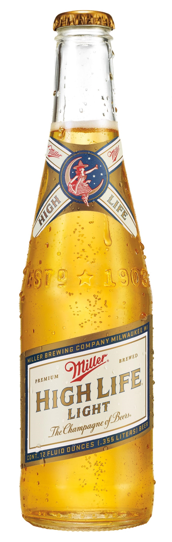
Re-introducing Miller High Life Light, a lighter take on the 120-year-old favorite, Miller High Life. Complete with the same signature effervescence, great taste, and iconic champagne-like bottle.
BRAND HIGHLIGHTS
As consumers become more price conscious, drive Economy Light beer growth with Miller High Life Light
Leverage Miller High Life’s brand badge, and in-market momentum, to win back lapsed drinkers and attract new ones
PRODUCT SPECIFICATIONS
STYLE: American-Style Light Lager
CALORIES: 107
CARBS: 6.2g
COLOR: light golden
CARBONATION: effervescent
ABV: 4.1%
LAUNCH DATE:
9/3/2024 (small packs)
2/3/2025 (large packs)
PLACEMENT:
Next to Miller High Life
PRICE GUIDANCE:
Line priced with High Life
SKUs
6pk 16oz Can
12pk 12oz Bottle
12pk 12oz Can
24 pk 12oz Can
30 pk 12oz Can
SHELF LIFE
18 weeks

Slide 2
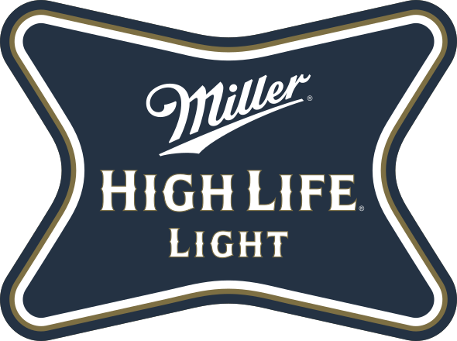
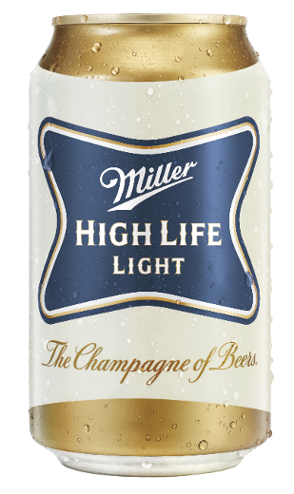
BRAND STORY
Miller High Life represents how American lagers were born to be. It was created as a perfect balance of flavor and refreshment and has remained so since 1903. It embodies a simplicity, purity and integrity typically associated with products that are expensive and ultra-premium – yet it remains widely available and economically priced.
Introduced in 1994, Miller High Life Light is the low-calorie, lighter profile version of Miller High Life.
BRAND FACTS
Introduced in 1903, Miller High Life is the oldest Miller Brewing Co. brand.,
For over 100 years, Miller High Life has been affectionately known as The Champagne of Beers, brewed to be the best of its kind
Served in the same iconic bottle since 1903 – a clear, champagne-like bottle to show the beer’s golden color and signature effervescence
Brewed with light-stable hops so quality is not compromised when served in a clear glass bottle
PRODUCT SPECIFICATIONS
STYLE: American-style Light Lager
COLOR: light golden
CALORIES: 107
CARBS: 6.2g
CARBONATED
ABV: 4.1%
IBUs: 5
SRM: 3.25
TASTING NOTES
APPEARANCE: Golden straw color, high clarity with creamy foam
AROMA: Low bready & fruity aroma with a slight hop character
TASTE: Malty with a slight sweetness balanced by a low bitterness and light body
FINISH: Crisp, dry finish

Slide 3
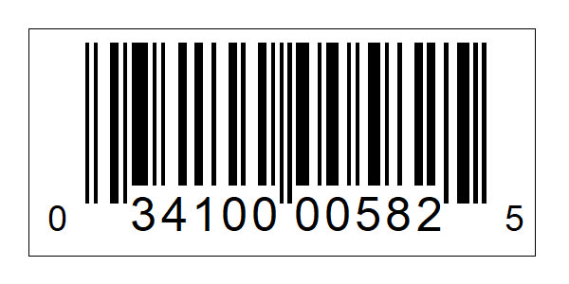
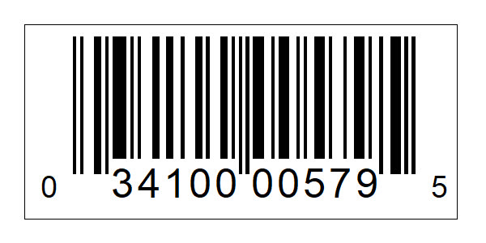
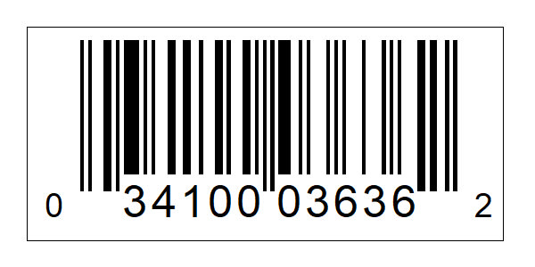
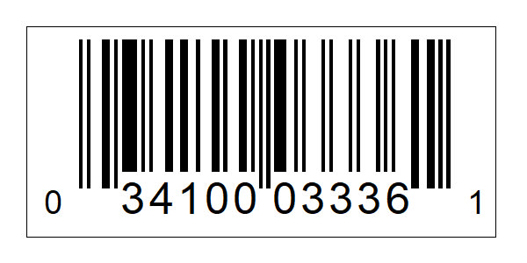
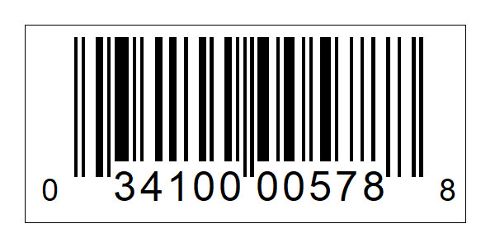
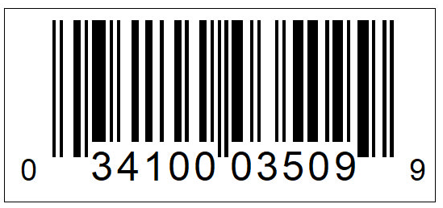
PRODUCT DETAILS | NEW ITEM DETAILS
STYLE | Light Lager
TARGET CONSUMER
MARKETS | Great Lakes Region
NUTRITION PROFILE | 107 calories /12oz, 6.2g carbs
ABV | 4.1% / 12oz
OSKU | 12pk Bottles; 700522 12pk Cans: 700828 6pk 16oz Cans: 700817
PACKAGE DIMENSIONS/ WEIGHT | 12pk Bottles 10 IN X 7.5 IN X 9.2 IN; 14.96 LB 12pk Cans: 10.5 IN X 8 IN X 5 IN; 10.2 LB 6pk 16oz Cans: 7.85 IN X 5.25 IN X 6.2 IN; 6.6 LB
CASE DIMENSIONS / WEIGHT | 12pk Bottles: 15.1 IN X 10 IN X9.25 IN; 30.75 LB 12pk Cans: 21.18 IN X 9.96 IN X 8.08 IN ; 20.52 LB 6pk 16oz Cans: 16.13 IN X 10.75 IN X 6.26 IN; 26.34 LB
UNITS PER PALLET | 12pk Bottles: 56 12pk Cans: 105 6pk 16oz Cans: 56
LAYERS PER PALLET | 12pk Bottles: 7 12pk Cans: 14 6pk 16oz Cans: 8
UNITS PER LAYER | 12pk Bottles: 8 12pk Cans: 7.5 6pk 16oz Cans: 7
SHELF LIFE | 18 weeks
PRICING GUIDANCE | Line priced with High Life
PLACEMENT | Adjacent to High Life
16oz Can Primary
12oz 12pk Can Primary
12oz 12pk Can Inner
12oz 12pk Can Outer
12oz 12pk Bottle Primary
12oz 12pk Bottle Inner

Slide 4
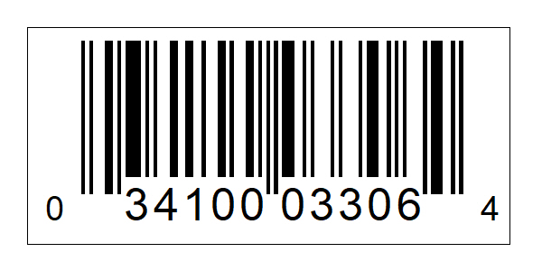
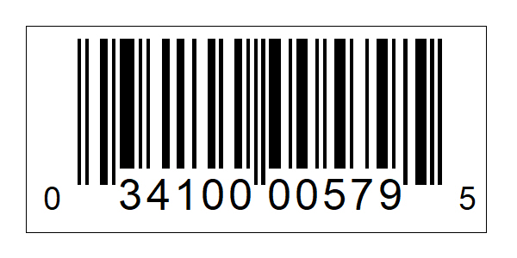
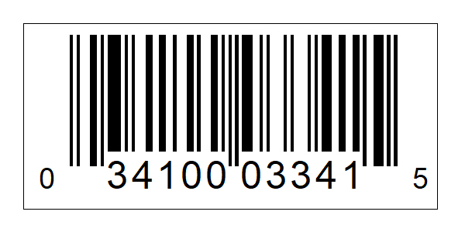
PRODUCT DETAILS – Large Packs | NEW ITEM DETAILS
STYLE | Light Lager
TARGET CONSUMER | Economy/Economy Light Beer Drinker
MARKETS | Great Lakes Region
NUTRITION PROFILE | 107 calories /12oz, 6.2g carbs
ABV | 4.1% / 12oz
OSKU | 24pk Cans: 700816 30pk Cans: 700824
PACKAGE DIMENSIONS/ WEIGHT | 24pk Cans: 15.73 x 4.93 x 10.58 30pk Cans: 13.15 x 7.86 x 9.75
CASE DIMENSIONS / WEIGHT | 24pk Cans: 20.25 lbs 30pk Cans: 25.01 lbs
UNITS PER PALLET | 24pk Cans: 98 30pk Cans: 91
LAYERS PER PALLET | 24pk Cans: 17 30pk Cans: 7
UNITS PER LAYER | 24pk Cans: 7 30pk Cans: 13
SHELF LIFE | 18 weeks
PRICING GUIDANCE | Line priced with High Life
PLACEMENT | Adjacent to High Life
12oz 24pk Can Consumer
12oz 24pk Can Outer
12oz 24pk Can Inner
12oz 30pk Can Consumer
12oz 30pk Can Outer
12oz 30pk Can Primary

