Slide 1
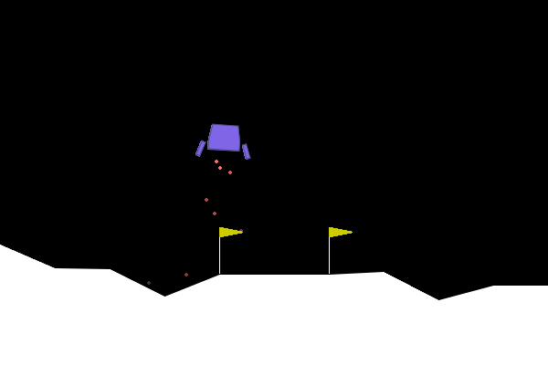
Autonomous Lunar Lander Using Deep Reinforcement Learning
Goal: teach an AI agent to land a spacecraft safely
Method: Deep Q-Network (DQN)
Built with: Python, PyTorch and Gymnasium
Presenters :
1. Jathin Kumar
2. Sreekar
3. Hareeshwar
The trained agent coming in to land
Notes:
This project teaches an AI agent to land a spacecraft in the LunarLander simulator, using a Deep Q-Network built with Python, PyTorch and Gymnasium. The picture is the trained agent coming down to land. (~30 seconds)

Slide 2
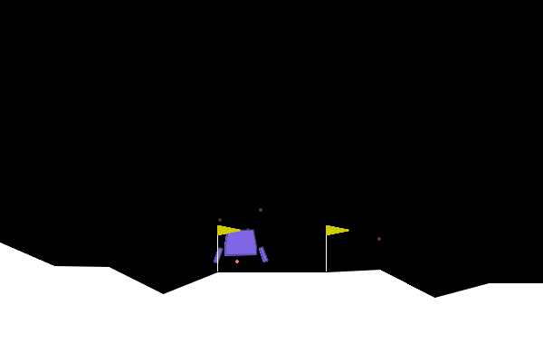
How Does the Agent Learn?
State
AI agent
Action
Environment
Learning
Reward
the lander, close to the pad
then it tries again, a bit better
State – what the lander sees: position, speed, angle, legs
Action – one of 4 choices: do nothing, left, main or right engine
Reward – a score for each move: good landing up, crash down
DQN – a neural network that guesses how good each action is
Notes:
The agent looks at the lander's state, picks one of four actions, and the environment gives back a reward and the next state. Doing this over and over, the agent gets better. DQN is the neural network that estimates how good each action is. (~50 seconds)

Slide 3
Project Architecture
train.py
runs the training
While training
runs episodes
Environment
LunarLander game
state, reward →
agent.py
picks actions, learns
state →
network.py
predicts Q-values
← action
← Q-values
experience
update weights
memory.py
keeps past experiences
sample batch
Learning update
trains on a random batch
After training
.pth checkpoint
saved model weights
load
watch_agent.py
loads it and runs a demo
actions
LunarLander
shows the trained agent
Notes:
train.py runs the training loop. The agent in agent.py picks actions using the network in network.py and keeps its experiences in memory.py. Random batches from memory are used to update the network. The weights are saved to a .pth file, and watch_agent.py loads that file to show the trained agent in the simulation. (~60 seconds)

Slide 4
How the Code Executes
Training
1. Initialize environment and agent
2. Observe the current state
3. Pick an action (epsilon-greedy)
4. Act and get the reward
loop back
Epsilon-greedy: mostly random moves early on, learned moves later
7. Repeat episodes; save checkpoint at reward target
6. Train network on a sampled batch
5. Store experience in replay memory
.pth file saved
Evaluation
watch_agent.py
8. Load the checkpoint and evaluate the agent
Notes:
Training is one loop: see the state, pick an action (random early, learned later), get a reward, store the experience, train the network on a batch, and go again. Once the average reward hits the target, the checkpoint is saved. Evaluation is separate: load the checkpoint and watch the agent. (~60 seconds)

Slide 5
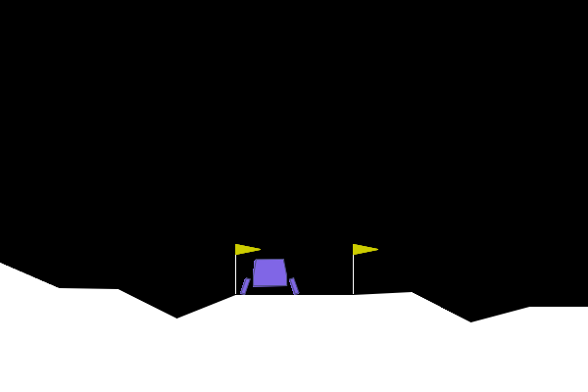
Results and Key Takeaways
On 20 test runs, the average score was 214.7, and 15 of 20 runs scored 200 or more.
The trained agent after landing (test run with seed 1, score 244.9)
Greedy test runs, seeds 0–19, using the repo checkpoint. Training reward curve: still to add.
The agent learns what to do by trying, getting a reward, and adjusting.
Next: make training steadier and tune the hyperparameters.
Next: test on more episodes.
Notes:
These are measured results: I ran the saved checkpoint for 20 test runs. The average score was about 215 and 15 of 20 runs scored 200 or more. A few runs scored lower, so steadier training and tuning are the next steps. The training reward curve still needs to be added from a fresh run of train.py. (~50 seconds)

