Slide 1


COVID Update
Rikesh Karmacharya, Hrishav Raghu Shrestha, Shubh Raj Dhital
4 October 2020

Slide 2
AIM
This app is to ease everyone to get the latest statistics and news about COVID-19 along with the bots which helps to find the posibility of ones being affected.

Slide 3

Idea Behind The App
Hamro Swasthya
OpenWHO: Knowledge For Health Emergencies
My Earthquake Alerts
Citizens

Slide 4
Application
Frontend

Slide 5


Login/ Registration
REGISTER SCREEN
(REGISTER USING YOUR OWN EMAIL)
SIGNIN SCREEN

Slide 6
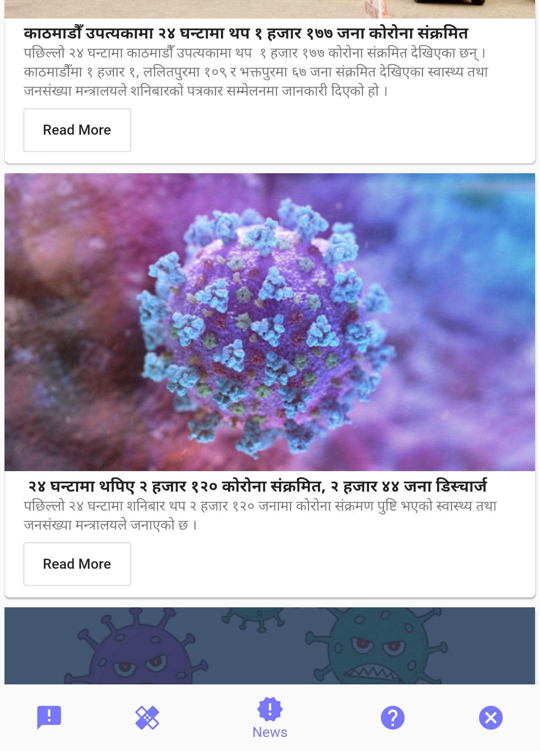
NAV-BAR
Directs to the Stats Section
Chatbot to check the infection
Uptodate NEWS
Basic knowledge and Emergency Contact Numbers
Take you back to the login screen

Slide 7
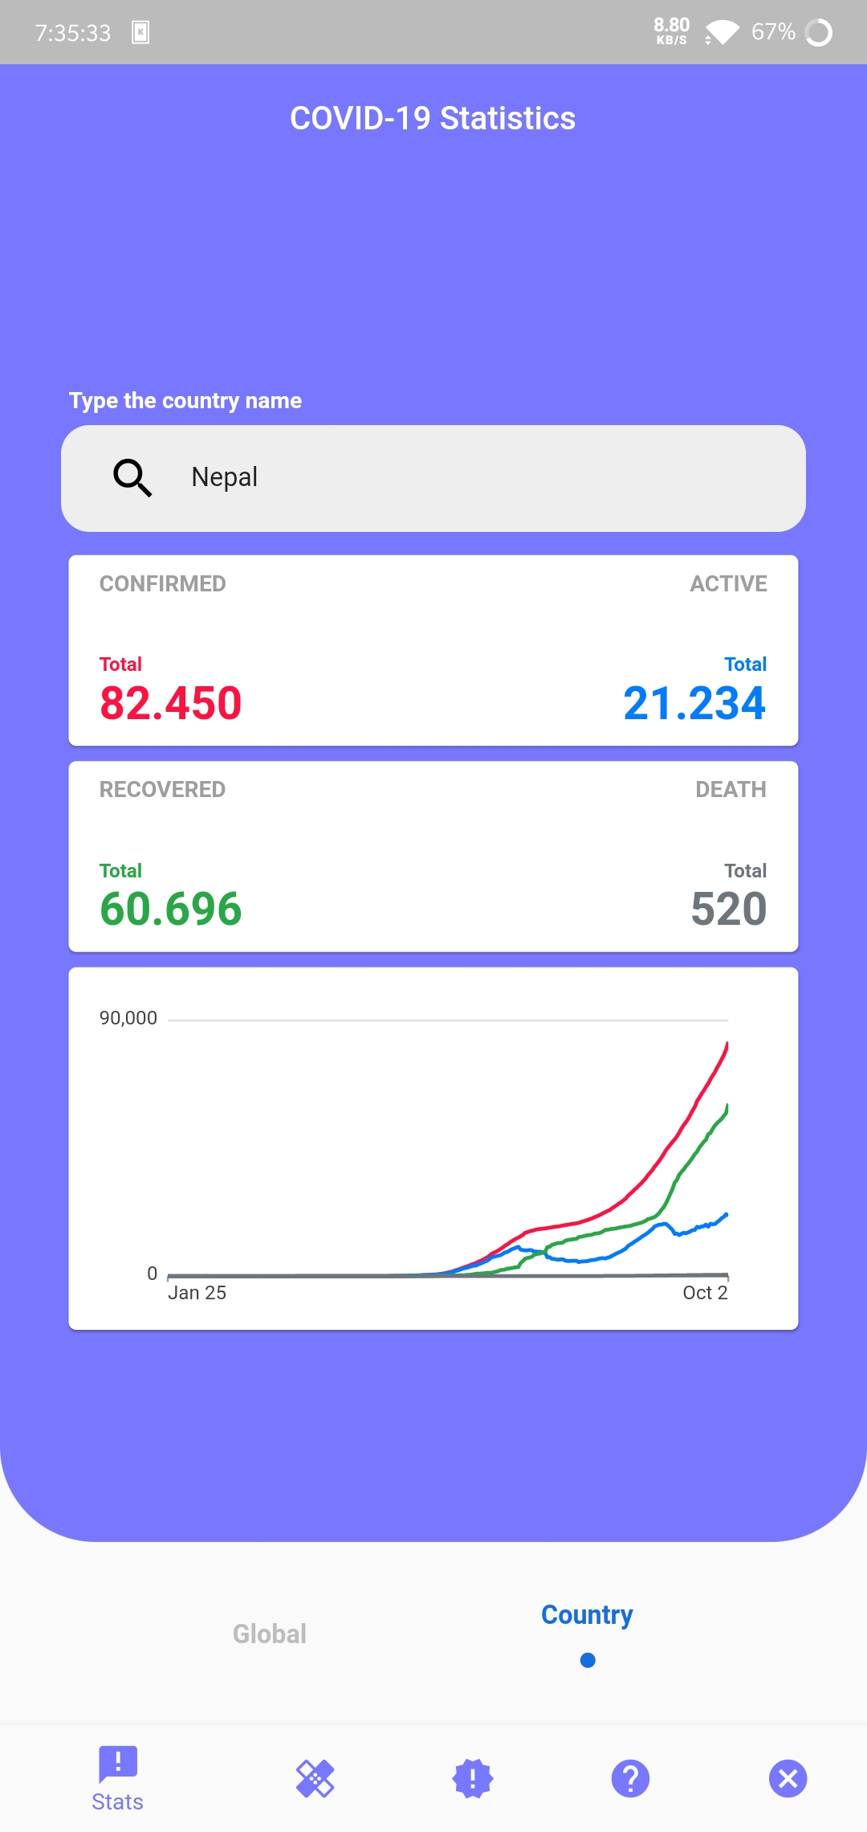
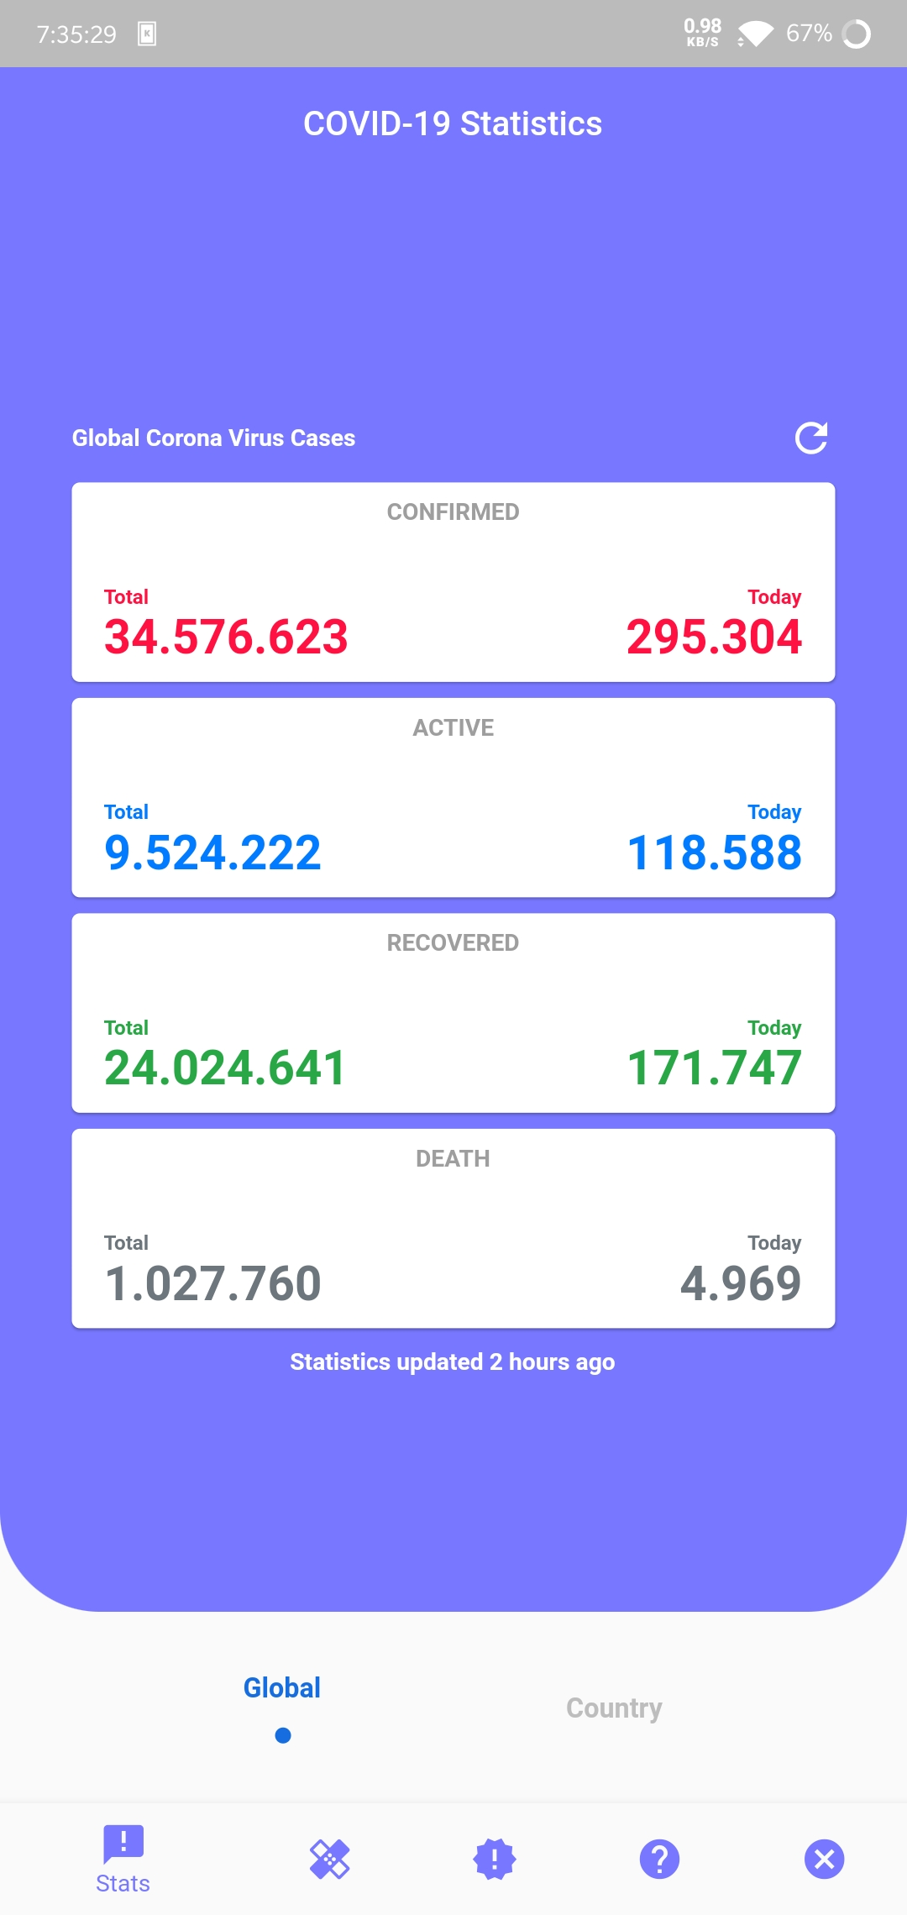
COVID-19 Statistics
Global Stats
Country Name
Paticular Country Stats
Graph

Slide 8
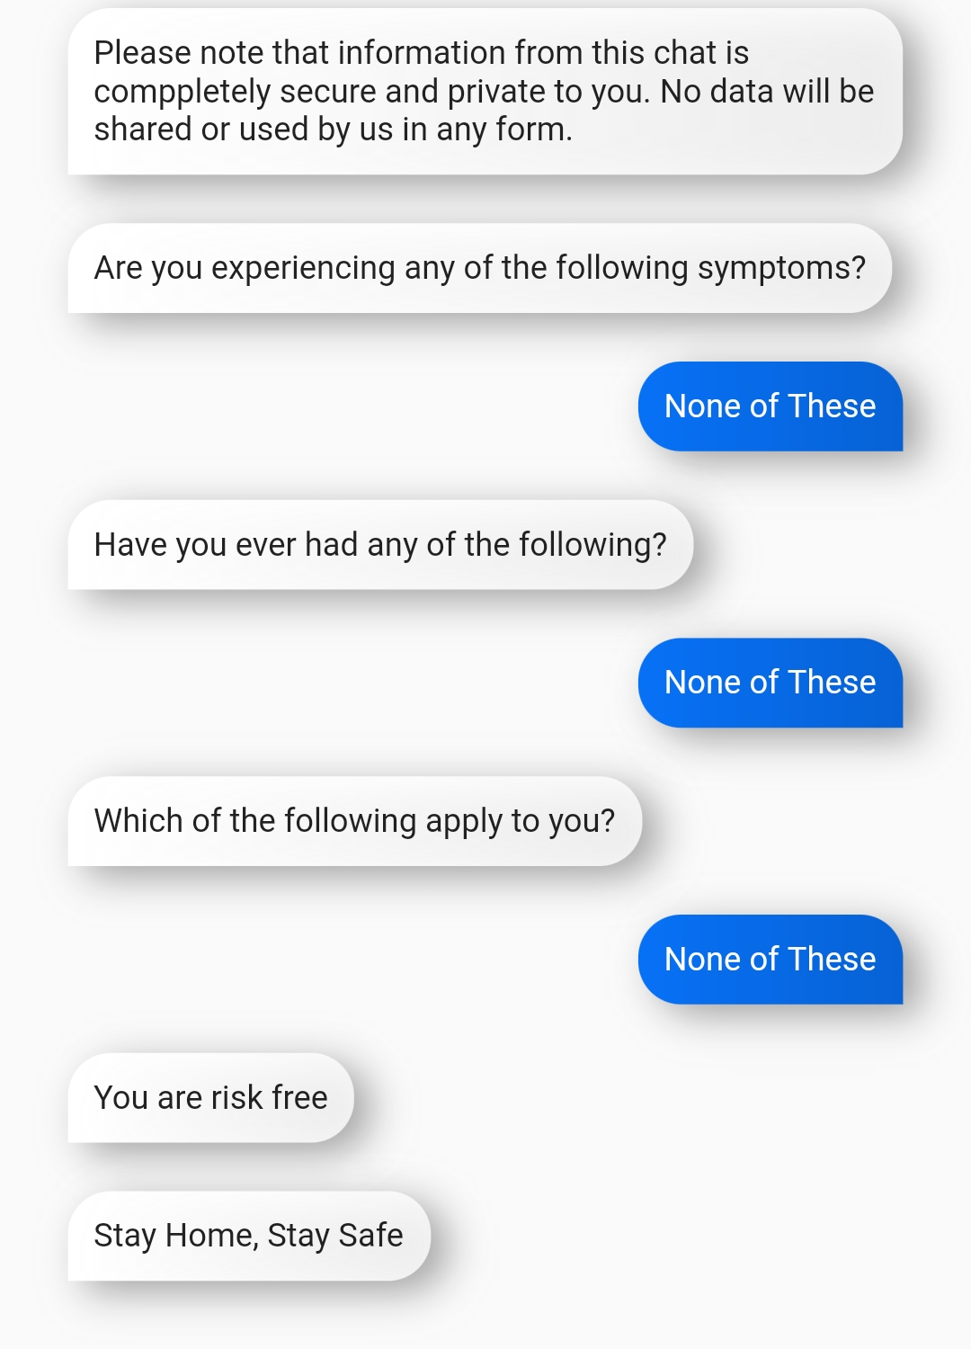
Chatbot
Lets to select if any symptoms are being experienced.
Lets select if suffering from any problems.
Lets to select the recent activities of the user.
Based on the input data the bot gives the appropriate status of user.

Slide 9
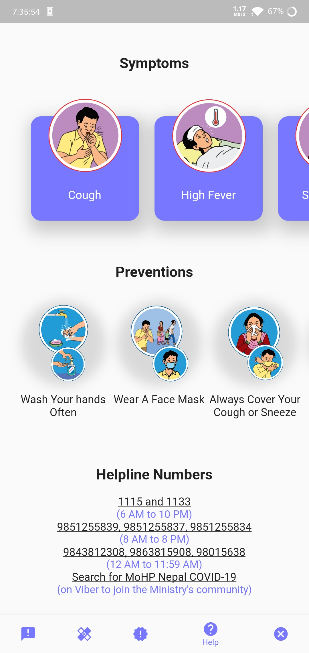
HELP BAR
Basic Symptoms and Preventive Measures.
Emergency Helpline Numbers

Slide 10
Works Offline
Memory Efficient - Only Required Data Is Loaded.
Dynamic Listing – All Countries & Stats.
Application
Other Features

Slide 11
Server and API
Backend

Slide 12
API Access
Firebase Integration
Server and API
Features

Slide 13
THANK YOU!

