Slide 1
Assignment
Breast Cancer Classification
Sumaiya Sultana Rika.
email: rikasumaiya@gmail.com

Slide 2
Problem Description
The given datasets contain data from 157 persons diagnosed with different types of breast cancer, including their DNA test data.
The BreastCancerAll.original.arff dataset contains 12181 variables for 157 observations which is too large to do any modeling.
The second dataset BreastCancerAll.reduced.using.cfs.arff is a reduced version of the original one which is the product of feature selection.

Slide 3
Problem Description
This reduced dataset contains 60 variables, 59 of them are DNA test data which are numeric or continuous variables and 1 of them is the class (type) of the breast cancer, it is a categorical variable.
The predictor variables' values range from 0 to 1 and the class variable has three levels: HER2, HR+ and TN.

Slide 4
Task
The task is to make a classification model to predict the class of the breast cancer from other DNA test data.
BreastCancerAll.reduced.using.cfs.arff is used to do the task.

Slide 5
Training and Testing Datasets
The dataset is randomly into two sets: train_set and test_set using the createDataPartition function with p=0.8 which means randomly 80% of the dataset goes to the training set and the rest is kept for prediction purpose.
The model will be built on the train_set and its predictive ability will be checked on the test_set which is unseen to the model.

Slide 6
Random Forest
The main idea of random forest is that it generates a lot of trees on the training sample and then simply average their outcomes. It is a very strong model which works very well in accuracy, does not overfit and keep a balance between bias and variance.
It picks a random subset of predictor variables to do splitting at each time.

Slide 7
Why Random Forest is chosen?
Every tree uses different predictors to split data at various times which makes it possible that 2 trees generated on same training data will have randomly different variables selected at each split. This is how the trees will get de-correlated and will be independent of each other.
Though decision trees are simple and easily understandable model, they tend to have poor predictive performance and high variance, whereas ensembling techniques like random forest can improve the performance of decision trees and reduce variance.

Slide 8
Why Random Forest is chosen?
Naive Bayes is also a strong predictive modeling technique. But since our all the predictors are numeric and they contain 0.00 value frequently which is disadvantageous for Naive Bayes model. Hence, random forest is considered as the best approach to do the given task.

Slide 9
Resampling Technique
Cross- validation technique is used so that we can avoid any biased results.
The 10-fold cross-validation procedure is repeated 3 times which gives 30 resamples to aggregate the final result.

Slide 10
Library and Functions
Package caret: for cross validation and tuning parameter
Package randomForest : for growing random forests
Function trainCotrol: to specify the type of resampling and how models will be generated
method=”repeatedcv”: resampling method
number=10 : number of folds of cross validation
repeats = 3: number of times k-fold cross validation will be repeated, in this model, it is 3 times 10 fold cross validation.
method = “grid” : to tune the parameter mtry.

Slide 11
Library and Functions
Function expand.grid: to tune the parameters. In this case, we can tune only mtry.
Function train: to train the model.
formula : class~.
data = train_set : specifying training dataset on which the model will be built.
method = “rf” : specifying the method to build the model, here it is random forest and since the target variable or class is a categorical variable, the default approach to build the model is classification.

Slide 12
Grid Search
Grid search means we have a set of models which all differ from each other in their parameter values, that lie on a grid. I have set the grid from 1 to 59.
Accuracy was used to select the optimal model.
The model with mtry = 5 is selected as the optimal model as it has the highest accuracy 84.43%. This model is used to predict the class of the unseen observations (test_set).

Slide 13
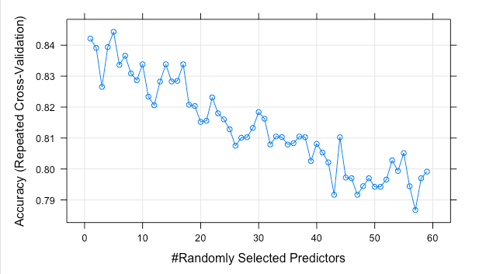
Accuracy vs mtry in the training model

Slide 14
Confusion Matrix
The diagonal cells are the correctly classified values and others are misclassified values. So in total 2 out of 30 are misclassified.
The out of sample error: 6.67%
The prediction accuracy is 93.3%.
Prediction | True values
 | HER2+ | HR+ | TN
HER2+ | 9 | 1 | 0
HR+ | 0 | 9 | 0
TN | 1 | 0 | 10

Slide 15
Variable Importance
I have used the varImp function of randomForest package to find the list of important predictors.

Slide 16
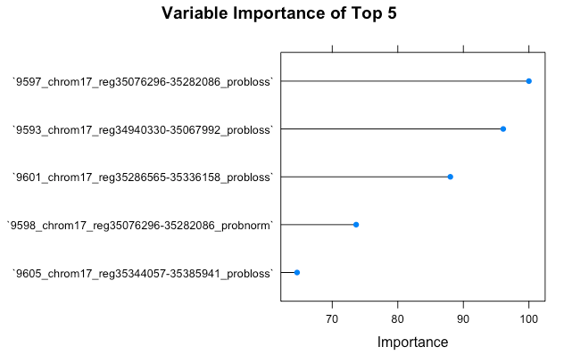
Top 5 Predictors

Slide 17
Discussion
The model gives a very low out of sample error rate and high out of sample prediction rate.
The generated model can be used to predict other future values as well.
But this model does not handle any missing values. So if future observations contain any missing values that should be handled explicitly in advance before feeding them in the model.
Though the train_set and test_set are set randomly, but it is possible that for different training and test set, the model gives different accuracy and out of sample error.

