Slide 1
Influenza A Virus Pandemic Prediction and Simulation Through the Modeling of Reassortment
Matthew Ingham
Integrated Sciences Program
University of British Columbia
Vancouver, BC, Canada

Slide 2
Outline
Background
  Influenza A Reassortment and Antigenic Shift
  BLAST
Methods
  Modeling Reality
  Sequence Similarity
  Simulation of Avian Subtype Integration
Demonstration
Future Improvements
Conclusion

Slide 3
Background (Antigenic Shift):
Influenza A is a single stranded RNA virus containing 8 RNA gene segments, two of which code for the two antigenic surface proteins, hemagglutinin (HA) and neuraminidase (NA). These proteins are involved in entry (HA) and release (NA) from host cells during infection through the binding and cleaving of sialic acid on the host cell surface. It is likely that certain combinations of HA and NA are best suited for this interaction with sialic acid. [1]
Antigenic shift is defined by a new subtype of HA and possibly of NA appearing in the population. Likely occurs when two viruses infect a single host, their gene segments are reassorted and viruses with a new combination of HA and NA proteins are created.
Such antigenic shifts are believed to be the cause of pandemics, as the human population has no immunity to the new subtype. An example is the H2N2 pandemic of 1957.
[1] Wagner, R, et al Functional balance between haemagglutinin and neuraminidase in influenza virus infections. Rev Med Virol. 2002 May-Jun; 12 (3): 159-66.

Slide 4
Background (BLAST):
Basic Local Alignment Search Tool
Algorithm for the comparison of two nucleotide or protein sequences
Involves the comparison of a query sequence against a database of sequences
Returns results about the alignments such as portion of identical or similar residues, score and the likelihood of finding a score equal or greater when searching a database of that size (Expect Value)
Used to determine how similar two sequences are
The closer two genes or proteins are in sequence, the more likely they are to have the same or similar function

Slide 5
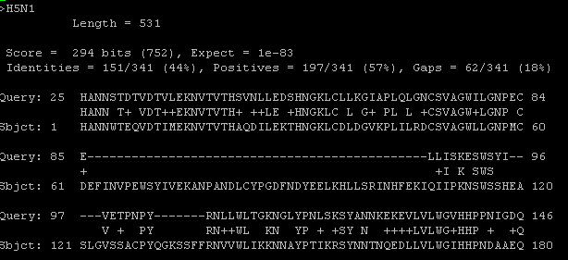
BLAST result:

Slide 6
Methods (Assumptions and Simplifications):
Avian influenza subtypes are less pathogenic but more virulent than human subtypes, as they are not well adapted to humans, but humans have no immunity to them
Assume new HA will work proportionate to how similar it is to another HA when combined with an NA
For simplicity, only N1 and N2 subtypes are capable of infecting humans
For simplicity, all strains of the same subtype are assumed to be the same. No antigenic drift or mutation is considered

Slide 7
Methods (Modeling current subtypes)
Model of a human population using NetLogo
Each virus has several attributes: Mortality rate, infection rate, and a coefficient of interaction for HA and NA proteins
When a virus infects a person, they are infectious for seven days, at the end of which they either become immune to the subtype temporarily, or die, depending on the viral attributes
Empirically determined values in order to maintain a level of infection 1 per ~150 people for the H1N1 and H3N2 strains [2]
Well studied avian subtypes (eg. H5N1) are then incorporated with viral attributes relative to H1N1, H3N2
[2] CDC Weekly Report: Influenza, http://www.cdc.gov/flu/weekly/, 2005

Slide 8
Methods(Sequence Similarity):
Script written using BioPerl to automatically BLAST all existing viruses against database of those known to infect humans (eg. H1N1 vs H1N1, H3N2, H5N1, H1N1 and H9N2)
Result is a table of similarity between all viruses used to predict viral attributes of avian flu subtypes in humans and new subtypes due to reassortment
Sequences acquired from the Influenza Sequence Database, chosen based on most recent strain

Slide 9
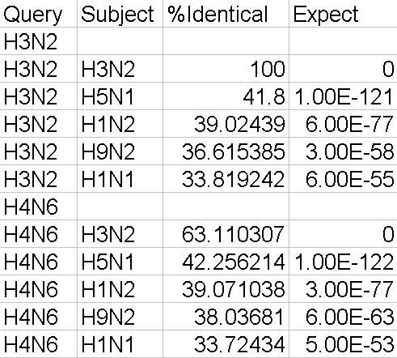
Sequence Similarity table:

Slide 10
Methods (Avian subtype integration)
Random humans are infected with avian subtypes of influenza
Avian subtypes then spread, and reassort to create new subtypes
Viral attributes are based on the sequence similarity between the avian HA protein and the most similar HA protein capable of infecting humans to date

Slide 11
DEMO!

Slide 12
Improvements:
Refine viral attribute values by developing formulae based on BLAST scores, as opposed to current ‘holistic’ nature
Susceptibility differing as a function of age
Genetic Algorithms: Ax + By = Z. Z = ~10 A = ? B = ?
  Used to teach the algorithm what values to use in order to reach certain final values for the equation. As data is compiled, the levels of occurrence of the virus can be used (Z) to determine the viral attributes (A and B)
Incorporate more than the two neuraminidase types N1 and N2 (eg. N7 and N3)
Weight similarity in specific domains, such as the sialic acid binding site of hemagglutinin
Model reassortment in avian, swine and equine populations to predict likelihood of certain subtypes becoming infectious to humans

Slide 13
Improvements (Mutation and Antigenic Drift):
In the future, mutation could be incorporated by randomly changing nucleotides, translating them, and calculating new viral attributes based on BLAST results from the new amino acid sequence
Formulae required to automate
Modeling of antigenic drift and the incorporation of various strains of the same subtype would be possible as a result

Slide 14
Conclusions:
“Every model is wrong” – Rik Blok, Integrated Sciences Program Director, University of British Columbia
Building a model to accurately predict how new subtypes will behave is extremely difficult based on current data
Once the data exists, it can be input into models such as this in order to better predict which subtypes are capable of causing a pandemic

Slide 15
References:
Wagner, R, et al Functional balance between haemagglutinin and neuraminidase in influenza virus infections. Rev Med Virol. 2002 May-Jun; 12 (3): 159-66.
Zambon, MC. The pathogenesis of influenza in humans. Rev Med Virol. 2001 Jul-Aug; 11 (4) 227-41.
Macken, C et al. The value of a database in surveillance and vaccine selection.” Options for the Control of Influenza IV. 2001, 103-106.
Altschul, SF, et al. Basic Local Alignment Search Tool, J Mol Biol. 1990 Oct 5; 215(3):403-10.

