Slide 1
APL Bootcamp – Part 1
History; basic syntax; dfns

Slide 2
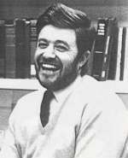
History of APL
Canadian of Norwegian Descent
Born on a small farm in Alberta (Canada)
Finished one-room school after 9th grade and worked on the farm
Army 1942, Flight Engineer in Air Force from 1943
Almost finished High School in the service
Promised his officers and mates that he would pursue an academic career after the war
B.A. from Queens University, Kingston Ontario
Ken didn’t know there was such a thing as University before he joined the army!
Kenneth E. Iverson 1920-2004

Slide 3

History of APL
Doctoral work at Harvard with Aiken and Leontief on evaluating input-output matrices
Taught at Harvard for 6 years,
Frustrated with inadequacies of mathematical notation
Developed ”Iverson Notation” in response
Published ”A Programming Language” in 1962
Used APL for modelling and teaching
Failed to get tenure at Harvard; moved to IBM
First APL Interpreter in 1966
IBM Fellow in 1970
J ("rationalised APL") from ca. 1989
Kenneth E. Iverson 1920-2004

Slide 4
History of APL
Doctoral work at Harvard with Aiken and Leontief on evaluating input-output matrices
Taught at Harvard for 6 years,
Frustrated with inadequacies of mathematical notation
Developed ”Iverson Notation” in response
Published ”A Programming Language” in 1962
Used APL for modelling and teaching
Failed to get tenure at Harvard; moved to IBM
First APL Interpreter in 1966
IBM Fellow in 1970
J ("rationalised APL") from ca. 1989
ACM Turing award in 1979:
“For his pioneering effort in programming languages and mathematical notation resulting in what the
computing field now knows as APL, for his contributions to the implementation of interactive systems, to educational uses of APL, and to programming language theory and practice.”
Kenneth E. Iverson 1920-2004

Slide 5
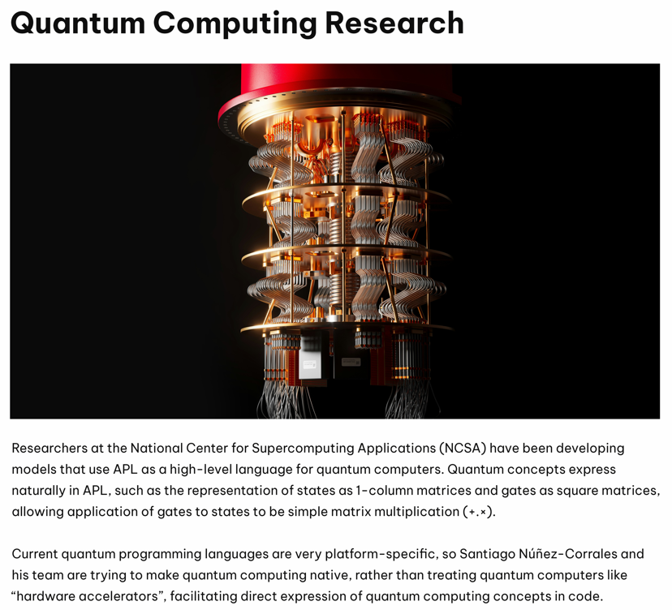
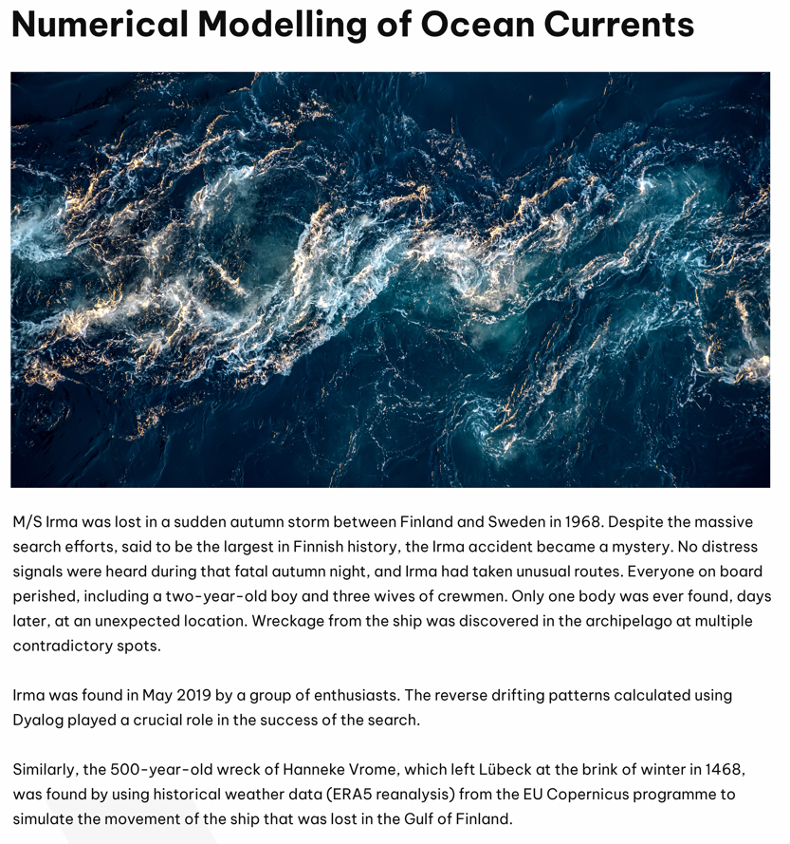


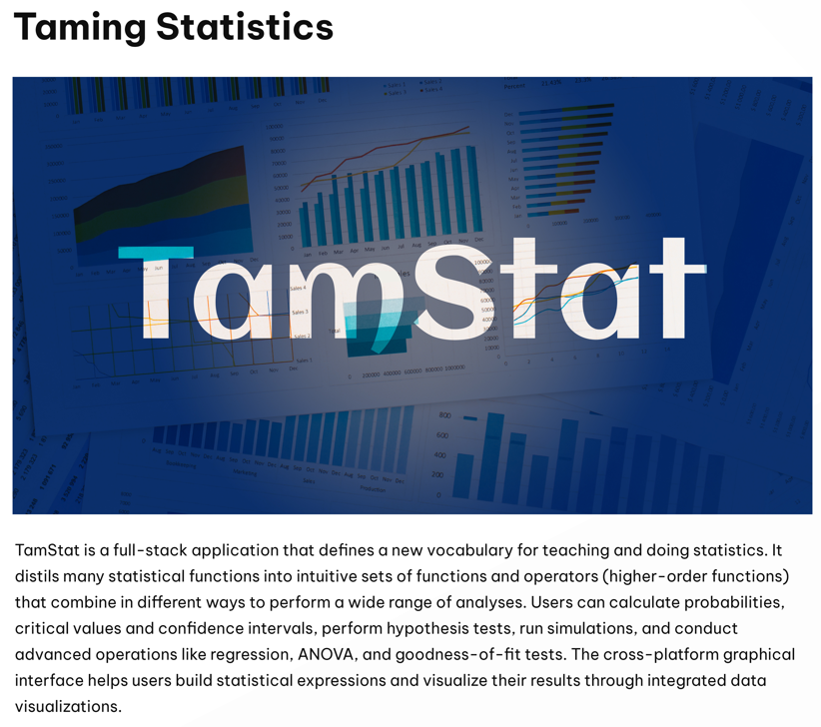
Uses of APL

Slide 6

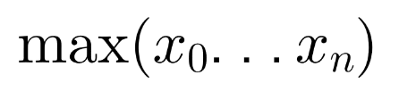
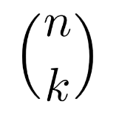

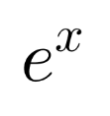
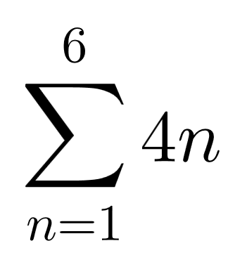
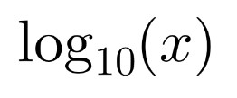
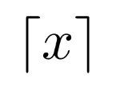
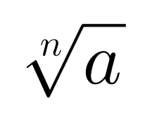
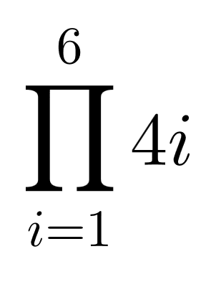
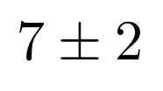
Syntaxes of Mathematics

Slide 7
Syntaxes of Mathematics
Problems:
- Wide variety of syntactical forms
- Strange and inconsistent precedence rules - Things get worse when you deal with matrices

Slide 8
Syntaxes of Mathematics
a×b
k!n
x÷y
10⍟x
⌈/x
*x
a*÷n
+/4×⍳6
⌈x
×/4×⍳6
7(+,-)2

Slide 9

Reading APL…
(2×a)÷⍨
2 times a divided into…
(2×a)÷⍨(-b)(+,-)
… -b plus or minus …
(2×a)÷⍨(-b)(+,-)0.5*⍨
… the square root of …
(2×a)÷⍨(-b)(+,-)0.5*⍨(b*2)-4×a×c
… b squared minus 4 a c ...

Slide 10



Reading Code
#include <stdio.h>
int main() {
int i;
int sum = 0;
for (i=0; i<5; i++) {
sum += i;
}
printf("%d\n", sum);
}
⎕←+/⍳5
console.log( Array.from( Array(5), (x,i)=>i ).reduce( (x,y)=>x+y ) )

Slide 11
Syntax of APL
Syntactical Form | Example | Result
array | 1 3.1415 1.2E18
function argument | ⍳ 6 | 1 2 3 4 5 6
left_arg function right_arg | 1 2 3 × 1 10 100 | 1 20 300
operand operator | ×/ 1 2 3 4 5 6 2 +/ 1 2 3 4 5 6 | 720 3 5 7 9 11
left_op operator right_op | 1 0 2 +.× 1 2 3 | 7
array[indices] | 'ABCDEF'[2 5 5 6] | BEEF

Slide 12

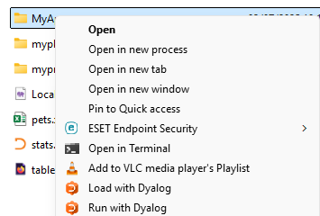
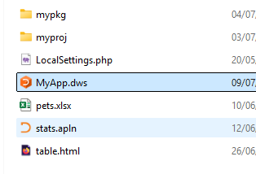
Starting and Stopping Dyalog
Dyalog is started like most normal applications (icon on desktop )

Slide 13
Starting and Stopping Dyalog
Dyalog is started like most normal applications (icon on desktop )
Exit Dyalog, like most other applications, using the at the top right
or enter
)OFF
at the keyboard (and press ENTER)

Slide 14
Let's Get Started

Slide 15
Let's Get Started
APL has two-argument, infix functions. These are called dyadic functions.
3 * 3
5 - 3
Try this:

Slide 16
Basic Syntax
There are also one-argument, prefix functions. These are called monadic functions.
~1
-6

Slide 17
Basic Syntax
Some functions map between elements of their left and right argument arrays. It is easy to add lists of numbers together:
1 2 3 + 4 5 6

Slide 18
Basic Syntax
Negative numbers are written with a high minus ¯ to differentiate between negation (-3) and literal negative numbers (¯3).
1 2 3 - 1 0 ¯1

Slide 19
Basic Syntax
All negative numbers are shown with a high minus sign, which is a part of the number, just like the decimal point in a fractional number. The high minus is NOT a function.
... 100............10.........3 2 1 0 1 2 3...........10................100...

Slide 20
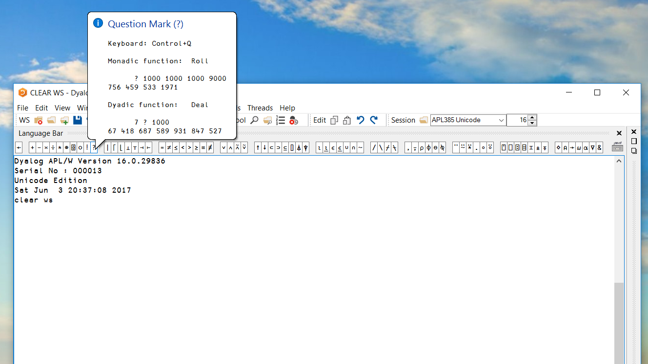
Typing APL

Slide 21
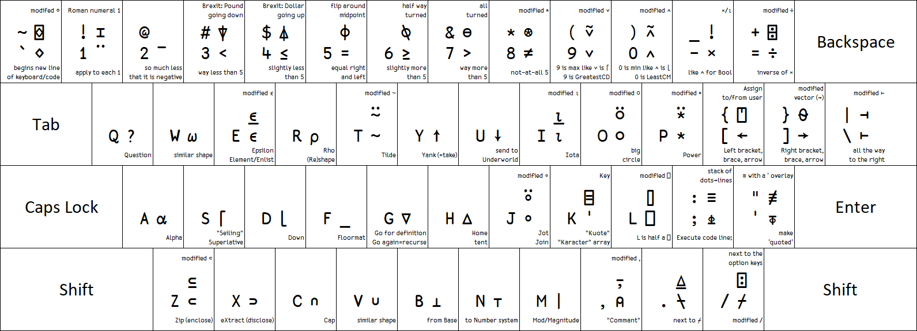
Typing APL
apl.wiki/mnemonics

Slide 22
Resources
In addition to the language bar:
Type a symbol and hit F1 to get more help
Use the Help → Documentation Centre menu item
Use Google

Slide 23
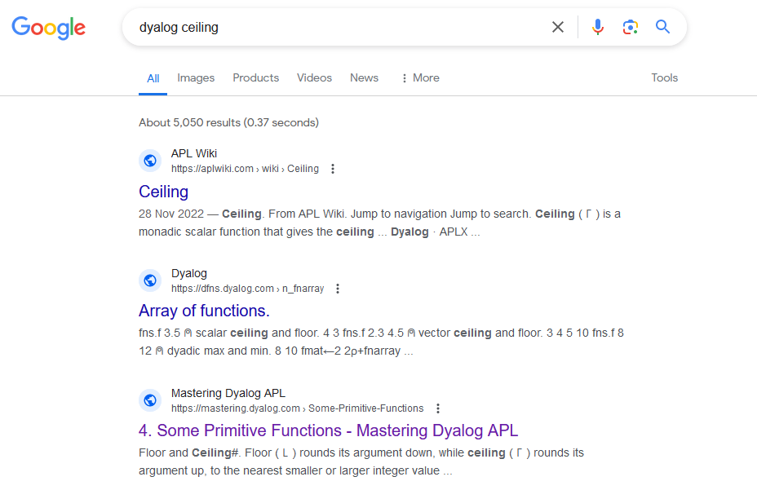
Resources
In addition to the language bar:
Type a symbol and hit F1 to get more help
Use the Help|Documentation Centre menu item
Use Google

Slide 24
Resources
The Dyalog installer includes a Windows IME (Input Method Editor).
It can be activated for ANY Windows application (like Notepad, Word, Powerpoint) and provides a complete / normal APL keyboard.
RIDE and the IME also support the "backtick" keyboard.
For alternatives, see: apl.wiki/typing_glyphs

Slide 25
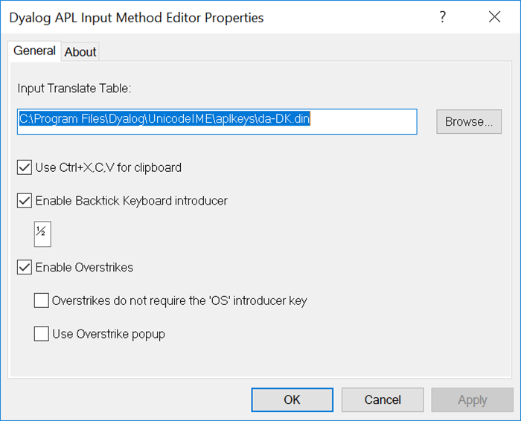
Resources
The Dyalog installer includes a Windows IME (Input Method Editor).
It can be activated for ANY Windows application (like Notepad, Word, Powerpoint) and provides a complete / normal APL keyboard.
RIDE and the IME also support the "backtick" keyboard.
For alternatives, see: apl.wiki/typing_glyphs

Slide 26
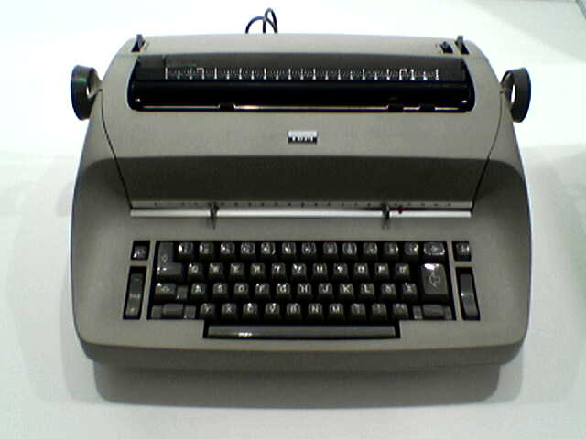
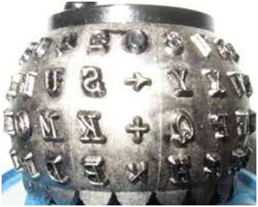
APL Demonstration 1975
https://www.youtube.com/watch?v=_DTpQ4Kk2wA&t=120s

Slide 27
Basic Syntax
Try these:
+ - × ÷ | * ⍟
APL can do arithmetic (add, subtract, multiply etc.) with integers (whole numbers) and floating point numbers (fractional numbers).

Slide 28
Basic Syntax
+ - × ÷ | * ⍟
All primitive APL functions and operators are represented by symbols.

Slide 29
Plus/Conjugate (+)
3+4
7
+¯4
¯4
+ 3J¯4
3J4

Slide 30
Minus/Negate (-)
3-4
¯1
-7
¯7

Slide 31
Times/Signum (×)
3×4
12
×4 ¯16 0 12
1 ¯1 0 1

Slide 32
Divide/Reciprocal (÷)
3÷4
0.75
÷9
0.1111111111

Slide 33
Residue/Magnitude (|)
3|10 11 12
1 2 0
|¯2 4 3j4
2 4 5

Slide 34

Power/Exponential (*)
2*3
8
*1
2.718281828

Slide 35
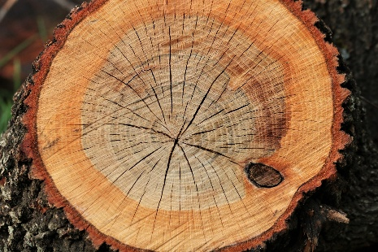
Logarithm/Natural Log (⍟)
10⍟1000
3
10*3
1000
⍟1000
6.907755279
*⍟1000
1000

Slide 36
Power and Log – for investors
How much money will I have if I invest $3 at 12% interest for 15 years?
3 × 1.12 * 15
16.42069728
How many years will it take to reach $5 if I invest $3 at 8%?
1.08 ⍟ 5÷3
6.637457293

Slide 37
Scalars and Vectors
A number on its own is called a scalar.
For example:
77 ⍝ a scalar
A list of scalars is called a vector:
23 77 10321 ⍝ a 3-element vector

Slide 38
Singleton Extension
Dyadic functions can map between a single value and an array of values.
3 × 1 10 100
3 30 300
3 = 1 2 3 4 5
0 0 1 0 0

Slide 39
Singleton Extension
Dyadic functions can map between a single value and an array of values.
Try this: Replace the functions in these expressions with
⌈ ⌊ <
3 × 1 10 100
3 30 300
3 = 1 2 3 4 5
0 0 1 0 0

Slide 40
Conformable Shapes
The shape of the arguments is said to be conformable if they are identical or if one of them is a singleton.
3 6 21 + 1
4 7 22
Here the left argument length is 3 and the right argument has a single element, so the shapes are conformable.

Slide 41
Common Errors
While experimenting, you may cause a LENGTH ERROR:
1 2+3 4 5
LENGTH ERROR: Mismatched left and right argument shapes
1 2+3 4 5
∧

Slide 42
Common Errors
While experimenting, you may cause a DOMAIN ERROR:
2 3 4÷1 0 4
DOMAIN ERROR: Divide by zero
2 3 4÷1 0 4
∧

Slide 43
Common Errors
While experimenting, you may cause a VALUE ERROR:
a
VALUE ERROR: Undefined name: a
a
∧

Slide 44
Common Errors
While experimenting, you may cause a SYNTAX ERROR:
3+
SYNTAX ERROR: Missing right argument
3+
∧

Slide 45
Common Errors
Spaces are only significant between numbers
2 11 +3
5 14
10 ÷ ¯1.25 .2
¯8 50
10÷¯1.25.2 ⍝ Missing space
SYNTAX ERROR
10÷¯1.25. 2 ⍝ Missing space
∧

Slide 46
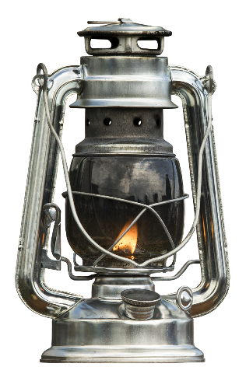

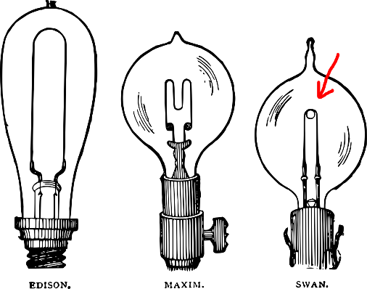
Comments
Anything after a lamp symbol ⍝ is ignored.
⍝ nothing happens on this line
2 × 3 ⍝ 4 5
6
'A' ⍝ lamp is not an "A"
A

Slide 47
APL Symbols
APL uses symbols to represent language features
APL uses approximately 70 symbols to represent functions and operators, thus providing an extremely compact notation
Some are normal ASCII symbols (+-/\!)
a few are Greek letters (⍺∊⍳⍴⍵)
others were created for APL (⌽⍉⌸⌈⌊↑↓)
All of the symbols are part of the Unicode character set and can be stored in UTF-8 text files.
APL symbols are now "decently" rendered by most operating systems without installing an APL font
but different Unicode code points!
Greek letter α is not ⍺ (APL Functional Symbol Alpha)

Slide 48
Review?
Terminate APL by typing )OFF or click ×
APL can be used as a calculator
The lamp symbol ⍝ is used to add comments
Negative numbers begin with a 
Vectors are lists of scalars
Arrays can be used as arguments to most primitives, but their shapes must be conformable

Slide 49
Questions?
🤔

Slide 50
Exercises
Start APL using the icon on your desk, if you have not done so already
Calculate your age in months (roughly)
Add a comment to the line and re-execute it
Add ¯10 to your age
Subtract 10 from the numbers 11, 1 and ¯4
Divide 100 by 20 and ¯30 by 10, in a single APL statement

Slide 51
Simple syntax
two-argument, infix: dyadic functions
one-argument, prefix: monadic functions
3 × 5
15
3 – 5
¯2
- 6 3 0 ¯12
¯6 ¯3 0 12
⍳ 7
1 2 3 4 5 6 7

Slide 52
Simple syntax
Short left scope; long right scope
⍳ 7
1 2 3 4 5 6 7
2 × ⍳ 7
2 4 6 8 10 12 14
¯1 + 2 × ⍳ 7
1 3 5 7 9 11 13

Slide 53
Simple syntax
Short left scope, long right scope
¯1 + 2 × ⍳ 7

Slide 54
Simple syntax
Short left scope, long right scope
¯1 + 2 × ⍳ 7

Slide 55
Simple syntax
Short left scope, long right scope
¯1 + 2 × 1 2 3 4 5 6 7

Slide 56
Simple syntax
Short left scope, long right scope
¯1 + 2 4 6 8 10 12 14

Slide 57
Simple syntax
Short left scope, long right scope
1 3 5 7 9 11 13

Slide 58
Operators
How to sum a list
2 5 8 ¯4 6
+ + + +

Slide 59
Operators
How to sum a list
2 5 8 ¯4 6
2 + 5 + 8 + 2
2 + 5 + 10
2 + 15
17
+ + + +

Slide 60
Operators
How to sum a list
2 5 8 ¯4 6

Slide 61
Operators
How to sum a list
+/ 2 5 8 ¯4 6
17

Slide 62
Operators
How to sum a list
+/ 2 5 8 ¯4 6

Slide 63
Operators
How to sum a list
×/ 2 5 8 ¯4 6
¯1920

Slide 64
Operators
How to sum a list
⌈/ 2 5 8 ¯4 6
8

Slide 65
Operators
How to sum a list
⌊/ 2 5 8 ¯4 6
¯4

Slide 66
Operators
Outer Product
1 2 3 ∘.× 1 2 3 4 5
1 2 3 4 5
2 4 6 8 10
3 6 9 12 15

Slide 67
Operators
Outer Product
1 2 3 ∘.× 1 2 3 4 5
1 2 3 4 5
2 4 6 8 10
3 6 9 12 15

Slide 68
Operators
Outer Product
1 2 3 ∘.+ 1 2 3 4 5
2 3 4 5 6
3 4 5 6 7
4 5 6 7 8

Slide 69
Operators
Outer Product
1 2 3 ∘.= 1 2 3 4 5
1 0 0 0 0
0 1 0 0 0
0 0 1 0 0

Slide 70
Operators
Outer Product
1 2 3 ∘.≥ 1 2 3 4 5
1 0 0 0 0
1 1 0 0 0
1 1 1 0 0

Slide 71
Booleans
Friendly 1s and 0s
1 2 3 ∘.≥ 1 2 3 4 5
1 0 0 0 0
1 1 0 0 0
1 1 1 0 0

Slide 72
Booleans
Friendly 1s and 0s
+/1 2 3 ∘.≥ 1 2 3 4 5
1 0 0 0 0
1 1 0 0 0
1 1 1 0 0

Slide 73
Booleans
Friendly 1s and 0s
+/1 2 3 ∘.≥ 1 2 3 4 5
1
2
3

Slide 74
Booleans
Friendly 1s and 0s
+/1 2 3 ∘.≥ 1 2 3 4 5
1 2 3

Slide 75
Booleans
Friendly 1s and 0s
+/1 2 3 ∘.≥ 1 2 3 4 5
1 0 0 0 0
1 1 0 0 0
1 1 1 0 0

Slide 76
Booleans
Friendly 1s and 0s
+/-1 2 3 ∘.≥ 1 2 3 4 5
1 0 0 0 0
1 1 0 0 0
1 1 1 0 0

Slide 77
Booleans
Friendly 1s and 0s
+/-1 2 3 ∘.≥ 1 2 3 4 5
1 0 0 0 0
1 1 0 0 0
1 1 1 0 0

Slide 78
Booleans
Friendly 1s and 0s
+/-1 2 3 ∘.≥ 1 2 3 4 5
3 2 1 0 0

Slide 79
Order of Execution
Order can be changed using parentheses.
(10×⍳2)+5

Slide 80
Order of Execution
Order can be changed using parentheses.
(10×⍳2)+5
5

Slide 81
Order of Execution
Order can be changed using parentheses.
(10×⍳2)+5
)+5

Slide 82
Order of Execution
Order can be changed using parentheses.
(10×⍳2)+5
(10×⍳2)+5

Slide 83
Order of Execution
Order can be changed using parentheses.
(10×⍳2)+5
(10×1 2)+5

Slide 84
Order of Execution
Order can be changed using parentheses.
(10×⍳2)+5
(10 20)+5

Slide 85
Order of Execution
Order can be changed using parentheses.
(10×⍳2)+5
15 25

Slide 86
GOTCHA! Stranding
Juxtaposed values form lists before any functions are applied. This is called stranding and lets us write very natural expressions, such as:
1 2 3 + 4 5 6
but this can lead to some surprises if we are not aware:
2 + 2 2 + 2

Slide 87
Naming Things
Names are assigned with the left arrow
name ← expression
We say "name gets [function or array]".
one←1
three←3
equals←=
plus←+
four←4
four equals one plus three

Slide 88
Naming Things
Named arrays are also called variables.
Names (variables) can be re-used:
n  1.5 ⍝ it was 0.55 before
n + items
2.5 3.5 4.5 5.5 6.5
n × n
2.25
NB: Re-using a name (for a different purpose) is a questionable practice. However, you will see it often in legacy code.

Slide 89
Naming Things
Several names can be assigned at once.
A←B←42 ⍝ A=B A←2xB←42 ⍝ A is twice B A←B+B←42 ⍝ A is twice B (nasty) (C D)←1 9 ⍝ C is 1 and D is 9
An array can be created by juxtaposing names:
A B C D
84 42 1 9 A A B B
84 84 42 42

Slide 90
Naming Things
Names can be composed of upper and lowercase letters and numbers:
abc123XYZ ← 23
abc123XYZ + 1
24

Slide 91
Naming Things
Names can include some special characters like ∆⍙_ and accented characters like ó:
a_ó∆ø1⍙ ← 230
a_ó∆ø1⍙ + 1
231
These are best avoided, but you may encounter them in old code.

Slide 92
Naming Things
Names MAY NOT begin with a digit:
2xy3 ← 321
SYNTAX ERROR
2 xy3←321
∧

Slide 93
Naming Things
To find all currently named arrays, use the system command
)VARS
Or the user command
]Names

Slide 94
System / User Commands
System commands and user commands are not APL language statements, but commands to the system.
)VARS and )OFF are system commands
)ERASE is another

Slide 95
System Commands
To remove a name you can enter:
)erase n
After which…
n
VALUE ERROR
n
^
The name is no longer defined!
System command names are case insensitive (but the arguments are not)

Slide 96
Dfns
A dfn (pronounced "dee-fun" with a very short "u" sound) is a way of writing functions in APL. It starts and ends with curly braces {}, has a right argument ⍵ (omega) and an optional left argument ⍺ (alpha).
{3+2×⍵} 6 15

Slide 97
Dfns
A dfn (pronounced "dee-fun" with a very short "u" sound) is a way of writing functions in APL. It starts and ends with curly braces {}, has a right argument ⍵ (omega) and an optional left argument ⍺ (alpha).
3 {⍺+2×⍵} 6 15

Slide 98
Dfns
Dfns can be named so that useful expressions can be reused.
Sum ← {+/⍵}
Sum 1 2 3
6

Slide 99
Syntactic Nameclass
You may come across the following error:
count ← {+/⍵}
count ← {+/⍵} 1 0 0 1 0 1 0
SYNTAX ERROR: Invalid modified assignment, or an attempt was made to change nameclass on assignment
count←{+/⍵}1 0 0 1 0 1 0
∧

Slide 100
Syntactic Nameclass
Things in APL have both a word and a number which identifies what type of thing it is. This is called its name class. So far, we have met variables (nameclass 2) and functions (nameclass 3). There are more than these, but they will be introduced later.
In Dyalog APL, if a name already has a function assigned, that same name cannot then be assigned an array value. Nor vice versa. If this happens, erase the name and try again.

Slide 101
Index Generator
APL provides an easy way to generate lists of numbers.
The primitive monadic ⍳ (iota) generates all the natural numbers from 1 to its argument. Ex:
⍳ 5
1 2 3 4 5

Slide 102
Index Generator
We can use iota to generate all sorts of sequences:
2010 + ⍳ 5
2011 2012 2013 2014 2015
2 × ⍳ 6
2 4 6 8 10 12

Slide 103
Index Generator
0.1 × ¯4 + ⍳ 7
¯0.3 ¯0.2 ¯0.1 0 0.1 0.2 0.3
2 * ⍳7
2 4 8 16 32 64 128
! ⍳ 7
1 2 6 24 120 720 5040
⍳0
Empty result

Slide 104
Index Generator
All kinds of sequences can be generated.
Here are the first 12 terms of the Fibonacci series:
⌊ 0.5 + (1.618* ⍳ 12) ÷ 5*0.5
1 1 2 3 5 8 13 21 34 55 89 144

Slide 105
Review
APL expressions are parsed right to left
Functions have a long right scope and short left scope
Dfns let us re-use expressions as functions
Functions and arrays can be named
Functions and arrays have different syntactic name classes

Slide 106
Questions?
🤔

Slide 107
Exercises
https://rikedyp.uk/APLBootcamp
Part 1

