Slide 1
APL Bootcamp – Part 7

Slide 2
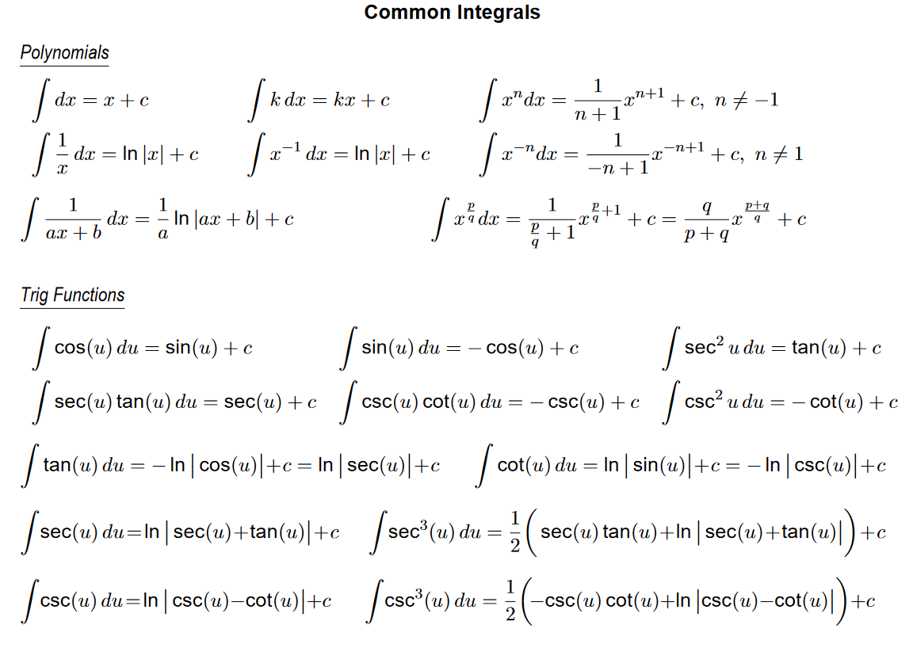
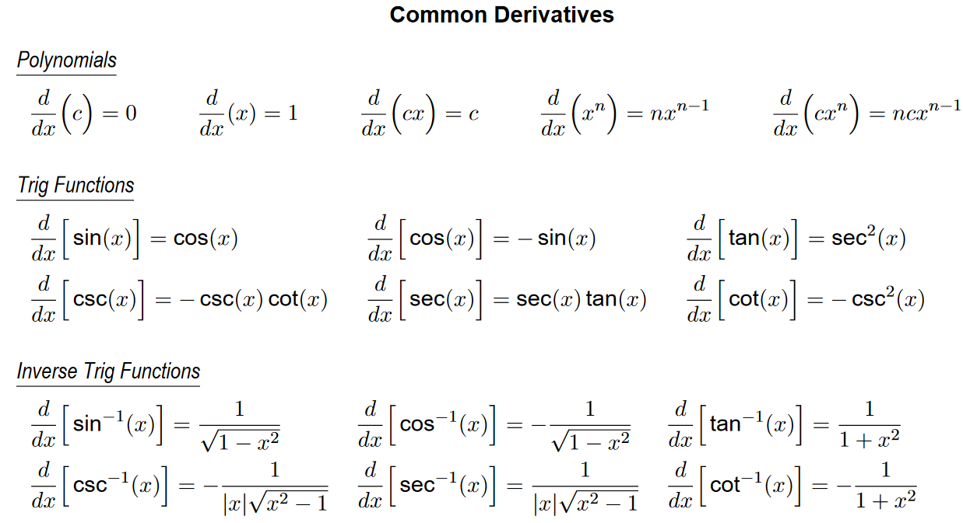
Operators
Operators take functions as arguments and return derived functions. In mathematics, derivation and integration are operators:

Slide 3
Operators
There are several primitive operators in APL
The arguments of an operator are called operands.
Monadic operators take an operand on the left. For example, +/ (except for ∘.f)
Dyadic operators take an operand on each side. For example, +.×
Operators return a derived function which may be used like any other function.

Slide 4
Tacit Programming
Derived functions (as well as primitive functions) can be assigned a name, just like variables and dfns:
plus← +
sum← +/
sum
+/
This is known as "tacit" programming (opposite of explicit)

Slide 5
Primitive Operators Overview
/ ⌿ \ ⍀ : insert, scan. We’ve seen these
¨ : each. Apply any function to elements (scalars) of an array
⍣ : power. Run a function a number of times or until a condition is met
∘ : compose. Glue 2 functions together . : inner product. Matrix product
⍠ : variant. Select a variation of a function (⎕OPT in Classic)
⍤ : rank. Apply function to "cells" of arrays (⎕U2364 in Classic)
⍨ : commute. Swap the arguments
⌸ : key. Apply function to partitioned data (⎕U2338 in Classic)
& : spawn. Start the function in a new thread
⌶ : special functions

Slide 6
Each (F¨)
Applies to arrays within each scalar
+/(1 2 3)(4 5 6)(7 8 9) ⍝ Sum a vector
┌────────┐
│12 15 18│
└────────┘
+/¨(1 2 3)(4 5 6)(7 8 9) ⍝ Sum EACH vector
6 15 24
1 2 3⍴¨4 5 6 ⍝ Dyadic applies between
┌─┬───┬─────┐ ⍝ corresponding pairs
│4│5 5│6 6 6│
└─┴───┴─────┘
Notes:
Dyadic applies between corresponding pairs of scalars

Slide 7
Each (F¨)
If you have a complex array structure, you can use the each operator to drill down until you feel you have a better understanding.
Notes:
Dyadic applies between corresponding pairs of scalars

Slide 8
Each (F¨)
nv ← (1 2)(3 4 (4 5))
nv
┌───┬─────────┐
│1 2│┌─┬─┬───┐│
│ ││3│4│4 5││
│ │└─┴─┴───┘│
└───┴─────────┘
⍴nv ⍝ 2-element vector
2
≡nv ⍝ Unevenly nested
¯3
Notes:
Dyadic applies between corresponding pairs of scalars

Slide 9
Each (F¨)
nv ← (1 2)(3 4 (4 5))
nv
┌───┬─────────┐
│1 2│┌─┬─┬───┐│
│ ││3│4│4 5││
│ │└─┴─┴───┘│
└───┴─────────┘
⍴¨nv ⍝ 2 vectors of lengths 2 and 3
┌─┬─┐
│2│3│
└─┴─┘
≡¨nv ⍝ 1st element is simple, 2nd is unevenly nested
1 ¯2

Slide 10
Each (F¨)
nv ← (1 2)(3 4 (4 5))
nv
┌───┬─────────┐
│1 2│┌─┬─┬───┐│
│ ││3│4│4 5││
│ │└─┴─┴───┘│
└───┴─────────┘
⍴¨¨nv ⍝ 2nd element appears to be 2 scalars followed by a vector
┌───┬─────┐
│┌┬┐│┌┬┬─┐│
││││││││2││
│└┴┘│└┴┴─┘│
└───┴─────┘
≡¨¨nv ⍝ 2nd element is 2 simple scalars and a non-nested array
┌───┬─────┐
│0 0│0 0 1│
└───┴─────┘
So we can tell we have a 2 element nested vector. The 1st element is a simple 2-element vector. The 2nd element contains 2 simple scalars and a simple vector of length 2.

Slide 11
Enclose-if-simple (⊆⍵)
Functions often take "one or more" items

Slide 12
Enclose-if-simple (⊆⍵)
Functions often take "one or more" items
'count' 'word' 'length'
┌─────┬────┬──────┐
│count│word│length│
└─────┴────┴──────┘
'count'
count
⊂'count'
┌─────┐
│count│
└─────┘
⊂'count' 'word' 'length'
┌───────────────────┐
│┌─────┬────┬──────┐│
││count│word│length││
│└─────┴────┴──────┘│
└───────────────────┘

Slide 13
Enclose-if-simple (⊆⍵)
Functions often take "one or more" items
{≢¨⍵} 'count' 'word' 'length'
5 4 6
{≢¨⍵} 'count'
1 1 1 1 1
{≢¨⊆⍵} 'count'
5
{≢¨⊆⍵} 'count' 'word' 'length'
5 4 6

Slide 14
Pervasive Functions
Scalar primitive functions are pervasive.
They map to each item of an array, and continue down through a nested array to the leaves:
]box on
Was OFF
1 + (2 3 4) (5 (6 7 (8 9)))
┌─────┬──────────────┐
│3 4 5│┌─┬──────────┐│
│ ││6│┌─┬─┬────┐││
│ ││ ││7│8│9 10│││
│ ││ │└─┴─┴────┘││
│ │└─┴──────────┘│
└─────┴──────────────┘

Slide 15
Pervasive Functions
Non-scalar primitive functions are NOT pervasive.
They apply to items at the top level, or the array as a whole.
VTV← 'def' 'as' VTV ⍳ 'as' 3 3
VTV ⍳ ⊂'as'
2
'as' ∊ VTV 0 0
(⊂'as') ∊ VTV
1

Slide 16
]Repr
The ]repr user command can be used to see the true nature of an array.
x1
a
x2
a
]disp x1
a
]disp x2
a

Slide 17
]Repr
The ]repr user command can be used to see the true nature of an array.
]display x1
a
-
]display x2
┌→┐
│a│
└─┘
]repr x1
'a'
]repr x2
,'a'

Slide 18
Array Notation
]repr -f=aplan 2 2⍴⍳4
[
1 2
3 4
]

Slide 19
Array Notation
]repr -f=aplan 0⎕JSON'{"name":"dave", "height": 42}'
(
height:42
name:'dave'
)

Slide 20
Array Notation
]repr -f=aplan 0⎕JSON'{"name":"dave", "height": 42}'
(
height:42
name:'dave'
)
]repr -f=js 0⎕JSON'{"name":"dave", "height": 42}'
{
height: 42,
name: "dave",
}

Slide 21
Array Notation
]repr -f=js (name:'dave' ⋄ height: 42)
{
height: 42,
name: "dave",
}
From v20.0

Slide 22
repObj
]Repr is a thin cover over ⎕SE.Dyalog.Utils.repObj
This is for learning, debugging and development – do NOT write code that relies on repObj

Slide 23
Power (F⍣g)
This operator will apply its left operand function a number of times as indicated by the right operand:
Catenate the string 'APL' 5 times:
'APL ' (,⍣5) 'is great'
APL APL APL APL APL is great

Slide 24
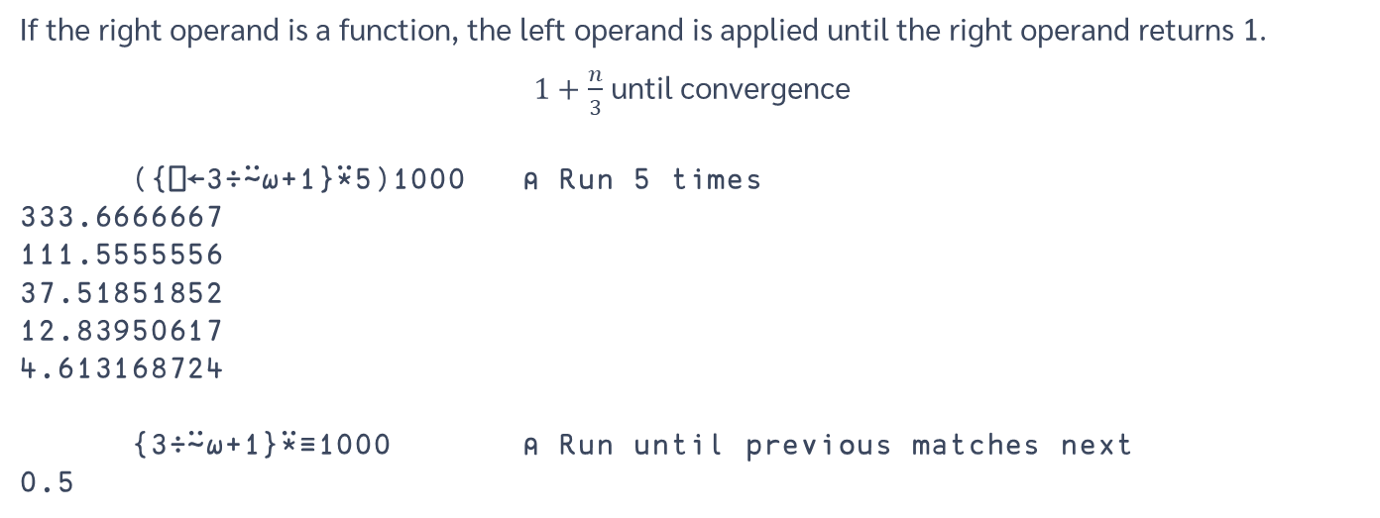
Power (F⍣g)
If the right operand is a function, the left operand is applied until the right operand returns 1.
$1+\frac{n}{3}$ until convergence
({⎕←3÷⍨⍵+1}⍣5)1000 ⍝ Run 5 times
333.6666667
111.5555556
37.51851852
12.83950617
4.613168724
{3÷⍨⍵+1}⍣≡1000 ⍝ Run until previous matches next
0.5

Slide 25
Inner Product (F.G)
F/ row G col for all combinations of rows left, cols right.
m1
m2
1 | 2 | 0
¯1 | 0 | 3
¯1 | 1
0 | 2
¯1 | 0
m1 +.× m2
+/ 1 2 0 × 1 2 0
¯1 | 5
¯2 | ¯1
(+.× is the regular "dot product")

Slide 26
Inner Product (F.G)
F/ row G col for all combinations of rows left, cols right.
m1
m2
1 | 2 | 0
¯1 | 0 | 3
¯1 | 1
0 | 2
¯1 | 0
m1 ∧.= m2
∧/ 1 2 0 = 1 2 0
0 | 1
0 | 0
(∧.= is "rows in m1 identical to columns in m2?")

Slide 27
Inner Product (F.G)
Commonly used with vectors
1 2 3 +.× 4 5 6
32
+/ 1 2 3 × 4 5 6
32

Slide 28
Inner Product (F.G)
Any functions can be used, and a vector on the right conforms with rows on the left:
names←3 5⍴'Paul Mary Peter'
names +.= 'Mary '
2 5 0
2 = +/
5 = +/
0 = +/
0 1 0 0 1
1 1 1 1 1
0 0 0 0 0
Paul⎕
Mary⎕
Peter
= Mary⎕
= Mary⎕
= Mary⎕

Slide 29
Commute (F⍨)
This operator swaps the arguments.
3 ÷⍨ 6 ⍝ 6÷3
2
Monadic application uses argument twice ("selfie" operator):
×⍨10 ⍝ 10x10
100

Slide 30
Commute (F⍨)
Produce the addition table for 1 to 5
∘.+ ⍨ ⍳5
2 3 4 5 6
3 4 5 6 7
4 5 6 7 8
5 6 7 8 9
6 7 8 9 10

Slide 31

Reading APL…
(2×a)÷⍨
2 times a divided into…
(2×a)÷⍨(-b)(+,-)
… -b plus or minus …
(2×a)÷⍨(-b)(+,-)0.5*⍨
… the square root of …
(2×a)÷⍨(-b)(+,-)0.5*⍨(b*2)-4×a×c
… b squared minus 4 a c ...

Slide 32
Variant (⍠ or ⎕OPT)
Variant is used to modify a function by supplying extra parameters.
⍝ define function to replace 'abc' by 'XX'
repl ← 'abc' ⎕R 'XX' ⍝ derive a case-insensitive variant of repl
cirepl ← repl ⍠ ('IC' 1)
cirepl 'abC012AbC'
XX012XX

Slide 33
Axis "operator" ([n])
[n] or Axis operator, has anomalous syntax.
When applied to a function it specifies the axis on which the operation is performed.
+/[2] Array
tells APL to perform function +/ on the 2nd axis.

Slide 34
Axis "operator" ([n])
[n] following a scalar function specifies the axis on which the operation is performed:
1 2 3 +[2] 2 3⍴10 20 30 11 22 33 11 22 33
1 ¯1 ×[1] 2 3⍴10 20 30 10 20 30 ¯10 ¯20 ¯30

Slide 35
Laminate (,[n.m])
Normally the Bracket Axis operator accepts only integers to specify the applied axis.
There is an exception however with , which defines function laminate:
⍴⎕←A ,[0.5] A←⍳5
1 2 3 4 5
1 2 3 4 5
2 5

Slide 36
Laminate (,[n.m])
Laminate joins two arrays, adding a dimension in the process. The number indicates where to add it:
⍴¨ A B
3 4 3 4
⍴A ,[0.5] B ⍝ before 1st dim
2 3 4
⍴A ,[1.5] B ⍝ between 1 and 2
3 2 4
⍴A ,[2.5] B ⍝ after 2nd dim
3 4 2

Slide 37
Merge Axes (,[j k])
Monadic ravel with consecutive axes can be used to merge those axes:
a←2 3 4⍴⎕A
a
ABCD
EFGH
IJKL
MNOP
QRST
UVWX

Slide 38
Merge Axes (,[j k])
Monadic ravel with consecutive axes can be used to merge those axes:
a←2 3 4⍴⎕A
a
ABCD
EFGH
IJKL
MNOP
QRST
UVWX
,[1 2]a
ABCD
EFGH
IJKL
MNOP
QRST
UVWX

Slide 39
Merge Axes (,[j k])
Monadic ravel with consecutive axes can be used to merge those axes:
a←2 3 4⍴⎕A
a
ABCD
EFGH
IJKL
MNOP
QRST
UVWX
,[2 3]a
ABCDEFGHIJKL
MNOPQRSTUVWX
Remember the Table function?
⍪⍵ ←→ ,[1↓⍳≢⍴⍵]

Slide 40
Key (⌸) (⎕U2338 in classic)
Apply a function to grouped sub-arrays.
The most common example is to sum, or count the items corresponding to a key:
'RBBRBG' {⍺,+/⍵}⌸ 1 2 3 4 5 6
R 5
B 10
G 6
,∘+/⌸ ⍝ Tacit with compose operator
_K←⎕U2338
{⍺,+/⍵}_K ⍝ in Classic edition

Slide 41
Key (⌸)
⍴⎕←'RBBRBG' {⍺ ⍵}⌸ 1 2 3 4 5 6 ┌─┬─────┐ │R│1 4 │ ├─┼─────┤ │B│2 3 5│ ├─┼─────┤ │G│6 │ └─┴─────┘
3 2

Slide 42
Key (⌸)
Keys can be ANY array
Data is partitioned on the leading dimension:
dates data
┌────────┬──────┐
│2017 6 5│100 10│
│2017 6 5│ 5 25│
│2017 6 6│ 50 75│
└────────┴──────┘
dates {⍺,+⌿⍵}⌸ data
2017 6 5 105 35
2017 6 6 50 75

Slide 43
Key and Interval Index (⌸⍸)
Interval Index groups values into buckets
0 10 30 ⍸ 12 50 9 10 11 15 8 31
2 3 1 2 2 2 1 3

Slide 44
Key and Interval Index (⌸⍸)
Interval Index groups values into buckets
0 10 30 ⍸ 12 50 9 10 11 15 8 31
2 3 1 2 2 2 1 3

Slide 45
Key and Interval Index (⌸⍸)
Interval Index groups values into buckets
0 10 30 ⍸ 12 50 9 10 11 15 8 31
2 3 1 2 2 2 1 3
Works with any data
'ADK' ⍸ 'DYALOG'
2 3 1 3 3 2

Slide 46
Key and Interval Index (⌸⍸)
,∘≢⌸'small' 'medium' 'large'[0 10 30 ⍸ 12 50 9 10 11 15 8 31]
┌──────┬─┐
│medium│4│
├──────┼─┤
│large │2│
├──────┼─┤
│small │2│
└──────┴─┘

Slide 47
Key and Interval Index (⌸⍸)
(size count)←↓⍉,∘≢⌸0 10 30 ⍸ 12 50 9 10 11 15 8 31
'small' 'medium' 'large'[size],⍪count
┌──────┬─┐
│medium│4│
├──────┼─┤
│large │2│
├──────┼─┤
│small │2│
└──────┴─┘
Perform computations on smaller data types for better performance

Slide 48
Spawn (F&)
This operator is used to run a function in a separate APL thread (not a separate OS thread).
For example, start program bigTask on each of the items in manyArgs independently:
bigTask& ¨ manyArgs
Useful for I/O bound tasks or monitor processes.

Slide 49
Spawn (F&)
If you have compute-heavy tasks that can be run in parallel, see the Isolate workspace.
)load isolate

Slide 50
I-beam (n⌶)
This operator is used to call special functions which may (or may not ☺) be candidates for future primitives or system functions.
'It is ',⊃'Dddd Doo Mmmm'(1200⌶)1⎕DT⊂⎕TS
It is Wednesday 30th July
(127⌶)⍬ ⍝ Overwrite free pockets
1
I-Beam is not on Classic language bar. Ctrl + Shift + i
⎕UCS 9014
⌶

Slide 51
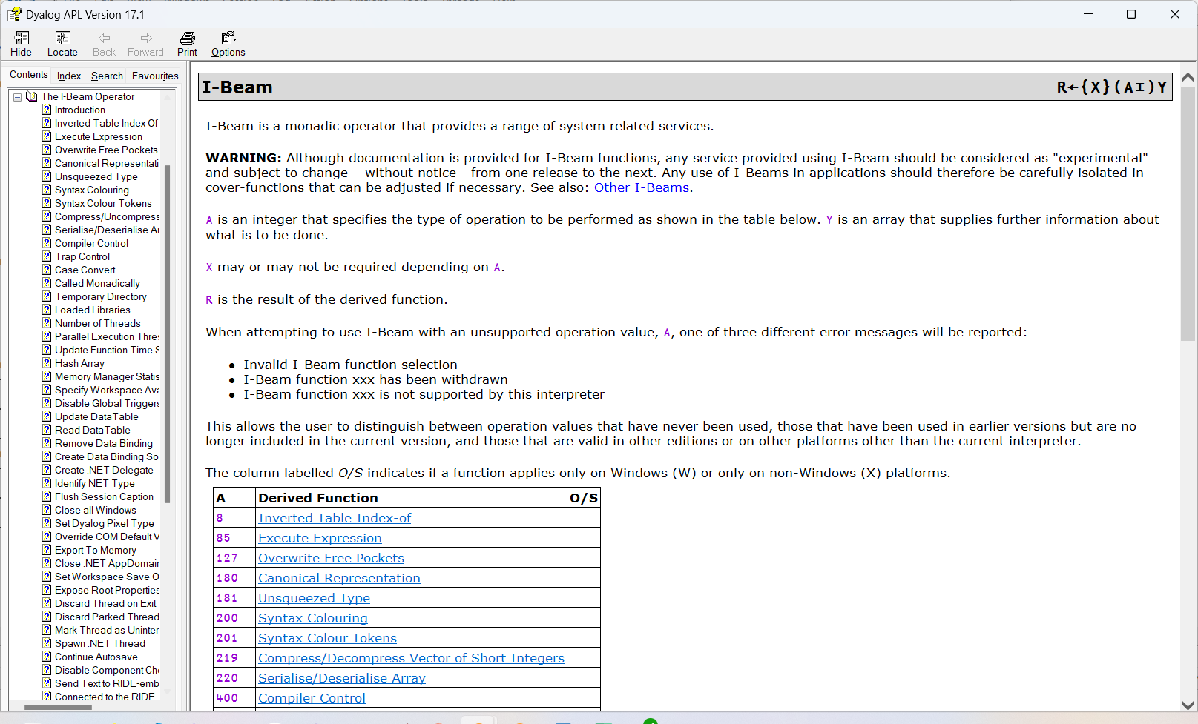

Slide 52
Review
Dyalog APL has several primitive operators
An operator takes one or two operands
It returns a derived function that can be used immediately – or named and used later

Slide 53
Review
The derived function may be purely monadic, dyadic, or ambivalent
Two operators have anomalous syntax:
Bracket Axis: f[axis]
Outer Product: ∘.f
Laminate is a special case of catenate which adds a dimension before catenating
Specifying multiple consecutive axes to merge them

Slide 54
Questions?
🤔

Slide 55
Exercises
https://rikedyp.uk/APLBootcamp
Part 5

Slide 56
System Names (⎕THINGS)
Use any name for user-defined functions and variables
In addition to primitives, Dyalog provides System Variables and System Functions
They are a bit like a standard library for APL applications
All system names are prefixed with a Quad (⎕), to prevent conflicts with user-defined names

Slide 57
System Variables
System variables describe a state of the system
Some variables are static and cannot change
Some variables are dynamic and can change without user intervention
The others can be changed by the user

Slide 58
System Variables
⎕A ⎕DM/X ⎕PATH ⎕SM ⎕TRAP
⎕AN ⎕EN ⎕PP ⎕STACK ⎕TS
⎕AV ⎕FR ⎕PW ⎕TC ⎕USING
⎕AVU ⎕IO ⎕RL ⎕THIS ⎕WA
⎕CT ⎕LC ⎕R/NSI ⎕TID ⎕WSID
⎕D ⎕LX ⎕RTL ⎕TNAME ⎕WX
⎕DCT ⎕ML ⎕SE ⎕TNUMS ⎕XSI
⎕DIV ⎕NULL ⎕SI ⎕TPOOL

Slide 59
System Variables
⎕A ⎕DM/X ⎕PATH ⎕SM ⎕TRAP
⎕AN ⎕EN ⎕PP ⎕STACK ⎕TS
⎕AV ⎕FR ⎕PW ⎕TC ⎕USING
⎕AVU ⎕IO ⎕RL ⎕THIS ⎕WA
⎕CT ⎕LC ⎕R/NSI ⎕TID ⎕WSID
⎕D ⎕LX ⎕RTL ⎕TNAME ⎕WX
⎕DCT ⎕ML ⎕SE ⎕TNUMS ⎕XSI
⎕DIV ⎕NULL ⎕SI ⎕TPOOL

Slide 60
System Variables (static)
⎕A the letters A-Z
⎕AN the user’s ID
⎕D the Digits 0-9
⎕NULL the constant NULL
⎕TC the characters BS, LF, CR
These cannot be changed

Slide 61
System Variables (dynamic)
⎕AV the list of APL characters
⎕DM the last error message
⎕DMX ⎕DM+⎕EN in a thread safe form
⎕EN the last error number
⎕RTL response time limit
⎕SE the session object

Slide 62
System Variables (dynamic)
⎕SI the list of functions stacked
⎕LC the current line number(s)
⎕STACK the execution stack
⎕NSI where called from (char form)
⎕RSI where called from (ref form)
⎕XSI the list of functions stacked with their
namespaces

Slide 63
System Variables
⎕LC ⎕NSI ⎕RSI ⎕SI ⎕XSI and ⎕STACK all relate to the execution stack.

Slide 64
System Variables (settable)
⎕AVU characters to use in ⎕AV
⎕CT Comparison Tolerance
⎕DCT Decimal Comparison Tolerance
⎕DIV how to handle division by 0
⎕FR float decimal system in use
⎕IO index origin
⎕ML Migration Level
⎕LX Latent eXpression
⎕PATH where to find functions

Slide 65
Comparison Tolerance (⎕CT)
⎕CT Comparison Tolerance
⎕DCT Decimal Comparison Tolerance
This is what APL uses to compare 2 numbers.
If a number is “close enough” to another they are considered equal.
This makes it possible to ignore round-off errors caused by limitations of fixed-precision floating-point numbers.

Slide 66
Comparison Tolerance (⎕CT)
⎕CT←1E¯14
{↑⍵(1=1+10*-⍵)}⍳16
1 2 3 4 5 6 7 8 9 10 11 12 13 14 15 16
0 0 0 0 0 0 0 0 0 0 0 0 0 1 1 1
For exact comparisons set ⎕CT to 0, but beware:
10=+/100⍴0.1
1
⎕CT←0
10=+/100⍴0.1
0
10-+/100⍴0.1
1.953992523E¯14

Slide 67
Comparison Tolerance (⎕CT)
⎕CT←1E¯14
{↑⍵(1=1+10*-⍵)}⍳16
1 2 3 4 5 6 7 8 9 10 11 12 13 14 15 16
0 0 0 0 0 0 0 0 0 0 0 0 0 1 1 1
For exact comparisons set ⎕CT to 0, but beware:
10=+/100⍴0.1
1
⎕CT←0
10=+/100⍴0.1
0
10-+/100⍴0.1
1.953992523E¯14

Slide 68
Division Control (⎕DIV)
Choose how to handle division by 0
Division by 0 (except 0÷0) is a DOMAIN error
Set ⎕DIV to 1, then 0=n÷0

Slide 69
Division Control (⎕DIV)
Calculate the sales growth for 5 products.
before←20 31 0 120 63
after← 22 27 0 149 59

Slide 70
Division Control (⎕DIV)
Calculate the sales growth for 5 products.
before←20 31 0 120 63
after← 22 27 0 149 59
⌊0.5+100×(after-before)÷before

Slide 71
Division Control (⎕DIV)
Calculate the sales growth for 5 products.
before←20 31 0 120 63
after← 22 27 0 149 59
⌊0.5+100×(after-before)÷before
10 ¯13 100 24 ¯6

Slide 72
Division Control (⎕DIV)
Calculate the sales growth for 5 products.
⎕DIV←1
before←20 31 0 120 63
after← 22 27 0 149 59
⌊0.5+100×(after-before)÷before
10 ¯13 0 24 ¯6

Slide 73
Floating-point Representation
⎕FR data type to use for floating-point arithmetic
By default, floating point operations generate “IEEE doubles” (type 645). Engineers like this.
To generate decimal floats instead (type 1287) set it to 1287. Bankers may find this useful:
⎕FR←1287

Slide 74
Index Origin (⎕IO)
This variable affects several functions:
⍳ ? ⍋ ⍒ i⌷ i⊃ [i] a⍉
It accepts 0 or 1 as value, the default is 1
⎕IO←0 ⋄ ⍳4
0 1 2 3
Talk to your team-mates before changing it!

Slide 75
Migration Level (⎕ML)
⎕ML Migration Level
This variable affects several functions:
V⊂ ⊃ ↑ ∊ ≡ ⎕TC
Its effect:
0: behaves like the original Dyalog
1: changes ∊ from type to enlist Type←{⊃0⍴⊂⍵}
default since v15.0
2: ↑ and ⊃ are switched, ≡ is positive
3: dyadic ⊂ like APL2, ⎕TC modified

Slide 76
Latent eXpression (⎕LX)
This is the expression executed when a workspace is )LOADed. It is used to have an application start when loaded.
⎕LX←'main'

Slide 77
Namespace Search Path (⎕PATH)
This variable specified where to search for functions, if a name is not found in the current namespace (more about namespaces later):
⎕PATH←'#.Utils'
This can make it difficult to know the origin of names, especially in functions called by a function that has set ⎕PATH. It might make sense to use ⎕PATH, or it might be better to make namespace references explicit.
Text←#.TextUtils
Text.Split 'some text’
┌────┬────┐
│some│text│
└────┴────┘

Slide 78
System Variables
⎕PP print precision
⎕PW print width
⎕RL Random seed (Link)
⎕SM screen map (deprecated)
⎕TRAP how to handle errors
⎕USING Microsoft.Net paths to search
⎕WSID Workspace Name (ID)
⎕WX Window eXpose

Slide 79
Print Precision (⎕PP)
This variable affects the default display of numbers.
⎕pp←4 ⋄ ○1
3.142
⎕pp←17 ⋄ ○1
3.141592653589793

Slide 80
Print Width (⎕PW)
This variable tells APL where to fold output.
⎕PW←42 ⋄ ⍳37
1 2 3 4 5 6 7 8 9 10 11 12 13 14 15 16 17
18 19 20 21 22 23 24 25 26 27 28 29
30 31 32 33 34 35 36 37

Slide 81
Random Seed (⎕RL)
This variable is used to generate random numbers.
⎕rl←5672341 ⋄ ?100 ⋄ ⎕rl
40
845754719 NB: In recent versions, ⎕RL can be a very large structure of Mersenne Twister state.
Modified after each use

Slide 82
Workspace ID (⎕WSID)
This is more or less equivalent to the system command )WSID:
)wsid
myWs
⎕WSID
myWs

Slide 83
Window eXpose (⎕WX)
It determines
Whether or not the names of properties, methods and events provided by a Dyalog APL GUI object are exposed as variables.
Certain aspects of behaviour of .Net and COM objects.
Make sure it is set to 3 and forget about it.

Slide 84
System Functions
System functions provide various services related to both the APL and the external environment.
They are always available without loading anything into the interpreter.

Slide 85
System Functions
These functions closely emulate system commands:
Name | Description
⎕CLEAR | Clear workspace = )CLEAR
⎕CY | Copy objects into active WS
⎕EX | Expunge objects
⎕LOAD | Load a saved WS = )LOAD
⎕NL | Name List
⎕OFF | End the session = )OFF
⎕SAVE | Save the active WS = )SAVE

Slide 86
Copy [name] from [workspace] (⎕CY)
[objects] ⎕CY 'wsname'
More or less equivalent to:
)COPY wsname [objects]
objects must be a character vector or matrix, if supplied.
The system command always copies into ⎕THIS, but the function can be used to copy into a specific namespace.

Slide 87
Expunge name (⎕EX)
⎕EX 'name'
Same as
)ERASE name
Objects must be a character vector, matrix or a vector of character vectors.

Slide 88
Name List (⎕NL)
[filter] ⎕NL nv
nv is a list of numbers, selecting one or more of:
2: variables
3: functions
4: operators
9: [name]spaces
Filter is a series of letters the names returned in matrix form must start with.

Slide 89
Name List (⎕NL)
User command ]Names is a pretty-printing cover for ⎕NL

Slide 90
Name List (⎕NL)
⎕nl 9
adviser
assent
attestation
beneficial
blustering
bodega
castes
circular
connected
crickets
distilleries
············
weave
whiskered
wrongly

Slide 91
Name List (⎕NL)
]names 9
─── 9 ─── distilleries influence printing sottish
adviser doltish insolubility reconstruct soviet
assent duets kamikazes reflexives sprawled
attestation elaborately logistically relearn standings
beneficial enunciation looser sailfish tomboy
blustering erasure macintoshes saucers took
bodega exasperating mugginess seacoasts tranquilly
castes expires nerviest sepulchral vibraphone
circular explicating niacin sheepdogs weave
connected hothouses potholders snooping whiskered
crickets hugged primmest softhearted wrongly

Slide 92
Name List (⎕NL)
 | Array (2) | Functions (3) | Operators (4) | N-spaces (9)
n.1 | Variable | Traditional | Traditional | Created by ⎕NS
n.2 | Field | D-fns | D-ops | Instance
n.3 | Property | Derived Primitive
n.4 |  |  |  | Class
n.5 |  | N/A |  | Interface
n.6 | External Shared | External |  | External Class
n.7 |  |  |  | External Interface

Slide 93
External Interfaces
Name | Description
⎕ARBIN | Arbitrary Input
⎕ARBOUT | Arbitrary Output
⎕CMD | Execute the Windows Command Processor or another program
⎕MAP | Map a file
⎕NA | Declare a DLL function
⎕SH | Synonym for ⎕CMD for UNIX (or is it vice versa?)

Slide 94
External Interfaces
Name | Description
⎕ARBIN | Arbitrary Input
⎕ARBOUT | Arbitrary Output
⎕CMD | Execute the Windows Command Processor or another program
⎕MAP | Map a file
⎕NA | Declare a DLL function
⎕SH | Synonym for ⎕CMD for UNIX (or is it vice versa?)
⎕SHELL | Improved ⎕SH with error handling and interrupts
V20.0

Slide 95
Windows Command (⎕CMD)
This command sends an expression to be executed by the host Operating System (OS)
To start Notepad and wait for it to terminate:
⎕CMD 'notepad c:\myfile.txt'
To start asynchronously add ‘’ (window mode)
⎕CMD 'notepad c:\myfile.txt' ''

Slide 96
UNIX Shell (⎕SH)
This command is identical to ⎕CMD, the name is aimed at UNIX users.
Under Linux/UNIX, it uses a command shell to execute an expression.

Slide 97
Execute External Program (⎕SHELL)
R←⎕SHELL 'notepad c:\myfile.txt'
(StreamData StreamIds ExitCode ExitReason Pid)←R
StreamData and StreamIds describe the output that was collected while the program ran.
ExitCode and ExitReason describe why the ⎕SHELL call ended.
Pid is either the positive integer process ID of the child process (if the ⎕SHELL call ends before the child process has ended), or ¯1.

Slide 98
Execute External Program (⎕SHELL)
NOTE:
Calling to external processes via the shell exposes severe security risk. Deployed, customer-facing applications should avoid this.
Instead, use proper interfaces such as ⎕NA (compiled DLLs) and ⎕USING (.NET)

Slide 99
Name Association (⎕NA)
This function provides an access to DLLs and external routines in the OS.
'div' ⎕NA 'F8 math|divide I4 I4'
The "C FFI" for Dyalog

Slide 100
Development Tools
Name | Description
⎕AT | Object Attributes
⎕CR | Canonical Representation
⎕CS | Change Space
⎕ED | Edit one or more objects
⎕EXPORT | Export objects
⎕FX | Fix definition
⎕LOCK | Lock a function
⎕MONITOR | Monitor set/query
⎕NR | Nested Representation
⎕NS | Create Namespace
⎕OR | Object Representation
⎕PATH | Search Path
⎕PROFILE | Profile Application
⎕REFS | Local References
⎕SHADOW | Shadow names
⎕STOP | Set/Query Stop vector
⎕THIS | This Space
⎕TRACE | Set/Query Trace vector
⎕VR | Vector Representation

Slide 101
Attributes (⎕AT)
This function returns metadata for programs:
4 elements returned.
This is the first one:
1 | Function result | 0 if the function has no result 1 if the function has an explicit result ¯1 if the function has a shy result
2 | Function valence | 0 if the object is a niladic function or not a function 1 if the object is a monadic function 2 if the object is a dyadic function ¯2 if the object is an ambivalent function
3 | Operator valence | 0 if the object is not an operator 1 if the object is a monadic operator 2 if the object is a dyadic operator

Slide 102
eXtended ATtributes (⎕ATX)
From v18.2 onwards:
One-stop shop for meta-data about a name
Function/operator valence (syntax)
When and who last edited? (workspace, not file system)
Nameclass
Source file information (for text source)
+ more (see docs)

Slide 103
Function Representation
These 3 functions show the representation of a function:
⎕CR "Canonical Representation": simple character matrix
⎕VR "Vector Representation": simple char vec with embedded new lines and decorators
⎕NR "Nested Representation": nested vector of character vectors with decorators
⎕vr 'avg'
∇a←avg list
[1] a←(+/list)÷⍴list
∇

Slide 104
Change Space (⎕CS)
This function allows you to Change Space.
⎕←⎕cs xfr
#
⎕←⎕cs #
#.xfr
It returns the namespace we started in (so you can return later).

Slide 105
Change Space (⎕CS)
Changing space makes debugging more confusing.
We recommend making explicit references.
Text←#.TextUtils
Text.Split 'some text'
┌────┬────┐
│some│text│
└────┴────┘
Notes:
Remember ⎕PATH

Slide 106
Edit (⎕ED)
This function allows you to edit code/data under program control.
Probably not a great idea in modern systems.

Slide 107
Fix Definition (⎕FX)
This function allows you to create functions dynamically, using arguments in the forms returned by ⎕CR/VR/NR.

Slide 108
Lock Definition (⎕LOCK)
This function allows you to lock functions, making it impossible to view the source.

Slide 109
NameSpace (⎕NS)
This function allows to create namespaces and copy names between them.
Dyadic form creates a namespace with a name.
'myNs' ⎕ns ''
Monadic creates a nameless namespace:
+mn←⎕ns ''
#.[Namespace]

Slide 110
NameSpace (⎕NS)
This function allows to create namespaces and copy names between them.
Dyadic form creates a namespace with a name.
'myNs' ⎕ns ''
Monadic creates a nameless namespace:
+mn←⎕ns ''
#.[Namespace]
https://www.youtube.com/watch?v=eBEwBSO5mBA

Slide 111
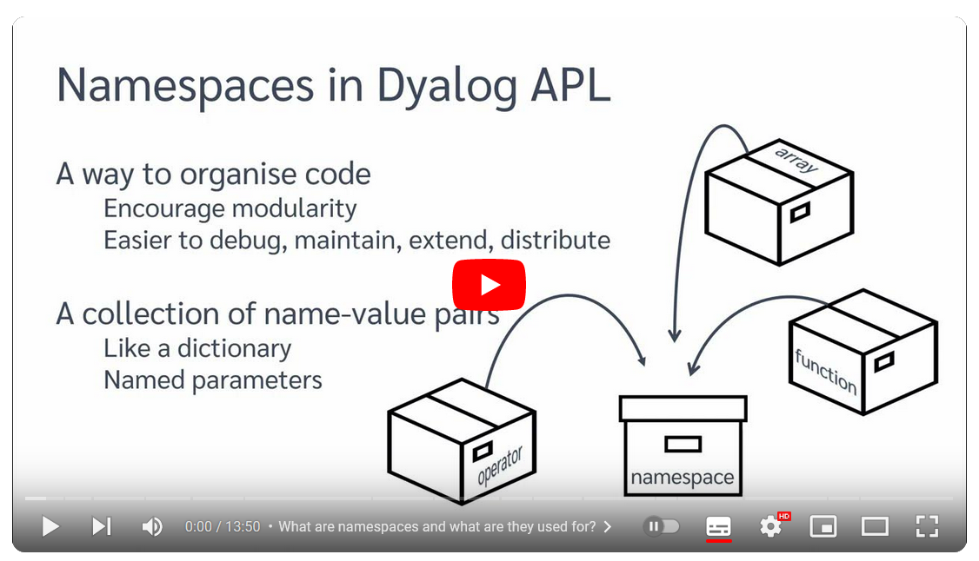
NameSpace (⎕NS)
This function allows to create namespaces and copy names between them.
Dyadic form creates a namespace with a name.
'myNs' ⎕ns ''
Monadic creates a nameless namespace:
+mn←⎕ns ''
#.[Namespace]
https://www.youtube.com/watch?v=eBEwBSO5mBA

Slide 112
Value Get/Set (⎕VGET/⎕VSET)
Safely (without using ⍎) get values from names with defaults

Slide 113
Value Get/Set (⎕VGET/⎕VSET)
Safely (without using ⍎) get values from names with defaults
r←MyAPI opts (amount type)←opts ⎕VGET('amount' 0)('type' 'default')

Slide 114
Value Get/Set (⎕VGET/⎕VSET)
Safely (without using ⍎) get values from names with defaults
r←MyAPI opts;amount;type (amount type)←opts ⎕VGET('amount' 0)('type' 'default')

Slide 115
Value Get/Set (⎕VGET/⎕VSET)
Safely (without using ⍎) get values from names with defaults
r←MyAPI opts;amount;type (amount type)←opts ⎕VGET('amount' 0)('type' 'default')
MyAPI(type:'new')
amount: 0
type: new

Slide 116
Object Representation (⎕OR)
This function returns a representation of a variable, function, operator or namespace as a variable that can be used to reconstruct it later.
Its use is no longer recommended.

Slide 117
Performance (⎕PROFILE)
This function replaces ⎕MONITOR as the preferred mechanism for monitoring and tuning code.
A user command ]Profile is provided for convenience.

Slide 118
Shadow Name (⎕SHADOW)
This function localizes dynamically a name, adding the name to the list of locals at runtime.
It should generally be avoided, and only used under very special circumstances, as it makes code hard to analyse.

Slide 119
⎕STOP/⎕TRACE
These functions allow you set or clear stop and trace flags on lines of a function:
2 5 7 ⎕STOP 'myReport'

Slide 120
Case Convert (⎕C)
From v18.0, replaces (819⌶)
1⎕C'Look at my teXt'
LOOK AT MY TEXT
1⎕C@(¯1⌽' '∘=)' ','title case here'
Title Case Here
'Are sAmE?' ≡⍥⎕C 'are same?'
1

Slide 121
Regular Expressions (⎕R/⎕S)
Interface to the Perl Regular Expressions (PCRE) engine
Rex ← 'rex' '\w'⎕R'\0' '*'⍠1
Rex 'Rex, I told you not to do that!'
Rex, * **** *** *** ** ** ****!

Slide 122
Data Representation (⎕DR)
Return or change
internal data type
Value | Data Type
11 | 1 bit Boolean
80/82 | 8 bits character
83 | 8 bits signed integer
160 | 16 bits character
163 | 16 bits signed integer
320 | 32 bits character
323 | 32 bits signed integer
326 | 32 bits Pointer
645 | 64 bits Floating
1287 | 128 bits Decimal
Checking prototype is faster if we just want to know “char or num?”
Type ← (⊃0⍴⊂)

Slide 123
Name Class (⎕NC)
This function returns the class of a name:
)fns
avg
⎕nc 'avg'
3
⎕nc ⊂'avg' ⍝ finer definition – see ⎕NL
3.1

Slide 124
Programmable Function Key (⎕PFKEY)
This function allows you to set Programmable Function Keys
]disp ( ')fns', ⊂'ER' ) ⎕pfkey 2
┌→┬─┬─┬─┬──┐ │)│f│n│s│ER│ └─┴─┴─┴─┴─→┘
https://www.dyalog.com/blog/2018/09/enhanced-debugging-with-function-keys/
https://www.dyalog.com/blog/2020/12/enhanced-debugging-with-function-keys-evaluate-selection/

Slide 125
Object Size (⎕SIZE)
This function returns the size an object takes in memory. For objects containing references, or arrays sharing elements, the results are not always accurate:
)fns
avg
⎕size 'avg'
280

Slide 126
Unicode Convert (⎕UCS)
This self-inverse monadic function turns Unicode point numbers into characters and vice versa.
⎕UCS 9035 65 32767
⍋A翿
⎕ucs '⍋A翿'
9035 65 32767
The dyadic version converts to or from a specific encoding:
'UTF-8' ⎕UCS '£€$'
194 163 226 130 172 36 Available in Classic – but can only produce characters in ⎕AV.

Slide 127
Verify & Fix Input (⎕VFI)
Validate and Fix input: turns numbers found in a string into numbers and tells which one are numbers.
⍴r←⎕←⎕vfi 'pay 12 $ and 50 cents’
┌───────────┬─────────────┐
│0 1 0 0 1 0│0 12 0 0 50 0│
└───────────┴─────────────┘
2
Useful patterns:
(//⎕VFI)'pay 12 $ and 50 cents'
┌─────┐
│12 50│
└─────┘
2⊃∘⎕VFI¨'13.4' '53' '69' '71'
┌────┬──┬──┬──┐
│13.4│53│69│71│
└────┴──┴──┴──┘

Slide 128
Questions?
🤔

Slide 129
Exercises
Write an expression to determine if a name is free (unused)
Write a function to find all the names in your workspace and return them along with their size, sorted in descending order.
Determine how many lines of code there are in your workspace.
Modify the function to take an argument consisting of the name classes of objects to return and a left argument to limit the number of results returned.

Slide 130
Exercises
Write an expression to determine if a name is free (unused) 0=⎕NC name
Write a function to find all the names in your workspace and return them along with their size, sorted in descending order. r←Sizes sz←⎕SIZE nms←⎕NL-⍳10 r←(nms,⍪sz)[⍒sz;]
Determine how many lines of code there are in your workspace. +/≢¨⎕CR¨⎕NL -3 4
Modify the function to take an argument consisting of the name classes of objects to return and a left argument to limit the number of results returned.
r←n Sizes nc sz←⎕SIZE nms←⎕NL-nc r←(nms,⍪sz)[(n⌊≢sz)↑⍒sz;]

