Slide 1
APL Bootcamp
Namespaces

Slide 2
Namespaces
Namespaces are containers, which can contain variables, functions - and other namespaces.
Nested arrays are arrays within arrays. Namespaces are like a workspace within a workspace.
They are similar to folders in a file system which contain files and other folders.

Slide 3
Namespaces
(a b)←⎕NS¨'' ''
(a b).name←'Jenny' 'Kieth'
(a b).age←42 57
a.name
Jenny
b.name
Kieth

Slide 4
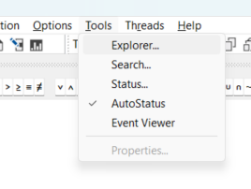
Namespaces

Slide 5
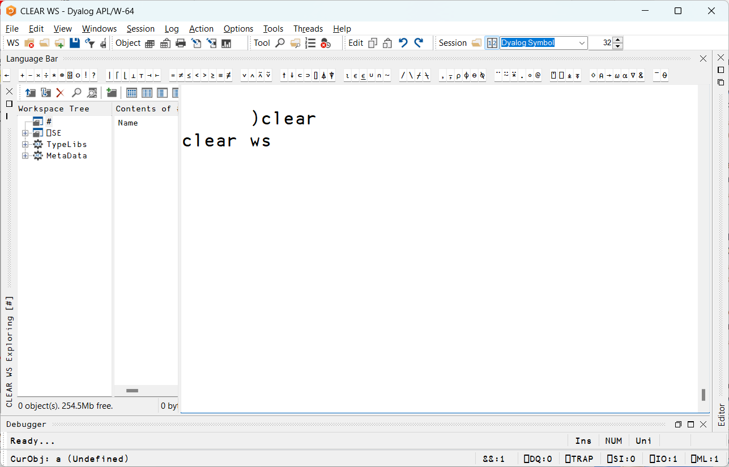
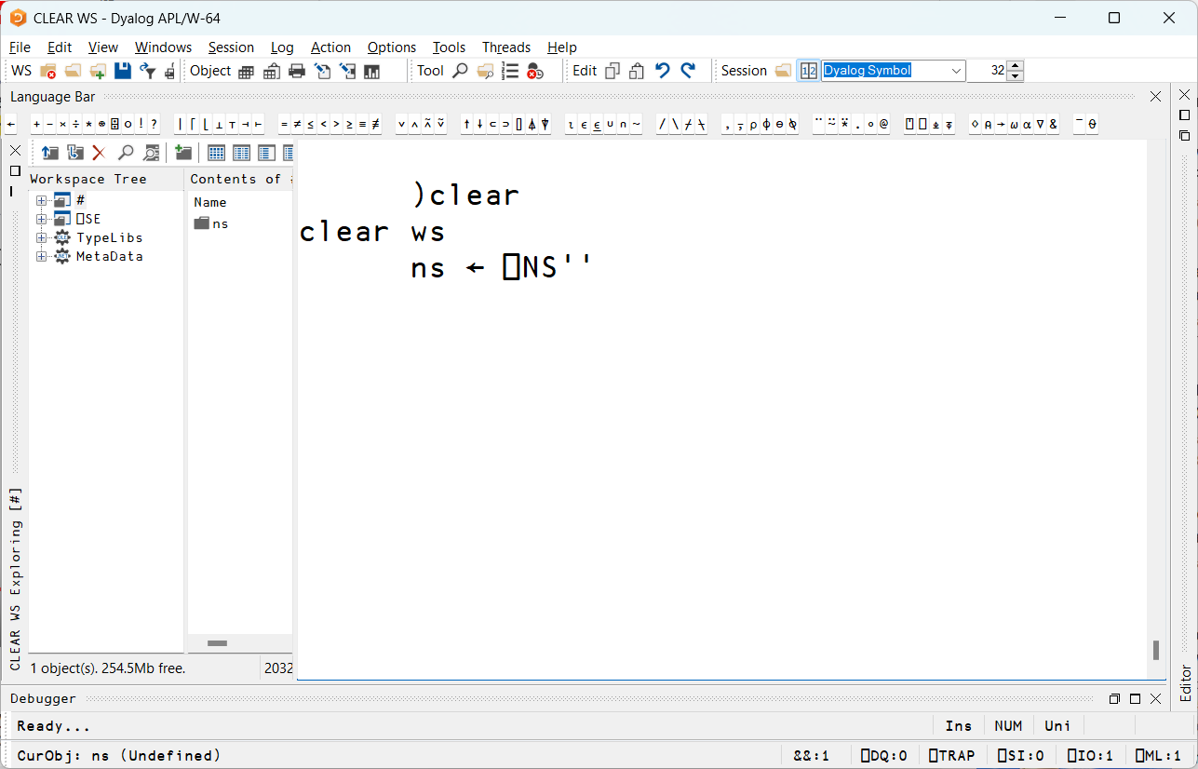
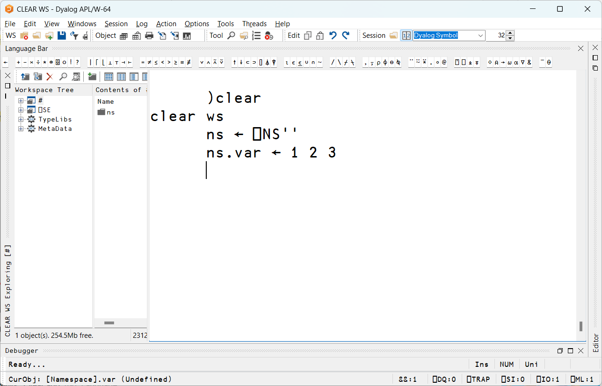
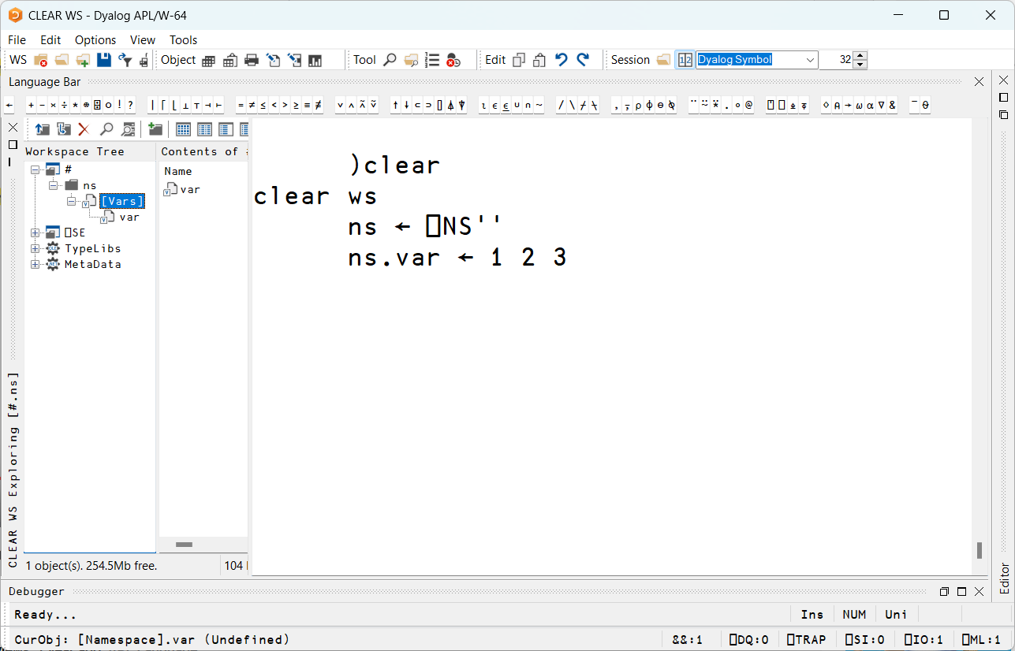
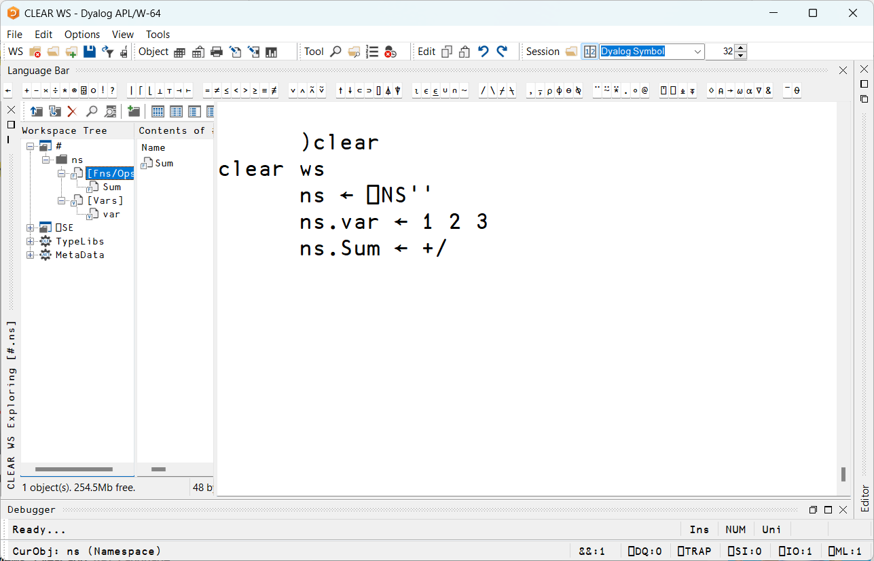
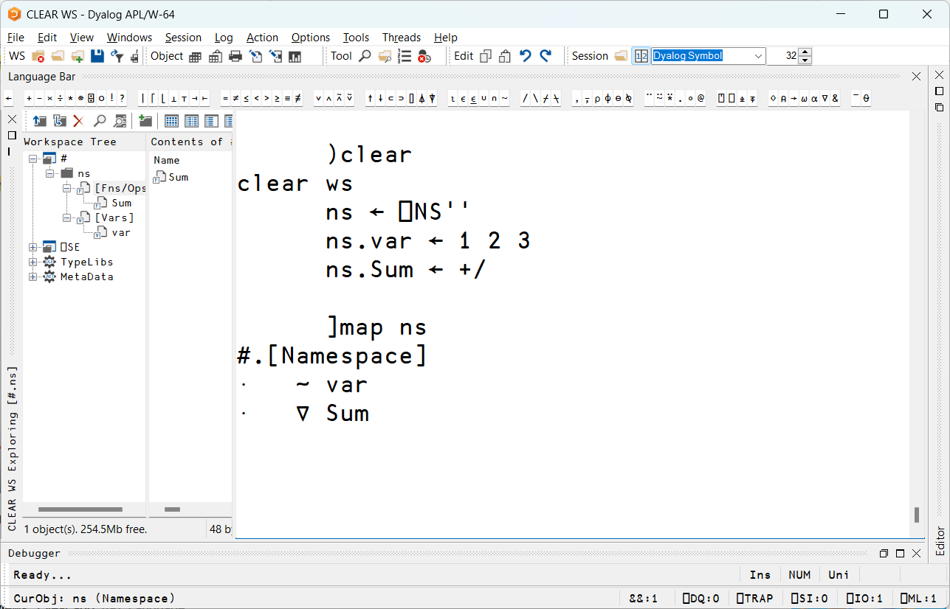
Intro to Dyalog, Part 6
Namespaces

Slide 6
Namespace References
old ← 1 2 3
old
1 2 3

Slide 7
old ← 1 2 3
new ← old
old
new
1 2 3
1 2 3

Slide 8
old ← 1 2 3
new ← old
old ← 'abc'
old
new
'abc'
1 2 3

Slide 9
old ← 1 2 3
new ← old
old ← 'abc’
⎕←new
old
new
'abc'
1 2 3

Slide 10
old ← 1 2 3
new ← old
old ← 'abc’
⎕←new
1 2 3
old
new
'abc'
1 2 3

Slide 11
old ← ⎕NS⍬
old
#.[Namespace]

Slide 12
old ← ⎕NS⍬
old.var ← 1 2 3
old
#.[Namespace]
var
1 2 3

Slide 13
old ← ⎕NS⍬
old.var ← 1 2 3
new ← old
old
new
#.[Namespace]
var
1 2 3

Slide 14
old ← ⎕NS⍬
old.var ← 1 2 3
new ← old
old.var ← '!!!'
old
new
#.[Namespace]
var
'!!!'

Slide 15
old ← ⎕NS⍬
old.var ← 1 2 3
new ← old
old.var ← '!!!'
⎕ ← new.var
!!!
old
new
#.[Namespace]
var
'!!!'

Slide 16
The Root Namespace (#)
# is the root namespace that contains everything in the workspace

Slide 17
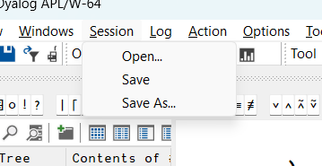
The Session Namespace (⎕SE)
⎕SE lives parallel to # and contains IDE configuration and other tools
Its contents are in a session file *.dse

Slide 18
The Current Namespace (⎕THIS)
⎕THIS is the namespace in which the current line of code is being run

Slide 19
The Current Namespace (⎕THIS)
'sub.utils'⎕NS''
a←sub.utils
⎕THIS
#
)CS sub
#.sub
⎕THIS
#.sub
We can see if two references point to the same namespace using the match function
##.a ≡ utils
1

Slide 20
Namespace References
Names can be referenced using a full path or a relative path from the current location:
)obs
bigstring docum
bigstring.⎕nl-⍳9 ⍝ names in bigstring
N find1stQuotes fixQuote
bigstring.N ⍝ relative path
123

Slide 21
Namespace References
Names can be referenced using a full path.
)cs #.text ⍝ move into #.text namespace
text
#.⎕nl-⍳9 ⍝ what in root?
bigstring text
#.bigstring.N ⍝ FULL path
123
A full path starts with #
A relative path does not.

Slide 22
Search Path (⎕PATH)
⎕PATH defines a search path for functions found in other namespaces.
For example, if #.Utils contains utility function Average
)cs myProject
#.myProject
Average ⍳99
VALUE ERROR
⎕PATH←'#.Utils'
Average ⍳99 ⍝ finds it in #.Utils
50
Rich thinks it is better to make explicit references than to use ⎕CS and ⎕PATH

Slide 23
Execution within a Namespace
Code within parentheses following a namespace reference is executed INSIDE the space:
#.bigstring.(N←N+1)
Careful: Names in the current space are not visible when running code in another space:
MY←42
There.(2×MY)
VALUE ERROR: Undefined name: MY
There.(2×MY)
∧
There.{2×⍵}MY
84

Slide 24
Review
Namespaces are like compartments within the workspace
Namespaces are created and manipulated with ⎕NS
The top namespace is called #
The parent namespace is referred to as ##
Names can be referenced relatively or with a full path
Functions in another namespace can be accessed by using ⎕PATH

Slide 25
Review
Code in parentheses following a dot is evaluated within the namespace(s) left of the dot
There is a special separate namespace named ⎕SE which holds the session objects

Slide 26
Questions?
🤔

Slide 27
Exercises
Create a namespace N1, insert 2 numeric variables A and B
List the variables in namespace N1
Using a dotted expression with parentheses make C in N1 the sum of A and B

Slide 28
Namespace References
Namespaces have name class 9
Namespaces in ⎕THIS can be viewed using:
)OBS or )OBJECTS system commands
⎕NL 9
]Names 9

Slide 29
Namespace References
Namespace references are simple scalars.
≡sub
0
≢⍴sub
0
2 2⍴sub
#.sub #.sub
#.sub #.sub

Slide 30
Namespaces
Create with ⎕NS
Dyadic ⎕NS creates a named namespace
⎕←'myNS'⎕NS''
#.myNS
The result of dyadic ⎕NS is a character vector

Slide 31
Namespaces
Monadic ⎕NS will create a namespace without a name:
⎕← new← ⎕NS ''
#.[Namespace]
⎕nc 'myNs' 'new'
9.1 9.1
The result of monadic ⎕NS is a scalar reference

Slide 32
Arrays of Namespaces
user ← ⎕NS¨4⍴⊂''
user
#.[Namespace] #.[Namespace] #.[Namespace] #.[Namespace]
user.name ← 'Abbie' 'Bobby' 'Charlie' 'Dave'
user.id ← ?4⍴10

Slide 33
Arrays of Namespaces
user[1 2 4].goo ← 1
user[3].name
Charlie
user.name
┌─────┬─────┬───────┬────┐
│Abbie│Bobby│Charlie│Dave│
└─────┴─────┴───────┴────┘
user.goo
VALUE ERROR: Undefined name: goo
user.goo
∧

Slide 34
:With and ⎕CS
The ⎕CS system function allows you to change into a new space.
As does the :With control structure:
∇ MyFoo;R [1] R←' hello'
[2] :With #.Utils
[3] R←dlb R
[4] :EndWith
∇
:With temporarily copies local variables (except refs) into the target space.

Slide 35
:With and ⎕CS
Morten thinks :With and ⎕CS are too clever. He recommends: U←#.Utils R←U.dlb R ... or using ⎕PATH to reach utilities.
:With was invented for creating or working with GUI: ∇ make caption [1] :With 'MyForm' ⎕WC 'Form' [2] Caption←caption [3] Coord←'Pixel' [4] Size←400 800 ⋄ Posn←20 30 [5] onClose←'HandleClose' ...
Rich thinks it is better to make explicit references than to use ⎕CS and ⎕PATH

Slide 36
The Stack and Namespaces
Calling a function in another namespace changes context to that namespace

Slide 37
The Stack and Namespaces
Calling a function in another namespace changes context to that namespace
'Utils'⎕NS''
Utils.Sum←{
+/⍵
}
∇ Foo arg
[1] Utils.Sum arg
[2] ∇

Slide 38
The Stack and Namespaces
There are several system variables to deal with the functions on the stack:
⎕LC the line numbers of the fns
⎕NSI the namespaces prior to call (char)
⎕RSI the namespaces prior to call (ref)
⎕SI the functions on the stack
⎕XSI the functions on the stack+namespace
⎕STACK the stack of functions+state

Slide 39
The Session Namespace (⎕SE)
All the session menus, toolbars, status bars, etc. are contained in a namespace called ⎕SE.
The contents of ⎕SE survive )LOAD and )CLEAR, and can contain tools that are always available.
⎕SE is parallel to, rather than contained within, #.

Slide 40
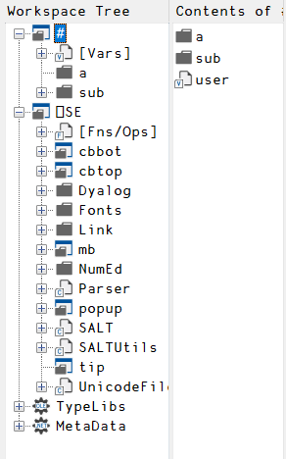
The Session Namespace (⎕SE)
All the session menus, toolbars, status bars, etc. are contained in a namespace called ⎕SE.
The contents of ⎕SE survive )LOAD and )CLEAR, and can contain tools that are always available.
⎕SE is parallel to, rather than contained within, #.

Slide 41
Questions?
🤔

Slide 42
Exercise
Write a function in one namespace and call it from a function in another. While tracing the functions, inspect the value of ⎕SI and ⎕XSI.

