Slide 1
APL Bootcamp – Part 6
The APL call stack; control flow

Slide 2
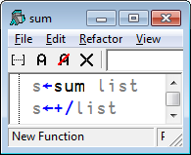
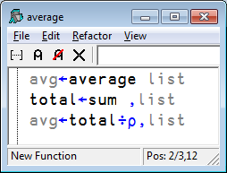
The Stack
Functions can call each other

Slide 3
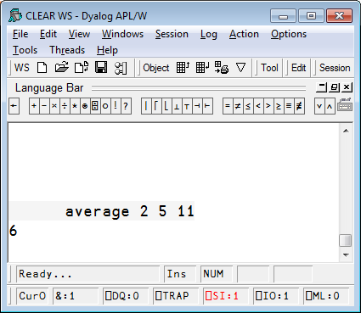
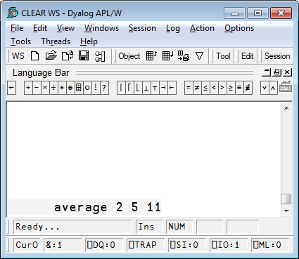
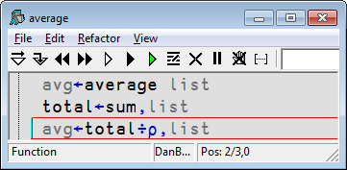
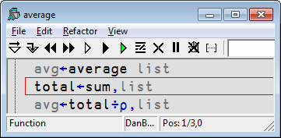
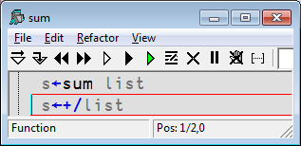
The Stack
When average is used it calls sum and the stack looks like this:

Slide 4
Local Names
Except for the name of the program, all names mentioned in the header only exist while the function is running.

Slide 5
Local Names
In this example s and list are local to sum they only exist while sum is running.

Slide 6

Local Names
Likewise, in average, avg and list are local names.
sum and total are NOT in the header and therefore are NOT localized.
Had sum been localized we could not use it as an external function because it would be shadowed.

Slide 7
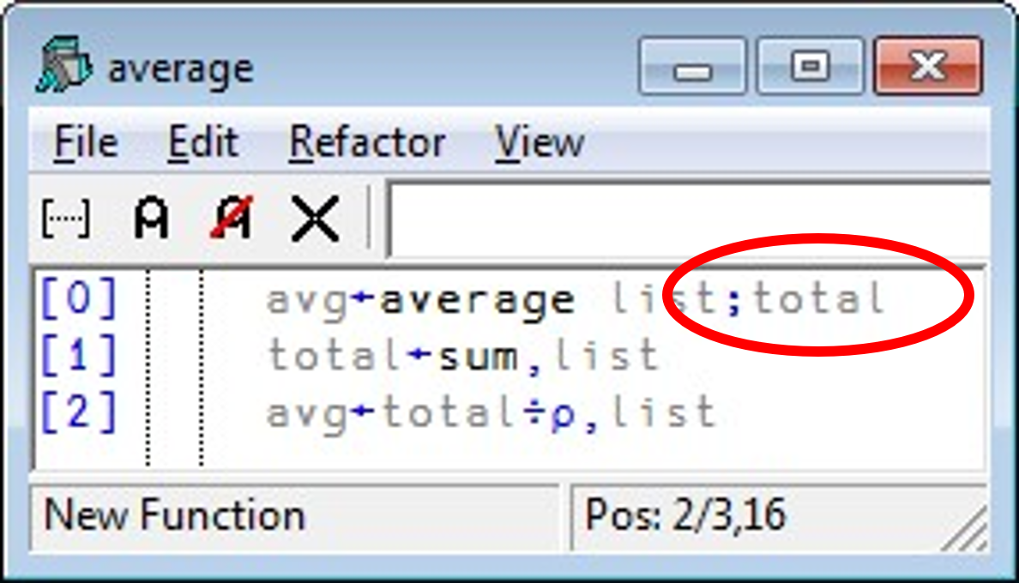
Local Names
In average, total is NOT in the header and setting it on line 1 creates a global variable.
It should be localized.
Notice that the syntax colouring changes to we can see total is now local.

Slide 8
Name Scope
The scope of a name describes the circumstances under which it is visible to code.
When a program is called, names in the calling environment are visible, unless explicitly localised in the header.

Slide 9
Name Scope
In a TradFn, names are localized by putting them in the header, separated by semicolons.
In a dfn names are automatically localized when a new name is assigned.

Slide 10
Avoid Globals
When possible, avoid using global variables.
Pass parameters to functions as arguments unless this becomes very awkward.
The use of global variables should be limited to state settings that affect the entire application, or tables containing databases that are shared globally.
If you need global constants, it is a good idea to create them in a function in order to be able to use source code management / change tracking

Slide 11
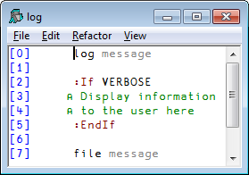
Meaningful Globals
For example, a global switch affecting the entire application:

Slide 12
Avoiding Globals
In recent years, a new reason is emerging to avoid globals:
A function which uses globals is difficult, if not impossible, to run in parallel.
If two copies of the function run in parallel and they update the global data, some kind of locking is required.
Locking often defeats the potential benefits of parallel execution.

Slide 13
Name Scope
When one program calls another, APL maintains a stack to it can find its way back and continue execution when a called function completes
Local names only exist while the function they are local to is on the stack.
Names should be localized unless they really really, really, really need to be global

Slide 14
Tracer Demo
Trace execution
Set breakpoints
Modify variables
Edit & continue

Slide 15
Keyboard Shortcuts
Edit
Edit name Shift+Enter
Save and close Esc
Trace
Trace / step into Ctrl+Enter
Skip line Ctrl+Shift+Enter
Step backwards Ctrl+Shift+Backspace
Search "Dyalog tips" online

Slide 16
Control Flow
By default, programs execute sequentially from top to bottom.
It is possible to alter the sequential execution of lines in a program.
In a TradFn, the best way to achieve this is to use control structures.
Control Structures are blocks of code in which the execution of APL statements follows certain rules and conditions.

Slide 17
Control Flow
Control structures are implemented using a set of control words which all start with the colon symbol (:).
Control words do not obey the normal rules of APL syntax (monadic, dyadic, etc) – each one has it’s own syntax
Control Words are case-insensitive, but we recommend that you use CamelCase:
:If condition
do this
:EndIf

Slide 18
Control Flow
Some of the available control structures:
:If
:Select
:While
:Repeat
:For
:Trap
:With
:Hold
Press F1

Slide 19
Interrupt
If you end up in an infinite loop, use:
Ctrl+Break key
Action → Interrupt
Right Click → Interrupt
Click system tray icon and select Strong Interrupt

Slide 20
:If … :EndIf
Execute a block of statements if a condition is fulfilled.
:If condition
do this
:EndIf
:If n>0
⎕←'n is >0'
:EndIf

Slide 21
:If … :Else … :EndIf
Execute a block of statements if a condition is fulfilled.
:If condition
do this
:Else
do that
:EndIf
:If n>0
⎕←'n is >0'
:Else
⎕←'n is < or =0’
:EndIf

Slide 22
:If … :ElseIf … :Else … :EndIf
:If condition
do this
:ElseIf other
do that
:Else
whats left
:EndIf
:If n>0
⎕←'positive' :ElseIf n=0
⎕←'n is 0'
:Else
⎕←'negative'
:EndIf

Slide 23
:Select … :Case … :CaseList … :EndSelect
:Select array
:Case c1
do this
:CaseList c2 c2
do that
:Else
the rest
:EndSelect
:Select ×N
:Case ¯1
⎕←'negative'
:CaseList 0 1
⎕←'non-negative' :Else ⎕←'impossible' :EndSelect

Slide 24
:While … :EndWhile
Loop 0 or more times
:While condition
do this
do that
:EndWhile
:While Snow
⎕←'go skiing'
Snow←1≠?6 :EndWhile

Slide 25
:While … :OrIf … :EndWhile
:While condition
:OrIf condition2
do that
:EndWhile
:While Temp>50
:OrIf Temp<¯15
⎕←'stay inside'
Temp←ReadThermo
:EndWhile

Slide 26
:While … :OrIf … :EndWhile
Normally:
:If a 'a is true' :EndIf
Only runs if a is true

Slide 27
:While … :OrIf … :EndWhile
:If a 'a is true' :OrIf b 'b is true' :EndIf
Only runs if a is false!
Rich does not like :OrIf with :If

Slide 28
:While … :OrIf … :EndWhile
Normally:
Using :OrIf
:If a 'a is true' :Else 'a is false' :EndIf
:If a 'a is false' :OrIf b 'a is true or b is true' :Else 'neither a nor b' :EndIf

Slide 29
Optimisation :While
Think!
:While LikelyToBeFalse
:AndIf expensiveTest
…
Is probably better than:
:While LikelyToBeFalse ∧ expensiveTest
…

Slide 30
Optimisation :While
You will often see:
:While PreCondition
:AndIf onlyComputableIfPreCondition
…

Slide 31
:Repeat … :Until
Loop at least once
:Repeat
do this
do that
:Until condition
:Repeat
⎕←'go skiing'
Temp←ReadThermo
:Until Temp>0

Slide 32
:Leave (any control structure)
For example, using :Repeat
:Repeat
do this
:Leave
do that?
:EndRepeat
:Repeat Temp←ReadThermo
:If Temp>0
:Leave
:EndIf
'go skiing'
:EndRepeat

Slide 33
:For … :EndFor
Execute a block repeatedly for a series of values:
:For v :In values
do this
:EndFor
:For n :In ⍳10
⎕←n,n*2
:EndFor

Slide 34
:For … :InEach … :EndFor
Execute a block repeatedly for respective items within a series of values:
:For v :In (1 2 3)(4 5 6)
⎕←v
:EndFor
1 2 3
4 5 6
:For v :InEach (1 2 3)(4 5 6)
⎕←v
:EndFor
1 4
2 5
3 6

Slide 35
:Continue (within a loop)
Skip the rest of the block.
:For v :In values
…
:Continue
do this
:EndFor
:For n :In ⍳10
:If n∊4 6
:Continue
:EndIf
⎕←n,n*2
:EndFor

Slide 36
:Leave
TradFns end when the last line is executed. You can exit earlier using:
→0
:Return

Slide 37
Branching
Historical note
In the early days, the only way to alter the flow of execution was the branch arrow (→) or goto.
To go to a specific line number one would write →lineNo. If lineNo was NOT one of the lines in the program, the program would exit.
Use of branching risks spaghettification, in which function calls form a confusing labyrinth. Do not use :Goto, either!
Goto may be used with strict sequence-based enumeration

Slide 38
Sequence-based Enumeration
Note every possible input for your system
Determine the correct response to that input

Slide 39
Branching
→⍳0 would continue to the next line
To conditionally branch to line 10 one would write
→Condition/10
To avoid renumbering the statements when the program would change LABELS were used.

Slide 40
Branching
A label appears at the start of a line, followed by a colon:
→Condition/Lab1
…
Lab1:
A label is a local variable which is automatically assigned the value of the line it appears on.

Slide 41
Branching
→(condition)/1+⎕LC ⋄ expression
… conditionally branches to the next line (⎕LC is the line counter). This is equivalent to …
:If ~condition expression :EndIf
DO NOT remove the diamond, you will BREAK the code!

Slide 42
Interrupt
If you end up in an infinite loop, use:
Ctrl+Break key
Action → Interrupt
Right Click → Interrupt
Click system tray icon and select Strong Interrupt

Slide 43
:Trap … :Case … :Else … :EndTrap
You can "trap" errors and handle them:
:Trap errorCode
do this
:Case errorX
do that
:EndTrap
:Trap 0 ⍝ all errors
a←b÷c
:Case 11 ⍝ DOMAIN ERROR
⎕←'divide by zero?'
:Else
⎕←'oops!'
:EndTrap

Slide 44
:Trap … :Case … :Else … :EndTrap
You can "trap" errors and handle them:
:Trap errorCode
do this
:Case errorX
do that
:EndTrap
See our Error Handling webinar series on Dyalog.TV!
:Trap 0 ⍝ all errors
a←b÷c
:Case 11 ⍝ DOMAIN ERROR
⎕←'divide by zero?'
:Else
⎕←'oops!'
:EndTrap

Slide 45
Flow in dfns
dfns intend to support declarative programming, without loops.
A dfn terminates when a condition is met.
The only loop construct allowed is recursion.
For geeks in the room:
Tail recursion *is* optimised.

Slide 46
dfn guards
A dfn line containing a colon (:) is a guard.
On the left is a condition, like ⍵>0
If satisfied, the result of the function is computed using the expression on the right.
Otherwise, the first line which does not do an assignment provides the result.
{ ⍵>0:'positive'
⍵<0:'negative'
'Zero'
}

Slide 47
dfn recursion
The only possible loop is recursion. The ∇ symbol is a self-reference.
(Thus, a dfn never needs to know its own name – or even have a name)
factorial←{ ⍵=0: 1
⍵ × ∇ ⍵-1 ⍝ call self(⍵-1)
}

Slide 48
dfn error guards
An error guard is an error number followed by ::
Div←{
11::'Division by zero'
⍺÷⍵
}
4 Div 2
2
4 Div 0
Division by zero

Slide 49
Naked Branch (→)
If you want to clear the last call from the stack you can use "naked" branch (no line number) as in
You can use the system command )SI
to view the stack:

Slide 50
)RESET
If you need to clear the stack completely you can use the system command )RESET: )RESET takes an argument of how many lines to remove (+ve) or keep (-ve)

Slide 51
Review
Control structures are :Keywords that alter the flow of execution
Dfns use guards to control flow and trap errors
To early exit a tradfn use →0 or :Return
Prefer control structures over branching

Slide 52
Review
The system command )SI shows the call stack
A naked branch (→ no line number) clears the last pending call
The system command )RESET clears the stack completely

Slide 53
Questions?
🤔

Slide 54
Exercises
Write a Tradfn that prints the integers ascending from the left argument to the right argument, one at a time
Write a Tradfn to compute the factorial (!⍵) of the right argument, using recursion
Write a dfn to display the numbers from ⍺ to ⍵, one by one
Write a dfn to compute the factorial of ⍵ using recursion

